Slide 1
Florida Probate
Administration Guide
Basic Process of Probating a Will
Clark Law PLLC
501 N. Magnolia Ave, Orlando, FL 32801
689-677-3233
info@clarklawpllc.com
This presentation is for informational purposes only and should not be considered professional legal advice.

Slide 2
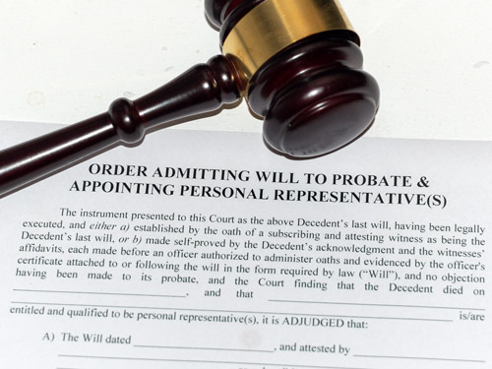
Introduction
This presentation represents a simplified format of Florida’s probate administration process.
It’s important to note, the process covered in this presentation may differ if:
The decedent died without a valid will
(see slide 12)
The decedent’s estate is worth less than $75,000 (see slide 12)
Clark Law PLLC • 689-677-3233 • info@clarklawpllc.com
Notes:
NOTE: “italian near me” is a text box. You can click it and edit the text to make it more customized to your specific client.

Slide 3
Table of Contents
Step 1: Filing The Will
Step 2. Filing The Petition For Administration
Step 3: Appointing The Personal Representative
Step 4: Determining Validity
Step 5: Accounting
Step 6: Notice To Creditors
Step 7: Closing The Estate
Probate Without a Will
About The Author
Disclaimer
Clark Law PLLC • 689-677-3233 • info@clarklawpllc.com

Slide 4
Step 1: Filing The Will
After someone passes away, the will needs to be filed in the local Circuit Court
Within the County where the decedent resides
Example: Decedent resides in Orange County;
the will should be filed at the 15th Circuit Court.
Clark Law PLLC • 689-677-3233 • info@clarklawpllc.com

Slide 5
Step 2: Filing The Petition For Administration
This is a formal request to administer a will through probate court
Three types of probate administration:
Formal Administration
Estates valued at $75,000 or more
Summary Administration
Estates valued less than $75,000
Disposition Without Administration
Decedent has no property or the estate is valued at less than the cost of probate.
Clark Law PLLC • 689-677-3233 • info@clarklawpllc.com

Slide 6
Step 3: Appointing The Personal Representative
The Personal Representative is the person in charge of gathering and distributing assets of the individual who passed away
Also may be referred to as executor.
Duties include:
Opening a probate case by filing a petition for administration
Gathering out-of-state assets
Paying owed estate taxes
Determine the creditors of the descendent
Serve the Notice of Administration on all beneficiaries
Distributing assets of the estate as stated
in the will
Closing the estate
Clark Law PLLC • 689-677-3233 • info@clarklawpllc.com

Slide 7
Step 4: Determine Validity
The court must ensure the will was properly and legally executed.
The will must be:
  Properly signed
  Witnessed
  Notarized
  Filed without undue influence/coercion
  See Statute 732.502 for more information.
Clark Law PLLC • 689-677-3233 • info@clarklawpllc.com

Slide 8
Step 5: Accounting
Clark Law PLLC • 689-677-3233 • info@clarklawpllc.com

Slide 9
Step 6: Notice To Creditors & Other Parties
It’s required that notice is given to all necessary parties regarding the descendant's estate.
Creditors
Beneficiaries
Surviving Spouses
Necessary parties include:
Parties have 30 days to contest the will after receiving notice.
Clark Law PLLC • 689-677-3233 • info@clarklawpllc.com
Notes:
Someone searches for something you provide
They see you business listing including a link to your menu / services
They see your up to date menu and current and pricing
All from within the mobile app

Slide 10
Step 7:
Closing The Estate
The Personal Representative files a final petition for discharge of the estate.
The court enters an order to finally close the estate.
Clark Law PLLC • 689-677-3233 • info@clarklawpllc.com

Slide 11
Probate Without a Will
Intestate Succession
When someone dies without a will who receives assets?
See flowchart below for a simplified breakdown
Clark Law PLLC • 689-677-3233 • info@clarklawpllc.com

Slide 12
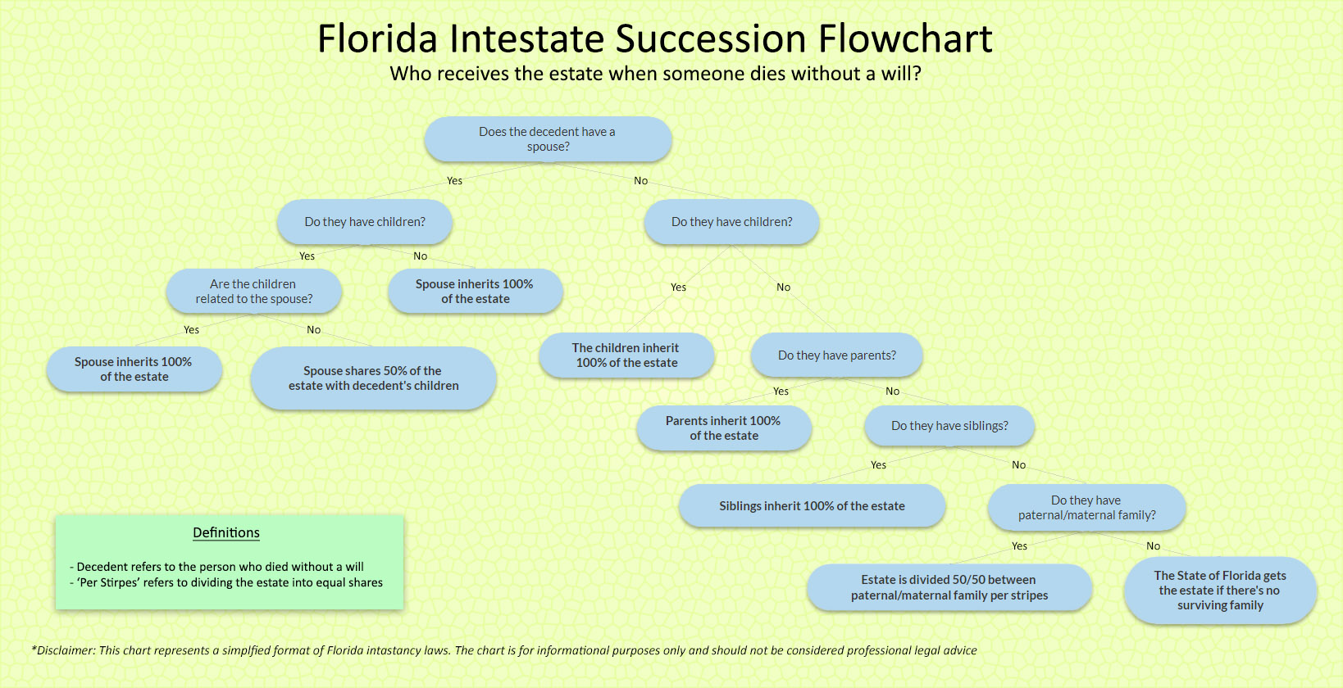

Slide 13
Disclaimer
This presentation represents a simplified format of Florida’s probate administration process. The presentation is for informational purposes only and should not be considered professional legal advice.
Clark Law PLLC • 689-677-3233 • info@clarklawpllc.com

Slide 14
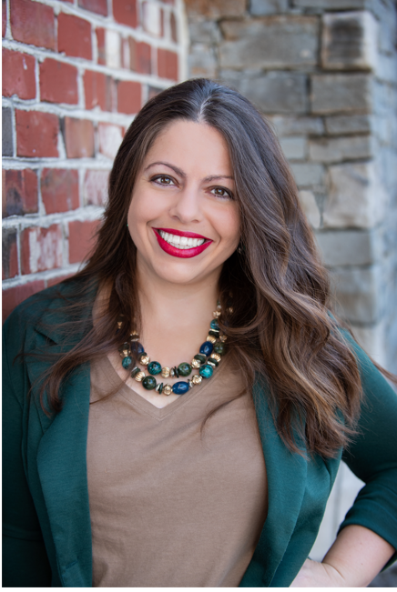
Contact Information
Clark Law PLLC
501 N. Magnolia Ave
Orlando, FL 32801
Phone: (689) 677-3233
Email: info@clarklawpllc.com
Website: www.clarklawpllc.com
Clark Law PLLC • 689-677-3233 • info@clarklawpllc.com

