Slide 1

Vehicle Security

Slide 2
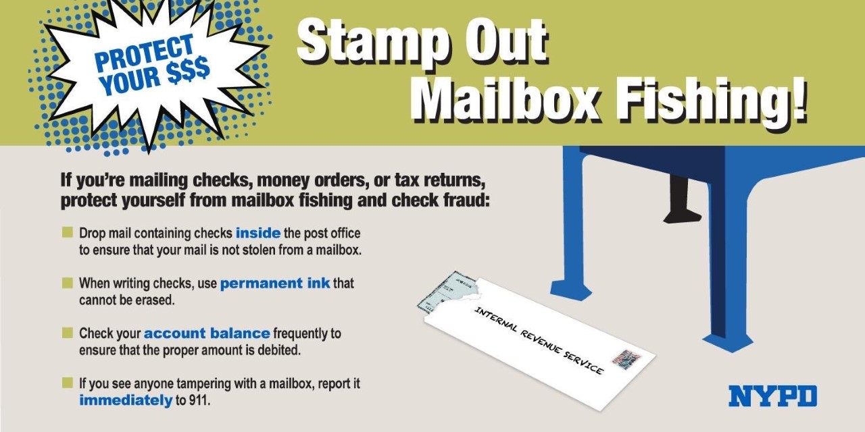
Mailbox Fishing

Slide 3
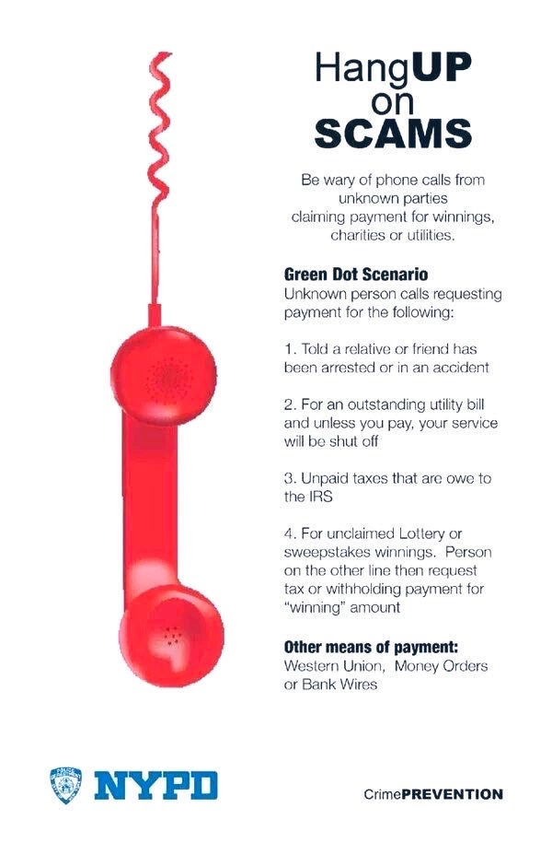
Hang Up On Scams

Slide 4
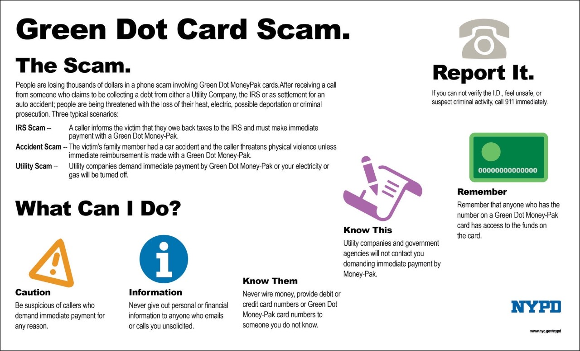
Green Dot Card Scam

Slide 5
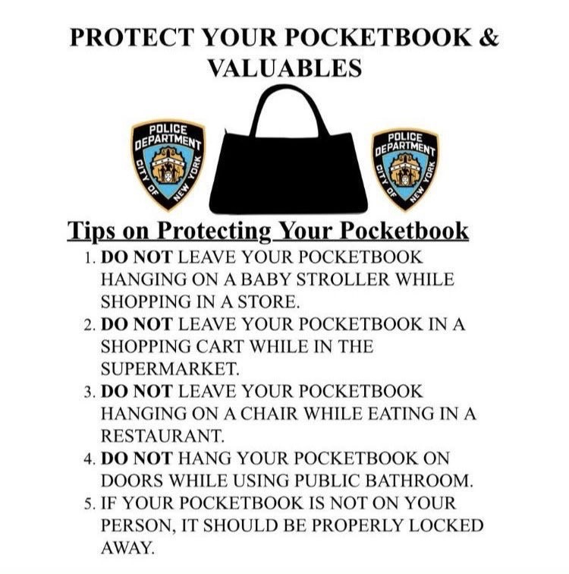
Protect Pocketbook & Valuables

Slide 6
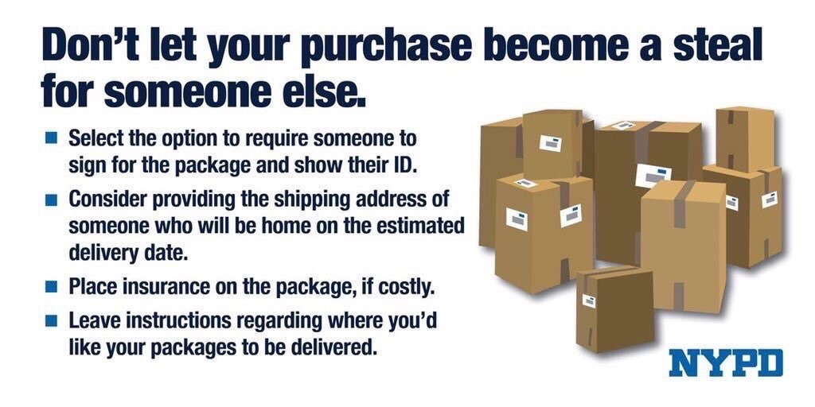
Package Security

Slide 7
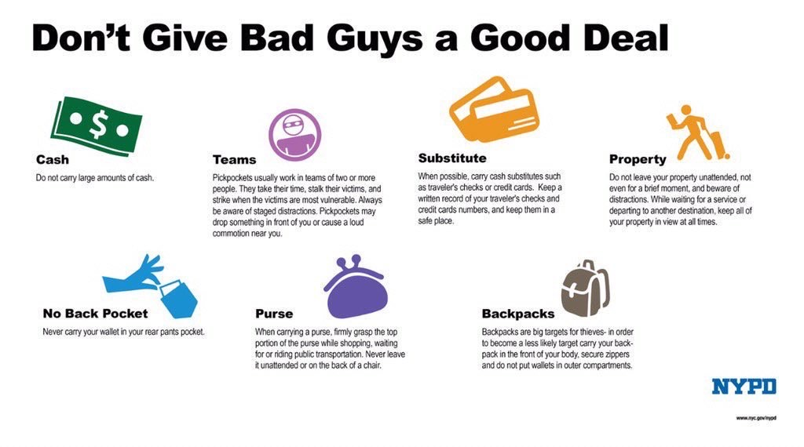
Beware of a Good Deal

Slide 8
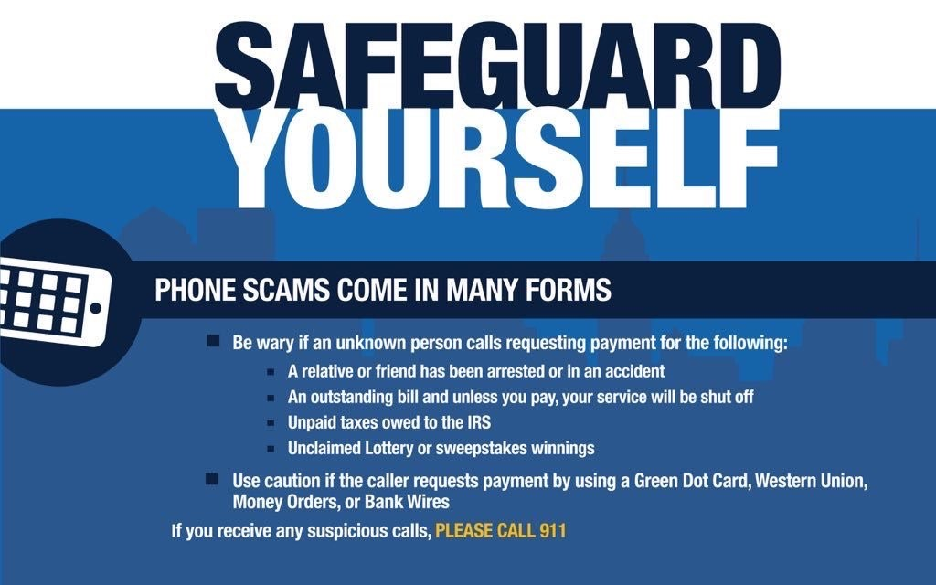
Safeguard Yourself

