Slide 1
Lesson 1: Responding to Illustration & Vocabulary
• Explore and respond to the front cover illustration • Develop vocabulary and descriptive language • Use visualisation to support imaginative writing
www.lisareneeruggeri.com

Slide 2
What is the first word, phrase or association that comes to mind when you look at this image?
What do you think you would hear if you were there?
What can we see?
How does this image make us feel?
What do you like about the image?
What does the image remind you of?
Is there anything you dislike about the image?
www.lisareneeruggeri.com

Slide 3
What kind of words and phrases can we use to describe this image?
What do you think you would hear if you were there?
What can we see?
How does this image make us feel?
What do you like about the image?
What does the image remind you of?
What do you dislike about the image?
A snow-covered roof.
Silent snow falling.
Freezing
www.lisareneeruggeri.com

Slide 4
Descriptive Paragraph
The old house sat quietly in the middle of the forest, its roof covered in thick, white snow. Long icicles hung from the edges, and the windows were frosted so you couldn’t see inside. The trees around it stood still, their branches cold and covered in snow. Everything was silent, and the freezing air made the whole place feel still and sleepy, like it was waiting for something to happen.
www.lisareneeruggeri.com

Slide 5
What could this book be called?
www.lisareneeruggeri.com

Slide 6
Lesson 2: Prediction & Vocabulary Exploration
• Make predictions based on the title • Identify and analyse descriptive language • Visualise setting using author's vocabulary
www.lisareneeruggeri.com

Slide 7
What kind of story might this be?
As I read the first chapter, write down your favourite vocabulary and phrases.
Who do you think lost the letters?
What did you like/dislike about the first chapter?
How did the language make you feel?
www.lisareneeruggeri.com

Slide 8
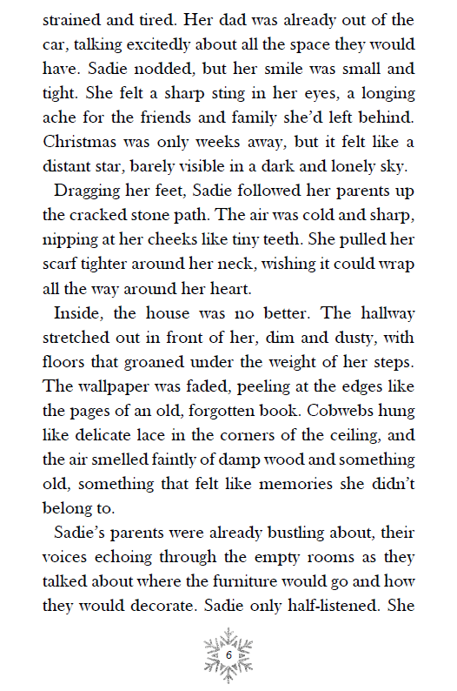
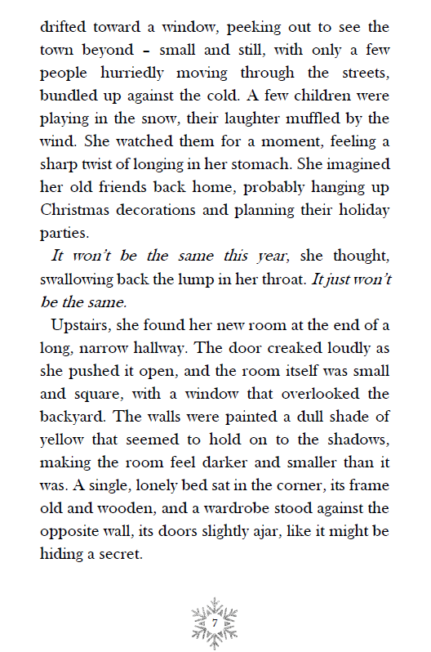
www.lisareneeruggeri.com

Slide 9
Checklist:
-Adjectives
-Verbs
-Adverbs
-Similes
-Personification
www.lisareneeruggeri.com

Slide 10
Lesson 3: Suspense & Character Development
• Identify techniques used to create suspense • Read and analyse character letters • Create character profiles using Role on the Wall
www.lisareneeruggeri.com

Slide 11
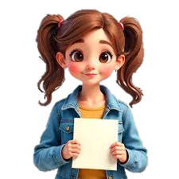
Who could the letters be from?
I think the letters are from ___________ because ____________.
www.lisareneeruggeri.com

Slide 12
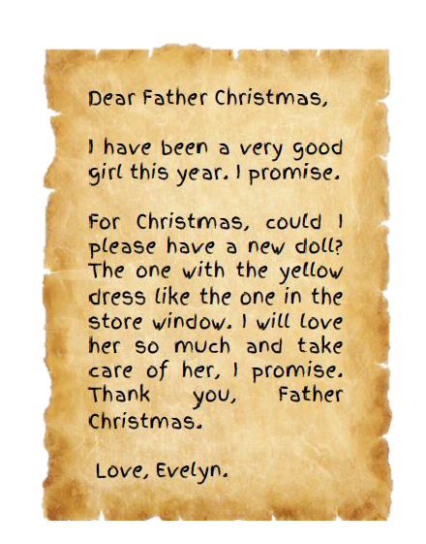
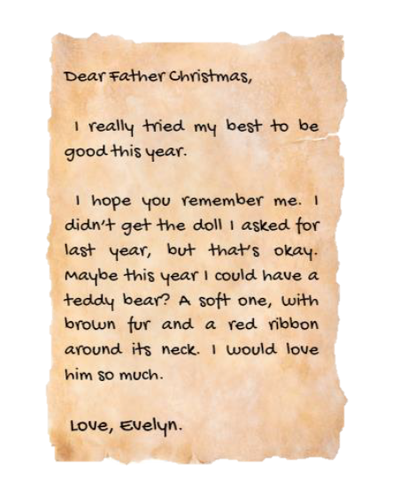
www.lisareneeruggeri.com

Slide 13
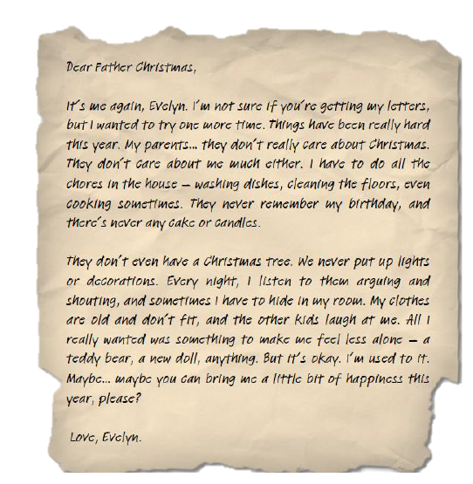
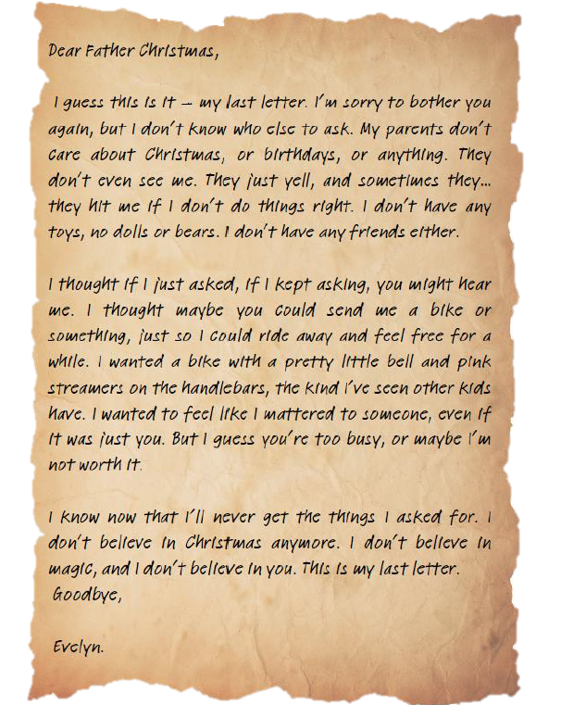
www.lisareneeruggeri.com

Slide 14
Evelyn
Sadie
Young girl
12-year-old girl
lonely
lonely
loved
scared
What are the similarities/differences between them?
www.lisareneeruggeri.com

Slide 15
Lesson 4: Planning a Persuasive Letter
• Write in role • Structure persuasive letter • Develop empathy and imagination
www.lisareneeruggeri.com

Slide 16
Who will Sadie ask for help?
What do we know so far?
What would Sadie say?
What does she want?
Why should Father Christmas help?
What’s the Christmas miracle she’s hoping for?
www.lisareneeruggeri.com

Slide 17
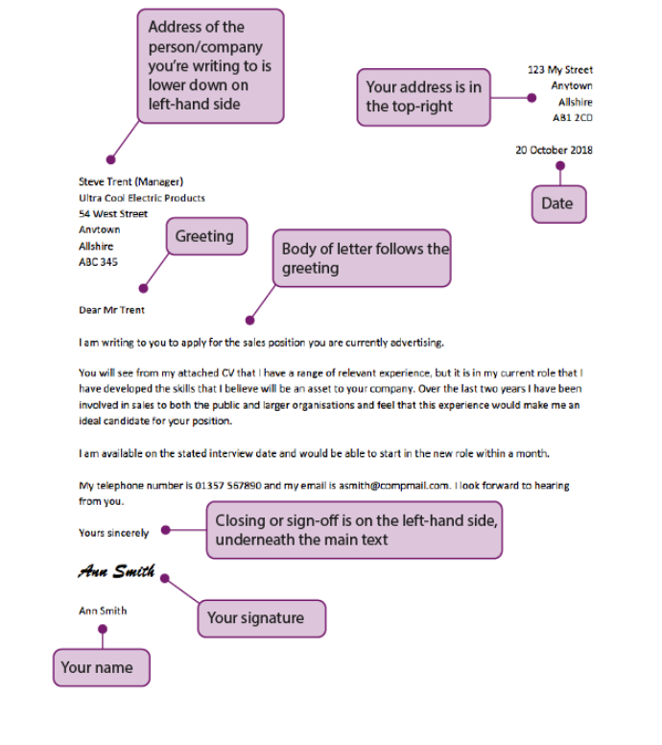
What are the features of a good letter?
www.lisareneeruggeri.com

Slide 18
PLAN:
Dear Father Christmas,
What is your name?
Why are you writing?
Who is Evelyn?
How can Father Christmas help?
What would it mean to Sadie if he helped?
www.lisareneeruggeri.com

Slide 19
Lesson 5: Writing & Editing the Letter
• Write and edit a persuasive letter in role • Use emotive language and structure • Publish a polished piece
www.lisareneeruggeri.com

Slide 20
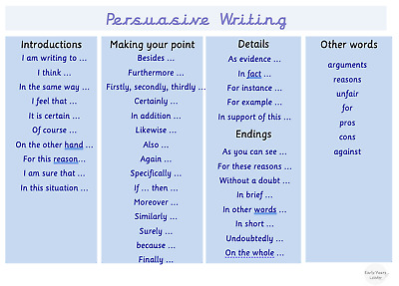
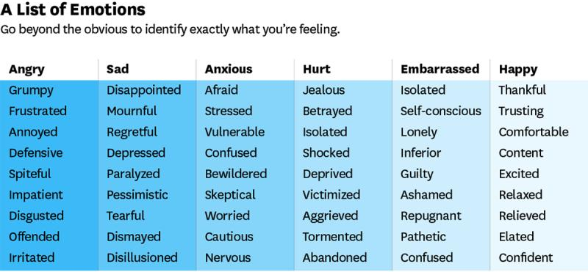
WRITING CHECKLIST:
-Adjectives
-Openers
-Adverbs
-Emotive language
-Persuasive Language
www.lisareneeruggeri.com

Slide 21
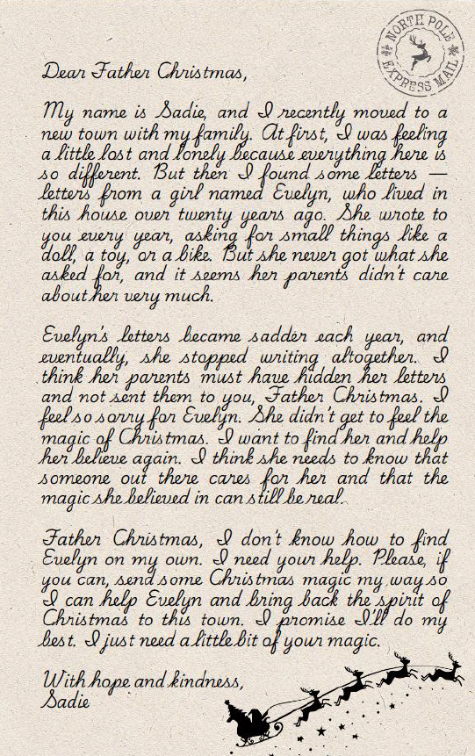
WRITING CHECKLIST:
-Adjectives
-Openers
-Adverbs
-Emotive language
-Persuasive Language
www.lisareneeruggeri.com

Slide 22
Lesson 6: Hot-Seating & Character Exploration
• Deepen understanding of character motivations and actions • Ask and answer questions in role • Use drama to infer and explore relationships
www.lisareneeruggeri.com

Slide 23
Evelyn
Sadie
Young girl
12-year-old girl
lonely
grumpy
lonely
determined
scared
loved
What new information have we found out about the characters?
www.lisareneeruggeri.com

Slide 24
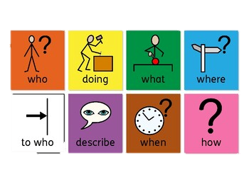
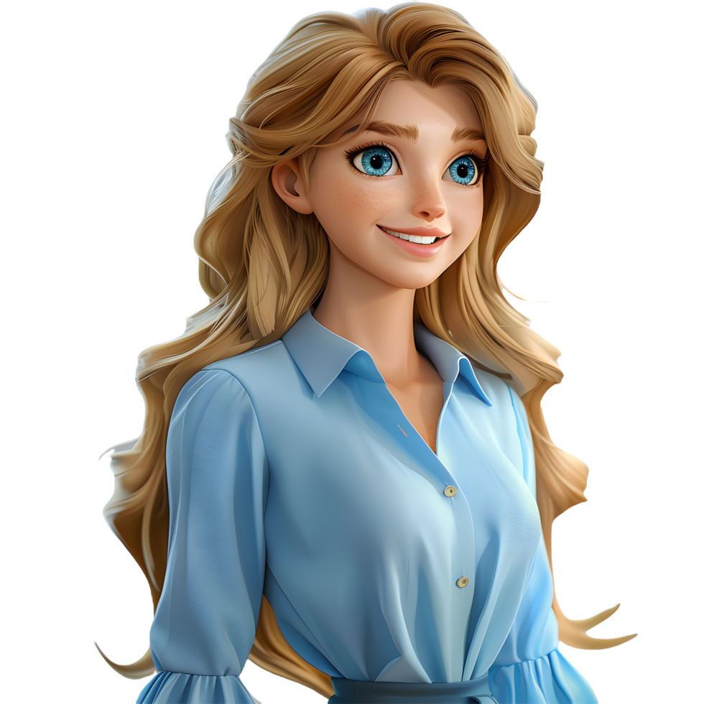
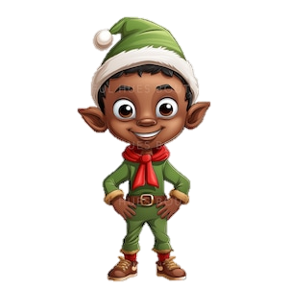
What would you want to ask Sadie, Evelyn or Noel?
www.lisareneeruggeri.com

Slide 25
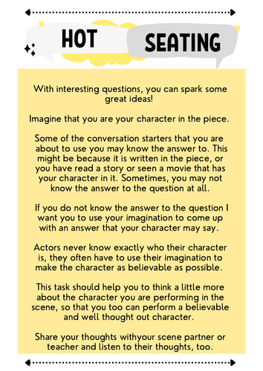
What would you want to ask Sadie, Evelyn or Noel?
www.lisareneeruggeri.com

Slide 26
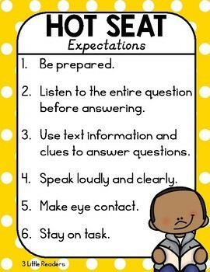
What would you want to ask Sadie, Evelyn or Noel?
www.lisareneeruggeri.com

Slide 27
Lesson 7: Persuasive Poster for the Winter Fair
• Apply persuasive techniques to a new format • Create visual and written content with a clear purpose • Use real-world contexts to make learning meaningful
www.lisareneeruggeri.com

Slide 28
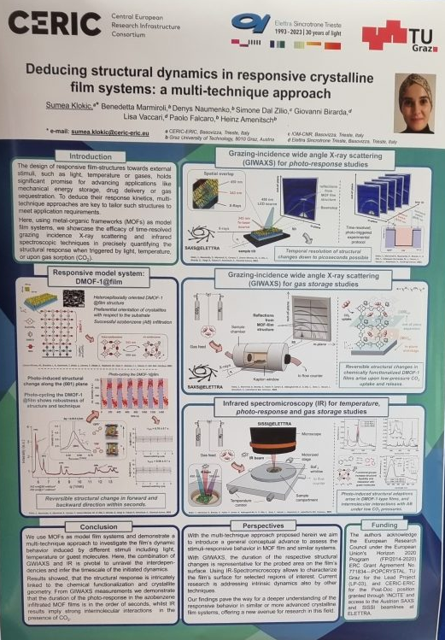
What makes a good poster?
Which one is better and why?
www.lisareneeruggeri.com

Slide 29
What makes a good poster?
www.lisareneeruggeri.com

Slide 30
What makes a good poster?
www.lisareneeruggeri.com

Slide 31
What makes a good poster?
www.lisareneeruggeri.com

Slide 32
What makes a good poster?
www.lisareneeruggeri.com

Slide 33
What makes a good poster?
www.lisareneeruggeri.com

Slide 34
1. Eye-Catching Title / Headline
Big, bold, and exciting
Grabs the reader’s attention straight away E.g. “Come to the Magical Winter Fair!”
2. Persuasive Language
Use emotive, positive, and enthusiastic language E.g. “You won’t want to miss it!” / “The best event of the year!”
3. Clear Purpose
What is the poster for?
Who is it aimed at? E.g. Inviting families, children, or friends to an event
4. Reasons Why
Include 3 clear reasons someone should come E.g. “Delicious treats, magical games, and a special surprise guest!”
5. Call to Action
Tell the reader what you want them to do E.g. “Join us at 3pm on Friday!” / “Bring your friends and family!”
6. Dates, Times, and Location
Important factual details must be easy to find and read
7. Colourful Visuals / Images
Pictures, drawings, or graphics to make it attractive and fun E.g. Snowflakes, fairy lights, Santa’s sleigh, children playing
8. Organised Layout
Information in sections or boxes
Use bullet points, bold fonts, or borders to separate ideas
Rhetorical questions (“Are you ready for the best day ever?”)
Alliteration (“Fantastic Festive Fun!”)
Slogans or catchy phrases
www.lisareneeruggeri.com

Slide 35
Which features can you see?
www.lisareneeruggeri.com

Slide 36
Lesson 8: Planning an Alternative Ending (Narrative Plan)
• Predict and create a new ending to the story • Use story mapping to structure ideas • Apply key vocabulary and themes from the unit
www.lisareneeruggeri.com

Slide 37
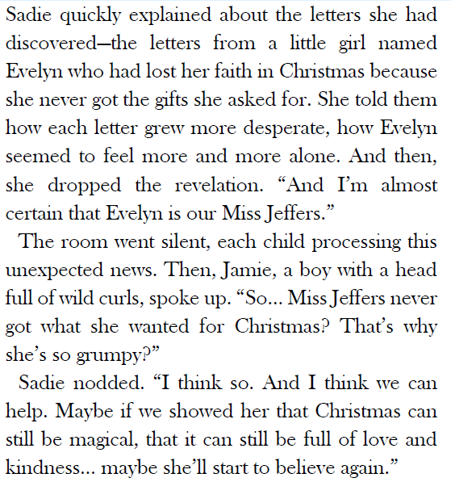
What might happen next …?
www.lisareneeruggeri.com

Slide 38
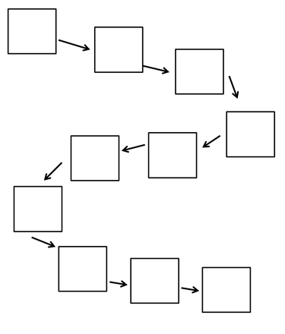
What might happen next …?
www.lisareneeruggeri.com

Slide 39
Bramblewood Bakes
www.lisareneeruggeri.com

Slide 40
Lesson 9: Writing a Narrative
• Begin writing a narrative based on plan • Focus on pacing, vocabulary and emotional impact • Apply all previous learning to create original content
www.lisareneeruggeri.com

Slide 41
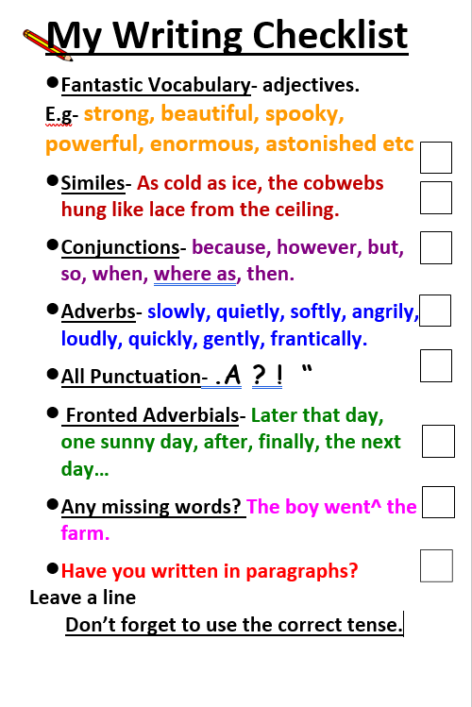
www.lisareneeruggeri.com

Slide 42
Lesson 10: Editing a Narrative
• Continue narrative writing • Edit and improve writing using success criteria • Reflect on author’s message and compare interpretations
www.lisareneeruggeri.com

Slide 43
Was your ending the same?
How did it differ?
Reflect: How does this story relate to us, especially at Christmas?
www.lisareneeruggeri.com

Slide 44
What message did the author want to convey to the reader?
www.lisareneeruggeri.com

Slide 45
www.lisareneeruggeri.com

