Slide 1

2021 ANNUAL Report Academy for Family Empowerment, Inc. 3205 Salem Road, SE Conyers, GA 30013 (770) 918-8003

Slide 2

Vision
To educate and empower our consumers to improve their quality of life based upon their individual strengths, needs, abilities, and preferences.

Slide 3
Mission
Academy for Family Empowerment, Inc. is committed to improving the quality of life for children and at-risk families. Our mission is to build healthy, loving and functioning families through supportive services that empower families to become nurturing and self-sufficient.

Slide 4
Values
In pursuit of our mission, we believe the following values are essential
to our agency:
We uphold high professional standards;
We practice continuous quality improvement;
We advocate for access to care for all people and support public efforts to fund services for vulnerable people who cannot pay;
We believe all people should have opportunities for development at all stages of life, and support learning which promotes healthy growth and well-being;
We create a work place which supports and nurtures employees;
We help people in ways which uphold dignity and choice;
We believe the use of community-based family and family-like supports is the best way of helping people with problems caused by mental illness, mental retardation, alcohol and other drug abuse;
We believe in the value of public service as a means of enhancing the quality of life for all citizens in our communities.

Slide 5
Purpose
The purpose of this report is to provide information
to our stakeholders, staff, and other interested
parties regarding the quality and effectiveness of
services provided to consumers and their families by
our programs from January 2021-December 2021.
The information included in this report will be
used to facilitate quality and performance
improvement activities, as well as to identify
areas of strength and areas needing improvements.

Slide 6
AFE Program Overview
Academy for Family Empowerment, Inc.
provides the following CORE services:
I. CORE SERVICES:
Individual Therapy
Family Therapy
Community Support Individual (CSI)
Physician Services/Nursing Services
Treatment Planning
Behavioral Health Assessments
Group Services (on hold due to COVID)

Slide 7
AFE Program Overview
Academy for Family Empowerment, Inc. provides the following mental
health services:
II. School-Based Mental Health Services:
Rockdale County Public School
Individual Therapy
Family Therapy
Treatment Planning
Behavioral Health Assessments
II. DFCS Services
Parent Aide
Early Intervention Services
Behavioral Aide
Homestead Services
Wrap Around Services
Drug Screening Services
Assessments (CCFA, SAA, PFA, DVA)

Slide 8
AFE Program Overview
From January-December 2021, Academy for
Family Empowerment, Inc. provided services to:
285 consumers in our CORE program
124 consumers in our School Based Mental Health Program(SBMH)
3334 consumers in our DFCS Program

Slide 9
CORE Program
Program
Overview

Slide 10
CORE Program Overview (2020)
Referrals received in 2020: 154
Referrals authorized in 2020: 153 (59% FEMALE/49%MALE)
Referred out: 0 Pending: 0 Non-Compliant: 0
Declined Services: 1 No Contact: 0

Slide 11
CORE Program Overview
In 2021, AFE received 324 referrals for our CORE
Mental Health Program. Of these referrals, 116
consumers completed an initial intake for services.
208 referrals did not engage in services:
32 refused services prior to scheduling
146 did not show-up for scheduled Intake appointment
30 were unsuccessful attempts to schedule an intake appointment

Slide 12
CORE Program Overview
In 2021, of the 116 scheduled intakes:
113 were authorized and serviced
3 were not served /authorized
In addition to these initial intakes, 169 consumers completed reauthorization assessments (already enrolled in services)

Slide 13
CORE Referral Status
Of the 3 referrals not served by AFE, a breakdown detailing explanations is below:
*** Not Authorized ***
 |  | Admissions Criteria | 0 | 0%
 |  | Already Receiving Services | 0 | 0%
 |  | Amerigroup | 0 | 0%
 |  | Guardian Declined | 3 | 0.02%
 |  | Inactive | 0 | 0%
 |  | Incarcerated | 0 | 0%
 |  | No Contact | 0 | 0%
 |  | Non-compliant with Initial appointment | 0 | 0%
 |  | Out of Area | 0 | 0%
 |  | Pending | 0 | 0%
 |  | Private Insurance | 0 | 0%
 |  | Referral Retracted | 0 | 0%
 |  | Totals | 116 | 100.00%

Slide 14
CORE Program Overview
Of the referrals received, the following referral sources were represented:

Slide 15
CORE Program Overview
Of the referrals received, the following Insurance companies were represented:

Slide 16
CORE CONSUMER DEMOGRAPHICS

Slide 17
Ethnic Comparison
In 2021, of 113 consumers, we served the following
race:

Slide 18
Gender Comparison
In 2021, we served:

Slide 19
Age Comparison
In 2021, we served the following age categories:

Slide 20
Diagnostic Categories
Of the 113 consumers served, the following diagnosis
were represented:

Slide 21
DFCS Program
Program
Overview

Slide 22
DFCS Program Overview
Academy for Family Empowerment’s Family
Preservation Program provides supportive and
therapeutic services to families involved with the
Department of Family and Children Services (DFCS).
In 2021, we provided services within 33 counties within the
state of Georgia:
Bibb, Baldwin, Bartow, Butts, Carroll, Chatham, Cherokee, Clarke, Clayton, Coweta, DeKalb, Elbert, Fayette, Franklin, Fulton, Greene, Gwinnett, Hall, Henry, Jackson, Lamar, Laurens, Morgan, Murray, Newton, Pike, Rockdale, Spalding, Troup, Upson, Walker, Walton, Whitefield

Slide 23
DFCS Program Overview
The overall goals of AFE’s Family Preservation
Program are:
To ensure the protection and safety of children at risk for maltreatment;
To reduce child abuse/neglect;
To reunify children in foster care with their families.

Slide 24
DFCS Program Overview
Our DFCS Program provides the following services:
Individual/Family Counseling
Psychological Evaluations
Drug Screening
Transportation Services
Early Intervention Services
Wrap Around Services
Parental Fitness Assessments
Comprehensive Child & Family Assessments (CCFA)
Domestic Violence Counseling & Assessments (DVA)
Substance Abuse Counseling & Assessments (SAA)
Home Evaluations
Parent Aide & Education
Supervised Visitation Services
Family Team Meetings
Homestead Services

Slide 25
DFCS Program Overview
In 2021, the DFCS program received 4,054
referrals. Of the referrals received, we served
the following number of consumers:
Total Number of Referrals Served = 3334
Total Number of Referrals Declined = 720
Decline referrals consisted of:
215 –SA errors(wrong codes/dates/fees)
505- declined by agency (lack of Staff, geographic location, scheduling, etc.)

Slide 26
DFCS Program Overview
In 2021, our DFCS Program served the
following program areas:

Slide 27
DFCS Program Overview
In 2021, our DFCS program provided the following services:

Slide 28
SBMH PROGRAM
Program
Overview

Slide 29
SBMH Program Overview
Academy for Family Empowerment, Inc.’s school-based mental health program was created in collaboration with the Rockdale County Public Schools STARS project in 2010. In 2020, we began to receive DBHDD APEX funding for this program.
The goal is to provide students with access to school-based mental health services (individual therapy, family therapy, and group therapy); as well as community resources.
Our program utilizes five licensed therapists to provide therapeutic services within all Rockdale County Public Schools.
For 2021, we served Rockdale County High Schools only. Students ranged in age from 14-19.

Slide 30
SBMH Program Overview
Program Goals:
To offer quality therapeutic services in a safe, familiar and accessible environment;
To contribute to improved academic performance;
To enhance academic, behavioral, emotional and social wellbeing of Rockdale County Public School students;
To provide guidance for appropriate behavior,
social, and emotional well-being;
To expand access to health care;
To expand referrals to community resources.

Slide 31
SBMH Program Overview
In the year of 2021, we received 203 referrals. Of these
referrals, 124 students were served.
95 new SBMH referrals were served
29 students were carried from 2020
108 referrals did not engage in services:
45 did not setup an intake appointment when contacted
63 intake appointments were set, but not completed due to:
Declined services at time of appointment: 15
Enrolled in other MH services: 6
Withdrew from school prior to appointment: 4
No call/ no show for appointment: 38

Slide 32
SBMH Program Overview
Of the referrals received, they were from the following Rockdale County Schools:

Slide 33
SBMH Program Overview
Of the students referred, we served:

Slide 34
SBMH Program Overview
Of the students referred, they were of the following races:

Slide 35
SBMH Program Overview
In 2021, 56 students were discharged from our
SBMH program:
46% were successfully discharged (Planned)
34% were unplanned discharges
20% were administrative discharges

Slide 36
SBMH Program Overview
Unplanned/Administrative discharge reasons, are
listed below:
Unplanned Discharge
Dropped out of Program | 7
Noncompliant | 1
Withdrawn from RCPS/Moved | 11
Administrative Discharge
Other: no longer providing SBMH services at that school | 10
Transitioned to other therapeutic setting | 1

Slide 37
AFE Outcome Measurements
2021 Outcome Measurements

Slide 38

Outcome Measurements
Academy for Family Empowerment, Inc. is
committed to incorporating the principles of
quality service and continuous quality
improvement into the services that we provide.

Slide 39
AFE/CORE Outcome Measurements
The chart below, breaks down our discharges for
2021:

Slide 40
AFE/CORE Outcome Measurements
The chart below, breaks down our administrative
discharges for 2021:

Slide 41
AFE/CORE Outcome Measurements
The chart below, breaks down our unplanned
discharges for 2020:

Slide 42
AFE’s Effectiveness
Goal 1:
65% of consumers that successfully completed
services will report a reduction in symptoms that
resulted in them seeking services.
Results:
100% of consumers reported
improvement in symptoms.
In 2021, this goal was met.

Slide 43
AFE’s Efficiency
Goal 1:
75% of consumers will successfully complete a
minimum of 90 days of treatment.
Results:
From Jan.– Dec. 2021:
76% completed over 3 months of services
24% completed less than 90 days
This goal was met.

Slide 44
AFE’s Efficiency
Goal 2:
Academy for Family Empowerment, Inc. will
maintain an audit score of 90% on all external
audits.
Results:
In 2021, we met this goal.
AFE maintained an average of 98% on external audit
scores by DBHDD.

Slide 45


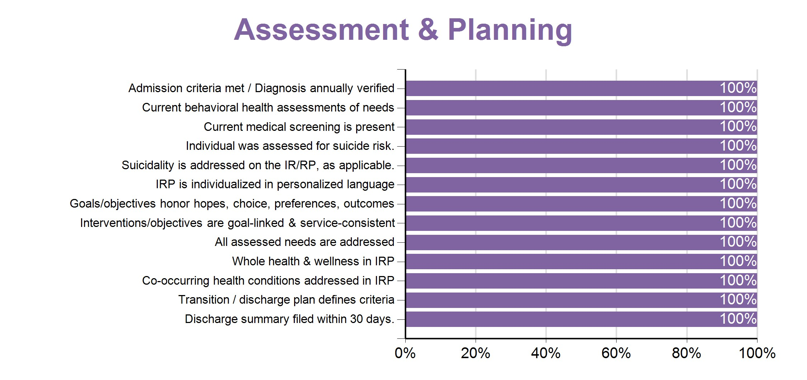
AFE’s Efficiency
GAC000366
Academy for Family Empowerment Services, Inc.
Billing
Validation
91
%
Service
Overall
Focused
Guidelines
Score
Outcome
100
%
98
%
Areas
99
%
Assessment
&
Planning
100
%
For more information, please review AFE Quality Report for 2021.

Slide 46
AFE’s Access to Services
Goal 1:
Consumers referred to Academy for Family
Empowerment, Inc. for CORE services will be seen
within 5 days for an initial intake appointment.
Results:
In 2021, this goal was not met.
Our agency implemented open access services prior to COVID but
due to staff shortage; had to return to scheduling intakes. We are
diligently hiring staff so that we can return to open access 4 days a
week.

Slide 47
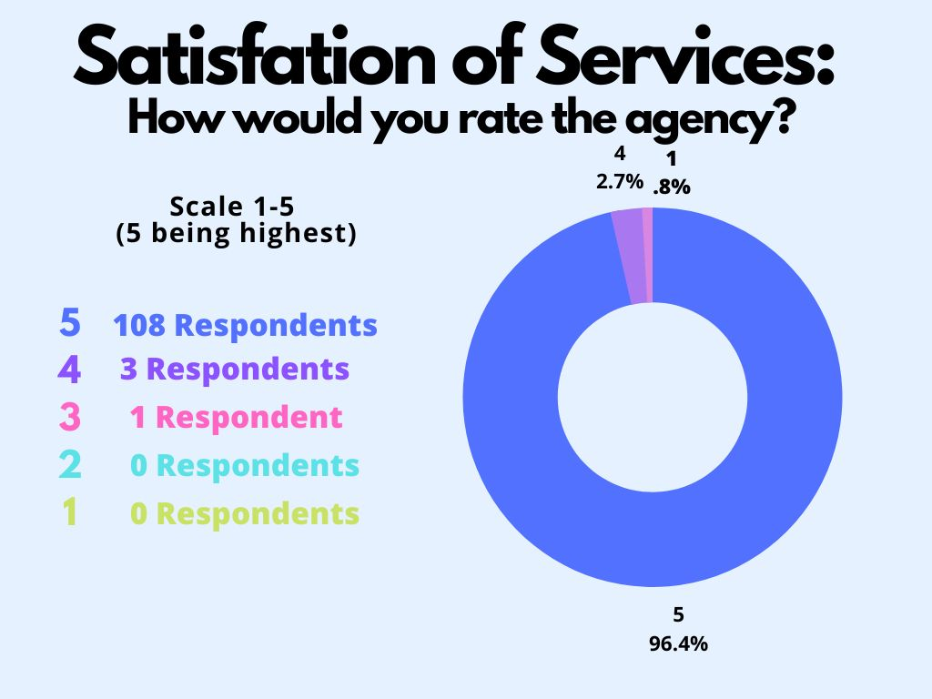
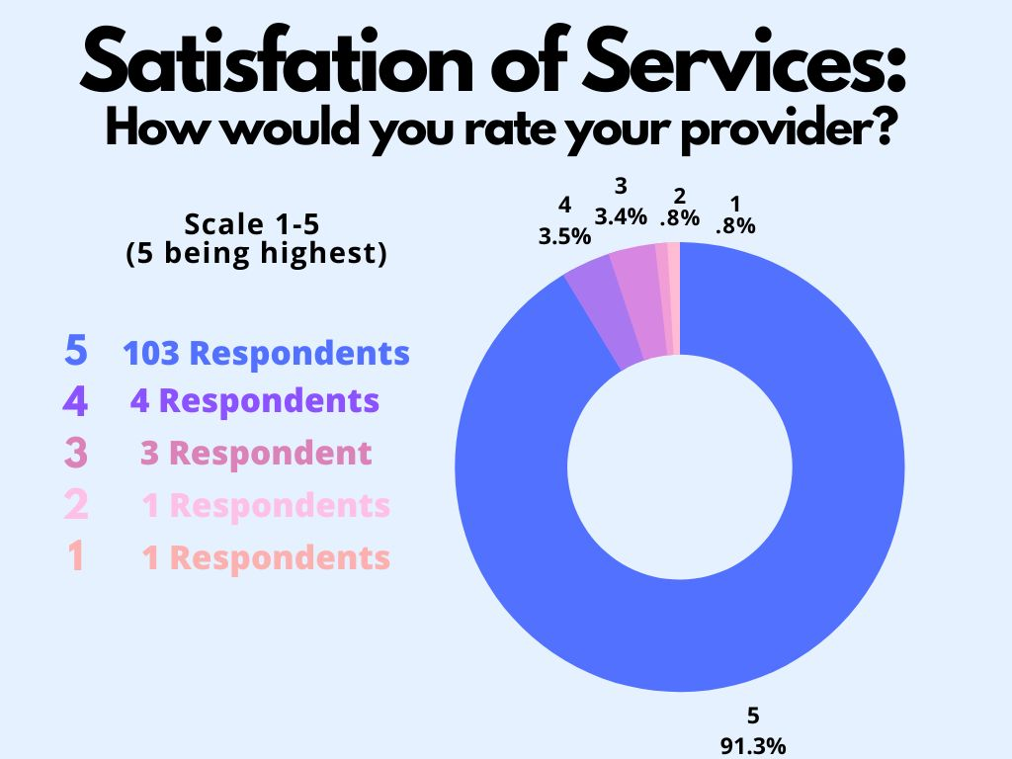
AFE Satisfaction with Services
Goal One:
85% of consumers/families served, will report being satisfied with the with the quality of services they received from AFE.
Results: In 2021, this goal was met.

Slide 48
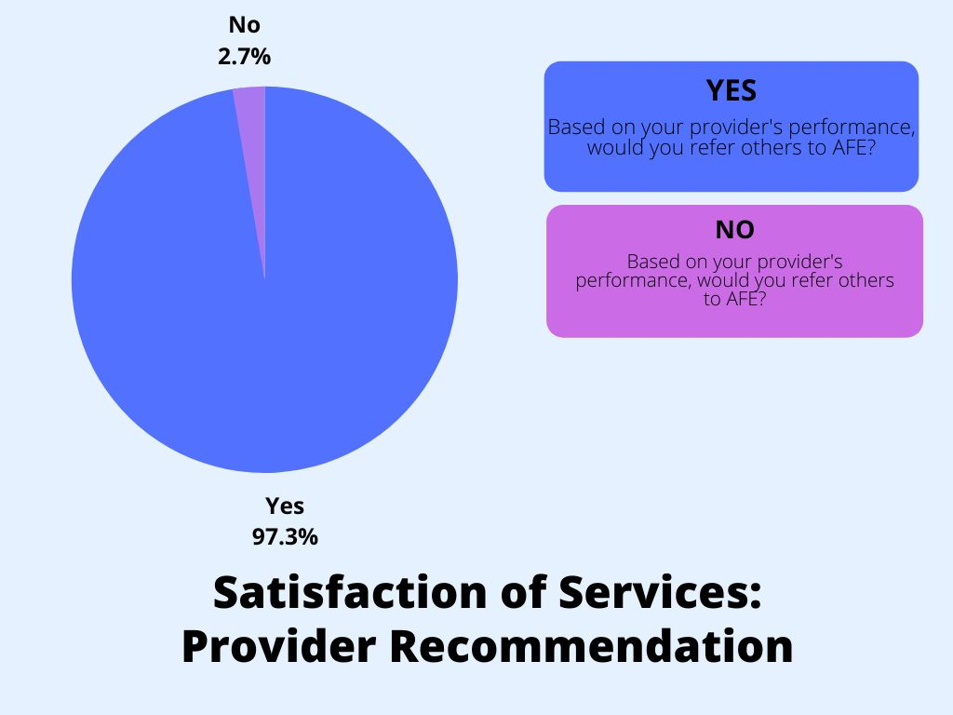
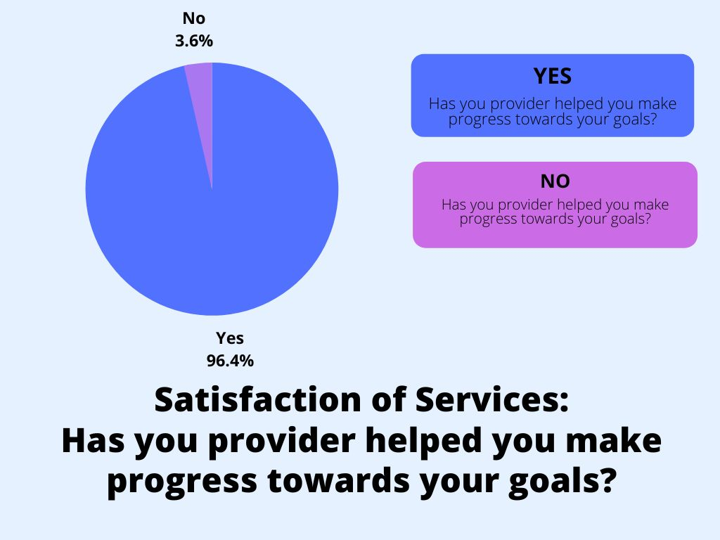
AFE Satisfaction with Services
Results for satisfaction with agency staff and progress towards goals are listed:

Slide 49
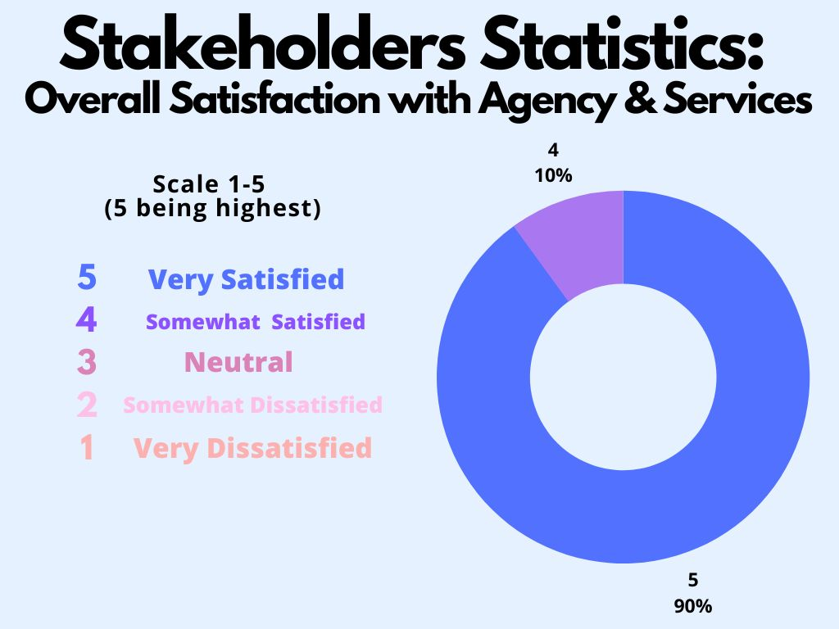
AFE Satisfaction/Stakeholders
85% of stakeholders will report being satisfied with the quality of services and interaction with AFE staff members.
Results: In 2021, this goal was met.

Slide 50
Human Resources
Human Resources Statistics

Slide 51
Human Resources Overview
GOAL: AFE will maintain a staff retention rate of 80%. In 2021, this goal was not met.
In 2021, AFE struggled with staffing as did most mental health agencies. In 2021, AFE had a retention rating of 76.81% and had a total of 54 employees/contactors at the end of the year.

Slide 52
Human Resources Overview
During 2021, AFE struggled with hiring staff to fulfill our mission and goals. We hired 17 staff for the year.
Goal: AFE will increase recruitment by 10% in 2022.
For more information, please review AFE Human Resources Annual Report for 2021.

Slide 53
Areas
of
Growth

Slide 54
Areas of Growth
Our approach is founded on a deep commitment to continually improving
our services. In an effort to continue to improve the services we provide,
AFE will implement the following:
To increase referrals, AFE will develop marketing and outreach strategies that will increase our potential for referrals from a wider geographic area throughout metro Atlanta. We will also educate referral sources on appropriate referrals based upon insurance, presenting needs, geographic location and ages.
Increase staff retention rate to 80% and increase work force by 10%. AFE is working diligently to hire staff to fill current open positions.
Return to open access scheduling for intakes 4 days a week (once sufficient staff has been hired).
Regular feedback from referral sources and consumers served will continue to be used to improve services.

Slide 55

Areas of Growth
AFE will work to increase successful discharge rate to 75%. We believe that our results were impacted by COVID. However, moving forward we will ensure that all families are aware of their discharge plan. AFE will train staff on discharge planning and ensure that AFE staff begin the discharge process prior to the end of services. AFE will ensure that each plan is written, presented to the family and the recommendations are implemented.
Continue to promote a diverse work force population that is able to meet the needs of the consumers served.
Explore new trends within the workforce as a result of COVID. Maintain a positive work culture and employee morale to enhance staff retention.

Slide 56

Questions/Comments
We welcome your comments and feedback. To
contact us, please call our office at (770) 918-8003
or by email at adenise@affeinc.org.

