Slide 1
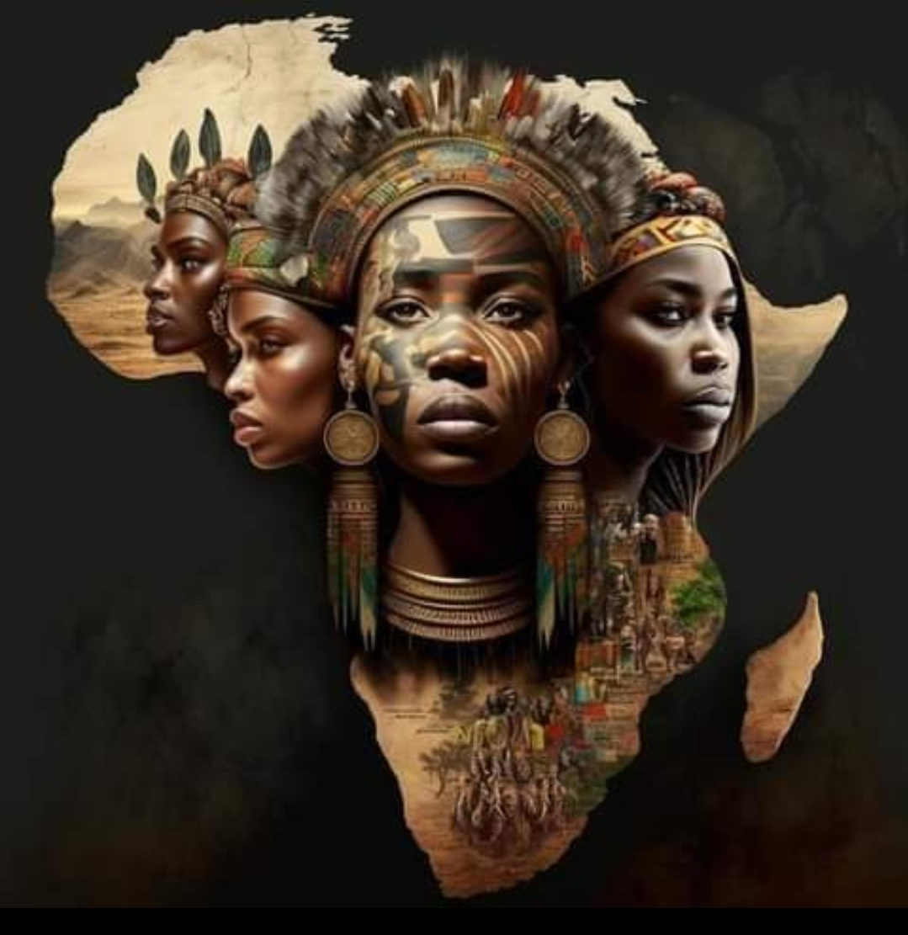
THIS IS CONGO

Slide 2


THIS IS CONGO

Slide 3
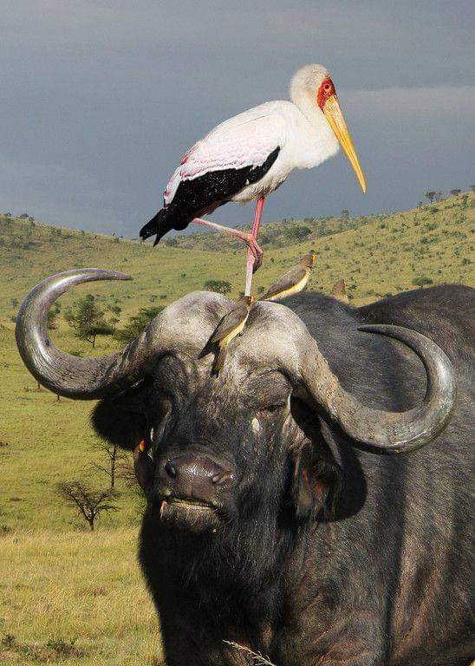
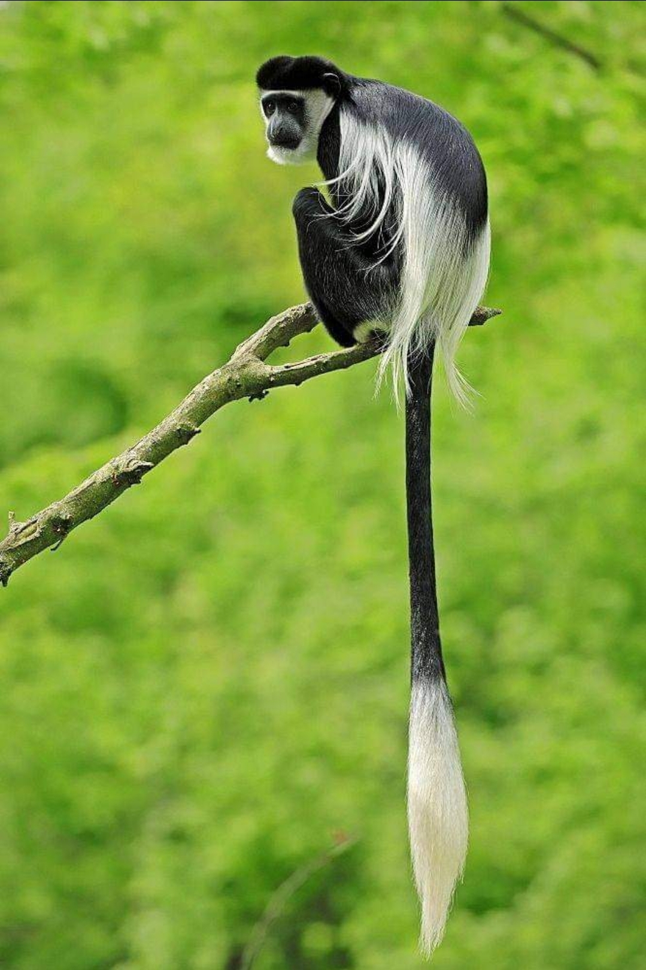
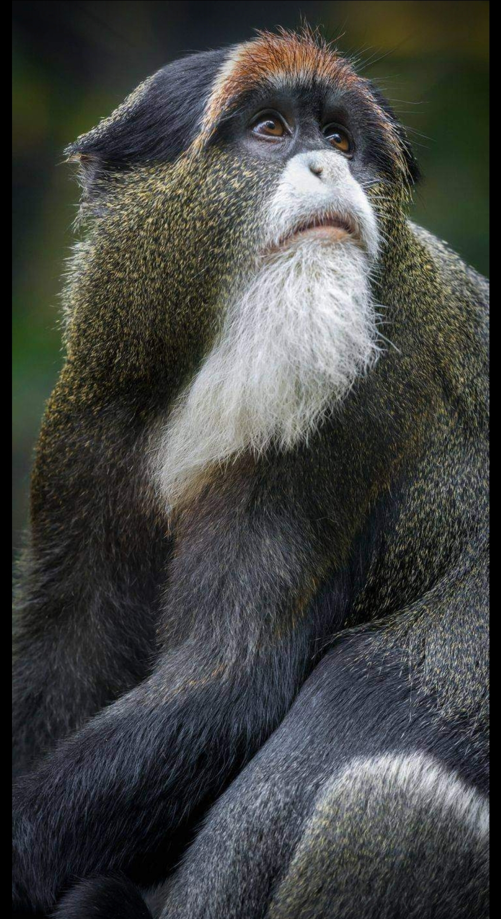
THIS IS CONGO

Slide 4
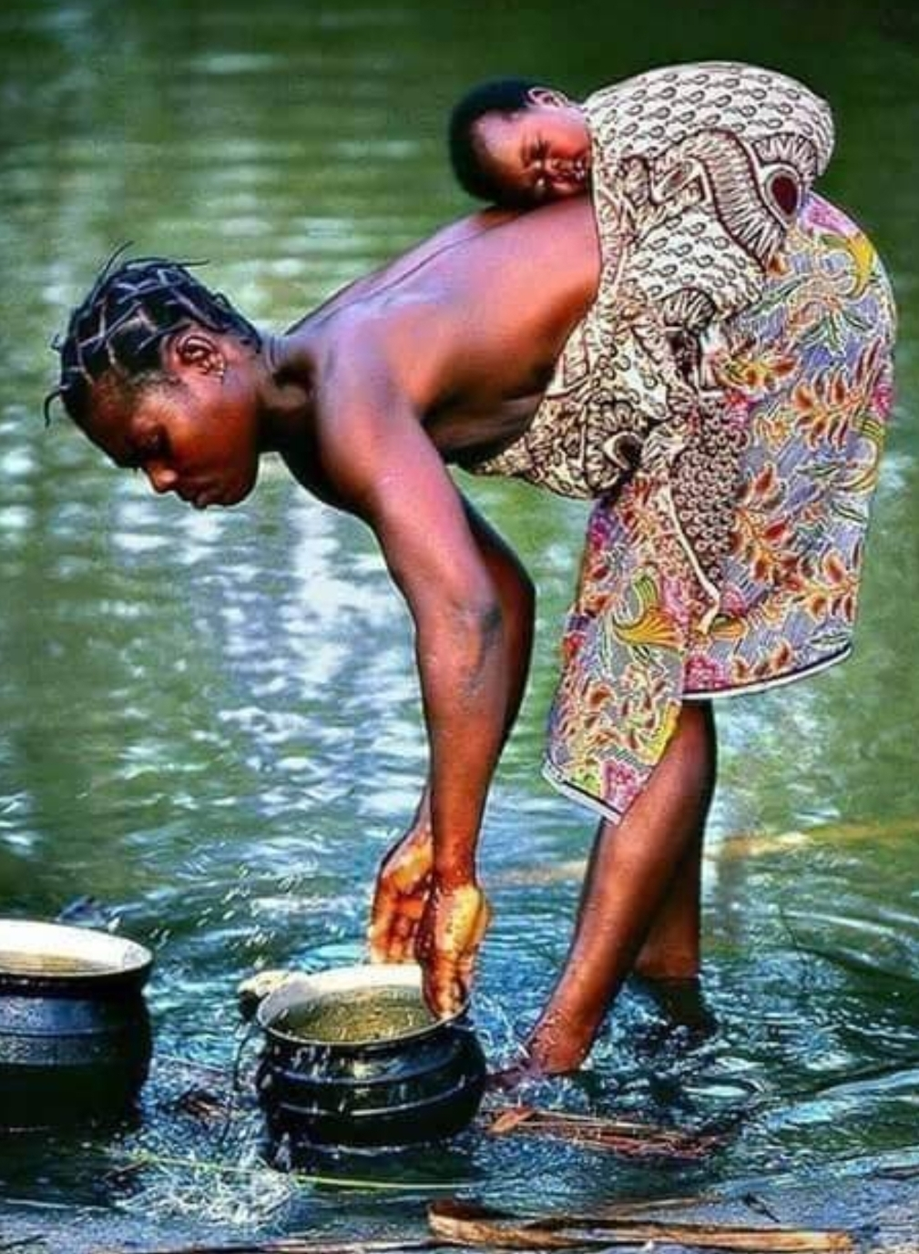
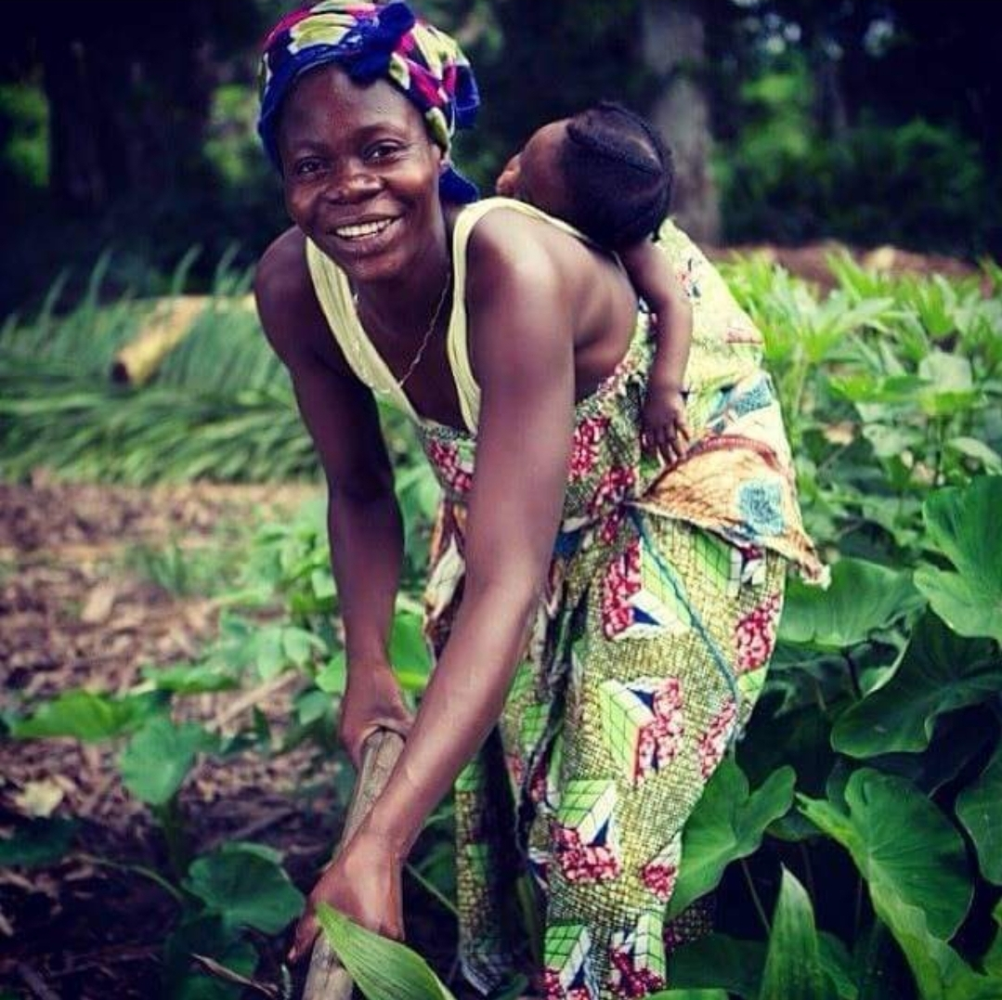
THIS IS CONGO

Slide 5

THIS IS CONGO

Slide 6
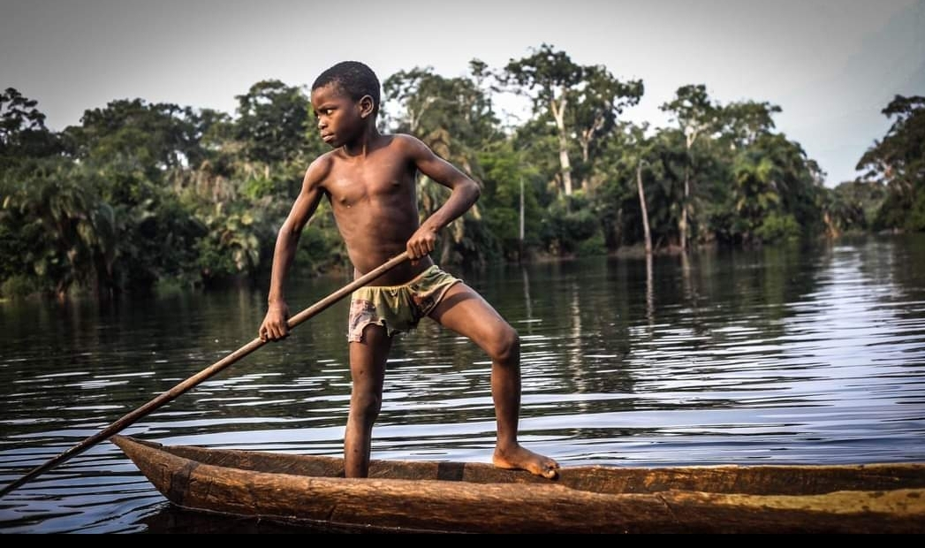
THIS IS CONGO

Slide 7
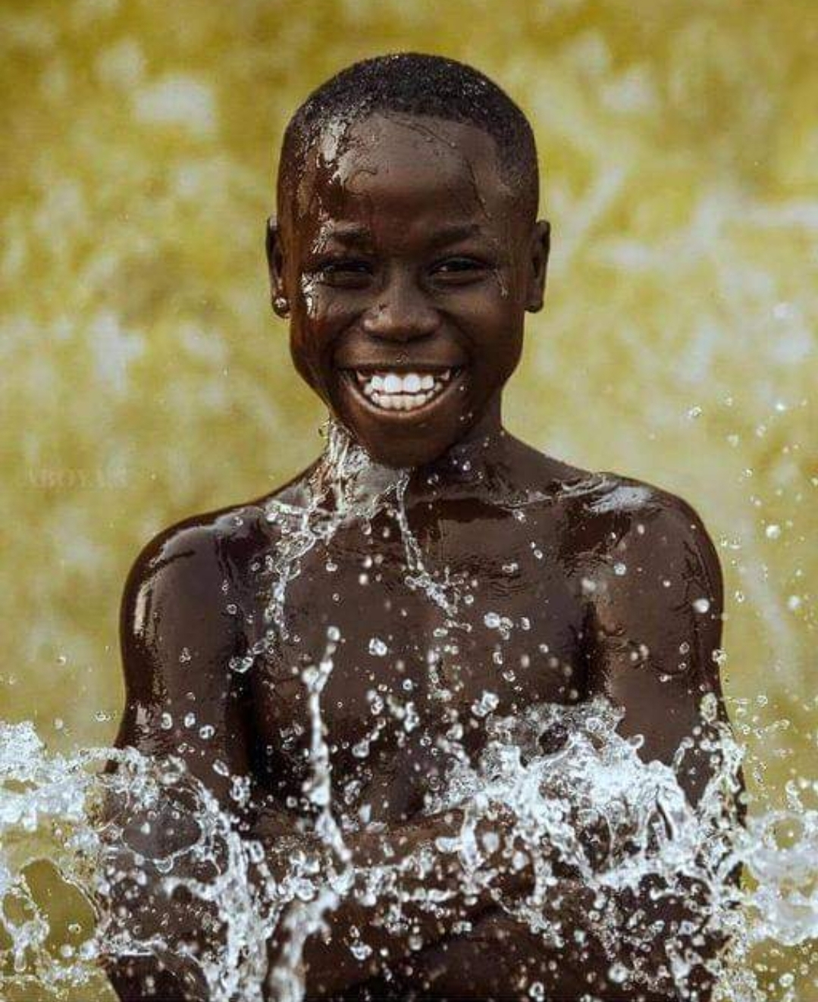
THIS IS CONGO

Slide 8
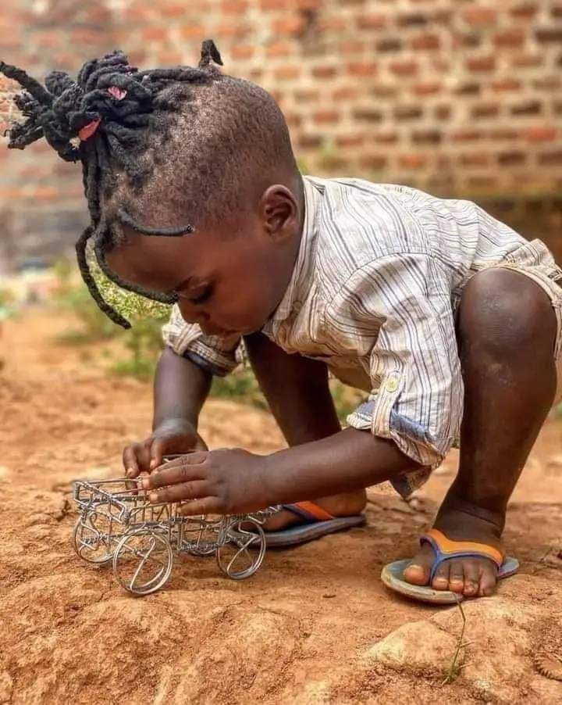
THIS IS CONGO

Slide 9
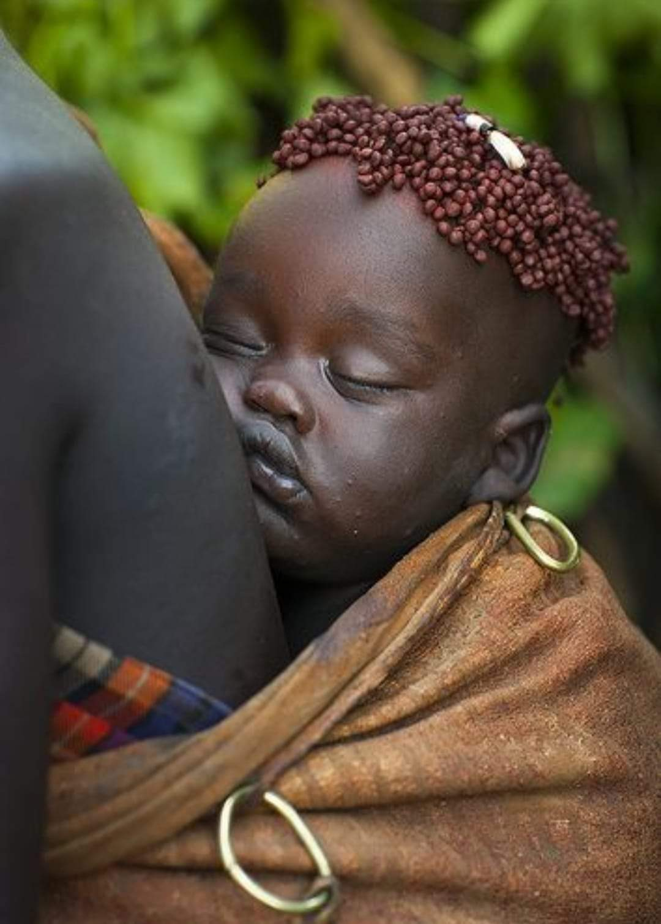
THIS IS CONGO

Slide 10
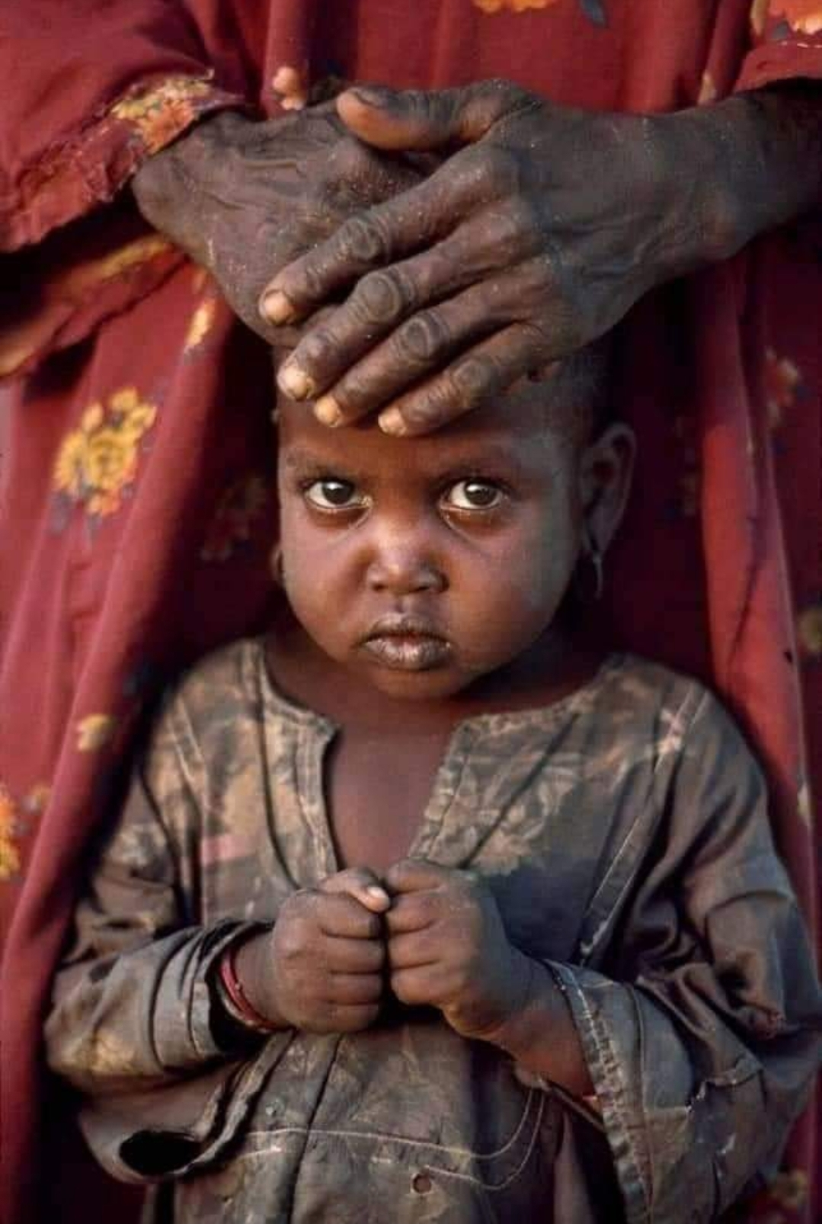
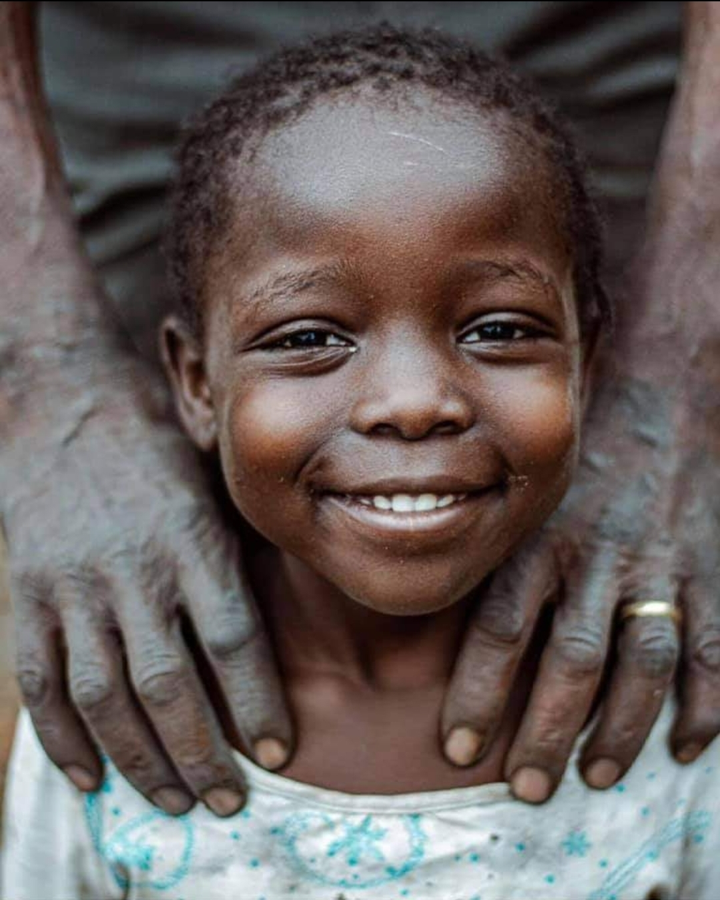
THIS IS CONGO

Slide 11
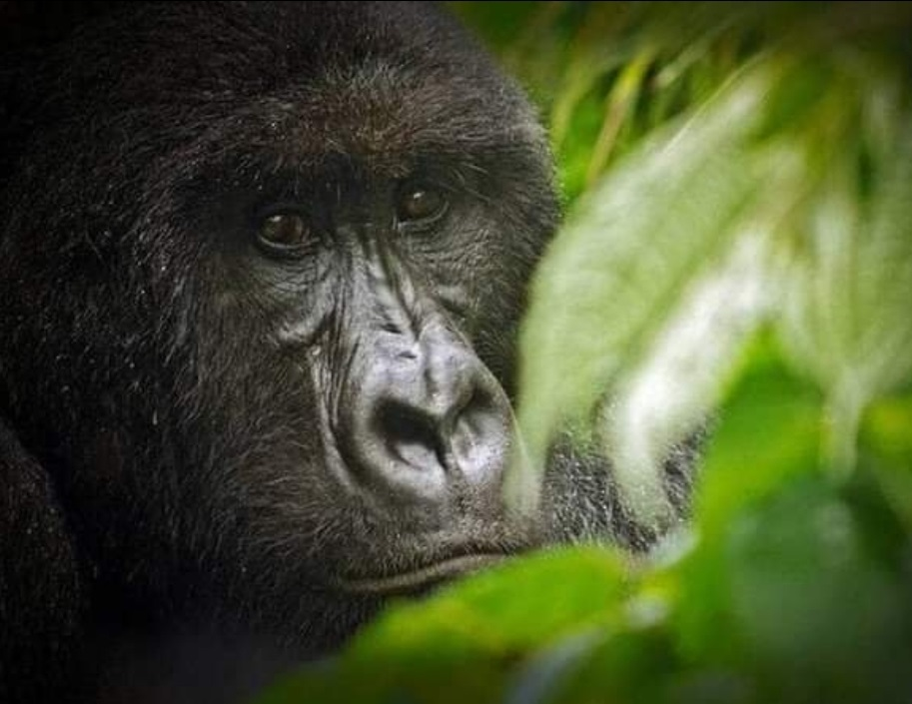
THIS IS CONGO

Slide 12
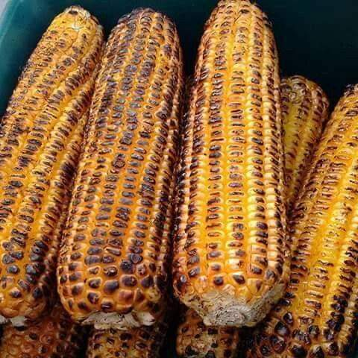
THIS IS CONGO

Slide 13
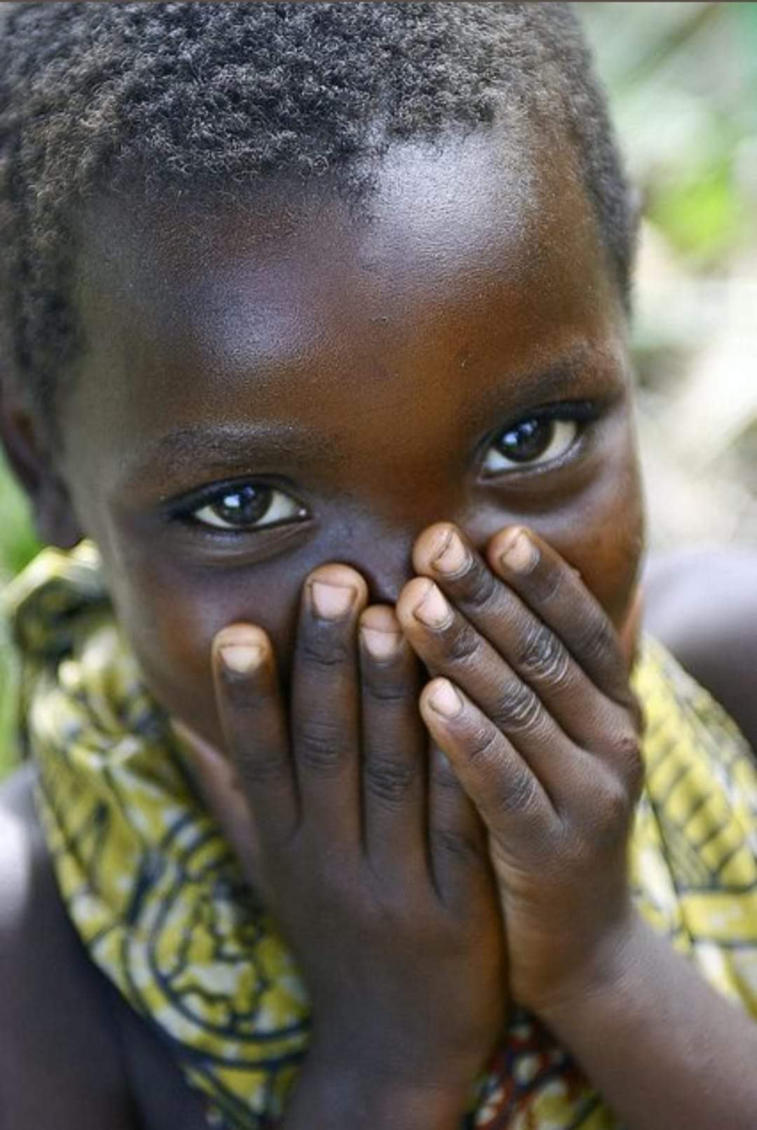
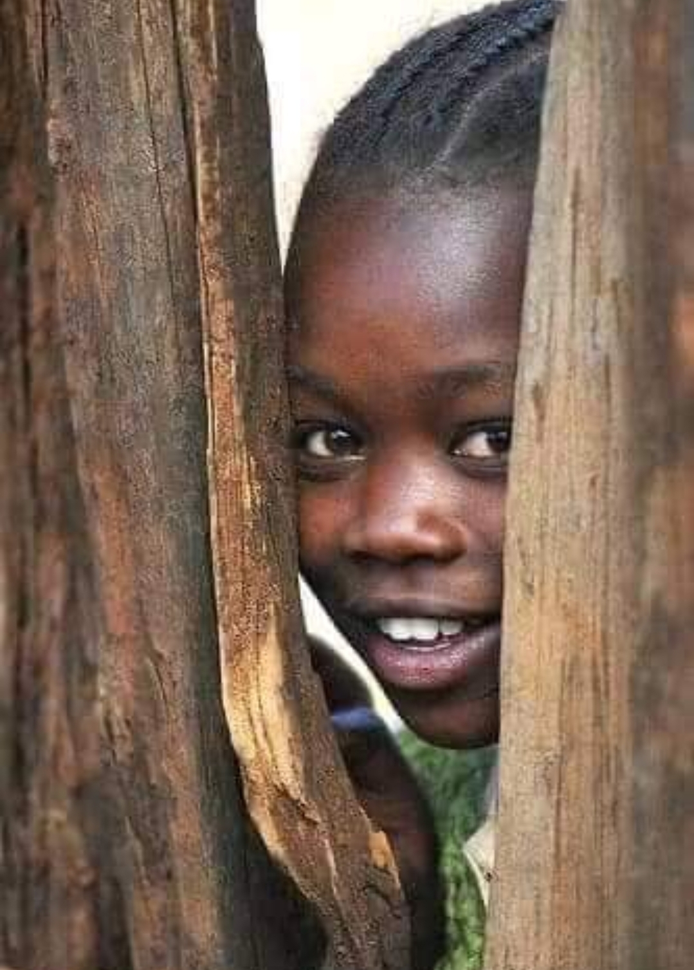
THIS IS CONGO

Slide 14
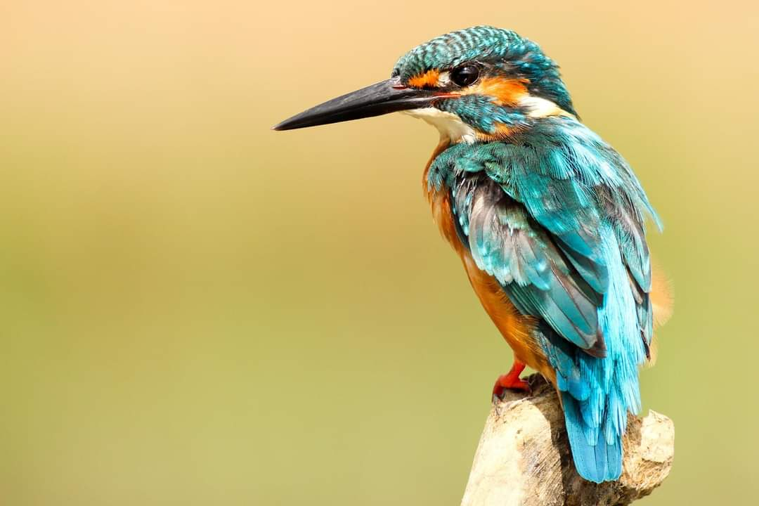
THIS IS CONGO

Slide 15
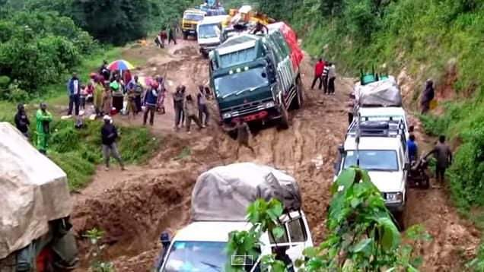
Life Here Is Hard

Slide 16
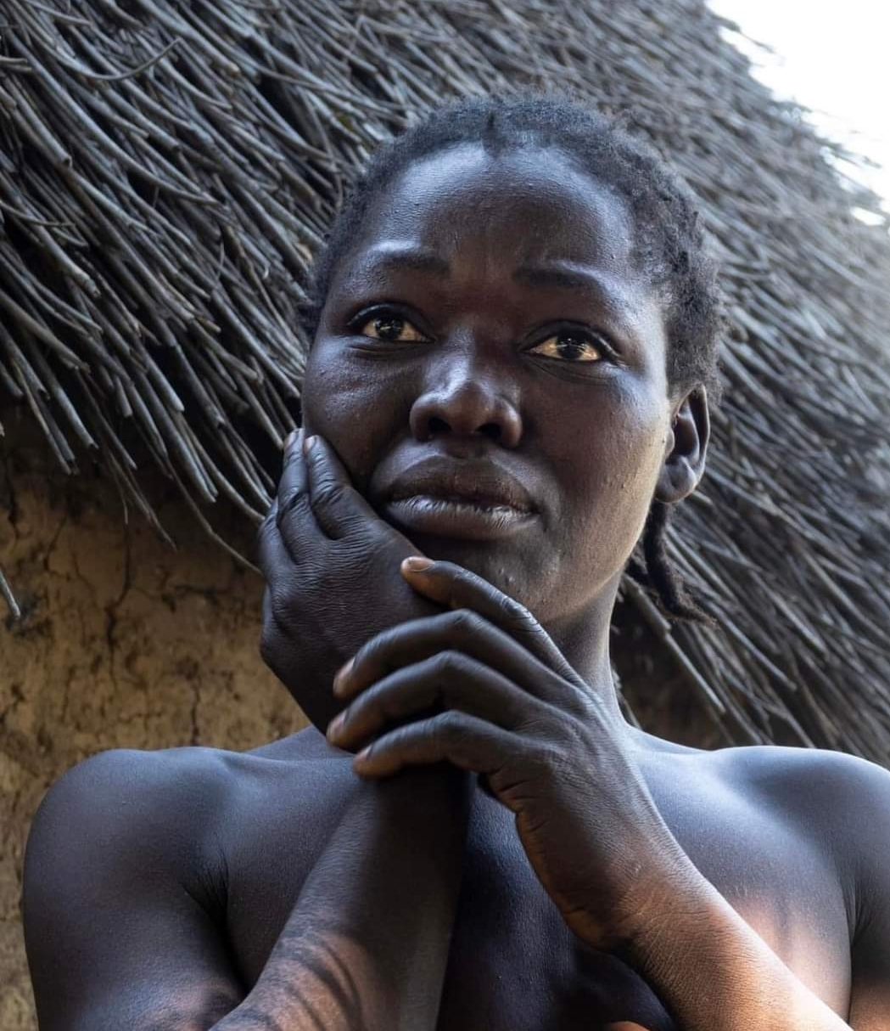
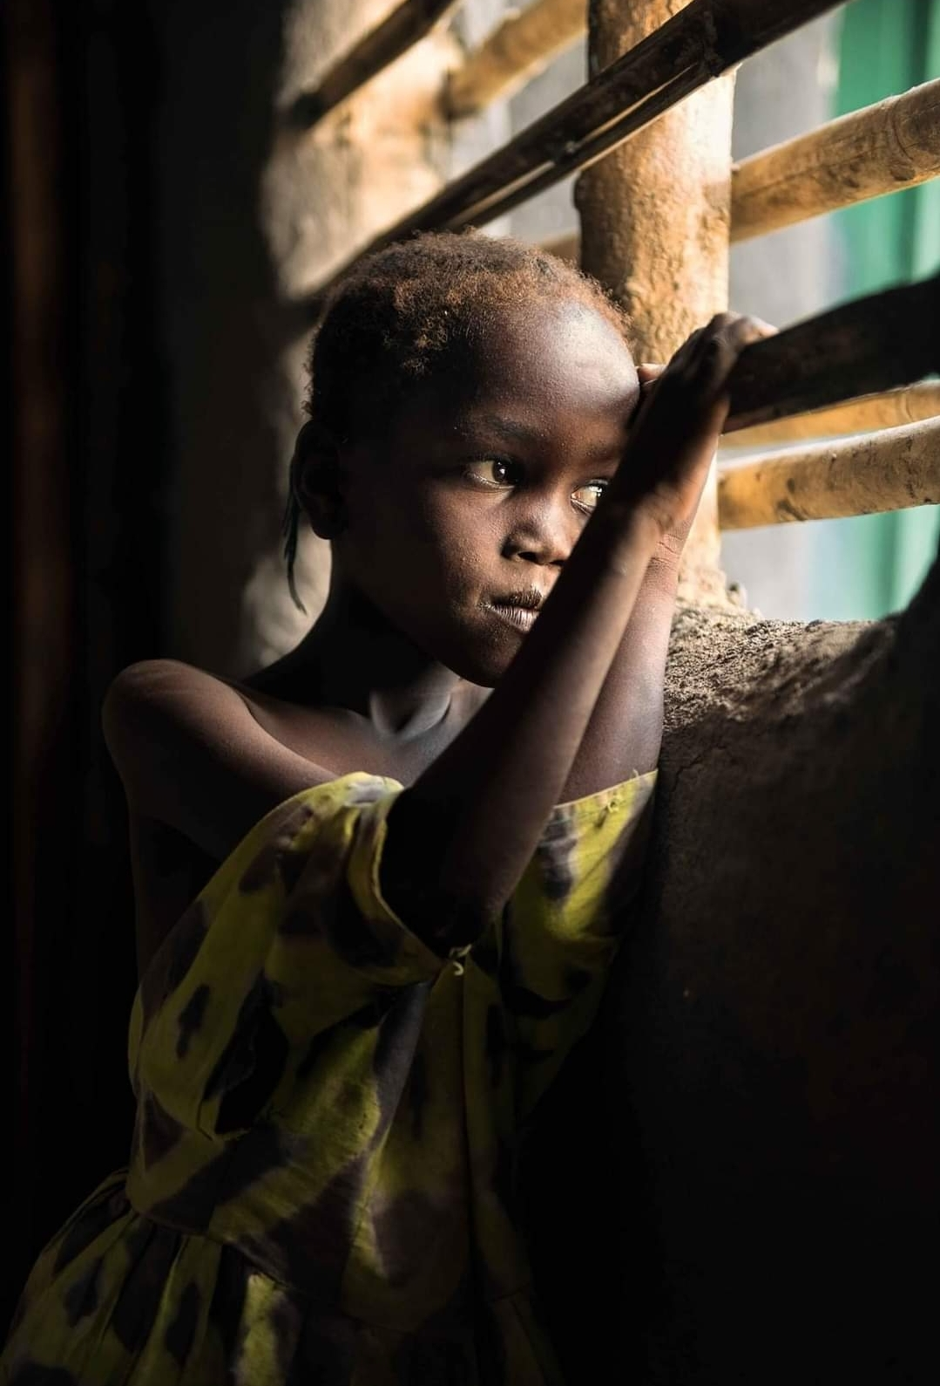
Life Here Is Hard

Slide 17
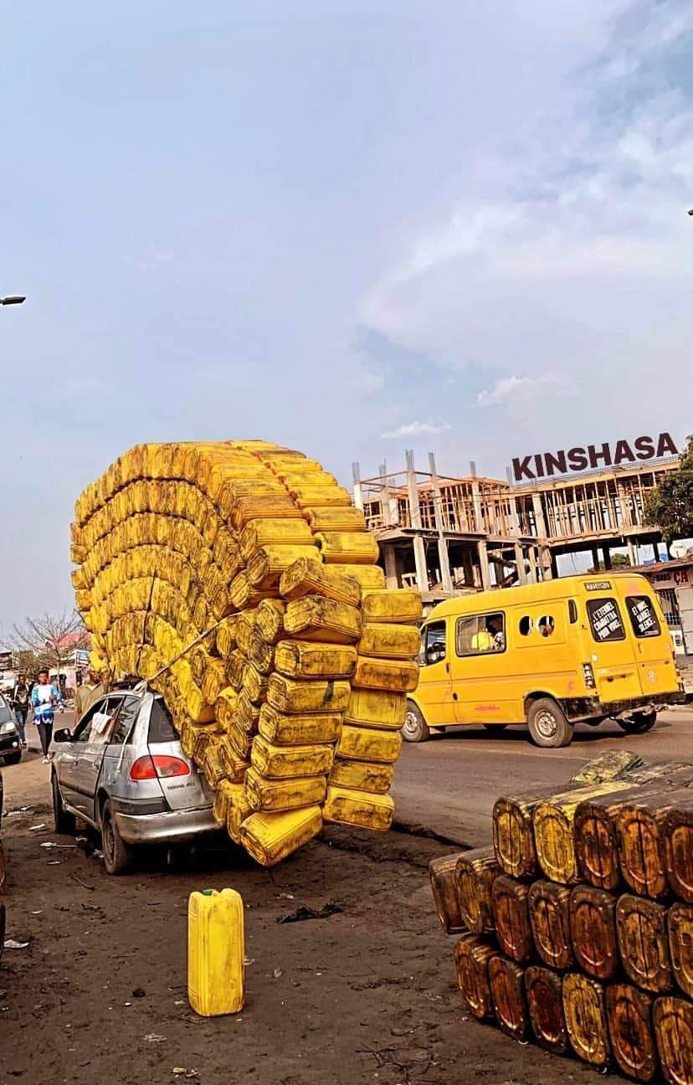
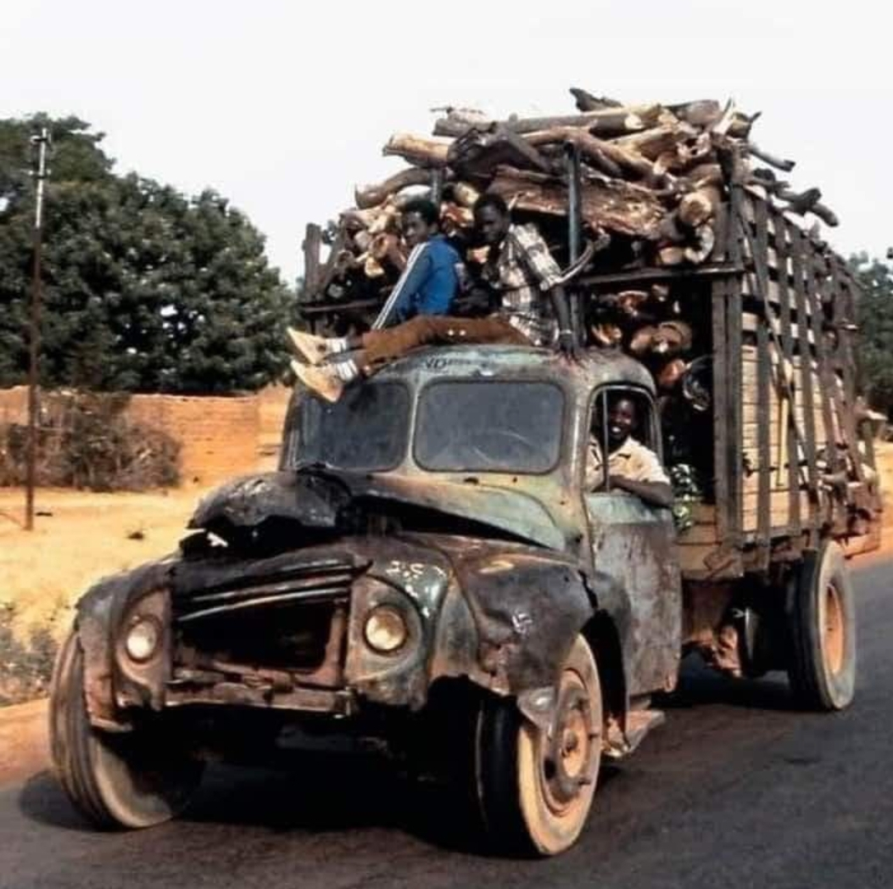
Life Here Is Hard

Slide 18
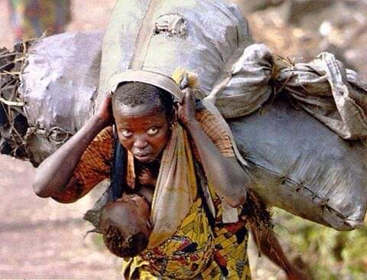
Life Here Is Hard

Slide 19
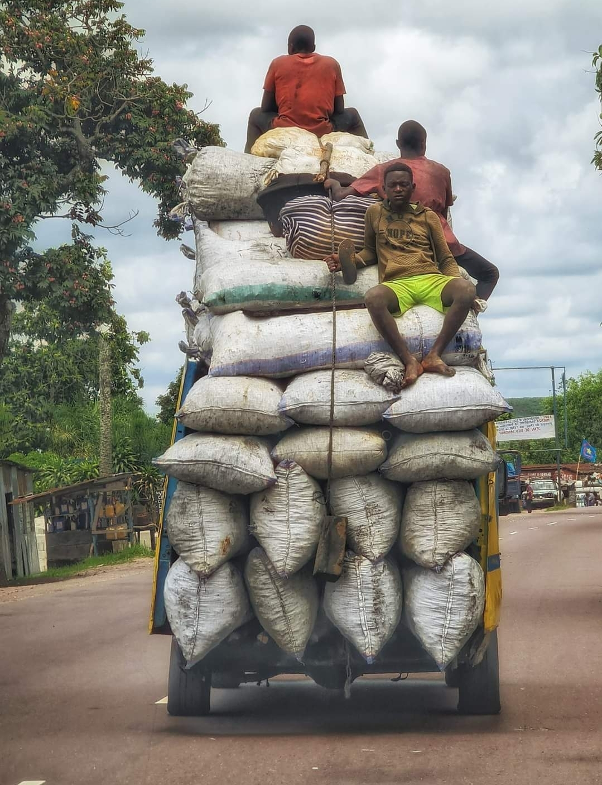
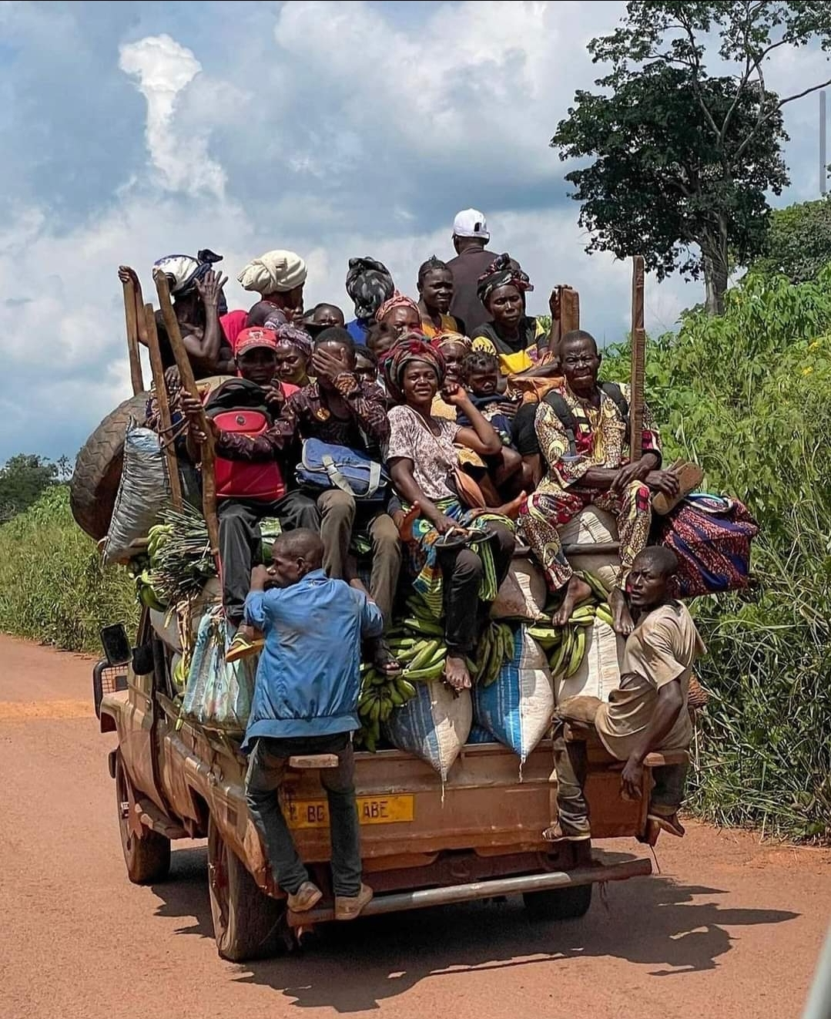
Life Here Is Hard

Slide 20
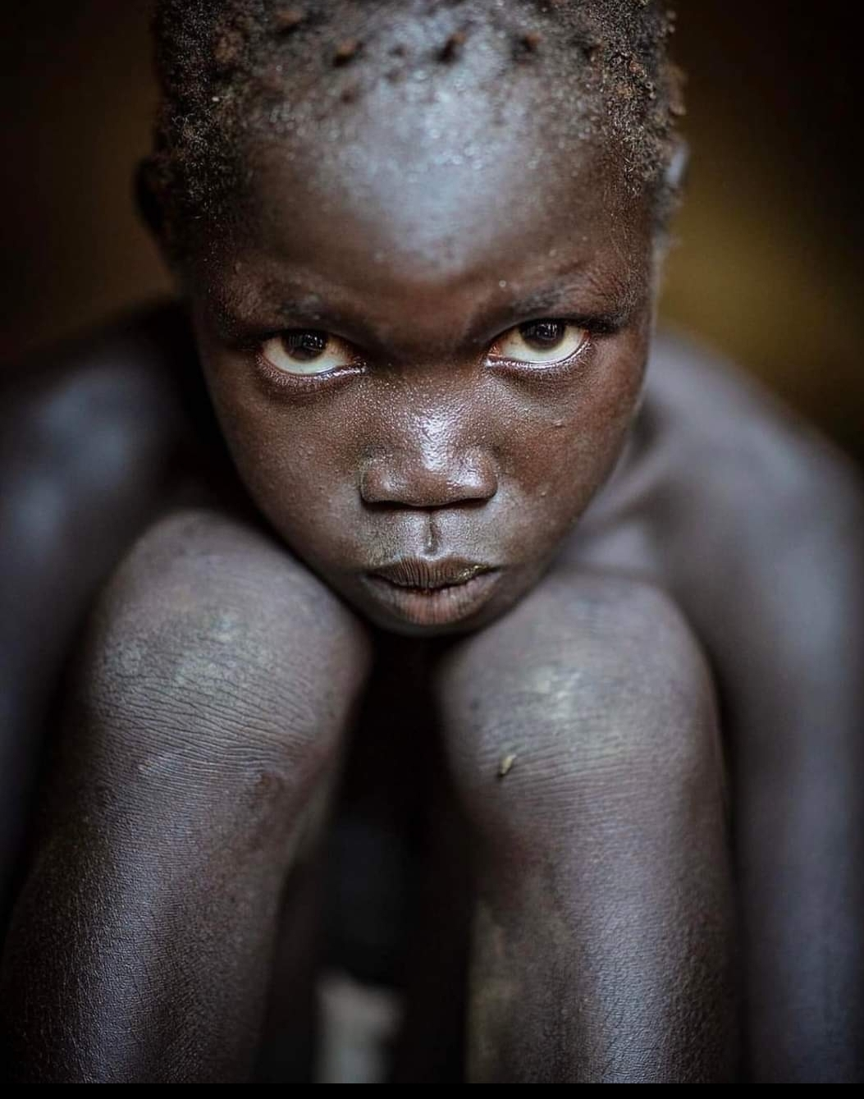
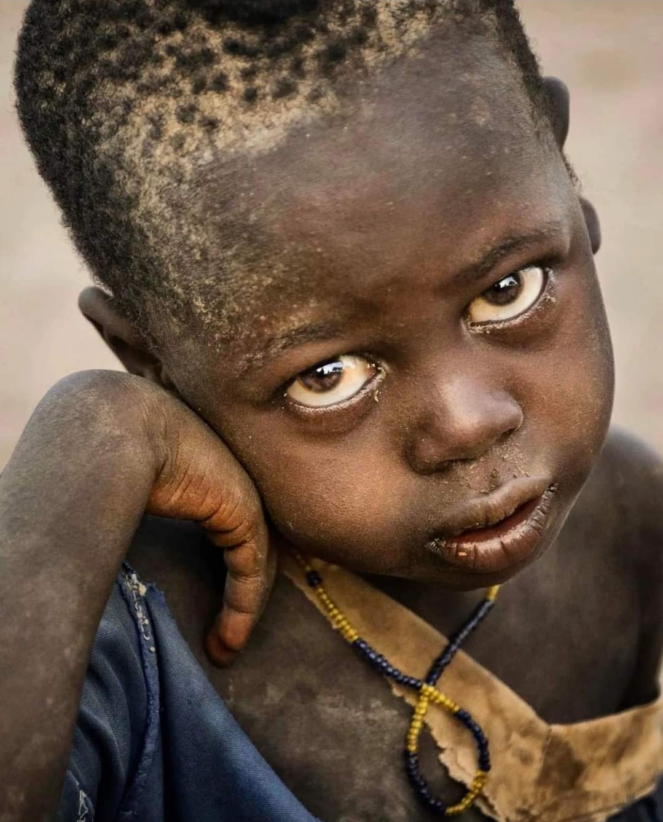
Life Here Is Hard

Slide 21


Slide 22

Why We Exist
To Ease Suffering
To Bring Healing
To Introduce People to the life giving presence of God

Slide 23
What We Do
Train Nurses
Train Midwives
Train Lab Techs
MISSIONARIES

Slide 24
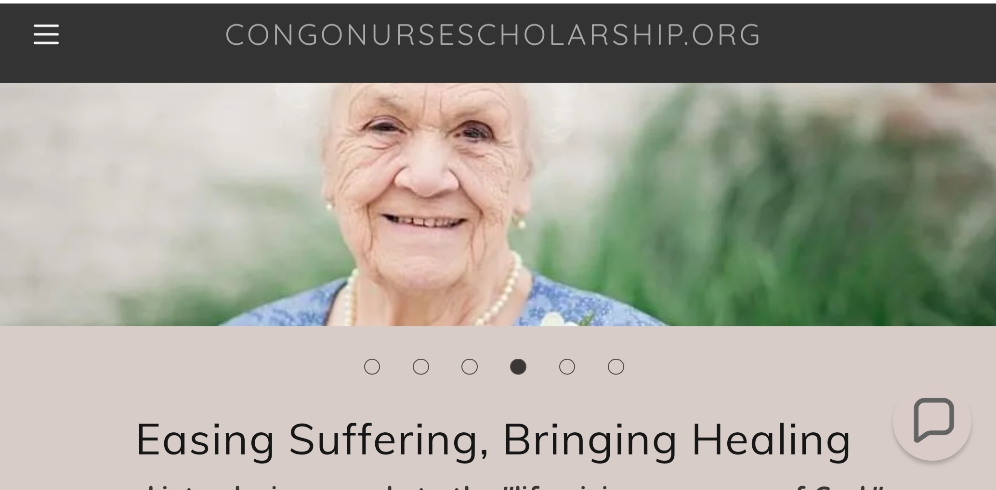

Slide 25
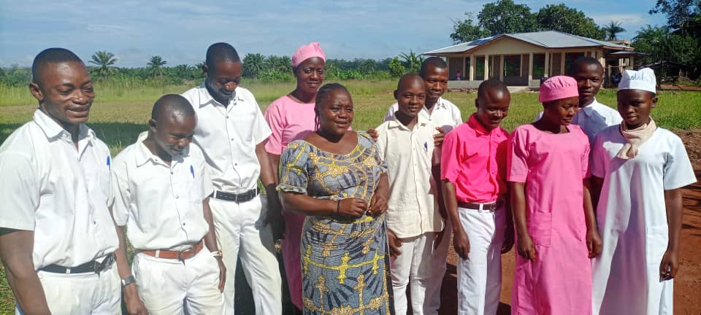
CNSP MEDICAL STUDENTS

Slide 26
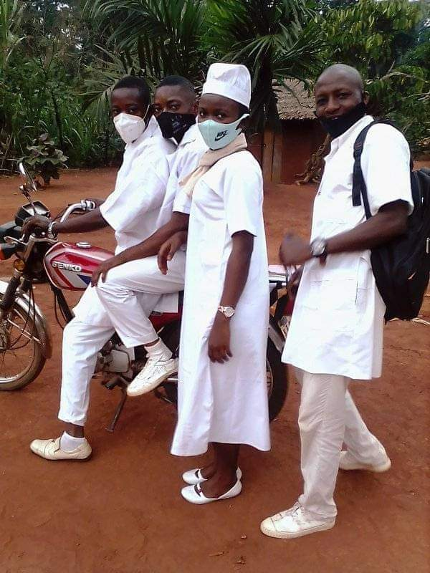
Village Rounds

Slide 27
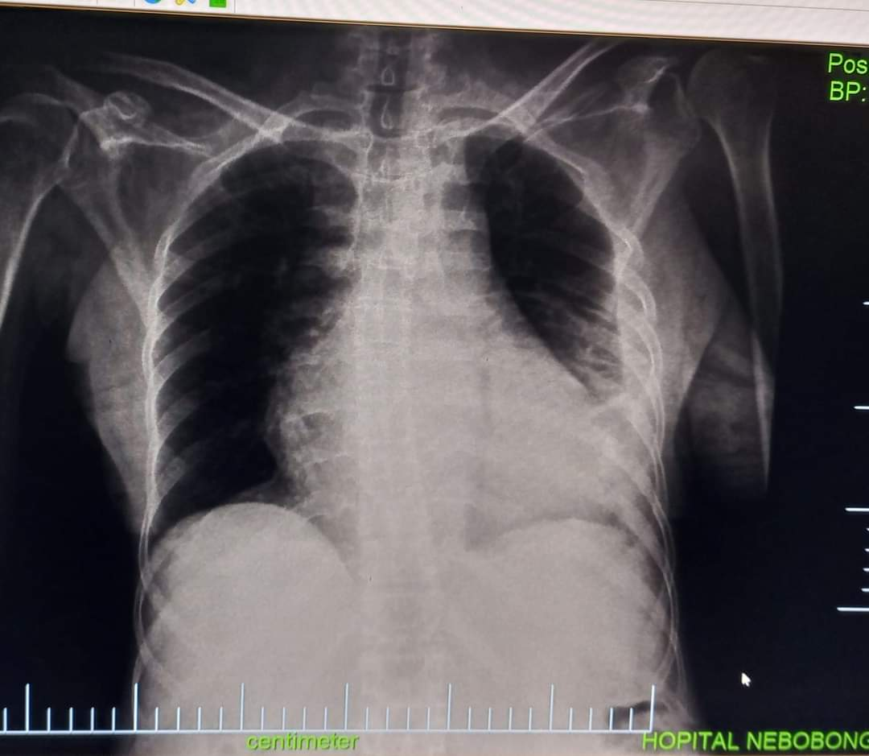
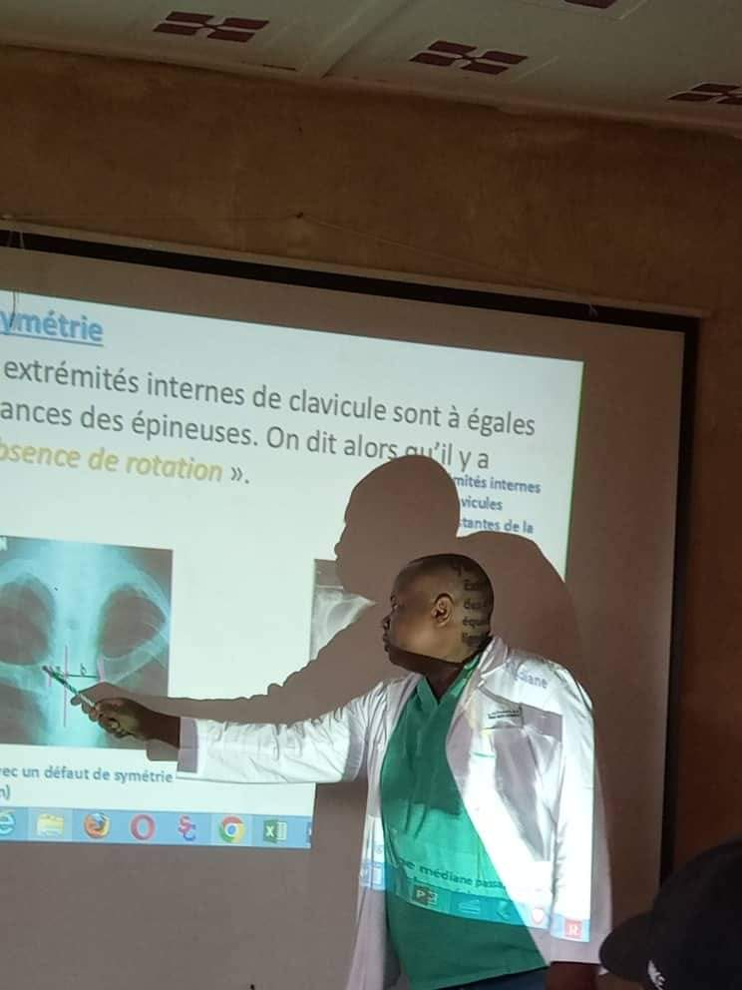
Dr. Sengi Teaches Radiology

Slide 28
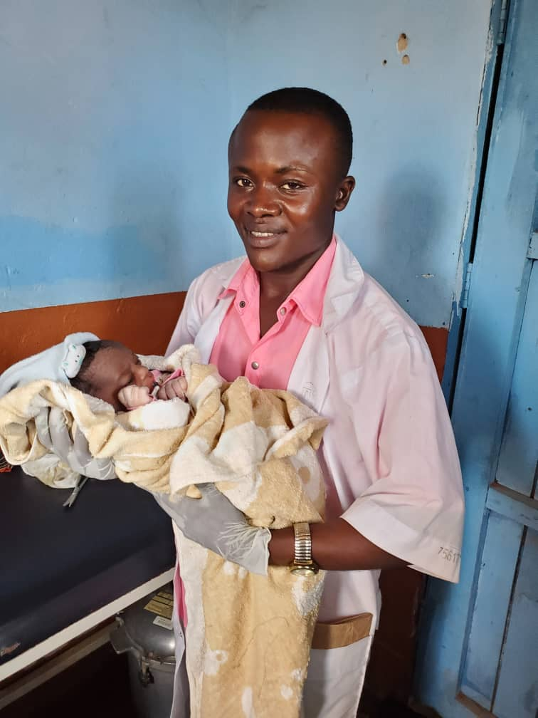
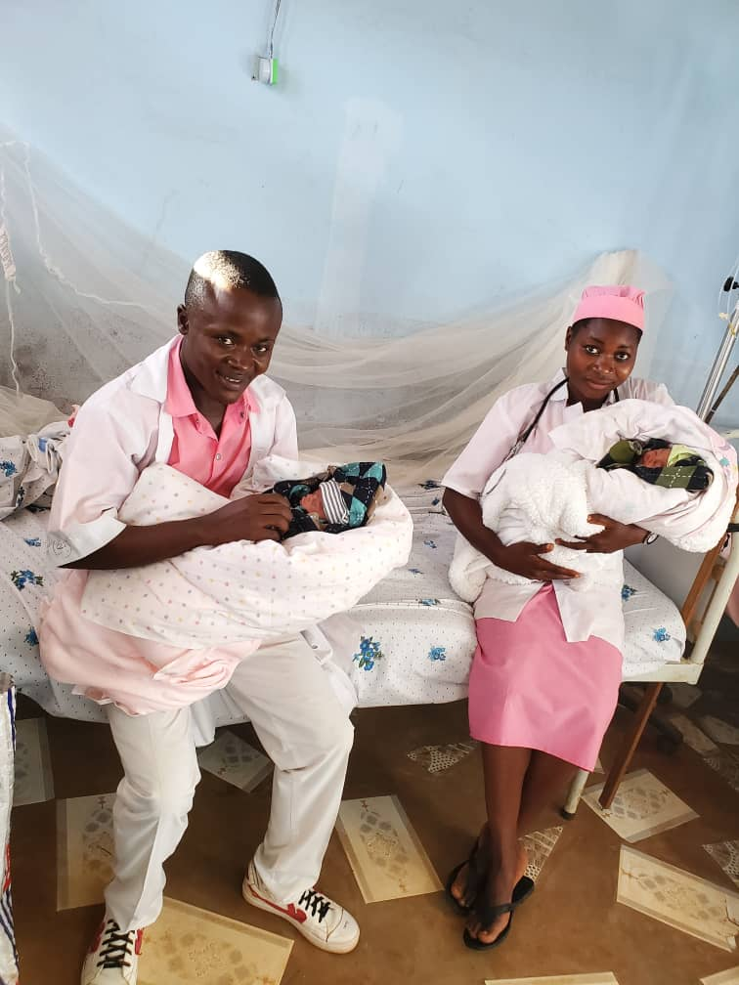
CNSP Midwives Deliver Twins!

Slide 29
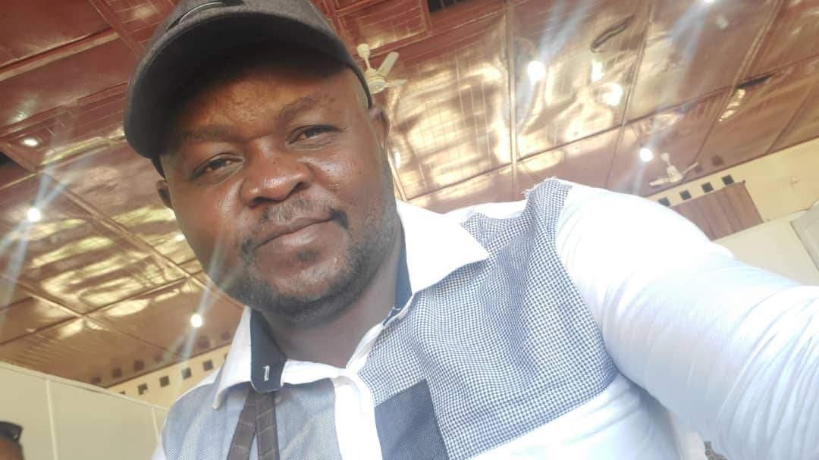
Dr. Steve Made: Our Director in Congo

Slide 30


Get Ready For a GREAT Service!

