Slide 1
Intellectual Property Protection For Yoga and Wellness Businesses

Slide 2
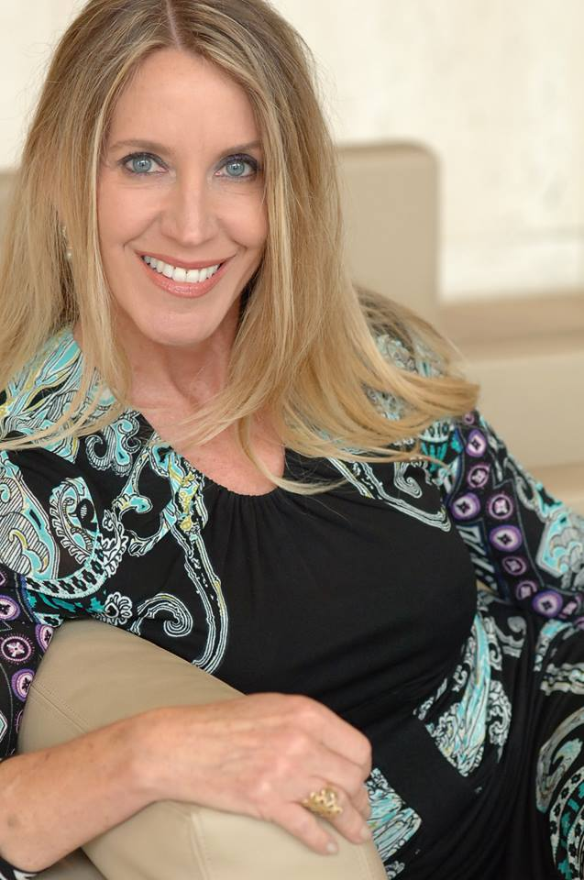
Caroline H. Mankey
Akerman LLP
Caroline H. Mankey is a partner in the Los Angeles office of Akerman LLP, a certified yoga instructor, and a seasoned trial lawyer representing clients in the entertainment, arts, fashion, wellness, sports, retail, and technology sectors, such as motion picture studios and production companies, major media companies, film libraries, actors, comedians, television personalities, musicians, artists, jewelry designers, retailers, manufacturers, architects, market research firms, and others, in disputes involving copyrights, trademarks, trade secrets, design patents, defamation, licensing and other contract rights, rights of publicity, business interference, and partnership disputes.
https://www.akerman.com/en/people/caroline-mankey.html

Slide 3
What Is Intellectual Property?
Trademarks – Identify the sources of goods and services.
Copyrights – Protect an author’s exclusive right to copy, broadcast, distribute and make derivative works from creative works, such as fine arts, music, movies, and writings.
Publicity Rights – Protect an individual’s right to control the commercial use of his or her name or likeness.
Patents – Protect the exclusive rights of inventors to exclude others from making or selling the inventor’s novel and non-obvious processes, designs or plants. Patent protection is outside the scope of this presentation.

Slide 4
Why do yoga and wellness businesses need intellectual property?
Trademarks – Protect your business name, logo or slogan from being used by competitors or others in a manner that is likely to confuse consumers about who the source of the goods or services is.
Copyrights – Protect the photographs, artwork and text on your website, signage and marketing material from being copied and used by competitors or others without your authorization.
Publicity Rights – Protect your name and likeness from being used commercially by competitors or others without your authorization.

Slide 5
What is a trademark?
  The term “trademark” includes any word, name, symbol, or device, or any combination thereof –
    (1) used by a person, or
    (2) which a person has a bona fide intention to use in commerce and applies to register on the principal register established by this chapter,
    to identify and distinguish his or her goods, including a unique product, from those manufactured or sold by others and to indicate the source of the goods, even if that source is unknown. 15 U.S.C. § 1127.

Slide 6


Trademark Examples
U.S. Reg. Nos. 2609355, 2645039 & 2720497 (Yoga Journal LLC)
U.S. Reg. Nos. 2991794 & 5668591 (Yoga Works, Inc.)
U.S. Reg. No. 2940533 (Beyond Yoga, Inc.)

Slide 7
Selecting a Trademark
GET CREATIVE!
The strongest trademarks are arbitrary or fanciful.
  Arbitrary marks are words that are unrelated to the goods or services they represent (MANDUKA (frog) for yoga mats)
  Fanciful marks are made-up words (GAIAM, which fuses “Gaia” and “I am”)
Weak or unprotectable trademarks are descriptive or generic.
  Descriptive marks are merely descriptive of the product or service (FREESTYLE HATHA YOGA or KABBALAH YOGA)
  Generic marks are the key ingredient, characteristic or style of the product or service (VINYASA YOGA)

Slide 8
How does one acquire a trademark?
Trademark rights are acquired through your use of the trademark in commerce. If you are selling or offering to sell goods or services, and using a trademark to identify you as the source of the goods or services, you are acquiring trademark rights.
Registering your trademark with the United States Patent & Trademark Office will afford you proof of your priority of use of the mark and other beneficial legal presumptions and remedies in the event that you need to sue a third party for infringing your trademark.
It’s possible to register your trademark yourself at www.uspto.com, but there are potential pitfalls that can result in a refusal to register your trademark, so it is best to engage an experienced trademark attorney.

Slide 9
What if someone else is already using the trademark you want to use?
The first person to use a trademark has priority of use and has superior rights, even without registering it.
Before you start using a trademark, you should make sure no one else is already using it in connection with the same, similar or related goods or services.
Search for your desired trademark on the Patent & Trademark Office’s database here: http://tmsearch.uspto.gov/bin/gate.exe?f=tess&state=4802:1hjv1l.1.1
Search online to see if anyone is using the trademark without a registration.
Engage an experienced trademark attorney.

Slide 10
Protecting Your Trademark
Use it or lose it! Trademark rights are maintained through continued use in commerce. Once you stop using it, it may be deemed abandoned and any registration may be cancelled.
Monitor and police infringers who may be using your trademark in a manner similar to your use. Google alerts and periodic searches are an easy way to monitor third party uses yourself.
Engage a trademark lawyer to monitor new applications for registration of similar marks for use in connection with similar goods or services to yours.
Have your lawyer send a “cease and desist” letter to infringers and to help you evaluate whether further measures are warranted.

Slide 11
What is a copyright?
Original works of authorship fixed in any tangible medium of expression, from which they can be perceived, reproduced, or otherwise communicated, including:
  (1) literary works;
  (2) musical works, including any accompanying words;
  (3) dramatic works, including any accompanying music;
  (4) pantomimes and choreographic works;
  (5) pictorial, graphic, and sculptural works;
  (6) motion pictures and other audiovisual works;
  (7) sound recordings; and
  (8) architectural works. (17 U.S.C. § 102)

Slide 12
Why are copyrights important to me?
Suppose you invest time and money shooting beautiful images of your studio, products, or you teaching yoga to display on your website. As soon as you post these beautiful shots online, they can be copied by anyone. Registering the copyright to the images will provide you with the necessary tools to prevent third parties from using your images without permission and potentially to recover damages and your attorneys’ fees from the infringer.

Slide 13
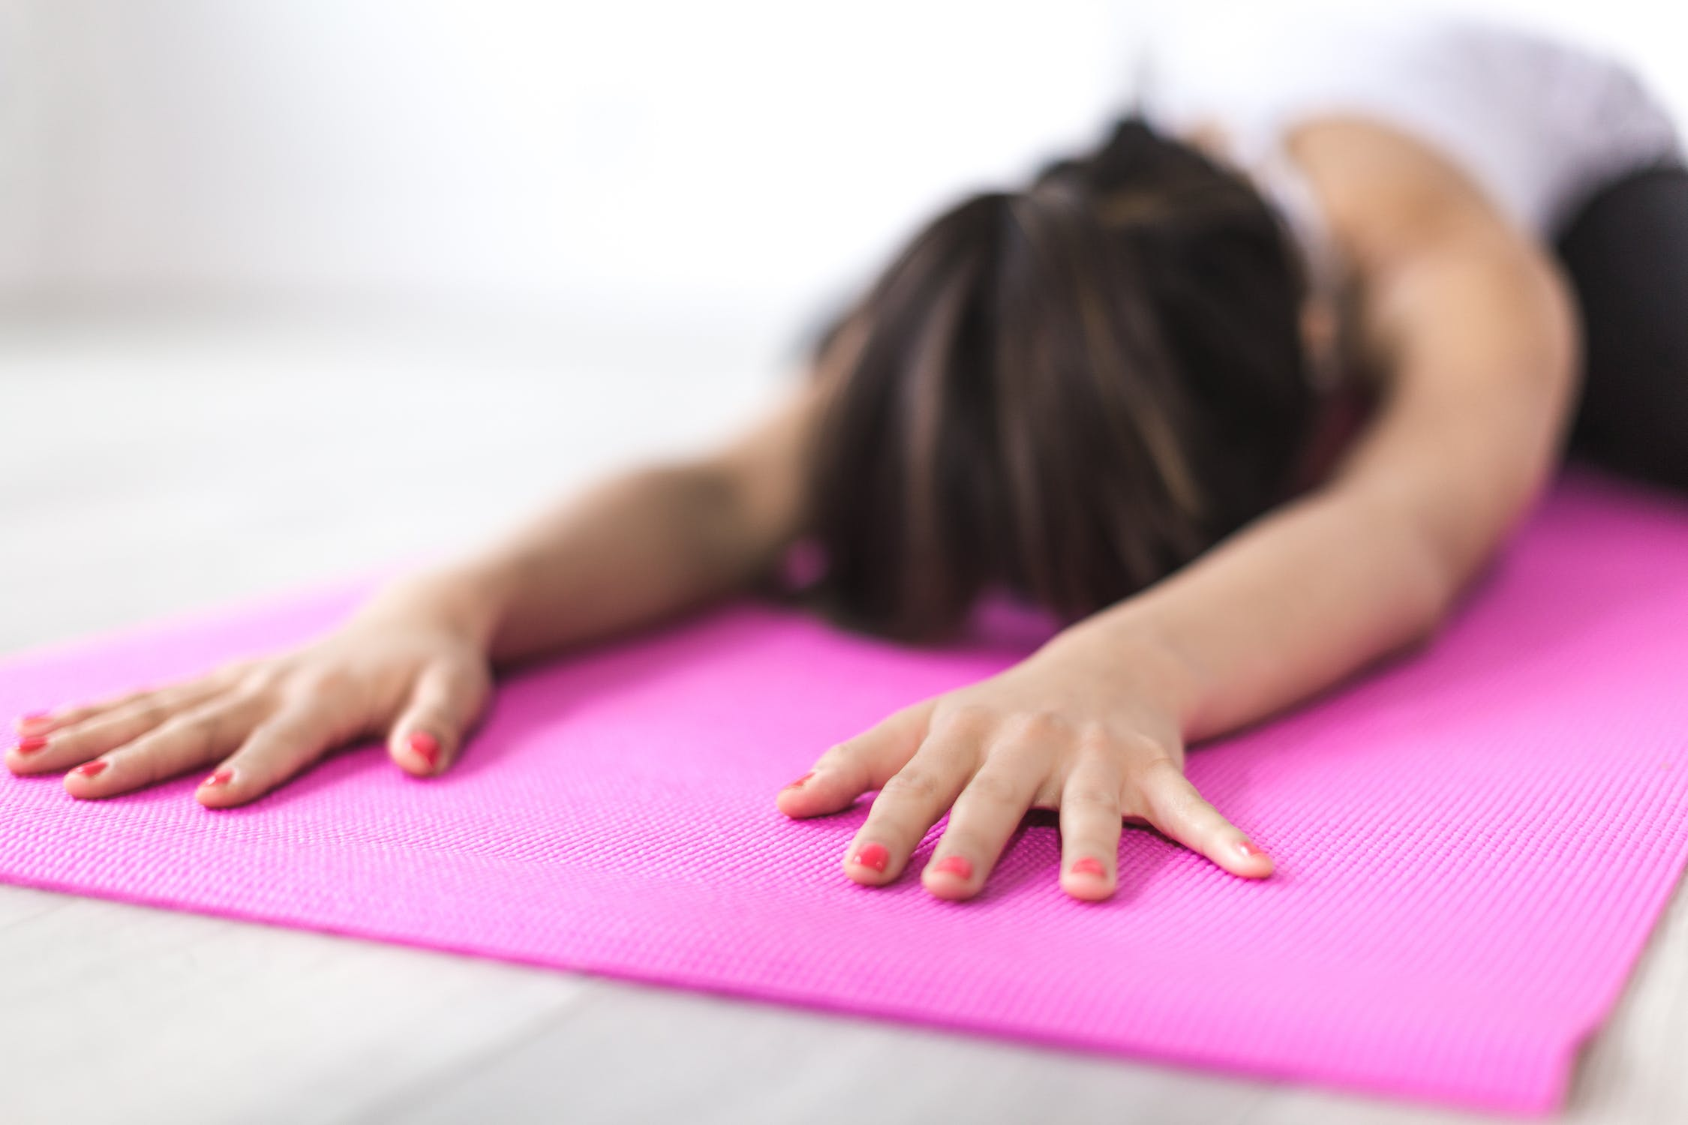
Copyright Examples
Photographs
Illustrations
Paintings
Graphic designs
Murals on your studio or office wall
Web design
Text or writing on your website or in blog posts
Ornamental, non-utilitarian, designs on clothing

Slide 14
What IS and IS NOT protected by copyright?
NOT PROTECTED: any idea, procedure, process, system, method of operation, concept, principle, or discovery
PROTECTED: the expression of ideas, such as the words or images used to express your ideas
NOT PROTECTED: yoga poses
PROTECTED: a book describing how to do yoga poses
NOT PROTECTED: a sequence of twenty-six yoga poses and two breathing exercises arranged in a particular order by Bikram Choudhury

Slide 15
Copyright Registration
By registering your copyrights, you put the world on notice that you own the exclusive rights to copy, broadcast, publish, and make derivative works from your copyright protected works.
Copyrights must be registered by the United States Copyright Office before a lawsuit for their infringement can be filed.
Copyrights can easily and inexpensively be registered by carefully following the instructions at copyright.gov.
You can register up to 750 photographs on the same application.

Slide 16
Traps for the Unwary
Just as you don’t want other people using your images without your permission, do not use other creators’ images, designs, music, writing or other work without obtaining permission in writing.
If you hire a photographer to shoot photos for your marketing materials, make sure to have a clear written agreement as to who will own the copyrights to the photographs.
Public performance licenses to play music in live classes may be obtained from organizations such as ASCAP, BMI, and SESAC.
Do not publish music online on your website or your streaming classes without securing licenses for both the musical composition and the sound recording. As licenses for hit music can be cost prohibitive, use music from sites offering free or low-cost licenses.
Free photographs and other images may be found online on websites like www.pexels.com, but read the fine print carefully before using images that aren’t yours to make sure there are really no strings attached.

Slide 17
What are publicity rights?
Approximately half of the United States have enacted statutes protecting publicity rights.
In California: “Any person who knowingly uses another's name, voice, signature, photograph, or likeness, in any manner, on or in products, merchandise, or goods, or for purposes of advertising or selling, or soliciting purchases of, products, merchandise, goods or services, without such person's prior consent, or, in the case of a minor, the prior consent of his parent or legal guardian, shall be liable for any damages sustained by the person or persons injured as a result thereof.” Cal. Civ. C. § 3344(a).
The federal Lanham Act prohibits using a person’s name or identity to falsely imply that the person endorses a product or service. 17 U.S.C. § 1125(a).

Slide 18
How might publicity rights impact a yoga or wellness business?
Always obtain permission in writing – a “release” - from any person whose image you use to advertise or promote your goods or services, including professional models, as well as students, customers, and other non-professionals, and even for use on your website and social media.
If you find another person or company using your name or photograph to promote their commercial activity without your permission, consider engaging an attorney to help you protect your right to control the commercial use of your identity.

Slide 19
FOR ASSISTANCE WITH INTELLECTUAL PROPERTY
OR OTHER LEGAL MATTERS,
PLEASE CONTACT:
Caroline H. Mankey
Partner
Akerman LLP
(213) 533-5949
caroline.mankey@Akerman.com

