Slide 1
Harnessing Technology to Make Us Better Leaders & Collaborators
www.productivity.com

Slide 2
What is an “online platform”?
The term “online platform” is used to describe a range of services available on the Internet including marketplaces, search engines, social media, creative content outlets, app stores, communications services, payment systems, services comprising the so-called “collaborative” or “gig” economy, and much more.
We rely on them to buy and sell goods and services, to find information online and to keep in touch with each other. We use them for entertainment, news, transportation, accommodation, finding jobs and employees, finding apps and for many other purposes.
An online platform is defined as a digital service that facilitates interactions between two or more distinct but interdependent sets of users who interact through a service.

Slide 3
Productivity Apps for the Executive
Get more done in less time.

Slide 4
BlueBolt
All your devices at your fingertips
BlueBOLT® IP Power Management delivers real-time remote control and monitoring of the energy used by your electronic devices, enabling remote reboots, scheduled conservation & more.

Slide 5
Resideo HVAC Systems
Put your facilities’ potential in the palm of your hand. Control your thermostat, monitor your security systems, even track energy usage from anywhere, all with ease and all with the Resideo App.

Slide 6
Hik-Connect
All your cameras at your fingertips
The Hik-connect app allows you to live view your cameras remotely. All you need to do is creating an account and adding device into the account, then you can enjoy the real-time video from cameras on a global scale.

Slide 7
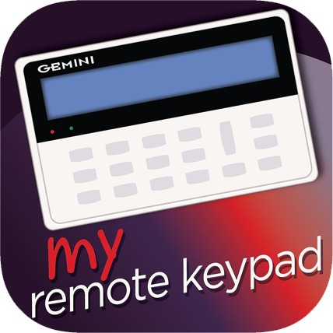
MyRemoteKeypad App
MyRemoteKeypad application provides real time access to the NAPCO Security Technologies security keypads. With this application, using a secure user id/password, the user can remotely access his/her Security device keypad.

Slide 8
OpenPath
Unlock Doors Handsfree
Openpath’s unique mobile credentials give users a completely hands-free entry experience, without needing to remove the smartphone from their pocket. With encryption at every level and patented Triple-Unlock technology, Openpath is the first and only solution to achieve 94% mobile adoption.

Slide 9
CapCut
CapCut is a specialized video editor designed specifically for web. Forever updated special effects to give you unlimited surprise.

Slide 10
B-Hyve
The B-hvye smart sprinkler timer app allows you to control or monitor your sprinklers from anywhere in the world with the convenience of your smart device.

Slide 11
Productivity Apps for Teams
Get more done in less time.

Slide 12
PanicButton
Instant Emergency Communication
In seconds, Rave Panic Button clearly communicates an emergency to 9-1-1, faculty, staff, and security resource officers.

Slide 13
Doodle App
Professional scheduling made easy ... Doodle is the fastest and easiest way to schedule anything — from meetings to the next great collaboration.

Slide 14
www.monday.com

Slide 15
www.notion.com

Slide 16
Coda
www.coda.com

Slide 17
Summary
Productivity for Executives
Productivity for Teams
Real Results
Presented by:
Ari Ginian, YKLI NY Racheli Hackel, HANC NY Lev Stark, Valley Torah High School CA

