Slide 1
School Management Software Roundup
(37 schools)
EDS V 2022 5783

Slide 2
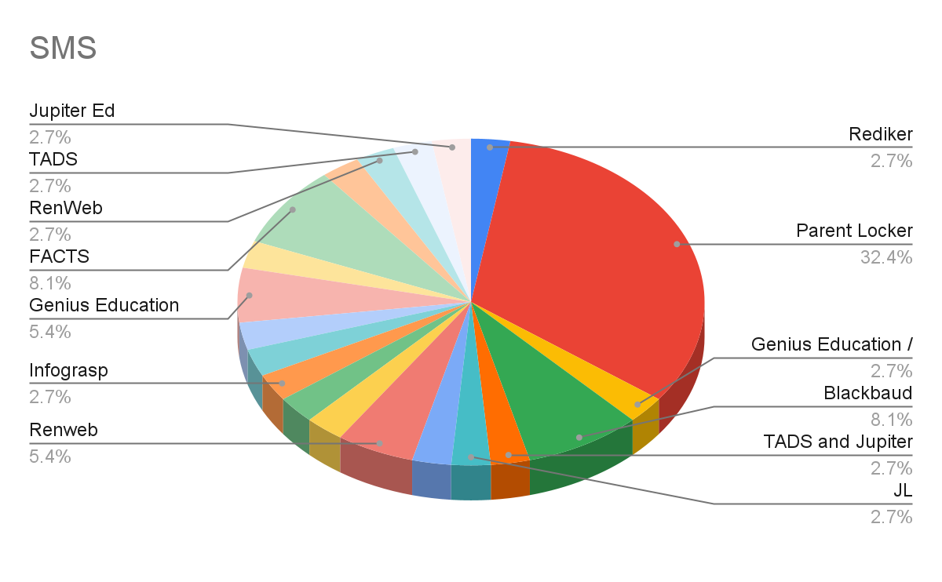
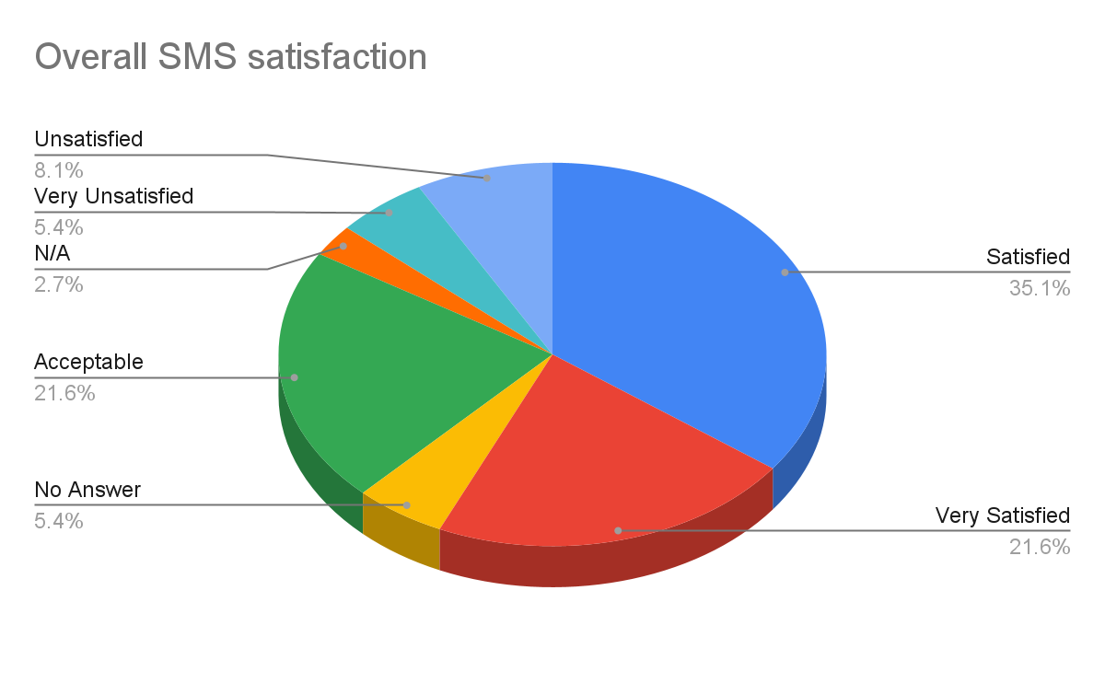
SMS Review
School Management System AKA School Information System
SMS/SIS
Notes:
What is the difference between an LMS and SMS - this is SMS
Who here has changed SMS in the last 5 years
Who here is thinking about changing SMS
If you are raised your hands for both- what did you choose - and name some issues

Slide 3
SMS Cost Analysis
1-249 students: 6 responses - average cost $3,575
250-499 students: 14 responses - average cost $8,700
500+ students: 16 responses - average cost $19,000

Slide 4
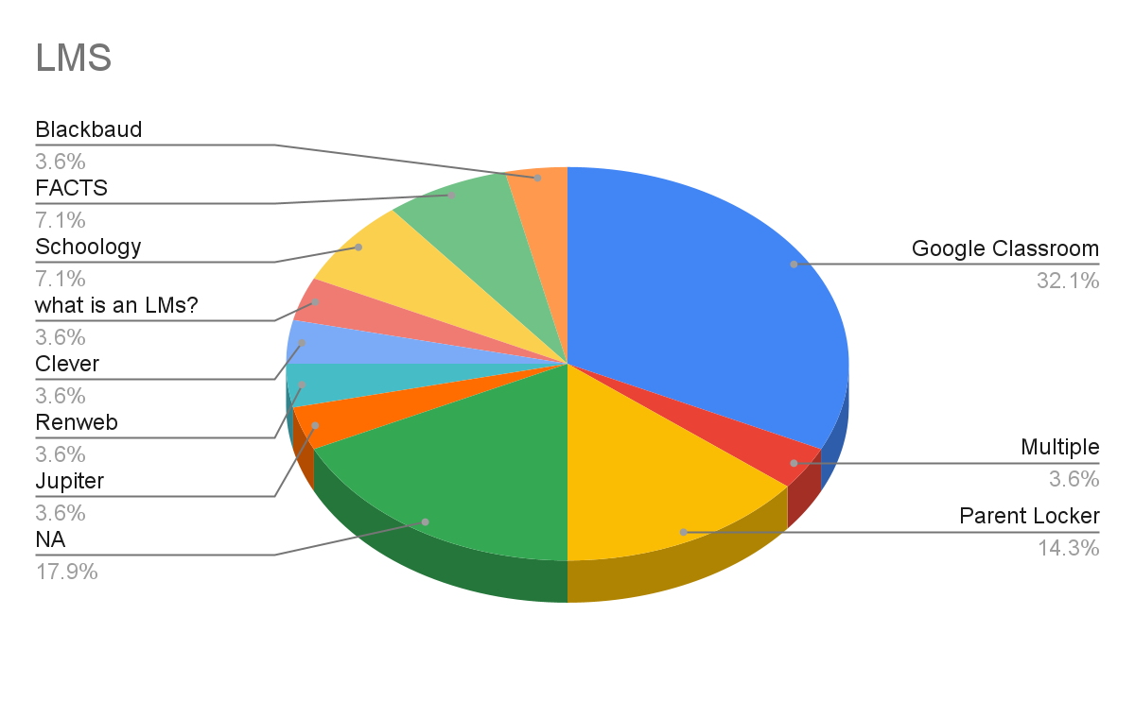
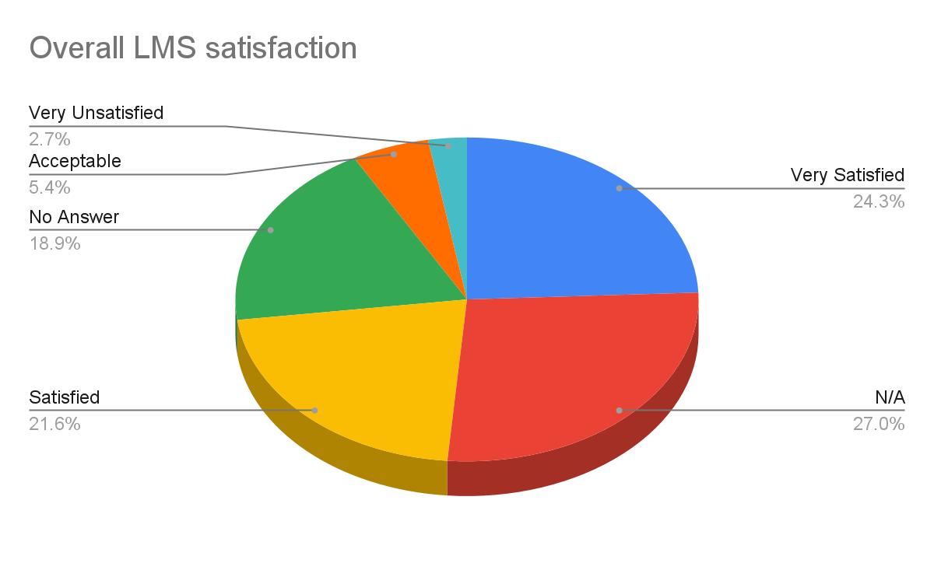
Learning Management System (LMS)
Notes:
Who here is satisfied with their LMS? Why? Feedback from teachers?

Slide 5
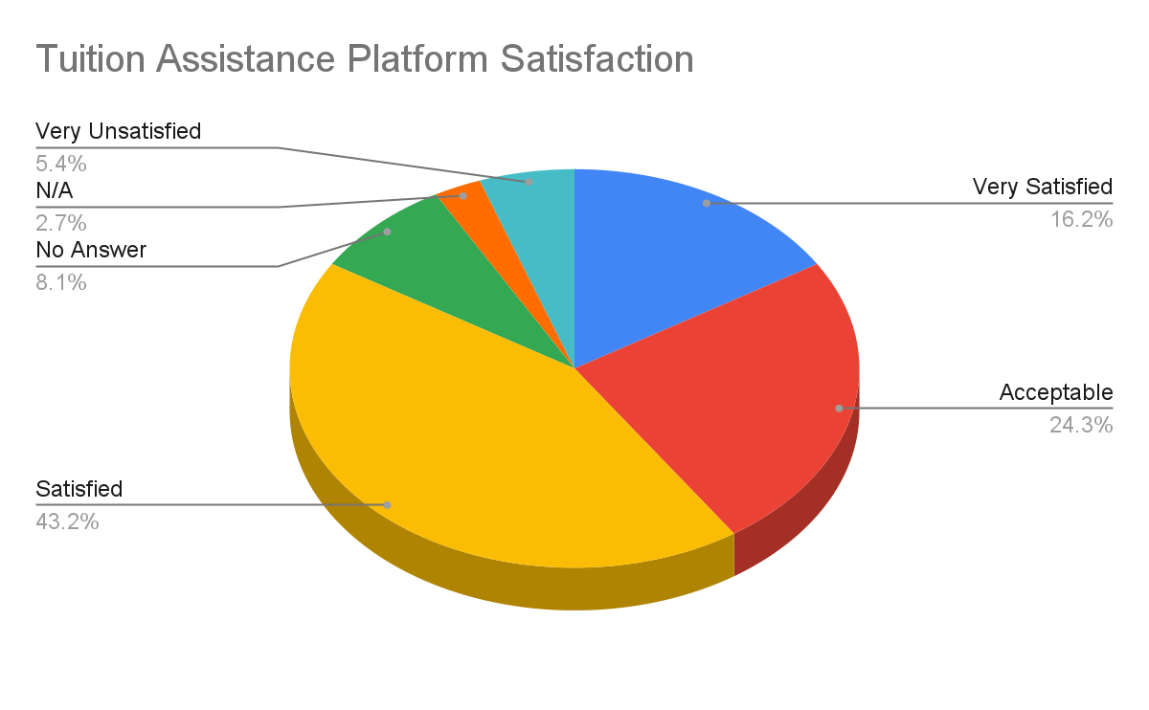
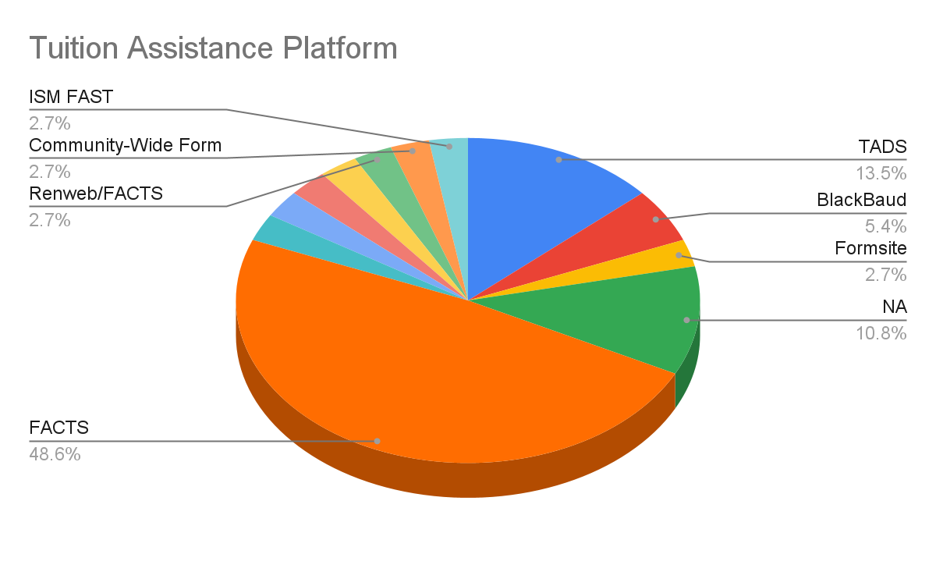
Tuition Assistance
Notes:
Who here has changed tuition assistance platform in the last 5 years
Who here is thinking about changing their Tuition Assistance platform
If you are raised your hands for both- what did you choose - and name some issues

Slide 6
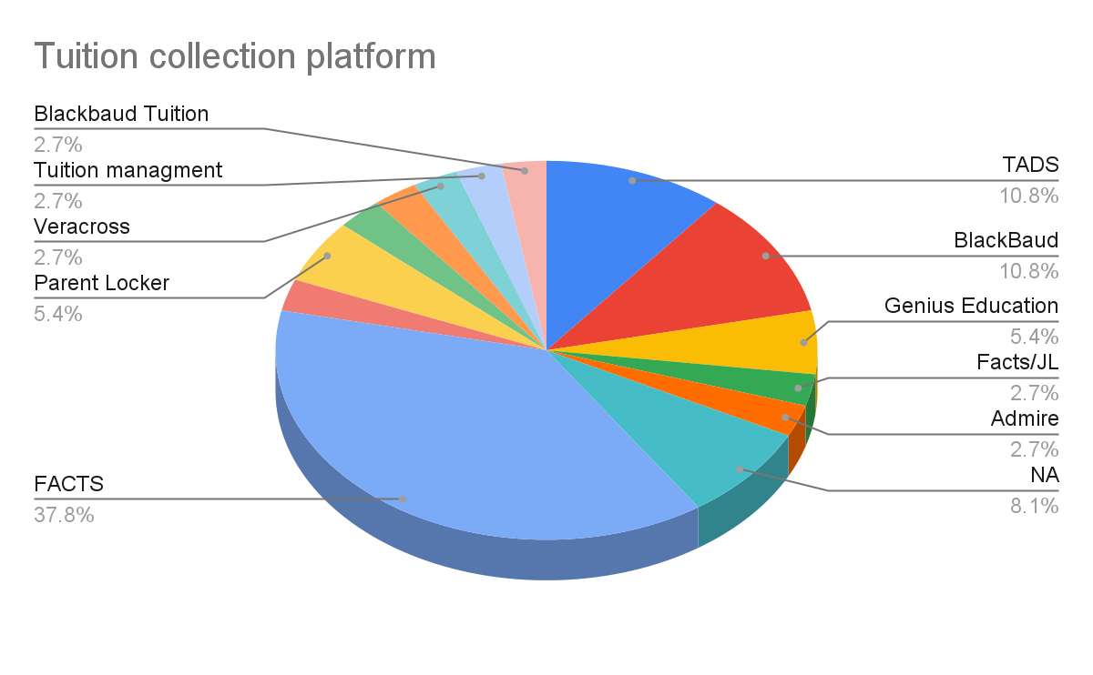
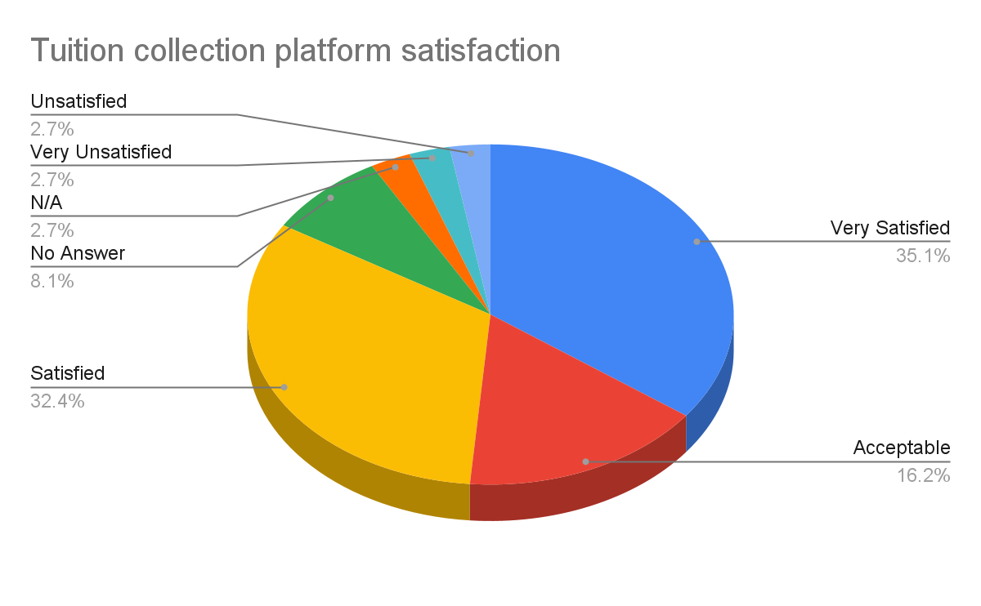
Tuition Collection
Notes:
Who here has changed tuition collection platform in the last 5 years
Who here is thinking about changing their Tuition collection platform
If you are raised your hands for both- what did you choose - and name some issues

Slide 7
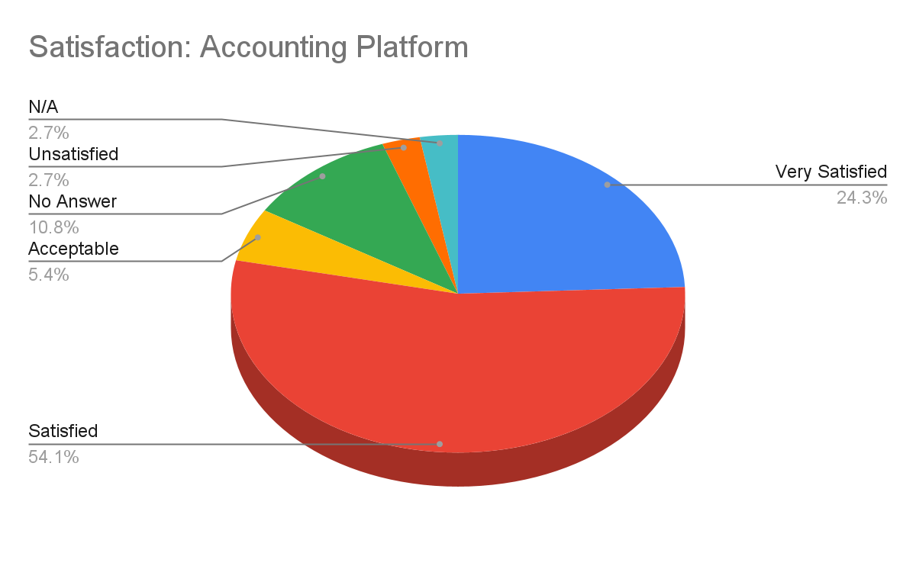
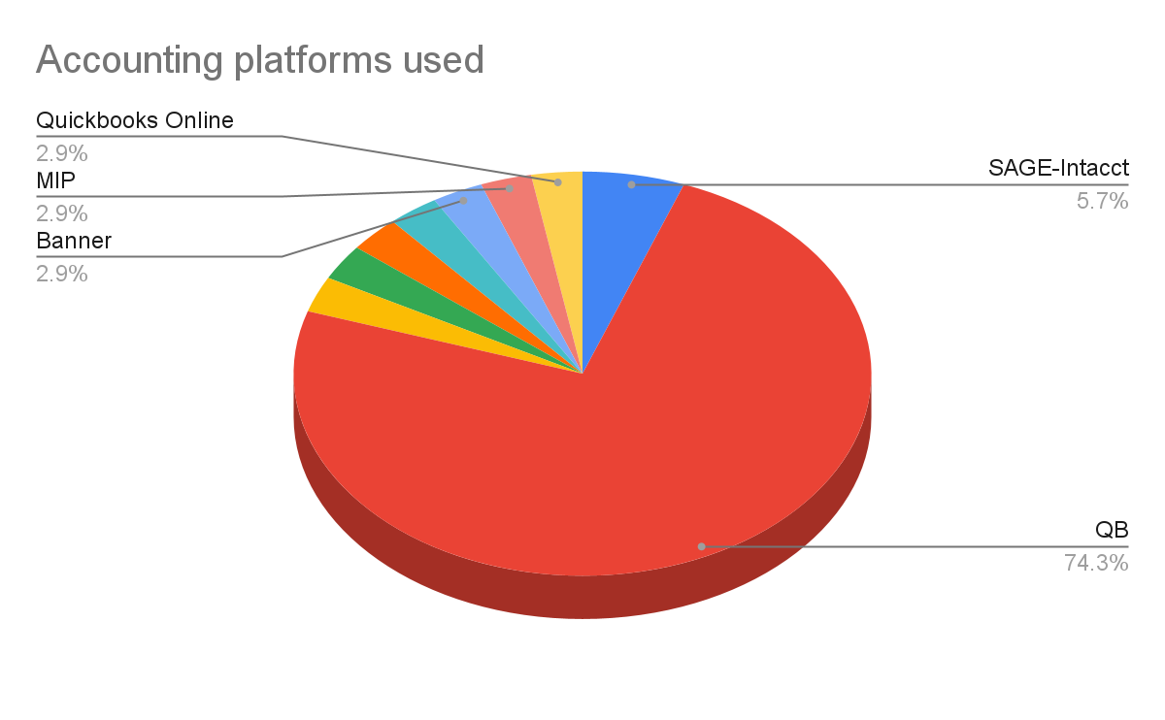
Accounting
Great Plains (GP) - 1
Notes:
If you could afford it, and have the patience, would change your accounting software

Slide 8
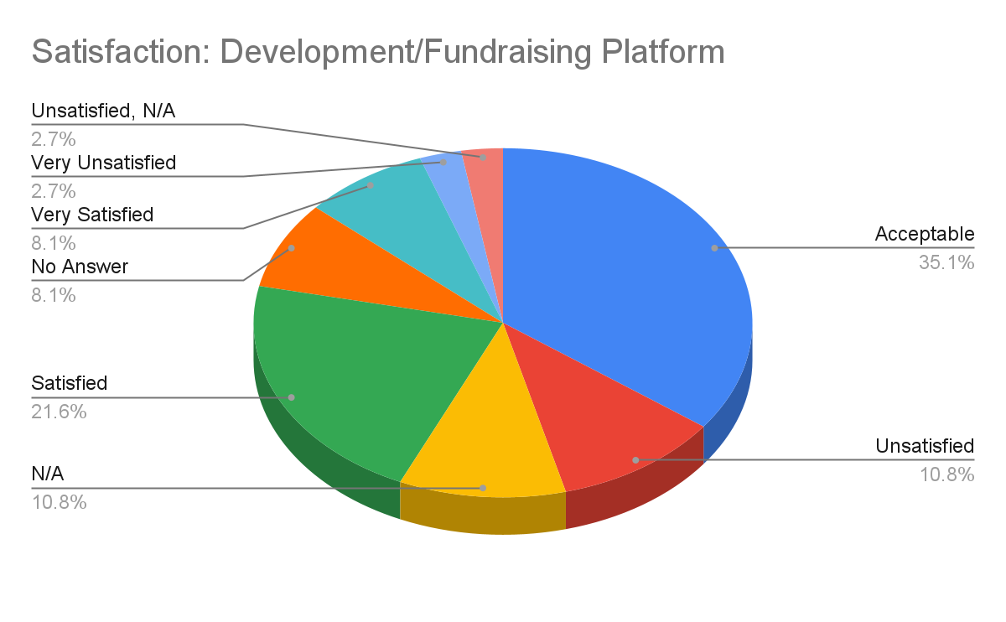
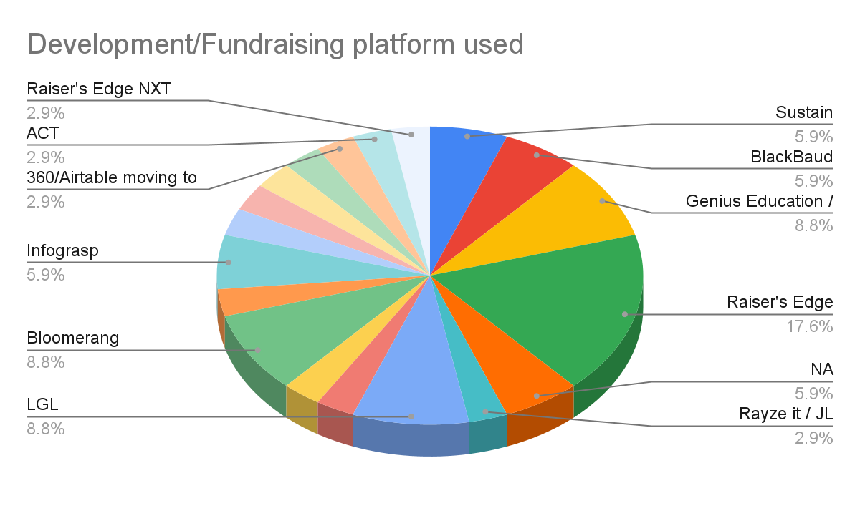
Development/Fundraising

Slide 9
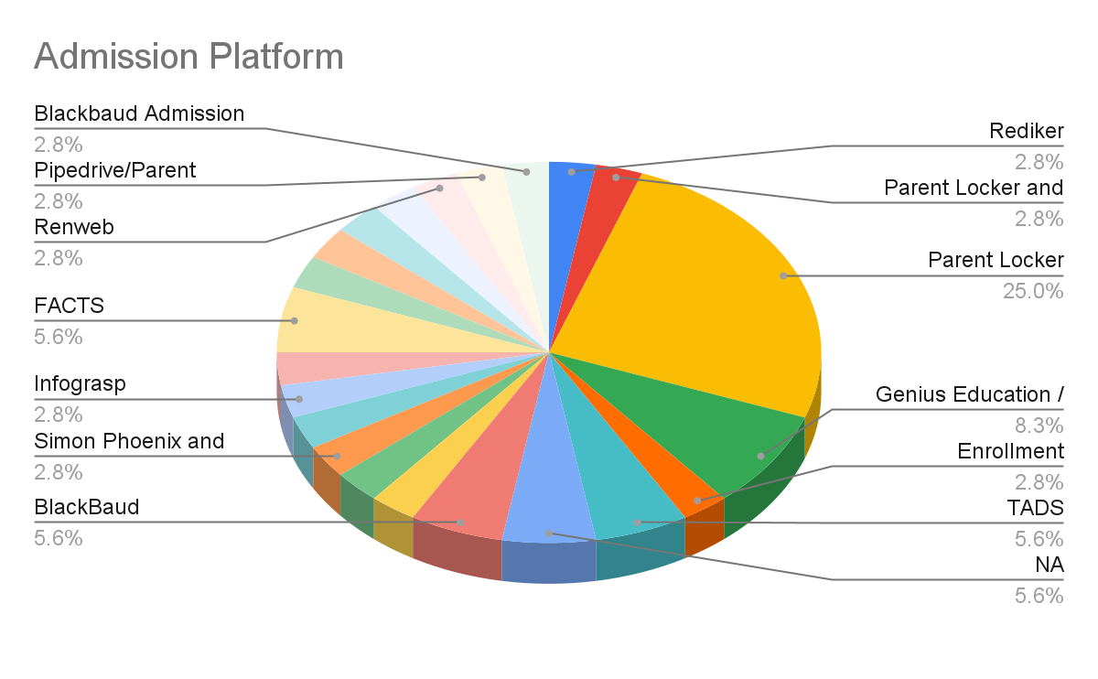
Admission

Slide 10
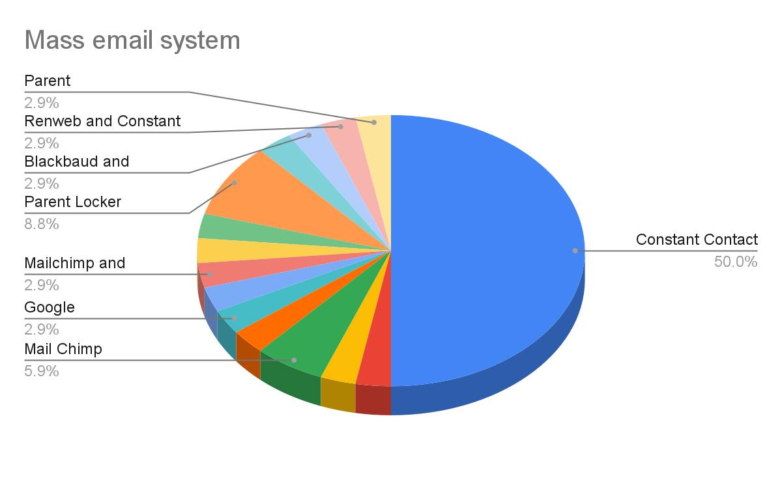
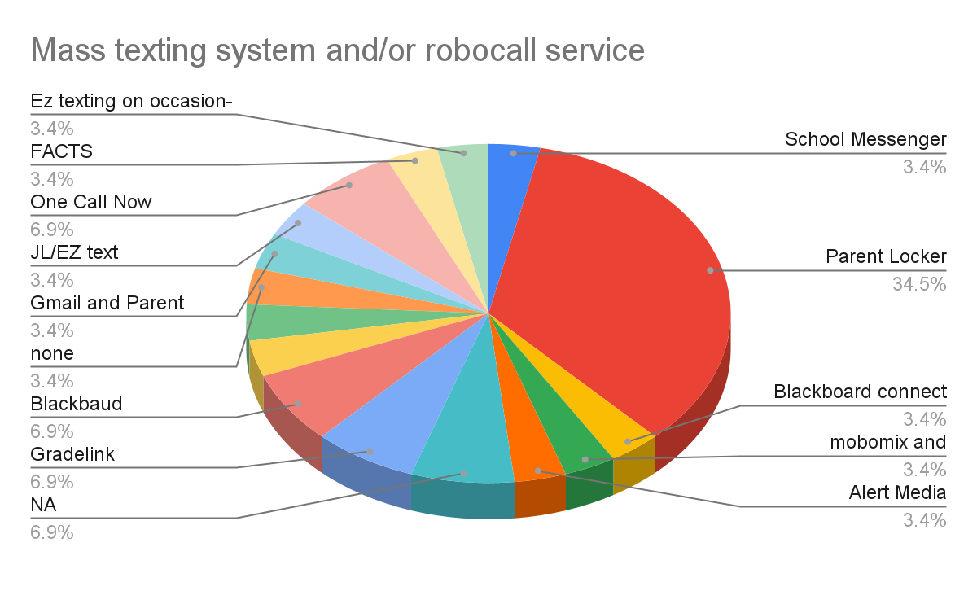
Email and Text Communication

Slide 11
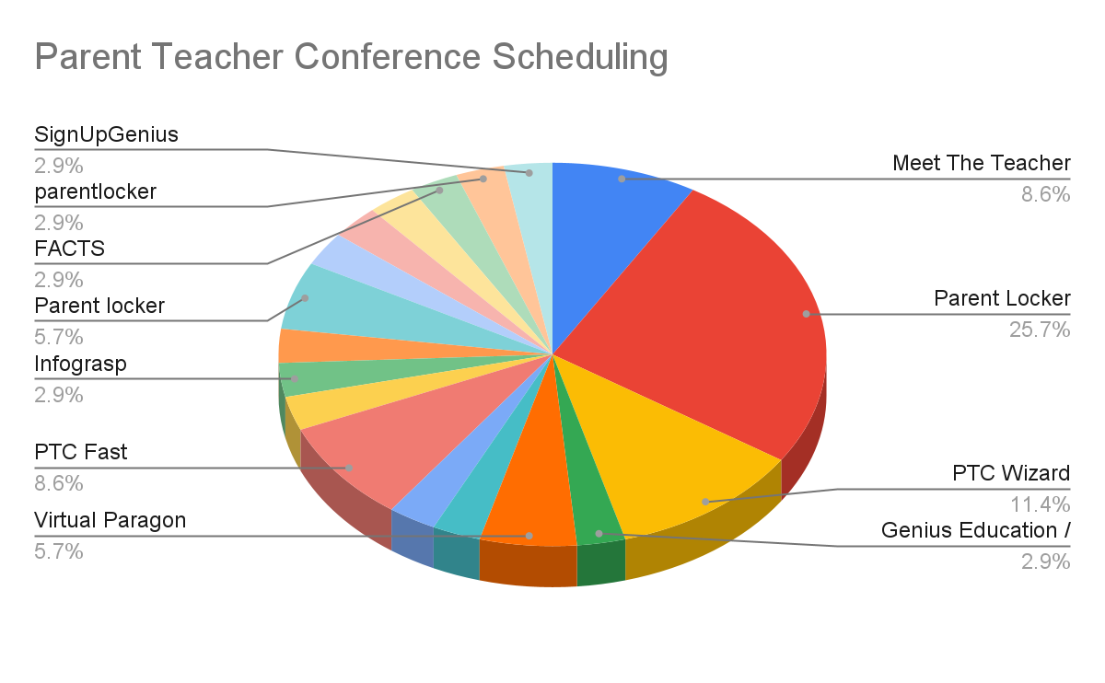
Parent Teacher Conference Scheduling

Slide 12
Credit Card Processing Options
Authorize.net
Mobile Cause
Swipe
Banquest
Transfirst
Stripe
Cardknox
Divvy
Embassy Bancard - authorize
Fidelity
Heartland
Hitec merchants
Merchpay
Parent Locker
WePay
Paypal
Zelle
PPS
Quickbooks
stripe (lgl), authorize.net, square
Cardworks
USAEpay
Through our bank (required - terms of a loan)

Slide 13
Legal E-Signatures
Internal WorkFlows
Adobe
BlackBaud
Dochub
DocuSign
Gradelink
PandaDocs
Right Signature
Clickup
email\whatsapp
excel
G Suite
google chat
Google classrooms

Slide 14
IT Desk
Onboarding/Offboarding
Clickup
email
Fresh Desk
IT Glue
NA
sourced out
zendesk
ADP
Balance Point - iSolve
Clear company
formstack
Pandadoc and Viventium
Rippling

