Slide 1
The Art & Science of the Perfect Pitch
- Maury Litwack

Slide 2
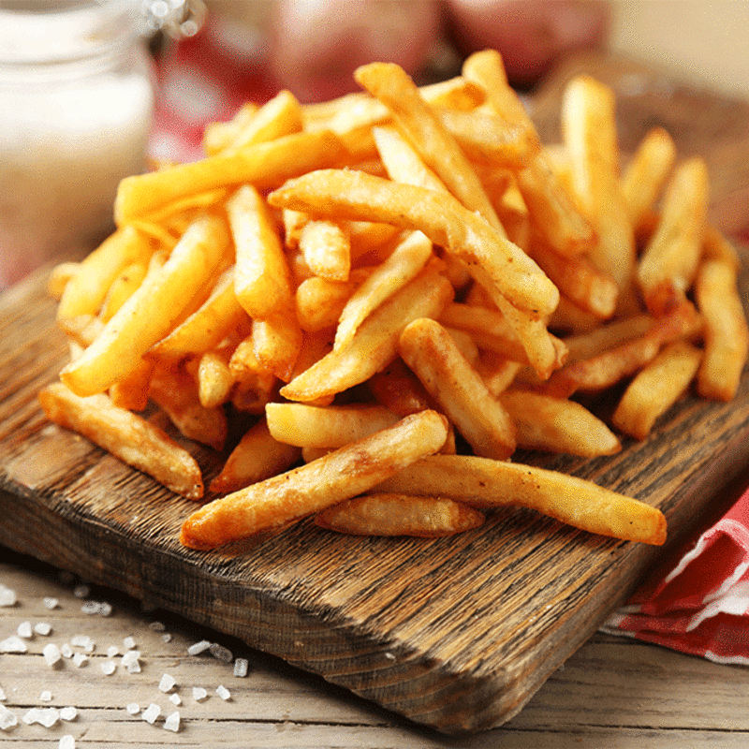
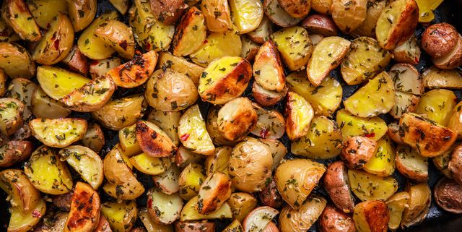
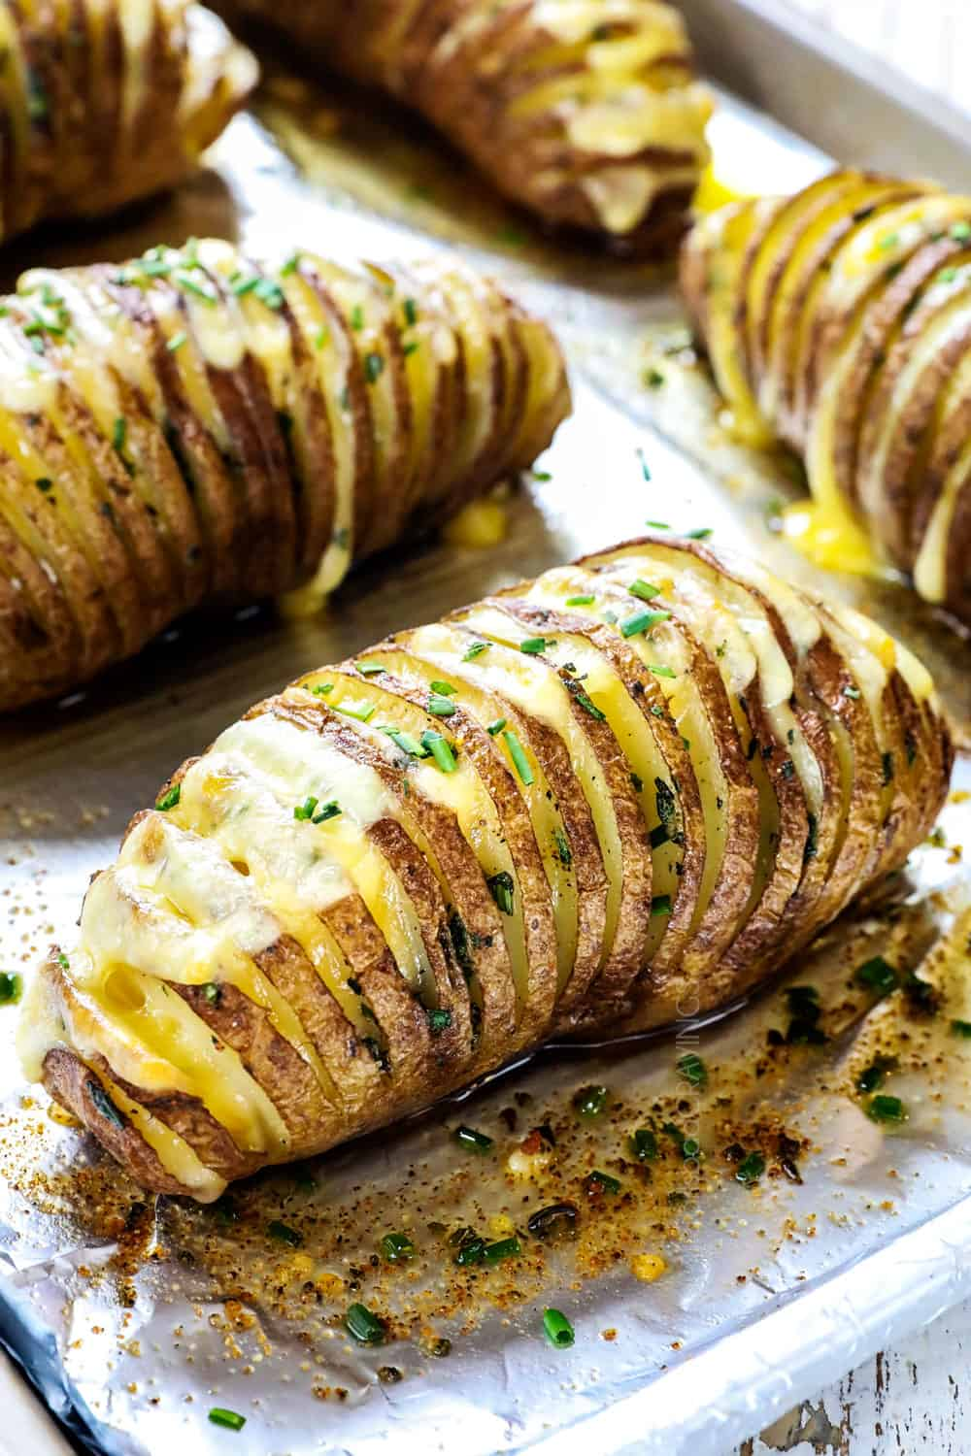
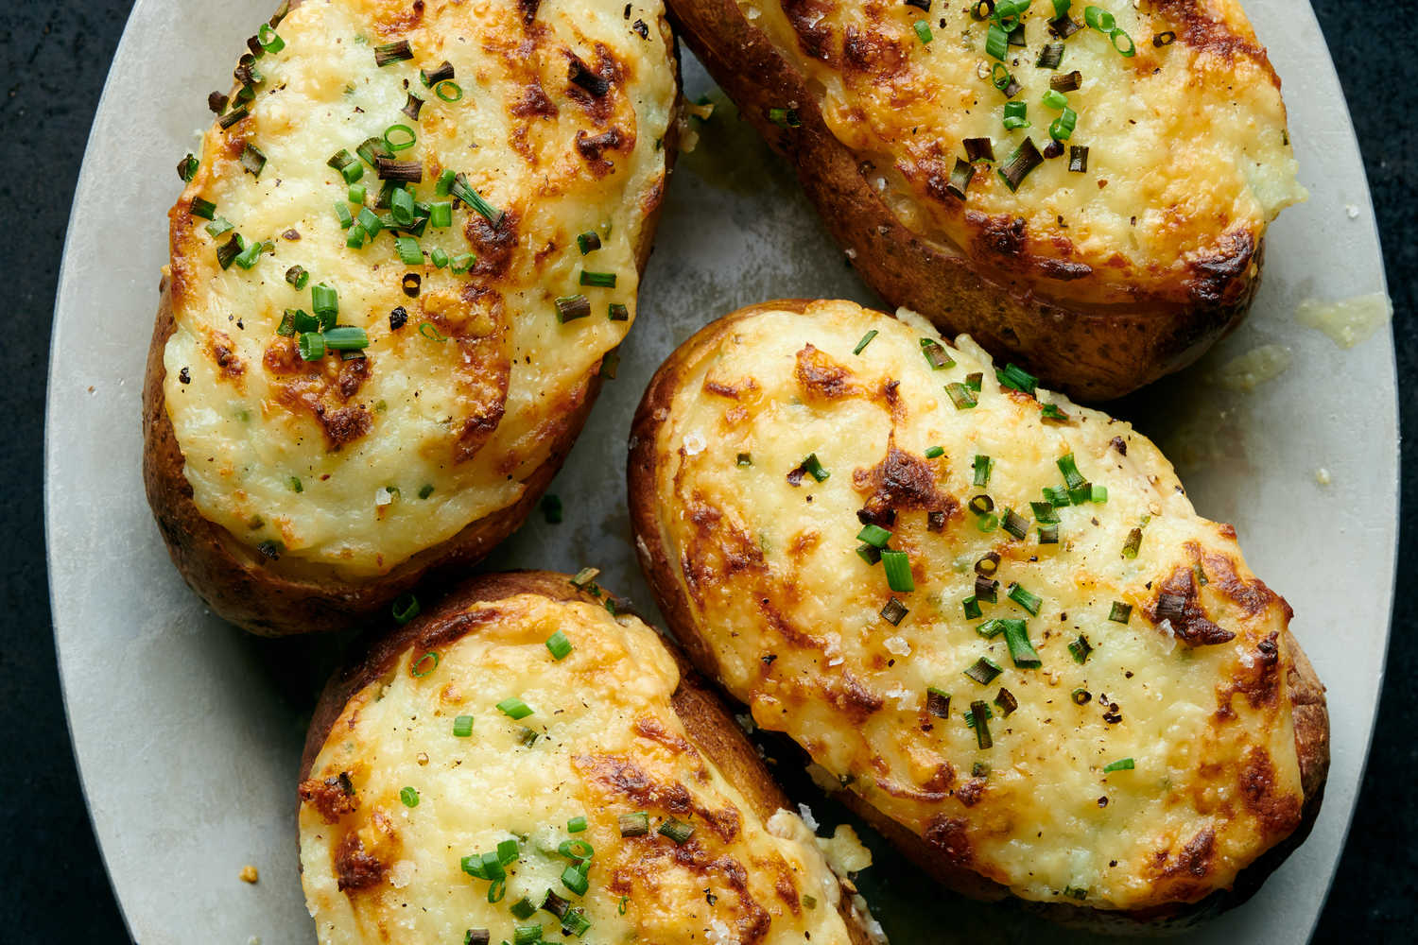
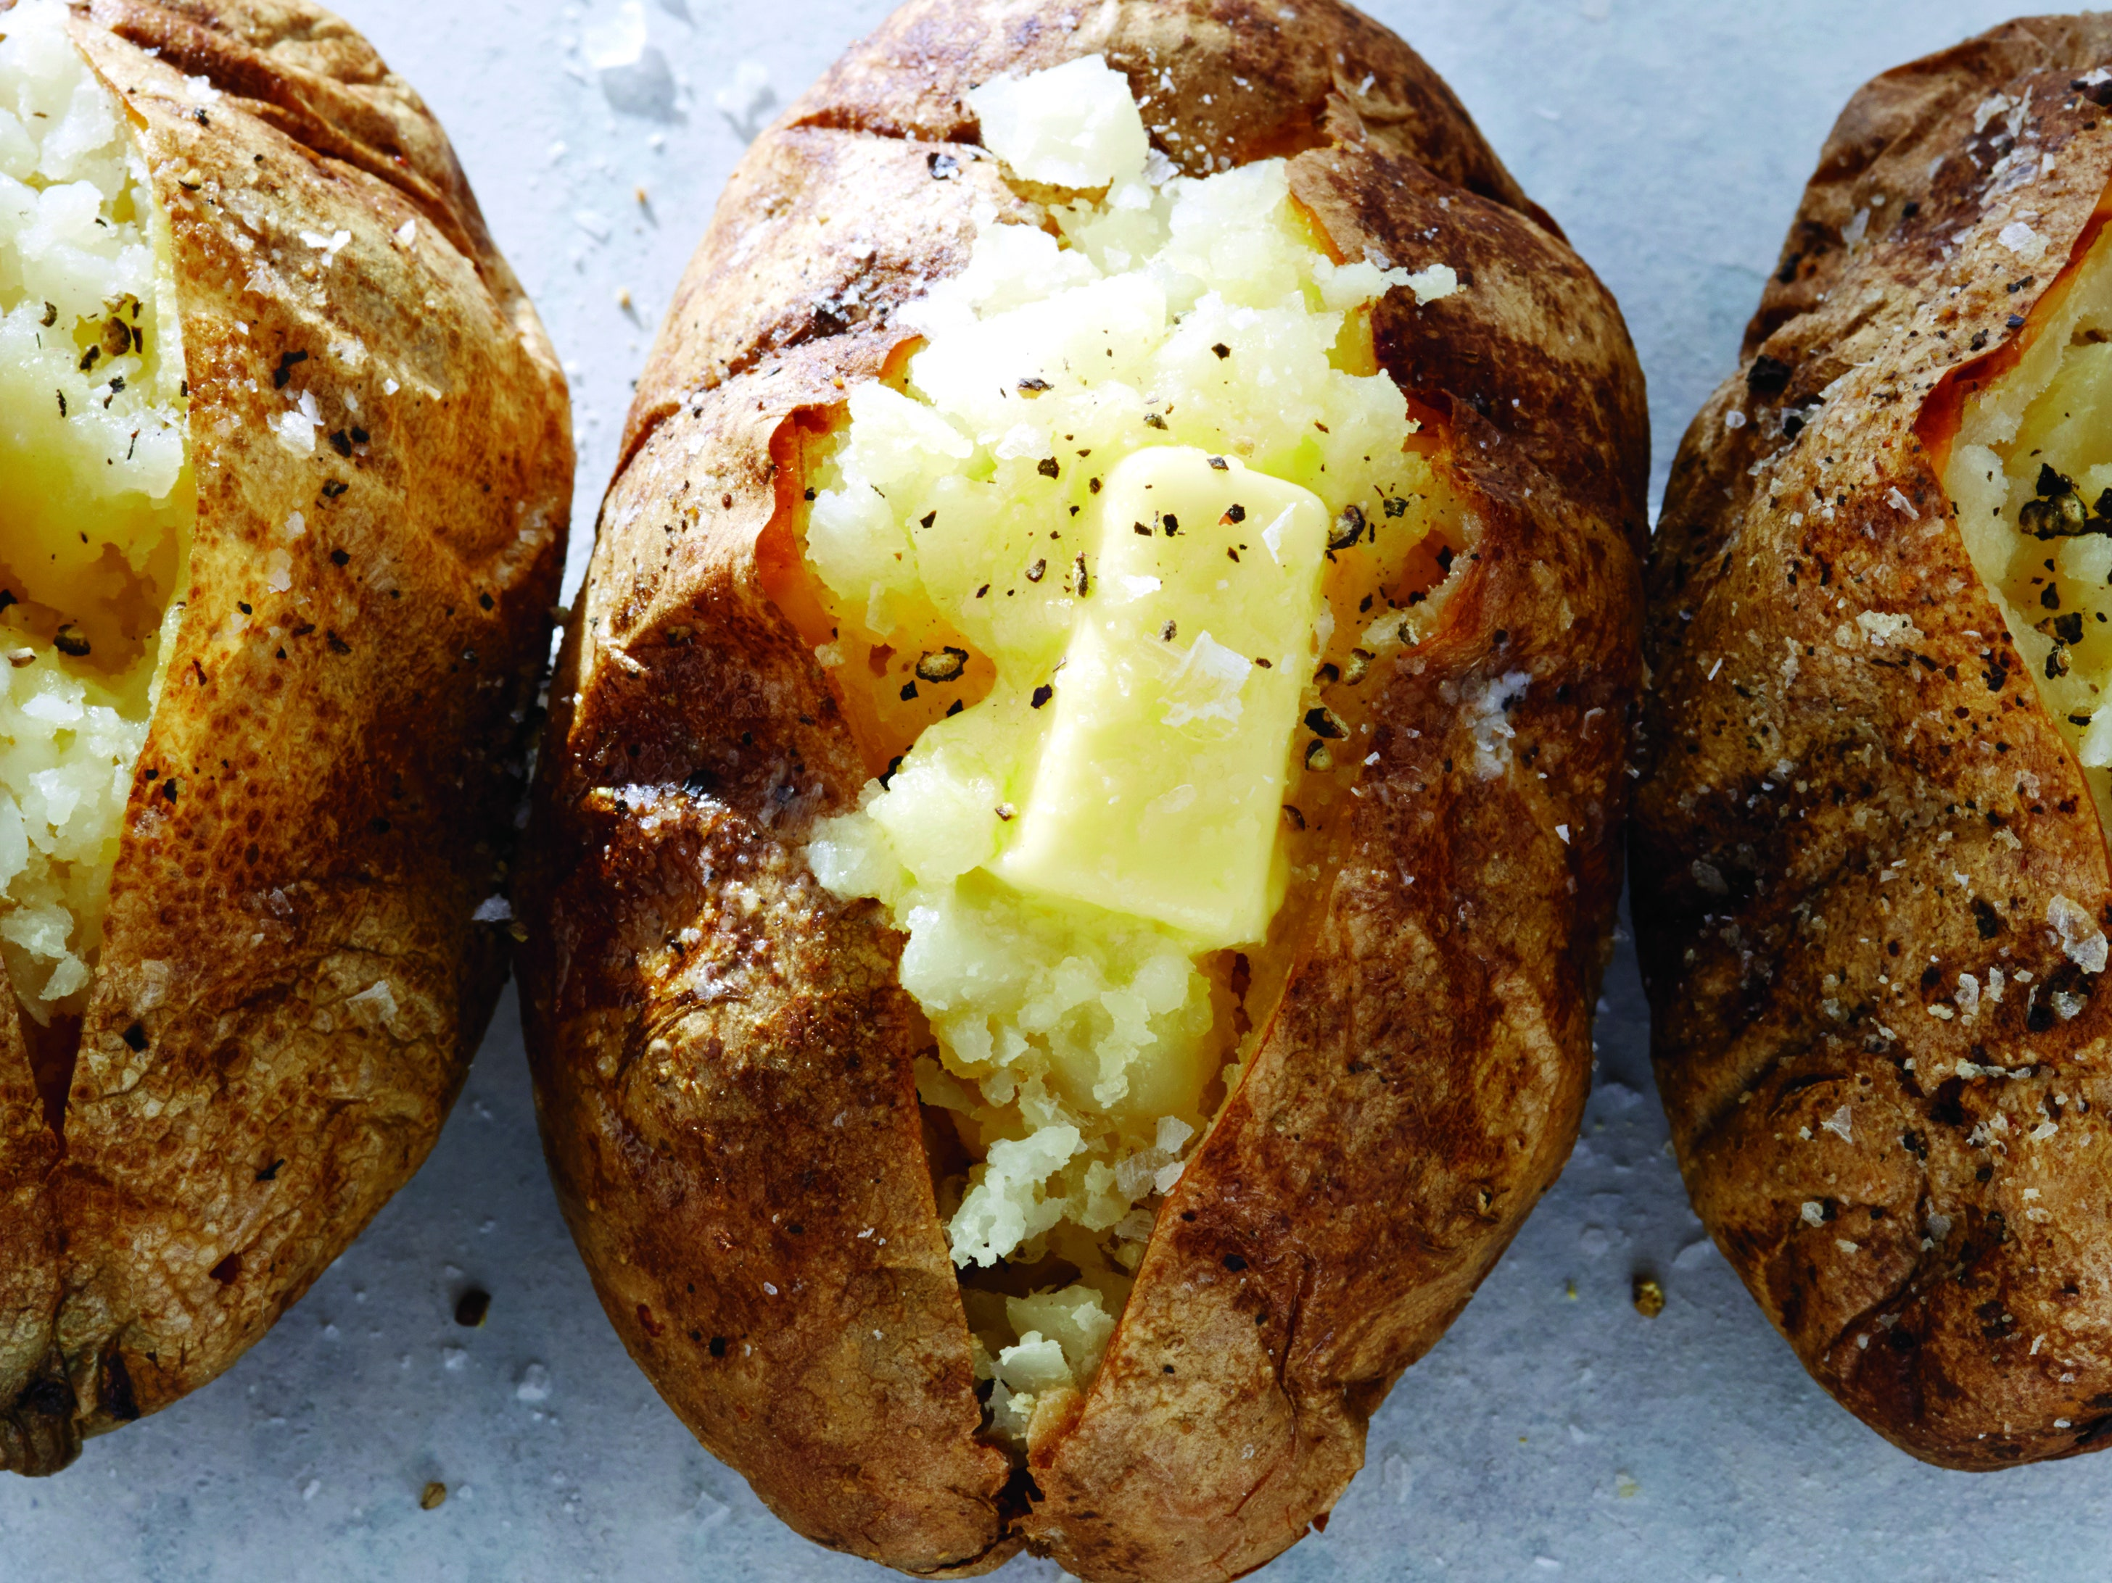
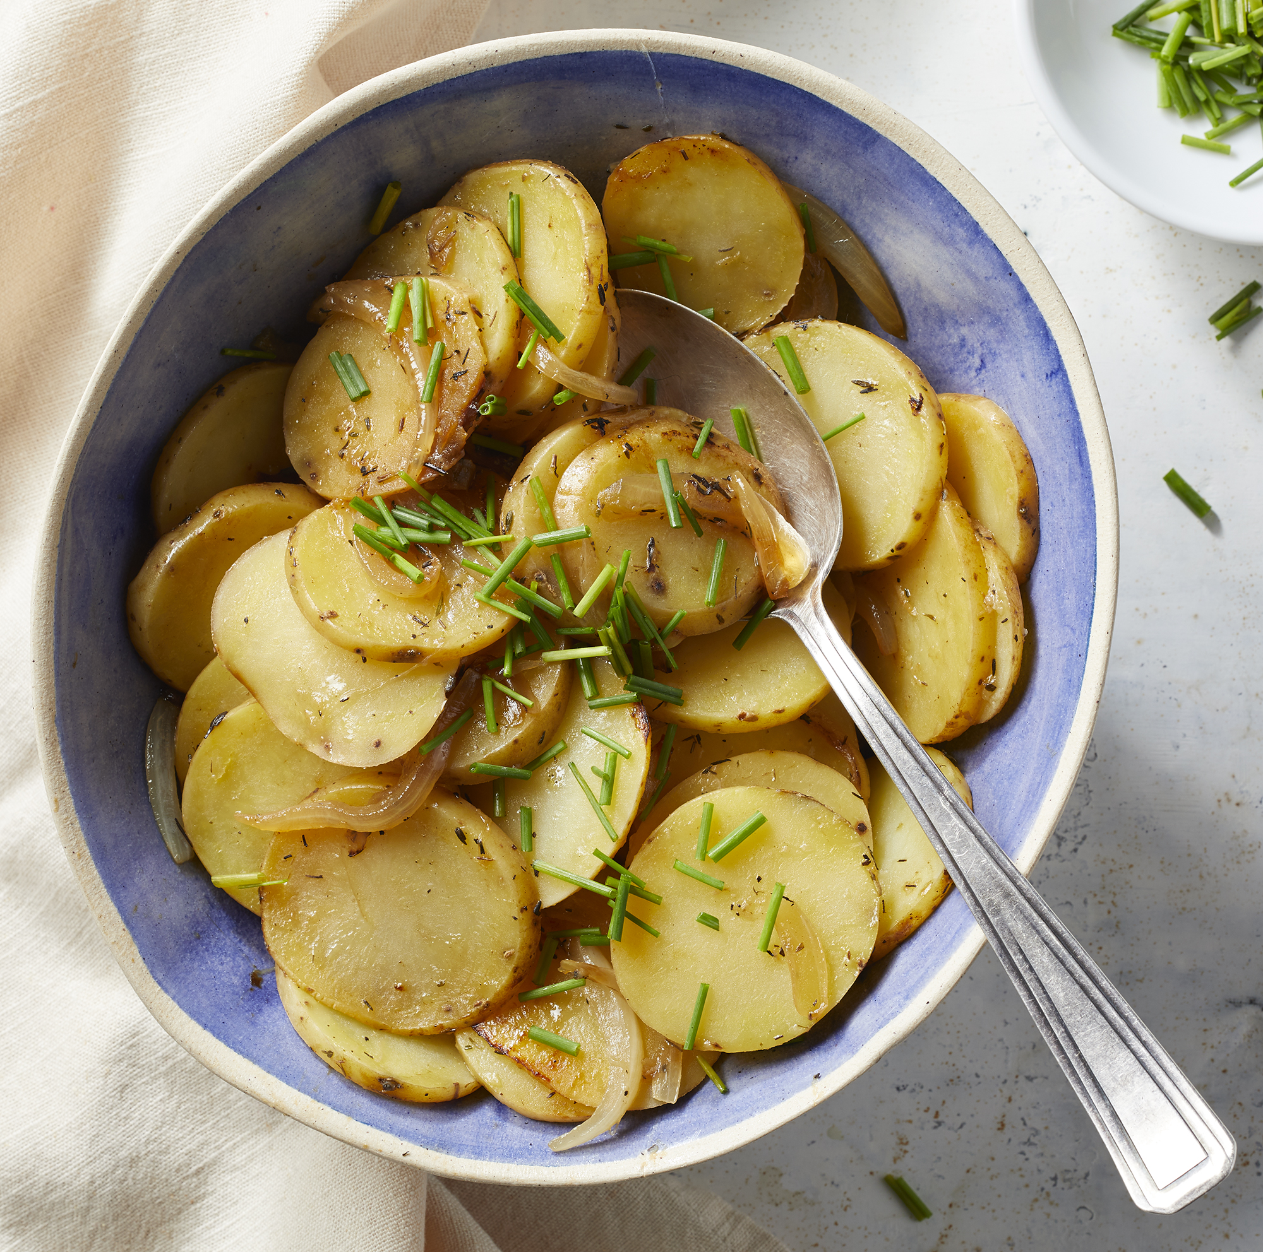
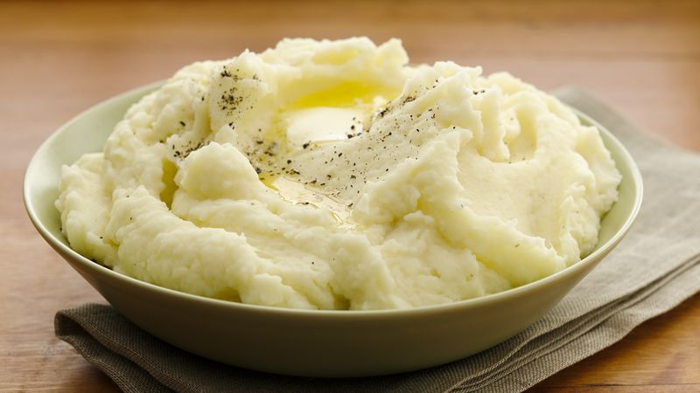

Slide 3
Bad Reputation
Beloved only in Spain & Ireland
Leprosy?
“No matter how you prepare it, the root is tasteless and starchy,” he wrote. “It cannot be regarded as an enjoyable food, but it provides abundant, reasonably healthy food for men who want nothing but sustenance. It is windiness.”
– Dennis Diderot

Slide 4
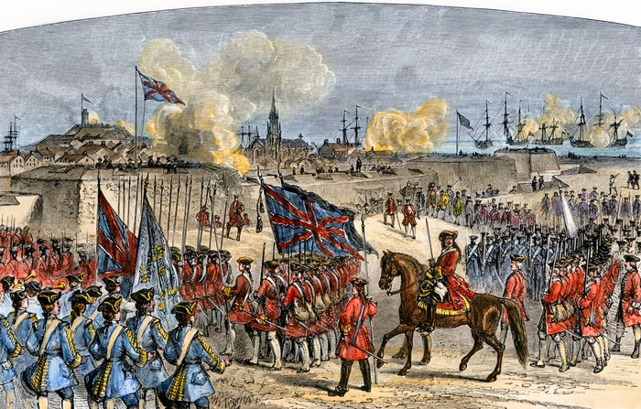

Slide 5
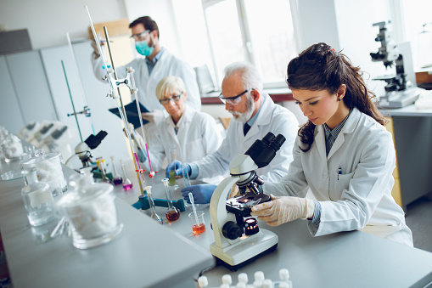

Slide 6
Rule 1: Does What Your Selling Do What You Think It Does? Or Are You Just Selling Another Cause?
Three ways to test it out:
A. Do you give to your own cause?
B. Lottery test
C. Would your friends and family give to this if you didn’t ask? Does it sell itself?

Slide 7
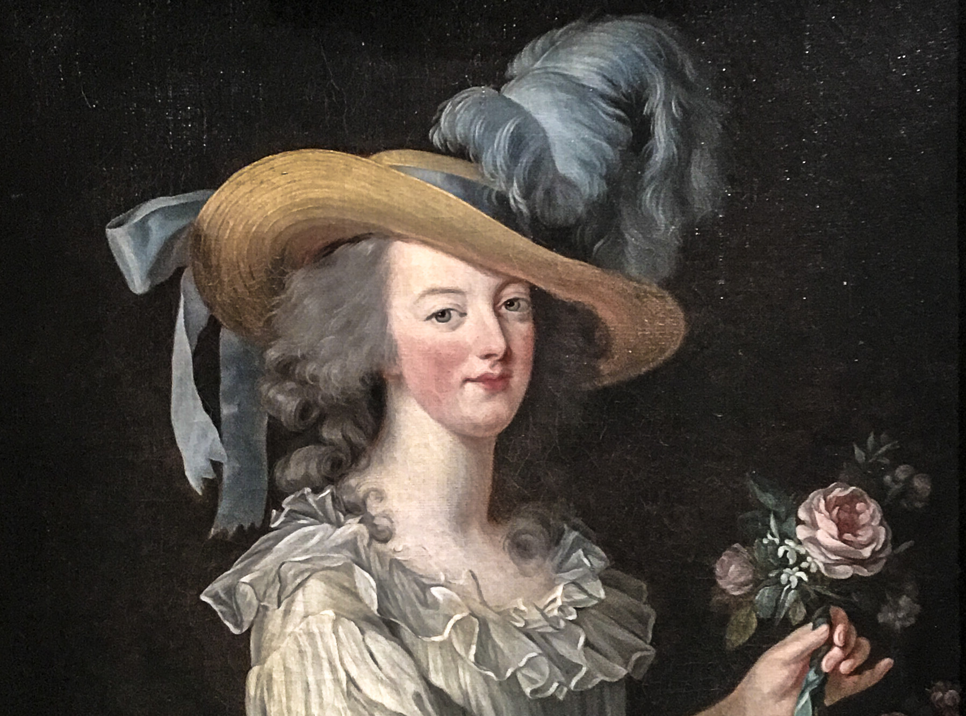

Slide 8
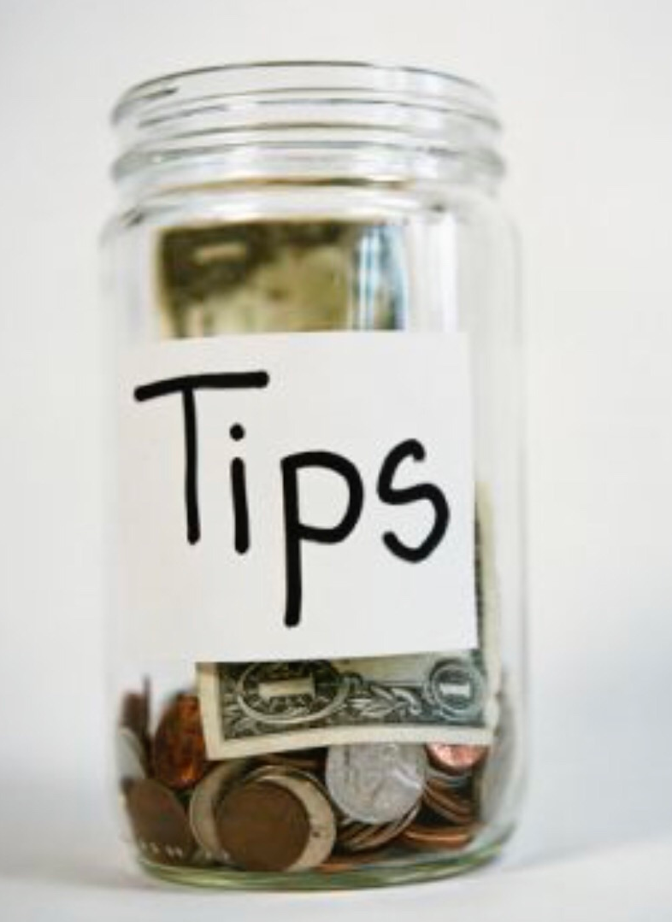
Social Proof Theory: Science
“A person who does not know what the proper behavior for a certain situation is, will look to other people to imitate what they are doing and to provide guidance for his actions.” – Robert Cialdini
Examples:

Slide 9
Social Proof Theory: Art & Fundraising
Dinner Committee With Major Names
50 Donors Ready to go on Crowd Funding Campaign
Social Influencers Who Give Publicly/Talk About Cause

Slide 10
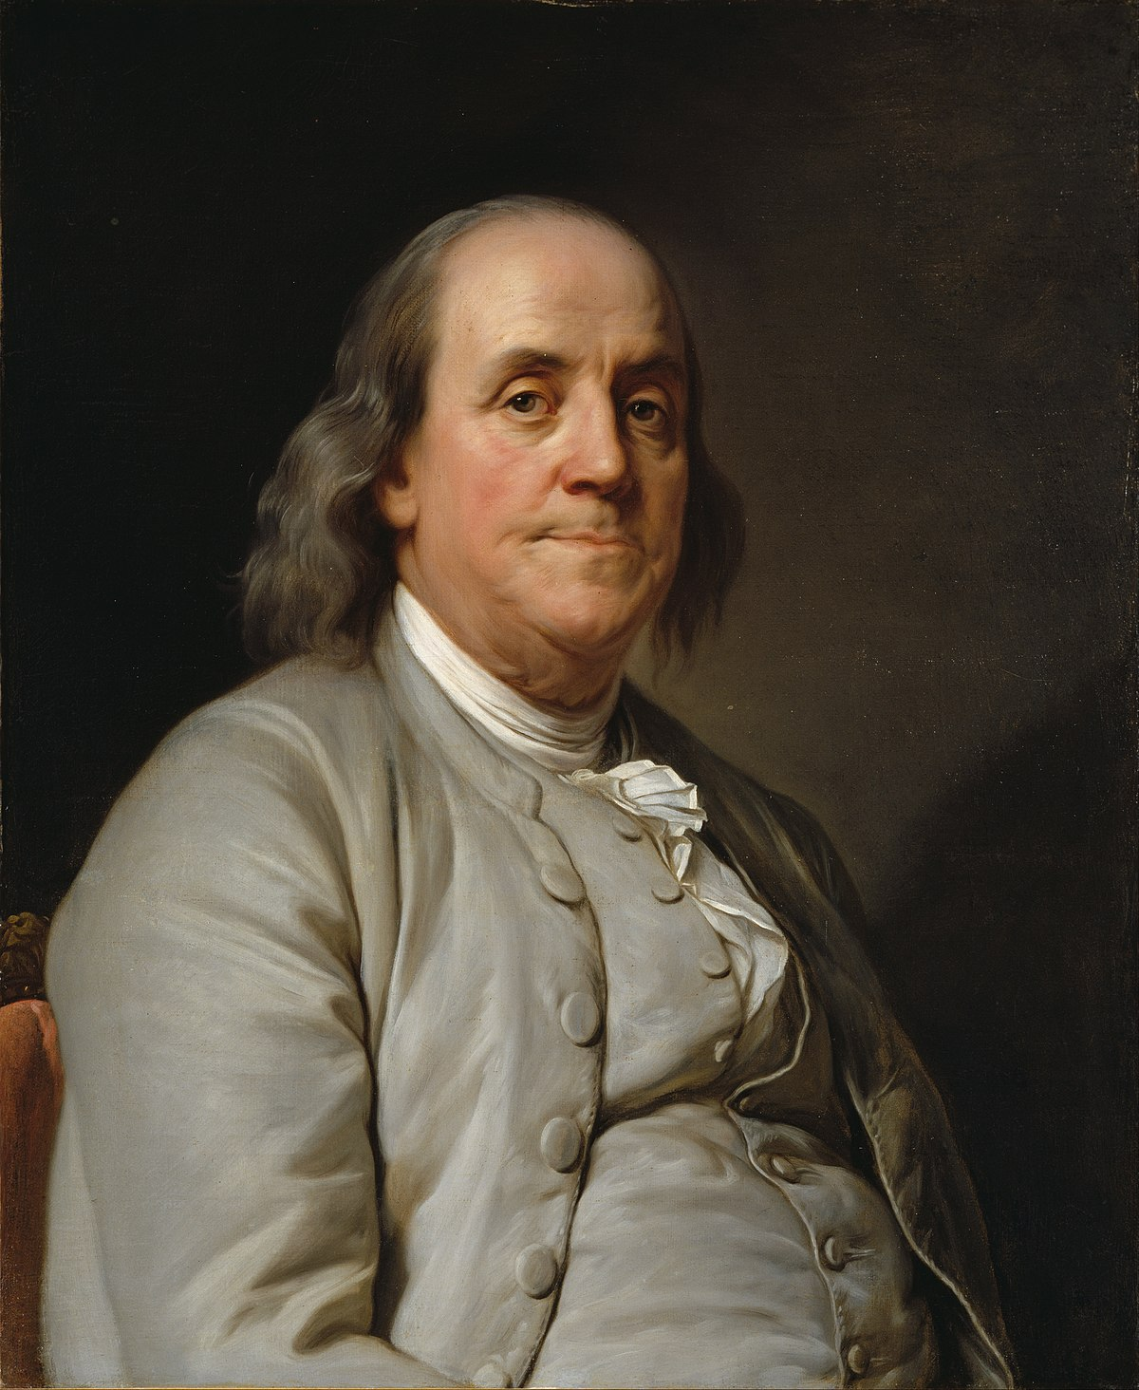
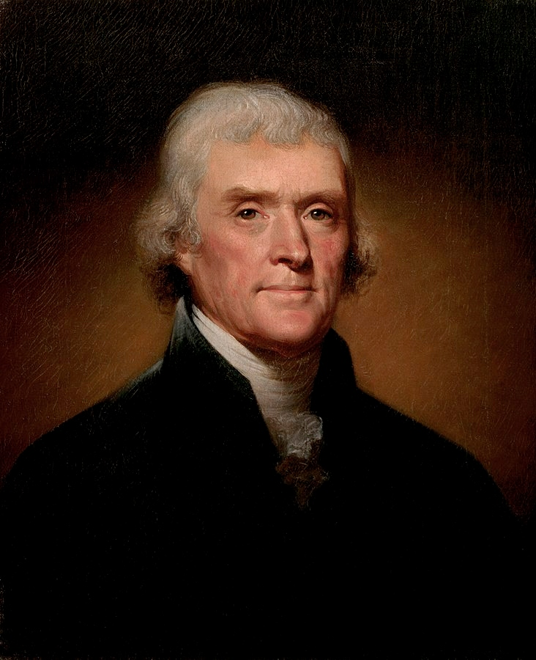

Slide 11
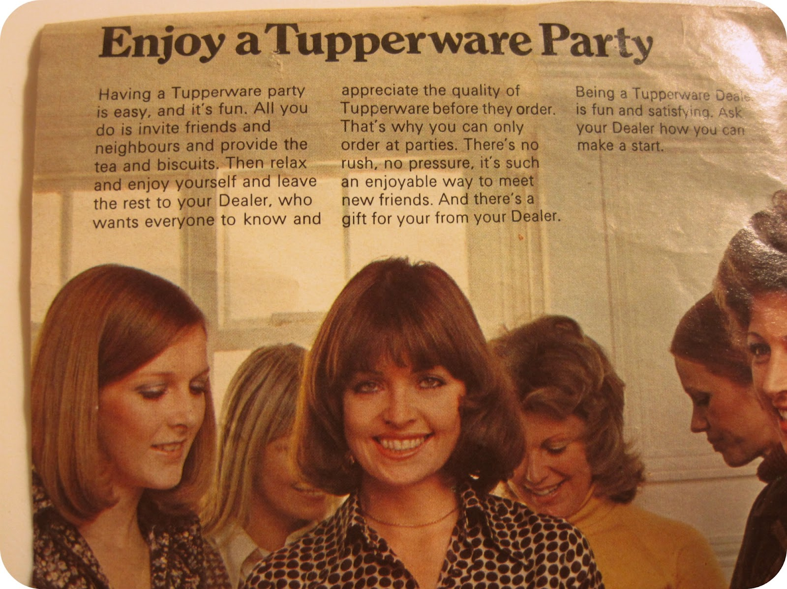
The “LIKING” Principle: Science
“Most people would prefer to say yes to the requests of somebody we know or like.” – Robert Cialdini
Example:

Slide 12
The “LIKING PRINCIPLE”: Art & Fundraising
Parlor Meetings – Friends don’t want to turn away friends
Having Lay Leaders Call for Dinner – Friends don’t want to turn away friends
BUT… Have to be similar to you… Jeffersons selling Jeffersons

Slide 13
Reciprocity: The Science
“We should try to repay in kind, what another person has provided us.” – Robert Cialdini

Slide 14
Reciprocity: Art & Fundraising
Gifts to donors
“Shut up and go away” Money
One Trick: Reciprocal Concession

Slide 15
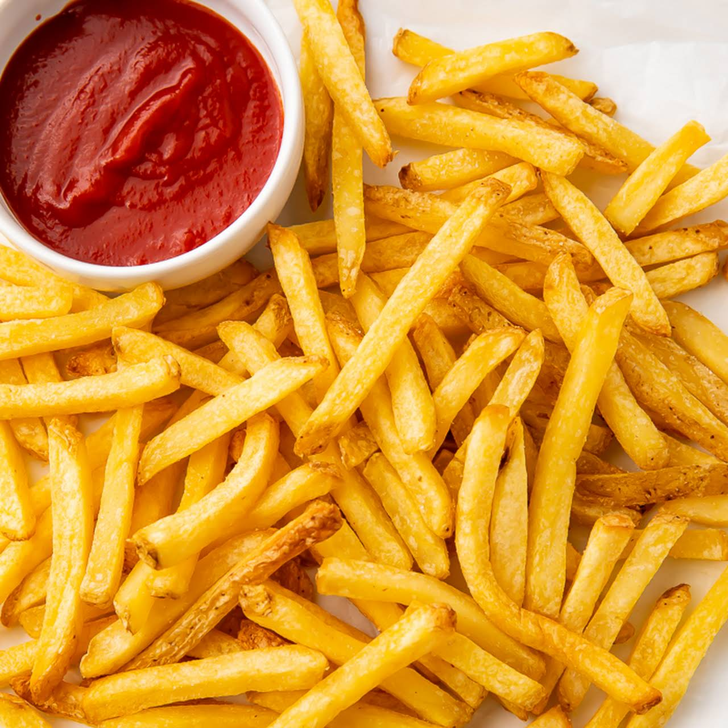

Slide 16
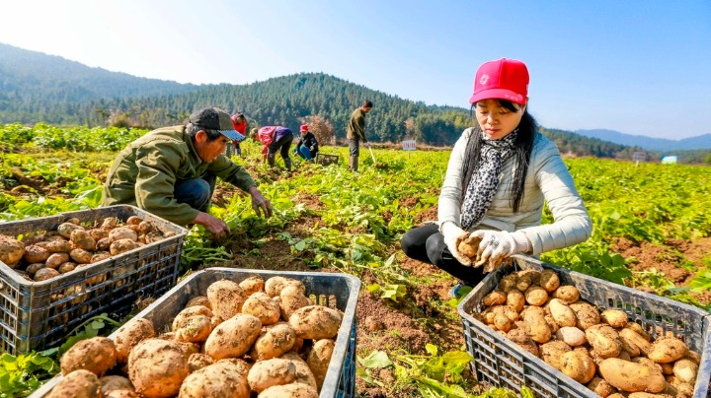

Slide 17
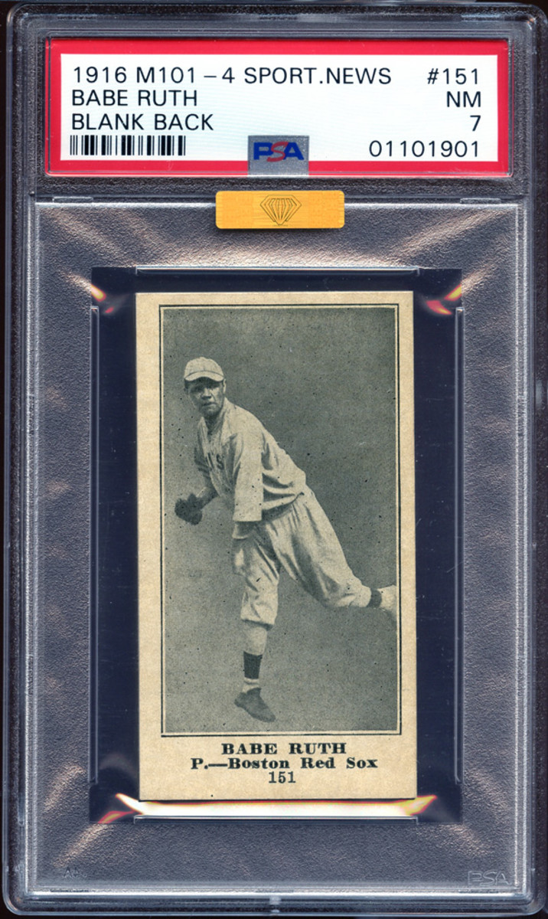
Scarcity Principle: The Science
“Opportunities seem more valuable to us when their availability is limited.” – Robert Cialdini

Slide 18
Scarcity Principle: The Art & Fundraising
“Sold Out” Dinners
Exclusive Events for Higher Donors

Slide 19
Translation: BY ORDER OF THE KING:
Treatise on the Culture and Use of the Potato, Sweet Potato, and Jerusalem Artichoke

Slide 20
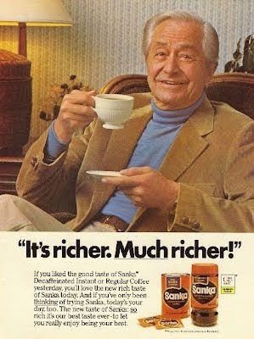
Power of Authority: The Science
“We are more likely to listen to an authority figure.”

Slide 21
Power of Authority: The Art & Fundraising
Rabbis
Heads of Schools
Communal Leaders
YOU – How you talk/look

Slide 22
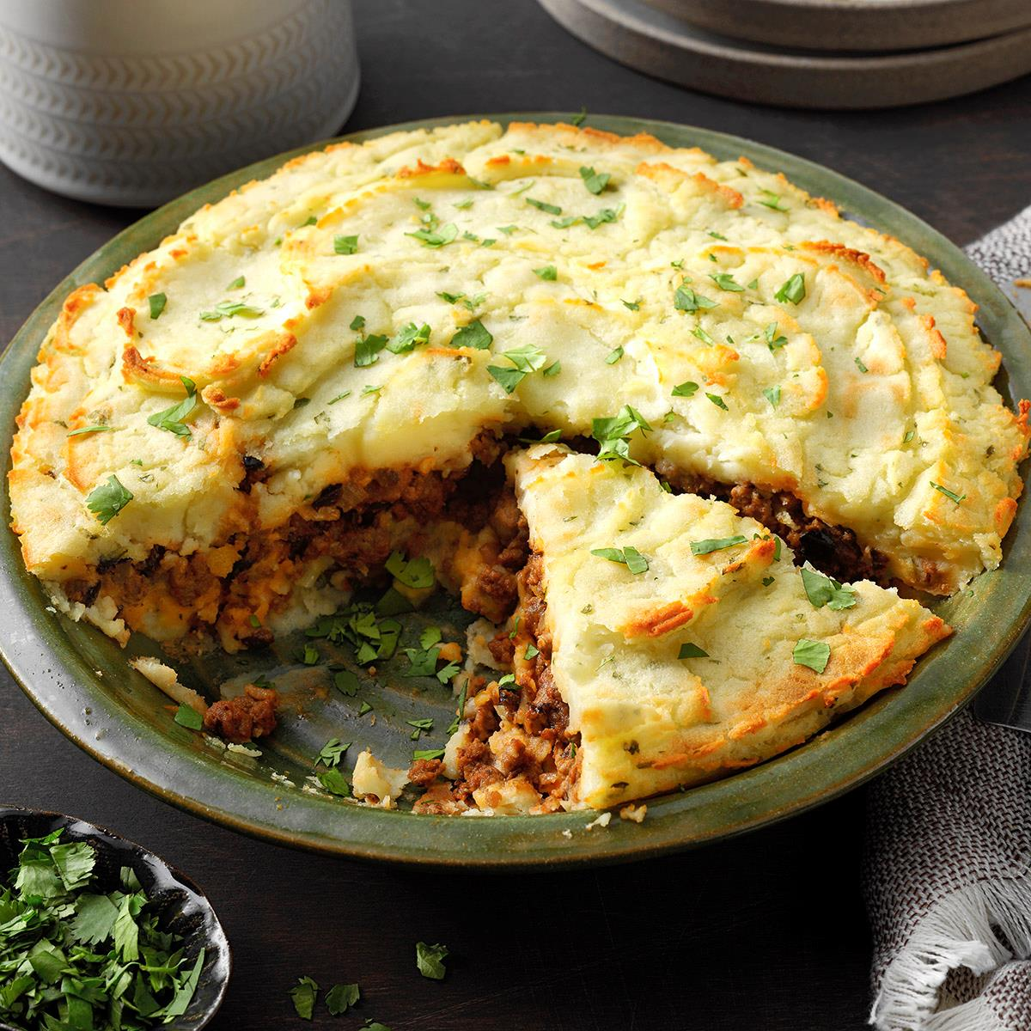

Slide 23
Lesson of Robert Broel
Cheap, Delicious and Feed The Masses:
“If you have never eaten frog meat you have a real treat coming to you because it is somewhat like the breast of chicken, only many folks think it is much more tasty and digestible.” – Tampa Daily Times

Slide 24
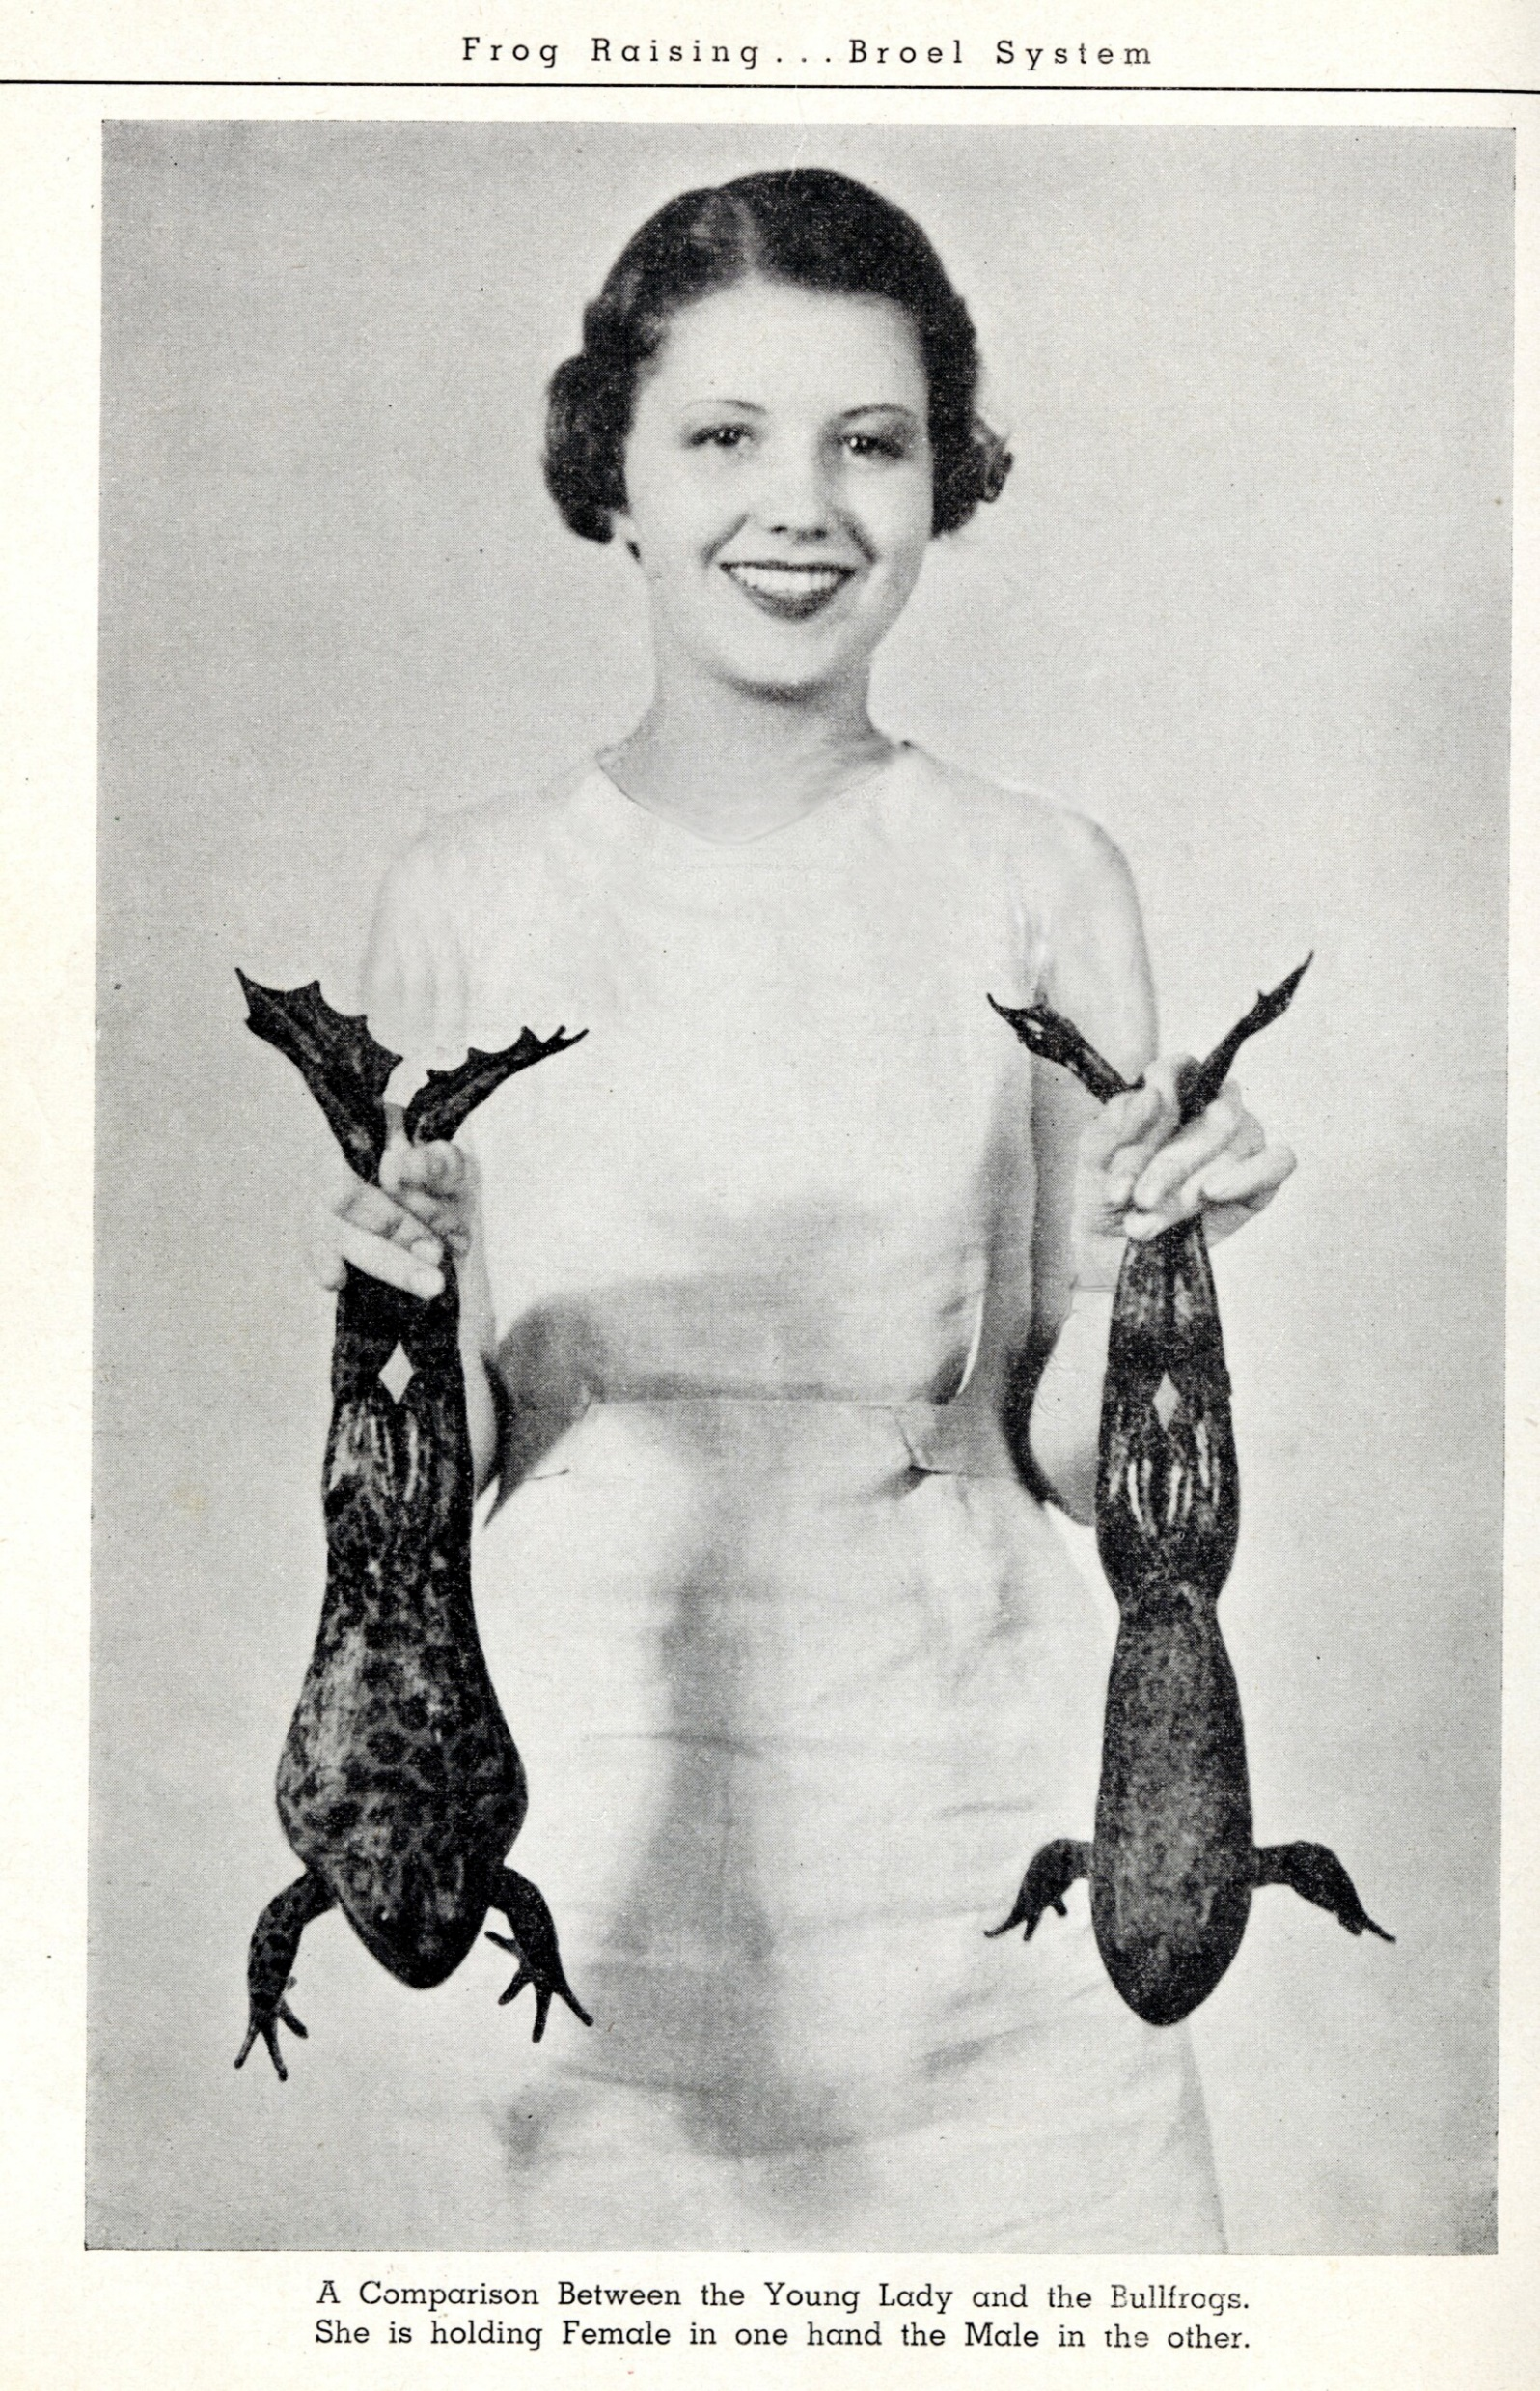

Slide 25
Broel Did It All Wrong
Didn’t test or believe in own product. You can’t raise frogs!
No Authority Principal, No Liking – People didn’t want Baked Apples with Bullfrog meat and American Giant Bullfrog Cocktails.
No Frog Tupperware Parties, No Social Proof. No scarcity because no frogs!

Slide 26
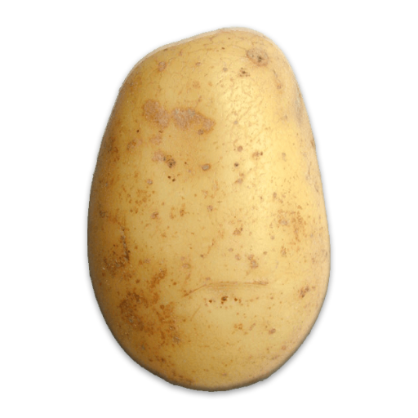
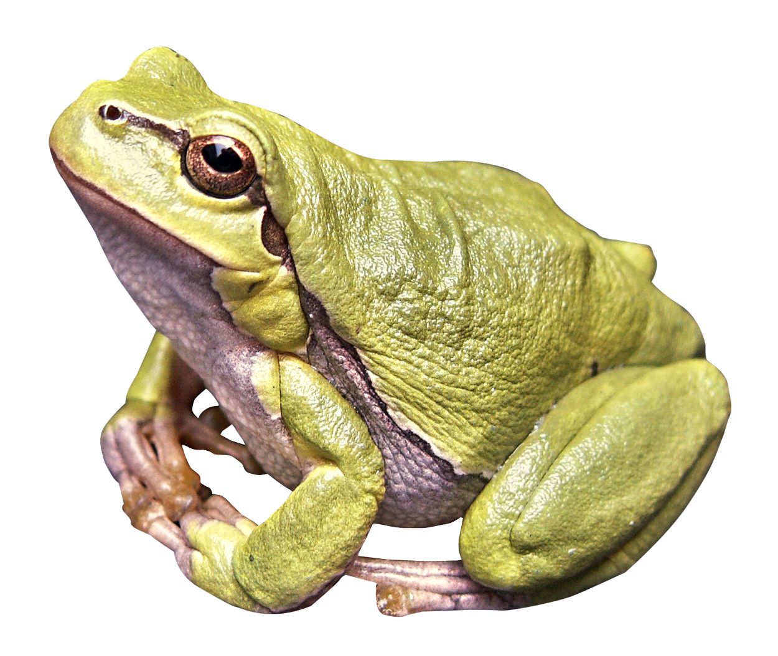
The Choice is Yours:

