Slide 1
Volunteering: How to Build Your Army
- Maury Litwack

Slide 2
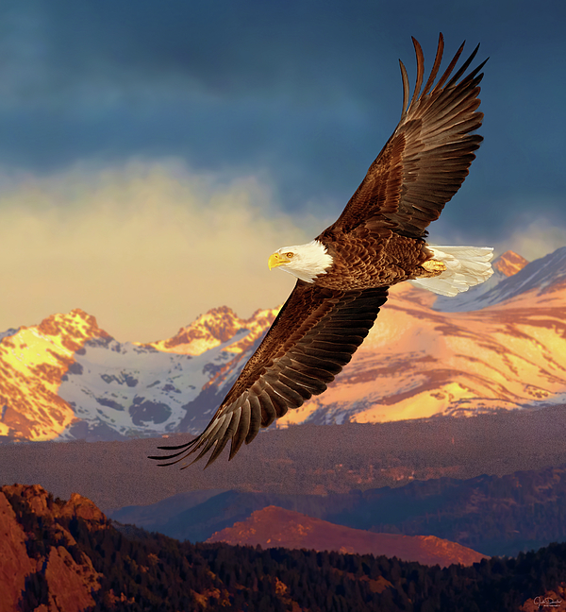

Slide 3
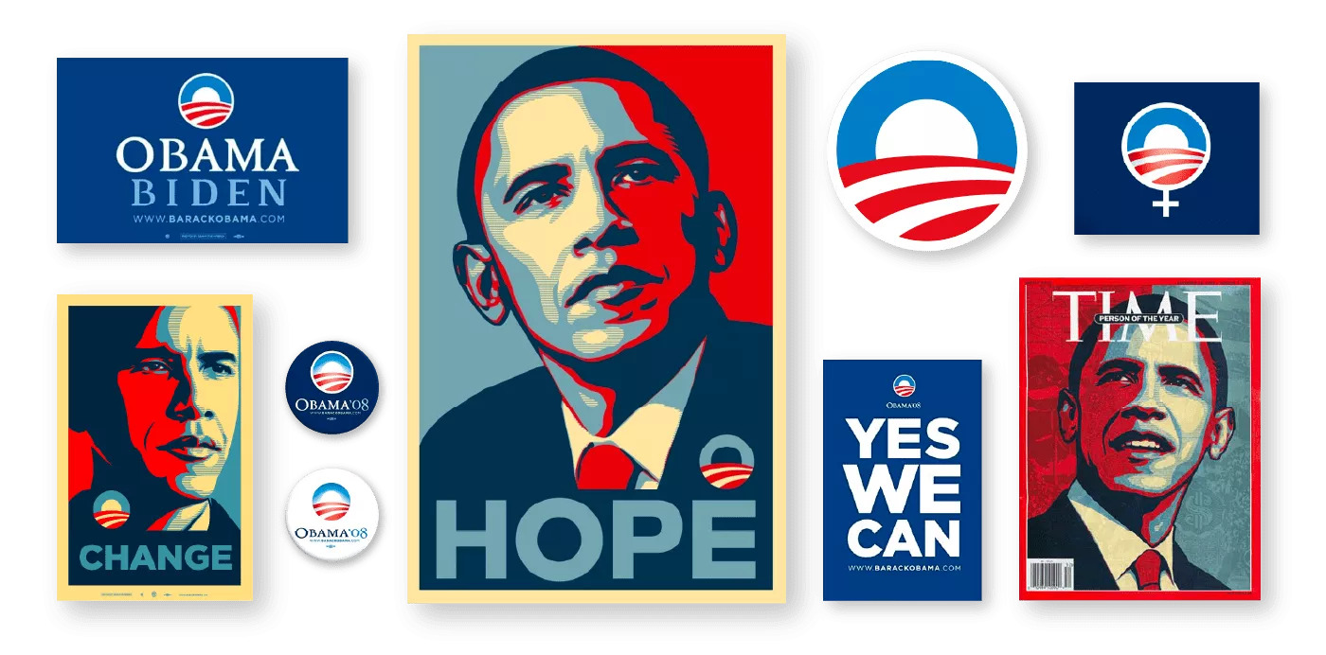
More than $45 million raised online in February
More than 90% of online donations were $100 or less
More than 50% of online donations were $25 or less
More than 75% of online donors in February were first-time online donors
More than a third of those new online donors in February went on to engage in volunteer activity on My.BarackObama.com (planning their own offline events, making phone calls from home, joining local grassroots volunteer groups

Slide 4
Volunteering is all the Rage!
Indiana University’s Last Major Study on Volunteering:
62.6 million volunteers
7.9 billion hours of service
184 billion of service contributed
78.8% of volunteers donate to charity vs 40.3% who don’t
24% fundraise or sell items to raise money
Volunteering increase your odds of finding employment by 27 percent
1 in 4 Americans volunteer
Religion makes up 34% of volunteers

Slide 5
Why not us? What’s holding us back?
SHOW OF HANDS?
Lack of interest
Lack of real work to do
Wrong people volunteering

Slide 6
What’s our goal? What kind of volunteers do we want.
“To be a successful creator you don’t need millions. You don’t need millions of dollars or millions of customers, millions of clients or millions of fans. To make a living as a craftsperson, photographer, musician, designer, author, animator, app maker, entrepreneur, or inventor you need only thousands of true fans….”
– Kevin Kelley, Co-Founder of Wired Magazine

Slide 7
How many of these do you have?
SHOW OF HANDS

Slide 8
Let’s set the True Fans Goal
How many people who will show up at your events?
How many people will give annually to your cause?
How many people will share all your good work with their friends?

Slide 9
Recruiting your volunteers
ONLY RULE: Embrace the Nos!!!!!

Slide 10
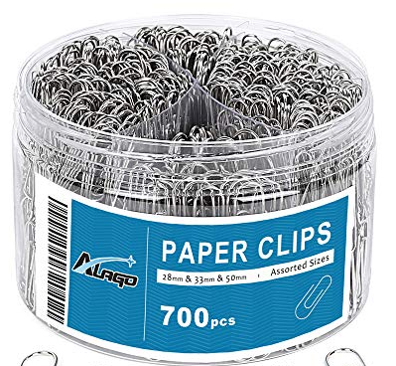
Recruiting your volunteer: Commit to the Clips
How many a day? Let’s have some volunteers

Slide 11
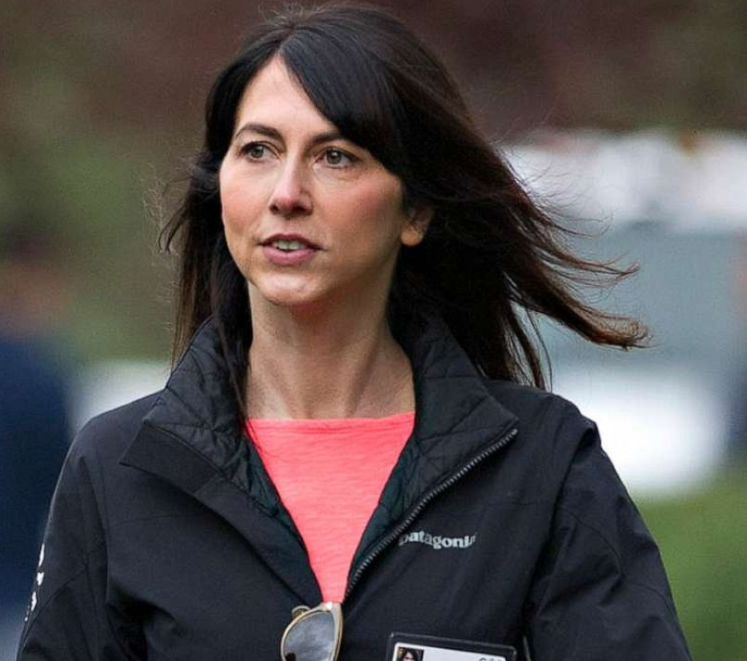
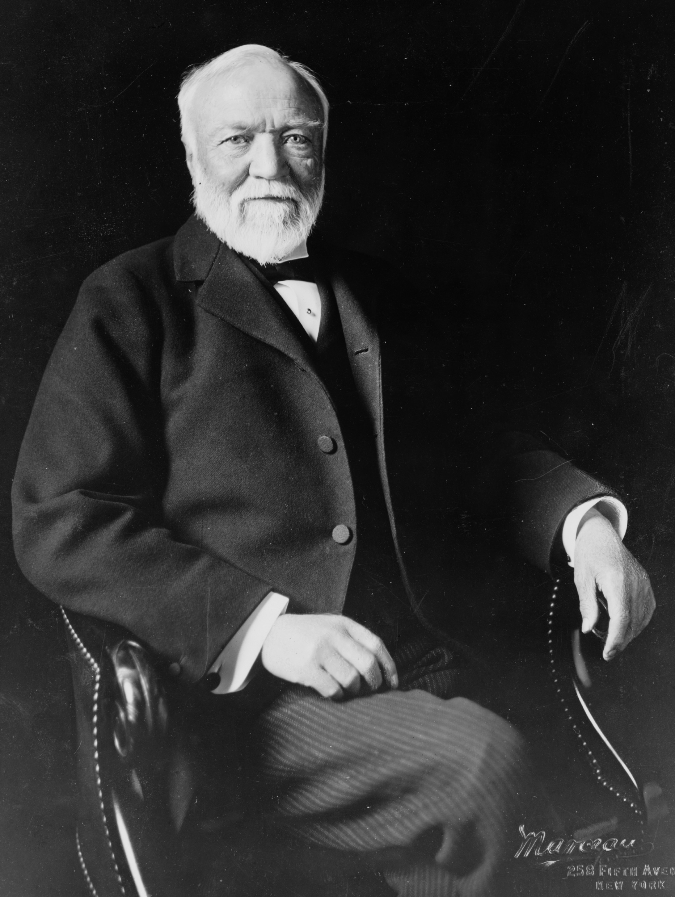
Now I have my volunteers, what do I do?
ONLY RULE: LISTEN!!!!

Slide 12
Time to give real work based on listening
Raise of hands – What’s “MAKE WORK”?
Raise of hands – What’s Real Work?
Raise of hands – What’s fun work you don’t want to give up?

Slide 13
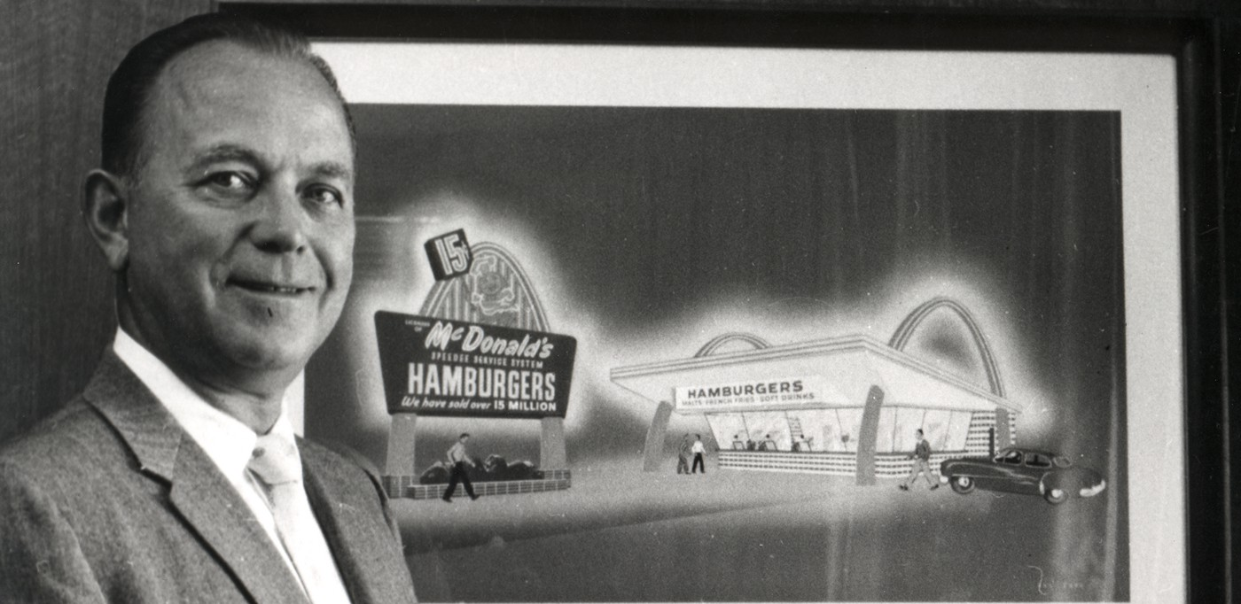
Maintaining the Volunteer
RULE: All about honesty

Slide 14
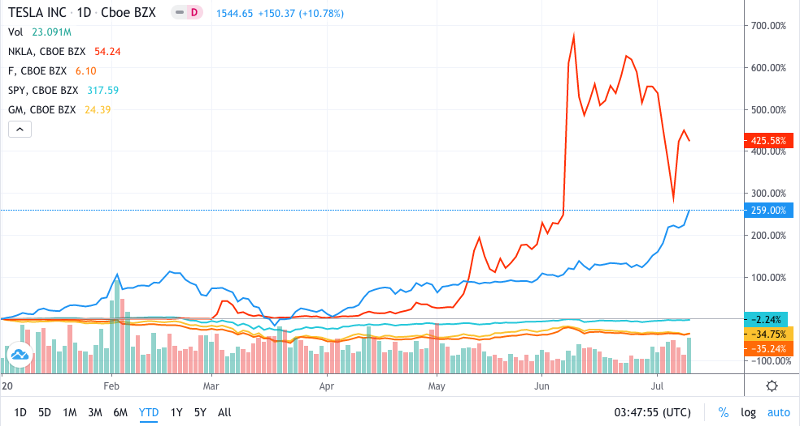
Maintaining the Volunteer
A Quarterly Report:
Rivian reported a loss of $12.21 a share on sales of $1 million.
Wall Street projected a loss of about $5 a share on sales of $1 million

Slide 15
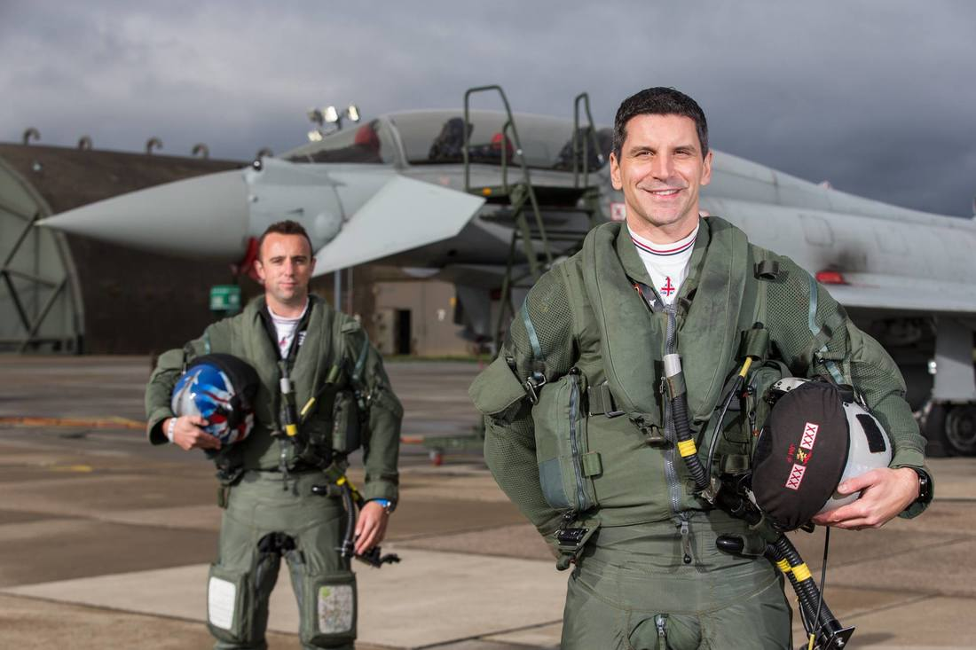
Recognition

Slide 16
Recognition
What are some ways we can recognize?
Raise of Hands.

Slide 17
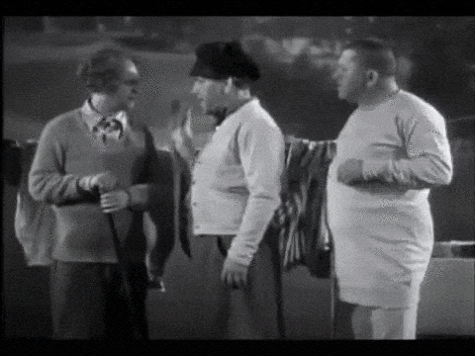
Secret Sauce
CIRCLE SELLING
Moe -> Larry -> Curly

Slide 18
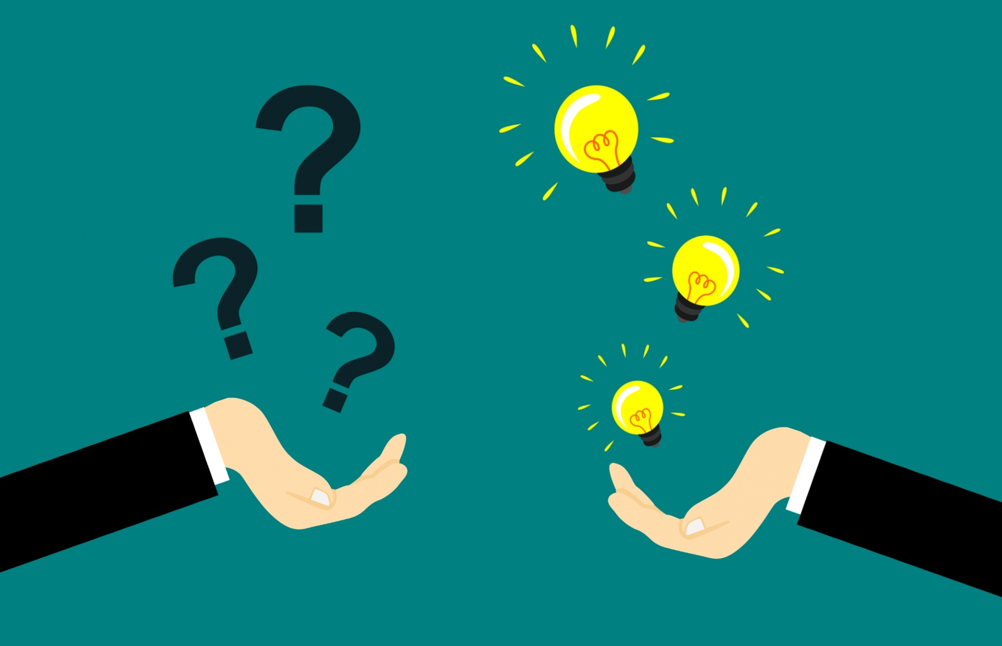
Q & A

