Slide 1
09 MAY 2023 EMALAHLENI,KWAGUQA CLC
NATIONAL CAREER WEEK CELEBRTATION

Slide 2
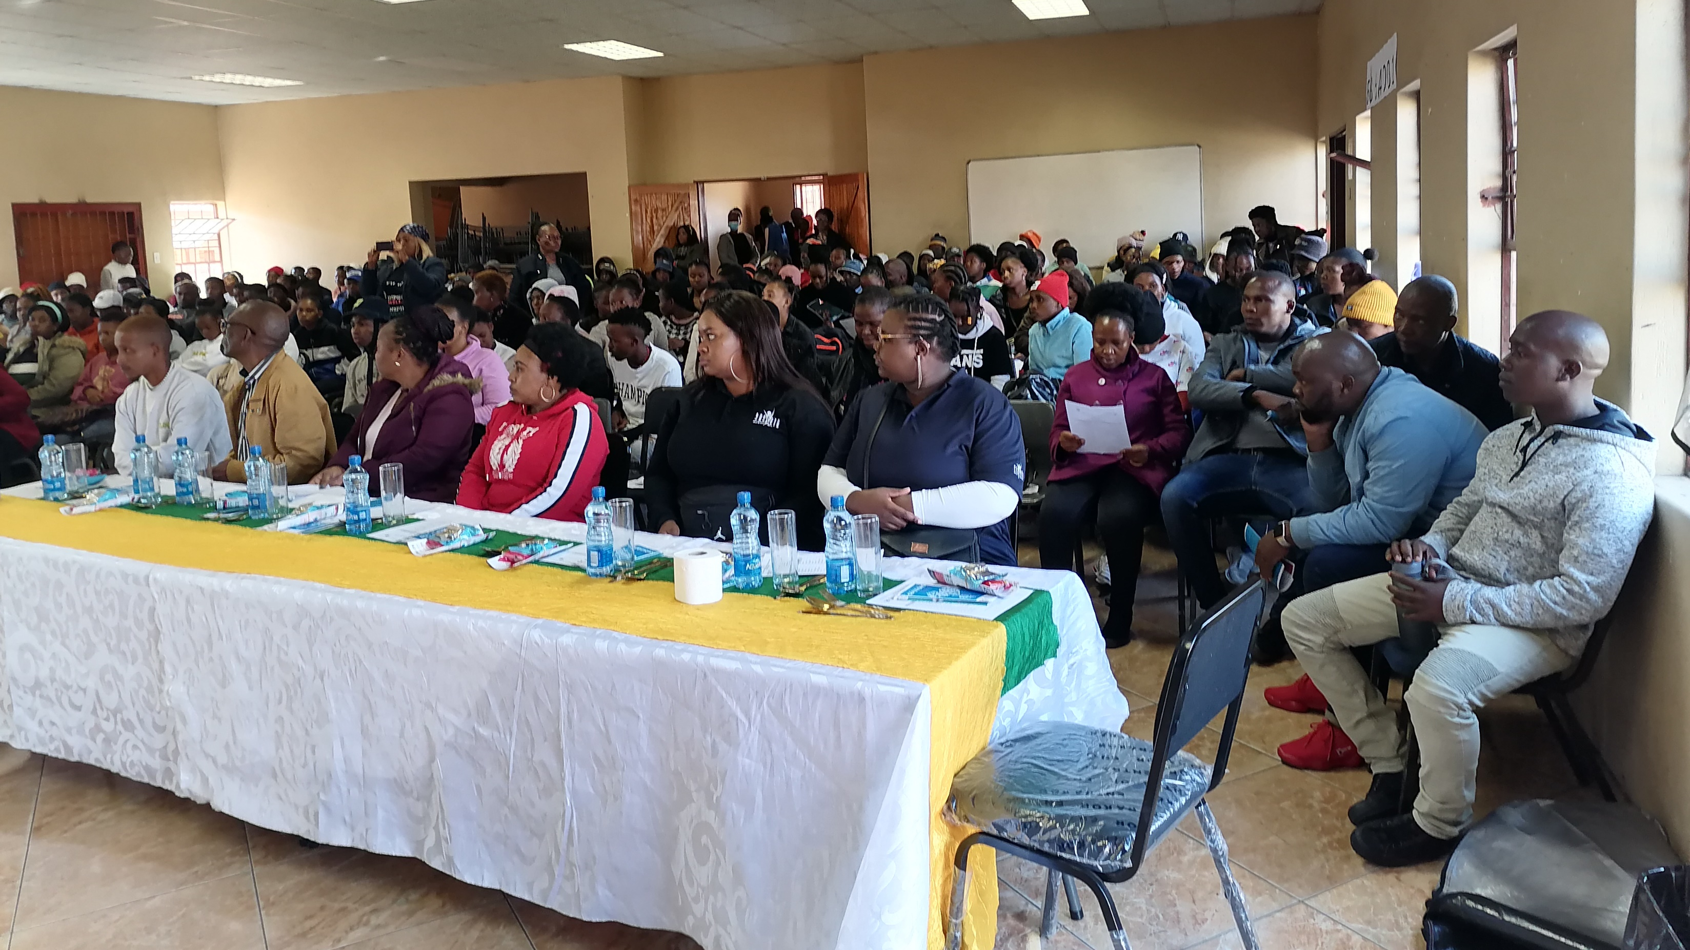

Slide 4
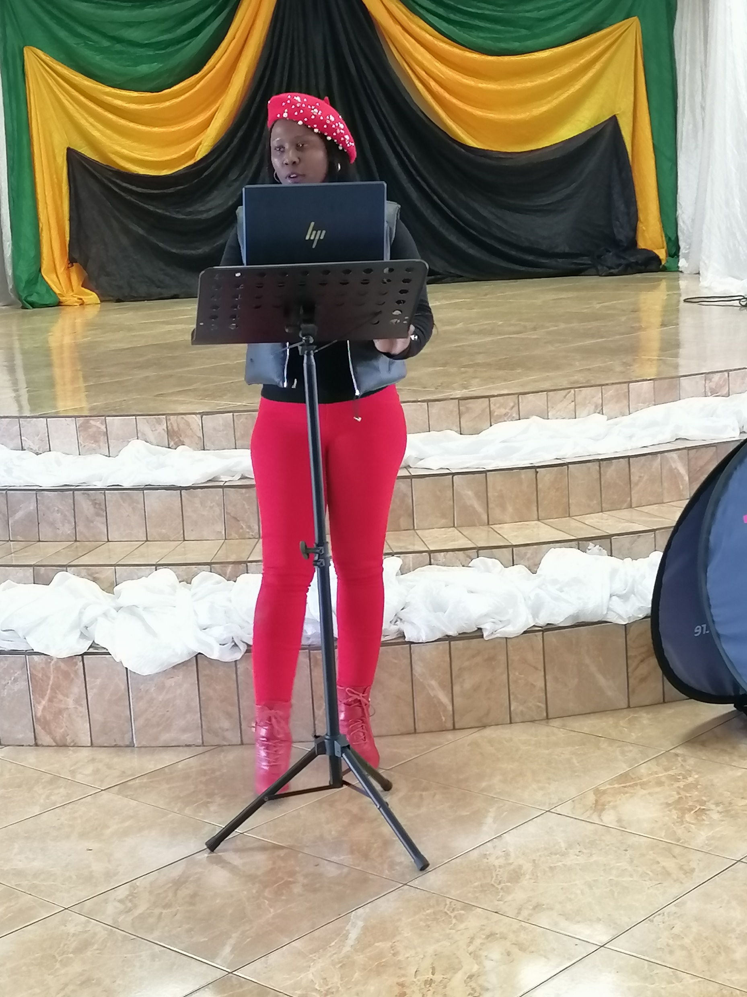

Slide 6
