Slide 1
10 MAY 2023 KAMAGHEKEZA
NATIONAL CAREER WEEK CELEBRATION

Slide 2
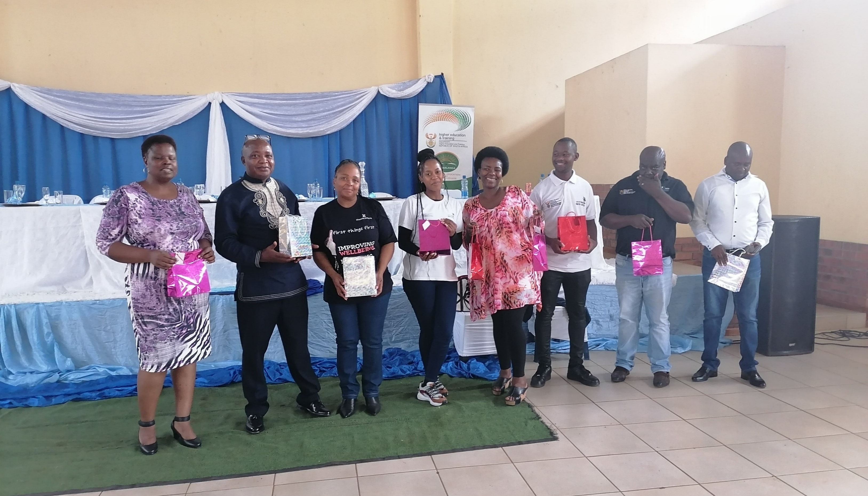

Slide 3
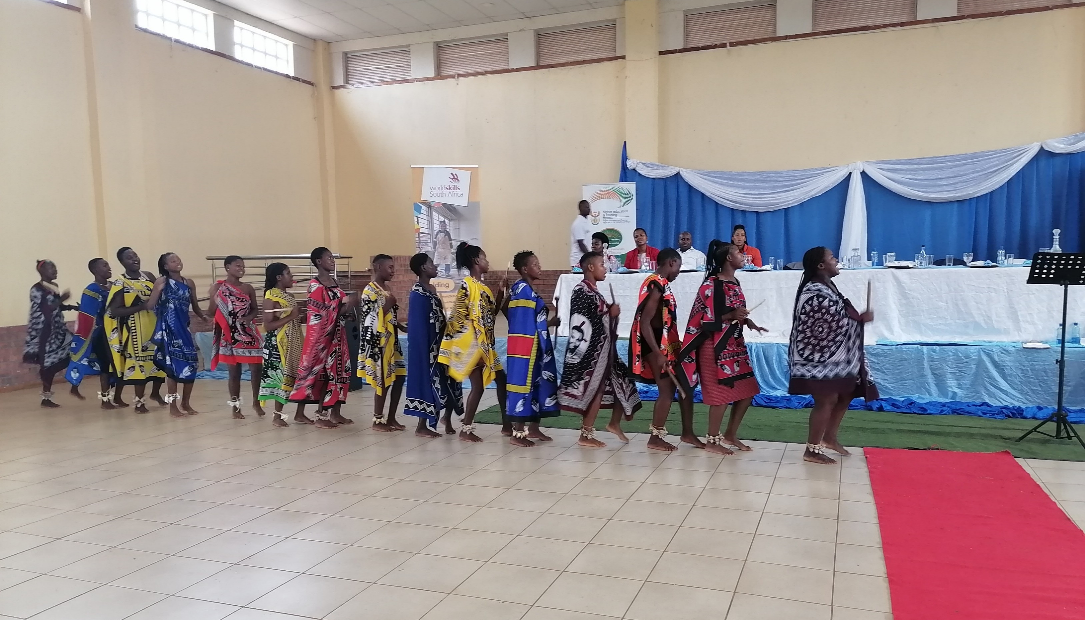

Slide 4
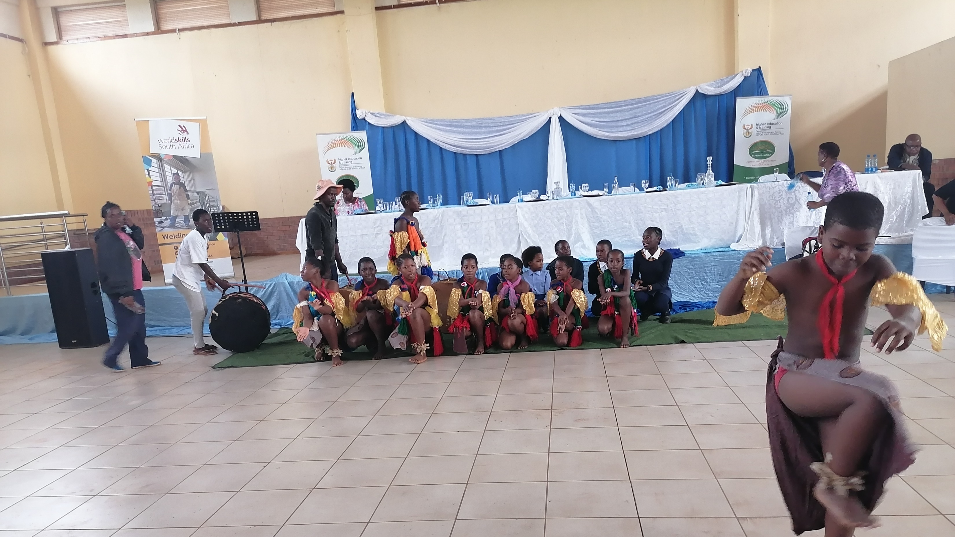

Slide 5
