Slide 1
MPUMALANGA COMMUNITY EDUCATION AND TRAINING COLLEGE STUDENTS REPRESENTATIVE COUNCIL 2023 MEETING AT KWAGUQA 19TH APRIL 2023

Slide 2
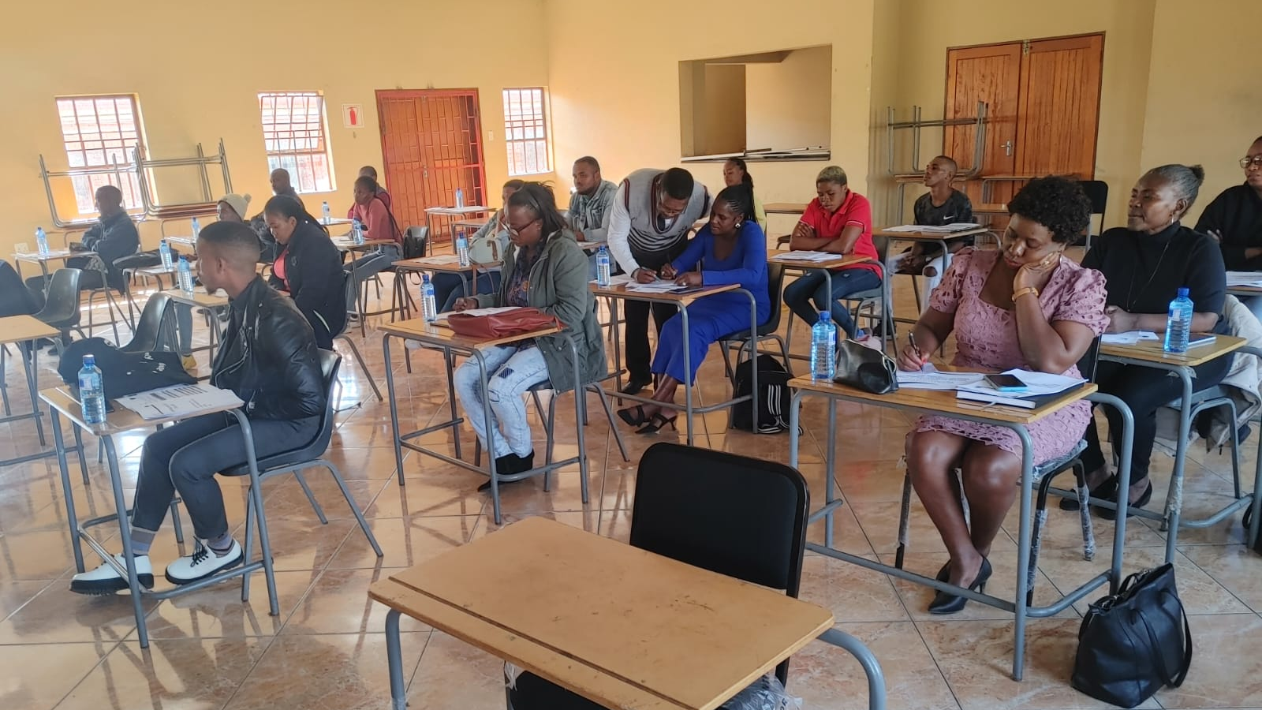

Slide 3
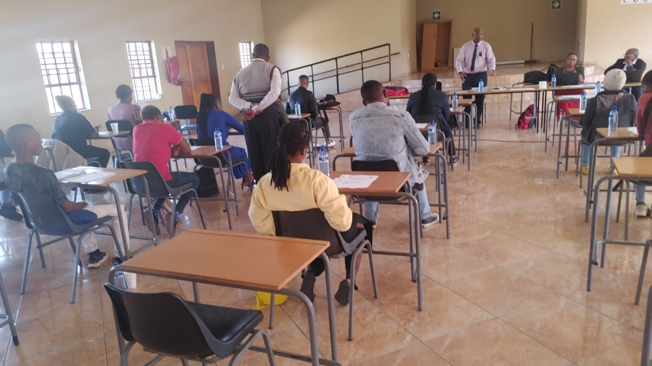

Slide 4
