Slide 1

MPUMALANGA CET
CPUT DIGITAL LEARNING PLATFORM TRAINING

Slide 2
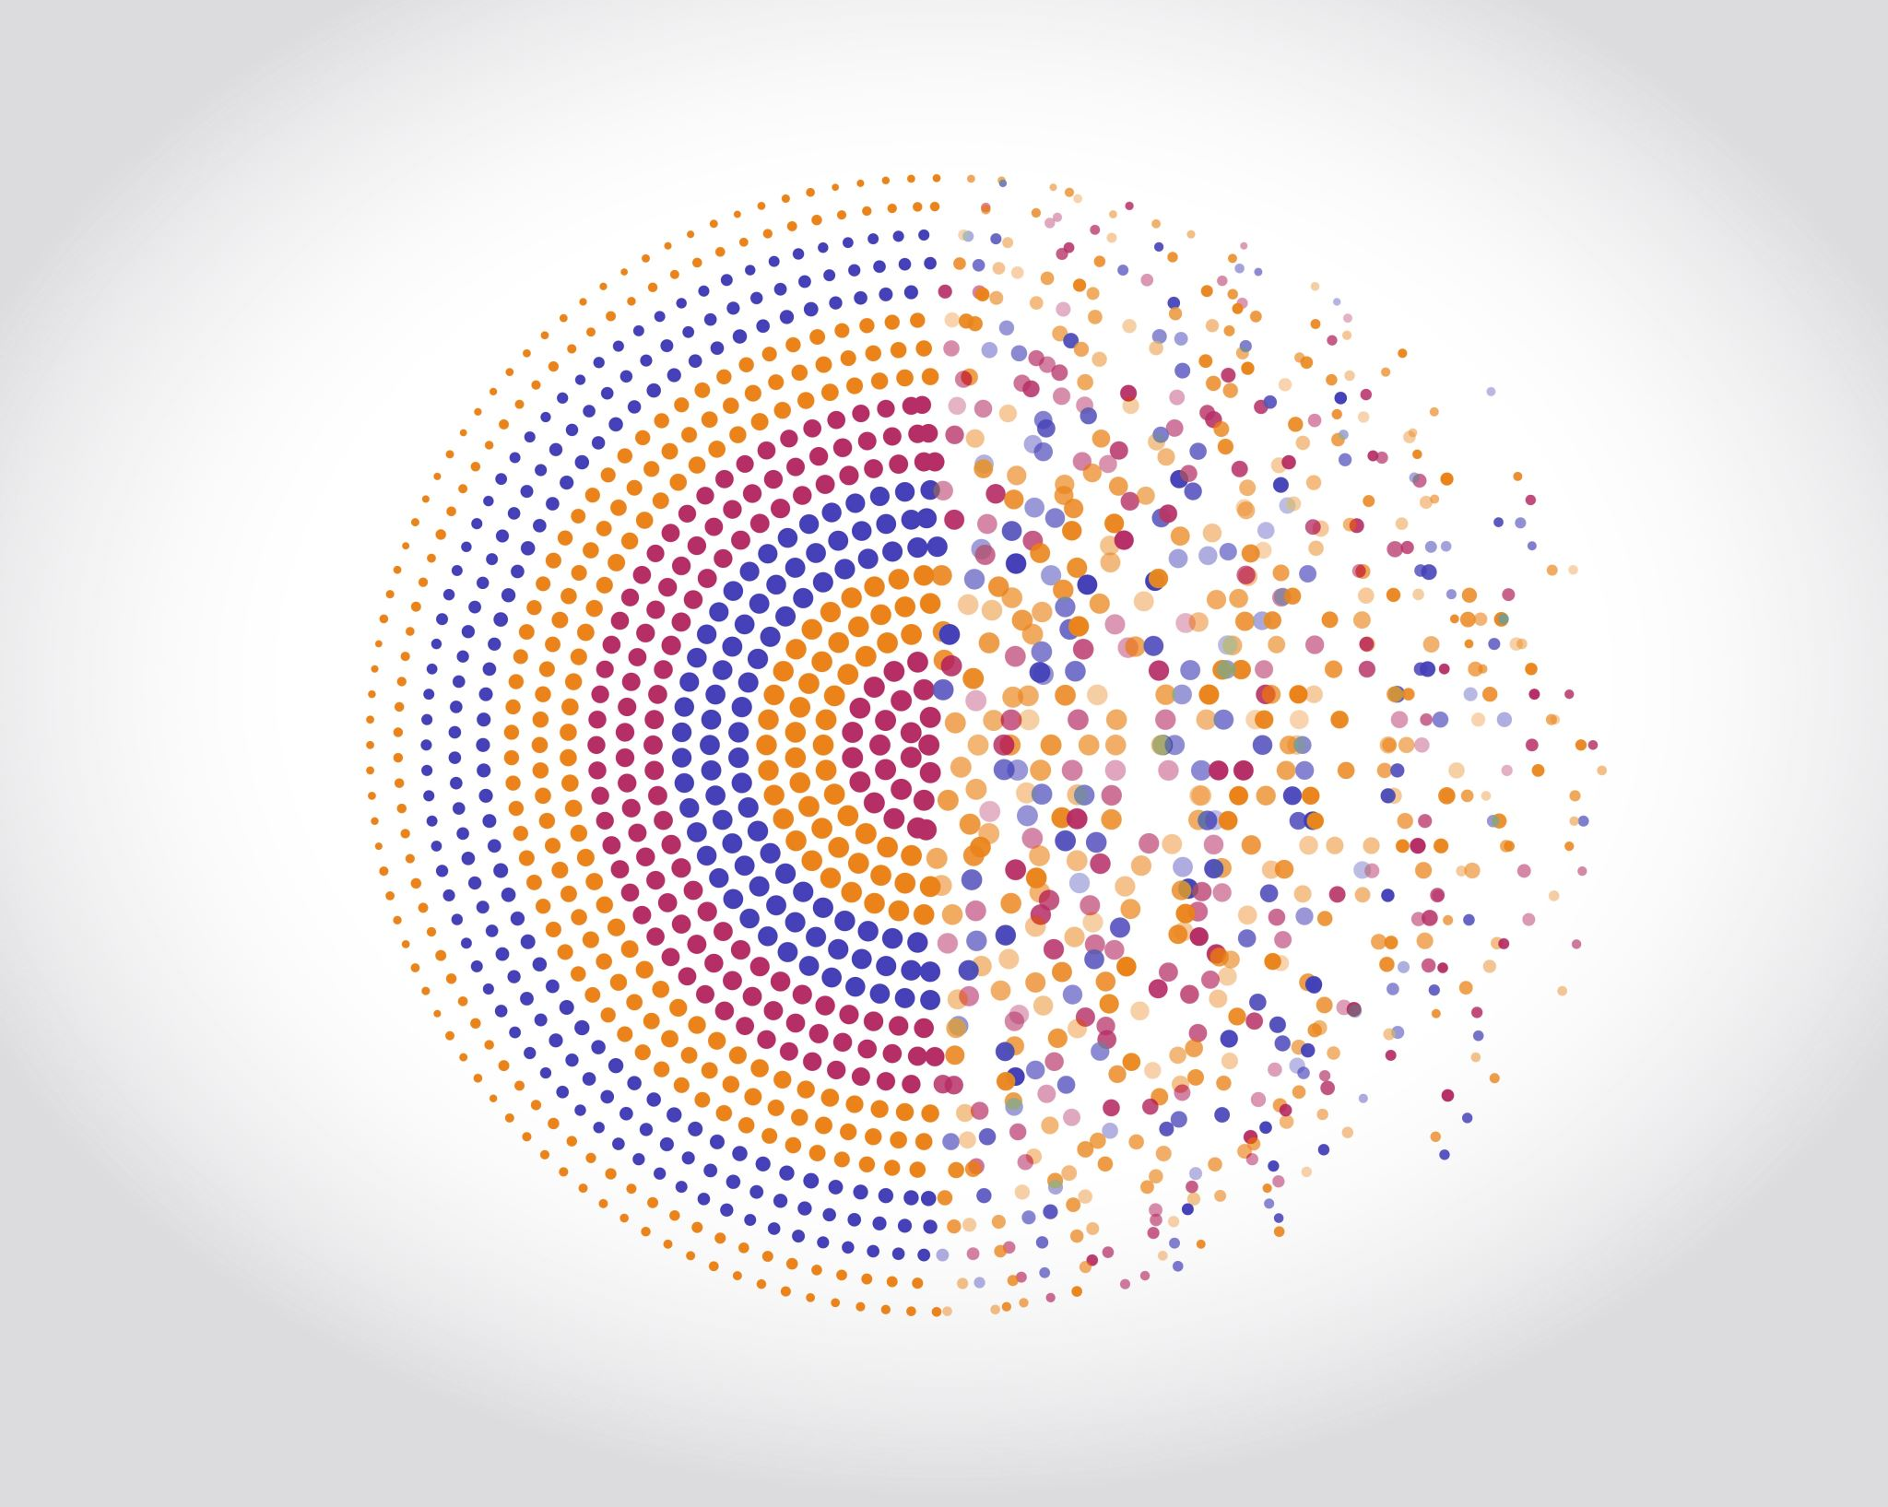

CPUT Digital learning platform training at kwaguqa clc on the 22nd of June 2023.

Slide 3
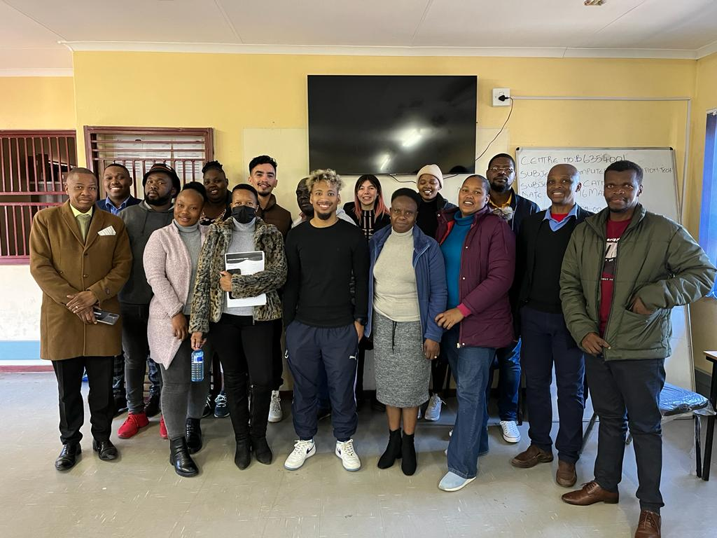

Slide 4
