Slide 1



Slide 2
Tuberculosis cases in Papua New Guinea

Slide 3

Mycobacterium Tuberculosis or
TB, is airborne
Coughing Transmits Tuberculosis

Slide 4
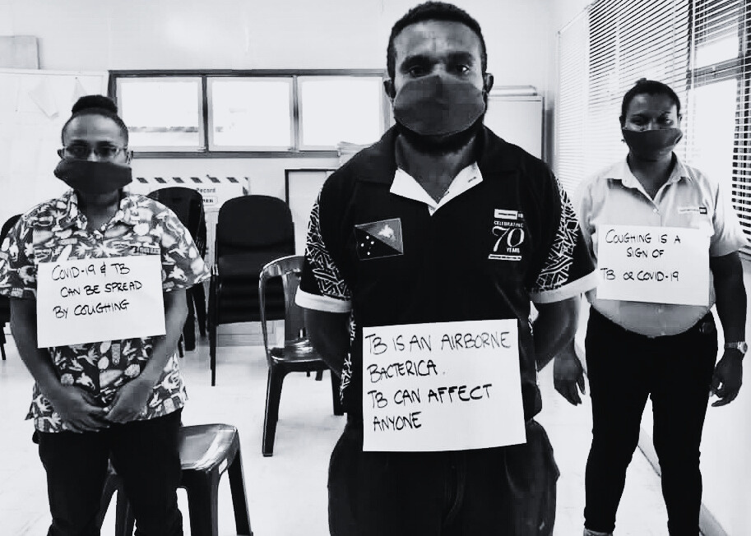
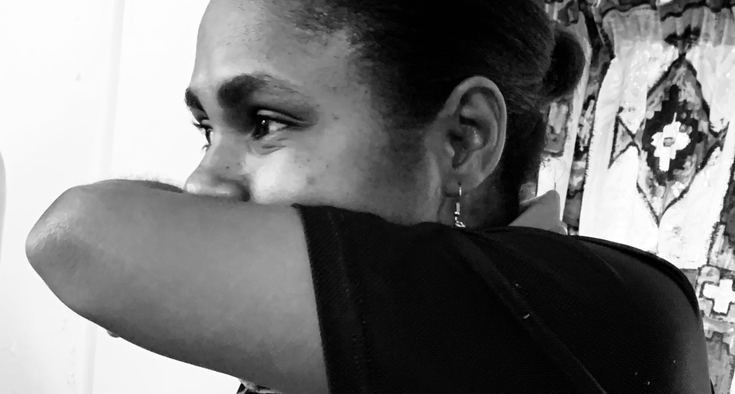
Prevent transmission
cover your cough
well ventilated workplaces and homes
early diagnosis
correct diagnosis and treatment
100% treatment adherence
Who is at RISK?
Children under 5
Smokers, drinkers, chewers, drug abusers
People in overcrowded homes and those in poorly ventilated rooms or workspaces
People not treated for HIV infection
People with Diabetes, Heart disease, High Blood Pressure
Poorly nourished children and adults

Slide 5
