Slide 1

Child Sexual Exploitation
Deborah Udakis Consultancy ltd

Slide 2
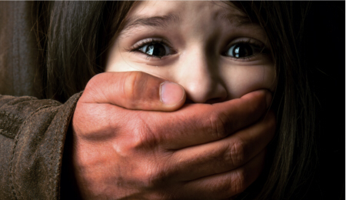
What is Child Sexual Exploitation (CSE)?
A type of sexual abuse
Grooming
Child may not be aware they are being abused
Involvement with gangs
Often ‘trafficking’
Often violence and intimidation
Anyone can be perpetrator – regardless of age, race, gender.
Notes:
What is child sexual exploitation?
Child sexual exploitation (CSE) is a type of sexual abuse.
When a child or young person is exploited they're given things, like gifts, drugs, money, status and affection, in exchange for performing sexual activities.
Children and young people are often tricked into believing they're in a loving and consensual relationship.
This is called grooming.
They may trust their abuser and not understand that they're being abused.
Children and young people can be trafficked into or within the UK to be sexually exploited.
They're moved around the country and abused by being forced to take part in sexual activities, often with more than one person.
Young people in gangs can also be sexually exploited.
Sometimes abusers use violence and intimidation to frighten or force a child or young person, making them feel as if they've no choice.
They may lend them large sums of money they know can't be repaid or use financial abuse to control them.
Anybody can be a perpetrator of CSE, no matter their age, gender or race.
The relationship could be framed as friendship, someone to look up to or romantic.
Children and young people who are exploited may also be used to 'find' or coerce others to join groups.
NSPCC

Slide 3

Types of CSE
In person or online
Perpetrator gains child’s trust
Coerced / forced to post / send explicit images of themselves
Sexualised conversations
Film or stream sexual activities
Exert power and control over child
Child May be violated / assaulted by one or many individuals.
Notes:
Types of child sexual exploitation
CSE can happen in person or online.
An abuser will gain a child's trust or control them through violence or blackmail before moving onto sexually abusing them.
This can happen in a short period of time.
When a child is sexually exploited online they might be persuaded or forced to:
send or post sexually explicit images of themselves
Film or stream sexual activities
Have sexual conversations.
Once an abuser has images, video or copies of conversations, they might use threats and blackmail to force a young person to take part in other sexual activity.
They may also share the images and videos with others or circulate them online.
Gangs use sexual exploitation:
To exert power and control
For initiation
To use sexual violence as a weapon.
Children or young people might be invited to parties or gatherings with others their own age or adults and given drugs and alcohol.
They may be assaulted and sexually abused by one person or multiple perpetrators.
The sexual assaults and abuse can be violent, humiliating and degrading.
NSPCC

Slide 4
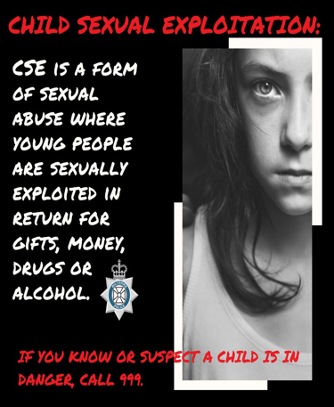
Signs of child sexual exploitation.
Unhealthy or inappropriate sexual behaviour
Being frightened of some people, places or situations.
Being secretive.
Sharp changes in mood or character.
Having money or things they can't or won't explain.
Notes:
Sexual exploitation can be difficult to spot and sometimes mistaken for "normal" teenage behaviour.
Knowing the signs can help protect children and help them when they've no one else to turn to.

Slide 5
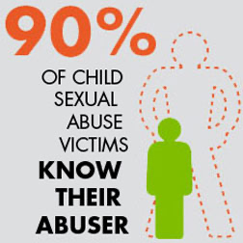
Signs of child sexual exploitation (cont…)
Physical signs of abuse, like bruises or bleeding in their genital or anal area.
Alcohol or drug misuse
Sexually transmitted infections
Pregnancy.

Slide 6
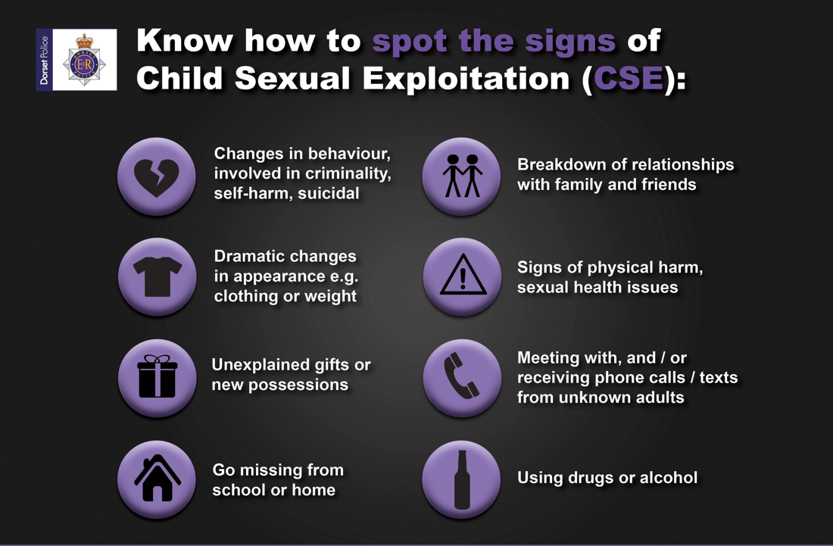

Slide 7
Other things you might notice
Having an older boyfriend or girlfriend.
Staying out late or overnight.
Having a new group of friends.
Missing from home or care, or stopping going to school or college.
Hanging out with older people, other vulnerable people or in antisocial groups.
Involved in a gang.
Involved in criminal activities like selling drugs or shoplifting.

Slide 8
Grooming
Any child is at risk of being groomed.
Both boys and girls can be groomed.
Vulnerable children are more at risk of grooming, e.g. children in care, with disabilities or who are neglected can be targeted by groomers.
Groomers exploit any vulnerability to increase the likelihood a child or young person will become dependent on them and less likely to speak out.
Notes:
Children and young people can be groomed online or in the real world, by a stranger or by someone they know. If you're worried about a child, the NSPCC have advice to help.
Grooming is when someone builds a relationship, trust and emotional connection with a child or young person so they can manipulate, exploit and abuse them.
Children and young people who are groomed can be sexually abused, exploited or trafficked.
Anybody can be a groomer, no matter their age, gender or race.
Grooming can take place over a short or long period of time – from weeks to years.
Groomers may also build a relationship with the young person's family or friends to make them seem trustworthy or authoritative.
Children and young people can be groomed online, in person or both – by a stranger or someone they know.
This could be a family member, a friend or someone who has targeted them – like a teacher, faith group leader or sports coach.
When a child is groomed online, groomers may hide who they are by sending photos or videos of other people.
Sometimes this'll be of someone younger than them to gain the trust of a "peer".
They might target one child online or contact lots of children very quickly and wait for them to respond.
The relationship a groomer builds can take different forms. This could be:
a romantic relationship
As a mentor
An authority figure
Adominant and persistent figure.
A groomer can use the same sites, games and apps as young people, spending time learning about a young person's interests and use this to build a relationship with them.
Children can be groomed online through:
social media networks
Text messages and messaging apps, like WhatsApp / email / text, voice and video chats in forums, games and apps.
Whether online or in person, groomers can use tactics like:
pretending to be younger
Giving advice or showing understanding
Buying gifts
Giving attention
Taking them on trips, outings or holidays.
Groomers might also try and isolate children from their friends and family, making them feel dependent on them and giving the groomer power and control over them.
They might use blackmail to make a child feel guilt and shame or introduce the idea of 'secrets' to control, frighten and intimidate.
It's important to remember that children and young people may not understand they've been groomed. They may have complicated feelings, like loyalty, admiration, love, as well as fear, distress and confusion.

Slide 9
Effects of child sexual exploitation
Struggle with trust
Become Isolated
Fail exams
Drop out of school / education
Abuse alcohol / drugs
Get involved in criminal behaviour
Become pregnant
Experience unemployment
Mental health issues
Attempt suicide
Self-harm
Become homeless.
Notes:
Both sexual exploitation in person and online can have long-term effects on a child or young person.
They may:struggle with trust and be fearful of forming new relationships
Become isolated from family and friends
Fail exams or drop out of education
Become pregnant at a young age
Experience unemployment
Have mental health problems
Make suicide attempts
Abuse alcohol and drugs
Take part in criminal behaviour
Experience homelessness.

Slide 10
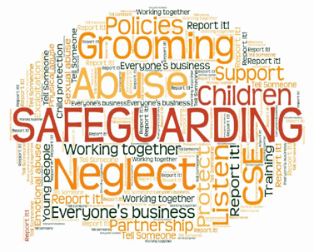
If a child reveals abuse
Listen carefully
Let them know they have done the right thing telling you
Tell them it is not their fault
Take the child seriously
Do not confront the alleged abuser
Explain to the child what you will do next
Report / make a referral ASAP.
Notes:
If a child reveals abuse
If a child talks to you about sexual exploitation it's important to:
listen carefully to what they're saying
Let them know they've done the right thing by telling you
Tell them it's not their fault
Say you'll take them seriously
Do not confront the alleged abuser
Explain what you'll do next
Report what the child has told you as soon as possible.

Slide 11

Preventing CSE
Talk to children about staying safe
Know what to do if you are worried about gangs
Help keep children safe online.
Notes:
Teaching children and young people about healthy relationships and how to stay safe online can help prevent sexual exploitation.
These foundations can be laid from a young age.
The NSPCC PANTS rules are a simple way to teach younger children how to stay safe from abuse.
And the NSPCC has got tips and advice on how to have difficult conversations.
It's also important to make sure children and young people know there are trusted adults they can speak to about their worries, including Childline.
Parents can ask their child's school to book a free Speak out Stay safe assembly for primary school children.
The NSPCC’s specially trained staff and volunteers hold assemblies and workshops, covering topics like bullying and abuse, but without using any scary words or adult language.
If you're worried about gangs, it can be difficult to know what to do to help protect young people.
Whether they're thinking about joining a gang, are already involved or want to leave, they need help and support.
You can contact the NSPCC helpline for details of organisations near you that can give you support and advice. Call the NSPCC on 0808 800 5000, email help@nspcc.org.uk or fill in a NSPCC online form.
Encourage transparency in what your children are doing online. You can keep gaming devices and computers and laptops with webcams in the living room or family spaces.
Share Aware helps children learn about the risks of sharing information online.
Use parental controls and keep up-to-date on the apps and games children and young people are using.
NetAware is regularly updated and has age ratings, information and advice.

Slide 12
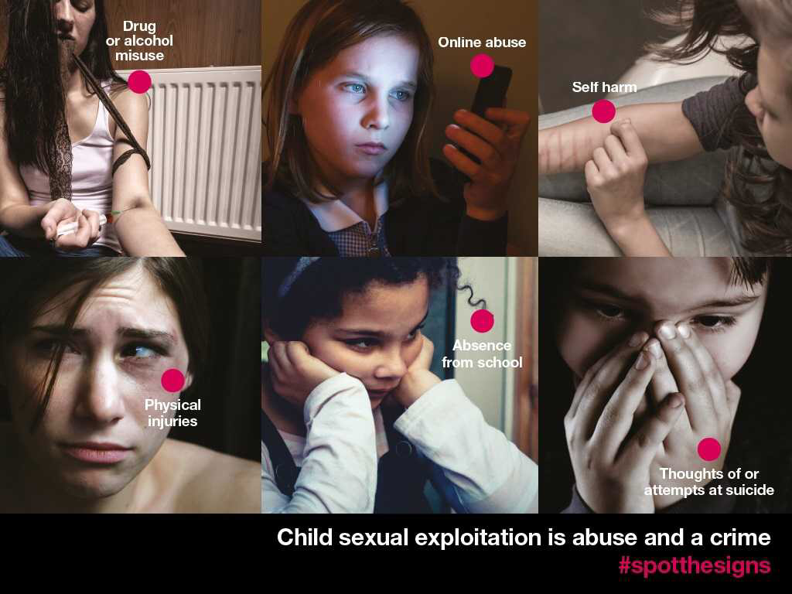

Slide 13


Slide 14

Follow your safeguarding procedures.
Notes:
Follow your safeguarding procedures
Make a referral without delay

Slide 15

Notes:
Promote childlike with children – it is a private and confidential service for all children up to 18 years of age
Free to call
24/7
365 days a year

Slide 16


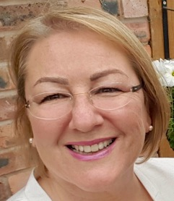
Deborah Udakis Consultancy Ltd
Follow me on …
Facebook
Pinterest
Subscribe to my website @
www.deborahudakis.co.uk

