Slide 1

PSM Training Course
TRW-PSM-RFPC-2018-E10
Process Safety Management Workshop
E10: Asset Integrity & Reliability
Presented by: Dr Fabienne Salimi
ADEPP Academy website
Nouri PSM Workshop Team sites

Slide 2
PSM Training Course
TRW-PSM-RFPC-2018-E10
©2018 Copyright. No part of this course may be copied or broad cast unless authorised. ADEPP is protected by APP (https://www.app.asso.fr/).
Copying is illegal and subject to prosecution.
Note: The CCPS PSM Roadmap slides are used with permission of
Mr Cesar Puma Medina who originated them.

Slide 3
Learning Objectives
E10: Asset Integrity
Developing, sustaining, and enhancing the organization's process safety culture is one of five elements in the RBPS pillar of committing to process safety. This course aims to provide a solid basis for this element by covering:
Basic Concept
Overview
What is it?
Why is it important?
Where / When is it done?
Who does it?
What is the Anticipated Work Product?
How is it done?
Self-Assessment
Gap Analysis
Implementation Roadmap

Slide 4
E10: Asset Integrity
Overview

Slide 5
E10: Asset Integrity
What, Why, Where/When, Who, How?
CCPS RBPS Book – Introduction
CCPS: Process Equipment Reliability Database (PERD)
HSE: Key Asset Integrity programmes

Slide 6
E10: Asset Integrity
What is it?
The asset integrity element is the systematic implementation of activities, such as inspections and tests necessary to ensure that important equipment will be suitable for its intended application throughout its life.
Specifically, work activities related to this element focus on:
preventing a catastrophic release of a hazardous material or a sudden release of energy and
ensuring high availability (or dependability) of critical safety or utility systems that prevent or mitigate the effects of these types of events.

Slide 7
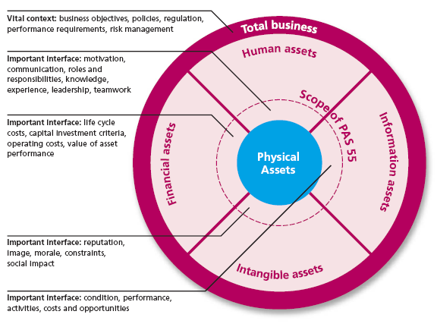
What is it?
Type of Assets

Slide 8
What is it?
Type of Assets
ISO 55000 is focussed primarily on the management of Physical assets, and other asset types are therefore only considered as they affect the optimal management of the physical assets.
These interdependences are extremely important in the holistic delivery of asset management objectives and, ultimately, the organizational strategic plan. The other assets are:
Human assets: the behaviours, knowledge and competence of the workforce have a fundamental influence on the performance of the physical assets;
Financial assets: financial resources are required for infrastructure investments, operation, maintenance and materials;
Information assets: good quality data and information are essential to develop, optimize and implement asset management plan(s);
Intangible assets: the organization’s reputation and image can have a significant impact on infrastructure investment, operating strategies and associated costs.

Slide 9
Asset Integrity Management
Life Cycle Approach for Management of Safety Critical Elements
Design & Build Integrity
Identify & create
Barriers
Sustain Integrity
Maintain the Barriers
Asset
Integrity
Operate with Integrity
Working within the
Barriers

Slide 10
Corrosion Management System
to ensure Operational Excellence
Design Integrity Management System
Asset Integrity Management System
Process Safety Management System
Operational Management System

Slide 11
What is it?
Physical Asset Breakdown
Asset Register
CE
SCE
Critical Element
BCE
“Safety Critical Elements (SCE) are any part of the installation or plant whose failure will either cause or contribute to a major accident, the purpose of which is to prevent or limit the effect of a major accident”.
Business Critical Elements (BCE) are plant or system whose failure would have a major impact on production or asset value.

Slide 12
Safety Critical System Management
From: Bow-Tie Diagrams in Downstream Hazard Identification and Risk Assessment

Slide 13
Safety Critical Elements in Oil & Gas facilities

Slide 14
Definition of Safety Critical Element (SCE)
From: The basics of verification
Safety critical elements is apart of installation which:
Eliminate the cause of:
Prevent
Control
Mitigate a Major Accident Hazard.
Examples of Safety critical element are:
Hydrocarbon containment
Overpressure protection
ESD
Flare and blowdown
Emergency power
Escape routes
Natural ventilation
High speed rotating equipment
EMEA
OIL & GAS
LLOYD’S REGISTER EMEA

Slide 15
Safety Critical Elements vs Safety Critical
From: The basics of verification
It is important to distinguish between a high-level SCE and items of safety critical equipment – these are often confused.
A number of (unwieldy) verification schemes have made the mistake of identifying particular items of equipment as SCEs. This makes for a very large number of SCEs and is very difficult to manage.
For example:
A gas compressor, for instance, is an item of Safety Critical Equipment
It may be related to a number of SCEs such as:
hydrocarbon containment,
overpressure protection,
high speed rotating equipment

Slide 16
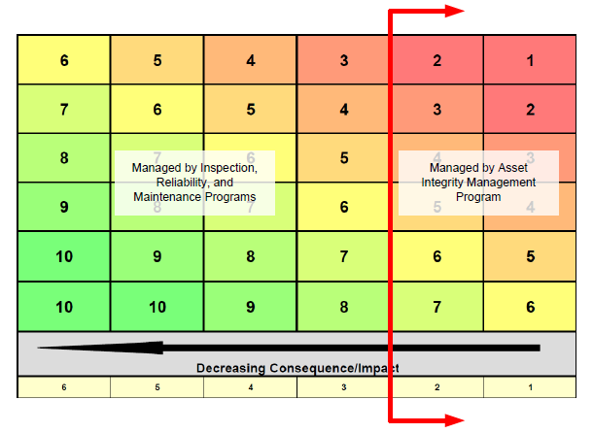
Scope of Asset Integrity Program based on Company Integrated Risk Matrix
Safety Critical Equipment
Managed by Inspection. Reliability, and Maintenance programs
Safety Critical Elements
Managed by Asset Integrity program

Slide 17
E10: Asset Integrity
Why is it important?
Designing and maintaining equipment that it is fit for its purpose and functions when needed is of paramount importance to process industries.
Maintaining containment of hazardous materials and ensuring that safety systems work when needed are two of the primary responsibilities of any facility.

Slide 18
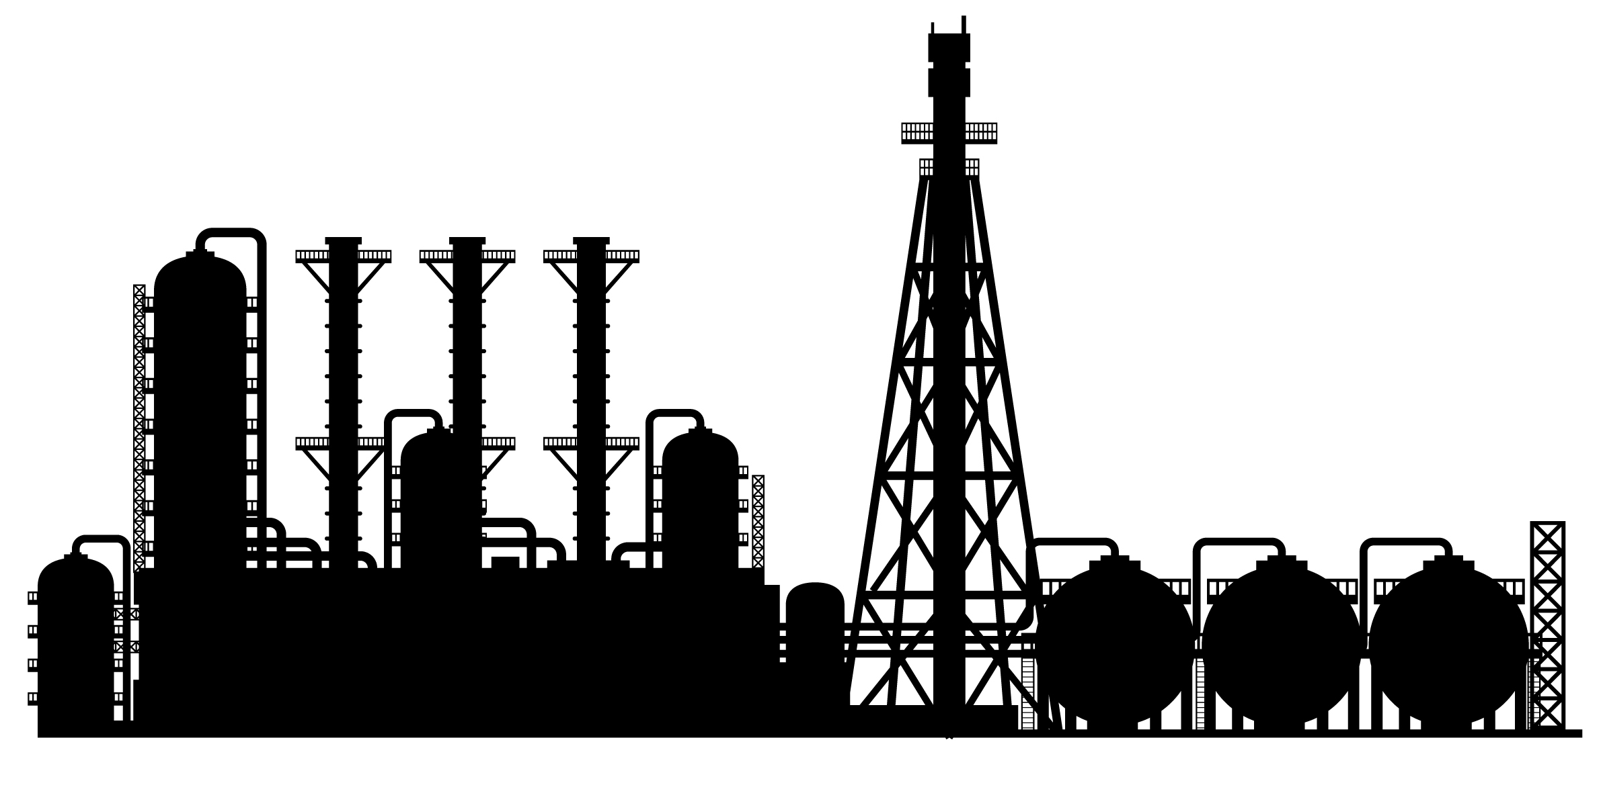
Why is it important?
Duty Holder Challenges
Optimise the Supply Chain value
(Business Critical Elements)
Prevent the Major Accidents
(Safety Critical Elements (SCE)
Who is a duty holder?
As a business manager, owner, director, health and safety manager, supervisor or even user you could be the Duty Holder. If you are responsible for a business, part of it, or the equipment it uses then you are the duty holder.

Slide 19
Why is it important?
Duty Holder Challenges
People (Personnel and Public) and Environment are protected by Laws & Regulations against the risk of Major Accident in the hazardous facilities.
The duty holders are the ultimate responsible of the accidents. They can be criminally prosecuted if their negligence about safety and environmental laws is proved.

Slide 20
Safety Case Regulation– Key Features
From: The basics of verification
Concept of duty holder
Safety Case
Identification of major accident hazards
Identification of safety critical elements (SCEs)
Setting of performance standards for SCEs
Written schemes of examination
Independent verification requirements

Slide 21
Duty Holder Responsible for
Safety Case Regulation Compliance
From: The basics of verification
Has overall responsibility for Safety Case Regulation compliance
Is subject to criminal sanctions under both “Safety Case Regulation”
Production and submission of the Safety Case to regulatory bodies
Identification of MAHs and SCEs
Setting appropriate performance standards for SCEs and specified plant
Implementation of the verification scheme
Selection of an appropriate ICP
Recording and acting on the results of examinations under the scheme
Review and revision of the scheme

Slide 22
E10: Asset Integrity
Where / When is it done?
Asset integrity activities range from technical meetings involving experts seeking to advance the state-of-the-art in equipment design, inspection, testing, or reliability, to a plant operator on routine rounds spotting leaks, unusual noises or odors, or detecting other abnormal conditions.
However, this element primarily involves:
inspections, tests, preventive maintenance, predictive maintenance, and repair activities that are performed by maintenance and contractor personnel at operating facilities and
quality assurance processes, including procedures and training, that underpin these activities.
Asset integrity element activities occur at many places and extend throughout the life of the facility.

Slide 23
E10: Asset Integrity
Who does it?
Asset integrity activities occur at several organizational levels.
Industry sponsored technical committees and organizations are continuously working to advance the state of knowledge regarding proper design and inspection, test, and preventive maintenance (ITPM) practices to help ensure that equipment is fit for service at commissioning, and remains fit for service throughout its life.
Companies (or business units) often establish centers of excellence in the asset integrity field, establish corporate standards, and promote efforts to continuously improve the safety and reliability of process equipment.
At an operating facility, the asset integrity element activities are an integral part of day-to-day operation involving operators, maintenance employees, inspectors, contractors, engineers, and others involved in designing, specifying, installing, operating, or maintaining equipment.
.

Slide 24
E10: Asset Integrity
What is the Anticipated Work Product?
Asset integrity element work products include:
      Reports and data from initial inspections, tests, and other activities to verify that equipment is fabricated and installed in accordance with design specifications and is fit for service at startup.
      Results from ongoing ITPM tasks, performed by trained or certified personnel and based on written procedures that conform to generally accepted standards, that help ensure that equipment remains fit for service.
      Controlled repairs and adjustments to equipment by trained personnel using appropriate written procedures and instructions.
      A system to control maintenance work, repair parts, and maintenance materials needed for the work to help ensure that equipment remains fit for service.
      A quality assurance program that helps prevent equipment failures that could result from:
      use of faulty parts/materials or
      improper fabrication, installation, or repair methods (e.g., improperly supporting the engine as discussed at the start of this chapter).

Slide 25
E10: Asset Integrity
What is the Anticipated Work Product?
The primary objective of the asset integrity element is to help ensure reliable performance of equipment designed to contain, prevent, or mitigate the consequences of a release of hazardous materials or energy.
Although proper execution of work activities associated with this element requires a high level of human performance, the ultimate work product for this element is reliable and predictable equipment operation.

Slide 26
Critical Elements Risk Management
General Process
Risk Assessment & Screening
Identify Major Accident
Bow-Tie analysis
Safety Barrier Category & Hierarchy
Criticality Test
Identification of Safety Critical Systems (SCS)
Performance Standards
Define:
Goals & objectives
Functionalities
Reliability/availability
Survivability
Interfaces
Survivability Analysis
Confirm that SCE will be functional during accidental conditions
Fault Tree Analysis
Create Safety Critical Elements (SCE)
Written Schemes
- Assurance activities & tasks
- Inspection/test time
Create SCE Register
Input to:
- Computerised Maintenance Management System (CMMS)
- Risk based Inspection (RBI)
Notes:
26

Slide 27

Typical Generic list of
Safety Critical Systems (SCE)
A1/A – Hydrocarbon Processing Systems
A1/B – Fuel Gas System
A1/C – Closed Drain System
A4 – Control of Ignition Sources
A6 – Inert Gas System
A8 – Crane and Lifting Systems
A9 – ESD& EDP System
A10 – Fire & Gas Detection System
A12 – Flare & Ignition Systems
B1 – Egress/Evacuation Routes
B2 – Personnel Refuge (PR)
B3 – Emergency (Escape) Lighting
B4 – Emergency Communications
B5 – Personal Protective Equipment (PPE)
C1 – Primary Means of Evacuation
C4 – Rescue Facilities
D7 – Export Pipeline Safety Valves
D8 – HVAC Systems
E1 – Blast Resistant Construction
E2 – Fixed Firewater Protection Systems
E5 – Essential Power Generation
E6 – Firewater Supply Systems
E7 – Fixed CO2 Fire Extinguishing Systems
E10 – Open Drain System
E12 – Passive Fire Protection
E13 – Uninterruptible Power Supplies (UPS)
E14 – Fixed FM200 Fire Extinguishing Systems
Notes:
27
UKOOA provides a generic list of Safety Critical system. This list shall be customized for Egyptian LNG plant by a brainstorming session.
This brainstorming session eases communication between ELNG team and SCE consultants.

Slide 28
Wishing You the
Reliable & Safe Operations!

