Slide 1
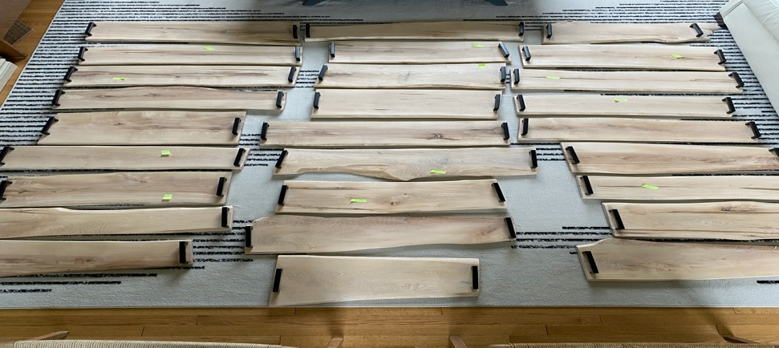
1
2
3
4
5
6
8
9
7
10
11
12
13
14
15
16
17
18
19
21
20
22
23
24
25
27
26

Slide 2
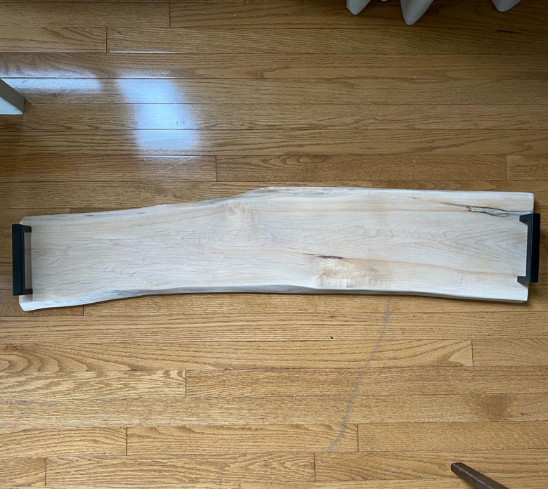
Board #2 - 28” x 8”

Slide 3
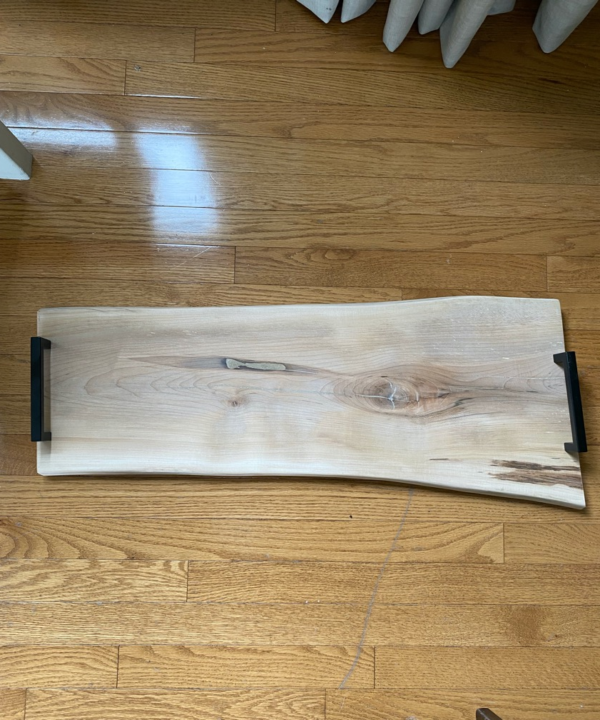
Board 1 - 27” x 10”

Slide 4
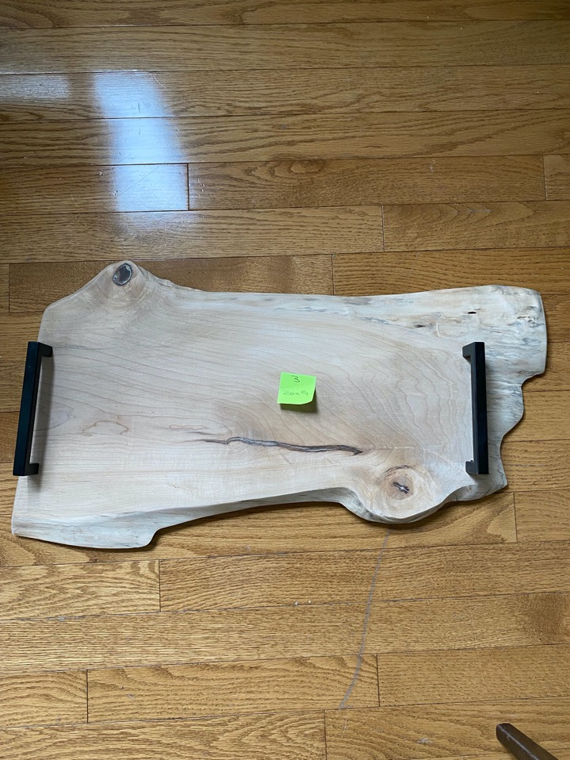
Board # 3 - 20”x 9”

Slide 5
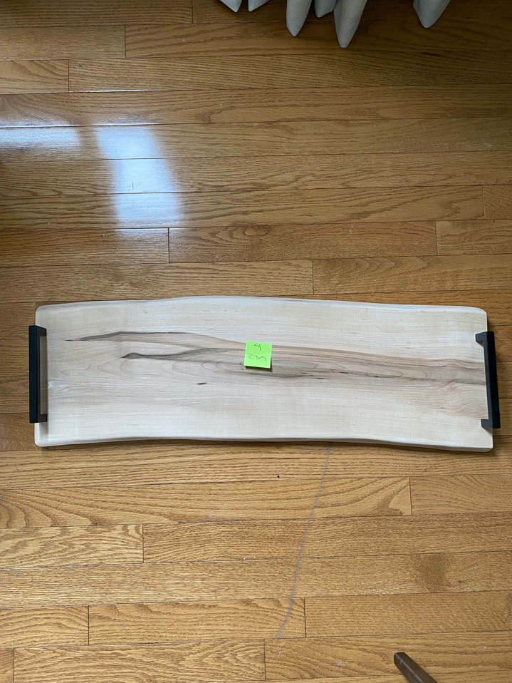
Board #4 - 27” x 9”

Slide 6
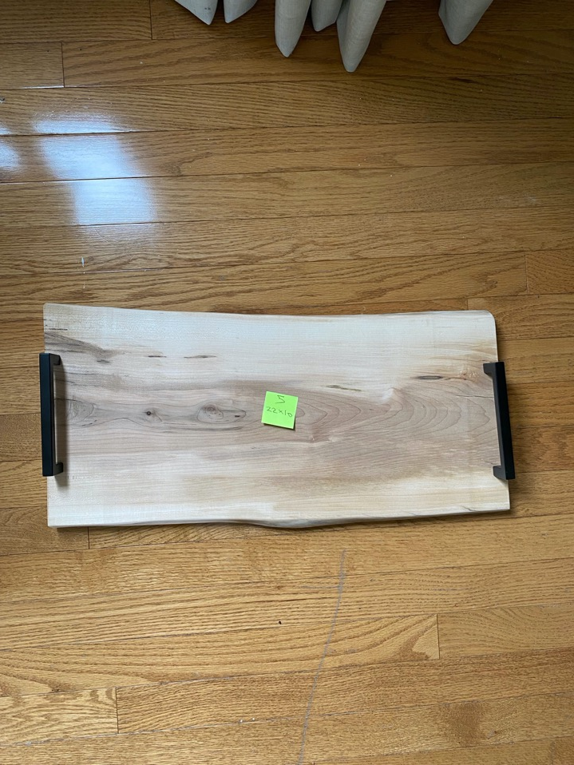
Board #5 – 22” x 10”

Slide 7
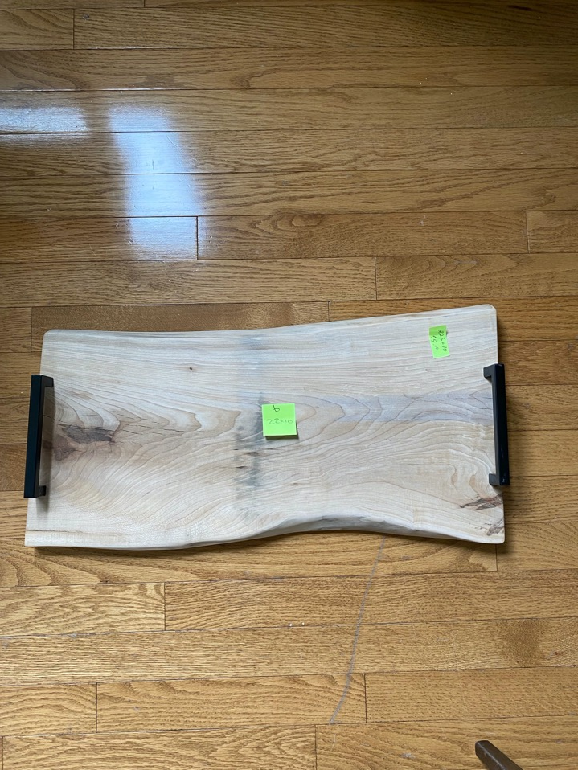
Board #6 – 22” x 10”

Slide 8
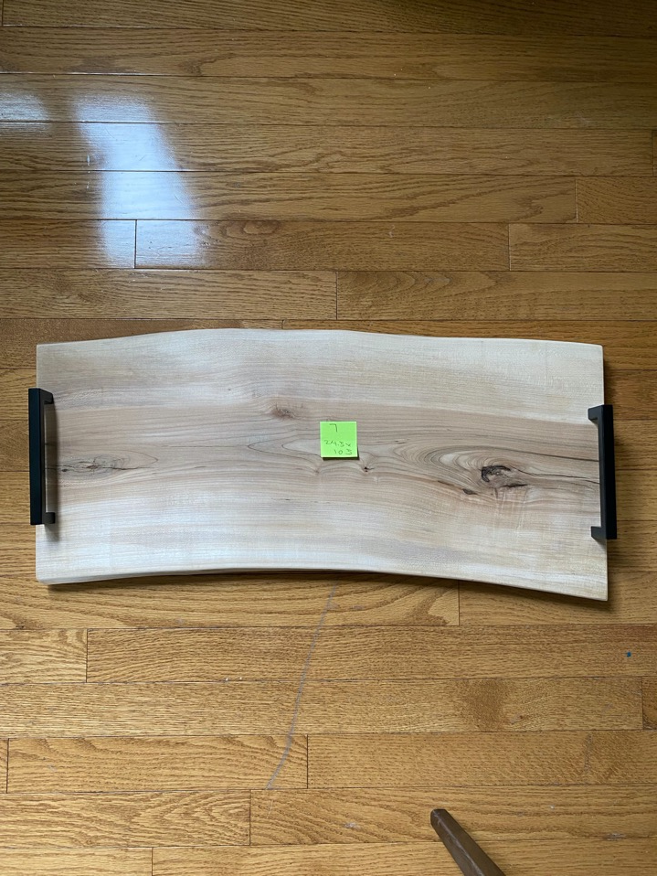
Board #7 - 24.5” x 10.5”

Slide 9
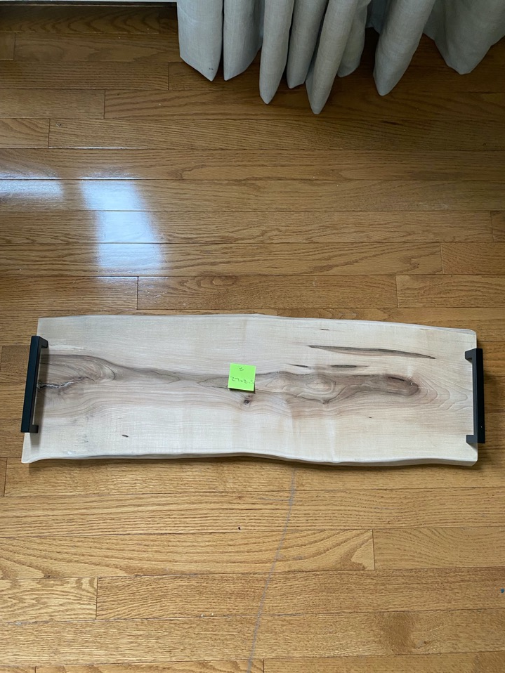
Board #8 – 27” x 8.5”

Slide 10
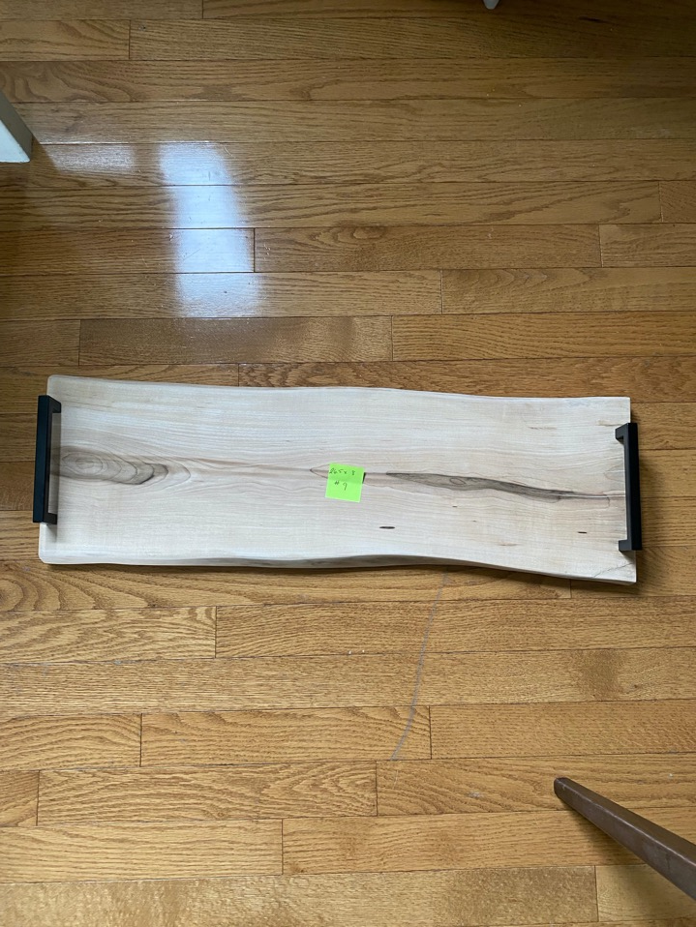
Board #9 – 26.5” x 8”

Slide 11
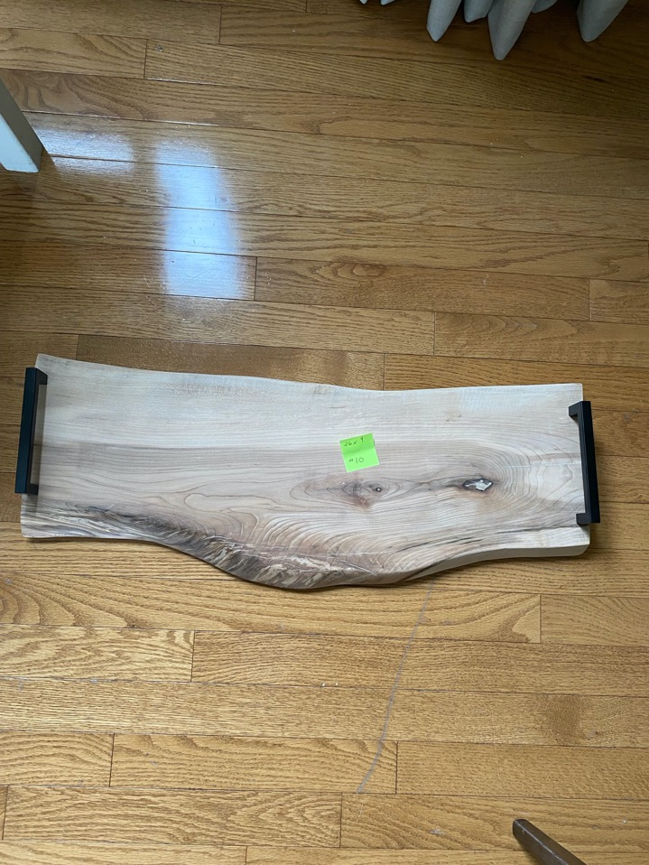
Board #10 – 26” x 9”

Slide 12
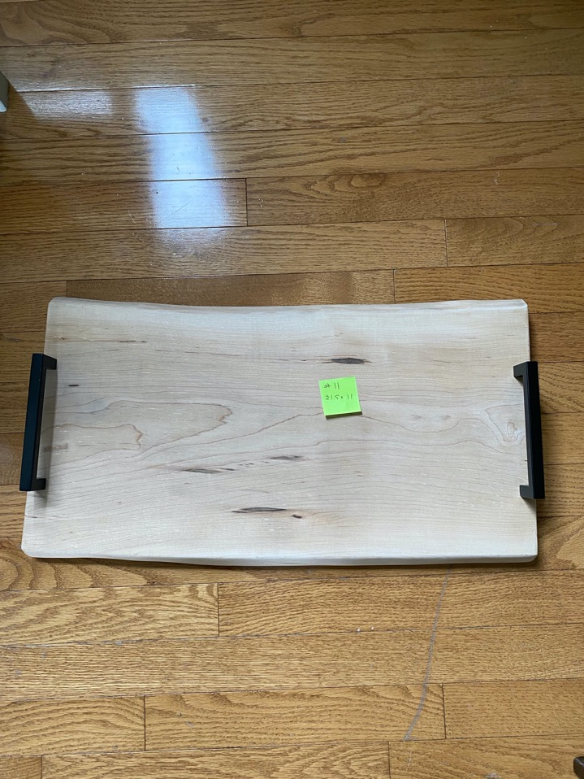
Board #11 - 21.5” x 11”

Slide 13
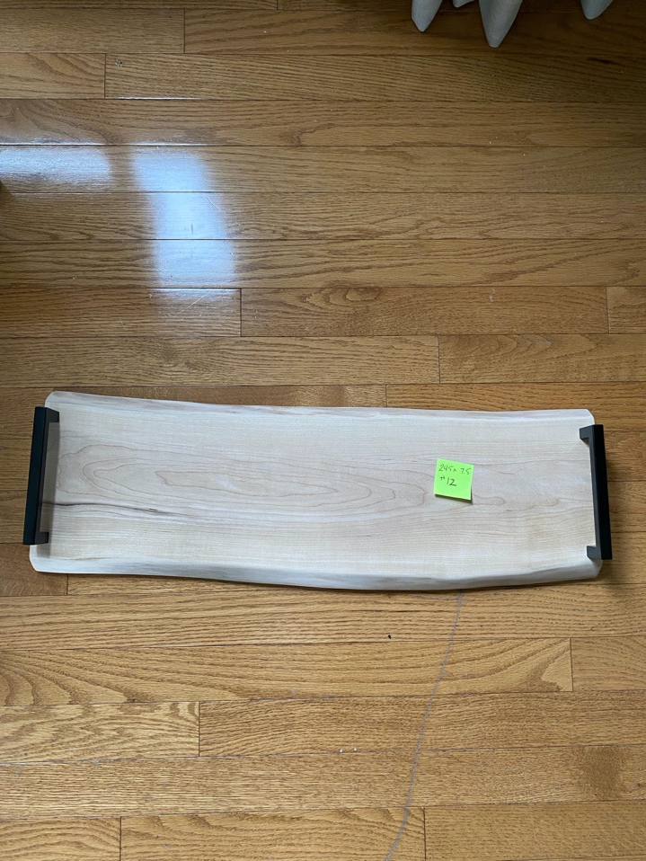
Board #12 – 24.5” x 7.5”

Slide 14
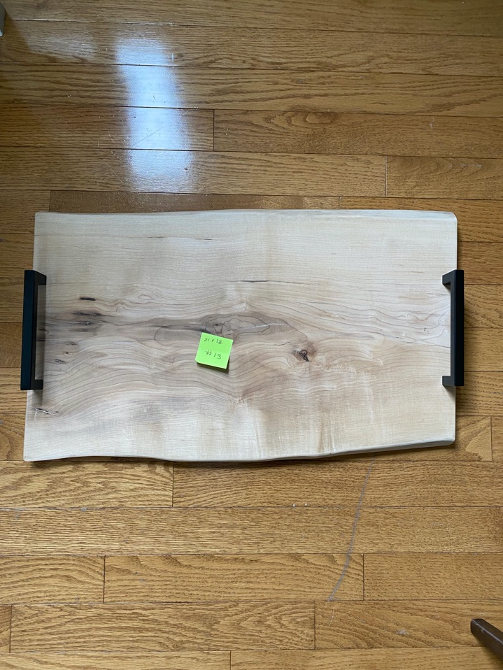
Board #13 – 21” x 12”

Slide 15
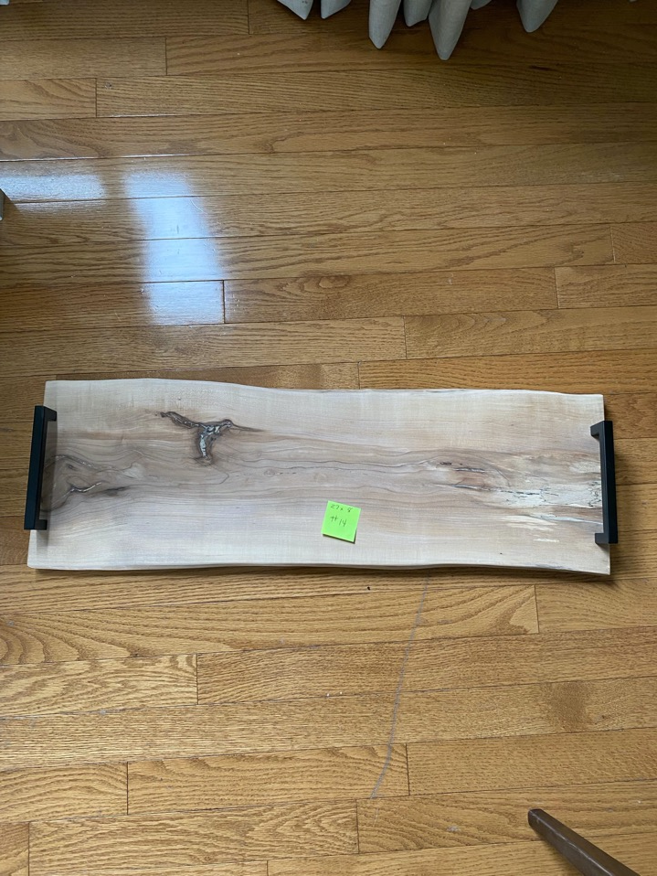
Board #14 – 27” x 8”

Slide 16
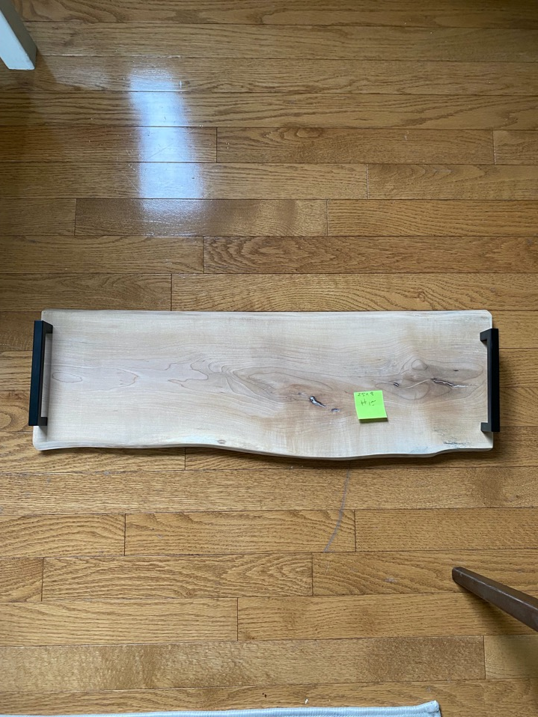
Board #15 – 25” x 8”

Slide 17
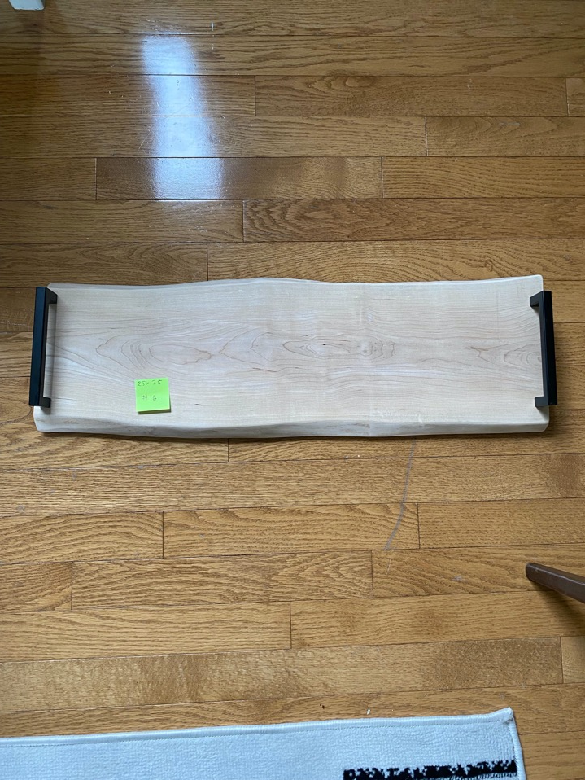
Board #16 – 25” x 7.5”

Slide 18
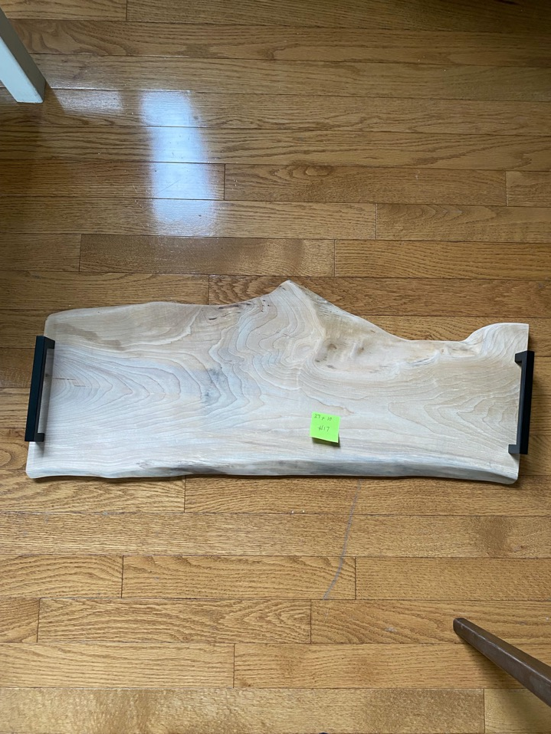
Board #17 – 27” x 10”

Slide 19
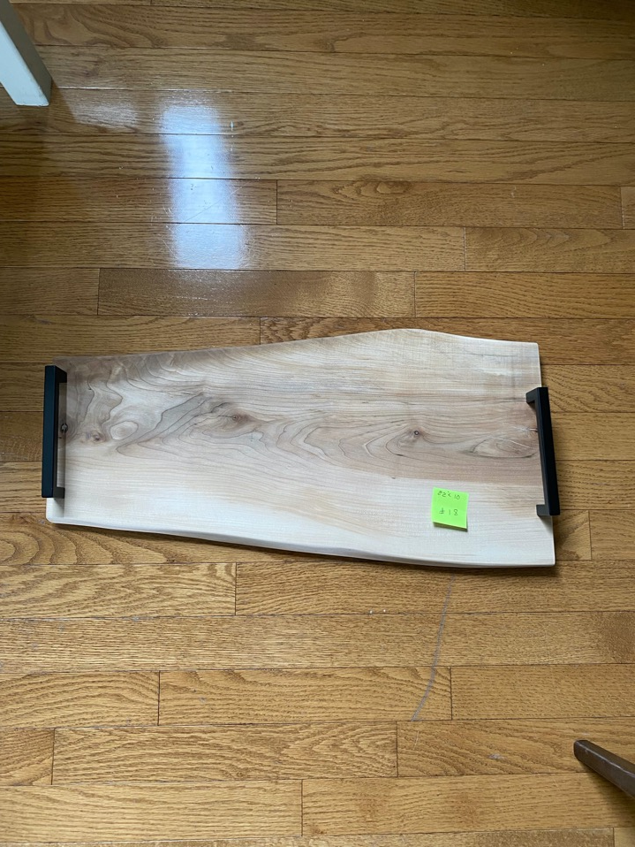
Board #18 – 22” x 10”

Slide 20
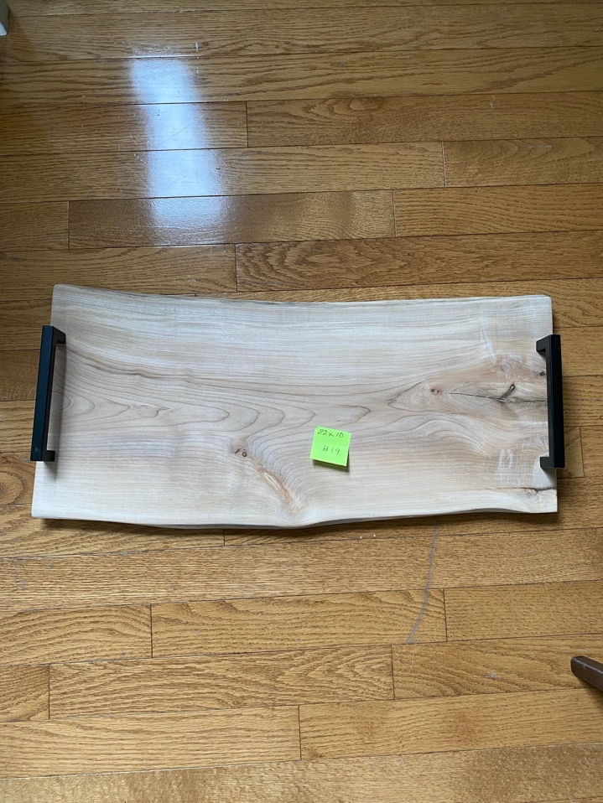
Board 19 – 22” x 10”

Slide 21
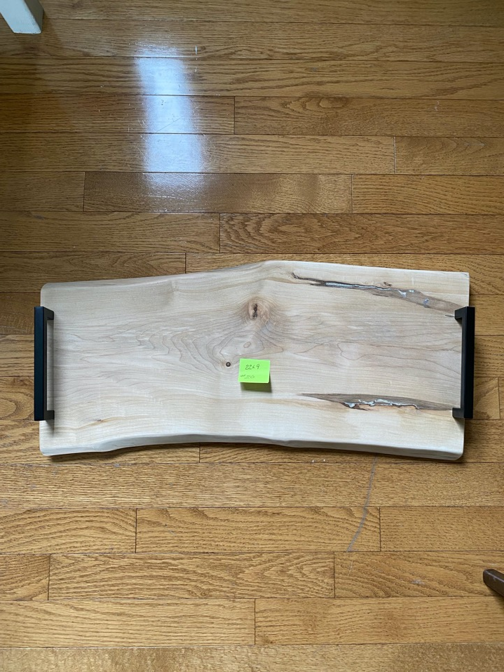
Board #20 – 22”x 9”

Slide 22
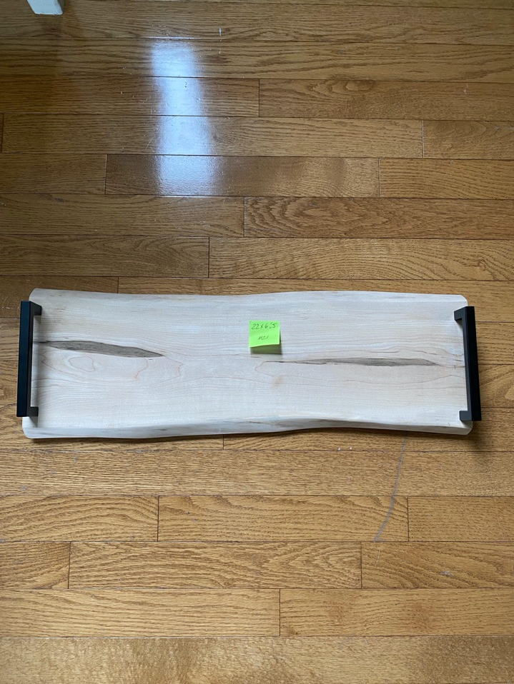
Board “21 – 22” x 6.5”

Slide 23
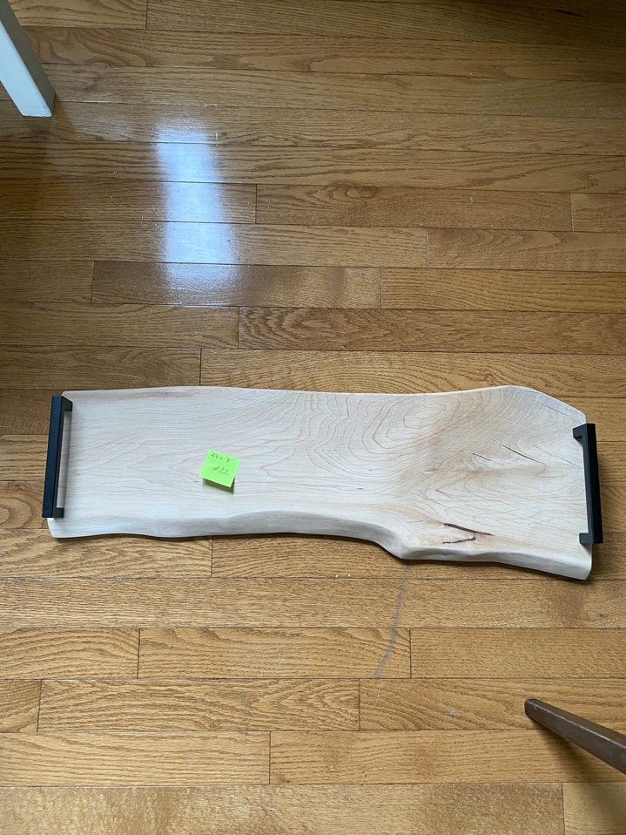
Board #22 – 26” x 8”

Slide 24
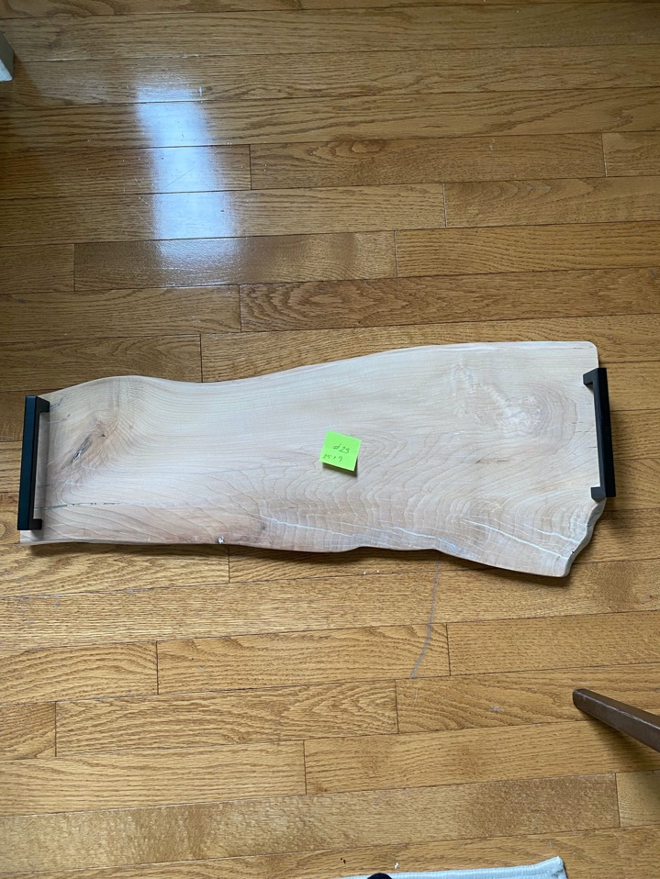
Board #23 – 25” x 9”

Slide 25
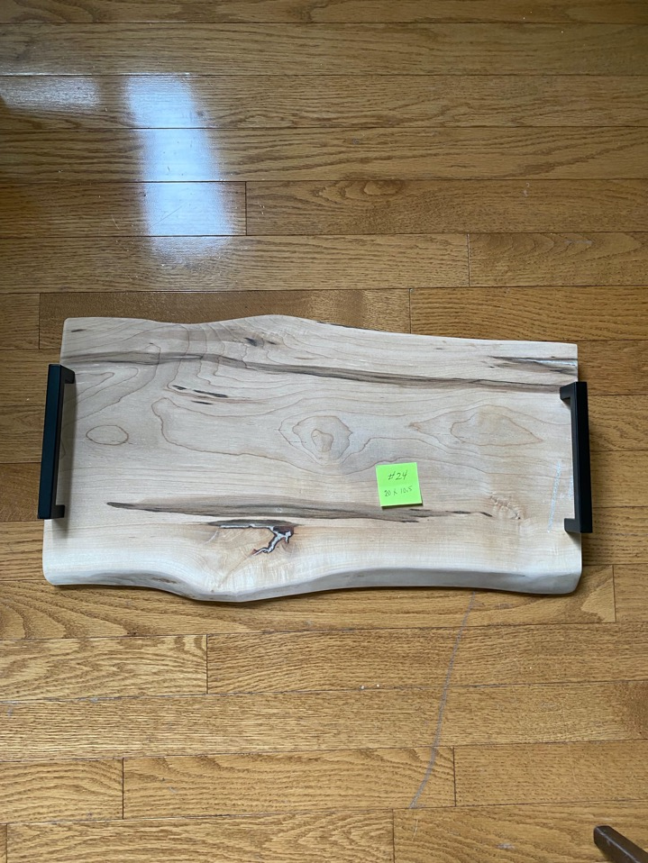
Board #24 – 20” x 10.5”

Slide 26
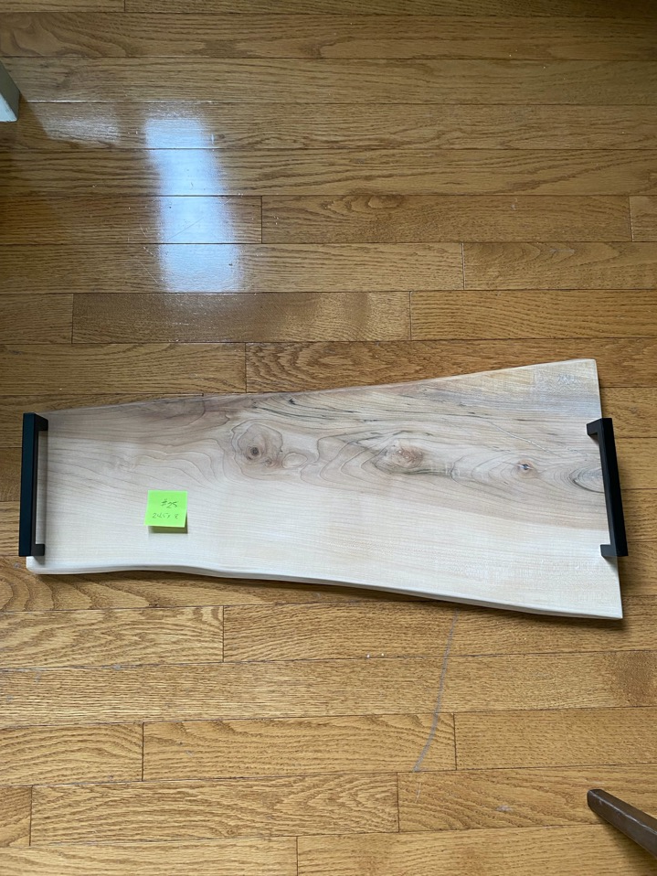
Board #25 24.5” x 8”

Slide 27
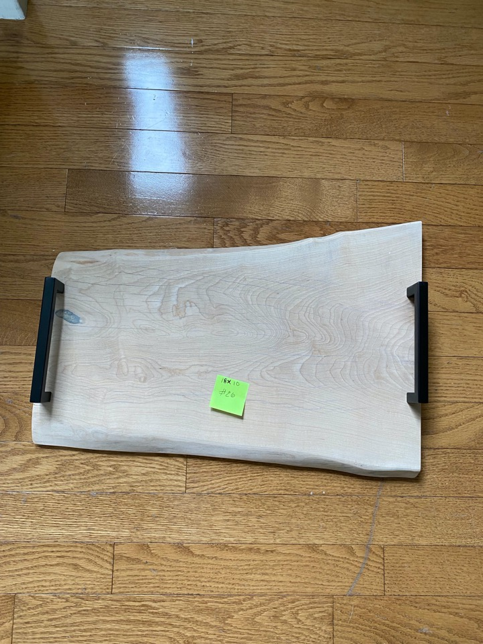
Board #26 – 18” x 10”

Slide 28
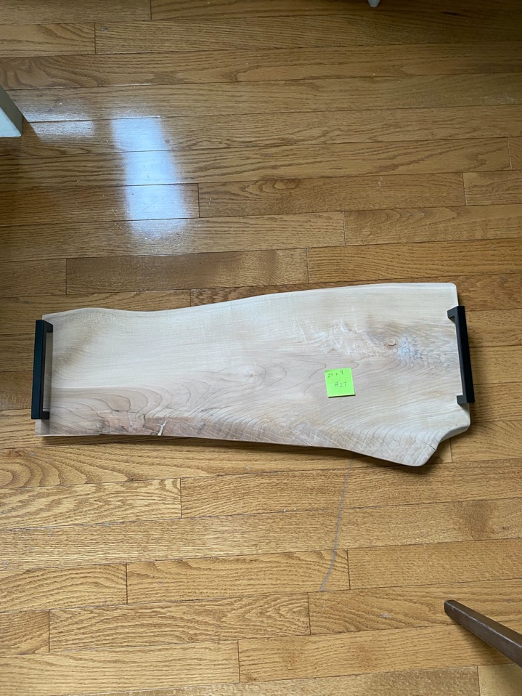
Board #27 – 25” x 9”

