Slide 1

The discovery of GLP-1 and the subsequent development of the GLP-1 analogs, their use and side effects
Norman O. Moser, DO, Pharm.D., R.Ph. PGY35
Nephrology, Lima, Ohio

Slide 2

There will be a 10 question Kahoot quiz at the end of the lecture.
Have your cell phones ready.

Slide 3

Agenda
How were GLP-1 and GLP-2 discovered?
What does human GLP-1 do?
How were GLP-1 analogs developed?
How are GLP-1 analogs best used?
How to avoid gastric side effects?
SGLT-1, SGLT-2, SGLT-3, SGLT-4

Slide 4


Slide 5


Slide 6
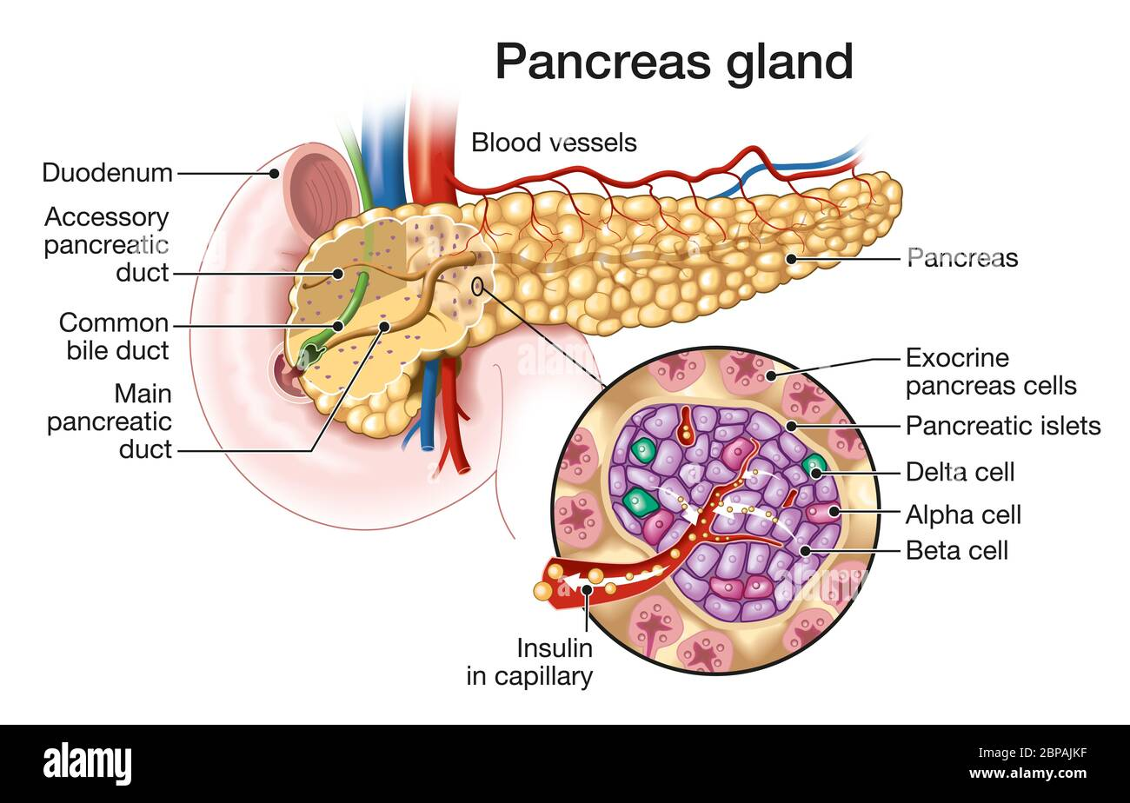
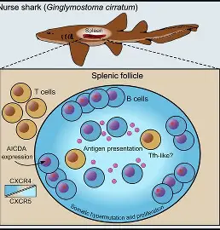
Once insulin was discovered, scientists began to wonder how the pancreas gland knew when to release insulin.
They postulated that there must be a signaling molecule from the intestines that was telling the pancreas when to release insulin.
So they began searching for such a peptide.
In humans, the insulin producing beta cells reside in the pancreas.
In fish, the insulin producing beta cells are located in separate organs called Brockman’s bodies.
This provided a much higher and enriched source of glucagon and insulin producing cells.

Slide 7
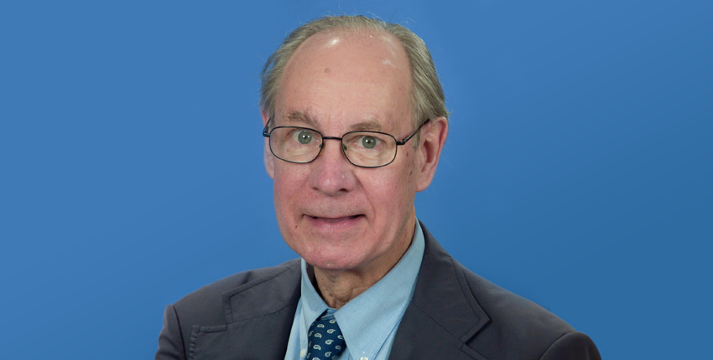
In 1986 Joel Habener studied fish and discovered GLP-1.
GLP-1 is a pro-hormone.
Svetlana Mojsov found that GLP-1 was made in the intestines by the “L” cells and published her findings.
In 1987, seven human volunteers received IV GLP-1 that subsequently increased insulin levels and reduced glucose levels.
Unfortunately, native GLP-1 is metabolized by Dipeptidyl peptidase-4 in less than 2 minutes.
They also found that transplanting GLP-1 producing tumors caused anorexia in lab animals.
This led to the thought that a GLP-1 analog could also be used to treat obesity.
Joel Habener

Slide 8
In 1906 a group in Liverpool, England wondered how the pancreas knew when to secrete insulin in relationship to intake of food.
After researching, they found that an extract from the intestine could lower blood glucose. This was dubbed “the Incretin Effect”.
In 1960 they showed that orally given glucose increased serum insulin concentration and lowered blood glucose to a greater degree than when the glucose was given IV.
This led to the postulation that there has to be a signaling peptide from the gut to signal the pancreas.
Thus, the search was on.

Slide 9
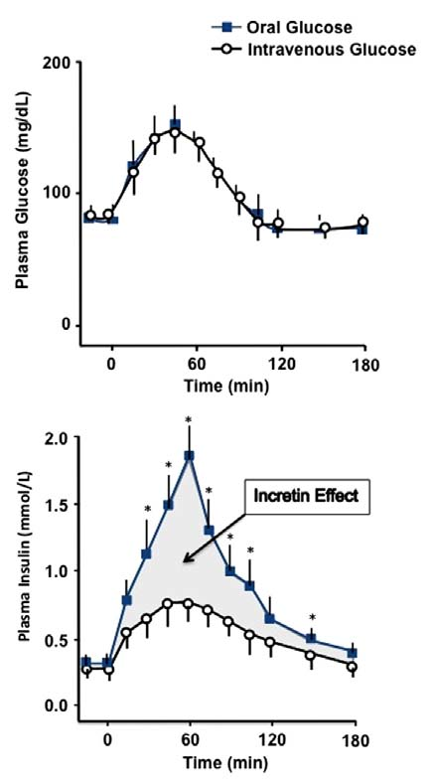

Slide 10

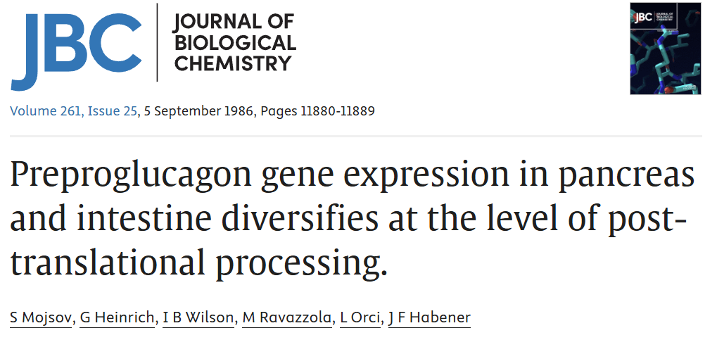
Svetlana Mojsov found the sequence and makeup of the peptide.
She also found that GLP-1 is produced by the “L” cells of the intestines and published this data in September 1986.
Novo Nordisk formed a team to begin working on this peptide to treat diabetes and obesity.
Svetlana Mojsov

Slide 11
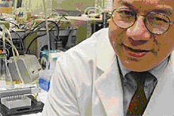

John Eng was studying bioactive peptides from the venom of the gila monster.
He found a peptide called Exendin-4 that was similar enough to human GLP-1 to work but different enough to not be metabolized readily by Dipeptidyl Peptidase-4.
Other companies began developing drugs to inhibit DPP-4 (the DPP-4 inhibitors).
John Eng

Slide 12
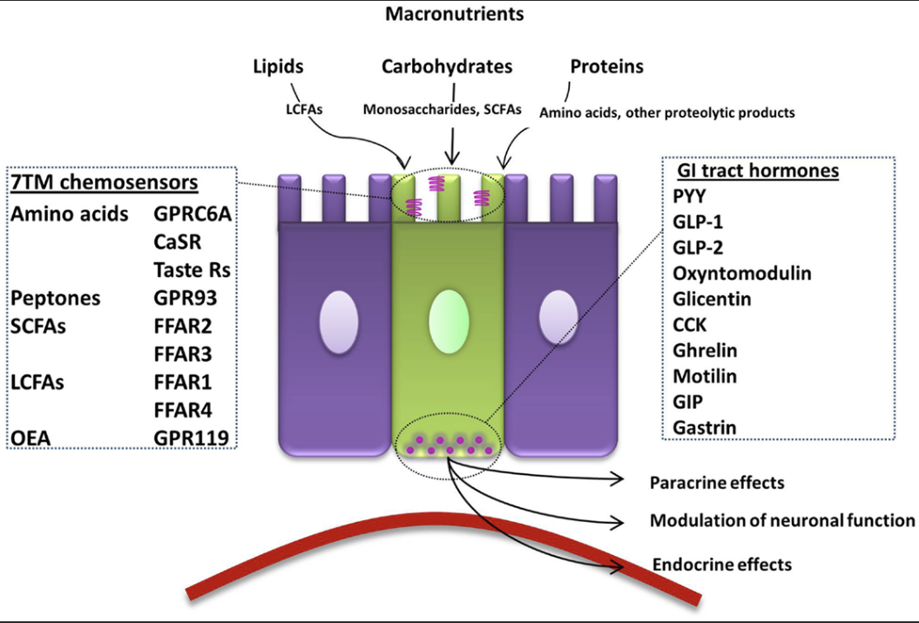
What does human GLP-1 do?
Secreted by the “L” cells of the small intestine in response to a nutrient load.

Slide 13
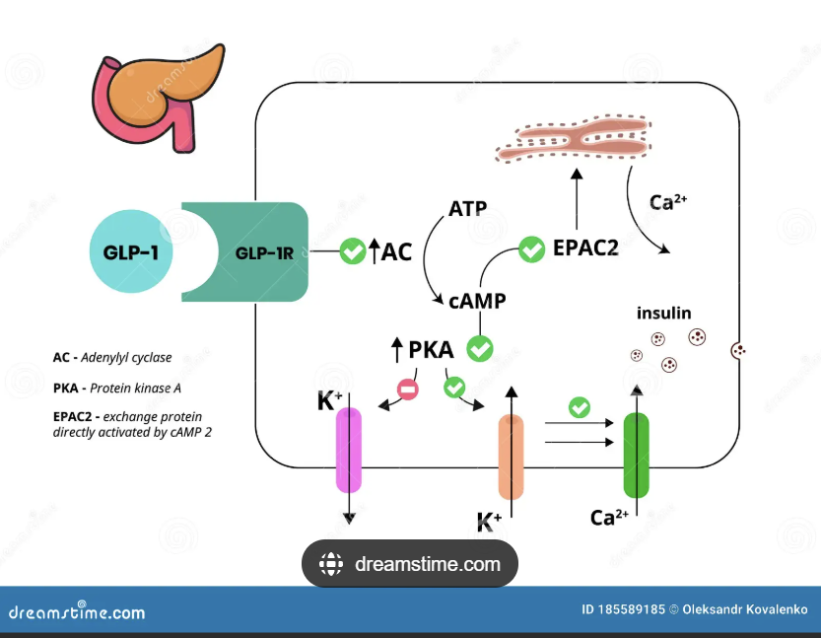
What does human GLP-1 do?
Stimulates insulin release by the pancreas gland.

Slide 14
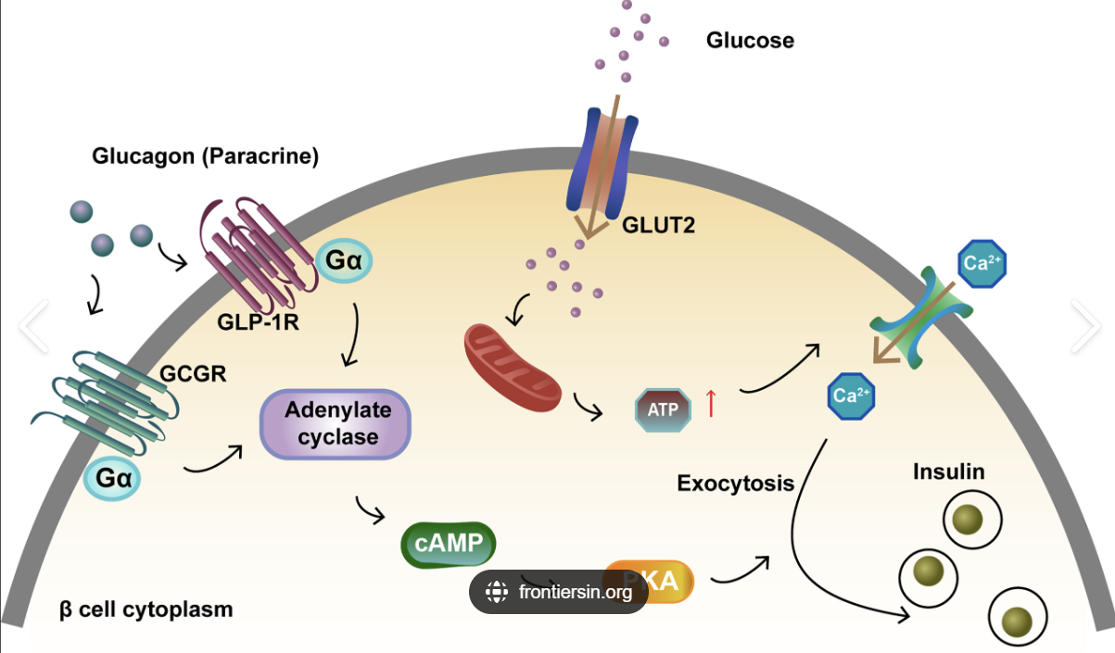
What does human GLP-1 do?
Inhibits the release of glucagon by the pancreas (glucagon will raise blood glucose).

Slide 15
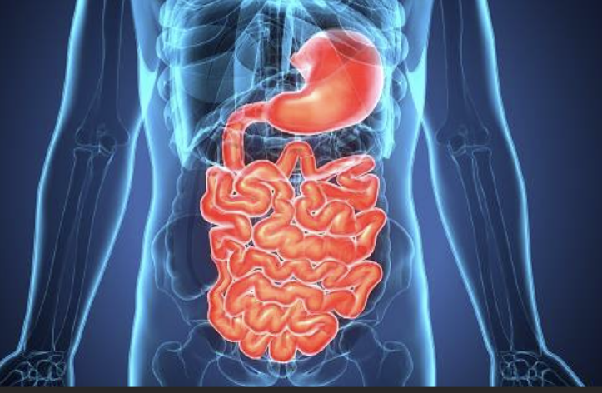
What does human GLP-1 do?
Maintains normal gastric emptying (normal GI transit time is 36-72 hours).
If GLP-1 is not being made or is not working correctly, GI transit time speeds up to 24-36 hours. This increases hunger.
In response to this speeding up of the intestines, patients develop more hunger and eat more.
Once you start a patient on a GLP-1 analog, bowel transit time returns to normal.

Slide 16
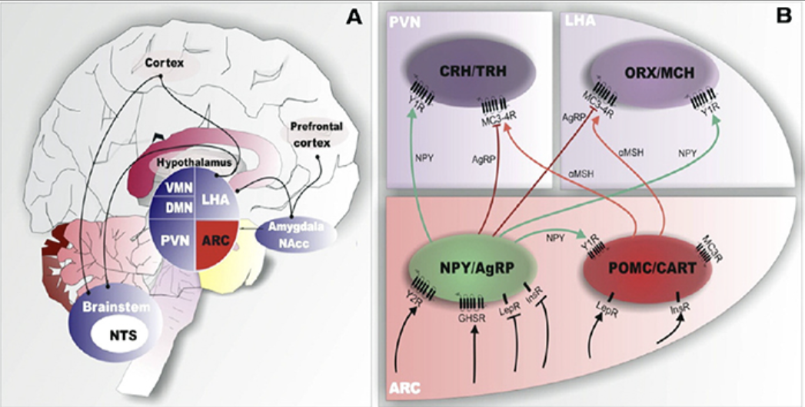
What does human GLP-1 do?
Stimulates the satiety center in the brain to reduce appetite.

Slide 17

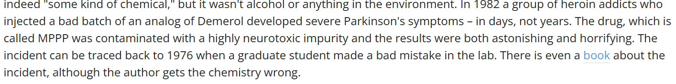
What does human GLP-1 do?
Neuroprotection. Reduces damage and inflammation in the brain. Improves the movement disorders in Parkinson‘s disease and Alzheimer’s disease.
Remember Michael J. Fox

Slide 18
Enhances myocardial function and is cardioprotective.
GLP-1 acts on the immune system to suppress inflammation.
Stimulates beta cell proliferation and neogenesis (actually improves the function of the pancreas gland).
Inhibits beta cell apoptosis (cell death).
Reduces addiction proneness.
Influences food reward by modulating the brains award pathways which curbs cravings.
Enhances the activity of brown adipose tissue.
What does human GLP-1 do?

Slide 19
Helps lower the blood pressure.
Improves endothelial function.
Reduces heart failure hospitalizations.
Reduces anxiety and depression.
Supports learning and memory.
Helps with sleep apnea syndrome.
Helps with liver fibrosis.
Improves some symptoms of Ehler’s-Danlos syndrome.
What does human GLP-1 do?

Slide 20
Known Side Effects of GLP-1 Analogs
Nausea (from overeating the drug).
Diarrhea
Constipation.
Stomach pain.
Headaches.
Fatigue.
Acute pancreatitis.
Hypoglycemia
Gallbladder disease.
Kidney disease.
Allergic reactions.

Slide 21
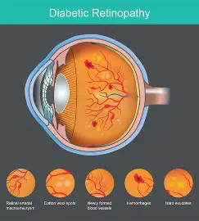
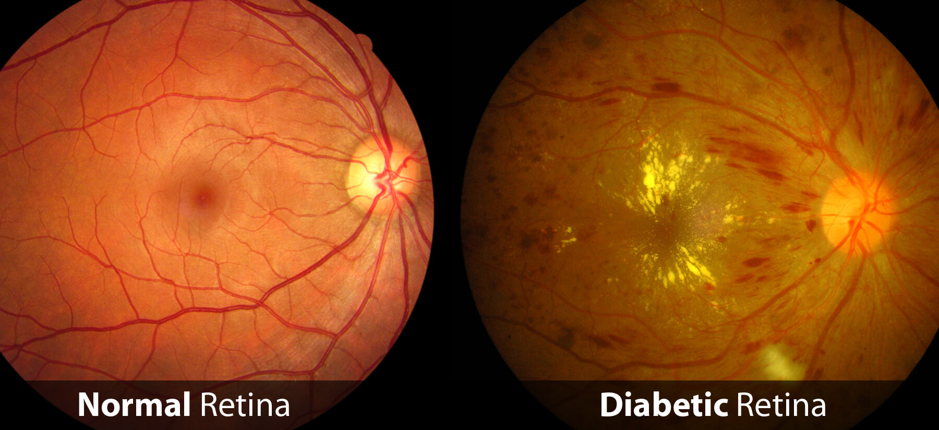
Known Side Effects of GLP-1 Analogs
Anorexia.
Injection site reactions.
Tachycardia.
Bowel obstruction.
Sagging and wrinkled skin on the face (“Ozempic face”).
Worsening of diabetic retinopathy.
Neovascular age related macular degeneration.
Non-arteritic anterior ischemic optic neuropathy.
Macular edema.

Slide 22
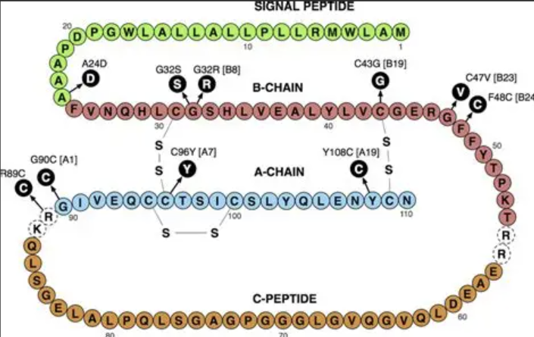
A1C. (averages glucose levels of the last 90 days)
C-peptide (tells you what the pancreas is doing in relation to insulin production(normal=1.1-4.4)).
Patient Assessment of Pancreatic Function

Slide 23
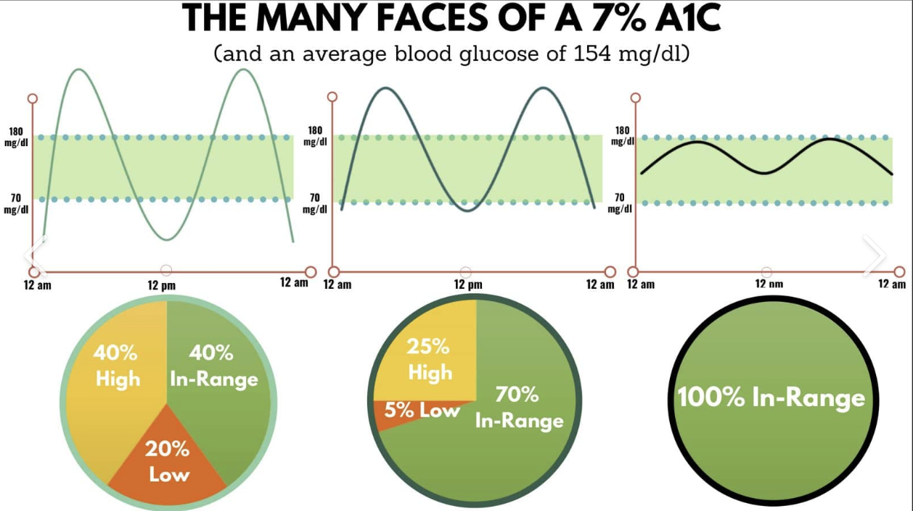

Slide 24
Effects of High Insulin Levels on Humans
Effects of high insulin levels on humans (insulin resistance).
Makes cells become less responsive to insulin requiring the pancreas to make even more insulin.
May cause beta cell burnout.
Increases the conversion of free carbohydrate in the blood stream into storage fat.
High insulin levels lead to coronary artery endothelial lining dysfunction causing CAD.
Causes metabolic syndrome.
Increases the risk of stroke.
High insulin levels are associated with polycystic ovarian syndrome. Can affect fertility.
May lead to increased triglyceride levels.
Causes hypertension.
Increases uric acid levels.
Can cause Acanthosis Nigricans.
Increases risk of breast, prostate and colorectal cancer.

Slide 25
Risk Factors of Developing High Insulin Levels
Risk factors contributing to high insulin levels.
High intake of refined sugars and processed foods.
Obesity with excess abdominal fat.
Sedentary lifestyle.
Genetics.
Advancing age.
Hypertension.
High cholesterol.
Polycystic ovarian syndrome.

Slide 26
How to Cope With the Side Effects of GLP-1
Educate the patient.
Small meals (the MOM effect).
Educate the patient about the change in gastric emptying time that the medicine will induce.
If the patient uses insulin, reduce the dose of long acting about 20%. Reduce short acting about the same.
Do what it takes to keep glucose 140-180.
Try to wean insulin to off first.
If the patient is taking a sulfonylurea, wean this to off (sulfonylyureas have been shown to promote beta cell burnout).
Try to remove all other diabetic drugs as indicated.

Slide 27

How to Cope With the Side Effects of GLP-1
Educate the patient.
Remember that the most common side effect of GLP-1 analog use is gastric with nausea, stomach pain and distention.
Lack of production of native GLP-1 or failure of it to work causes increased gastric emptying and bowel transit.
This makes the stomach empty faster and increases appetite.
Patients respond to this by eating more and more often.
Once they are started on a GLP-1 analog, gastric emptying returns to normal.
If we don’t educate the patient, they will continue to eat too much and overeat the GLP-1 analog.
The stomach will empty slower while taking a GLP-1 analog.
The patient will add food on top of food already in the stomach.
This provides more food for bacteria in the stomach to eat.
The bacteria produce gas as a byproduct of their metabolism.

Slide 28
Known Benefits of GLP-1 Analog Use
Improved stimulation of the pancreas with improved glucose control.
Stimulation of the satiety center to promote weight loss.
Decreased gastric emptying.
Improvement in Beta cell health.
Decreased Beta cell apoptosis.
Reduced cardiovascular risk.
Improved blood pressure control by influencing sodium reabsorption.
Reduces inflammation of atherosclerosis and improves endothelial lining.
Reduces proteinuria.
Improves the movement disorder of Alzheimer's disease and Parkinson’s disease.
Reduces general inflammation.
Helps manage moderate to severe obstructive sleep apnea.
Improves the pain of osteoarthritis.
Will reduce elevated intracranial pressure.
Reduces addiction proneness.
Reduced stroke incidence.
Semaglutide has recently been shown to improve the dementia of Alzheimer’s disease (Sept. 2025)

Slide 29
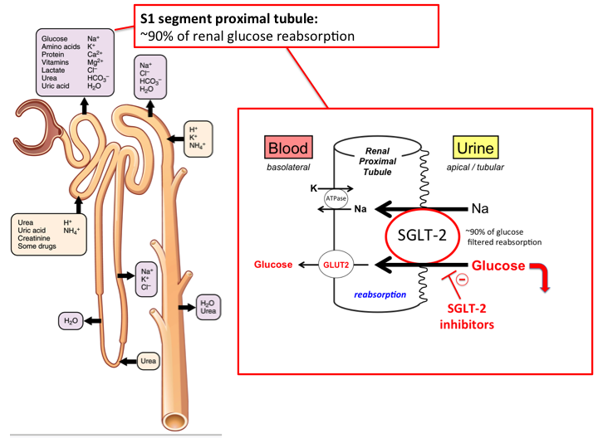
A Brief Comment About SGLT
SGLT-1 reabsorbs about 10% of filtered glucose.
SGLT-2 reabsorbs about 90% of filtered glucose.
SGLT-3 (AKA: SLC5A4). A protein that functions as a glucose sensor rather than a glucose transporter.
SGLT-4 sodium dependent glucose transporter that reabsorbs some glucose.

Slide 30
The Best Way to Treat Disease
Is
To Prevent Disease
Time for Kahoot.
Get your cellphones out.

Slide 31


