Slide 1
Northwest Ohio Osteopathic Association
November 8, 2025 Continuing Medical Education
Scribing, A.I., and Technology
Overview of Methodologies
Advantages and Dangers
John R. Irwin, J.D., M.D.

Slide 2
Documenting what you did
“The tools of a surgeon are scalpels; the tools of a lawyer are words.”
The words you use count!
Always remember your audience.
How do I get my thoughts into words?
The advent of EMR
HITECH Act 2009
Penalties began 2015

Slide 3
Are all these rules making for better patient care?
Tethered to the EHR: Primary Care Physician Workload Assessment Using EHR Event Log Data and Time-Motion Observations
https://doi.org/10.1370/afm.2121
September/October 2017 issue

Slide 4
Methods
METHODS We conducted a retrospective cohort study of 142 family medicine physicians in a single system in southern Wisconsin. All Epic (Epic Systems Corporation) EHR interactions were captured from “event logging” records over a 3-year period for both direct patient care and non–face-to-face activities, and were validated by direct observation. EHR events were assigned to 1 of 15 EHR task categories and allocated to either during or after clinic hours.

Slide 5
Results
Clinicians spent 355 minutes (5.9 hours) of an 11.4-hour workday in the EHR per weekday per 1.0 clinical full-time equivalent: 269 minutes (4.5 hours) during clinic hours and 86 minutes (1.4 hours) after clinic hours. Clerical and administrative tasks including documentation, order entry, billing and coding, and system security accounted for nearly one-half of the total EHR time (157 minutes, 44.2%). Inbox management accounted for another 85 minutes (23.7%).

Slide 6
Just 8 Years Later
Widespread integration of EMR with Speech Recognition and A.I.
June 2025 AMA article
https://www.ama-assn.org/practice-management/digital-health/ai-scribes-save-15000-hours-and-restore-human-side-medicine

Slide 7
Speech Recognition
Dragon Naturally Speaking Version 16
Vast progress over 30 years
I own no stock nor have ever had any relationship with Nuance or Microsoft
Just a longtime user
What any smart phone can do today

Slide 8
In Medicine:
Dragon, AI, Epic, etc.
Dragon Ambient Experience “Nuance DAX”
Integrates with Epic and 200 other EMR’s
DAX to record patient-physician encounter MS AI to compose a clinically appropriate chart entry
This is just the beginning
Key: It is not enough to document what you do.
Always explain your thinking, why you did it.
Justify your claim for payment.
That’s where you tell the story.
Almost all EMR’s have A.I.

Slide 9
Artificial Intelligence
Let’s get a little bit into the weeds
What is so special? It is just beginning.
How does it work? LLM.
What was it fed? Who chose the data?
Where did it come from?
Content Revenue: Hollywood $8.6 B v. Video Games $51 B
CPU (multitasker) v. GPU (parallel processing)
Nvidia $5 trillion
All about controlling the pixels on your screen
Each pixel is controlled by three transistors

Slide 10
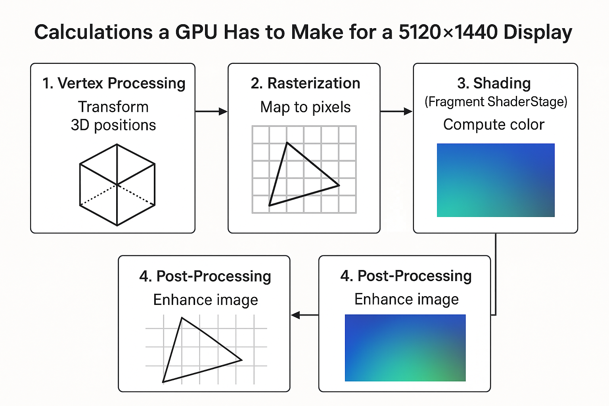
GPU calculations for each pixel on my screen

Slide 11
My Dell Display 49 inch UltraWide
🚀 Example Calculation Load for my Nvidia GeForce RTX 3060 Ti
Resolution: 5120 × 1440 = 7.37 million pixels
Refresh rate: 120 Hz
Operations per pixel: ~200 FLOPs (floating point ops)
7.37M × 120 × 200 = 176.9 billion floating-point operations per second
✅ That’s ~177 GFLOPS just to draw your desktop or a simple 3D scene —
modern GPUs handle tens of thousands of GFLOPS (TFLOPS), so they can easily manage far more complex shading.
My screen has 22.1 million transistors
All of this takes a lot of electricity
Current data centers require the output of one nuclear reactor
Northern Virginia (7 GW) would require two nuclear reactors

Slide 12
My Nvidia RTX 3060 GPU is 3 years old. What if I replaced it with Nvidia’s current model RTX 5090
Specification | NVIDIA GeForce RTX 5090 | NVIDIA GeForce RTX 3060 Ti
Architecture | Blackwell (latest) (nvidia.com) | Ampere (2nd-gen RT Cores, 3rd-gen Tensor Cores) (nvidia.com)
CUDA Cores | ~21,760 (Vast AI) | 4,864 (Notebookcheck)
Boost Clock | ~2.4 GHz (2,407 MHz) (Vast AI) | ~1.665 GHz (1,665 MHz) reference (Tom's Hardware)
Memory Size / Type | 32 GB GDDR7, 512-bit bus (Vast AI) | 8 GB GDDR6, 256-bit bus (GIGABYTE)
Memory Bandwidth / Interface | ~1,792 GB/s (Vast AI) | Memory interface 256-bit, 8GB GDDR6 (Notebookcheck)
Total Graphics Power (TGP) / Power Consumption | ~575 W TGP (Vast AI) | ~200-220 W typical power consumption (Notebookcheck)

Slide 13
Copilot A.I.
There’s a wave of innovation aimed at freeing physicians from the tyranny of the keyboard. Here are some of the most promising technologies making headway:
🧠 Ambient AI Scribes
These are perhaps the most transformative. Systems like those used by The Permanente Medical Group passively “listen” to patient-physician conversations and generate draft clinical notes in real time. One such program reportedly saved over 15,000 hours of documentation time in a year, while also improving patient interaction and physician satisfaction.
🎙️ Medical Speech Recognition
Tools like Dragon Medical and M*Modal let physicians dictate notes instead of typing. While they still require some manual editing, they’ve been shown to improve efficiency and reduce EHR time by up to an hour per day.
👨‍⚕️ Medical & Virtual Scribes
In-person scribes shadow physicians and handle documentation live, though they can be costly and hard to scale.
Virtual scribes work remotely, often transcribing audio recordings. They’re more affordable but may have delays and data security concerns.
🧾 Customizable EHRs & Smart Templates
Some systems now allow physicians to design workflow-specific templates, automate patient instructions, and integrate drug databases—cutting down on repetitive data entry.
🤖 AI-Powered Documentation Tools
Emerging platforms like PatientNotes.AI use real-time transcription and intelligent summarization to streamline note-taking. These tools are still evolving but show strong potential to reduce “pajama time” and burnout.

Slide 14
The 10 Best A.I Medical Scribes:
According to One Human
https://blog.chartnote.com/10-best-ai-medical-scribes-a-complete-comparison-guide/

Slide 15
The 10 Best A.I Medical Scribes:
According to One Chatbot (ChatGPT)
Here are several of the leading AI-medical-scribe tools on the market — along with key strengths, considerations, and how they differ — to help you decide which might be the best fit for your organization or practice.
✅ Strong Contenders
1. DeepScribe
Specializes in ambient AI for clinical notes, converting patient-provider conversations into structured notes. (deepscribe.ai)
Notable performance: quoted score of 98.8/100 in a KLAS Research spotlight. (deepscribe.ai)
Supports major EHR integrations, and offers features like coding insights (HCC), diagnoses, orders. (deepscribe.ai)
Consider: May be better suited for larger practices or those with strong EHR integration needs.

Slide 16
Page 2
2. Freed
Marketed as “the best AI scribe for small and midsized clinics”. (getfreed.ai)
Emphasizes ease of use, quick setup, and adapting to specialty workflows. (getfreed.ai)
Consider: For smaller clinics or those wanting faster ramp-up and less heavy infrastructure.
3. Heidi Health
Global footprint: AI medical scribe used internationally (50+ countries claimed) according to their website. (Heidi AI)
Strength in broad adoption and cross-country use.
Consider: If you operate in a multinational or multi-jurisdiction environment, their global support may matter.

Slide 17
Page 3
4. Sunoh.ai
Focuses on transcription of physician-patient audio into structured notes. (sunoh.ai)
“No more late-night charting” is their tagline — useful for solo practitioners or high volume clinics.
Consider: Check EHR integration depth and whether the transcription-to-note accuracy meets your specialty’s needs.
5. Vero Scribe
Offers AI scribe features including ICD-10 coding, templates, custom notes, one-of-a-kind learning feature (adapts to your style). (Vero Scribe)
HIPAA- and PIPEDA-compliant; emphasis on privacy/security. (Vero Scribe)
Consider: If you operate in Canada, or want cross-border compliance (PIPEDA) plus adaptive note-style features.

Slide 18
Page 4
⚠️ Things to Evaluate / Be Aware Of
Integration with your EHR/EMR: Many tools claim “works with major EHRs,” but the depth of integration (orders, coding, flowsheet, macros) can vary. (innovaccer.com)
Accuracy & human-review: While AI scribes reduce burden, they do not yet eliminate the need for clinician review. For example, ambient AI documentation can omit or mis-classify details. (American Medical Association)
Specialty fit: Some tools are better for general practice; others tailor to oncology, behavioural health, PT/OT etc. Example: DeepScribe mentions oncology-specific support. (deepscribe.ai)
Compliance & data security: Privacy of patient audio, transcription, storage, access — very important. Some tools highlight HIPAA, PIPEDA, GDPR compliance.
Change management & workflow impacts: Implementation will affect clinicians’ workflows. Buy-in, training, establishing review protocols matter.
Return on investment (ROI): While documentation burden is improved, some early reports suggest that the financial/efficiency benefits are still emerging. (Axios)

Slide 19
Page 5
ChatGPT says, “My Recommendation If I Were You”
Given you’re asking for “best AI medical scribes,” I’d recommend this approach:
Pilot two tools: Pick one geared for your size / volume and one more premium. E.g., Freed for smaller clinic, DeepScribe for larger or specialty.
Define metrics up front: How much time are providers spending on documentation now? How much reduction do you expect? What note-quality threshold is acceptable (e.g., < 5% edits)?
Evaluate integration & specialty fit: Ensure the tool supports your specialty (if you’re not general primary care) and plays nicely with your EHR.
Plan for human review: Make sure clinicians understand the AI scribes are assistants, not replacements. Build review workflows.
Check pricing & contracts: Many of these are SaaS models. Ensure you understand what’s included, what’s extra (templates, specialties, coding support).
Look for compliance/regulatory readiness: Especially if your practice is in multiple jurisdictions (US, Canada, global) or has special privacy requirements.

Slide 20
Dangers and Landmines
HIPAA Privacy Rules.
Internet upload and download encryption security
Dragon all local, but only one speaker
A.I. Multiple speakers but internet transfer, check each vendor,
EMR integration, Microsoft/Nuance Dragon DAX, EPIC
Never forget your audiences.

Slide 21
Hybrids v. Humans
A.I. transcription and summation with human oversight.
or
A live human with you.

Slide 22
Details and Duties
Get consent.
Consider an annual agreement.
Have a separate, dedicated device.
Always have good backup protocols.
Train staff adequately.
Check it out!

