Slide 1
FIRM BAPTIST AREA
AIM CAMP SURVIVAL TIPS
An orientation for sponsors

Slide 2
Welcome & Thank You
YOU ARE ESSENTIAL
We couldn't do AIM Camp without you!
Camping Survival Tips Presentation

Slide 3
THE APPEAL OF NATURE
THE MOUNTAINS ARE CALLING AND I MUST GO.
JOHN MUIR

Slide 4
Introduction
Being a good sponsor means stepping up to the AWESOME 24 hours a day, responsibility of caring for someone else's children physically, mentally, emotionally and spiritually.
A sponsor is acting "Loco Parenti" which means "in the place of parents" this is an opportunity that should be taken with great care, thought and PRAYER.
SPONSOR RESPONSIBILITIES
AIM Camp Sponsor Orientation

Slide 5
MEDICAL NEEDS
SPIRITUAL NEEDS
Be sure you know the medical needs of the kids in your group...also be aware that these needs should not be announced to everyone.
You are a trusted church leader shepherding precious young people...sometimes the most unlovable need loving the most.
AIM Camp Sponsor Orientation

Slide 6
Why Go To
AIM CAMP
OUTDOOR OPPORTUNITIES
There are lots of things to do, challenges to try and familiar games to play.
RELATIONSHIP-BUILDING
Being away from regular distractions enables time for kids to connect with you, each other and Jesus
FOCUS ON GOD'S WORD
There will be lots of opportunity to hear, read and learn from God's Word
AIM Camp Sponsor Orientation

Slide 7
SPONSOR PRIVILIEGES
TEACHER, FRIEND
REPRESENT JESUS CHRIST
parent, confidant, disciplinarian, to each campers in your group.
your church and Latham Springs
SPIRITUAL GROWTH
GUIDE
for both you and the campers. Be aware and sensitive that Jesus is working in lives.
awesome opportunities to show campers how relationships work from a Kingdom view.
AIM Camp Sponsor Orientation
AIM Camp Sponsor Orientation

Slide 8
Make camp the most fun experience EVER!
THIS COULD BE THE BEGINNING OF A LIFETIME RELATIONSHIP WITH JESUS...
AIM Camp Sponsor Orientation

Slide 9
SPONSOR RESPONSIBILITIES
BACKGROUND CHECK YEARLY
CHILD PROTECTION CLASS
This is on the Latham Springs Website and must be completed every 2 years.
Please check the dates you took this, as you may need to retake to be in compliance with the TX state regulations
AIM Camp Sponsor Orientation
AIM Camp Sponsor Orientation

Slide 10
SPONSOR RESPONSIBILITIES
CONTINOUS SUPERVISION
SAFETY
be vigilant for safety issues 24 hours a day.
This is a TX Health Department requirement. Be sure you know where all your campers are at all times.
SICKNESS
Many times is due to not drinking enough water and consuming too much sugar. Try to encourage 3 glasses of fluids at meals and water at activities.
LIGHTS OUT
sponsors bed 'em down and shut-em off at appropriate times...firtst night is hardest
AIM Camp Sponsor Orientation
AIM Camp Sponsor Orientation

Slide 11
SPONSOR RESPONSIBILITIES
SEEK OPPORTUNITY
LEAD IN PRAYER
to listen to campers about their relationship with Jesus.
this is a great beginning and ending of the day.
BIBLE STUDY
HAVE FUN
This year we have devotionals for the kids and sponsors to use as a way to help the kids track what they have learned at worship and during church times
relax and enjoy getting to know your campers and let them know you and show them who Jesus is by your example
AIM Camp Sponsor Orientation
AIM Camp Sponsor Orientation

Slide 12
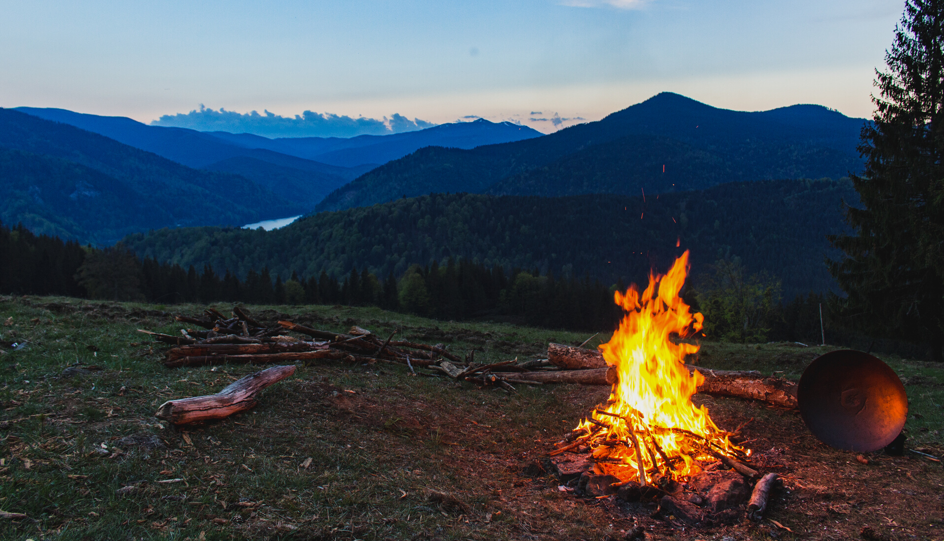
COVID WELLNESS CHECK
Be sure to check with your campers every morning and evening to see how they are feeling. We do not have to take temperatures, but you need to ask if they are feeling OK.
If they are not, they need to go see the Nurse.

Slide 13
CAMPER PROBLEMS
BEHAVIOR
PERSONAL
DISCIPLINE
TRANSPORTATION
needs are serious and should be handled as soon as practical. You won't be able to handle them all and may need to refer to pastoral care.
Remember you are the grown up...don't be mean but expect your campers to follow directions.
further discipline, refer to Church leader or Camp Dean or Director
if needed to take a sick patient contact the camp nurse who will help you in making arrangements.
AIM Camp Sponsor Orientation

Slide 14
ILLNESS OR INJURY
FIRST AID STATION
SERIOUS INJURY
MEDICATION
CALLING PARENTS
the Nurse or group leader will call parents, if needed.
remember HIPAA Laws relating to the "Need to Know' aspect.
campers MUST be taken to the nurse...DO NOT give any medications out
the Nurse will contact all the necessary people in order to transport a camper
ONLY the Nurse can give out medications at prescribed times and amounts
EVEN Tylenol!
AIM Camp Sponsor Orientation

Slide 15
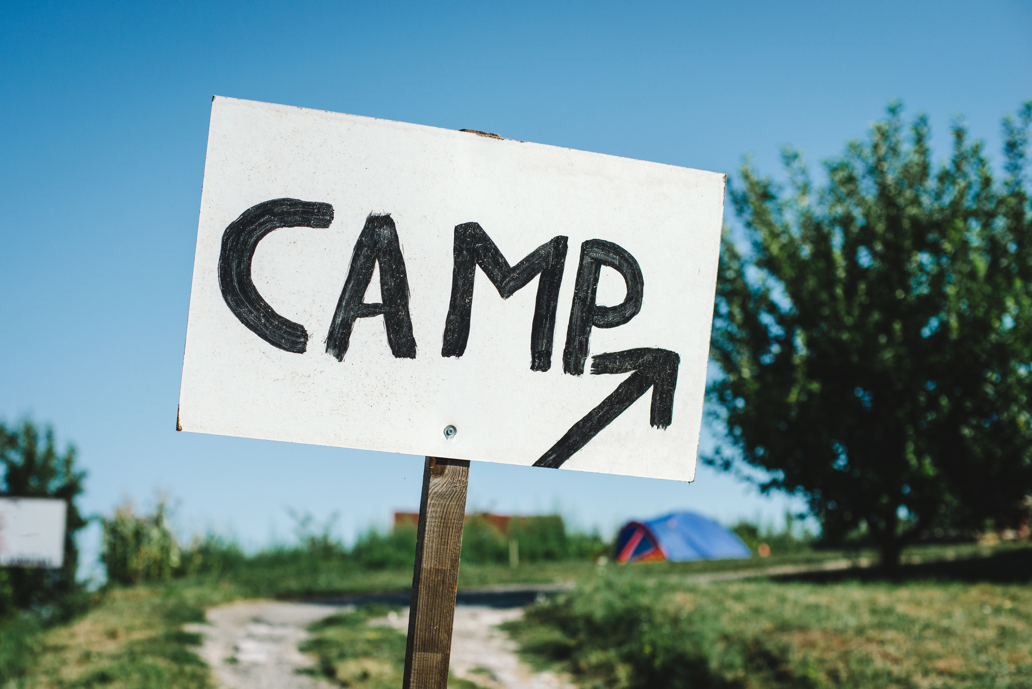
Camp Schedule
3 COLOR GROUPS
DIVIDED INTO SMALLER GROUPS
Everyone will have a lanyard to help keep track of where they should be
AIM Camp Sponsor Orientation

Slide 16
Church Time
EVERY NIGHT AFTER WORSHIP
This is a great time for you to be able to connect with your campers after the worship time...they may have questions or concerns but remember NOT to make this time too long, unless you can see the need.
Church time can be outside.
Camping Survival Tips Presentation

Slide 17
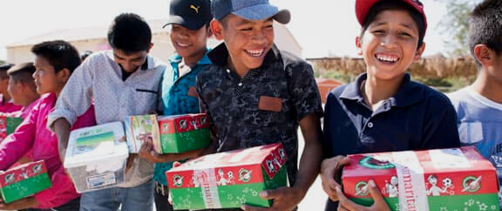
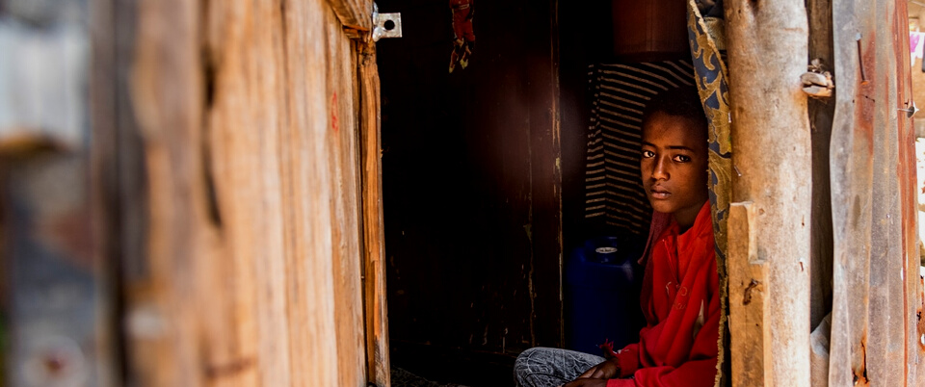
MISSIONS TIME
THE GOAL IS TO SHOW THEM THEY CAN DO SOMETHING RIGHT NOW!
KIDS CLEAN WATER PROJECT
OPERATION CHRISTMAS CHILD
COMPASSION INTERNATIONAL
JOURNEY
Filter of Hope
Kids can contribute to this project...$10 helps to
buy a filter that will
last up to 10 years!
and they share the
Hope of Jesus.
Campers will learn how they can participate in packing a shoebox for a child and how this program shares Jesus with kids all over the world.
Kids will learn how they could be part of sponsoring a child, become pen pals, share in giving them gifts and becoming friends and Share Jesus.
AIM Camp Sponsor Orientation

Slide 18
Leave No Trace Principles
RULES TO LIVE BY
Respect wildlife.
Do not litter.
Leave what you find.
AIM Camp Sponsor Orientation

Slide 19
THESE PRINCIPLES ARE TRUE FOR
AIM Camp
HAVE KIDS HELP KEEP CAMP CLEAN

Slide 20
Cabin Cleaning &
Check Out
TURN-AROUND TIMES ARE CRITICAL
LEAVE YOUR CABIN CLEAN
CHECK OUT DAY
PLEASE ASK CAMPERS TO KEEP OUT OF THE BUILDINGS
be sure all campers and belongings are out of the building and have camp director inspect before departure
there will be cleaning products in the cabins to help keep it clean
we will have inspections daily and awards given
they may use restrooms in the Auditorium...fees are charged for leaving without cleaning

Slide 21
Camp can be an amazing time to make that vital connection with Jesus, but it is also vital that you continue that connection...follow up with the kids that came with you...don't just leave it to the Pastor
AIM Camp Sponsor Orientation

Slide 22
Feedback builds a better camp
PLEASE HELP US OUT BY GIVING US YOUR CONSTRUCTIVE FEEDBACK
VOLUNTEER TO HELP US IN THE PLANNING, PREPARATION AND IMPLEMENTATION
STAY CONNECTED
ON FACEBOOK, BE SURE WE HAVE YOUR EMAIL

Slide 23
Pray for
AIM Camp
START PRAYING FOR THE KIDS, ADULTS AND STAFF.
AIM Camp Sponsor Orientation

