Slide 1







RAT PACK
2021

Slide 2







WELCOME,
RP!
Notes:
So glad you are here! We may be few in number but mighty in Spirit!

Slide 3





PREPARING FOR
AIM CAMP
You are an important part of AIM Camp. This year more than ever...Latham Springs has been struggling to recruit staff, so they are short on some staff. They really need your help during free time to fill these gaps. Our schedule is probably going to look a little different because of the staff shortage and COVID practices.

Slide 4
MICAH 6:8
He has shown you, O mortal,
what is good.
And what does the Lord require of you?
To act justly and to love mercy
and to walk humbly with your God.
Notes:
You will know this verse by the end of camp...we will talk about it every day

Slide 5

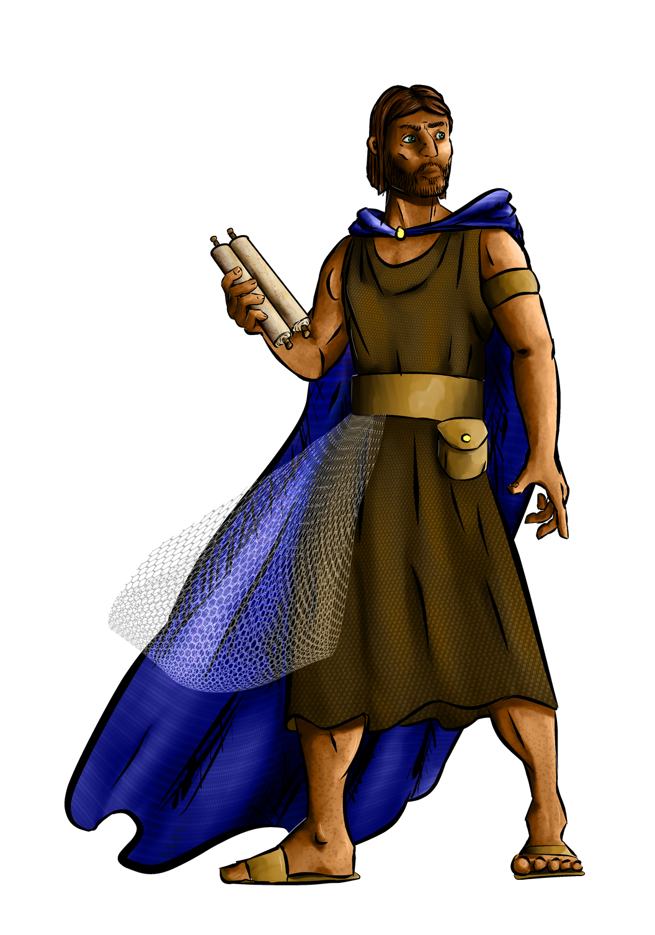
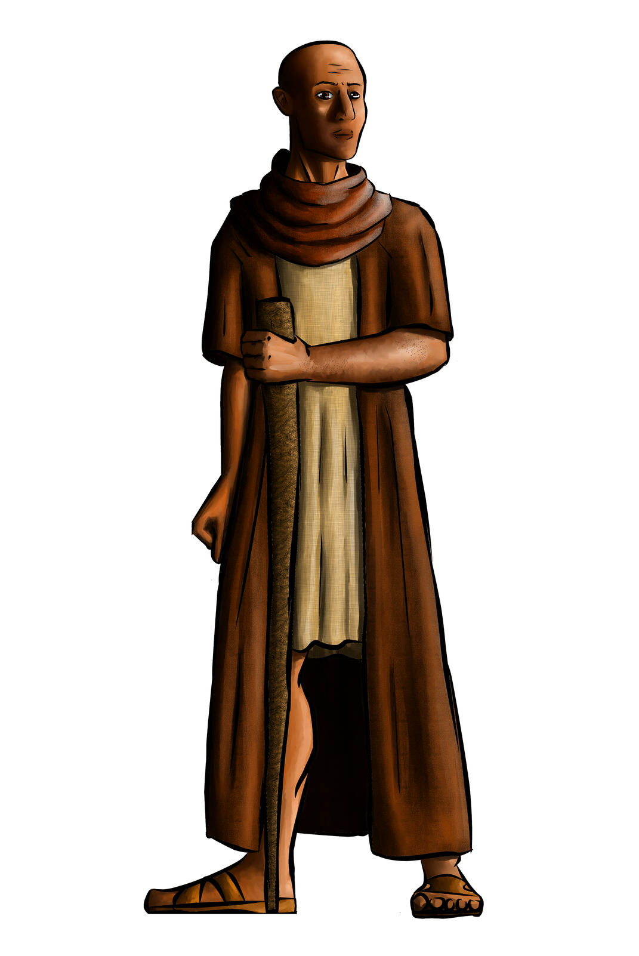
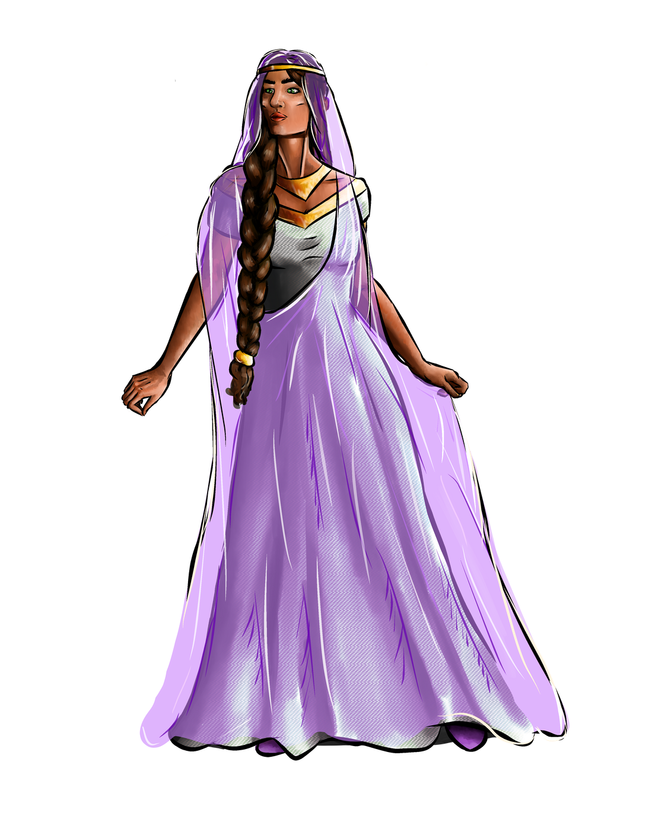
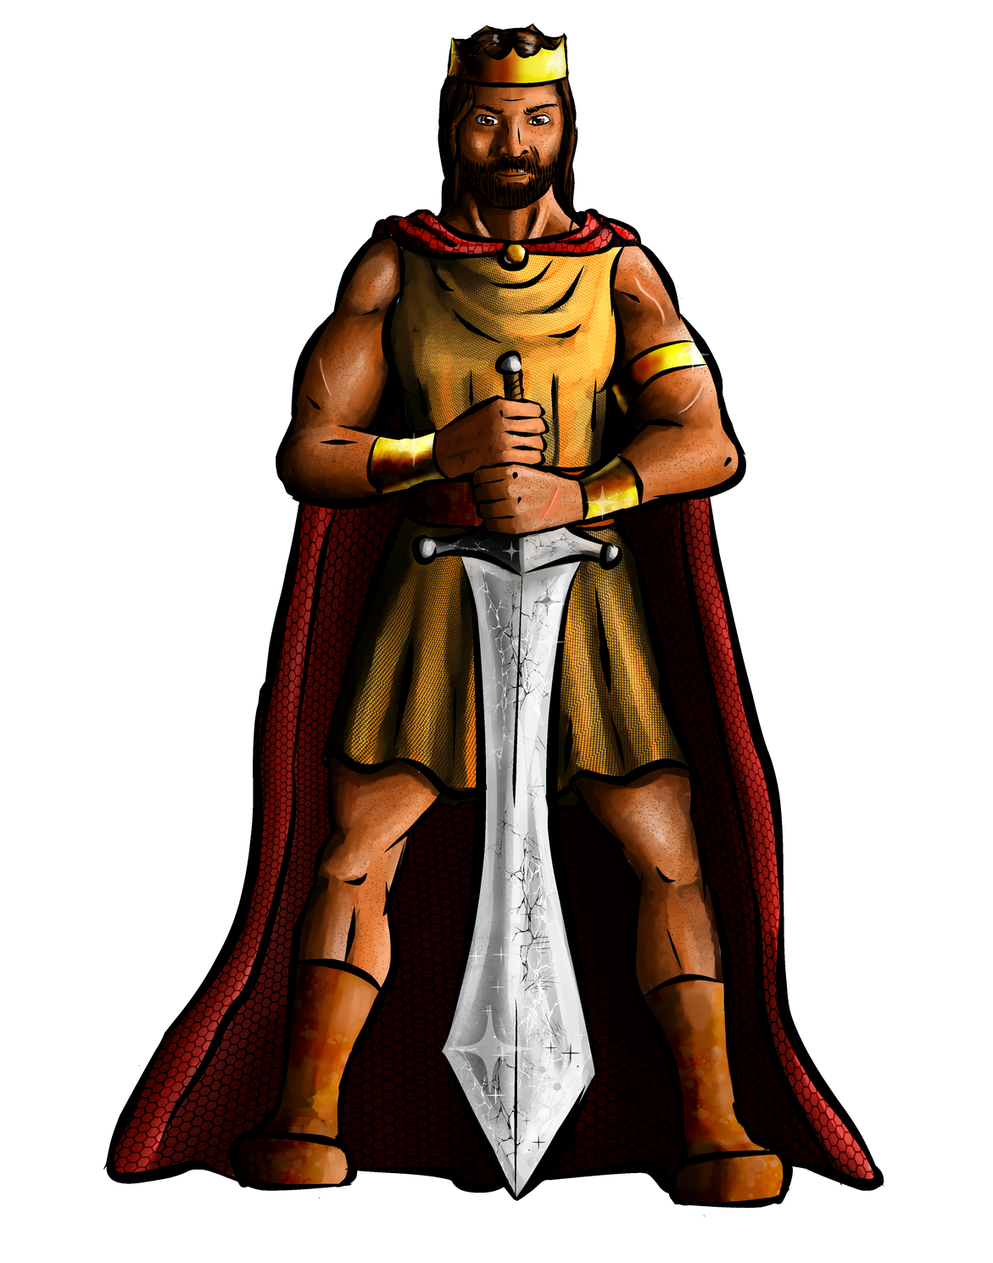
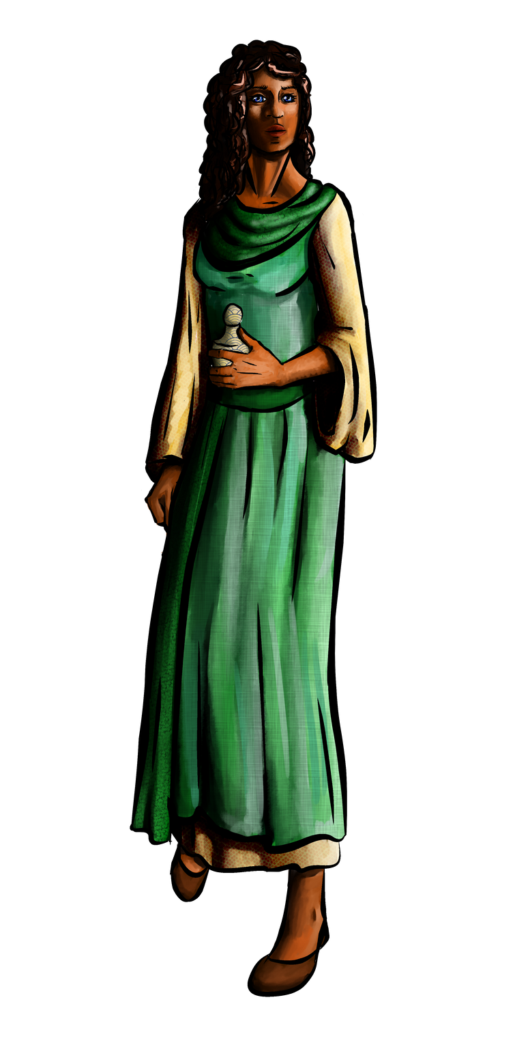
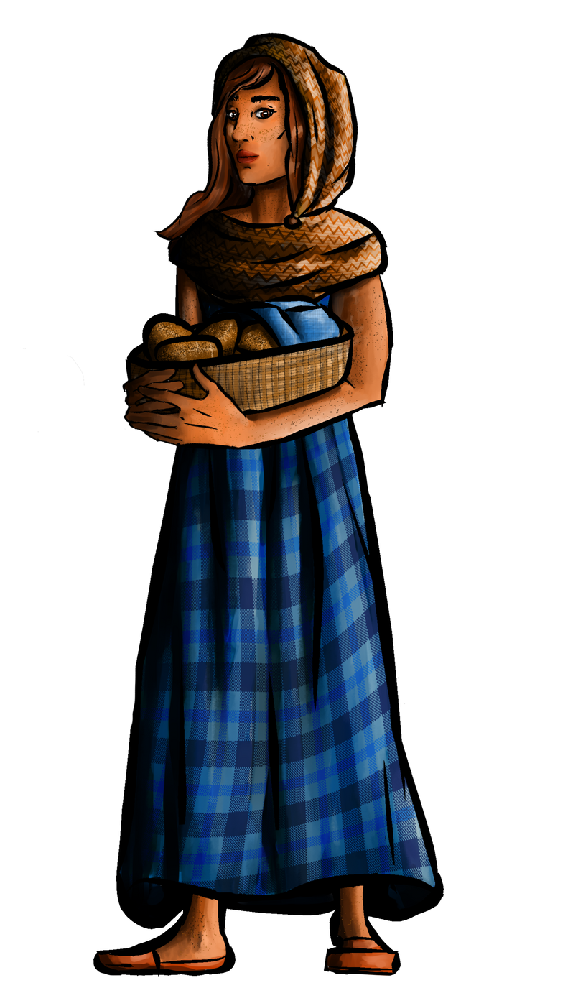
JUST HIS LEAGUE
Notes:
You are gonna see these guys and gals often this week! There will be banners set up in the auditorium for photo ops...feel free to take and post pictures. Help kids and groups take pictures too.

Slide 6




RESPONSIBILITIES
Ready for the day
Help Motivate campers
Watch for needs
ON TIME!
Sign up sheets will be available each morning, FIRST come FIRST served.
I will have a schedule posted in the cabin and you will have lanyards with basic times (hopefully)
whether this is for the adults or students be aware and ready to help if needed.
You showing up with a good attitude will help everyone throughout the day...think about some things that motivate you
Notes:
Each day RAT Pack will all wear the same color tshirts so you are easier to spot. I will have a laundry basket for these to go in nightly, so they can be used again next year. Many of you got a RP tshirt last year, you can bring that if you want...you will get a camp shirt to wear.
You do not have to wear the RP shirts after 5pm if you don't want to.

Slide 7
RESPONSIBILITIES
Helping at Rec
Bible Study
Missions
participate to encourage great sportsmanship,
not to show you can beat a 3rd grader
I have talked with DBU to give them a heads up.
Be the example
Remind the kids to be attentive to the teacher.
I want the kids to see that they can be part of sharing the Gospel right now.
I do have a simple skit I will need you to participate in that will lead them into the idea their participation.

Slide 8
RESPONSIBILITIES
Thurdsay
Debrief Nightly
Bible Studies
during the afternoon time RAT Pack will participate in the large group time with games and swag distribution.
I would love to have a time to talk about what worked, what didn't, changes we can make, how we can have an awesome day tomorrow
This year we have daily devos, but your Bible study leader is going to dive deeper into these daily stories with you each night.

Slide 9
WHAT MAKES CAMP FUN?
your ideas
Notes:
Check to be sure shirt sizes are accurate since most of them are from 2020.
Who is 18 or over?
Need to do Child Safety thru Latham and have a background check run, FIRM will do that.

