Slide 1
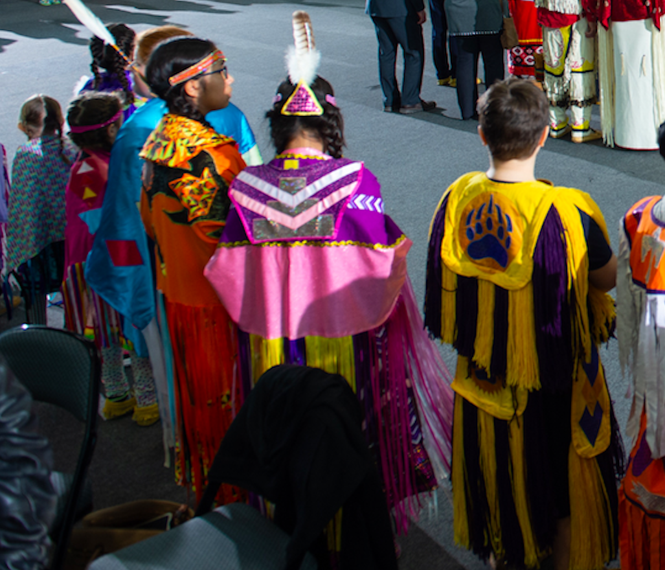
NB FIRST NATIONS
CHILD WELFARE
JURISDICTIONAL MODEL INITIATIVE
February 18, 2020

Slide 2
NB First Nations
Jurisdictional
Model
Initiative
PRESENTATION AGENDA
Project Overview
Project Partners
  Canada
  New Brunswick
Discussion

Slide 3

Project
Theme
Jurisdictional models for child and family services to support child and family well-being.

Slide 4
The purpose of the Initiative is to reimplement jurisdictional control over Child and Family services, and lay the foundation for other First Nations within New Brunswick.
Purpose

Slide 5
OBJECTIVE
Prepare First Nation governments and to:
re-establish jurisdiction over the delivery of child and family services through a set of regulations/rules that ensures culturally relevant programs and services; and,
the delivery of those programs and services by First Nation agencies and First Nation recognized service professionals.

Slide 6
EXPECTED OUTCOMES
Bill C-92 Impact Analysis Briefing
Summary Report of Subject-Matter Expert Presentations
Multi-year Work Plan
  Negotiation Process

Slide 7
ACTIVITIES
Conduct regular meetings of Child and Family Services Directors to discuss how First Nations should assuming control.
Engage federal and provincial government authorities in discussions on a process that will lead to First Nation control of child and family services programs.
Establish a technical advisors group, being comprised of Directors of CFS, with a mandate to examine the legal, operational and political dimensions of the proposed federal and provincial legislation and/or policies with a view to re-establish jurisdiction over the child welfare.
Conduct research relevant to engaging other jurisdictions in negotiations.
Develop a comprehensive multi-year work plan that layout the pathway for First Nations to assume jurisdiction over First Nation child and family services in New Brunswick.

Slide 8
TENTATIVE
SCHEDULE
OF
ACTIVITIES
Site Visit - Anishinabek Nation Sept 09, 2019
Launch Event Sept 18, 2109
Mapping Exercise Nov 14, 2019
An Indigenous Perspective of the NB System Nov 14, 2019
Impact Analysis of Bill C-92 Dec 06, 2019
Jurisdictional Control and the Path Forward Dec 12, 2019
Anishinabek Child Welling-Being Law Dec 12, 2019
Nation Building and Law Making processes Jan 16, 2019
Jurisdictional Best Practices Jan 16, 2019
Summary Report of Presentations Mar 13, 2020
Multi-year Work Plan Mar 20, 2020
Leadership meetings 4 Meetings

Slide 9
Presentations
# Presenter
&
Subject Matters
Graydon Nicholas
An Indigenous Perspective of the NB System
Maggie Wente
Jurisdictional Control & Path Forward, Analysis of Bill C-92
Adrienne Pelletier
Anishinabek Child Well-Being Law
Miriam Jorgensen
Jurisdictional Best Practices
Troy Jerome
Self-Government Negotiation Process

Slide 10
PROJECT
TEAM
Partner
Project
Management
Project Proponent
Indigenous Services Canada
PROVINCE NB
STRATEGIC ADVISOR
TROY JEROME
TECHNICAL ADVISOR
BEAVER PAUL
FACILITATOR
DANA FRANCIS
TCFSA, COO
NEIL PERLEY
TCFSA, DIRECTOR
CINDY MARSHALL

Slide 11
Indigenizing
Social Work
Practice
MWASW Social Workers
Our Thoughts

Slide 12
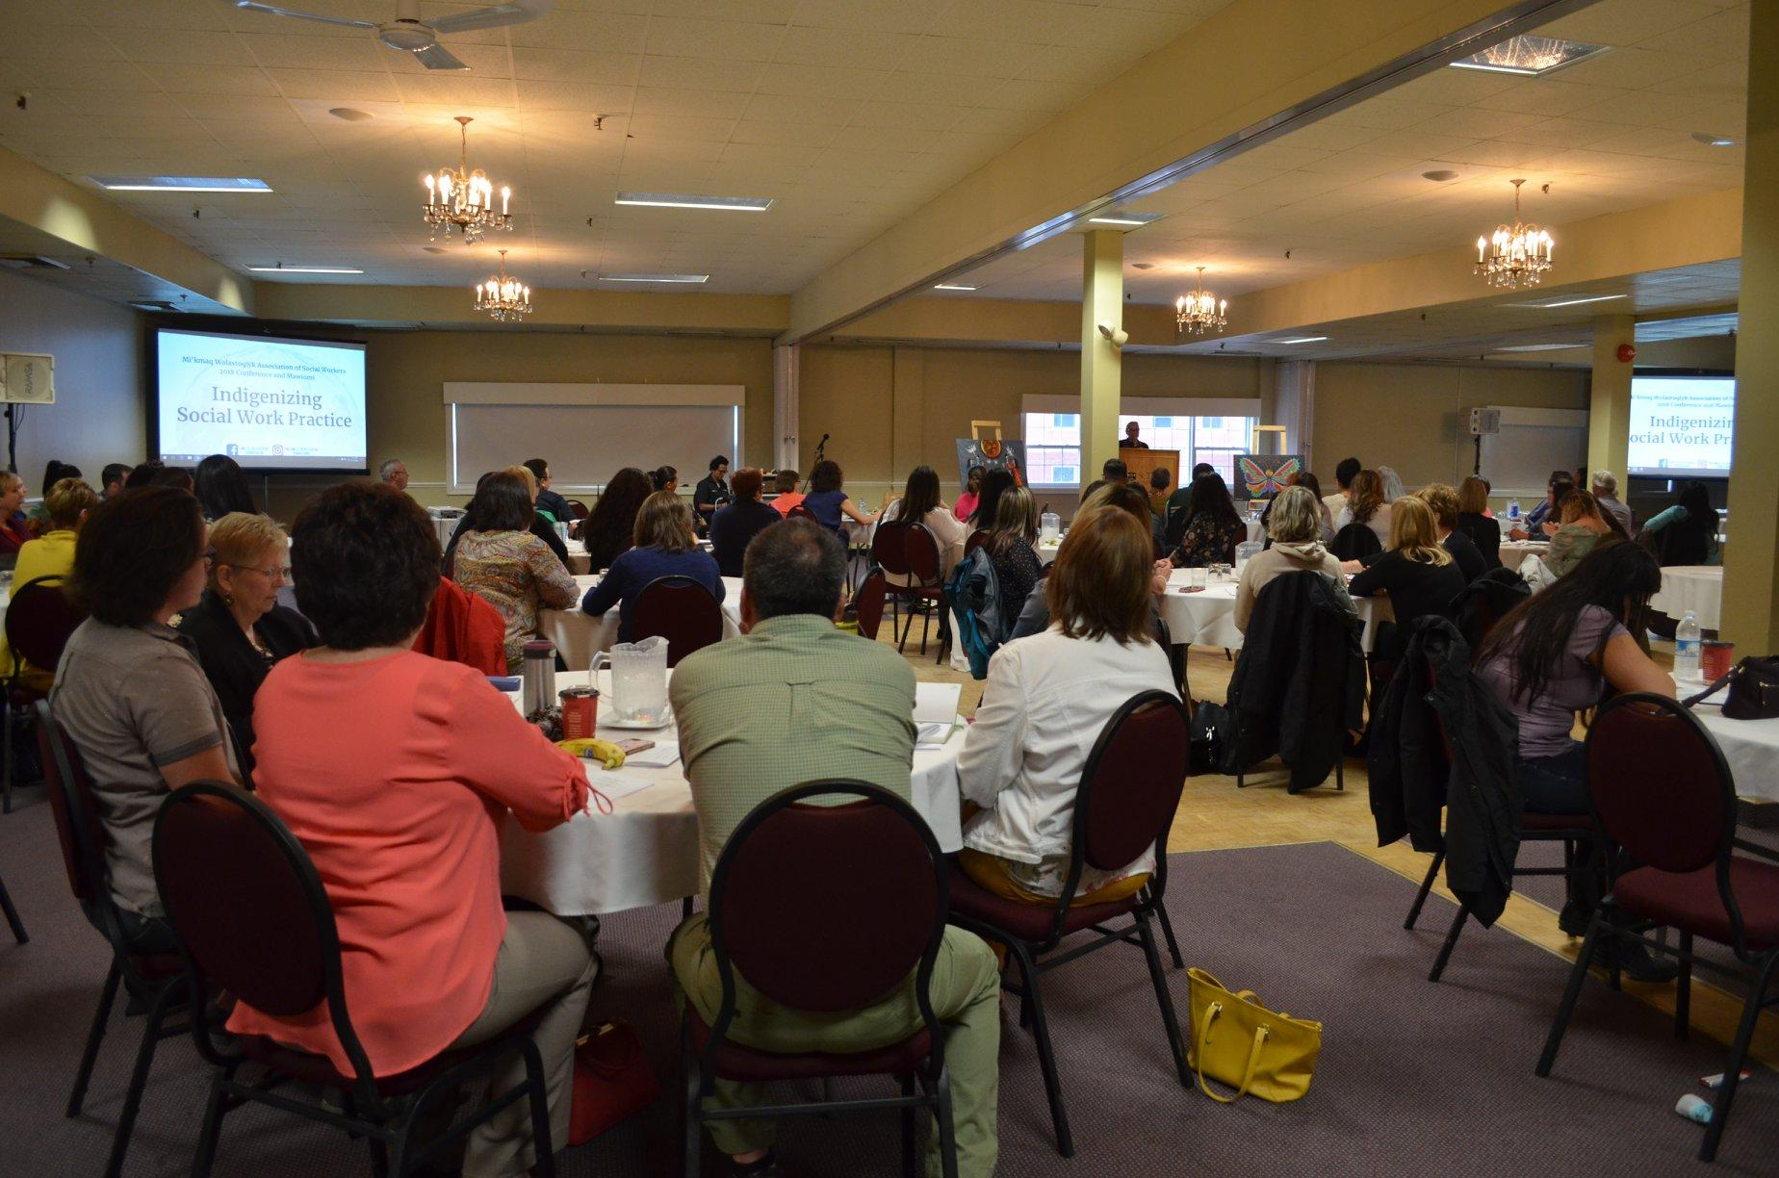
DISCUSSION
PROJECT ACTIVITIES
  INPUT/ADVICE/GUIDANCE

