Slide 1
Courts of Justice Claims
Claims Up to $100,000.00

Slide 2

Breach of Contract
Start a claim when one of the parties to the contract:
    fails to deliver promised goods,
    performs substandard work, or
    fails to pay for services rendered

Slide 3
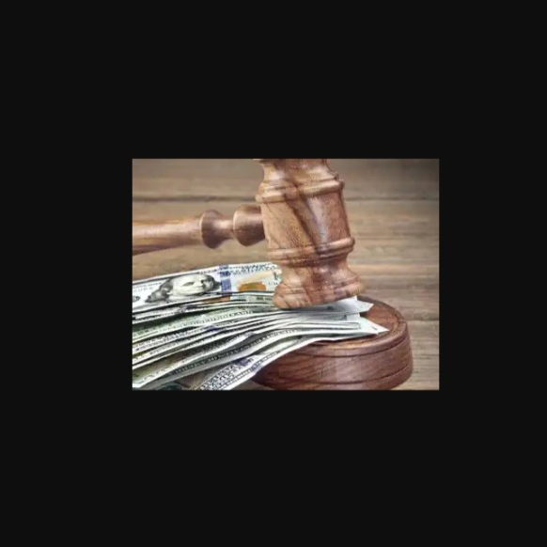
Unpaid Debts
Start a claim when financial obligations or loans remain unsettled after the agreed due dates

Slide 4

Wrongful Dismissal
When an employer terminates your employment without 'just cause' and fails to provide adequate notice or fair severance pay, it raises questions about the legality of the termination
  Did they handle it properly ?
  Was this bad faith termination?

Slide 5

Landlord-Tenant Disputes
Disagreements between a property owner and a renter regarding
  Terms of a lease
  Property conditions
  Financial obligations

Slide 6

Legal Research

Slide 7
Negligence (Torts)
The absence of reasonable care
  This can lead to harm to you
  This can lead to harm to your property

Slide 8
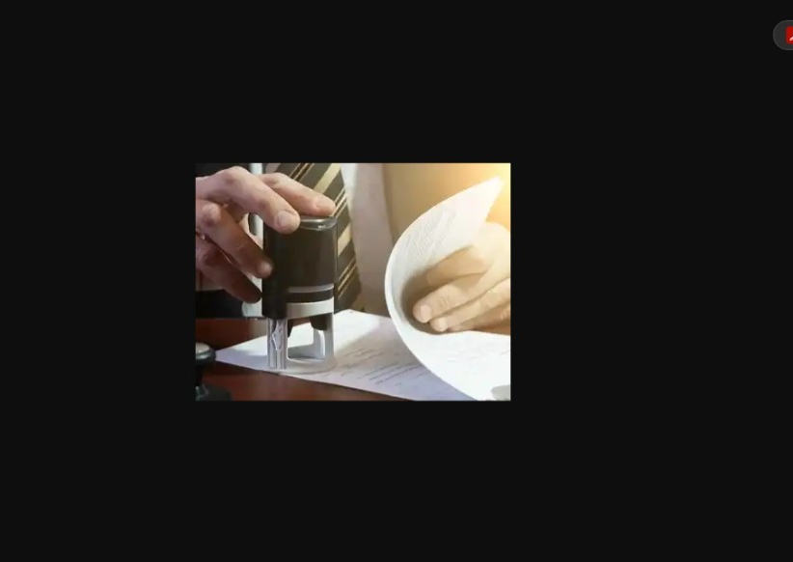
Commissioner For Oaths
We assist with the requirement to swear or affirm the contents of a document are true.

Slide 9
Process Service
Officially serving as document is crucial in ensuring all parties involved in a legal dispute are properly notified of the litigation.
This is a procedural fairness requirement.

Slide 10
Online Pardon Applications
Record Suspension applications involve requesting the government to remove your criminal record from the main police database.

Slide 11

Our Fee Structure Overview
Initial
Initial Retainer $500.00 flat fee (Payable upfront; covers all work up to court)
Court
Court Appearance: $250.00 flat fee (applicable only if required and requested)
Court
Excluded Costs: Court and private registry fees are billed separately.

Slide 12
Thank You
Let's Build A Successful Path Forward together.

