Slide 1



it’s time to
grow
GUIDED SALES PLAYBOOK

Slide 2

What’s In It For You?
BUSINESS OBJECTIVES
Drive Profitable Revenue Growth – PRG | ”It’s Grow Time”
Greatly increase MRR (monthly recurring revenue) as a % of the Business
Increase revenue per rep
Increase average revenue per customer through high margin product penetration
Increase the number, scope and size of net new deals with large strategic logos
Increase rep earnings
Reduce rep churn and customer churn
CURRENT CHALLENGES
Focusing on the customer’s and partner’s business… not just their products / services capabilities
Connecting to the customer’s Critical Business Objectives and the strategic / financial pains or gains associated with their CBO’s
Lots of competitor noise in the market making [Your Company Name] unique differentiators hard to stand out
Lack of Cohesiveness between Product Development and Pipeline / Go to Market Strategy
Lack of formal Pipeline Management Activity Management… aka FLYWHEEL
PRIORITIES
Transition from a Transactional-focused to an Insight based Strategic-focused model
Transition from a Product-oriented approach to a Solution-oriented approach
Differentiate [Your Company Name] message and value proposition
Achieve a Strategic advisor mentality at all levels of the customer / partner organization

Slide 3
Complex Sales Winning Formula
…deliver the Right Message…
…to the Right Person…
…connected to the Right Pain / Gain
…at the Right time
Deliver the Right Message…
To the Right Person…
Connected to the Right Pain / Gain...
At the Right time...
RIGHT?
WRONG!
You must deliver it the right way based on the buyers Personality Style.

Slide 4
How to Read the Four Styles
DIRECT COMMUNICATION
(Talks Fast)
DOER
TALKER
Direct-No Nonsense
Execution-Get It Done
Operations-Hands On
Task Driven
Energy
Decisive
Marketing /Sales
Persuasive
Working Together
Communicators
People Oriented
Social
TASK ORIENTED
(Serious Face)
PEOPLE ORIENTED
(Friendly Face)
COUNTER
THINKER
Organized
Procedures
Cautious
Data
Consistent
Detailed
Creative
Planning / Strategy
Idea-Generation
Caring
Thinking
Emotional Connection
INDIRECT COMMUNICATION
(Talks Slow)

Slide 5
How to Read the Four Styles
RED | GREEN | YELLOW | BLUE
Task | Relationship | Task | Relationship
Swift Confident | Quick Impulsive | Cautious Analytical | Unhurried Idealistic
Dominate Becomes Impatient | Becomes emotional Disorganized | Withdraw Stubborn | Conform Becomes Indecisive
Results | Freedom | Accuracy | Support
Loss of Control | Loss of Prestige | Embarrassment | Loss of Harmony
Objectives | Ideas | Thoughts | Feelings
Frankness | Adventure | Logic | Friendly Demeanor
Options Measurable Results | Testimonials Recognition | Proof/Precision Thoroughness | Loyalty Follow through
Task | Relationship | Task | Relationship
Body Language
Tone of Voice
Method of Talking
Orientation to Time
Definition of Success
Personal Motivator
Tone of Voice
Office
Don’t be fooled

Slide 6
How to Approach the Four Styles
Orientation | RED | GREEN | YELLOW | BLUE
 | Task | Relationship | Task | Relationship
Decision Style | Swift Confident | Quick Impulsive | Cautious Analytical | Unhurried Idealistic
Under Stress | Dominate Becomes Impatient | Becomes emotional Disorganized | Withdraw Stubborn | Conform Becomes Indecisive
Expects | Results | Freedom | Accuracy | Support
Pressure Point | Loss of Control | Loss of Prestige | Embarrassment | Loss of Harmony
Pays Attention to | Objectives | Ideas | Thoughts | Feelings
Responds to | Frankness | Adventure | Logic | Friendly Demeanor
Needs | Options Measurable Results | Testimonials Recognition | Proof/Precision Thoroughness | Loyalty Follow through

Slide 7
In Meetings
RED | GREEN | YELLOW | BLUE
Make points in a simple and efficient manner. Don’t overdo questioning or interrogate. Prepare for direct and specific questions. Give the customer control over the discussion. Start by clarifying objectives that let them set the direction of the meeting. Avoid yes/no questions. Be aware of the time. | Allow some time for sharing personal topics. Start with general questions that encourage the customer to talk. If the conversation wanders off topic, return to the purpose. Reinforce favorable responses that match our strengths. Mention case studies/references that are well known. Look for opportunities to brainstorm and discuss new ideas. | Encourage a two-way conversation Take time to ask questions. Be prepared to answer questions in an accurate, organized and specific manner. If you don’t know, commit to finding out. Listen carefully to understand their priorities. Don’t be overly general – specifics are better. Present in a logical manner and stay on topic and in sequence. | Open with some general questions to encourage them to talk. Listen for hints to understand their key relationships. Don’t ask close-ended questions that may be perceived as interrogation. Don’t be too formal or data-oriented. Respect their emphasis on feelings and intuition. Beware of whether they are acquiescing rather than agreeing.

Slide 8
In Meetings
Being more Direct
Get to the point
Volunteer information
Be willing to disagree
Acting on convictions
Initiate conversations
DIRECT
Being more Task-focused
Focus on facts and figures
Organize your logic before speaking
Describe the process
Communicate the expected results
Being more People-focused
Verbalize feelings
Pay compliments
Make small talk, socialize, build rapport
Spend time on relationships
Break the routine
TASK
PEOPLE
INDIRECT
Being more Indirect
Be open to other opinions
Place value on other’s time
Follow the lead of others
Ask for cooperation

Slide 9

Accelerate Your Success By Leading With Insights.
GUIDED SALES PLAYBOOK

Slide 10
Top Ten Things To Know About Your Account
Customer’s Business Description and Organization:
How do they describe their business?
What is the organization structure of parent and all subsidiaries?
What is the business unit structure?
What is the Account or Business Unit mission statement?
Does their operational performance support the mission?
Are staff and management aware and driven to align with that mission?
What internal resources may benefit [Your Company]?
Business Plan and Key Objectives:
What is their business model?
What are their future plans / strategy?
What are the major initiatives to accomplish this strategy?
Financial Trends:
What are the key financial trends and how will they influence our account strategy?
How do they finance / fund software and IT acquisitions?
Company and Business Unit Issues:
What are the “stay awake” issues, also known as “critical business objectives,” that are uniquely affecting the company or business unit?
Outside Forces:
Who are their current and emerging competitors?
What other outside organizations have influence with this company?
What economic, political, regulatory, “natural” trends and events are having significant impact?
Major Industry Issues:
What are the issues that are facing the company’s industry as a whole?
Who is the most respected analyst for the account’s industry? What are their comments regarding current trends facing the account?
What emerging market trends are occurring that may impact the customer?
How does the account compare to competitors and industry standards?
Account Decision Making:
How are decisions made? Autocratic? Democratic? Centralized? Decentralized?
What is the authority of the business unit?
Relationship with [Your Company Name] Competitors:
What is the accounts perception of other Technology firms?
Who are the competitor’s executive sponsors? How strong is their sponsorship?
What is the competitor’s strategy for the account?
Current Services Strategy:
What professional services are currently installed and in use? By application area? By business unit?
What is the current TCO for existing services and installed software applications?
What are the issues with the current software strategy and implementations?
Where can [Your Company Name] impact overall TCO?
Revenue Opportunity:
What is the total [Your Company Name] revenue opportunity over the next 3-5 years? In product? In services?

Slide 11
Stakeholder Analysis
KEY CUSTOMER RELATIONSHIPS
Executives & Owners
Board of Directors
Key Department leaders:
Sales / Marketing
Supply Chain Management
Warehouse Management
Customer Management
Financial Management
Human Capital Management
CUSTOMER BOARD
KEY OUTSIDE STAKEHOLDERS
Advisors/Consultants
Alliance Partners
Audit Firm
Banks & Financial Institutions
Government officials / Politicians
Media
Regulatory Agencies
CEO
PREFERENCE FOR [Your Company] | ACCESSIBILITY | [EXECUTIVE] | ROLE IN DECISION PROCESS | ACTION
1 - Highly negative 2 - Mixed, but generally negative 3 - Indifferent 4 - Mixed, but generally positive 5 - Highly positive | 0 - No relationship 1 - “Have met once” 2 - Limited 3 - Base-level working relationship 4 - Good relationship 5 - Excellent relationship (e.g. deep, long-term relationship) | PREFERENCE - ACCESSIBILITY - ROLE - ACTION - | ES - Executive Sponsor DM - Decision maker TB - Technical Buyer I - Influencer U - User | L - Leverage C - Cultivate M - Motivate E – Enlighten N - Neutralize

Slide 12

Guiding Principles
“O” Focus
7 Why’s
SELF FOCUS
OTHER’S FOCUS
QUESTIONS
ANSWERS
OUTCOMES
Focus on product capability
Mastery of technical and competitive arguments
Seeks to win with features and functions
Product presentations and demonstrations
Urgency to close
  Focus on business value
  Mastery of the customer’s business problems
  Significant industry knowledge leads to credible recommendation
  Maps recommended solutions to how it solves customer business problems
  Urgency to deliver results
  Why Listen?
  Why Care?
  Why Change?
  Why Not?
  Why Now?
  Why You?
  Why Promote?
CBO Identified.
Executive Interest Confirmed
Executive Sponsorship Confirmed
No-Decision Defeated
CBO Value Confirmed
Contract Signed
Value Achieved
MQL | Phone / Web Call
SQL | Discovery Meeting
SQO | Pipeline Opportunity
Have – to – Have Solution
Qualified Deal
Forecasted Opportunity
Trusted Advisor
Customer Buying Process
WHY LISTEN?
WHY CARE?
WHY CHANGE?
WHY NOT?
WHY NOW?
WHY YOU?
WHY PROMOTE?
Interest
Strategy
Decision
Exec
Awareness
Education
Initiative
Measure Value
Kick-off
Go-Live
Mgr
Recommendation
Plan
Research
Project
Investigation
Implement
SME
Evaluation
Develop
TIME
CBO IDENTIFIED
EXECUTIVE INTEREST CONFIRMED
EXECUTIVE SPONSORSHIP CONFIRMED
N0-DECISION DEFEATED
CBO VALUE CONFIRMED
CONTRACT SIGNED
VALUE ACHIEVED

Slide 13
Sales Process & Pipeline Management
SALES PLAYBOOK

Slide 14
Customer Buying Process
WHY LISTEN?
WHY CARE?
WHY CHANGE?
WHY NOT?
WHY NOW?
WHY YOU?
WHY PROMOTE?
Interest
Strategy
Decision
Exec
Awareness
Education
Initiative
Measure Value
Kick-off
Go-Live
Mgr
Recommendation
Plan
Research
Project
Investigation
Implement
SME
Evaluation
Develop
TIME
CBO IDENTIFIED
EXECUTIVE INTEREST CONFIRMED
EXECUTIVE SPONSORSHIP CONFIRMED
N0-DECISION DEFEATED
CBO VALUE CONFIRMED
CONTRACT SIGNED
VALUE ACHIEVED
Awareness: based on input from a variety of sources, the customer realizes that particular challenge/issue can be addressed. This often occurs at the executive level but could occur at any level. If the problem is worth solving, an Investigation will be started
Research: Through focused analysis and research, acquire deep vendor, industry and solution knowledge that identifies the highest priority business drivers and technology needs that multiple vendors… including [Your Company]… can address.
Interest: the executive leadership reviews the research findings and decide whether or not to continue investing resources in this area
Investigation: all potential options are considered. An RFI may be written, there may be demos, etc. to better understand the alternatives
Education: the executive team must understand the results of the Investigation: what problem is being addressed, the viable alternative and general pros/cons of each, the potential results
Strategy: the leaders set their strategy, which implies trade-offs and prioritization
Initiative: based on the strategy, a list of initiatives are funded, assigned resources, aligned with business goals and given timelines
Project: a project team is established, with objectives, a budget, and identified stakeholders, constituencies, etc. Technical / functional goals and requirements are defined
Evaluation: an evaluation of all feasible options is done. An RFP process may be implemented, demonstrations, proof-of-concept, references, etc. are all done here. The sales team typically spends most of their time in this step
Recommendation: the evaluation team makes a formal recommendation to management and executive approvers
Decision: the executives re-engage for the final decision and any negotiations required

Slide 15



SALES PROCESS
TARGET
PREPARE
DELIVER
Create Demand
Gain Sponsorship
Deliver Value
Plan Business
Generate Opportunity
Gain Sponsorship
Develop Solution
Confirm Solution
Negotiate & Close
Implement Solution
Success & Expand
MILESTONES
& CLOSE PROBABILITY (%)
  Decision-maker agrees to business/technical issue/opportunity to be addressed and communicates support for the [Your Company Name] solution vision – 10%
  Decision-maker identifies strategic initiatives and influencers, and will support [Your Company Name] involvement in the process – 15%
  Customer confirms current contractual and financial issues, specific budget considerations and timeframes – 20%
  Executive Sponsor has confirmed priority, financial support and agrees to sponsor a Value Assessment – 25%
  Executive Sponsor and influencers confirm their support for the Value Assessment and their intention to make a buying decision – 30%
  Executive Sponsor and influencers confirm their support for the [Your Company Name] Solution based on the Value Assessment Report of Findings– 35%
  Executive Sponsor and influencers confirm feasibility of proposed financial strategy for acquiring the [Your Company Name] Solution – 40%
  Stakeholders confirm all presentations, demos, reference calls, site visits are complete – 45%
  Technical Buyers confirm that all technical issues have been resolved and recommends [Your Company Name] – 50%
  Evaluation Team (technical buyers) or committee recommends [Your Company Name] – 55%
  Executive Sponsor confirms that all business issues have been resolved – 60%
  Executive Sponsor agrees on business terms prior to contract T&C’s review - 65%
  Executive Sponsor tells us we have won – 70%
  Decision Maker has received a base contract for review – 75%
  Decision Maker returned red-lined final contract – 80%
  All legal issues are resolved by the customer and [Your Company Name] – 85%
  Board Approval, Executive Management Committee Approval, Owner Approval – 90%
  Date is set for contract signing and picking up complete Contract Package – 95%
  Contracts received and deal is booked - 100%
ES Definition
Owns the strategy that we are enabling
Owns or controls the budget
Directly benefits from the results we will deliver
If Executive Sponsorship (ES) is not achieved, proceed knowing that not having executive involvement introduces risk. Close Probability is never greater than 50% until signed contracts are received.

Slide 16
Opportunity Generation
Sales Process
Plan Business
Generate Opportunity
Gain Sponsorship
Develop Solution
Confirm Solution
Negotiate & Close
Implement Solution
Service & Expand
Opportunity Strategy (for Individual Sales Opportunities)
  Business Value Strategy
  Conduct a Discovery process to determine potential value and solution requirements with business case
  Prepare initial business value strategy based on customer’s compelling events
  Document the business value objectives with the Executive Sponsor
  Solution Strategy
  From Discovery process, align business driver / [Your Company Name] solution component to potential value driver
  Relationship Strategy
  Identify and meet with the Executive Sponsor and decision makers who are accountable for “critical business driver”
  Work the influencers broadly, but identify and focus on decision-makers
  Competitive Strategy
  What Traps are being set for [Your Company Name]? When and How should we respond?
  What Traps should we set for each competitor? When should we set those traps?
  Partner Strategy
  Are the Partners involved with a competitor?
  What has been their past success together?
  Closing Plan
  What is the customer’s process for:
  Evaluation / Approval / Budgeting / Signature / Procurement

Slide 17
Opportunity Qualification
IS THERE AN OPPORTUNITY? |  |  |  |  | CAN WE COMPETE?
1 | Customer’s Application or Project | Defined / Undefined |  |  | 1 | Formal Decision Criteria | Defined / Undefined
2 | Customer’s Business Profile | Strong /Weak |  |  | 2 | Solution Fit | Good / Poor
3 | Customer’s Financial Condition | Strong / Weak |  |  | 3 | Sales Resource Requirements | Low / High
4 | Access to Funds | Yes / No |  |  | 4 | Current Relationship | Strong / Weak
5 | Compelling Event | Defined / Undefined
 |  |  |  |  | 5 | Unique Business Value | Strong / Weak
Red | Yellow | Green
 |  |  |  |  | Red | Yellow | Green
CAN WE WIN? |  |  |  |  | IS IT WORTH WINNING?
1 | Inside Support | Strong / Weak |  |  | 1 | Short-Term Revenue | High / Low
2 | Executive Credibility | Strong / Weak |  |  | 2 | Future Revenue | High / Low
3 | Cultural Compatibility | Good / Poor |  |  | 3 | Profitability | High / Low
4 | Informal Decision Criteria | Defined / Undefined |  |  | 4 | Degree of Risk | High / Low
5 | Political Alignment | Strong / Weak |  |  | 5 | Strategic Value | Yes / No
Red | Yellow | Green |  |  |  |  | Red | Yellow | Green

Slide 18
Pipeline Management
Pipeline Stages, Sales Activities and Customer Buying Milestones with Close Probability %
With Executive Sponsorship
Sales Activities
PLAN BUSINESS
Without Executive Sponsorship
With ES
Without ES
  Assess Territory
  Create Strategy and Action Plan
  Monthly Territory and Pipeline Review
  Review the customer’s website
  Understand industry challenges and trends
Customer Milestones
10%
Generate Opportunity
10%
  Contact and Interest
  Business and technical needs identified
  Interest is confirmed
  Support for [Your Company] involvement
15%
  Initial Contact
  Cultivate Contact
20%
  Business issues confirmed as a priority
  Customer confirms current contract and financial issues
  Budget availability verified
  Agreement to an assessment
Gain Sponsorship
10%
25%
  Meet with Executive Sponsor
  Identify Strategic Business Issues
  Identify Communications Issues
30%
  ES and influencers confirm support for a Value Assessment
  ES confirms intention to make a buying decision
  ES and influencers confirm support for [Your Company Name] solution based on Value Assessment Report of Findings
Develop Solution
15%
35%
  Conduct Assessment
  Deliver Solution Proposal
  Demo Solution
  Verbal award received
40%
45%
15%
  ES, influencers confirm feasibility of [Your Company Name] pricing model
  ES and stakeholders confirm demos, references & site visits complete
  Technical buyers confirm recommendation of [Your Company Name]
  Evaluation team/committee recommend [Your Company Name]
  ES confirms all business issues are resolved
  ES agrees on business terms prior to contract T&C’s reviewed
50%
55%
Confirm Solution
25%
60%
65%
70%
75%
50%
  ES tells [Your Company Name] we have won
  Decision maker reviews and red-lines contract
  All legal issues resolved
  Board, Executive Management, Owner approval received
  Signed contracts received
  Contract Negotiation
  Customer Signature
80%
85%
NEGOTIATE
CLOSE
90%
95%
100%
100%
  Project Kickoff Call with Customer
  Measure Value
  Executive Sponsor acknowledge value of [Your Company Name] Solution
  Obtain references or create other opportunities
SERVICE & EXPAND

Slide 19
Pipeline Management
Quantity
PLAN BUSINESS
Without ES
Health | Analysis and Coaching
Quantity | Do I have enough opportunities (8x -> 3x)
Quality | Do they match the Qualification Criteria? Have I entered early into the buying process? Does my solution match well with their needs?
Velocity | Do we have the right level of executive sponsorship to drive these deals to closure? Are we getting stuck in any one step?
Balance | Is there a good balance between early, mid and late-stage deals?
With ES
10%
10%
15%
GENERATE OPPORTUNITY
20%
25%
GAIN SPONSORSHIP
10%
Velocity
30%
Balance
DEVELOP SOLUTION
15%
35%
Challenge | Immediate Actions
Quantity | Aggressive prospecting activities
Quality | Executive Sponsorship, CBO linkage, Compelling Events
Velocity | Leverage [Your Company Name] leadership team to assist in calling higher and gaining executive sponsorship
Balance | Invest time in weak stages
40%
45%
50%
55%
CONFIRM SOLUTION
15%
60%
65%
25%
70%
75%
80%
85%
NEGOTIATE
CLOSE
50%
90%
95%
100%
100%
SERVICE & EXPAND
Quality

Slide 20
The “7-7-1” Principle
  Target strategic accounts within your ideal vertical markets/industries (aka Ideal Client Profile - ICP).
  Secure meetings with Executives as an ”Authority” based on your Industry Insights, Business Acumen and Strategic Literacy.
  Prepare your strategic business conversation talk tracks connected to their specific business objectives.
  Leverage Social Selling assets appropriately to “Teach” your customers and prospects online.
  “Tailor” your selling activities to the customer’s “Critical Business Objectives.”
  “Take Control” of your Customer Buying Process while differentiating [Your Company Name] from the competition through a more effective executive conversation framework.
  Close larger deals faster… Exceed your quota… Make more money!
1. Why Listen?
2. Why Care?
3. Why Change?
4. Why Not?
5. Why Now?
6. Why You?
7. Why Promote?
CUSTOMERS FOR LIFE

Slide 21
Don’t Let This Be Your Reality!
88%
of executives felt that salespeople were knowledgeable about their own products
55%
of executives thought that salespeople were knowledgeable about the client’s industry
15%
find their meetings with salespeople valuable
6%
of executives felt that the salespeople’s agenda was to help them deliver results

Slide 22

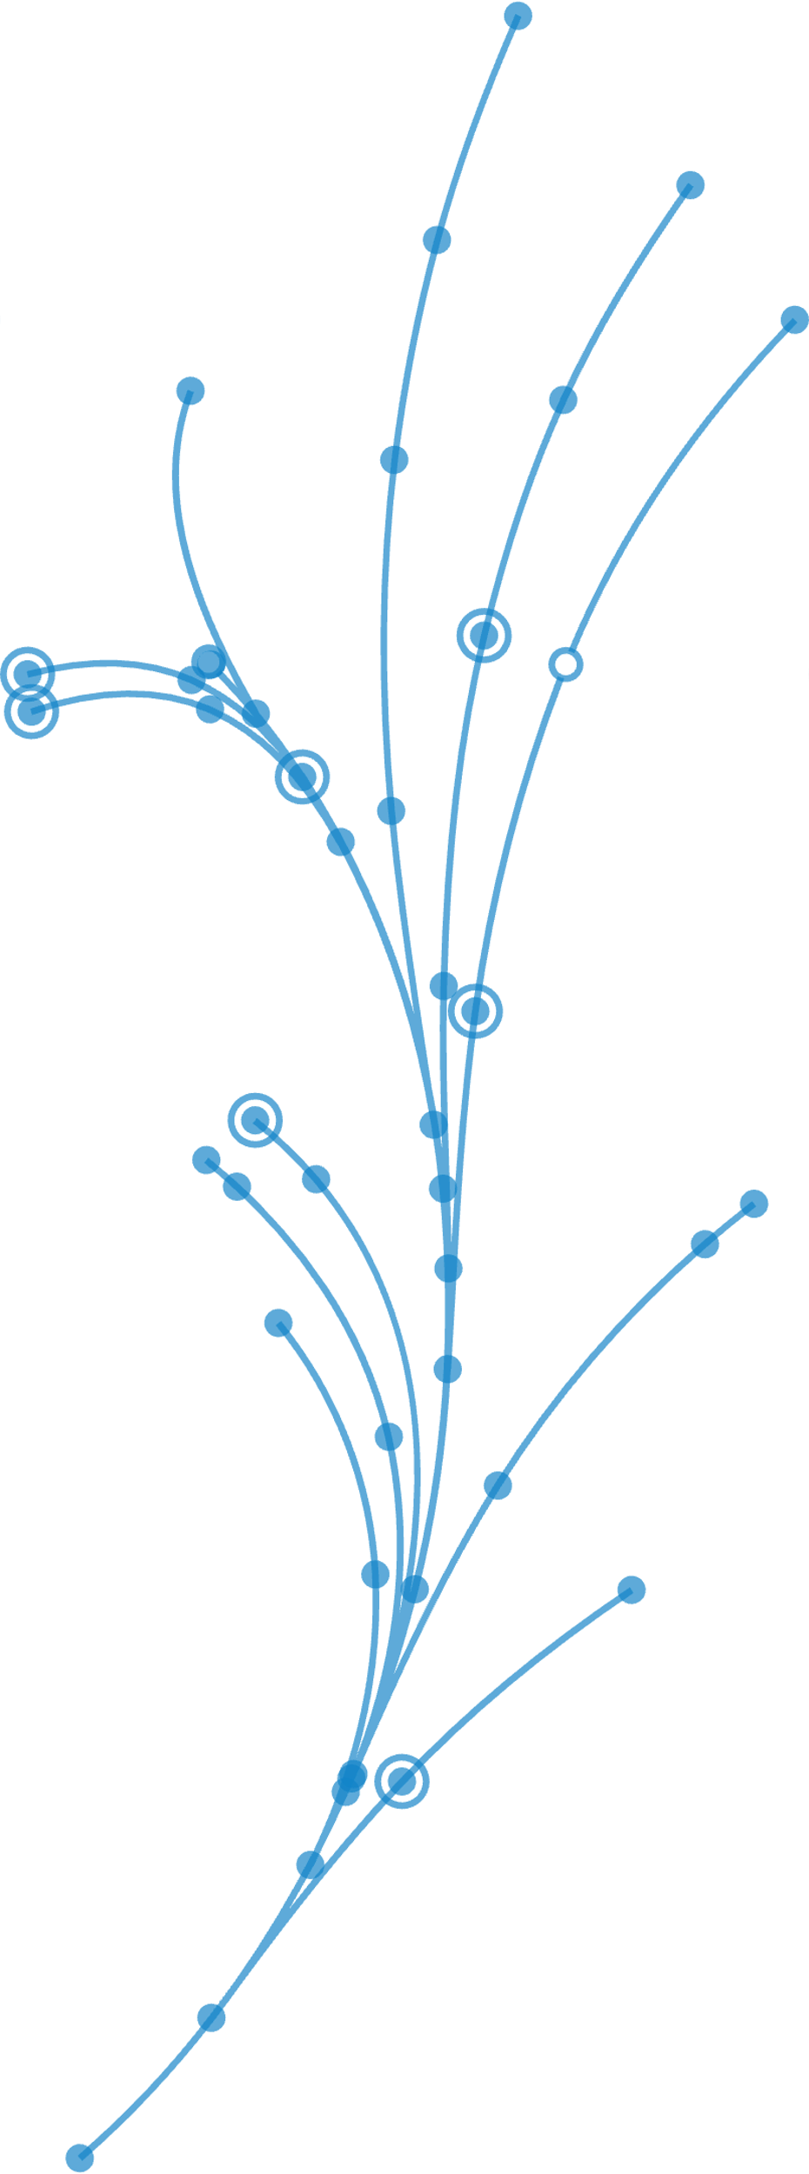
Implications Of Today’s Reality?
Must provide insight in new ways
    Through video, web, social media, blogs, discussion groups, etc.
    Not just a marketing activity, but a sales activity!
Must introduce new criteria to disrupt the buying cycle
    i.e. new insights, new challenges, new requirements
As you disrupt, must engage higher than the department/director level
    Link to C-level objectives that drive their strategy
You are the messenger… “The Authority”

Slide 23
Planning, Development & Delivery
Messaging
GUIDED SALES PLAYBOOK

Slide 24
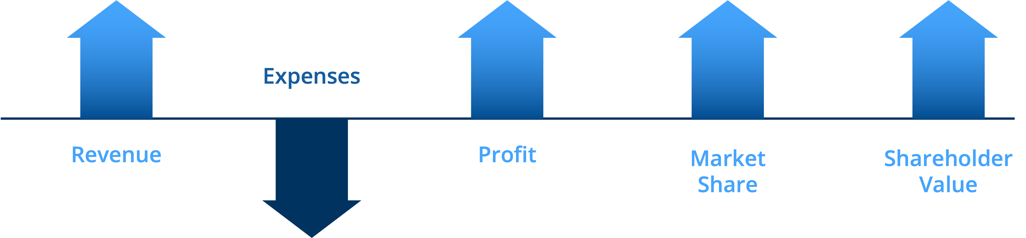
Engaging Executives
“There are only 5 metrics every Executive cares about…
…and every Salesperson in the World must know what they are and lead a compelling Executive conversation on those metrics!”

Slide 25

Getting to the Decision Maker’s Why Now
1. WHAT
What are the key facts to highlight?
2. SO WHAT?
What is the impact (+/-) of those key facts to their business?
3. NOW WHAT?
What are the immediate priorities you recommend to take advantage of or remedy the situation?

Slide 26
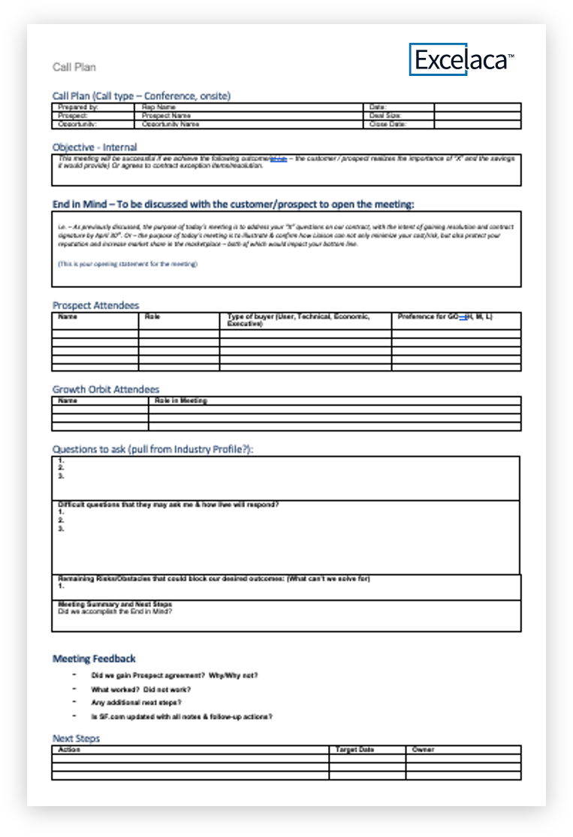
Call Plan
Example
Research Industry Trends
Plan Insights for key customer meetings
Confirm customer objectives, strategy, and challenges
Align all participants and ensure objectives are understood and achievable
Connect relevant insights to business Pain / Gain with discovery questions

Slide 27
Give To Grow Sales Professional Attributes
Leverage Data
Embrace Technology
Seek Collaboration
Share
New Ideas
Communicate Effectively
Exhibit Business Acumen

Slide 28



The Importance of generating demand through Story Selling
Dating back to the stone age, Storytelling has been the most effective form of communication
Today, we are bombarded with information and data.
On average, a businessperson process about 74 gigabytes of data daily from sources including:
  Email
  Text
  Web meetings
  Social media…
roughly 16 DVDs worth of data each day
People retain 65-70% of new information shared via a story vs. only 5-10% of information conveyed through statistics or written copy

Slide 29





Story Selling Best Practices
Make it relevant to the customer – generic stories typically fail with customers
Frame the situation - align on their objectives; make it about them, not about you and your products
Introduce the Challenge – layout the key problems, obstacles, conflicts, i.e. the enemy
Describe Success – this is what victory looks like; build to a crescendo. Describe the impacts and outcomes. Use statistics, facts, actual customer stories…don’t describe products specs
Collaborate on next steps – provide options, describe what others are doing, get their involvement and commitment

Slide 30
The Story Selling
5 O’s Approach
THE POWERPOINT PRESENTATION TRAP
Scripted monologue
Only tells our side of the story
Just like the competition
THE 5 O’S APPROACH
Framework for delivering Insight
Creates a dialogue
Dynamic and flexible
Obtain sponsorship for next steps

Slide 31
Story Selling 5 O’s
It creates a visual framework for connecting the customer’s challenges and our vision by using a graphical approach to share our unique, [Your Company] point of view.
The process of drawing the framework further engages the customer and establishes a common space for lively discussion, engagement, and meeting of the minds.
Provoke interest
High “Customer” focus
Observations
Market Trends/Insights – Why Listen & Why Care?
Goals, Strategies & Tactical drivers
Create common ground / interest in the rest of the story
Objectives
Call Point Goals & Objectives – Why Change?
Issues and business challenges
Understand why they are hard to solve
Obstacles
Why Now & Why Not?
Unique [Your Company] approach to solve the challenge
Addressing the obstacles
Offerings
Why You?
Value and business benefits delivered
Customer examples and proof-points
Outcomes
Why Promote?

Slide 32
Executing The Story Selling 5 O’s Approach – Whiteboard Conversation
Observations
Industry trends, issues, business challenges, business opportunities, and forecasts
Answers: Why Listen & Why Care?
Objectives
Critical Business OBJECTIVES (CBOs)
Answers: Why Change?
Obstacles
Strategic, Financial, Political, Cultural issues
Answers: Why Now & Why Not?
Offerings
Outcomes
Your Solutions that break through the obstacles and achieve the objectives in-spite of / in-support of the Industry observations
Answers: Why You?
Customer Success Stories
Answers: Why Promote?
* REFER TO THE STORY SELLING – STRATEGIC BUSINESS CONVERSATION TOOL – [Your Company] MESSAGING PLAYBOOK

Slide 33
5 O’s Exercise Conversation Preparation
CLIENT: _______________________ DECISION-MAKER: _______________________
1. Observations
2. Objectives
3. Obstacles
4. Offerings
5. Outcomes

Slide 34
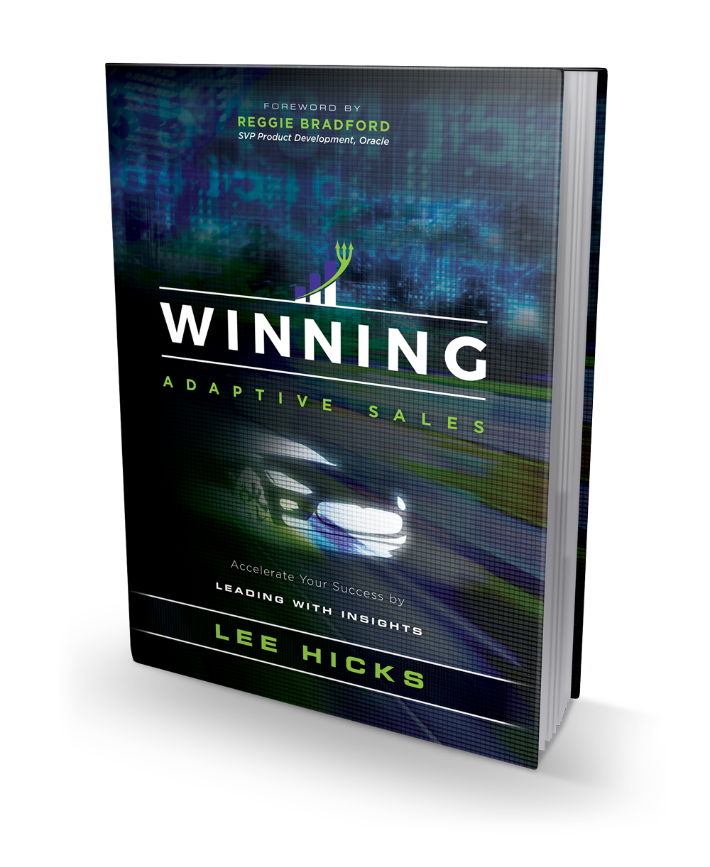


LEE HICKS
+1 (678) 592-1434
Lee.Hicks@Rev1.ai
https://www.linkedin.com/in/leehicks/

