Slide 1
Exhibits from the Book
Google Forms Survey
SWOT Analysis
Startup Costs Estimate
Break-even Analysis Formula
Financial Model Template
Competitive Analysis Template
Trademark, Patent, Copyright
Product vs. Service
Tools by Stage
Types of QA Testing
QA Tools by Stage
Categories of Enablement Systems
CRM: Evaluate Build vs. Buy Decision
CRM Vendor Evaluation Criteria
Vendor Management Tools & Resources
Popular Accounting Software Options
Accounting Bonus Tools & Resources
Key Financial Concepts
Budget & Cash Flow Scenarios
Manage & Improve Cash Flow
Output Table (12-Month Snapshot)
Launch Timeline with Milestones
Launch Week Calendar
Launch Plan Bonus Tools
Marketing Campaign Checklist
The “7 Why’s”
Top 10 List of Business & Life Results
The “O” Factor
Customer Buying Process (CBP)
Insight-Led Talking Points by Role
Message Delivery Channels & Use Cases
Sales Process Stage Tied to the Customer Buying Process
StorySelling 5 O’s Framework – Explained
StorySelling 5 O’s Framework – Whiteboard Conversation Example
Sales Leadership – Coaching Cadence
Tax, Security, Legal Recuring Checklist & Timeline
Industry Regulations Monitoring Tools
General Associations – Focus & Value
Industry Specific Associations
Stay Updated on Industry Regulations – Summary Checklist
Business Performance Reviews
Sample Review Schedule
Phases of Expansion – Tiered Strategy
Types of Exit Strategies
C PORT Solutions Data Room that led to 2011 Newell Rubbermaid Acquisition
Exit Strategy Tech Stack Overview
Get the Free Tools at https://thenewventurecoach.com/receive

Slide 2
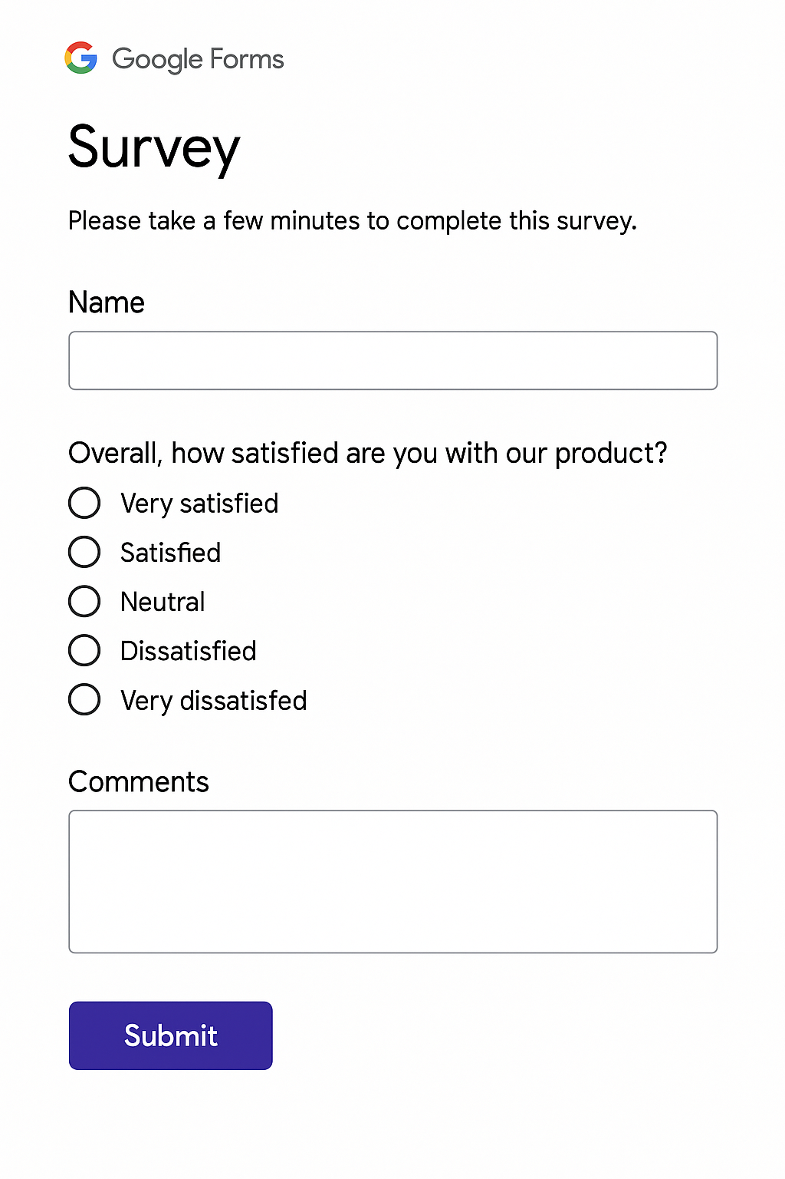
Exhibit 1 - Google Forms Survey
Get the Free Tool at https://thenewventurecoach.com/receive

Slide 3
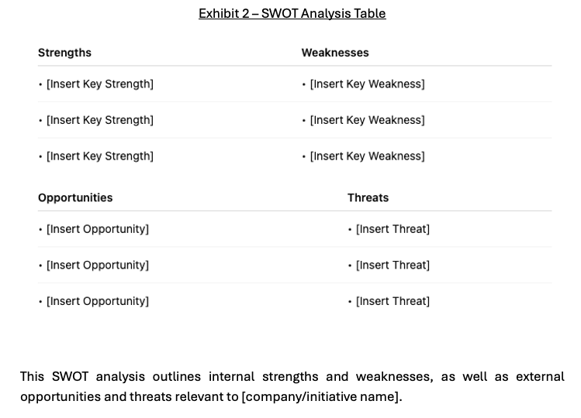
Get the Free Tool at https://thenewventurecoach.com/receive

Slide 4
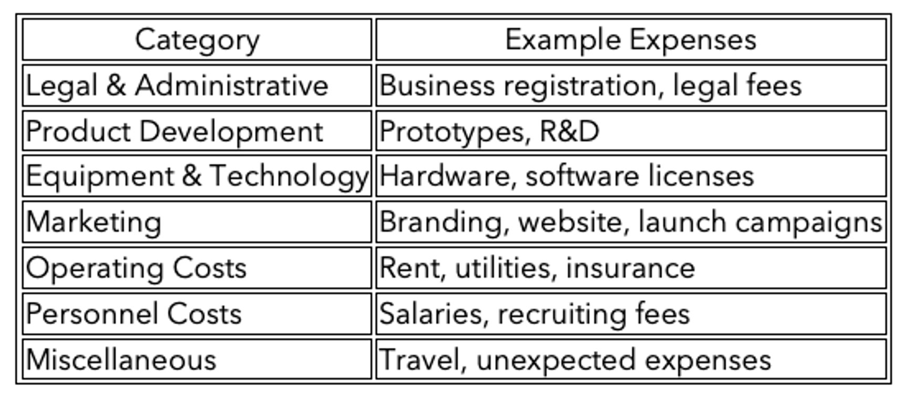
Exhibit 3 – Startup Costs Estimate
Get the Free Tool at https://thenewventurecoach.com/receive

Slide 5
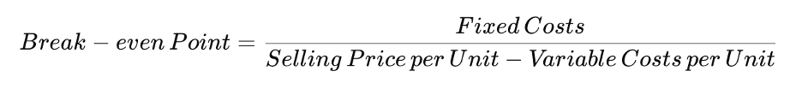
Exhibit 4 - Break-even Analysis Formula
Get the Free Tool at https://thenewventurecoach.com/receive

Slide 6
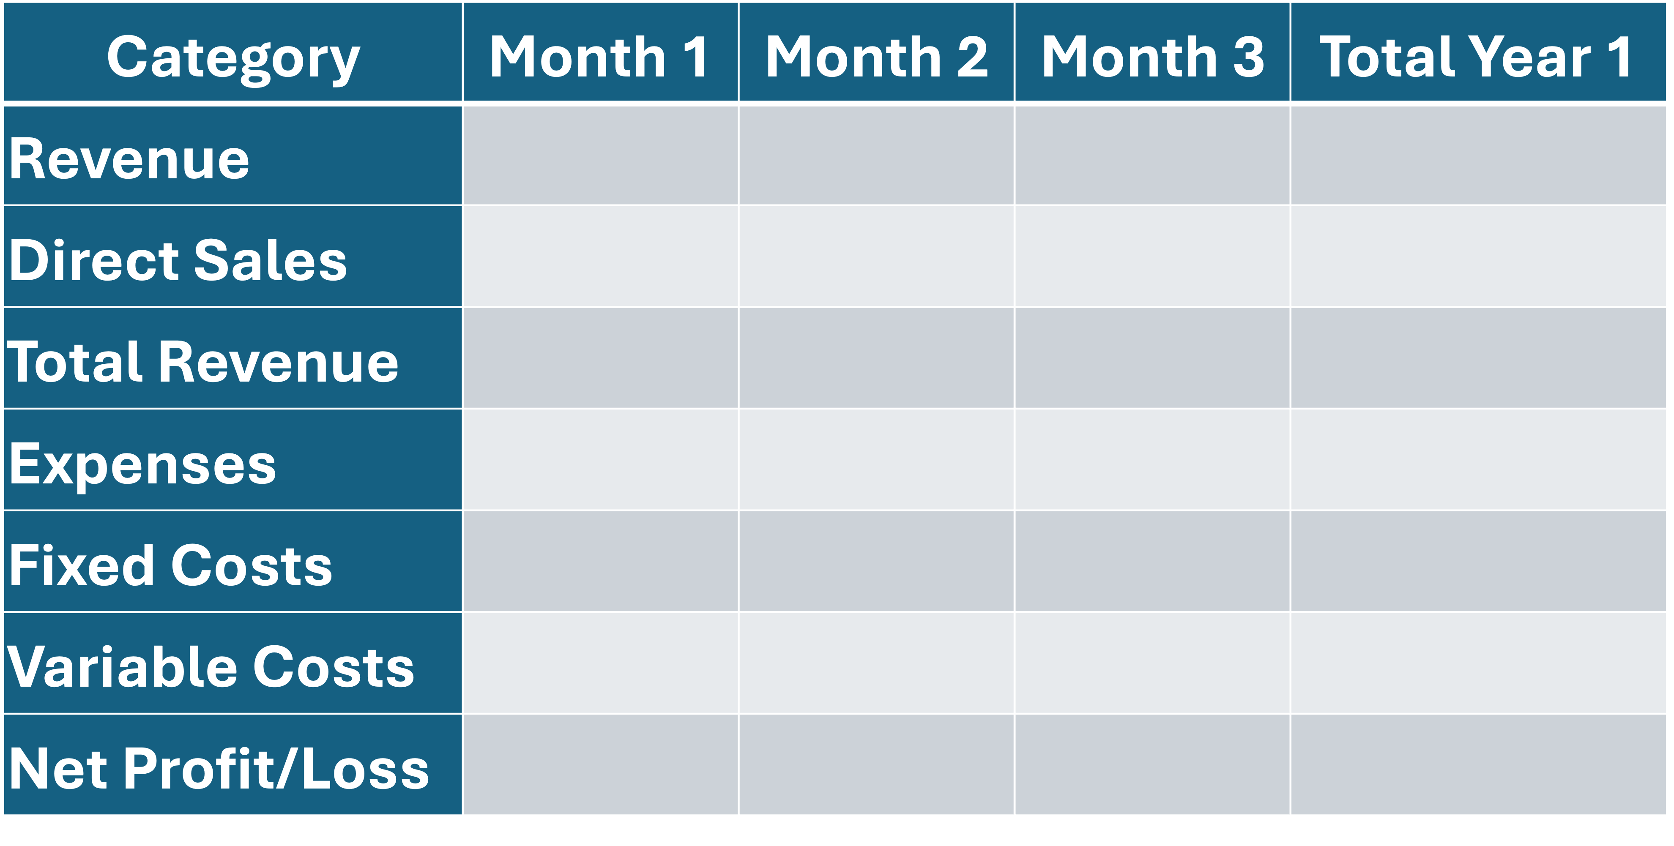
Exhibit 5 - Create a Financial Model Template
Get the Free Tool at https://thenewventurecoach.com/receive

Slide 7
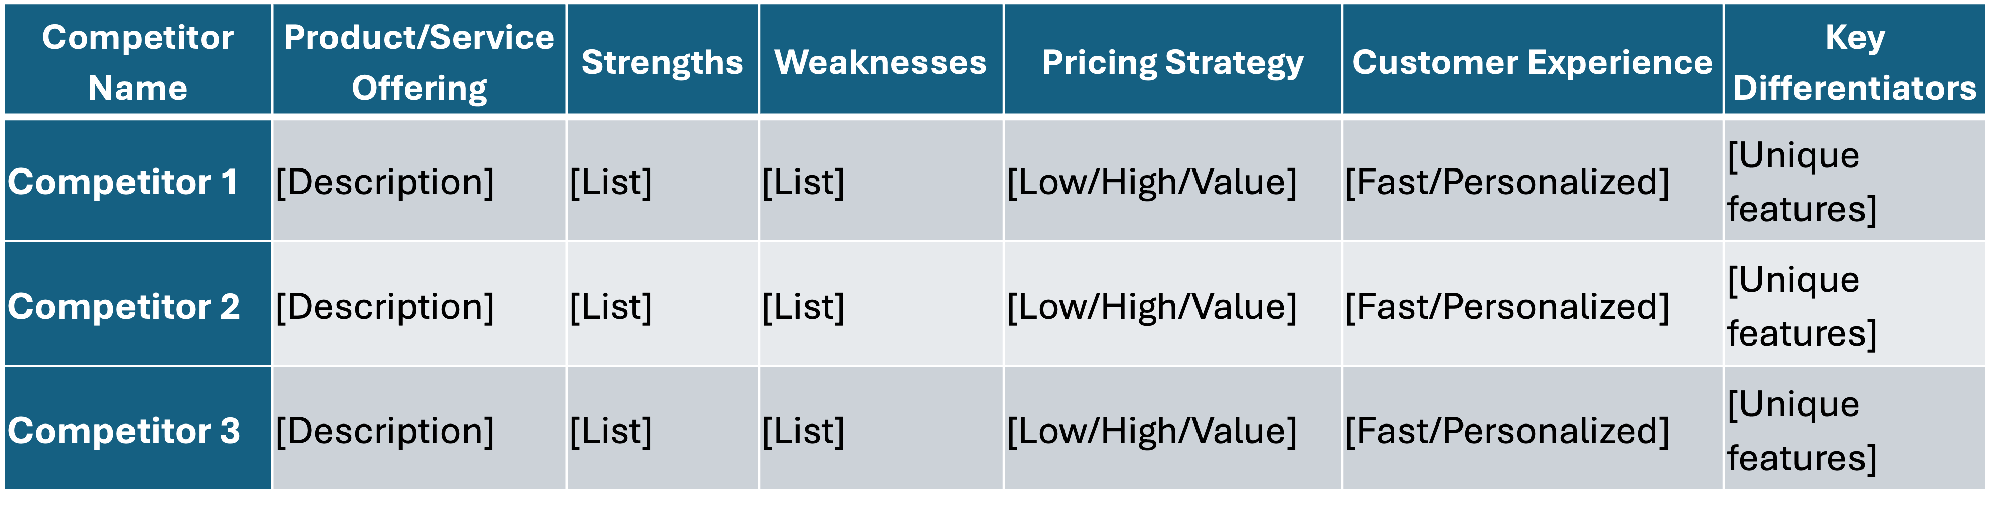
Exhibit 6 - Competitive Analysis Template
Get the Free Tool at https://thenewventurecoach.com/receive

Slide 8
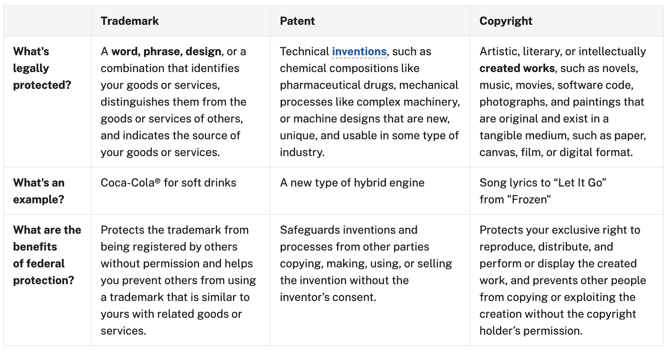
Exhibit 7 – Trademark, Patent, Copyright
Get the Free Tool at https://thenewventurecoach.com/receive

Slide 9
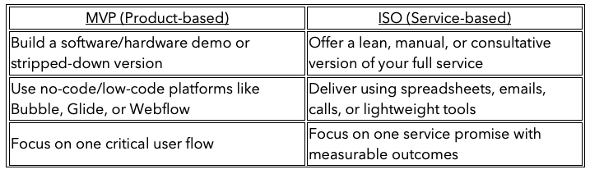
Exhibit 8 – Choose Your Format: Product vs. Service
Get the Free Tool at https://thenewventurecoach.com/receive

Slide 10
Exhibit 9 – Tools by Stage
Stage | Tools
Persona & Research | Typeform, Google Forms, Hotjar, Otter.ai
Landing Page MVP | Carrd, Webflow, Unbounce, Leadpages
No-Code Product | Bubble, Glide, Softr, Zapier
Concierge MVP (manual) | Notion, Airtable, Google Sheets, Calendly
Customer Interaction | Intercom, Loom, Slack, Zoom
Metrics & Analytics | Mixpanel, Amplitude, Google Analytics
Service Delivery (ISO) | Trello, Asana, Dubsado, Stripe, G Suite
Get the Free Tool at https://thenewventurecoach.com/receive

Slide 11
Exhibit 10 – Types of QA Testing
Test Type | Description | In-App Surveys
Unit Testing | Validates individual components or functions | JUnit, NUnit, pytest
Integration Testing | Ensures modules work together as expected | Postman, REST Assured
Functional Testing | Confirms software behaves per specifications | Selenium, TestRail
Regression Testing | Checks that new code doesn't break old functionality | Selenium, Katalon
UI/UX Testing | Verifies interface elements, layout, and usability | Cypress, BrowserStack
Performance Testing | Assesses speed, scalability, and stability under load | JMeter, LoadRunner
Security Testing | Identifies vulnerabilities and compliance gaps | OWASP ZAP, Burp Suite
User Acceptance Testing (UAT) | Final testing by end-users to approve release | Userback, Usetrace
Get the Free Tool at https://thenewventurecoach.com/receive

Slide 12
Exhibit 11 – QA Tools by Stage
Category | Recommended Tools
Test Management | TestRail, Zephyr, TestLink
Automation | Selenium, Cypress, Playwright, Puppeteer
CI/CD | GitHub Actions, GitLab CI, Jenkins
Bug Tracking | Jira, ClickUp, Linear
Collaboration | Slack, Notion, Confluence
Code Coverage | Coveralls, Codecov, SonarQube
Get the Free Tool at https://thenewventurecoach.com/receive

Slide 13
Exhibit 12 – Categories of Enablement Systems
Function | Example Systems
CRM | HubSpot, Salesforce, Pipedrive
Marketing Automation | ActiveCampaign, Mailchimp, Marketo
ERP / Accounting | QuickBooks, NetSuite, Xero
HR & Payroll | Gusto, BambooHR, Rippling, Paychex
Collaboration | Slack, Notion, Asana, Monday.com
Support & Help Desk | Zendesk, Freshdesk, Intercom
Get the Free Tool at https://thenewventurecoach.com/receive

Slide 14
Exhibit 13 – CRM: Evaluate Build vs. Buy Decision
Factor | Build Your Own | License a CRM Platform
Speed to Launch | Slower | Faster
Customization | High | Moderate to High (depends on vendor)
Upfront Cost | High (Dev resources) | Low to Medium
Maintenance | Your responsibility | Vendor handles
Integration Support | Requires dev team | Often plug-and-play
Scalability | Must be built in | Built-in with most SaaS platforms
Get the Free Tool at https://thenewventurecoach.com/receive

Slide 15
Exhibit 14 – CRM Vendor Evaluation Criteria
Evaluation Category | Questions to Ask
Functionality | Does it meet your key use cases and workflows?
User Experience | Is it intuitive and easy to use across departments?
Scalability | Will it support 2x, 10x, or 100x customer growth?
Integration | Does it work with your email, marketing tools, billing, and support tools?
Customization | Can you customize fields, workflows, and automations?
Reporting | Can you track KPIs for leads, sales, retention, and revenue?
Security & Compliance | GDPR, CCPA, HIPAA (as needed)?
Support | What support and onboarding services are available?
Total Cost of Ownership | Monthly/yearly cost, implementation cost, add-ons?
Get the Free Tool at https://thenewventurecoach.com/receive

Slide 16
Exhibit 15 – Supply Chain & Vendor Management Tools & Resources
Function | Tool | Notes
Sourcing | Alibaba, ThomasNet | Ideal for component/vendor discovery
Logistics | Flexport, Freightos, ShipBob | Global logistics, customs, and warehousing
Inventory Mgmt | NetSuite, QuickBooks Commerce | Track and reorder parts
Collaboration | Slack, Asana, Monday.com | Track vendor-related projects/tasks
Quality Control | QIMA, SGS | 3rd party inspection & compliance
Get the Free Tool at https://thenewventurecoach.com/receive

Slide 17
Exhibit 16 – Popular Accounting Software Options
Software | Best For | Key Features
QuickBooks Online | Small to mid-sized businesses | Invoicing, bank sync, payroll, tax reporting
Xero | International or multi-currency users | Mobile friendly, project tracking
Wave | Freelancers / very small businesses | Free core features
FreshBooks | Service-based businesses | Time tracking, client invoicing
Zoho Books | Integrated Zoho suite users | Automation, workflows, client portal
Get the Free Tool at https://thenewventurecoach.com/receive

Slide 18
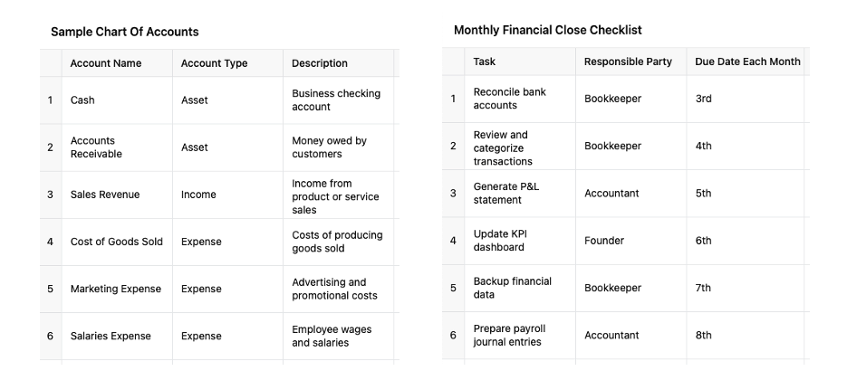
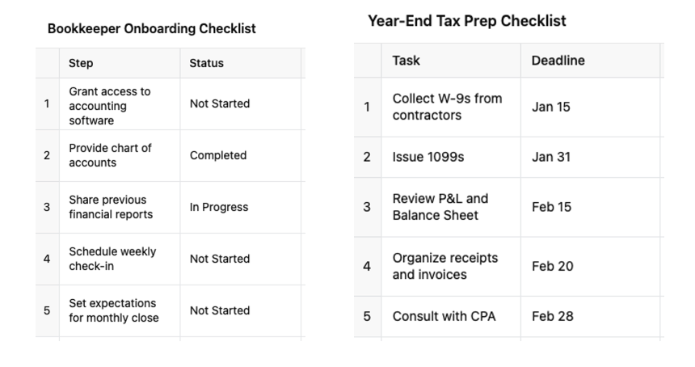
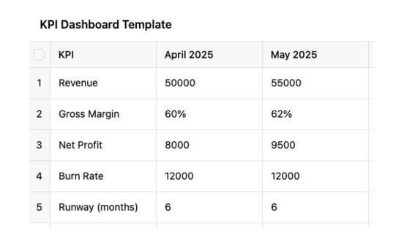
Exhibit 17 – Accounting Bonus Tools & Resources
Get the Free Tool at https://thenewventurecoach.com/receive

Slide 19
Exhibit 18 – Key Financial Concepts
Concept | Definition
Revenue Forecast | Projected income from sales based on pricing and volume assumptions.
Cost of Goods Sold (COGS) | Direct costs to produce goods (only for product-based companies).
Operating Expenses (OPEX) | Costs to run your business (rent, salaries, marketing, etc.).
Gross Margin | Revenue – COGS.
Net Income | Revenue – COGS – OPEX – Taxes.
Burn Rate | The rate at which cash is used per month.
Runway | The number of months you can operate before running out of cash.
Get the Free Tool at https://thenewventurecoach.com/receive

Slide 20
Exhibit 19 – How to Build Budget & Cash Flow Scenarios
Variable | Best-Case | Base-Case | Worst-Case
Revenue Growth | Fast growth; new customer wins; high conversion rates | Realistic, steady growth | Delayed revenue; low customer traction
Customer Acquisition Cost (CAC) | Lower due to high referral or organic traffic | Industry benchmark or internal historical avg | Higher due to underperforming marketing
Sales Cycle | Shorter than expected (fast deal closure) | Average expected time | Longer than expected; delayed decision-makers
Pricing Power | Premium pricing or upsells work well | Standard pricing | Discounts needed to close deals
Churn Rate (for services/SaaS) | Very low (strong retention) | Normal churn | High churn or contract terminations
Hiring Plan | Hire ahead of demand | Hire to match growth | Delay hiring; freeze new roles
Operating Expenses | Stable or lower than forecasted | As forecasted | Unexpected cost increases (tools, legal, logistics)
Access to Capital | Easily raise new funds or line of credit | Moderate access, takes time | No additional funding available
Get the Free Tool at https://thenewventurecoach.com/receive

Slide 21
Exhibit 20 – Manage & Improve Cash Flow
Tactic | Description
Negotiate vendor terms | Ask for Net 30/60 terms with suppliers.
Invoice faster | Send invoices promptly and automate reminders.
Offer early payment incentives | Discount for early payment (e.g. 2/10 Net 30).
Delay non-critical expenses | Phase out unnecessary tools, delay capex.
Maintain buffer reserves | Aim for 3–6 months of OPEX in cash.
Get the Free Tool at https://thenewventurecoach.com/receive

Slide 22
Exhibit 21 – Example Output Table (12-Month Snapshot)
Metric | Best-Case | Base-Case | Worst-Case
Revenue | $1.2M | $800K | $400K
Gross Margin | 60% | 55% | 50%
Net Profit | $200K | $50K | -$150K
Cash Burn | -$5K/mo | -$15K/mo | -$40K/mo
Runway | 24 months | 12 months | 4 months
Get the Free Tool at https://thenewventurecoach.com/receive

Slide 23
Exhibit 22 – Launch Timeline with Milestones
Phase | Milestone | Target Date
Prep | Final QA Testing Complete
Soft Launch | Beta or Pilot Program Live
Launch | Public Launch (Website/PR/Sales)
Post-Launch | 30-Day Review & Adjustments
Get the Free Tool at https://thenewventurecoach.com/receive

Slide 24
Exhibit 23 – Launch Week Calendar
Day | Activity
Mon | Soft Launch to Beta List
Tue | Final Tech Check & QA
Wed | Team Training & Go-Live Rehearsal
Thu | Launch Day – Marketing & Sales Go Live
Fri | Debrief & Early Metrics Review
Sat | Customer Feedback Analysis
Sun | Rest & Reflect (with emergency monitoring)
Get the Free Tool at https://thenewventurecoach.com/receive

Slide 25
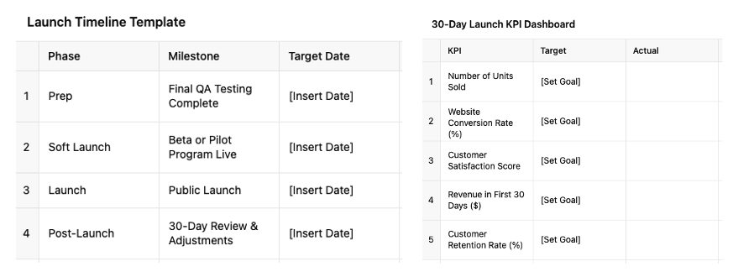
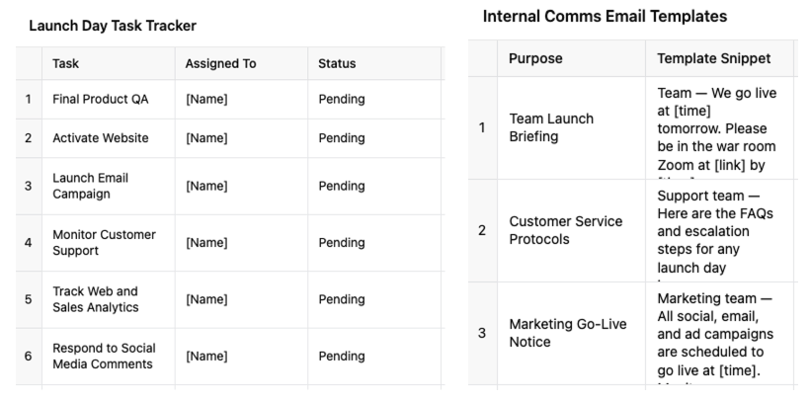
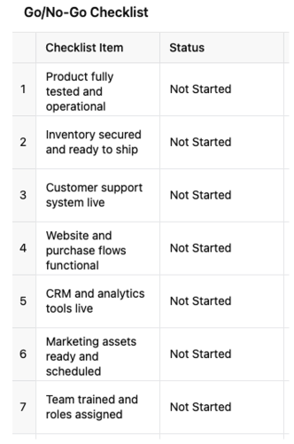
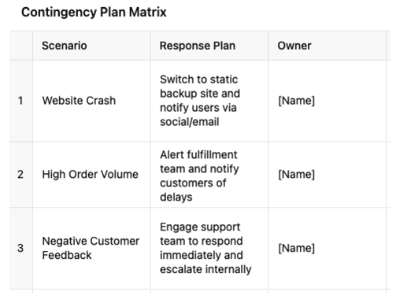
Exhibit 24 – Launch Plan Bonus Tools
Get the Free Tool at https://thenewventurecoach.com/receive

Slide 26
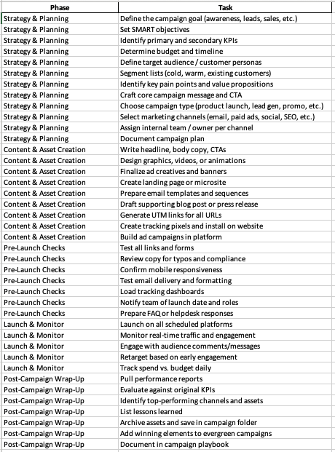
Exhibit 25 – Marketing Campaign Checklist
Get the Free Tool at https://thenewventurecoach.com/receive

Slide 27
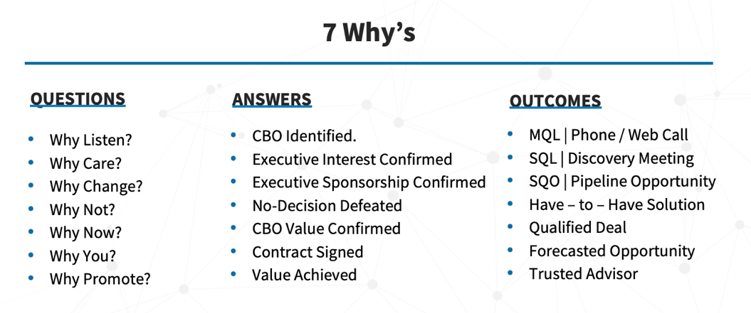
Exhibit 26 – The “7 Why’s”
Get the Free Tool at https://thenewventurecoach.com/receive

Slide 28
Exhibit 27 – Top 10 List of Business & Life Results
# | Result | Positive Outcome | Negative Outcome
1 | Success | Fulfillment, recognition, impact | Burnout, ego, isolation
2 | Growth | Learning, resilience, expansion | Overwhelm, instability, growing pains
3 | Wealth | Freedom, security, generosity | Greed, entitlement, disconnection
4 | Influence | Leadership, inspiration, impact | Manipulation, pressure, arrogance
5 | Power | Authority, effectiveness, protection | Corruption, control, fear
6 | Fame | Reach, opportunity, voice | Scrutiny, loss of privacy, vanity
7 | Freedom | Autonomy, peace, choice | Isolation, lack of structure, chaos
8 | Productivity | Efficiency, accomplishment, momentum | Exhaustion, pressure, imbalance
9 | Love | Connection, joy, meaning | Codependence, heartbreak, distraction
10 | Legacy | Purpose, contribution, remembrance | Pressure, regret, missed presence
Get the Free Tool at https://thenewventurecoach.com/receive

Slide 29
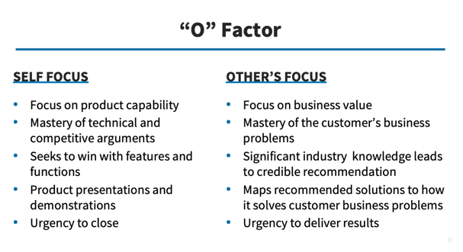
Exhibit 28 – The “O” Factor
Get the Free Tool at https://thenewventurecoach.com/receive

Slide 30
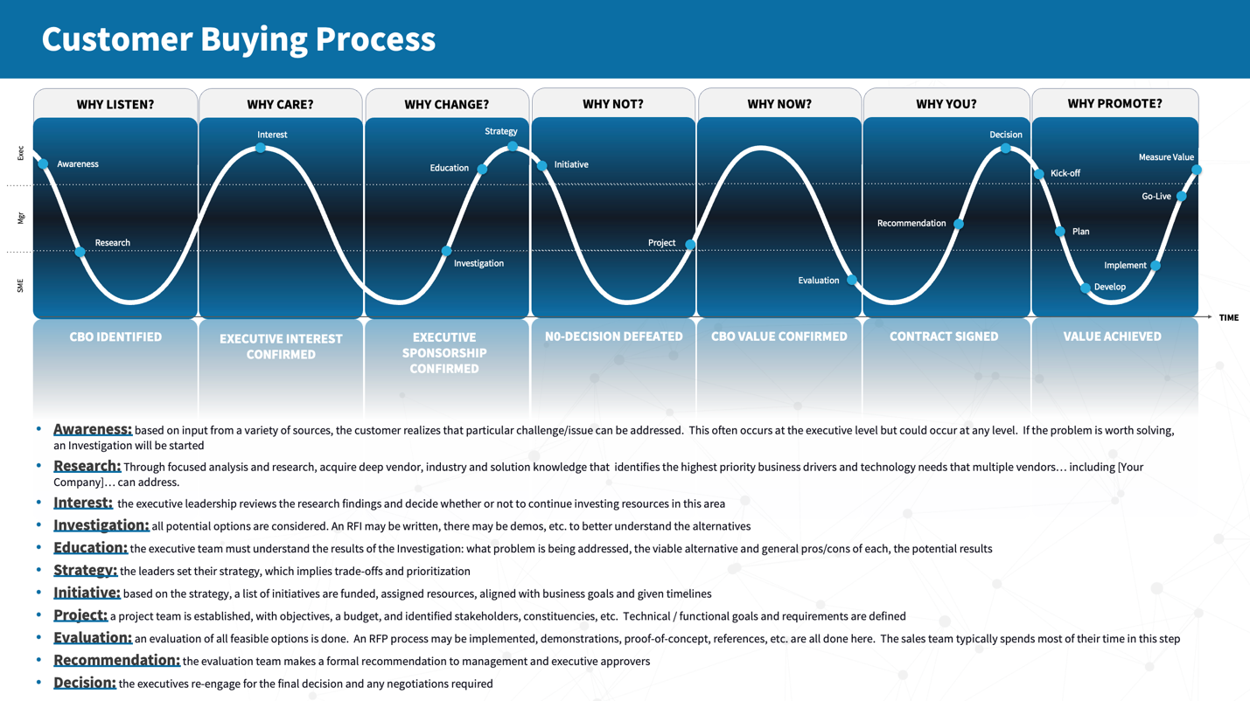
Exhibit 29 – Customer Buying Process (CBP)
Get the Free Tool at https://thenewventurecoach.com/receive

Slide 31
Exhibit 30 – Insight-Led Talking Points by Role Example
Buyer Role | Strategic Goal | Key Insight | Problem Framing | Value Story
CIO | Reduce TCO | 73% of IT budgets are spent on maintenance | Legacy systems are draining innovation | “A global peer used our platform to cut costs 40% and reallocate to R&D”
Get the Free Tool at https://thenewventurecoach.com/receive

Slide 32
Exhibit 31 – Message Delivery Channels & Use Cases
Channel | Usage | Messaging Focus
Website | Core BrandScript | Hero as customer, CTA-driven
Sales Deck | Role-based modules | Insight + success stories
Email Campaigns | Nurture & CTA | Problem-solution-outcome
Social Selling | Micro-insights | Thought leadership (TRUST: T)
Demos & Calls | Tailored role insights | Challenges + measurable impact
Enablement Tools | Internal training | Consistency across team
Get the Free Tool at https://thenewventurecoach.com/receive

Slide 33
Exhibit 32 – Sales Process Stage Tied to the Customer Buying Process
Sales Process Stage | Objective | Sales Activities | Tools/Artifacts
1. Plan Business | Prioritize territory | Territory Plan, Funnel Review | SF.com, Funnel Tracker
2. Prospect/Cultivate | Generate interest | Research, call planning, executive outreach | Value Props, Industry Playbooks
3. Qualify/Gain Sponsorship | Confirm pain and engage execs | Executive Whiteboards, Budget Check | Whiteboard Toolkit
4. Propose/Confirm | Recommend solutions | Proposal, ROI, solution mapping | Business Continuity Report
5. Commit | Close the deal | Negotiation strategy, close plan | Contract Templates
6. Service & Expand | Ensure value and upsell | Kickoff call, value review, upsell plan | Success Stories, Referral Scripts
Get the Free Tool at https://thenewventurecoach.com/receive

Slide 34
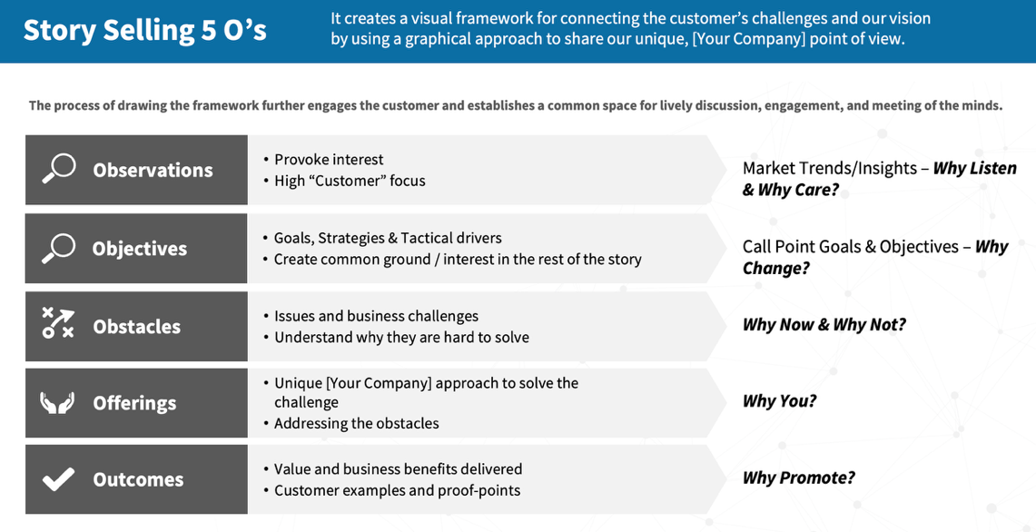
Exhibit 33 – StorySelling 5 O’s Framework - Explained
Get the Free Tool at https://thenewventurecoach.com/receive

Slide 35
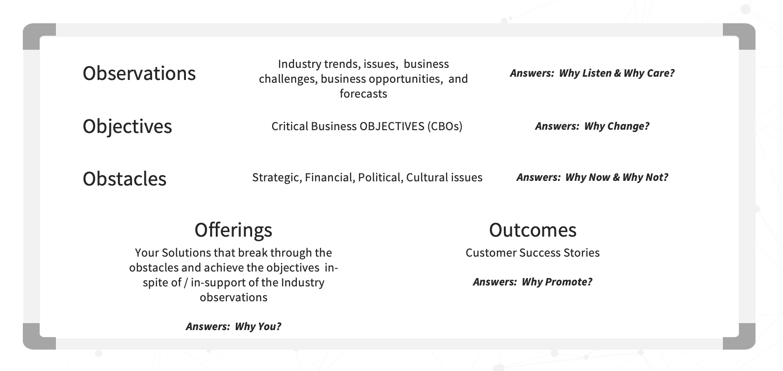
Exhibit 34 –
Get the Free Tool at https://thenewventurecoach.com/receive

Slide 36
Exhibit 35 – Sales Leadership – Coaching Cadence
Type | Frequency | Focus | Duration
Opportunity Review | Weekly | Top 5 deals | 45–60 mins
Activity Review | Weekly | Funnel build, account focus | 60 mins
Forecast Review | Monthly | Close accuracy, funnel health | 90 mins
Territory Review | Quarterly | Strategy alignment | 90 mins
Get the Free Tool at https://thenewventurecoach.com/receive

Slide 37
Exhibit 36 – Tax, Security, Legal Recuring Checklist & Timeline
Frequency | Task | Owner | Tool/Platform
Monthly | Reconcile books, check tax obligations | Founder/CPA | Bench, QuickBooks
Quarterly | Estimated taxes, board review, security audit | CPA/CTO/Legal | IRS, Drata, internal review
Bi-Annually | Update privacy policy and website terms | Legal/Marketing | LegalZoom, Ironclad
Annually | File taxes, annual reports, renew trademarks | CPA/Legal | IRS, State portals, USPTO
As Needed | Update contracts, add vendors, employee docs | HR/Legal | Gusto, Justworks, Dropbox
Get the Free Tool at https://thenewventurecoach.com/receive

Slide 38
Exhibit 37 – Industry Regulations Monitoring Tools
Tool | Description | Industry Coverage
LexisNexis Regulatory Compliance | Customizable rulebooks, alerts, risk assessment tools | Financial services, healthcare, energy, etc.
Thomson Reuters Regulatory Intelligence | Global regulatory tracking, horizon scanning, compliance tools | Banking, insurance, legal, more
CB Insights or PitchBook | Tracks regulatory trends alongside market and tech shifts | Tech, fintech, healthcare
VComply | Cloud-based compliance tracking and task management | SMBs across industries
GovTrack.us (U.S.) | Tracks federal legislation and regulation | Public policy impact
OpenRegulations.org | Public access to proposed rules and regulatory changes | U.S. and some international
Get the Free Tool at https://thenewventurecoach.com/receive

Slide 39
Exhibit 38 – General Associations – Focus & Value
Association | Focus | Value
[Relevant Trade Association] | Your venture’s primary industry | Access to policy updates, whitepapers
Chamber of Commerce | General business and legal affairs | Advocacy & local compliance updates
NFIB (National Federation of Independent Business) | Small business policy and compliance | Alerts, webinars
Get the Free Tool at https://thenewventurecoach.com/receive

Slide 40
Exhibit 39 – Industry Specific Associations
Industry | Association
Healthcare | American Health Law Association (AHLA), HIMSS, UCAOA
Finance | FINRA, American Bankers Association (ABA)
Retail | National Retail Federation (NRF)
Energy | American Petroleum Institute (API), Edison Electric Institute
Manufacturing | National Association of Manufacturers (NAM)
Education | EDUCAUSE, Association of American Educators (AAE)
Get the Free Tool at https://thenewventurecoach.com/receive

Slide 41
Exhibit 40 – Stay Updated on Industry Regulations – Summary Checklist
Action | Owner | Frequency
Subscribe to alerts & newsletters | Compliance Lead | Weekly
Join trade associations | Ops Lead | Quarterly Review
Create a compliance calendar | Admin or Legal | Monthly
Meet with regulatory advisors | CEO/COO | Bi-annually
Update team with digest | Compliance Lead | Monthly
Review customer industry changes | Product & Sales | Quarterly
Get the Free Tool at https://thenewventurecoach.com/receive

Slide 42
Exhibit 41 – Business Performance Reviews
Review Type | Frequency | Primary Focus
Daily Stand-ups | Daily (15 min) | Individual task progress, blockers, daily priorities
Weekly Reviews | Weekly (30-60 min) | Department-level metrics, tactical execution, progress on short-term goals
Monthly Reviews | Monthly (60–90 min) | Strategic KPIs, cross-functional performance, issues, and opportunities
Quarterly Reviews (QBR) | Quarterly (2–4 hrs) | Deep dive into OKRs, financials, customer success, market changes
Annual Strategic Review | Annually (Half-day to full-day) | Long-term vision, performance vs. plan, organizational priorities, budget planning
Get the Free Tool at https://thenewventurecoach.com/receive

Slide 43
Exhibit 42 – Sample Review Schedule
Timeframe | Review | Owner | Notes
Every Day | Team Stand-Up | Team Lead | 15 min. Sync on tasks
Monday AM | Weekly Kickoff Review | Dept. Heads | Review weekly metrics + priorities
1st Friday | Monthly Performance Review | CEO | All-hands metrics & performance
Start of Qtr. | Quarterly Business Review | CEO + Execs | Full strategic review + planning
Year-End | Annual Strategic Review | CEO + Board | Plan goals, budget, and hiring
Get the Free Tool at https://thenewventurecoach.com/receive

Slide 44
Exhibit 43 – Phases of Expansion – Tiered Strategy
Phase | Focus | Sample Milestones
Startup | Product/Market Fit | MVP validated, 100+ paying customers
Scale-Up | Process & Team Building | $1M ARR, scalable delivery model, repeatable sales
Expansion | Geographic, Vertical, Product Lines | International launch, new segments, product extensions
Maturity | Optimization & M&A | Efficiency, margin growth, acquisitions, exit prep
Get the Free Tool at https://thenewventurecoach.com/receive

Slide 45
Exhibit 44 – Types of Exit Strategies
Exit Type | Description | Ideal For
Acquisition (M&A) | Selling the company to a larger firm (strategic or financial buyer) | Startups with strategic IP, customer base, or talent
Initial Public Offering (IPO) | Selling shares to the public via stock exchange listing | Scalable companies with strong growth, profitability, and compliance
Private Equity Recap | Selling a portion to PE firm while retaining some ownership | Founders who want liquidity but continued involvement
Management Buyout (MBO) | Sale to current management team | Businesses with strong internal leadership and cash flow
Employee Stock Ownership Plan (ESOP) | Transfer ownership to employees over time | Values-driven companies or stable mature businesses
Acqui-hire | Selling mainly for talent rather than IP or product | Small teams in hot tech sectors
Liquidation | Shutting down and selling off assets | Non-viable ventures or end-of-life cycle
Get the Free Tool at https://thenewventurecoach.com/receive

Slide 46
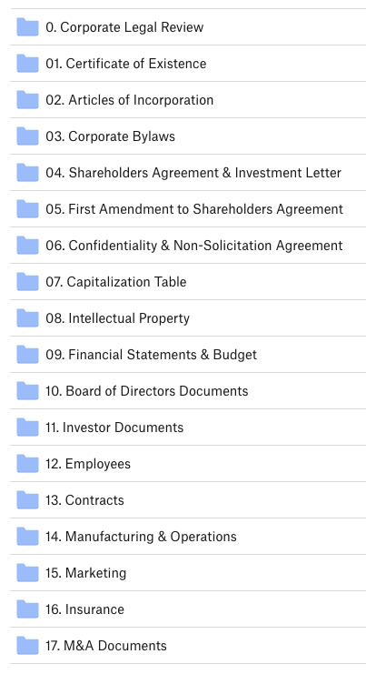
Exhibit 45 – C PORT Solutions Data Room that led to 2011 Newell Rubbermaid Acquisition
Get the Free Tool at https://thenewventurecoach.com/receive

Slide 47
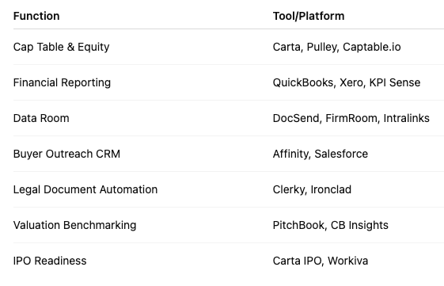
Exhibit 46 – Exit Strategy Tech Stack Overview
Get the Free Tool at https://thenewventurecoach.com/receive

