Slide 1
Canvas LMS Library Research Course
Ben Bell, MLIS
For University of West Florida Libraries
2021-2022

Slide 2
Because UWF Libraries does not offer credit bearing courses that ensure basic research skills, I digitally transformed the library through engaging, interactive and experiential learning for young adults. In a Google world and social media, my approach is based on Why Libraries for research.

Slide 3
Ben, Thank you for looping me into the course. I love your energy and enthusiasm, and the course itself is much more robust than I expected. You've been busy! It looks really thorough. I especially like the bits of information I've never thought to cover, such as Why Libraries and the information about algorithms.
From a UWF Professor

Slide 4
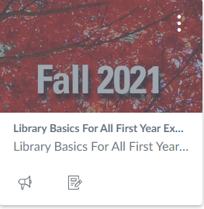
Intro Icon to Access eLearning Course Customizable

Slide 5
Course Homepage Canvas Learning Management System

Slide 6
Following the arrow, Modules takes us to course contents. The first module is a detailed how-to. Observe the organizational lay out.
The module above, The Library Basics, is the primary instructional goal.

Slide 7
As the Library is not in the official curriculum, we provide digital badge incentives for each completed module.
Badges are the students’ currency to provide evidence to anyone who requires the skills.

Slide 8
The Basic Library Services Tutorial
Includes brief Subject Matter Expert narrative, video, learning outcomes, and a quiz to earn a badge of completion.

Slide 9
Basic Library Services Module Quiz Six auto-graded questions drawing from experience and lesson

Slide 10
Other Library Modules: Academic Integrity (So Much More Than Not Plagiarizing) Algorithm Literacy Library Science Certification (Spring curriculum)
Badges awarded for each module completed. Last year’s pilot program exponentially increased Library Learning participation and outcomes.
I collaborated with our Online Learning Coordinator for this course. I am primarily responsible for designing the instruction and teaching but am well-versed in the technology, too.

