Slide 1
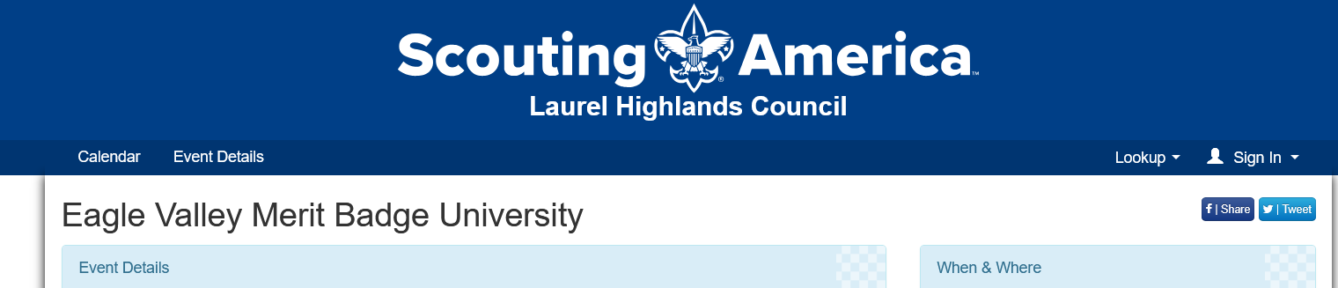
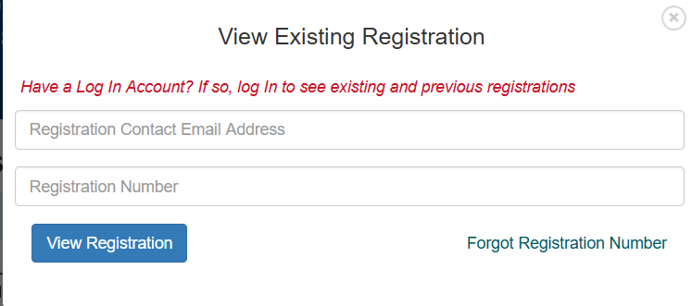
Go to the registration page: MBU 2026 Click on Lookup on the top right and fill in the information.
Fill in the required information. This will allow you to edit your existing registration

