Slide 1
120 to Landfall: 2.0 Tabletop Exercise | April 29, 2021
BACKGROUND
REGISTRATION
The goal of the exercise is to address any identified gaps, incorporate the continuing care community, and continue to improve healthcare response capabilities across both regions. The exercise will help further validate the North Carolina Coastal Region Evacuation and Sheltering Standard Operating Guide as well as organizational plans and procedures.
Please register at https://www.surveymonkey.com/r/VPPXVJF for the exercise.
EXERCISE SPONSORS & DIRECTORS
OBJECTIVES
Eastern Healthcare Preparedness Coalition
Stephanie Seals | 252-814-8294 Stephanie.Seals@vidanthealth.com
Chris Starbuck | 252-847-6634 CStarbuc@vidanthealth.com
Southeastern Healthcare Preparedness Region
Hans Edwards | 910‐508‐4865 Hans.Edwards@nhrmc.org
Heather Griffin | 910-398-5022 Heather.Griffin@nhrmc.org
Identify the established lines of communication and facility points of contact used by healthcare stakeholders for emergency notifications and information sharing.
Identify the information sharing process for ancillary healthcare providers (e.g., dialysis, home healthcare, assisted living, etc.), emergency management agencies, and regional emergency coordination points, prior to and during an emergency incident.
Describe the decision-making triggers used by healthcare stakeholders for executing the safe evacuation or shelter-in-place of healthcare facilities during an emergency incident.
Describe the resource needs for executing a full facility evacuation during an emergency incident.
Identify the prioritization process for emergency evacuation of patients when transportation resources are limited.
SCHEDULE
9:00 am Registration/Virtual Log-In
9:30 am Welcome and Opening Remarks
9:45 am Module 1: 72 hours pre-landfall
10:45 am Group Reports
11:15 am Module 2: 24–12 hours pre-landfall
12:15 am Group Reports
12:45 pm Hot Wash
1:00 pm Closing Comments and Dismissal
Coastal Region Evacuation & Sheltering Guide Operational Phases (Phases 3 and 4)
PHASE 3: Decision | 96–72 hours | PHASE 4: Implementation | 72–12 hours
Activity Overview | Activity Overview
May Pre-Position Resources Regional Evacuation Decision Making Recon Evacuation Routes Prepare Evacuation Timeline Disseminate Pre-Event Public Information Coordinate Shelter Openings | Enhanced Coordination Evacuation Monitoring Respond as Required to Observed Delays Assess Need to Terminate Monitor Shelter Populations and Transportation Assist Shelter Logs

Slide 2
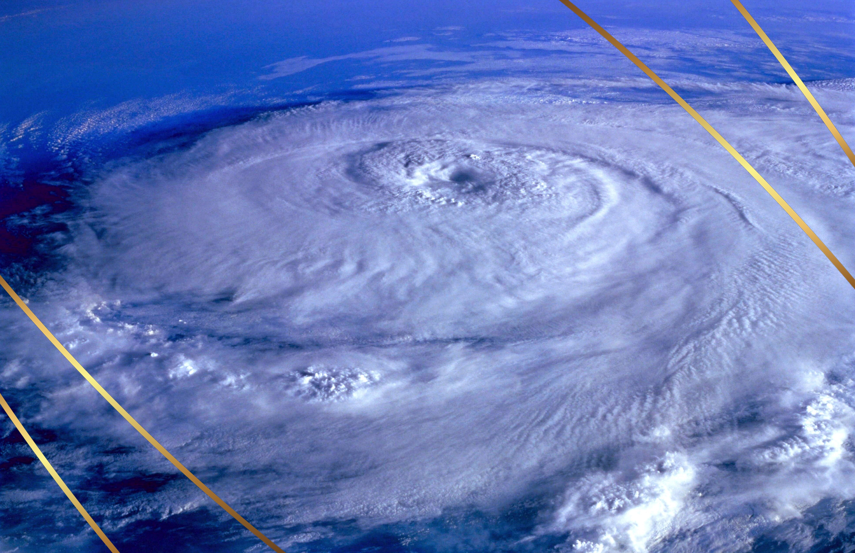
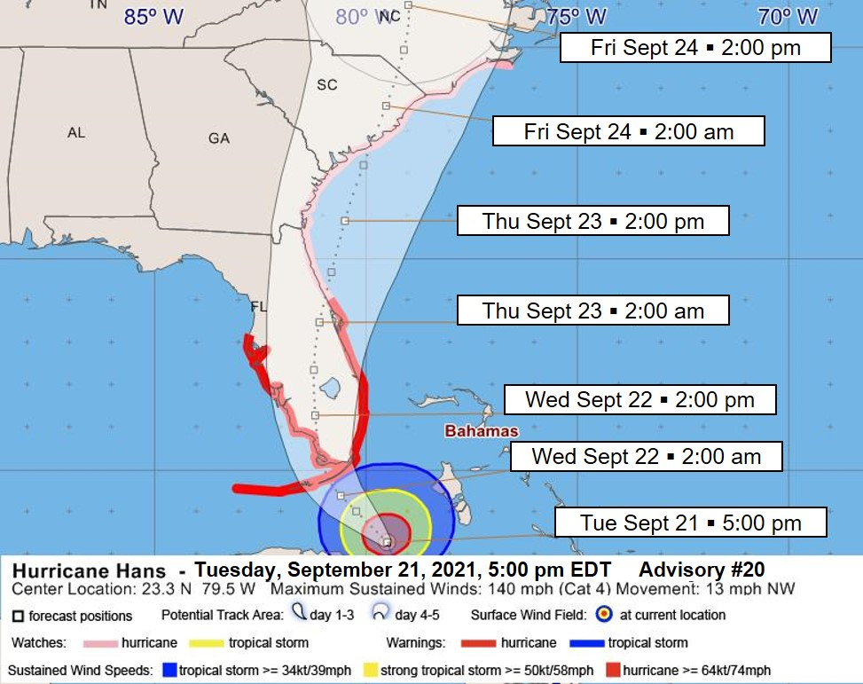
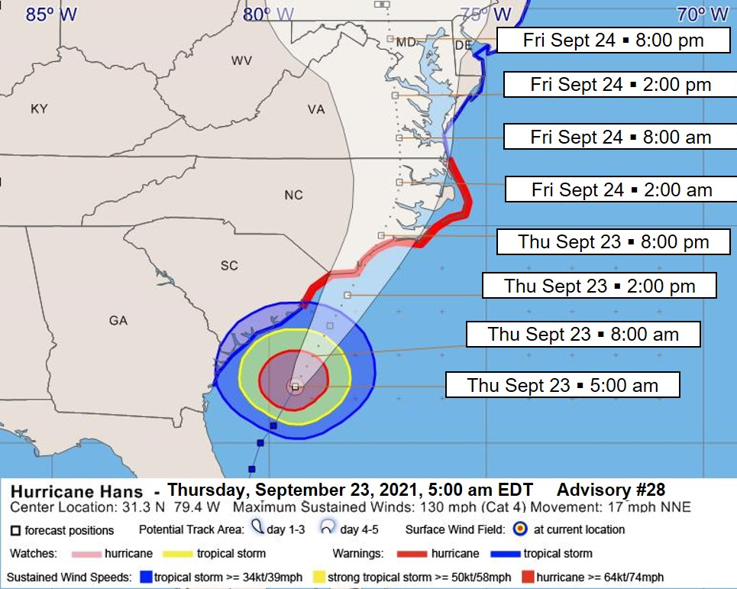
MODULE 2: 24 hours pre-landfall
September 22, 5:00 pm (24 hours to landfall)
Weather Advisory #24 indicates Hurricane Hans has weakened to a category 3 but is still moving in northeasterly direction along the Atlantic Coast. A hurricane warning has been extended to Cape Fear, North Carolina and a tropical storm warning has been issued from Cape Fear to Currituck Beach, North Carolina. Many hospitals and healthcare facilities in North Carolina have made progress in evacuating staff and patients to inland counties. North Carolina county and state emergency operations centers are trying to coordinate resources for the increased requests for medical transportation assets to move patients out of the coastal communities. Increased traffic congestion is seen along many highways as evacuees begin to try and make their way inland. Several motorists have run out of gas and blocking travel lanes. This causes a slowed response for incoming medical transportation as they try and make their way to coastal healthcare facilities to aid with evacuation. Hundreds of medically homebound residents with no means of transportation are in need of assistance evacuating the area, many requiring travel by ambulance. Similar issues are also occurring in the dialysis community with concern of how patients will be treated if they cannot evacuate and have no access to dialysis care.
September 23, 5:00 am (12 hours to landfall)
Weather Advisory #28 indicated Hurricane Hans has been upgraded to a category 4. The hurricane center is located 225 miles south-southwest of Wilmington, North Carolina and 105 miles south-southeast of Charleston, South Carolina. A hurricane warning remains in effect from the South Santee River extending northward to Currituck Beach Light, North Carolina including the Pamlico and Albemarle sounds. Heavy rain developing ahead of the storm is causing flooding in low lying areas in several of the coastal counties to include Brunswick, Columbus, New Hanover, Pender, and Onslow. Secondary evacuation routes as well as sections of State and US routes in those counties begin to see roadway flooding. Outer bands of wind have toppled trees, utility poles, and unsecured building materials. This causes telephone loss and intermittent power outages and blocked roads in Carteret, Jones, Craven, Pamlico, and Duplin counties. State law enforcement officials are receiving reports of a large, multi-vehicle traffic accident on US 264 that has all lanes of traffic shut down between Washington and Greenville. There is also unconfirmed tornado activity in central North Carolina along the North Carolina/South Carolina border. An increase in storm surge causes flooding along the Cashie, Neuse, and Cape Fear rivers. Smaller waterways are also beginning to overflow threatening facilities in these areas. The center of Hurricane Hans is expected to make landfall just south of North Topsail Beach, North Carolina later today. Hurricane-force winds, storm surge flooding, flash flooding, and isolated tornadoes are possible over eastern North Carolina tonight and tomorrow.
Resource Coordination and Patient Movement Discussion Issues:
Patient movement resources on hand
Coordinating for resource needs
Resource prioritization
Patient movement prioritization
MODULE 1: 72 Hours pre-landfall
September 20, 5:00 pm (72 hours to landfall)
Weather Advisory #16 indicates category 4 Hurricane Hans moving over eastern Cuba. A hurricane watch has been issued for portions of Florida. Most counties in North Carolina have issued evacuation orders and are requesting all those with the ability to move inland to do so. There is a concern at the state-level about the vulnerability of patients at long term and skilled care facilities in the high-risk counties and ESF-8 at the State Emergency Operations Center is tasked with assessing in needs these facilities may have.
September 21, 5:00 pm (48 hours to landfall)
Weather Advisory #20 indicates Hurricane Hans continues to push toward southern Florida. A hurricane watch is now issued for the east coast from New Smyrna Beach, Florida to Cape Lookout, North Carolina. There is a possibility of coastal flooding and storm surge due to heavy rain. North Carolina authorities are monitoring evacuation routes and travel seems to be progressing smoothly but not as many people are heeding the order at this time. Shelters are now open around the state and actively accepting evacuees that have nowhere to go.
Evacuation/Shelter-in-Place Discussion Issues:
Decision-making triggers
Authorities
Plans/procedures

