Slide 1

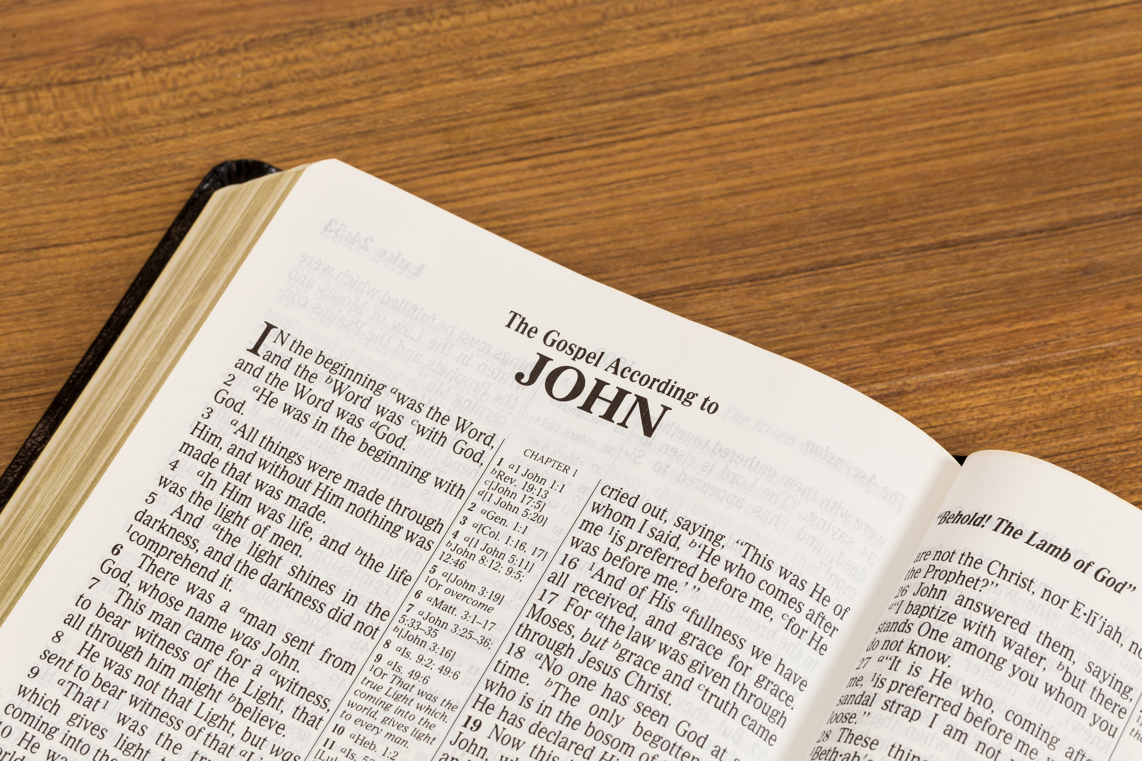

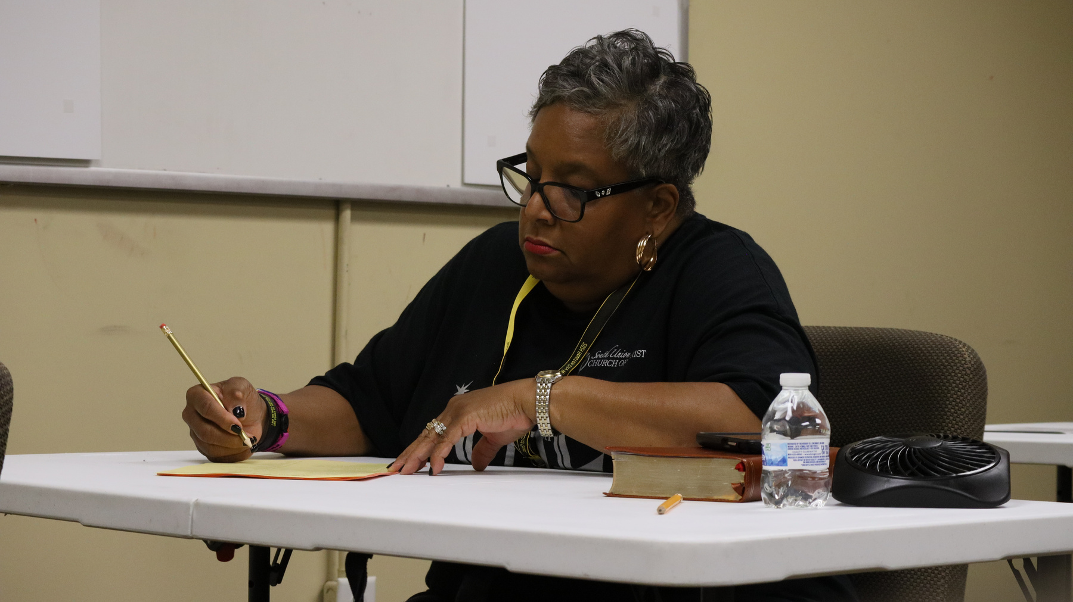
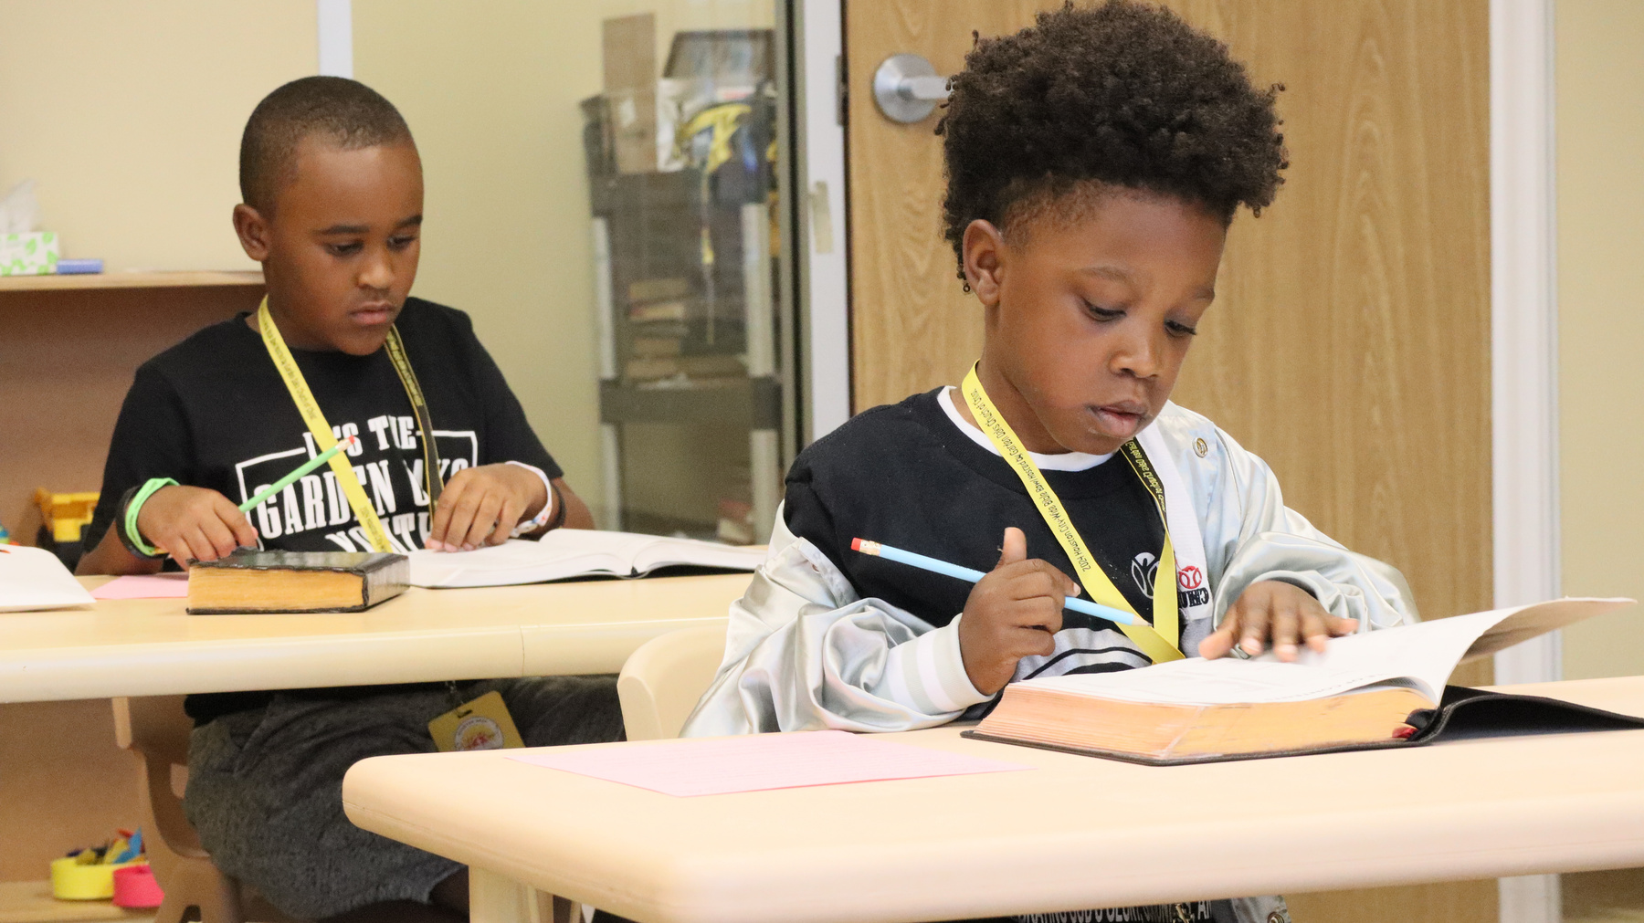
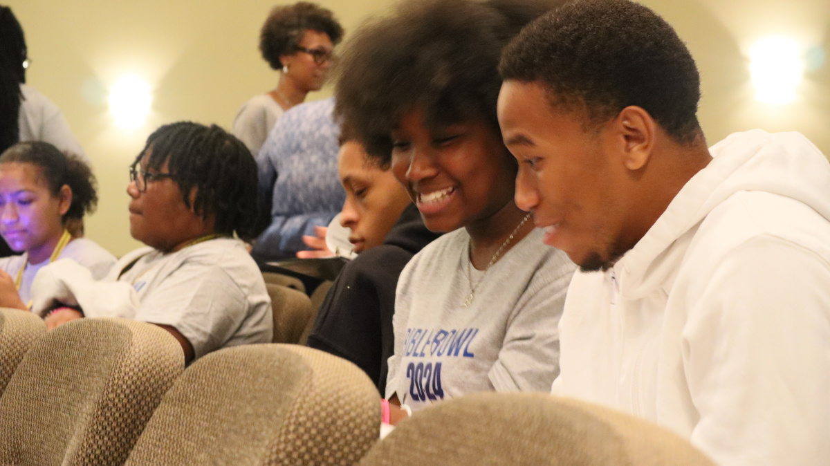
4TH ANNUAL
HOUSTON AREA CITYWIDE BIBLE BOWL
2025
BIBLE
BOWL
NOVEMBER 8, 2025
HOST CONGREGATION:
MISSOURI CITY CHURCH OF CHRIST
SAVE THE DATE AND GET READY TO GET YOUR STUDY ON FOR OUR 2025 CITYWIDE BIBLE BOWL. COMPETITION IS OPEN TO ALL YOUTH GRADES 1ST TO HS SENIORS AND ADULTS!!!
  STUDY OF GOSPEL OF JOHN
  INDIVIDUAL COMPETITION
  TEAM COMPETITION
  $500 SCHOLARSHIP TO TOP SCORER IN HS GRADE
houstonareacitywidebiblebowl.com

