Slide 1


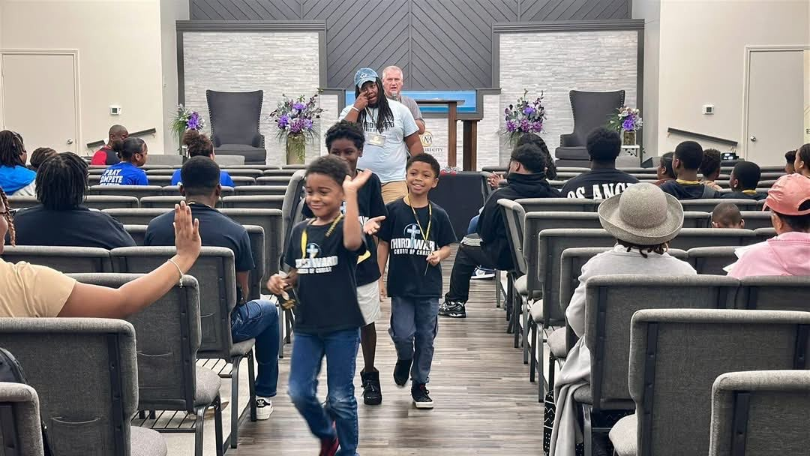
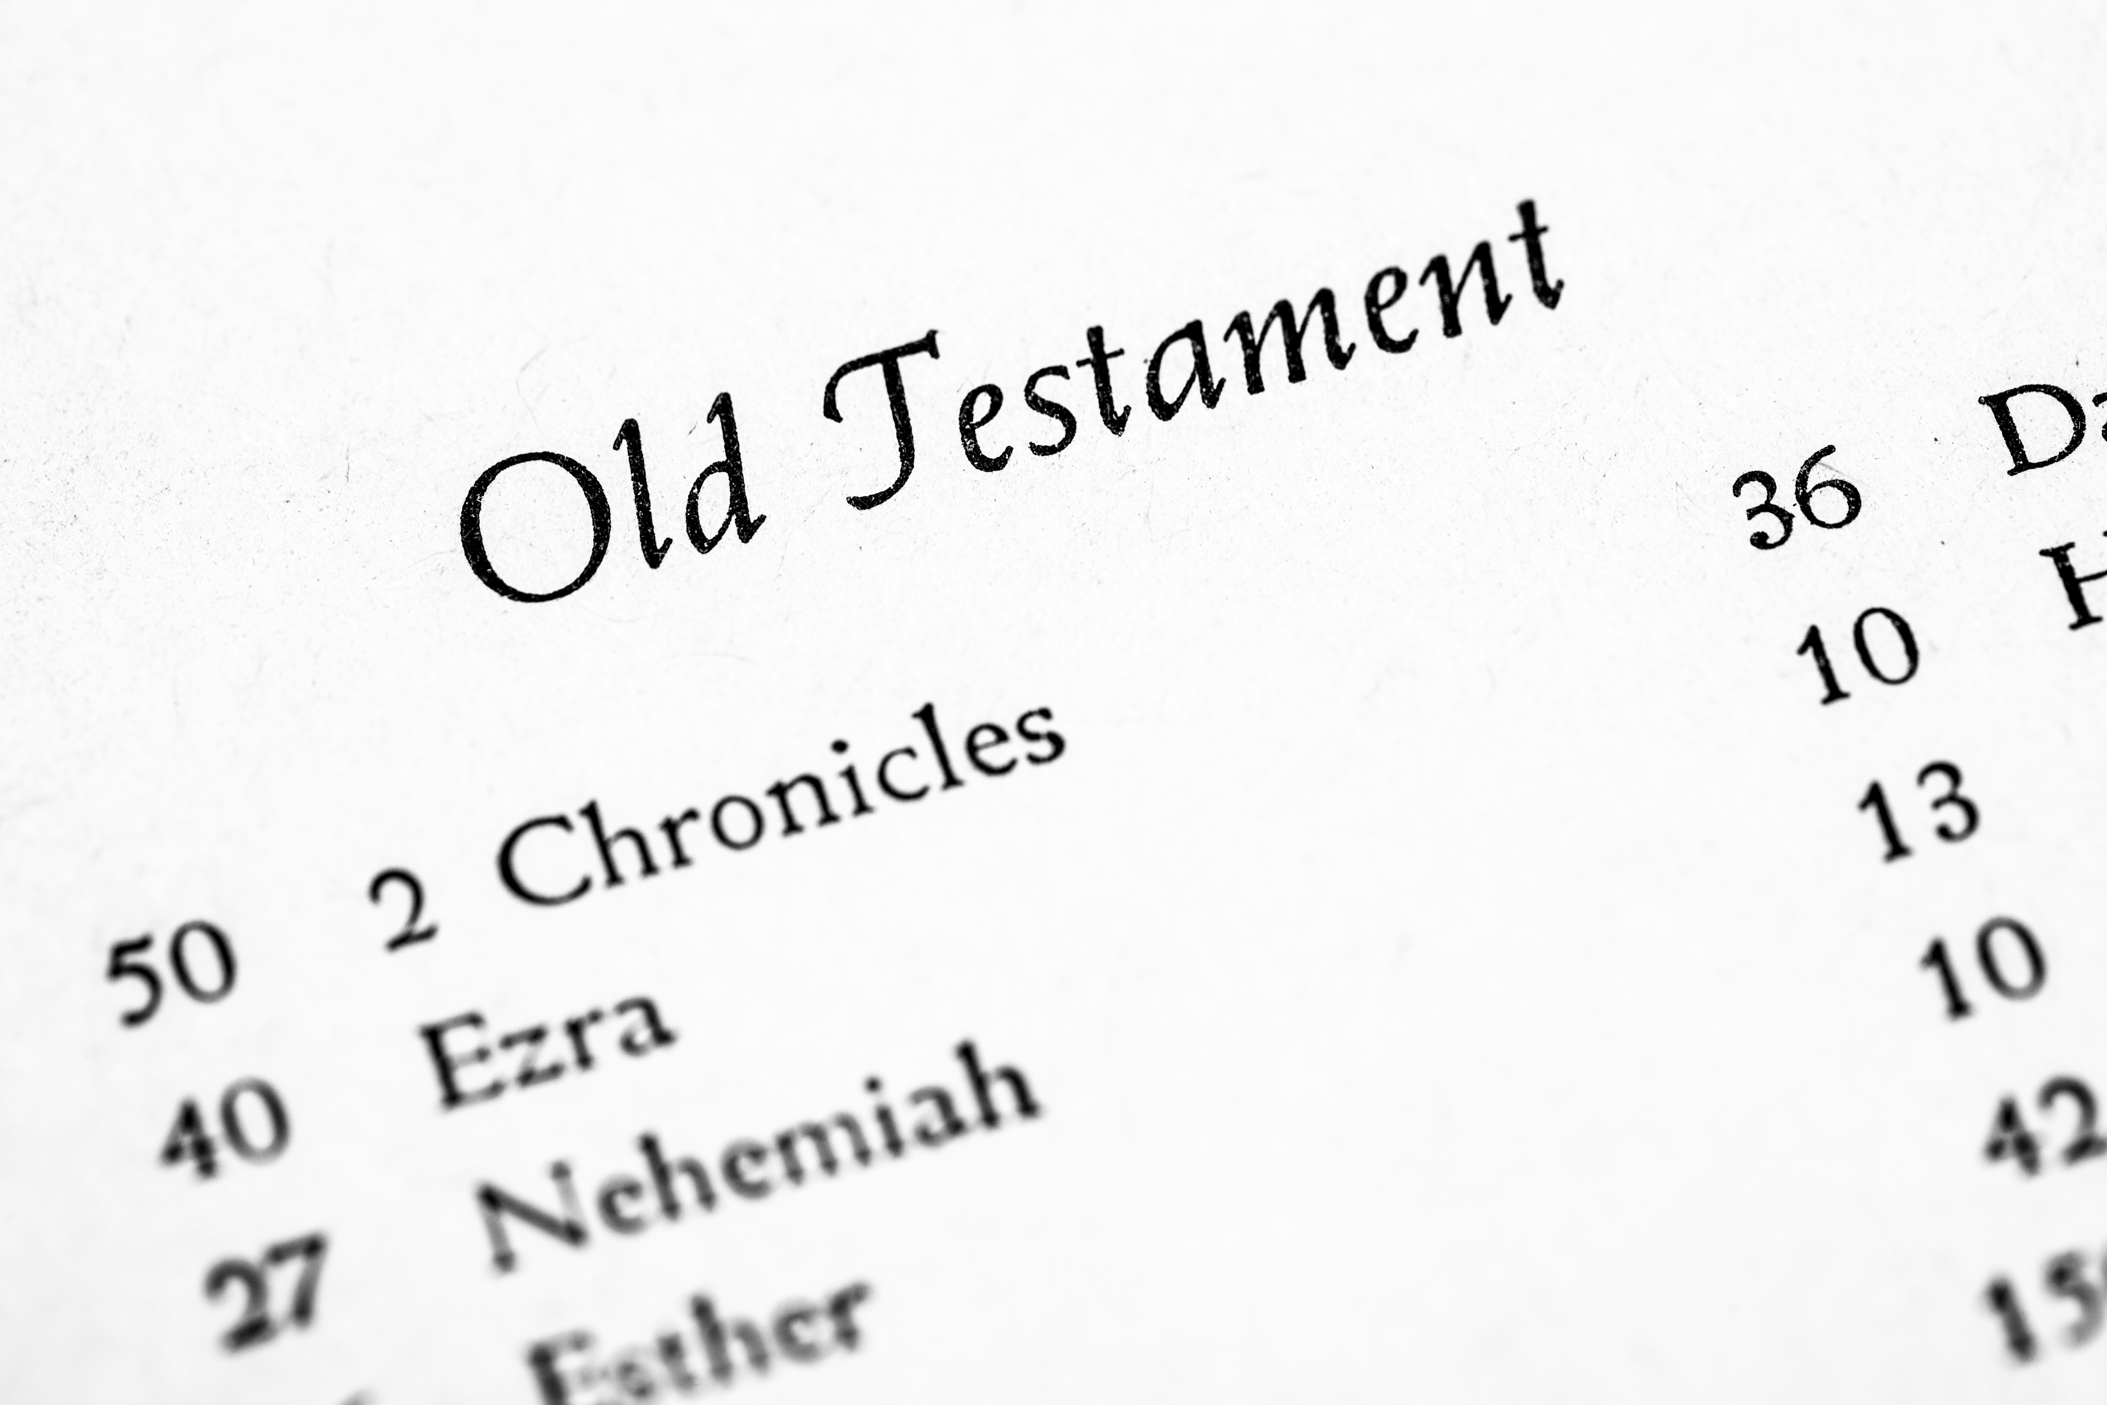
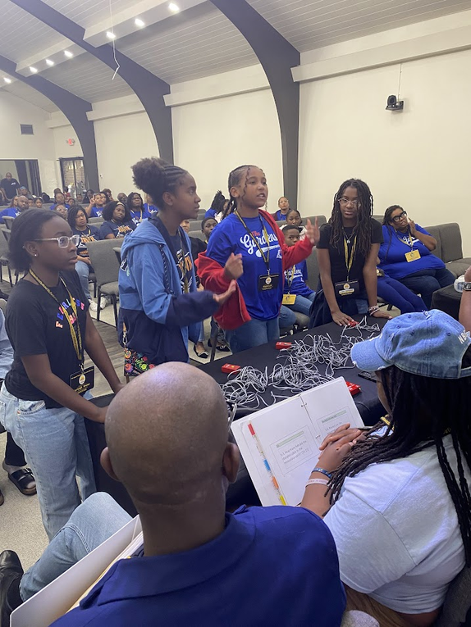
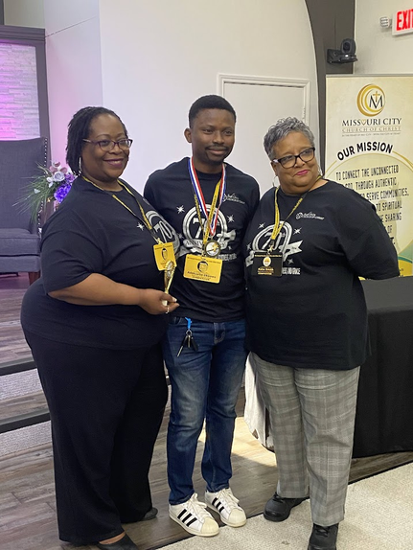
5TH ANNUAL
HOUSTON AREA CITYWIDE BIBLE BOWL
2026
BIBLE
BOWL
NOVEMBER 14, 2026
HOST CONGREGATION:
TRINITY GARDENS CHURCH OF CHRIST
SAVE THE DATE AND GET YOUR STUDY ON FOR OUR 2026 CITYWIDE BIBLE BOWL. COMPETITION IS OPEN TO ALL YOUTH GRADES 1ST TO HS SENIORS AND ADULTS!!!
  REVIEW OF OLD TESTAMENT (GENESIS - SONG OF SOLOMON)
  INDIVIDUAL COMPETITION
  TEAM COMPETITION
  $500 SCHOLARSHIP TO TOP SCORER IN HS GRADE
DOWNLOAD STUDY MATERIALS AT:
houstonareacitywidebiblebowl.com

