Slide 1


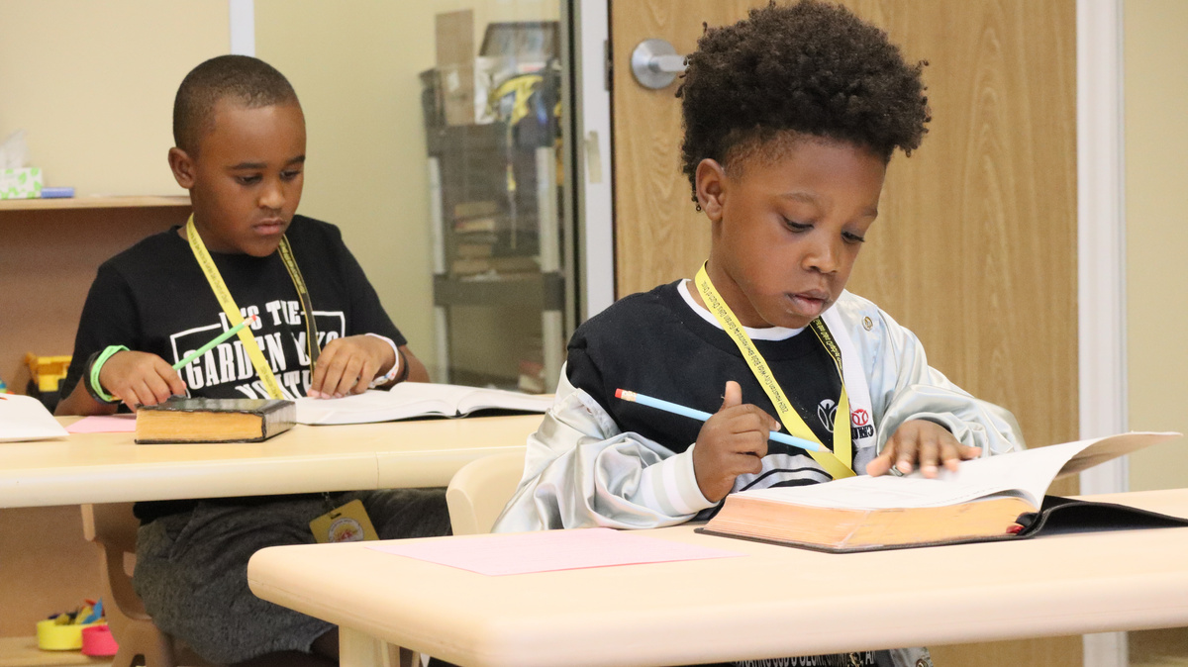
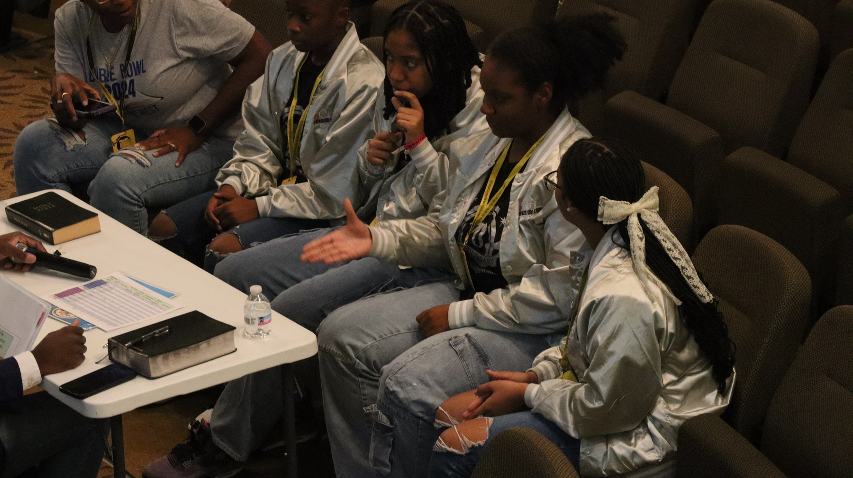
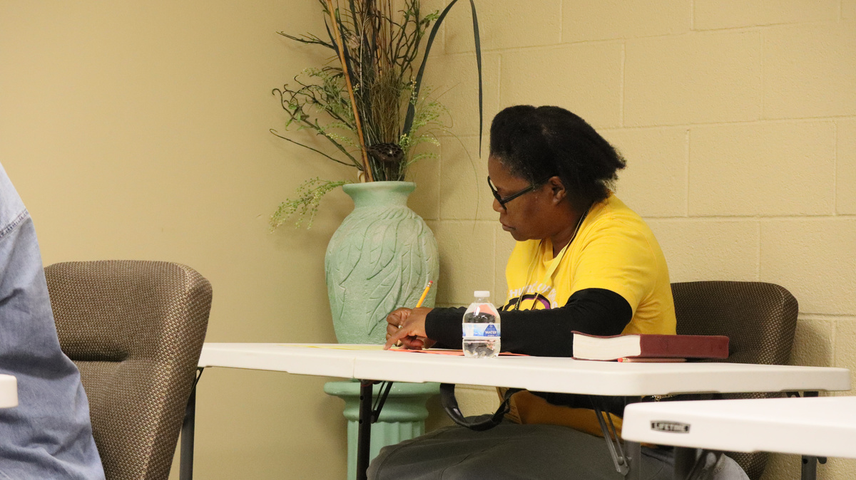
4TH ANNUAL
HOUSTON AREA CITYWIDE BIBLE BOWL
2025 Bible Bowl
Saturday, November 8, 2025
Join US for FUN Individual & Team Bible Bowl Competition! Open to all Youth 1st grade to HS Seniors & ADULTS!!!
Host: Missouri City Church of Christ
STUDY OF GOSPEL OF JOHN
What to Expect:
  Study of Gospel of John
  Individual Competition
  Team Competition
  Individual & Team Awards
  $500 Scholarship for Top HS Competitor
houstonareacitywidebiblebowl.com

