Slide 1
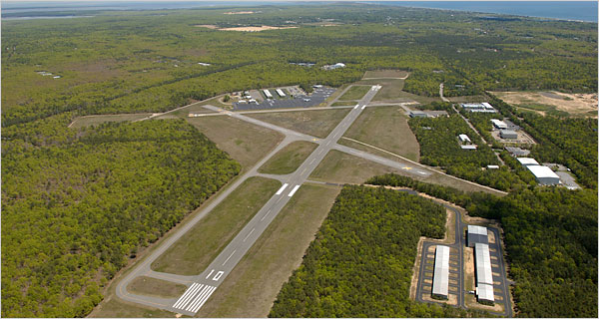
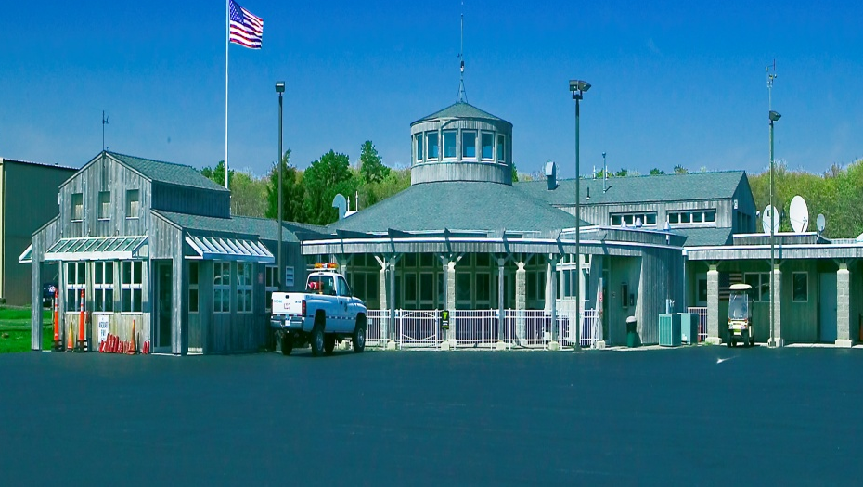
East Hampton Airport
EHRC Letter of Agreement 2014
James Brundige
Airport Manager

Slide 2
Airport Policy
To establish safe and efficient helicopter routes into and out of the East Hampton Airport at the highest altitude and the lowest community impact.

Slide 3
ERHC Letter of Agreement—Proposed for 2014
The following Helicopter Noise Abatement Procedures have been developed in collaboration with the FAA’s East Hampton Control Tower, the Eastern Region Helicopter Council and Airport Operations. They have been reviewed by both sub-committees of the Airport Planning Committee—the Noise Abatement Advocates Sub-Committee and the Aviation Community Sub-Committee.

Slide 4
Arrivals
November:
Arrivals from the northwest proceed to “November 1” (N40.59.5.48 W072.25.58.48) at or above 3500 feet, continue to “November 2” (N40.58.15.10 W072.20.26.56) at or above 3000 feet, to “November 3” (N40.58.2.70 W072.17.31.67) at or above 2500 feet, then to the airfield.
Sierra:
Arrivals from the south fly along the south shore at or above 3000 ft., when weather and traffic permit, to “Sierra 2” (N40.55.46.1 W072.13.25.5) Proceed over the center of Georgica Pond to the airport above the traffic pattern, descending north of the airport for landing. HTO fixed wing traffic pattern attitudes are 1000 ft. AGL for light single and twin aircraft, and 1500 ft. AGL for Jets.

Slide 5
Departures
Echo
When possible, climb above 2000 ft. within the airport boundary before initiating the outbound leg so as to fly the route at the highest possible altitude. Depart heading northwest over the power lines to “Echo 1” (N40.58.02.0 W072.16.16.5). Turn right, remaining well east of Town Line Road and proceed to the west side of Barcelona Neck “Echo 2” (N41.00.47.5 W072.15.44.3 Use max performance climb so as to cross Barcelona Neck at or above 3000 ft. MSL
Sierra
Depart South by climbing above the traffic pattern north of the airport before proceeding south over the center of Georgica Pond at or above 2000 ft. to Sierra 2 (N40.55.46.1 W072.13.25.5). When weather and traffic permit, continue climbing to fly off shore at or above 3000 ft.

Slide 6
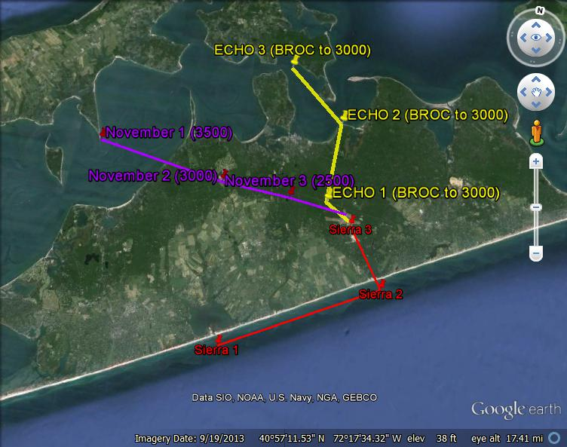
2014 Noise Abatement Routes

Slide 7
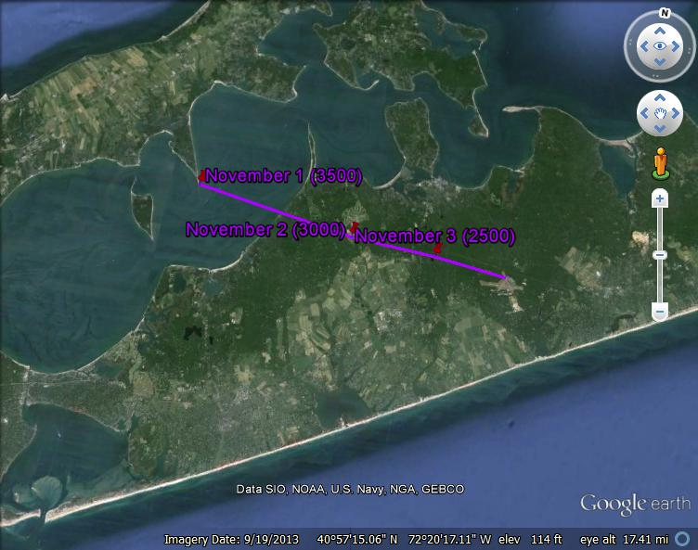
November Route

Slide 8
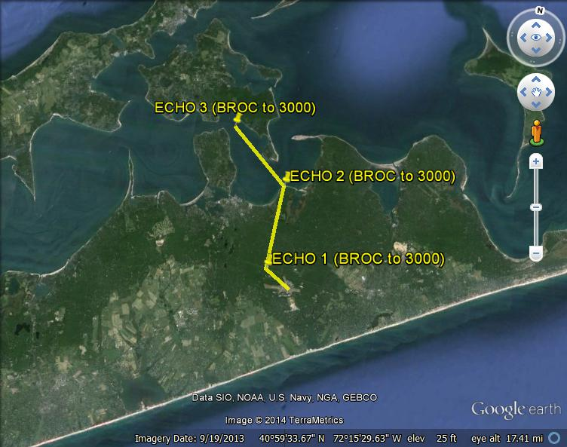
Echo Route

Slide 9
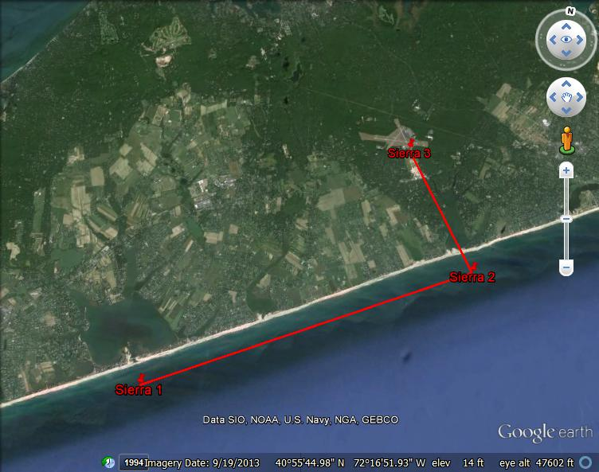
Sierra Route

Slide 10
Example of Route deviation to be sent to ERHC

Slide 11
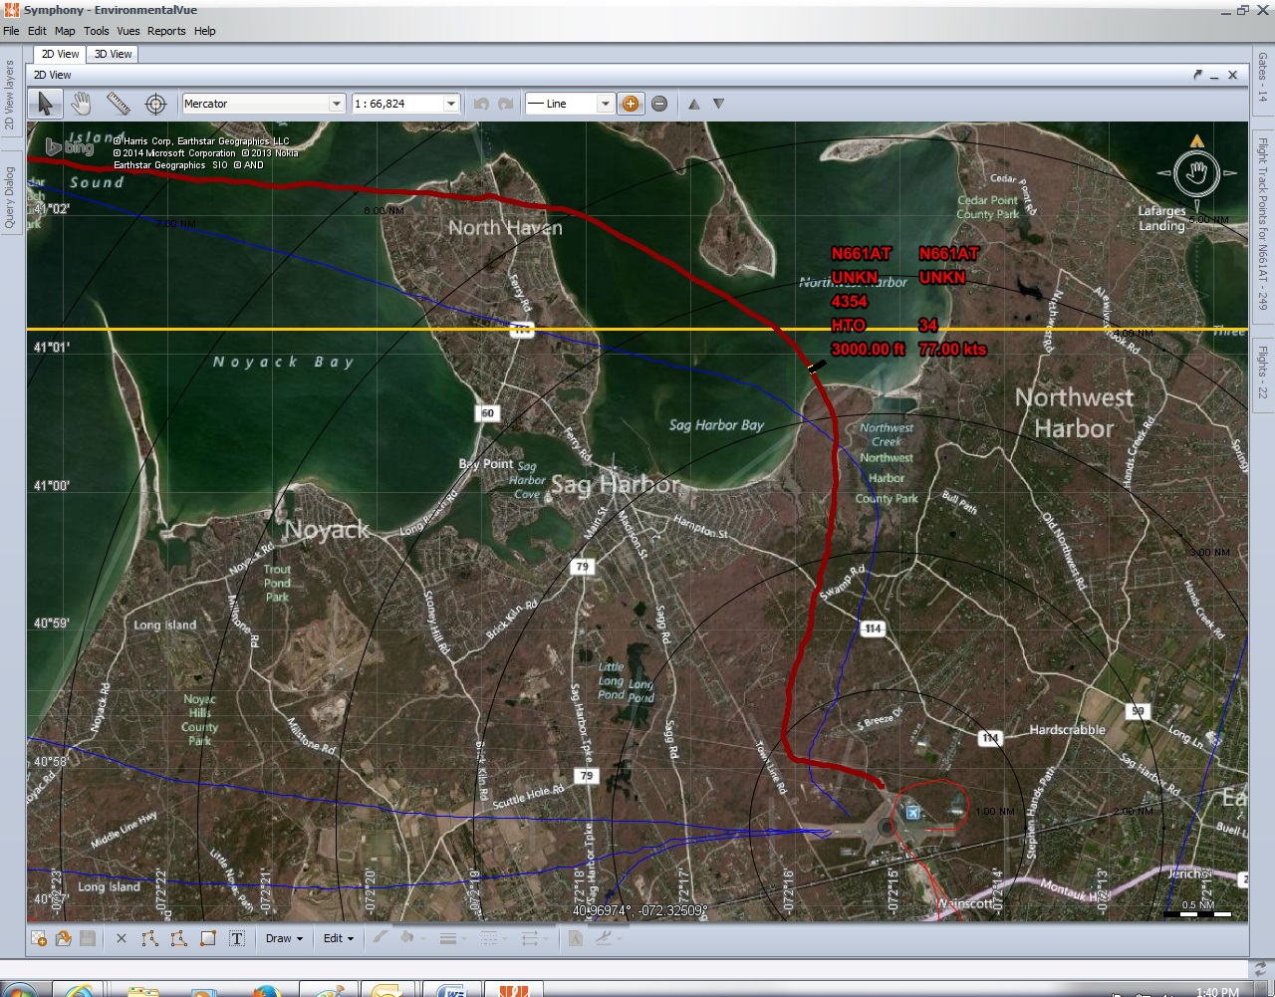
Example of
Good Route, Good Altitude

Slide 12
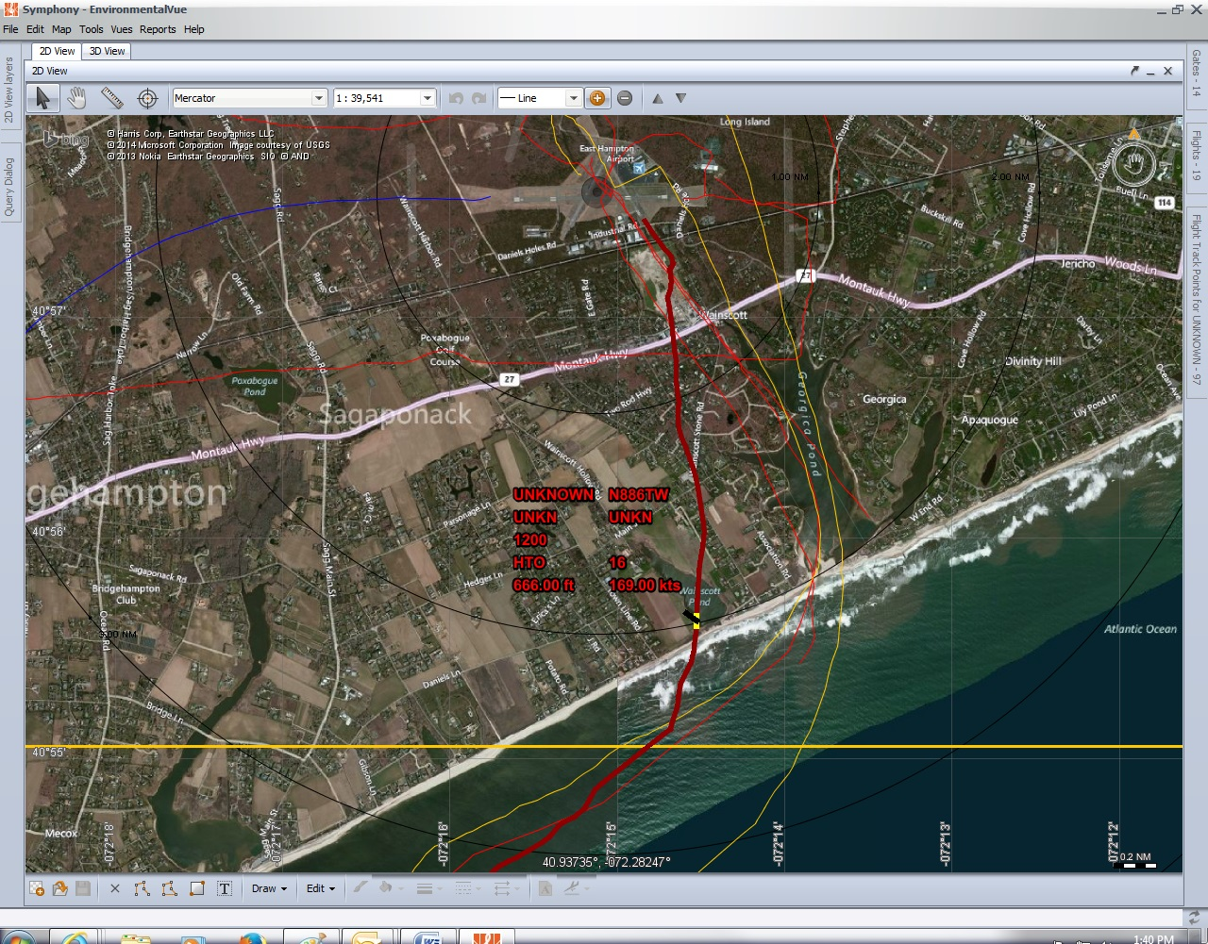
Example of
Bad Sierra Departure Route

Slide 13
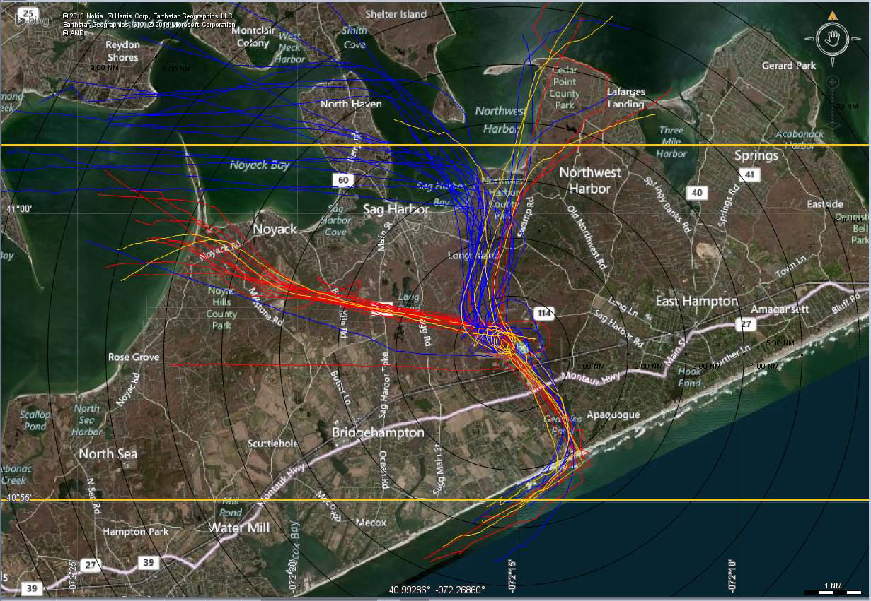
Example of multiple Helicopter Tracks over a weekend Friday-Monday

