Slide 1


Sometimes stepping back is better than a closer look
Jean Bolognia, MD

Slide 2
Conflicts of Interest
None
Mention of non-FDA-approved drugs
Yes

Slide 3
Learning Objectives
• To appreciate the need to “step back” and have a “low power” view when examining the skin
• To illustrate the concept of a “4X” clinical examination via the ddx of toxic epidermal necrolysis (TEN)

Slide 4
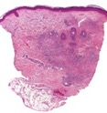
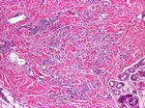
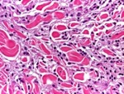




Physical versus histologic examination of the skin
4X
20X
100X
Nevi

Slide 5
Physical versus histologic examination of the skin
4X
20X
100X
Step back and drop the dermatoscope
Nevi

Slide 6
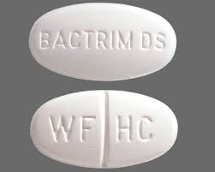
Patient as example
• Resident says patient in the ICU has Stevens-Johnson syndrome, maybe SJS/TEN overlap, due to TMP-SMX
• ICU team wants to know which Rx we want – IVIG vs CSA vs 3 days of high-dose corticosteroids vs injection of etanercept?

Slide 7
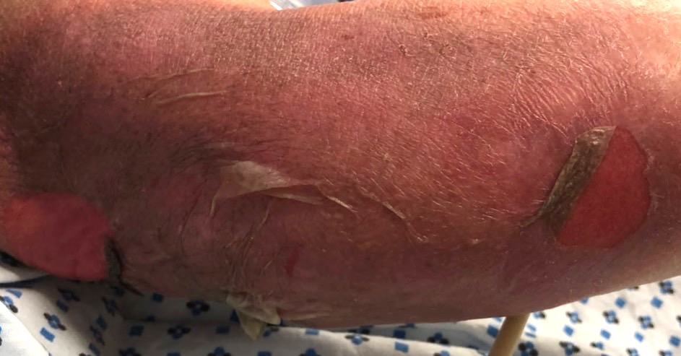
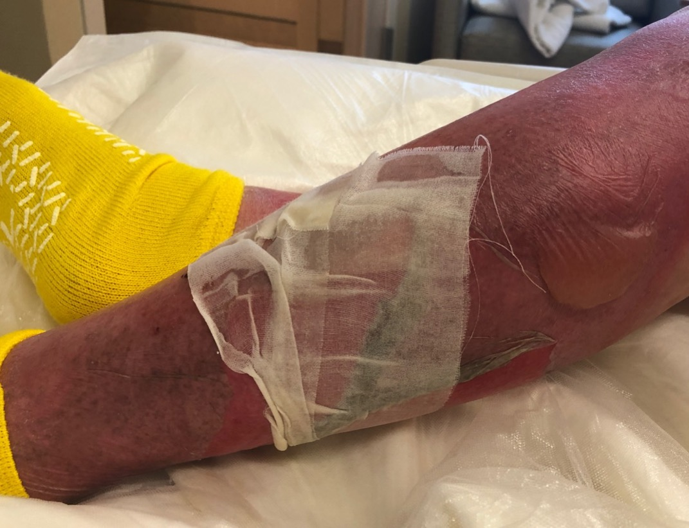

Slide 8
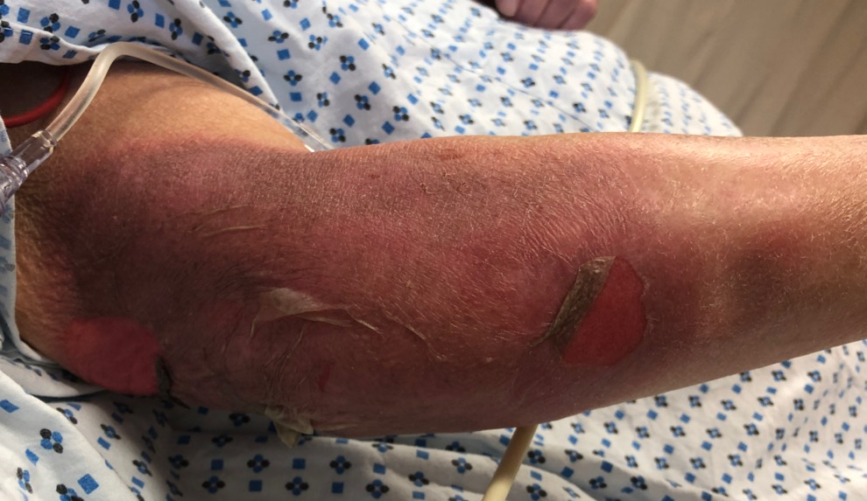

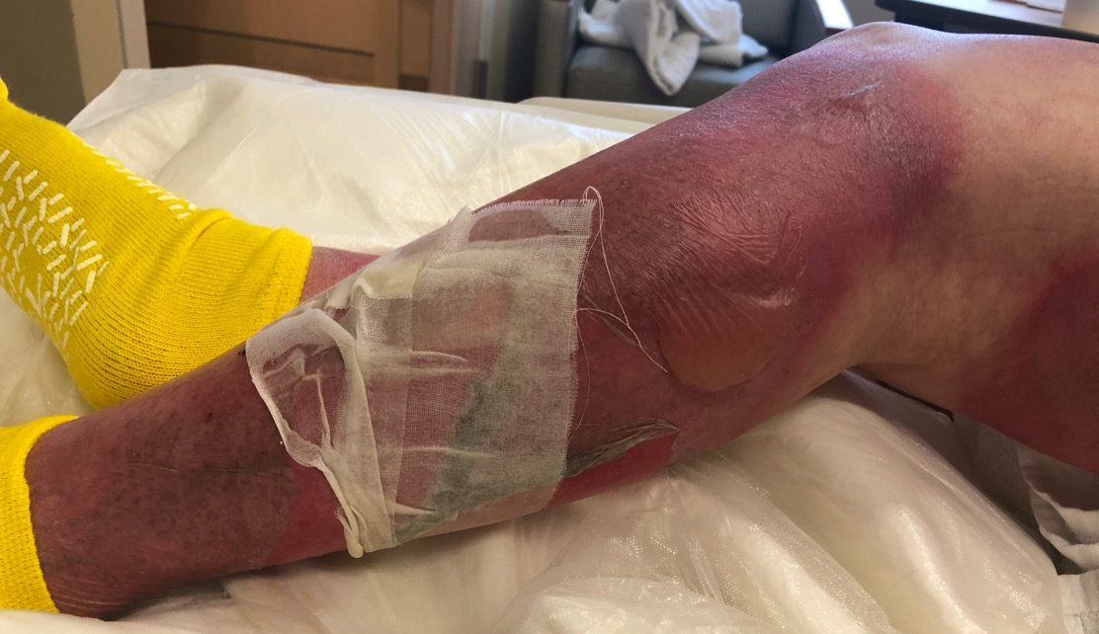


Slide 9

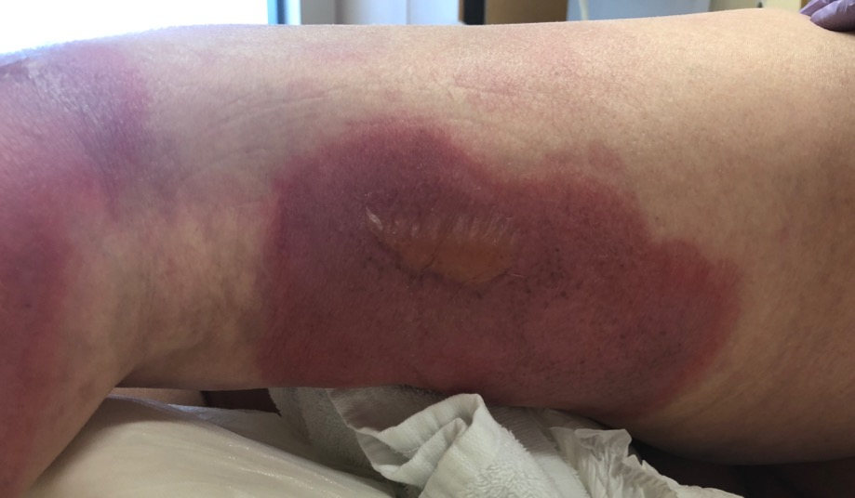
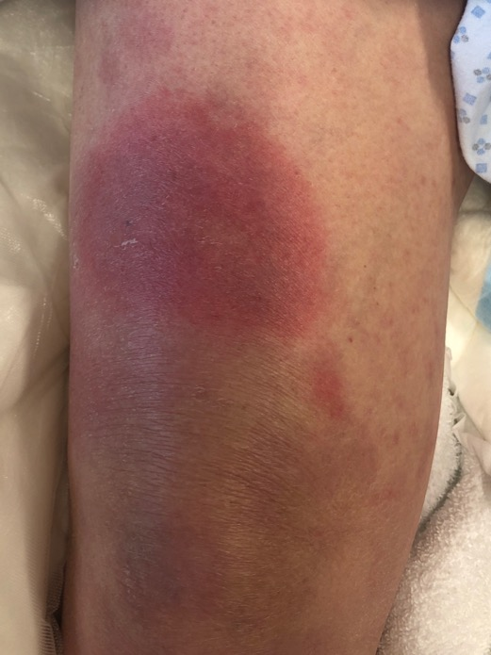
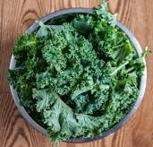


Slide 10
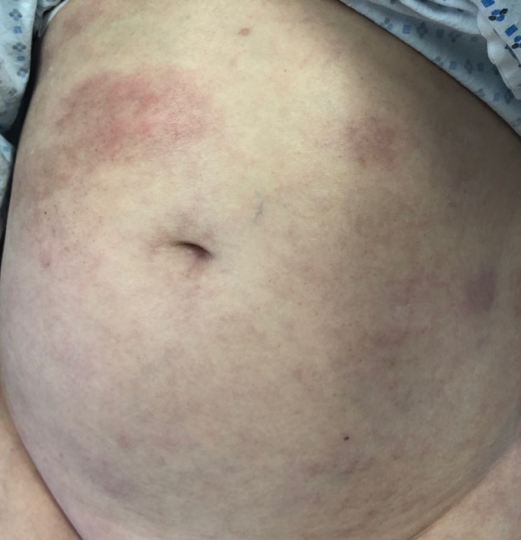
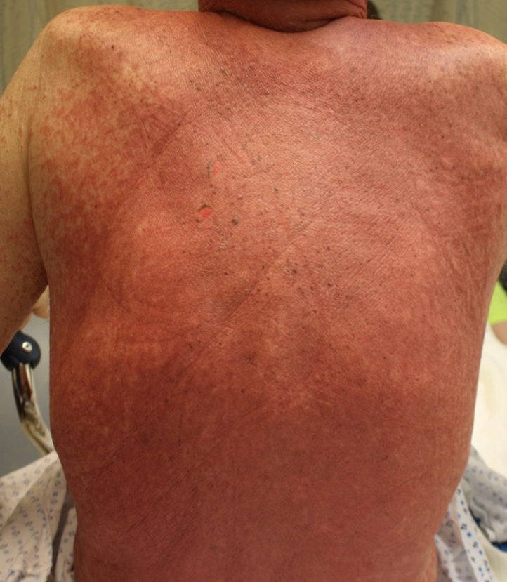
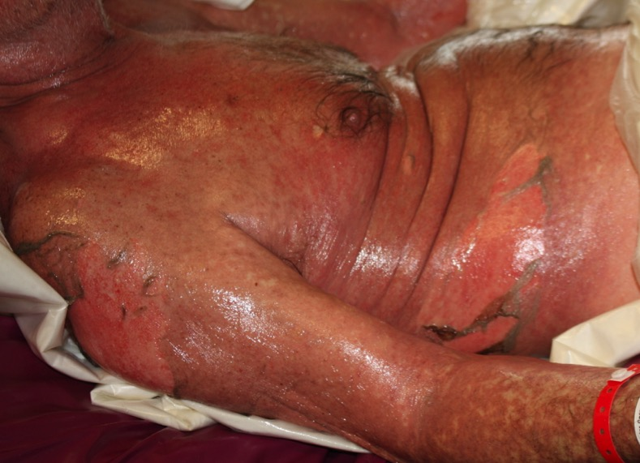
Generalized bullous FDE
TMP-SMX
ipilimumab plus nivolumab
SJS/TEN
YDRSC

Slide 11
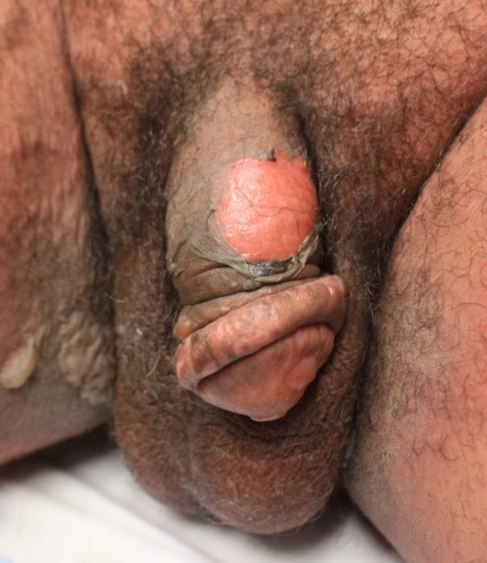
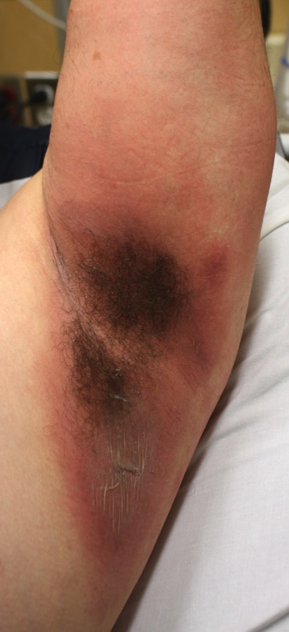

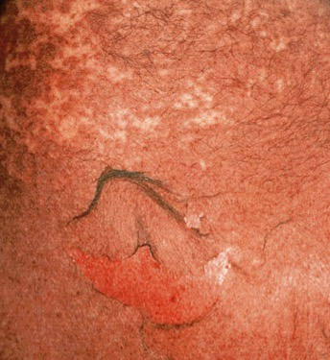
Fourth admission for same disorder

Slide 12
Step back -- limited distribution

Slide 13
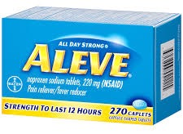
Generalized bullous fixed drug eruption

Slide 14
How many series of patients with TEN include patients with generalized bullous fixed drug eruption?

Slide 15
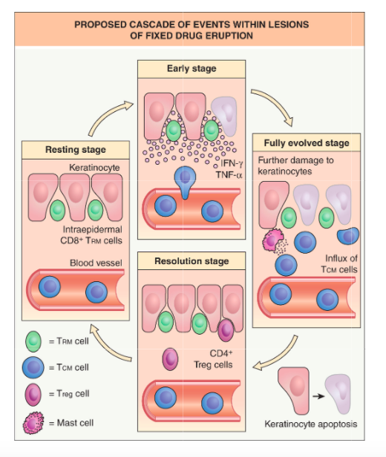

Slide 16
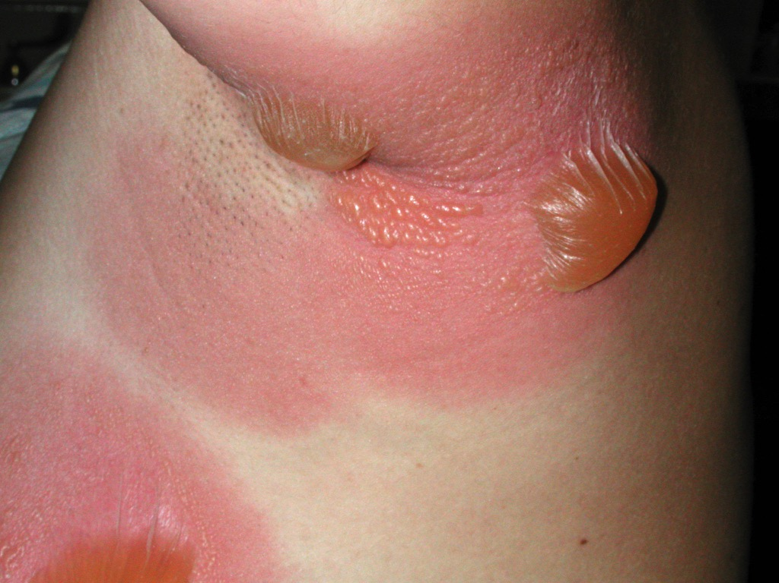
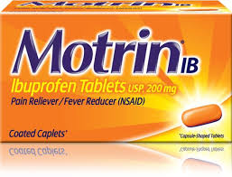
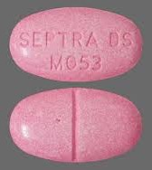
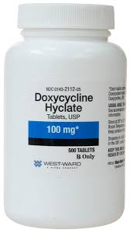

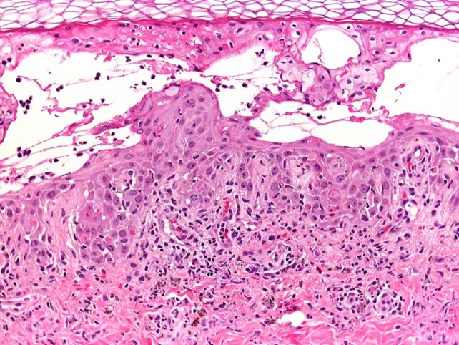
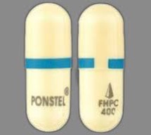
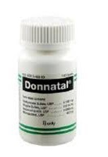
Courtesy, Ed Cowen, MD
Similar high-prob drugs
Courtesy, Lorenzo Cerroni, MD

Slide 17
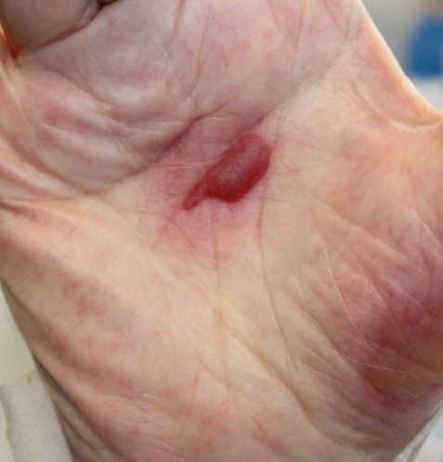
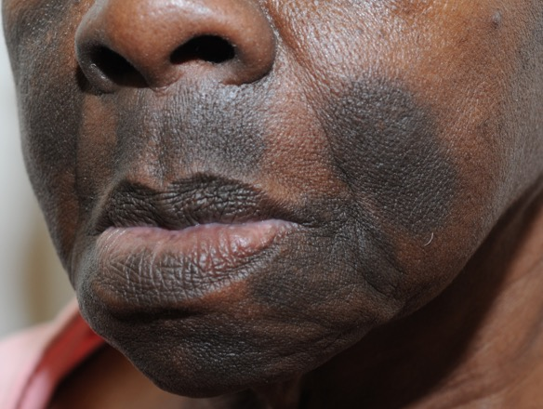
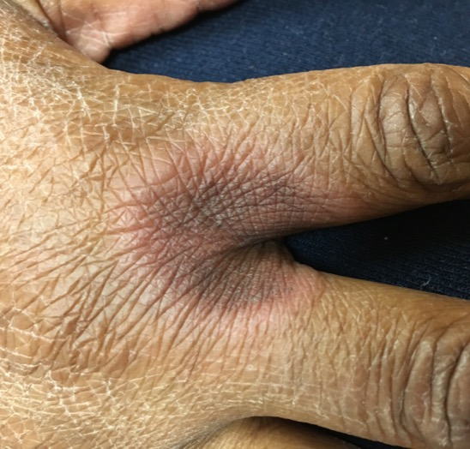
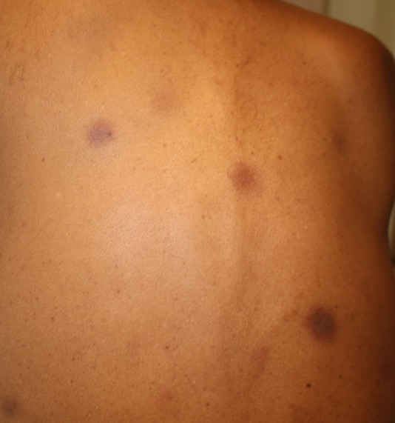
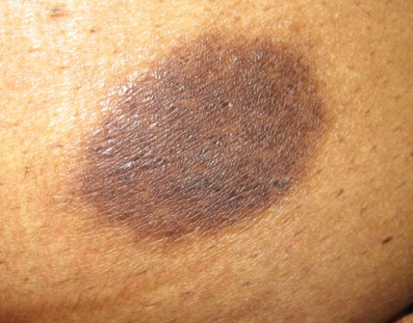

Courtesy, Mary Stone, MD
Mental image
Courtesy, Kal Watsky, MD; YDRSC

Slide 18
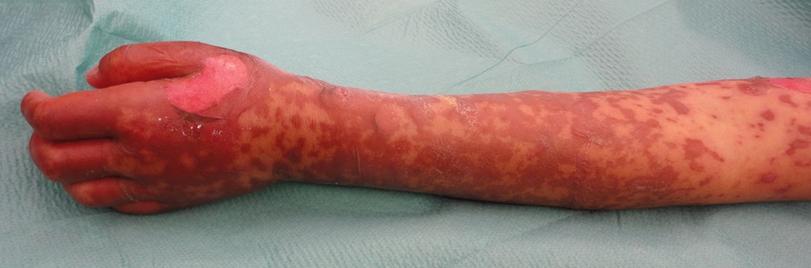
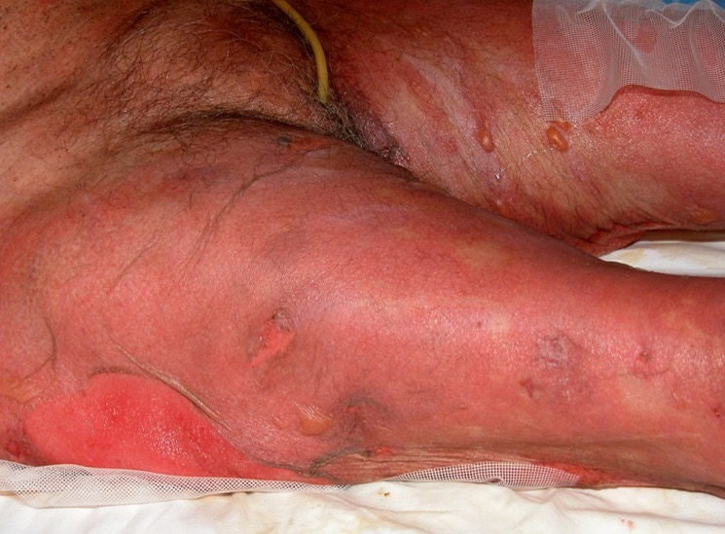
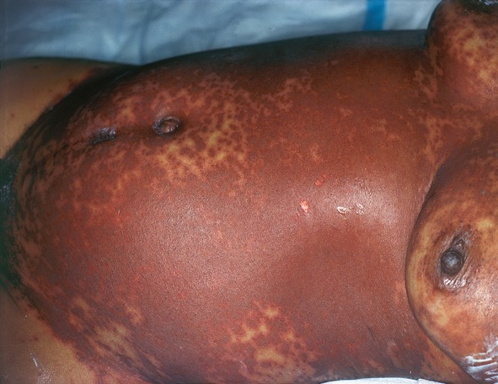
Courtesy, Lisa Weibel, MD
Courtesy, Luis Requena, MD

Slide 19
While generalized bullous fixed drug eruption might be confused with TEN, it should not be confused with SJS

Slide 20

Think of SJS as an “extra crispy”
morbilliform drug eruption
Vesicles or
bullae?
Fragility?
Mucosal erosions?
Duskiness?
Sloughing?

Slide 21
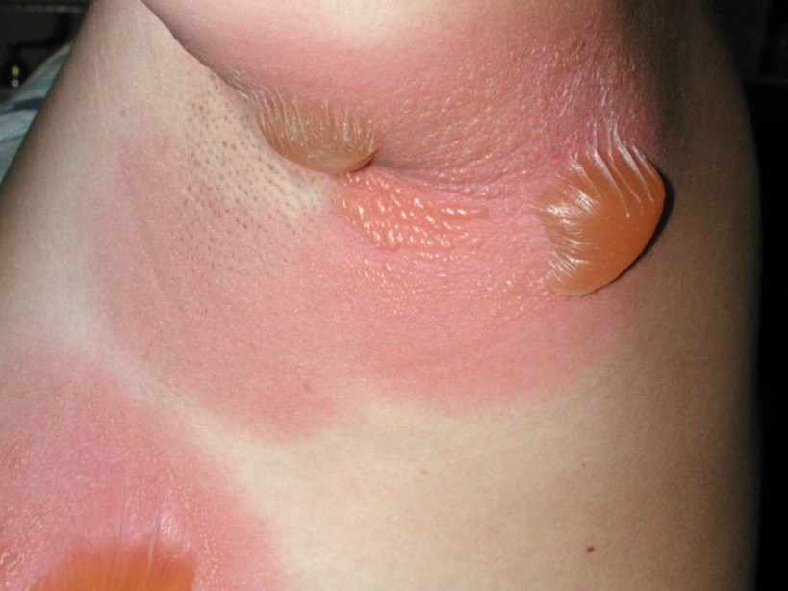
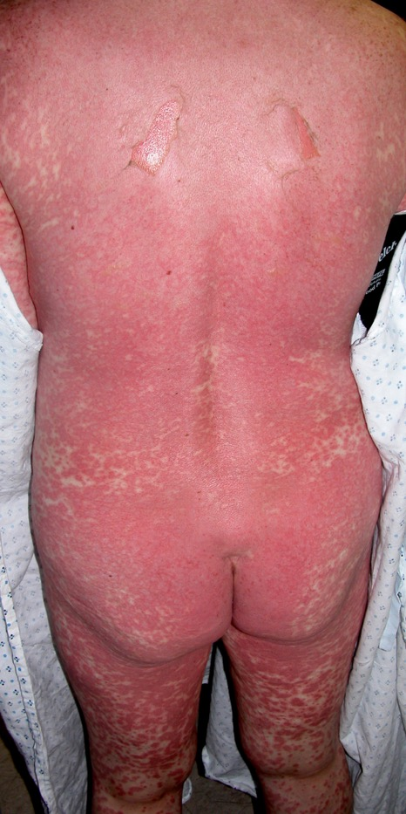

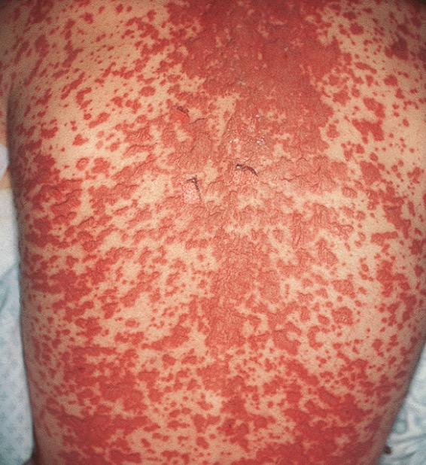
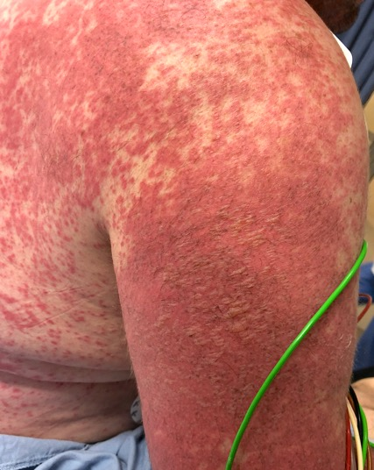
Courtesy, Ed Cowen, MD

Slide 22
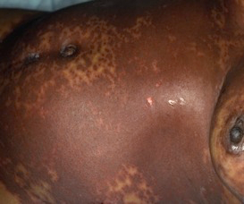
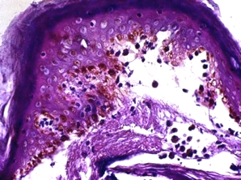
DDx of toxic epidermal necrolysis
Stevens-Johnson
syndrome
Staphylococcal scalded skin syndrome
%BSA: 10% vs 10-30% vs >30%
Age and location of split histologically

Slide 23
Extended DDx of toxic epidermal necrolysis
• Stevens-Johnson syndrome
• Staphylococcal scalded skin syndrome
• Generalized bullous fixed drug eruption
• TEN-like presentation of SLE
• Vancomycin-induced linear IgA bullous dermatosis
• Toxic erythema of chemotherapy (severe)
• Severe (grade IV) acute graft-versus-host disease
• In premature infants, congenital candidiasis
• Acute generalized exanthematous pustulosis
• Bullous pemphigoid, paraneoplastic pemphigus

Slide 24
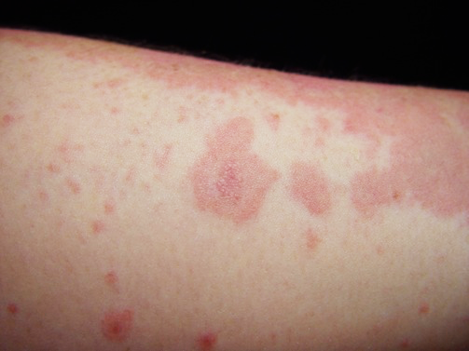
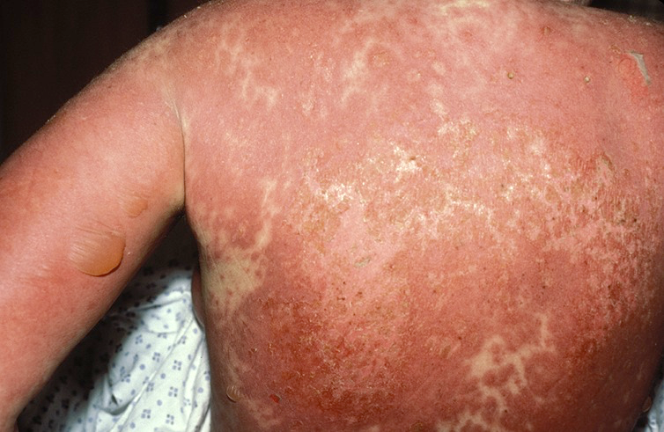
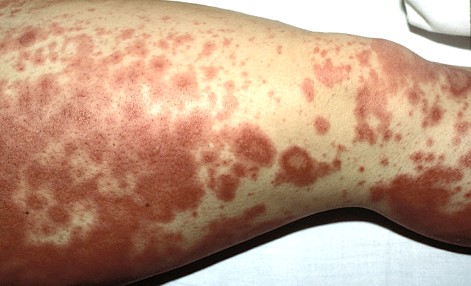
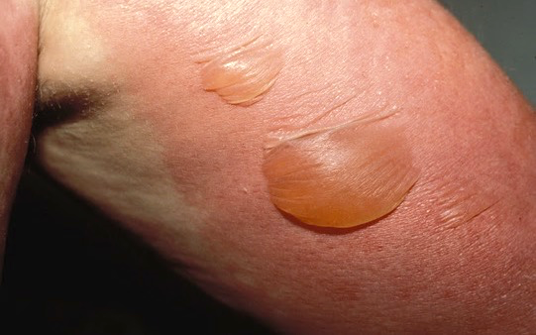
Rowell’s syndrome
Courtesy, Jeff Callen, MD
Acute syndrome of apoptotic pan-epidermolysis (ASAP)

Slide 25
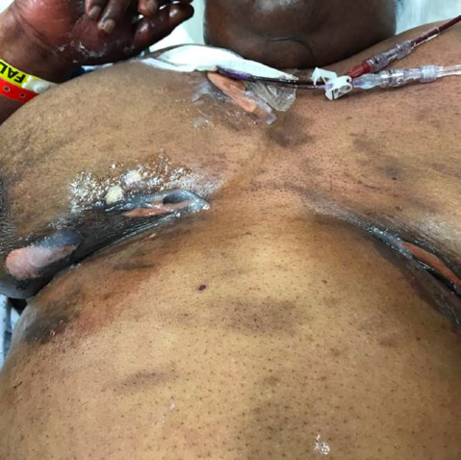
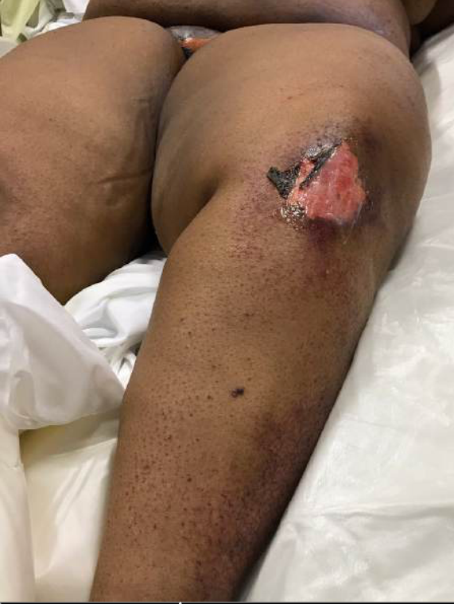
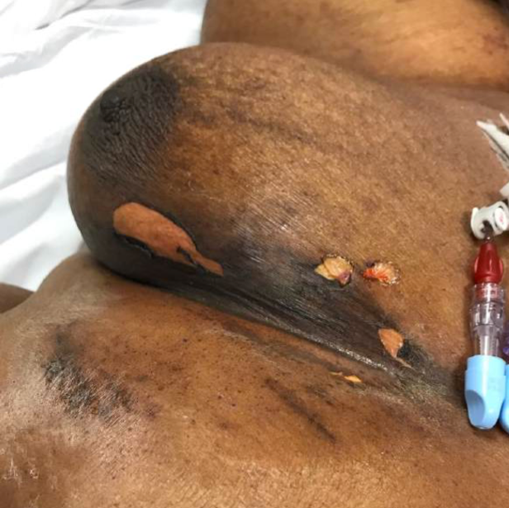
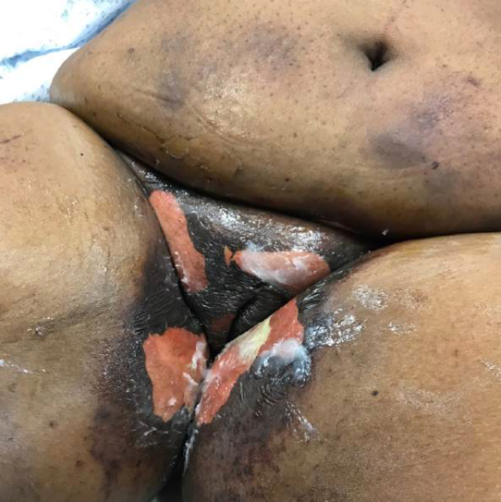

Slide 26
Toxic erythema of chemotherapy

Slide 27
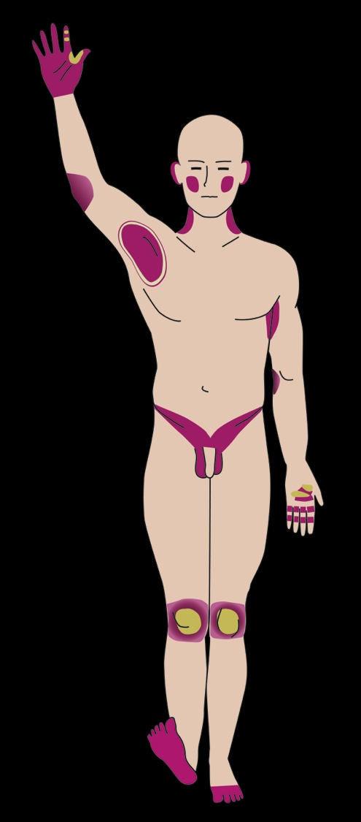
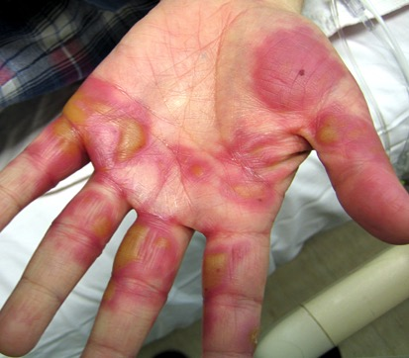




Courtesy, Lenny Crystal, MD
YDRSC

Slide 28

Courtesy, Lenny Crystal, MD
YDRSC

Slide 29
Toxic Erythema of Chemotherapy – most commonly associated drugs
• Cytarabine (Ara C)
• Anthracyclines*
• 5-FU# & pro-drugs
• Taxanes
• Methotrexate
• Thiotepa
• Gemcitabine
• Multi-kinase inhibitors^
• Busulfan
• Clofarabine
• Pralatrexate
^e.g. sorafenib, sunitinib, pazopanib, axitinib,
regorafenib
*especially pegylated liposomal
#especially continuous infusions

Slide 30


Courtesy, Boni Elewski, MD

Slide 31


Busulfan plus fludarabine
Day 25
Day 33

Slide 32






Courtesy, Jacqueline Sasaki, MD

Slide 33

Unilateral Toxic Erythema of Chemotherapy (TEC)
• Unilateral axillary TEC
• Spared axilla where previous axillary lymph
node dissection and radiation therapy for
breast cancer
• Mitoxantrone, VP-16, and Ara-C for AML
• Bilateral inguinal TEC
• Role of eccrine sweat glands vs decreased
Langerhans cell function and cytokines
• Another indication for botulinum toxin A?
JAMA Dermatol 2016;152:727-8.

Slide 34




Door #1
Door #2
TEC so do dose reduction
TEN and I wouldn’t touch that drug with a 10-foot pole

Slide 35






Courtesy, Jeff Callen, MD, Luca Borradori, MD, Julie Schaffer, MD

Slide 36
Disseminated
intravascular
coagulation
Bullous pemphigoid
Congenital candidiasis
Severe toxic erythema of chemotherapy
Vancomycin-induced
LABD
Acute graft versus
host disease
Courtesy, Jeff Callen, MD, Luca Borradori, MD, Julie Schaffer, MD

Slide 37
How to treat toxic epidermal necrolysis?
excellent supportive care
IVIg
cyclosporine
short course of high-dose corticosteroids
TNF inhibitors (etanercept)

Slide 38
How to treat moderate-to-severe SJS/TEN?
Prospective, randomized, controlled trial comparing:
etanercept (25 or 50 mg [>65 kg] 2x/wk) vs systemic corticosteroids*
reduction in:
    • SCORTEN-based predicted mortality rate: 17.7% vs 8.3%
    • Healing time: 14 days vs 19 days
    • Gastrointestinal hemorrhage: 2.6% vs 18.2%
Wang C-W, et al. JCI;128:985, 2018
*prednisolone 1-1.5 mg/kg/day IV until skin lesions healed

Slide 39
Physical versus histologic examination of the skin
4X
20X
100X
Nevi

