Slide 1
Pediatric Dermatology Potpourri: A Variety of Cases
Teresa S. Wright, MD, FAAD, FAAP
LeBonheur Children’s Hospital
Memphis, TN

Slide 2
Disclosures
Sanofi Genzyme- Advisory Board

Slide 3
Learning Objectives
Recognize features of several unusual skin conditions in children.
Describe the key features that support the correct diagnosis.
List one important lesson demonstrated by each case.

Slide 4
Case #1
14 mo old female
Pit on the nasal bridge
With hairs
No hx of redness, pain, swelling, drainage
Mom advised to “pluck the hairs”

Slide 7
Nasal Dermoid Sinus Cyst (NDSC)
Most common congenital midline nasal lesion
1-3% of all dermoids
4-12% of head/neck dermoids
Kim HK et al. Clinical and Experimental Otorhinolaryngology. Vol 3(1):48-51, March 2010.

Slide 8
NDSC
Cystic mass or sinus opening
Midline nasal dorsum
Between glabella and columella
At birth or during early childhood

Slide 9
NDSC
Potential Complications
Nasal deformity
Infection
Meningitis
Intracranial abscess

Slide 10
NDSC
Imaging
CT and/or MRI
Complete surgical excision
Plastic surgery
Neurosurgery

Slide 11
Lesson
A tiny lesion can have potential for serious complications.

Slide 12
Case #2
21 mo old female
2 weeks of blistering rash
No fever or other systemic symptoms
No new medications
+ pruritus

Slide 13
Case #2
Physical exam:
tense vesicles and large tense annular bullae (many with hemorrhagic centers)
serous and hemorrhagic crusts
superficial erosions
scattered diffusely over face, trunk, groin, buttocks, and bilateral upper and lower extremities
mucous membranes are clear

Slide 14
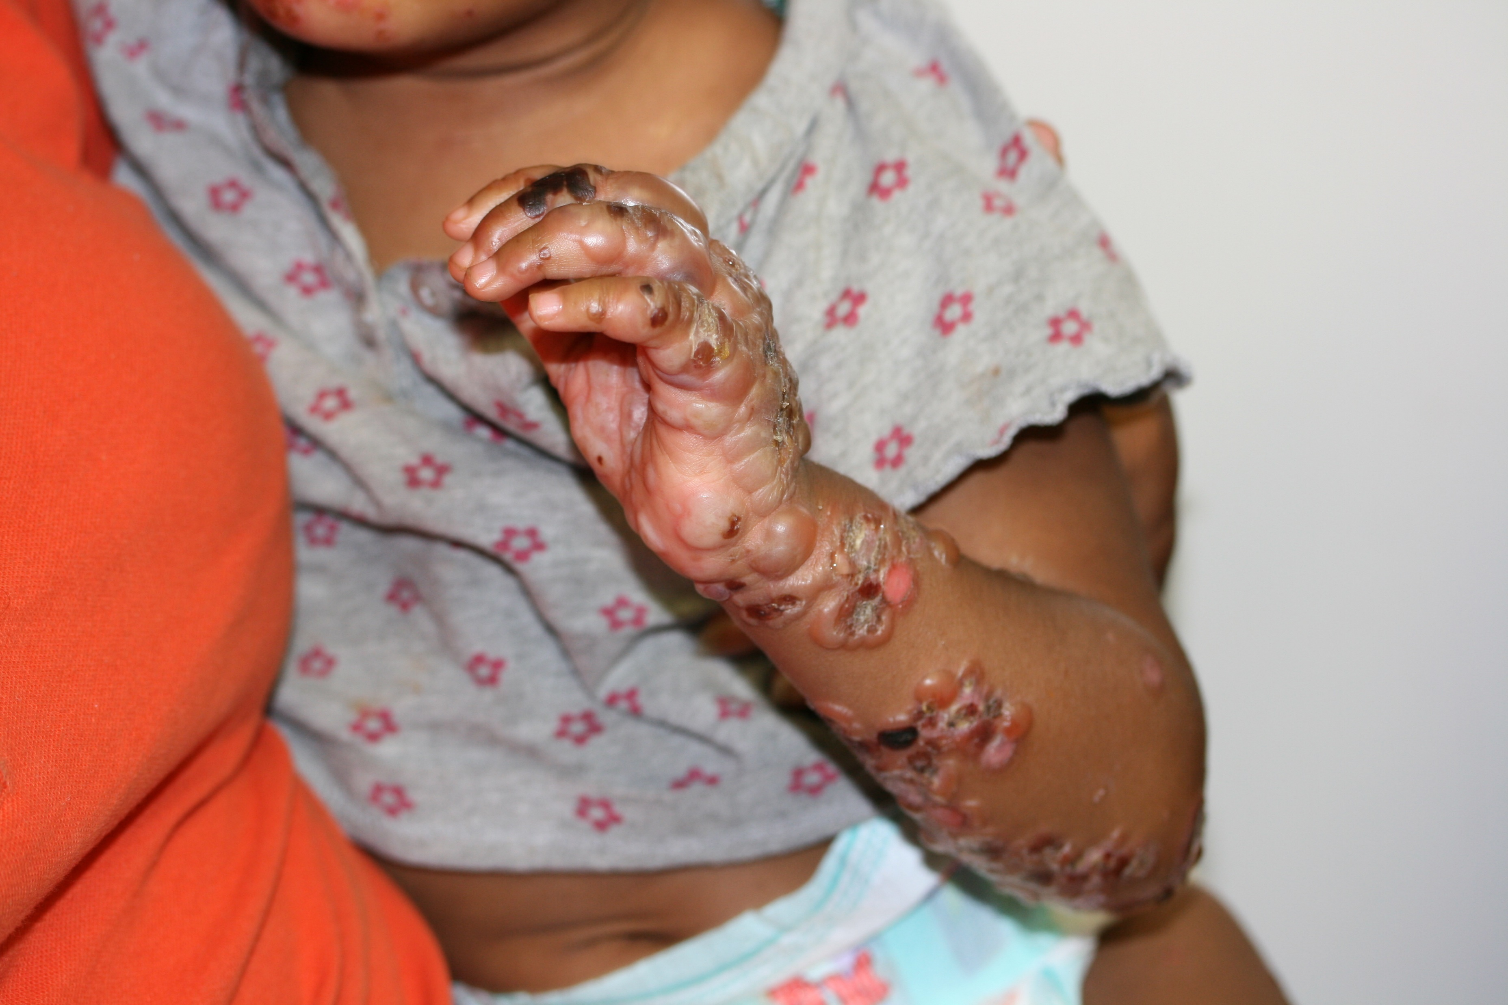

Slide 15
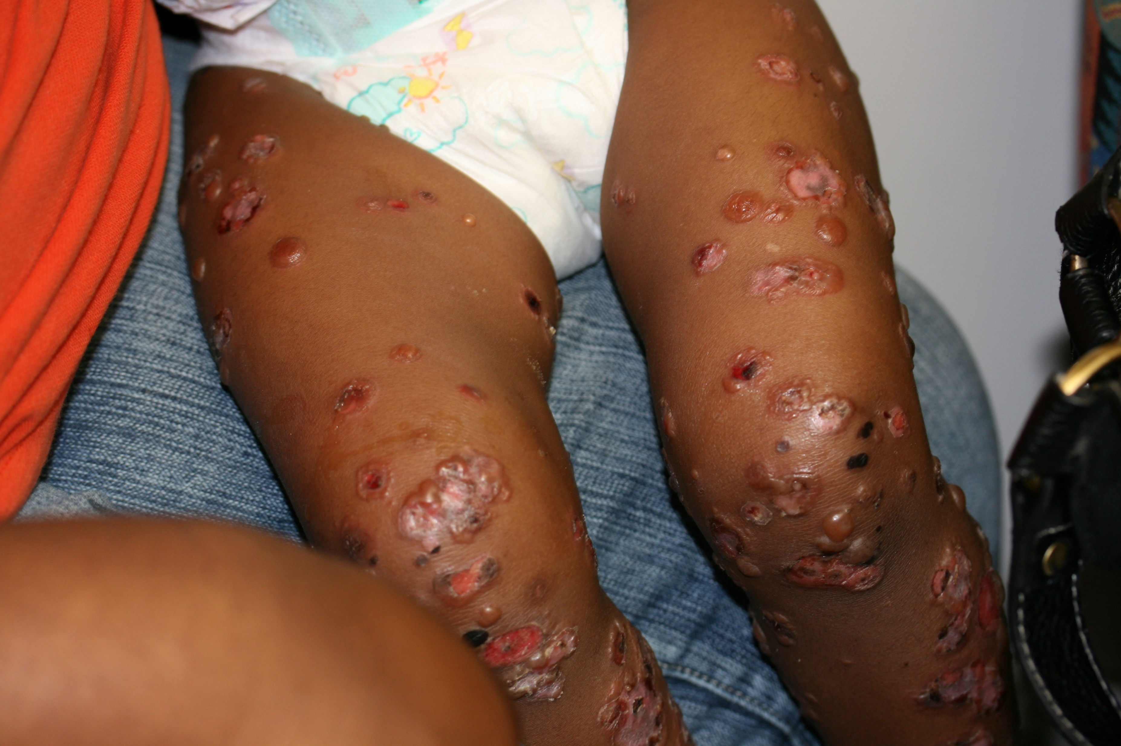

Slide 16
Chronic Bullous Disease of Childhood (CBDC)
Most common acquired AI blistering disorder of children
6 mo – 10 yr (mean = 4.5 yr)
Mintz EM and Morel KD. Dermatol Clin 29(2011) 459-462.

Slide 17
CBDC
Presentation
Abrupt onset
Clear/hemorrhagic tense vesicles/annular bullae
String of pearls
Cluster of jewels
Rosette

Slide 18
CBDC
Distribution
Face, trunk, extremities
Lower trunk, groin, medial thighs
+/- mucous membranes
Symptoms
Variable
Asymptomatic to severe pruritus
+/- burning

Slide 19
CBDC
DDx
Bullous impetigo
Superficial, fragile bullae
EBA
Other AI bullous

Slide 20
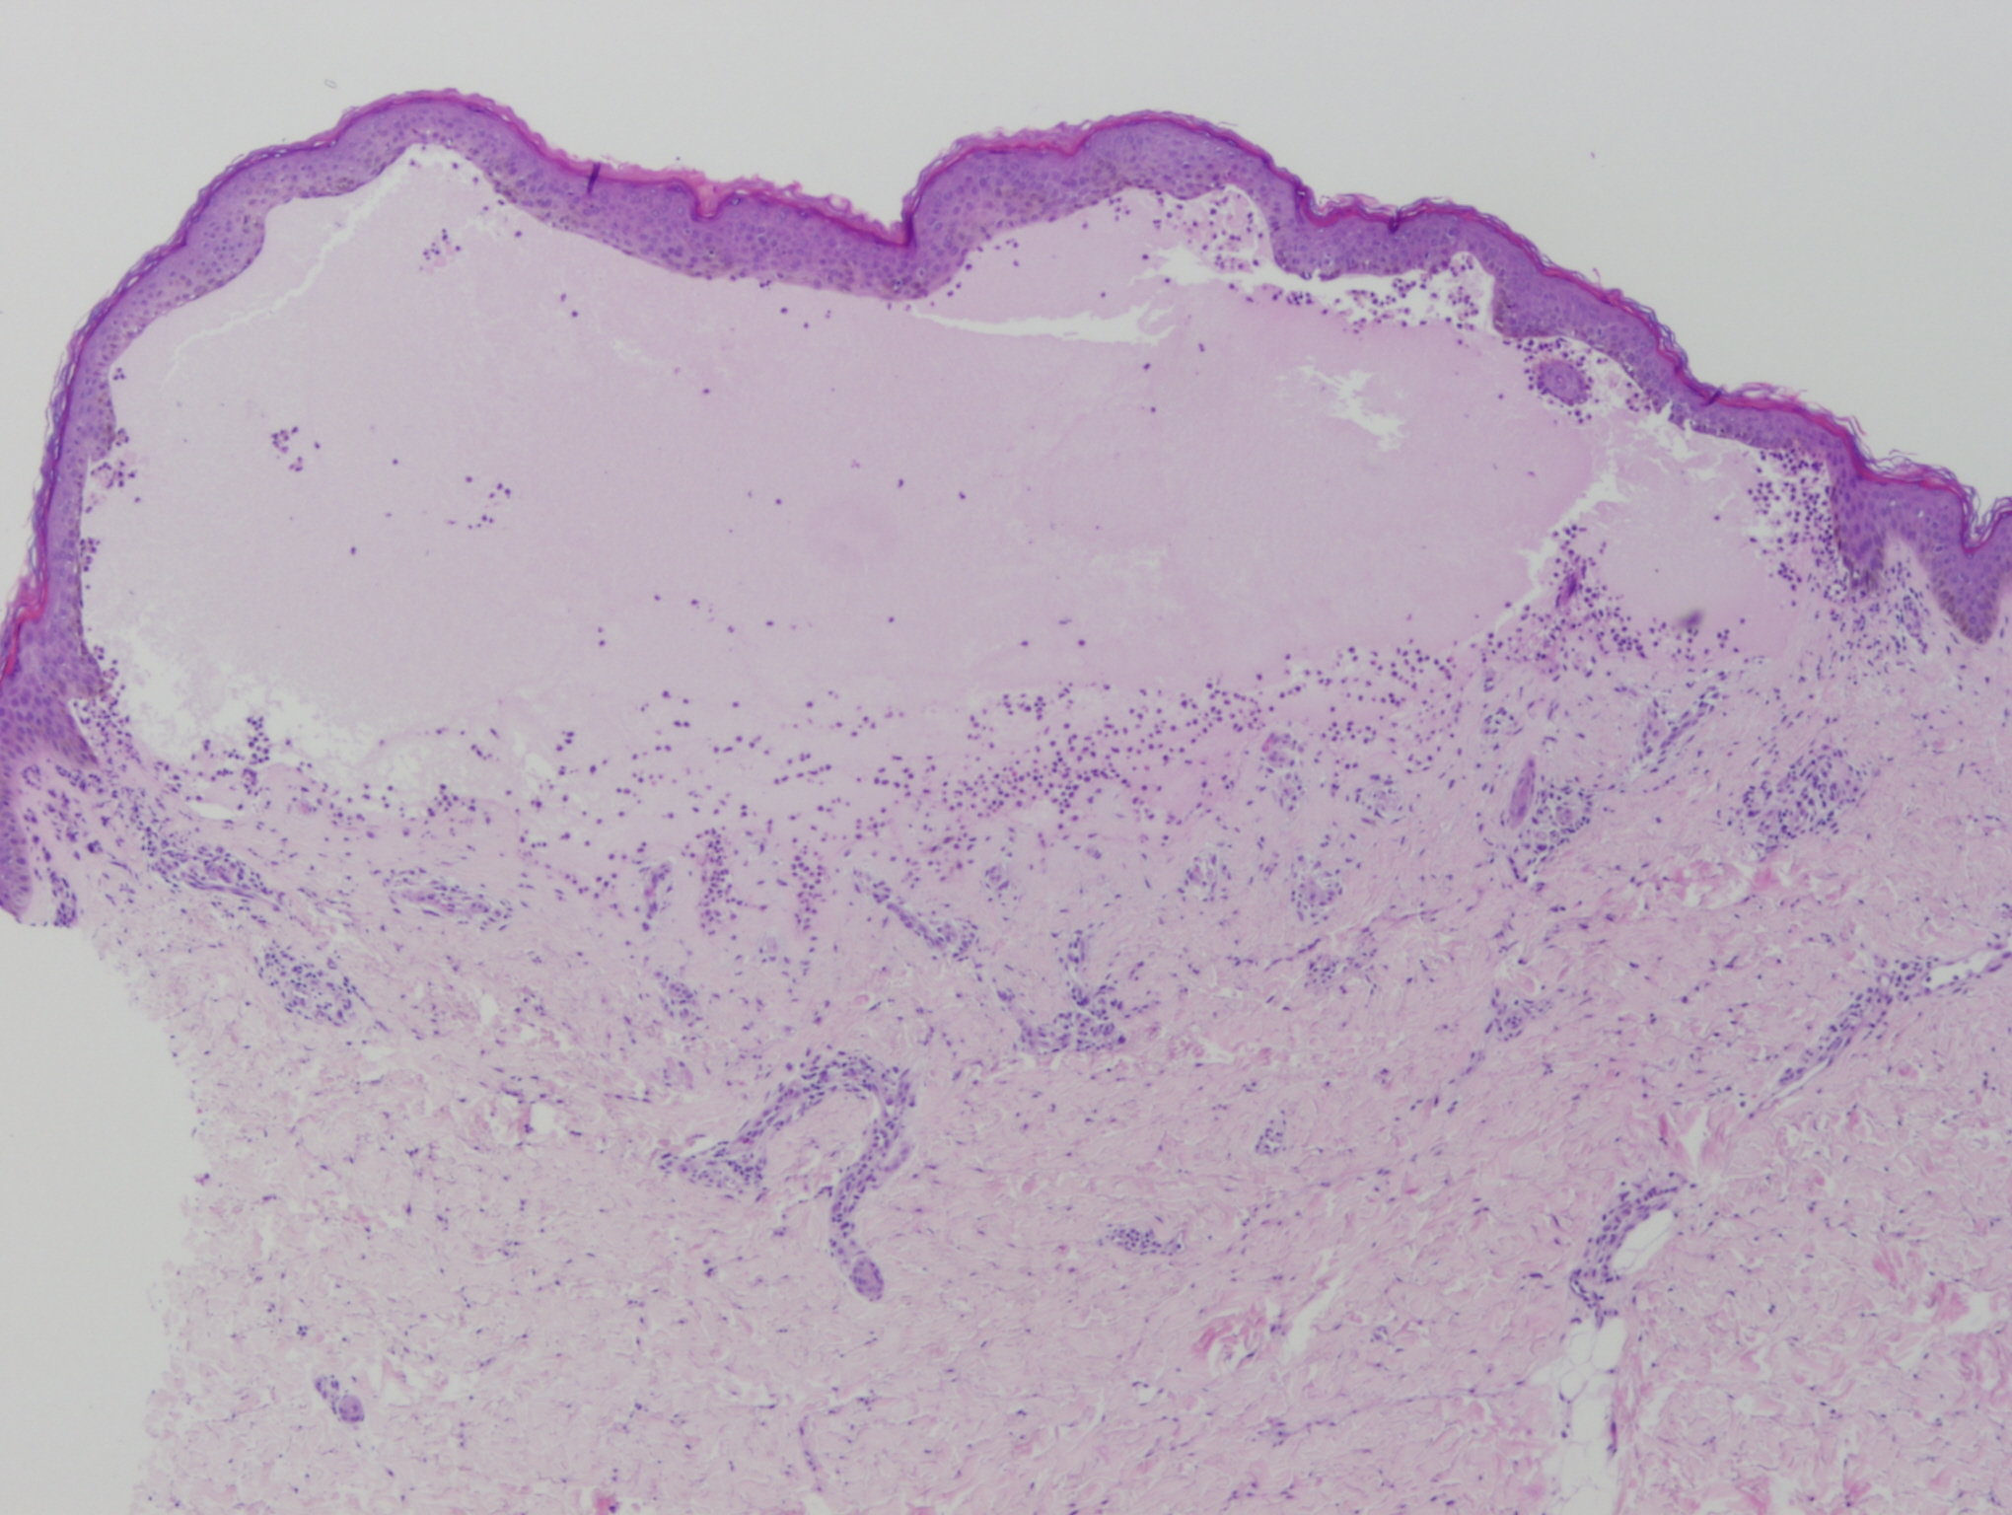
CBDC
Diagnosis
Biopsy
Subepidermal
Neutrophilic infiltrate
DIF
Linear IgA at BMZ

Slide 21
CBDC
Pathogenesis
Not well understood
Component of BMZ becomes antigenic
Often idiopathic
Genetic susceptibility
haplotypes HLA-B8, Cw7, DR3
Triggers
Infections, drugs, vaccinations, UV radiation, malignancy

Slide 22
CBDC
Course
Remits spontaneously
Several mos to 4 years
By puberty
Non-scarring
dyspigmentation

Slide 23
CBDC
Treatment
Dapsone*
Topical steroids
Systemic steroids
Other IS agents
MMF, CsA
Antibiotics
Anti-inflammatory
Mintz EM and Morel KD. Dermatol Clin 29(2011) 699-700.

Slide 24
Lesson
Can be difficult to control
Multiple agents may be needed
Will generally remit

Slide 25
Case #3
37 week male
Triplet gestation
Fetal demise at 17 weeks
Remaining sister healthy

Slide 29
Aplasia Cutis Congenita (ACC)
Congenital absence of skin
Localized or widespread
Superficial or deep
Typically presents with eroded, absent, or scarred areas of skin at birth

Slide 30
ACC
Etiology
No single cause
Disruption of skin development has occurred
Multi factorial
Genetic factors
Teratogens
Decreased blood supply
Trauma

Slide 31
ACC
Scalp is most common site
86% of solitary lesions
80% at parietal hair whorl
Size ranges from small to large
Large may extend to dura or meninges
? Graft for >3-4 cm2
Shape varies
Round, oval, linear, stellate
Frieden, IJ. J of Am Acad Derm. Volume 14(4):646-656.

Slide 32
ACC (9 Groups)
Scalp ACC without multiple anomalies
Scalp ACC with assoc limb abnormalities
Scalp ACC with assoc epidermal and organoid nevi
ACC overlying embryologic malformations
ACC with assoc fetus papyraceus or placental infarcts
ACC assoc with EB
ACC localized to the extremities, without blistering
ACC caused by specific teratogens
ACC assoc with syndromes

Slide 33
ACC (Group 5)
Etiology
Ischemic and/or thrombotic events in the placenta and fetus
Sporadic
Management
Conservative
Gentle cleansing
Vaseline gauze dressings

Slide 36
Lesson
Severe lesions will often heal well with minimal intervention.

Slide 37
Case #4
FT healthy male
Several crusted papules on face and trunk at birth

Slide 38
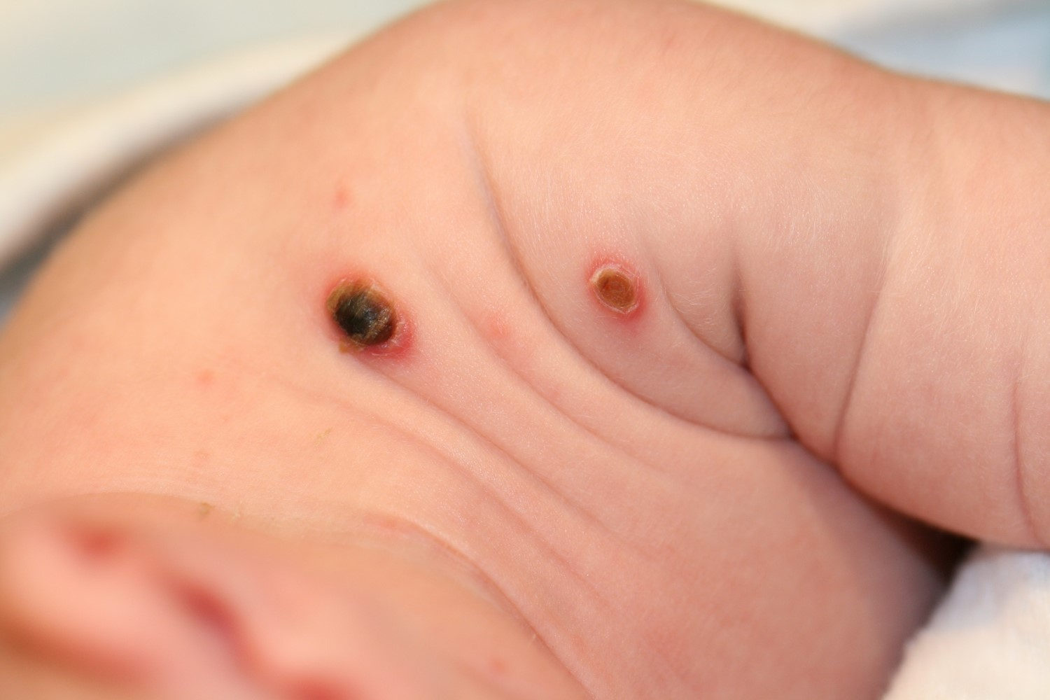

Slide 39
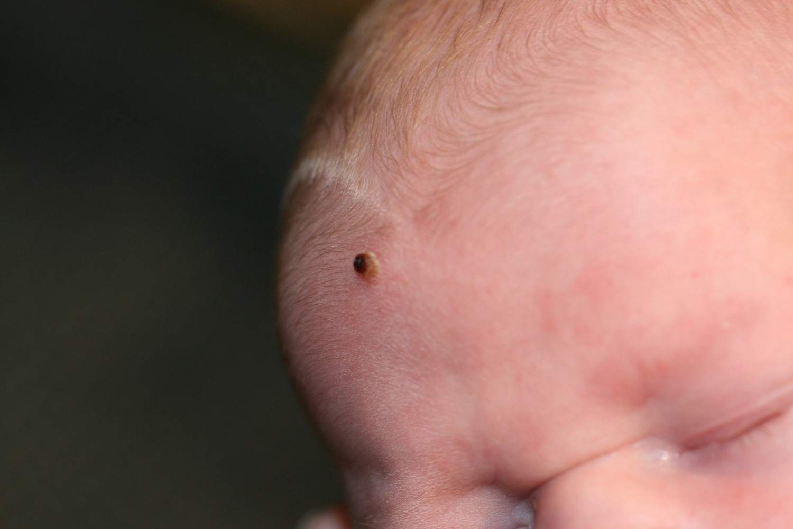

Slide 40
Congenital Self Healing Reticulohistiocytosis (CSHR)
“Hashimoto-Pritzker Disease”
Rare variant of LCH
Limited to skin only

Slide 41
CSHR
Birth or neonatal period
Red brown papules/nodules
+/- ulceration
Single or multiple
Involute w/in weeks to months

Slide 42
CSHR
Incidence?
Not clear
Likely underreported
Spontaneous resolution
Lack of recognition

Slide 43
CSHR
True CSHR is a benign process.
However:
cannot predict systemic involvement based on skin findings
thorough evaluation and follow up are indicated
Stein SL et al. Arch Pediatr Adolesc Med 2001;155:778-783.

Slide 44
CSHR
Up to 53% of pts with multisystem LCH present with skin lesions
35 patients referred for presumed skin limited LCH
40% had multisystem dz
Bone (70%)
Risk organ (liver, spleen, bone marrow) (50%)
Simko SJ et al. J Pediatr Nov 2014; Vol 165(5):990-996.

Slide 45
Lesson
Babies with “CSRH” should have a thorough evaluation for multisystem disease.

Slide 46
Case #5
2 yr old male
p/w “bumps on the skin” and an abnormal fingernail

Slide 47
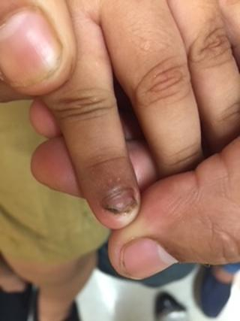

Slide 48
Case #5
History
“bumps” on arms present for months
Nail change present for months
Chronic dermatitis at the base of penis
Recent “abscess” in left thigh
I&D with negative cultures

Slide 49
Case #5
PExam
Few small waxy dome shaped papules on arms
Molluscum contagiosum
Left index fingernail
Subungual hyperkeratosis, onycholysis
Faint pink patch at base of penis
Non tender nodule in left thigh with well healed scar

Slide 50
Langerhans Cell Histiocytosis!
Nail changes (rare)
Nail dystrophy
Subungual hyperkeratosis
Purpuric striae
Subungual pustules
Onycholysis
Longitudinal grooves
Paronychia
Loss of nail plate
Kumar V et al. Pediatr Dermatol. 2017;34:732-734.

Slide 51
Nail Changes in LCH
DDx:
Psoriasis, LP, AA, Darier’s, Reiter syndrome
Infection
Bacterial (esp with paronychia)
Fungal

Slide 52
Nail Changes in LCH
Prognostic factor?
Controversial
? Correlation with multisystem disease
Poor prognosis
Spontaneous resolution
even a severe case
Prayogo RL et al. Pediatr Dermatol. 2020;37:180-183.

Slide 53
“Molluscum”
“LCH mimicking molluscum contagiosum: A case series”
Fernandez Armenteros et al. Pediatr Blood Cancer. 2018; 65:e27047.
Up to 80% have skin involvement
Wide range of features
Classic: mimics seb derm
Erythematous scaly papules/plaques on scalp and diaper area
“molluscum” type is rare

Slide 54
Lesson
LCH can present with nail dystrophy.
LCH can mimic molluscum.
Have a high index of suspicion when patient has multiple unusual skin findings.

Slide 55
Case #6
FT male
Uncomplicated pregnancy
Right leg swollen, hard, purple, tender

Slide 58
Kaposiform Hemangioendothelioma (KHE)
Rare vascular tumor
Extremities, trunk, retroperitoneum
Labs
Platelets low (16,000)
Fibrinogen low
D-dimer elevated
PT/PTT WNL

Slide 59
Kasabach-Merritt Phenomenon (KMP)
Severe thrombocytopenic coagulopathy
Typically seen with rare vascular tumors
KHE > tufted angioma
Mechanism
Platelet trapping
Clinical
Rapidly enlarging infiltrative vascular tumor
Often painful

Slide 60
KHE/KMP
Management
Avoid platelet transfusion!
Unless active bleeding
Exacerbate platelet trapping
Cryoprecipitate may be given, if needed
PRBC’s for symptomatic anemia only
Pain control

Slide 61
KHE/KMP
Management
Primarily pharmacologic
Systemic steroids
Vincristine
Alpha interferon
Sirolimus
Blatt J et al. Pediatr Blood Cancer 2010;55:1396-1398.

Slide 62
KHE/KMP
Surgery (for small tumors)
Rarely possible
Other:
Radiation
Embolization
Mahajan P et al. Clin Med Insights Blood Disord. 2017 Mar 16:10.

Slide 63
KHE

Slide 64
Lesson
Avoid platelet transfusions!
Sirolimus can be very effective for KHE/KMP.

Slide 65
Case #7
2 week old FT female
p/w "red marks" on left chest, arm, and hand
Present at birth
Not visibly changing

Slide 66
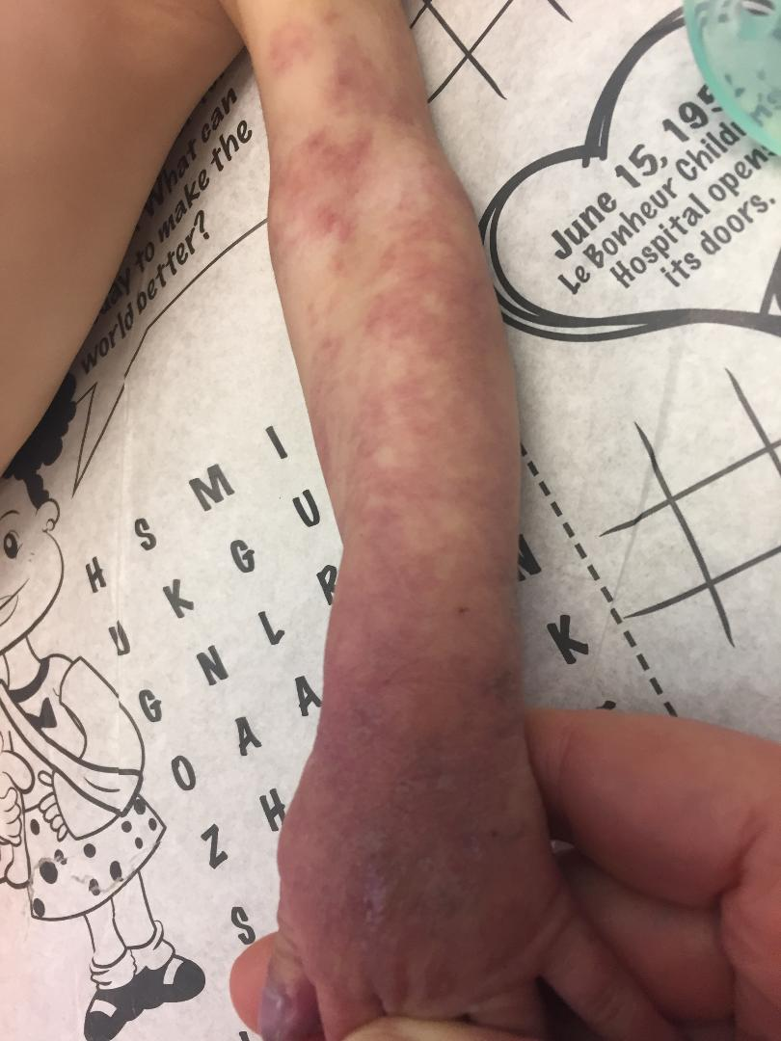
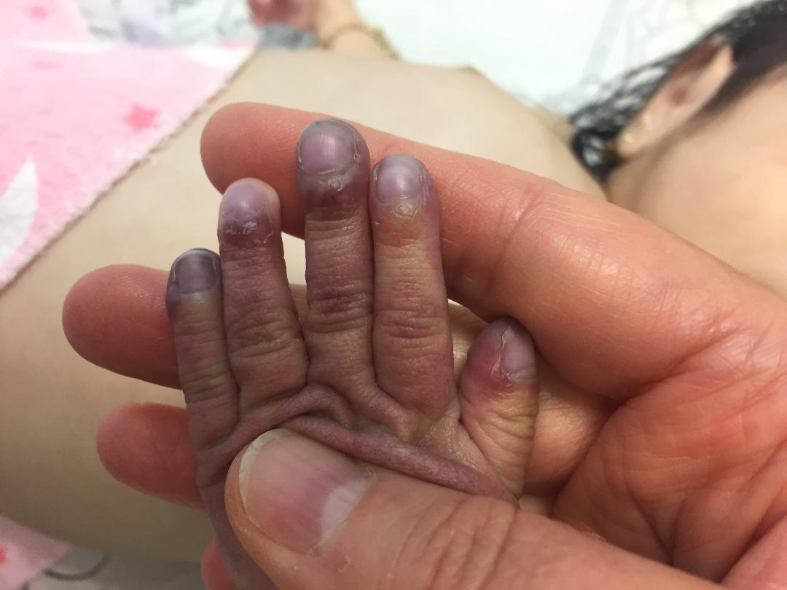

Slide 67
Interim History
Delay in follow up
RSV
Anemia
Heme/onc consult
prbc’s
LeB ED
Swelling, ? tenderness of left chest

Slide 68
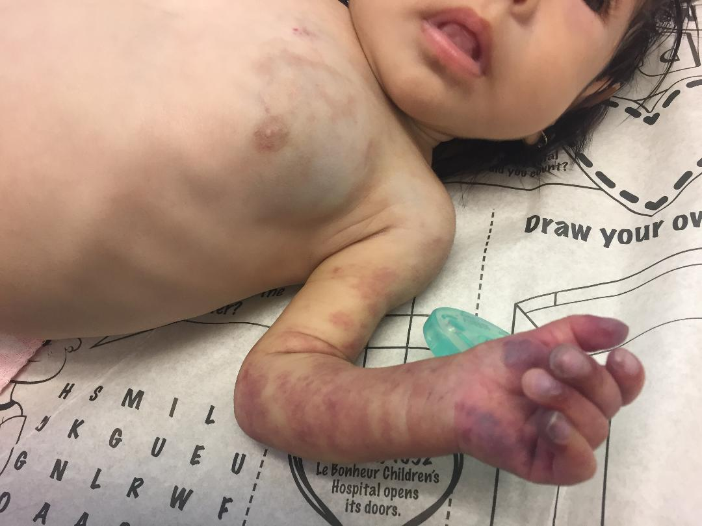

Slide 69
Hospital Course
Hgb/HCT= 6.6/21.5
Transfused with prbc’s
Stool guiaic +

Slide 70
Hospital Course
Imaging
Head ultrasound
Abdominal ultrasound
One lesion c/w “hemangioma”
Ultrasound of left chest
c/w deep infantile hemangioma
MRI of chest/arm
c/w “venous malformation”
Echocardiogram
WNL

Slide 71
Hospital Course
Anemia continues
GI work up
EGD and colonoscopy negative
OR:
Laparotomy with push endoscopy
Biopsy of left chest lesion

Slide 72
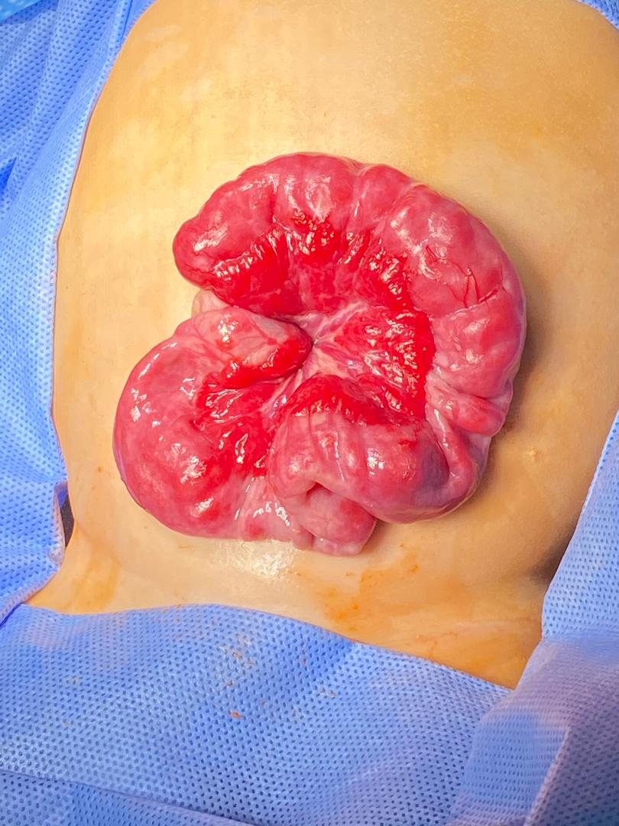

Slide 73
Hospital Course
Biopsies of small intestine and chest lesions
c/w infantile hemangioma
GLUT-1 positive
MRI/MRA of head/neck
negative

Slide 74
Treatment
Propranolol
Prednisone
Close follow up
prbc’s

Slide 75
Segmental Hemangioma
Increased risk
Complications
Associated abnormalities
PHACE, LUMBAR syndrome
Visceral lesions

Slide 76
Segmental Hemangioma
Assoc of non facial segmental HOI
Visceral lesions
Liver> GI tract> brain
Metry DW et al. Arch Dermatol May 2004. Vol 140:591-596.

Slide 77
GI Bleeding as a Complication of Segmental HOI
Report of 10 patients
Female
Hispanic or Caucasian
Large segmental HOI
Facial (8) and non-facial (2)
+/- PHACE syndrome (9/10)
Drolet BA et al., J Pediatr. Vol 160(60):1021-1029.

Slide 78
Segmental HOI of GI Tract
Lower GI bleeding
Multiple rbc transfusions
Difficult to diagnose
Located in small intestine/mesentery
Segmental
Assoc with arterial anomalies
Vascular dysplasia of the aorta

Slide 79
Lessons
Atypical morphology of segmental hemangioma
Risk of visceral HOI
Even with non-facial segmental HOI
Localized
Segmental
Present with GI bleeding

Slide 80
Thank You!
twrigh43@uthsc.edu

