Slide 1
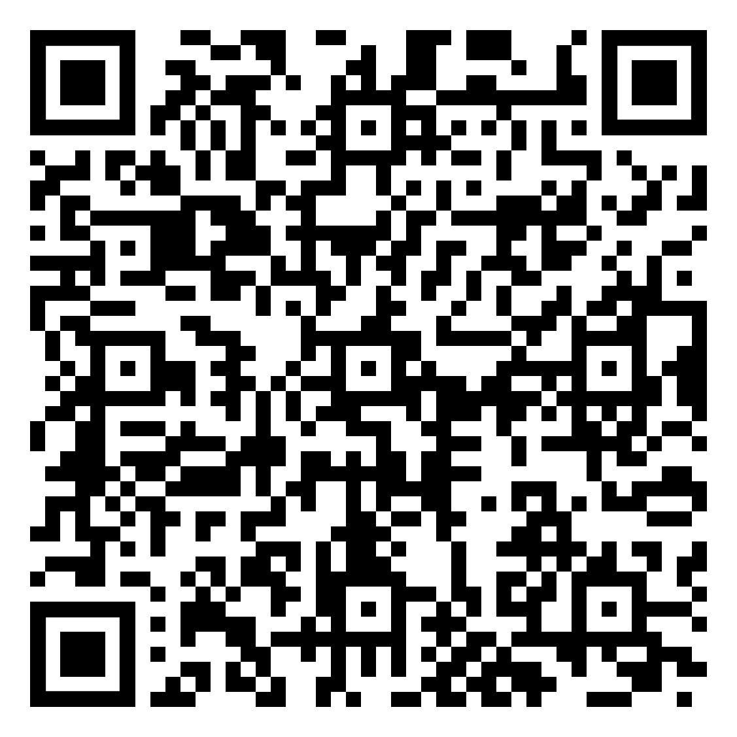

Slide 2
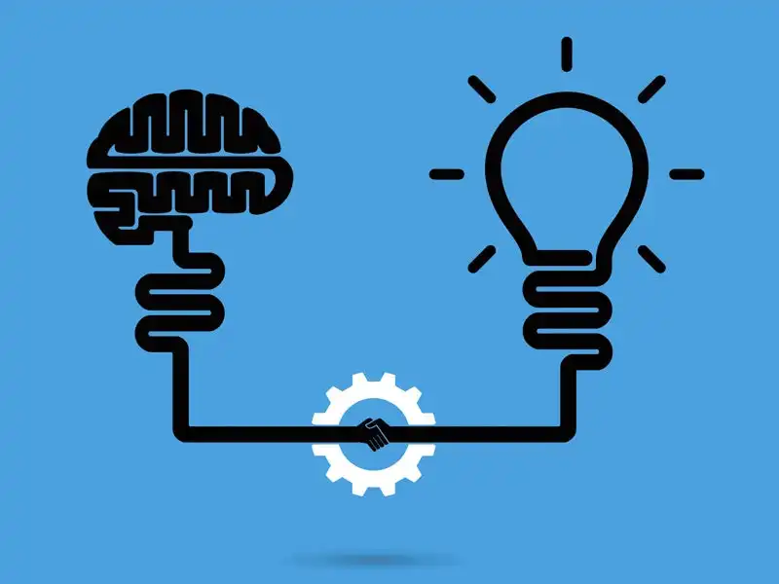
Product Innovation and research

Slide 3
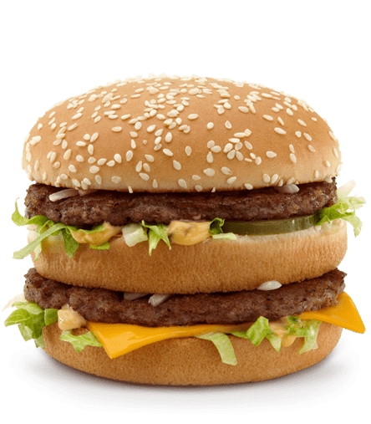

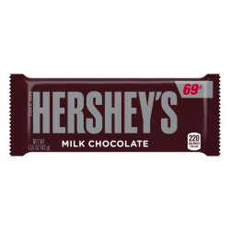
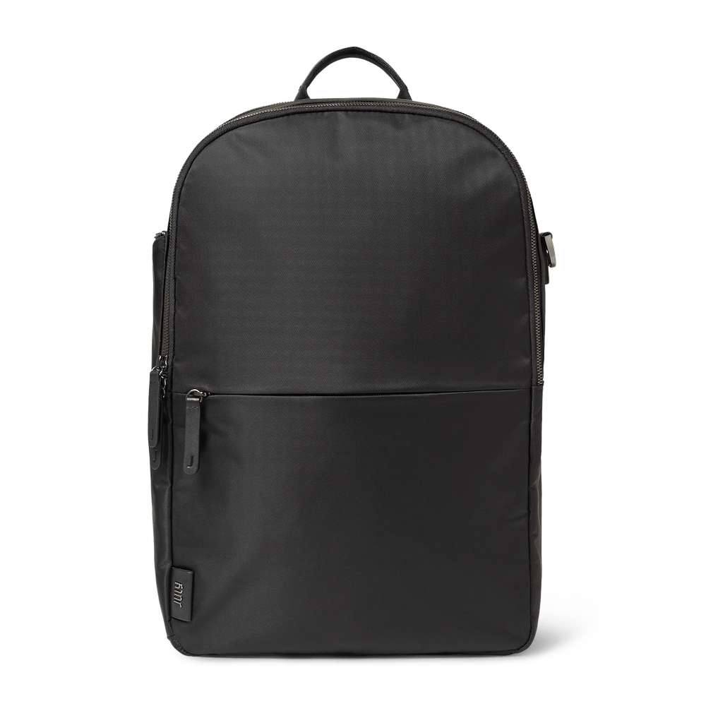
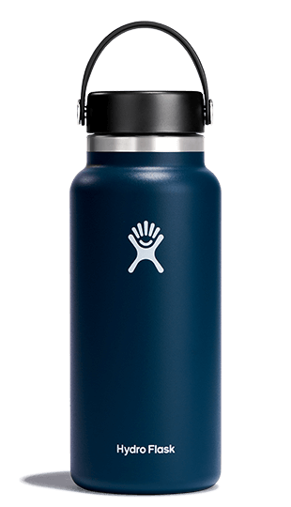
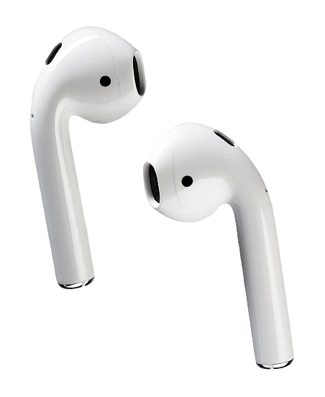
Guess the product
Guess the product​

Slide 4


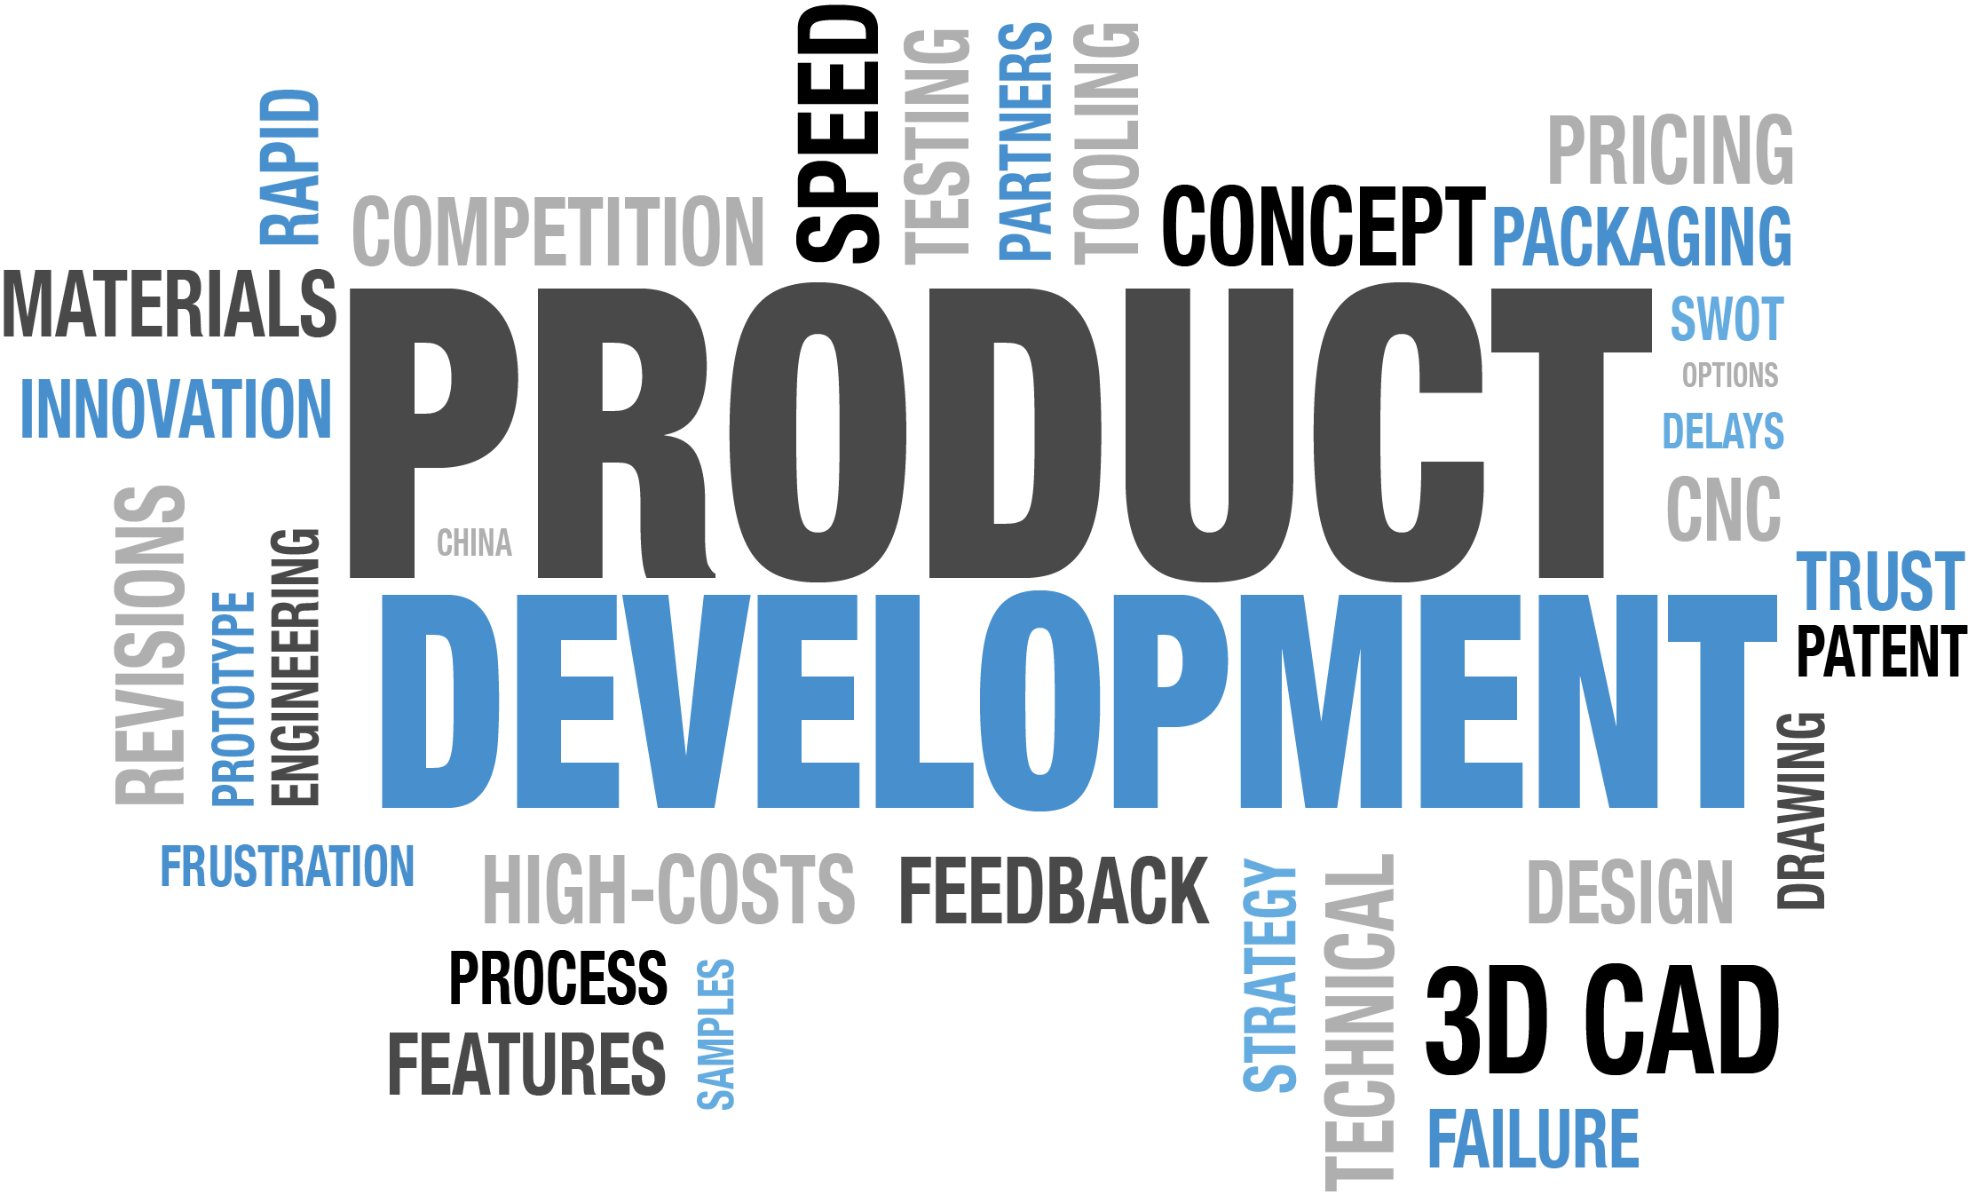
Raise The Bar
IT’S TIME TO
What is product innovation?
Product innovation involves the development of new products or the enhancement of existing ones to meet customer needs and market demands.
Steps of
product innovation
Ideation:
Generating creative ideas for new products or product improvements based on research findings.
Prototyping:
Building prototypes or minimum viable products (MVPs) to test concepts and gather feedback.
Sustainability:
Considering environmental and social factors to create eco-friendly and socially responsible products.
Research and Analysis:
It starts with in-depth market research and analysis to identify opportunities and understand customer preferences.

Slide 5
Market Research
Market Research
Research and Analysis
Market Segmentation
The systematic process of gathering information, data, and insights to gain a deeper understanding of a subject, issue, or problem. It involves collecting, evaluating, and interpreting data to make informed decisions or draw conclusions. In business and various fields, research and analysis are essential for market research, problem-solving, decision-making, and the development of strategies and solutions. This process may encompass various methodologies, such as surveys, interviews, data analysis, and literature reviews, among others, depending on the specific goals and objectives of the research.
Demographic
Demographic segmentation categorizes a market by characteristics such as age, gender, income, and education to target specific consumer groups with tailored marketing strategies.
Geographic
Geographic segmentation divides a market based on geographical factors like location, climate, or urban/rural distinctions to address the unique needs and preferences of consumers in different areas.
Psychographic
Psychographic segmentation classifies consumers into groups based on their psychological and lifestyle traits, such as values, interests, and attitudes, to create marketing messages that resonate on a deeper, emotional level.
Behavioral
Behavior in behavioral segmentation refers to how customers act and engage with products, marketing, and brands, helping businesses create targeted strategies.

Slide 6

Invention convention
Directions
You have 5 minutes to:
Draw A Product
Give it a Name
Give it A Description
State your Target Market from your "Research"

