Slide 1
Starting your business

Slide 2
Choosing your location
Physical
Customer Access: A physical location provides a point of access for local customers who prefer in-store shopping, immediate product availability, or personal assistance.
Brand Visibility: The physical presence of a business in a specific area contributes to brand visibility and awareness within the local community.
Community Engagement: Physical locations allow businesses to engage with and contribute to the local community, fostering positive relationships and brand loyalty.
Market Expansion: A local presence can serve as a stepping stone for businesses looking to expand into new geographic markets and diversify their customer base.
------------------------------------------------------------------------------------------------------------------------------------------------------------------------------------------------------------------------------
E- Commerce
Global Reach: E-commerce allows businesses to reach customers globally, breaking down geographical barriers and expanding market opportunities.
Convenience: Online shopping offers unparalleled convenience, enabling customers to shop 24/7 from the comfort of their homes or mobile devices.
Time-Saving: E-commerce eliminates the need for physical travel, parking, and waiting in lines, saving customers valuable time.
Accessibility: E-commerce is inclusive, making it accessible to people with disabilities, the elderly, and those in remote or underserved areas.

Slide 3
Funding
Funding is like the fuel that keeps a business or project running. It's the money that a company needs to get started, stay afloat, and grow. Without it, businesses can't hire employees, expand, or even cover everyday expenses. Whether you're starting a new business, launching a product, or trying to stay competitive, having the right funding is key to making things happen and keeping your venture alive and thriving.
Ways of Funding
Bootstrapping: Bootstrapping involves using personal savings, revenue generated by the business, or funds from friends and family to finance a venture without external debt or equity financing.
Bank Loans: Businesses can secure loans from banks or financial institutions, which can be used for various purposes, such as working capital, expansion, or purchasing assets.
Crowdfunding: Crowdfunding platforms like Kickstarter and Indiegogo allow businesses to raise funds from many individuals who contribute relatively small amounts of money in exchange for products, services, or other incentives.
Fundraisers: Fundraisers are events or campaigns organized to raise funds for a specific cause, organization, project, or charity. They can take various forms, including charity galas, auctions, crowdfunding campaigns, benefit concerts, sales and product fundraisers, and more. Fundraisers involve engaging the community and supporters to contribute directly to a particular cause or project.

Slide 4
What is branding?
At its simplest, branding is the process of creating a distinct and memorable image or identity for a product, service, or company. It involves using visual elements like logos, colors, and design, as well as messaging and values, to establish a unique and recognizable presence in the minds of customers. Effective branding helps products or businesses stand out, build trust, and connect with their target audience.

Slide 5
Guess the
Logo

Slide 6


Slide 7


Slide 8


Slide 9


Slide 10


Slide 11


Slide 12


Slide 13


Slide 14
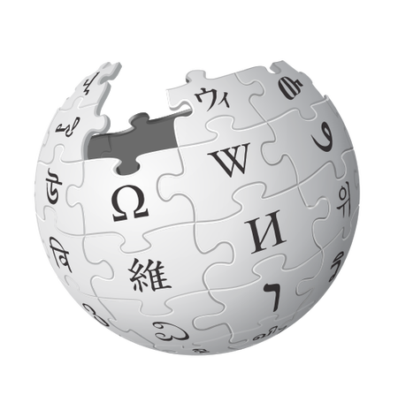

Slide 15


Slide 16


Slide 17
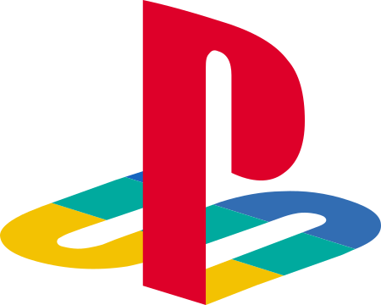

Slide 18


Slide 19


Slide 20


Slide 21


Slide 22


Slide 23
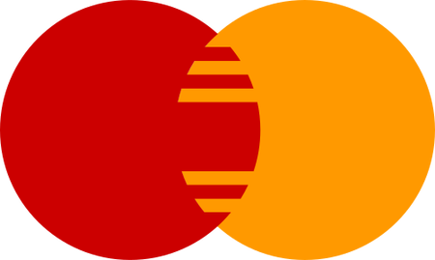

Slide 24
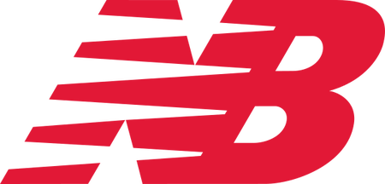

Slide 25


Slide 26


Slide 27


Slide 28


Slide 29


