Slide 1
Marketing Strategies
Next Level

Slide 2
AGENDA
Market Segmentation Review
Marketing Mix
5 M’s of Marketing
SWOT
Influenced

Slide 3
Market Segmentation Review
● Demographics: Covers whole societies, or groups defined by “black and white” criteria
such as gender, age, income, class, or education.
● Psychographics: The study of personality, values, opinions, attitudes, interests, and
lifestyles.
● Geographics: The segmentation of a market by area, such as cities, counties, regions,
countries, and international regions.
● Behavioral: Segments the intended market into consumers based on their behavior
regarding our product. This can involve the consumer’s loyalty, knowledge of, attitude

Slide 4
Marketing mix (4 P’s)
Marketing Mix: Contains the four Marketing Activities (4 P’s) - Product, Place, Promotion, and Pricing.
These parameters CAN be controlled by marketers to appeal to the target market.
● Promotion- The advancement of a product, idea, or a point of view through informing the consumers through various communication channels.
● Product - a good or service that most closely meets the requirements of a particular
market and yields enough profit to justify its continued existence
● Place/Distribution - where the product will be sold and how it will be delivered to the
market
● Price - quantity of payment someone gives in return for a good or service

Slide 5
Why use a marketing mix?
Typically, successful marketers and businesses consider the four Ps when creating marketing plans and strategies to effectively market to their target audience.

Slide 6
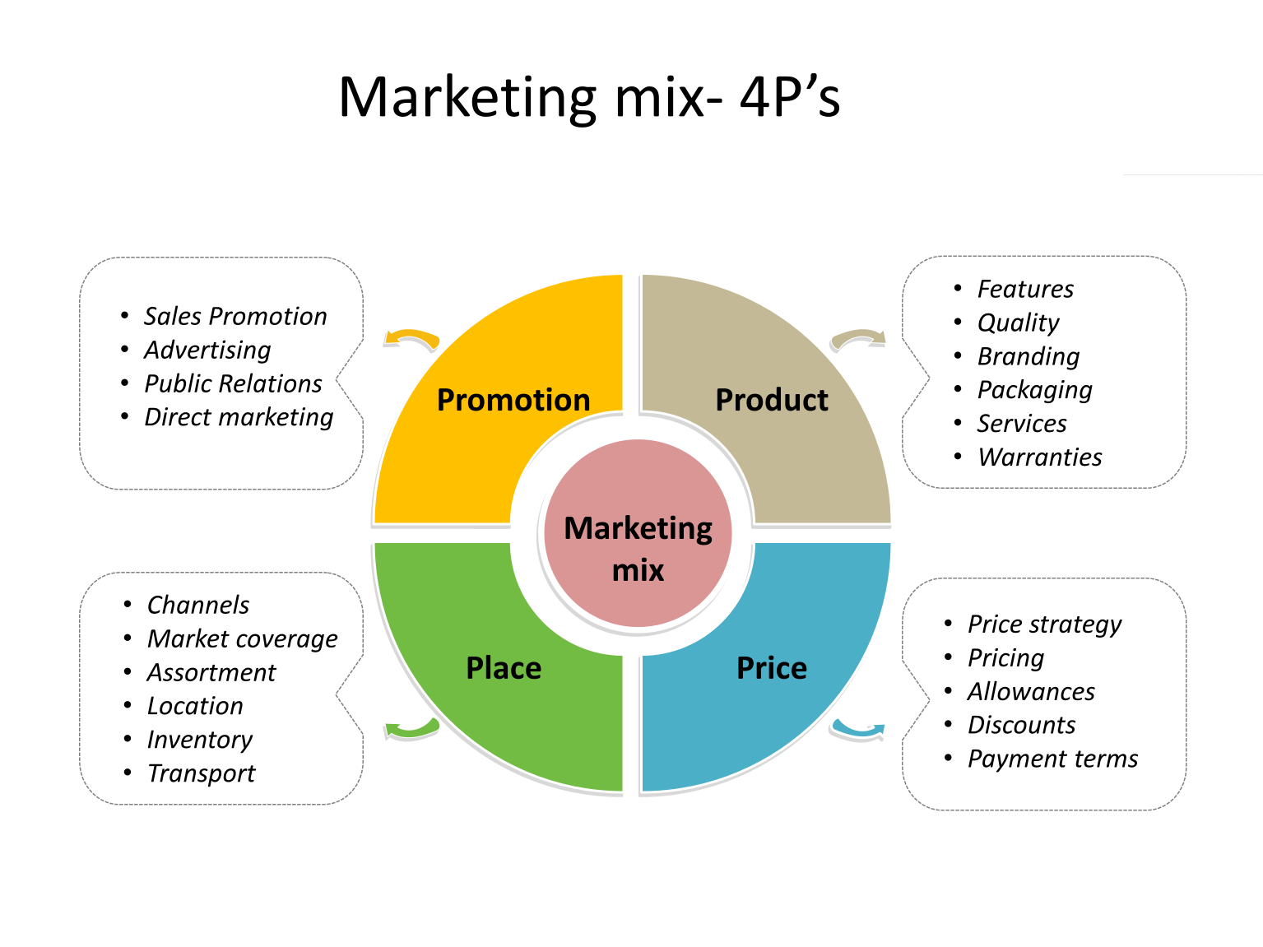

Slide 7
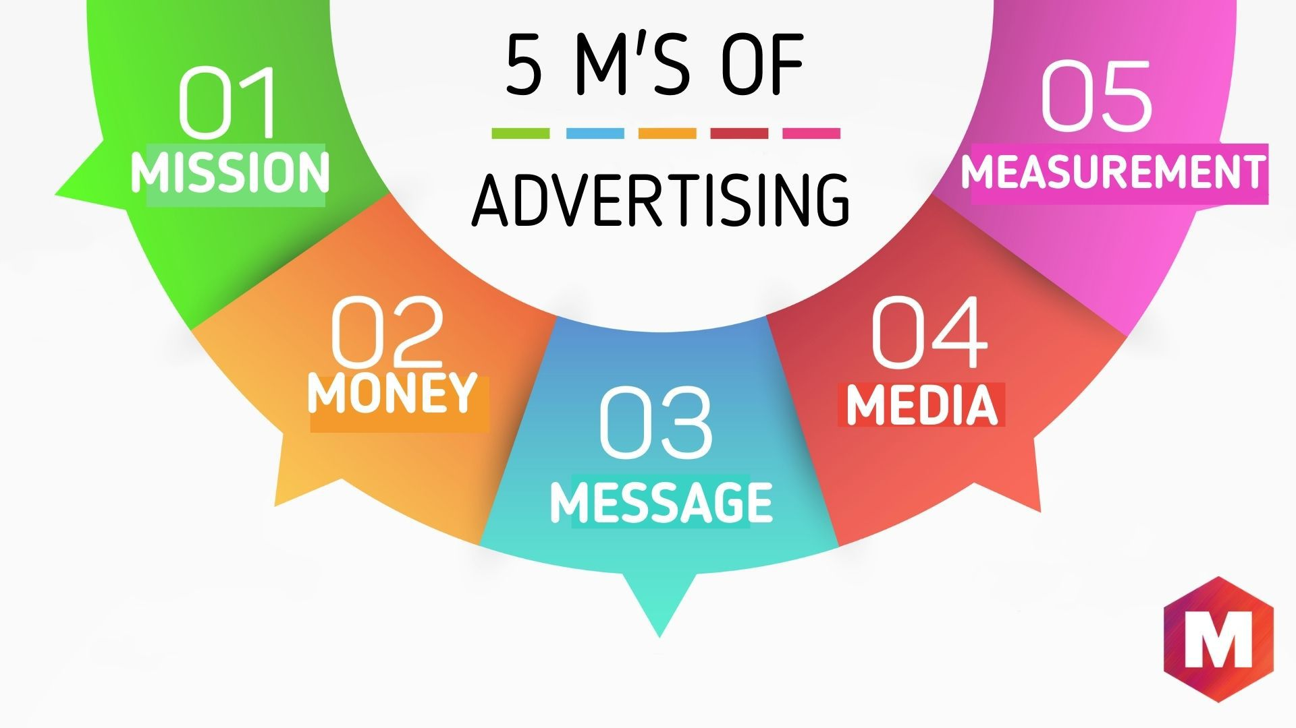
5 M’s of Marketing

Slide 8
Break down
MEASUREMENT
MEDIA
In marketing, the choice of media is crucial; it's about selecting the right channels—be it social platforms, traditional advertising, or other mediums—to effectively reach and engage your target audience.
To gauge the success of your marketing efforts, measurement tools are essential. Tracking key indicators provides valuable insights, allowing you to refine strategies and optimize for better results.

Slide 9
Break down
MISSION
MONEY
MESSAGE
Every marketing initiative should align with your overall mission or purpose as a brand. It's not just about selling a product; it's about conveying a larger message that resonates with your audience.
Financial considerations are integral to marketing planning. Allocating budgets wisely ensures a balanced approach, optimizing spend to maximize returns on investment in various marketing activities.
Crafting a clear and compelling message is at the core of effective marketing. Your communication should resonate with your target audience, conveying your brand's value proposition succinctly and persuasively.

Slide 10
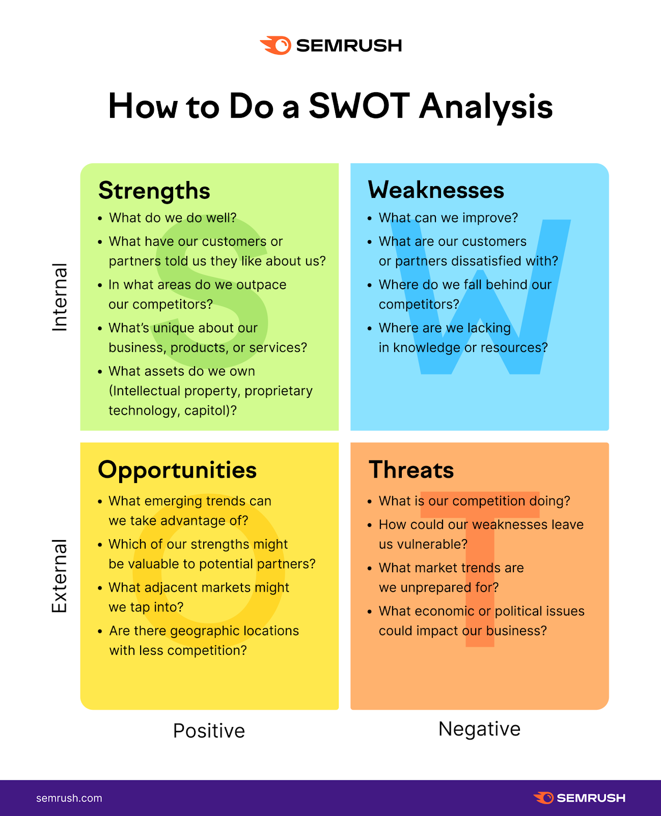
SWOT
A SWOT analysis helps you assess internal factors that might affect your business (strengths and weaknesses) and external factors (opportunities and threats).

Slide 11
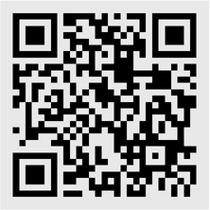
Follow us on Instagram:
@nextlevelbrains
Follow us on Tiktok: @nxtlevelbrains

Slide 12
THANK YOU
https://playinfluencd.com/

