Slide 1

Welcome to our
In Person Learning Family Orientation
We are so glad you are here!

Slide 2
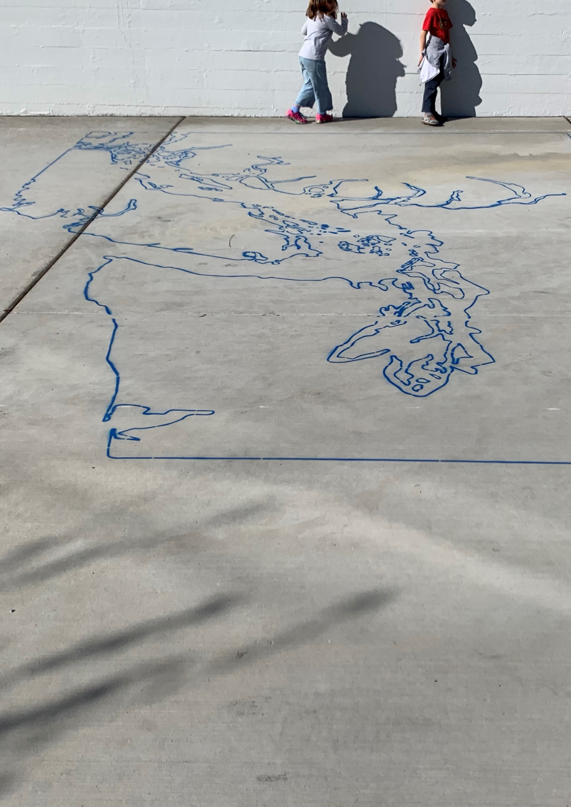


Slide 3


Slide 4


Family Orientation
Return to In-Person Learning
Magnolia Elementary School
March 31, 2021

Slide 5




Return to In-Person Learning
Top 10 Things SPS Families Need to Know
1
An electronic required daily health screening must be submitted prior to 7 a.m. Families will receive an “approved” or “not approved” notice.
2
Students will be required to wear a mask. Masks must be worn on the bus and in school except for when students are drinking or eating. If a student doesn’t have a mask, one will be provided. Plexiglass barriers have been installed in specialized classrooms for students who can’t wear a mask.
3
One student will be assigned to each bus seat, unless from the same household. Windows will be open or adjusted to provide air flow. Bus drivers will wear approved PPE, such as a mask, and sanitize high touch areas between each route. The bus will be sanitized daily after the last run.
Notes:
I thought it might be helpful to walk through the steps families and students will take during an in-person learning day. This is our “top ten” list.
Before entering a school building, parents and staff will submit a daily, required health screening. This screening will be sent to families electronically and they will be able to access via home language through email or text. The screening needs to be submitted by 7 a.m. every school day. Families will receive an “approved” or “not approved” notice. If families haven’t completed the health screening before arriving at school, they can at the school site. If a child arrives with a “not approved” notice, they will be guided to a supervised waiting room and staff will contact the family. Only students with an “approved” notice will enter classrooms.
All students and staff must wear a cloth face covering – a mask- or other approved alternative. Some staff, because of proximity to students will be required to wear a higher level of PPE including a face shield. Masks must be worn on the bus and while at school except for when students are eating and drinking. If a child doesn’t have a mask, we will provide one. Staff have also installed plexiglass barriers in the front office AND in specialized rooms that may serve students that because of development or disability can’t wear a mask. All mask protocols align with CDC and Public Health requirements.
There will be fewer students on our yellow buses to support physical distancing. Students will maintain 6 feet while waiting for the bus and wear a mask on the bus. If a student doesn’t have a face covering one will be provided for them. Seats will be assigned, and routes have been designed to ensure little interaction between households. One student will be assigned to each bus seat, unless from the same household. Windows will be open or adjusted to provide air flow. Students will exit the bus at the direction of the bus driver, from front to back, while maintaining 6 feet of physical distance.
Bus drivers will wear approved PPE in compliance with Labor and Industries, such as a mask, and sanitize high touch areas between each route.

Slide 6
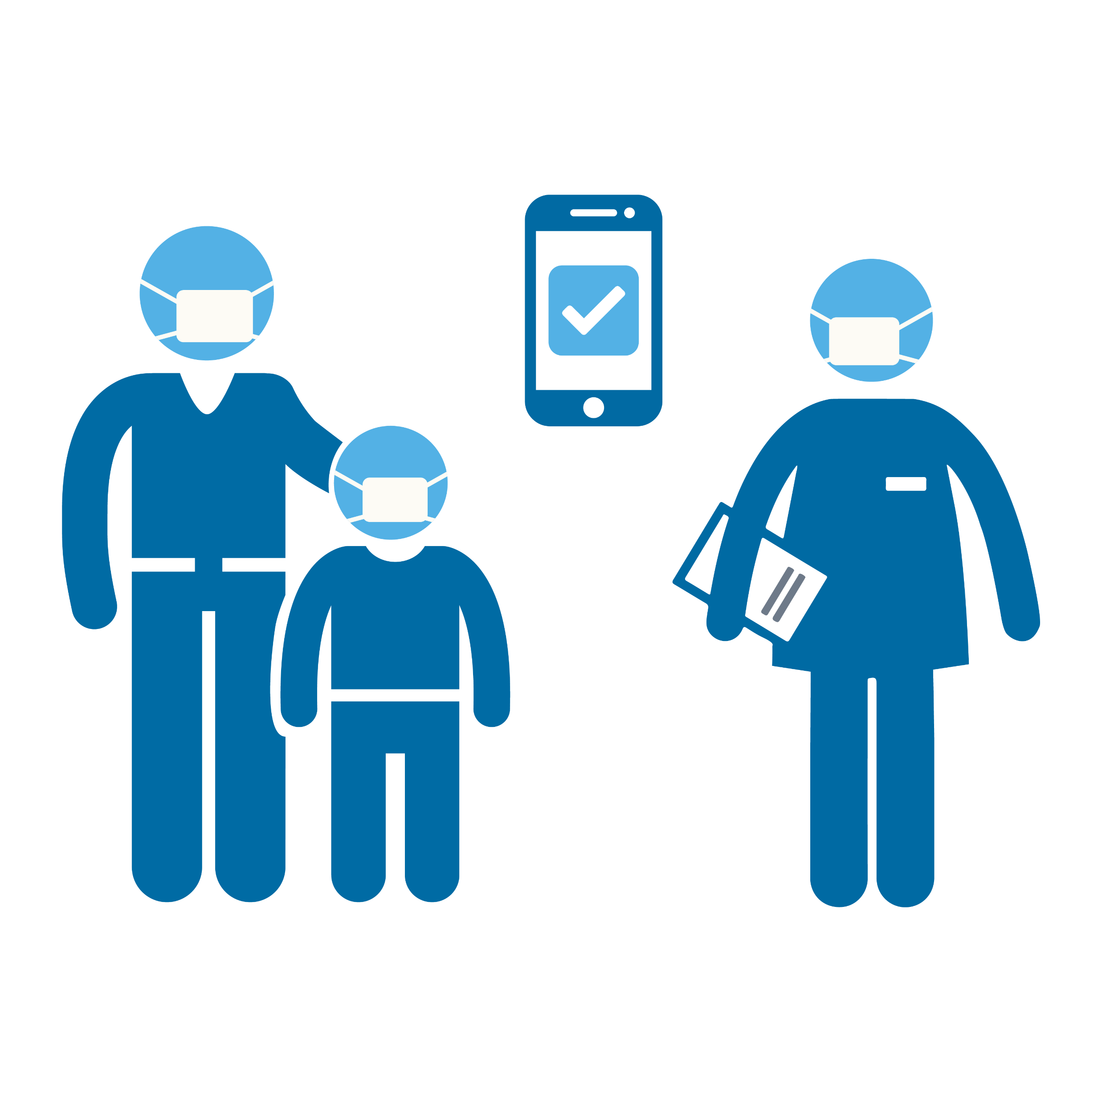

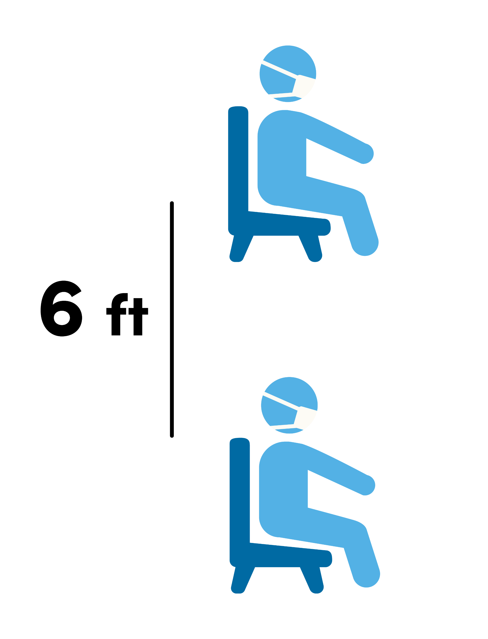
Return to In-Person Learning
Top 10 Things SPS Families Need to Know
4
All students will be met by staff at a designated drop off area. The required, daily health screening will be confirmed. If a health screening is not complete, the family will attest on site or will be contacted, and the student will remain in a separate waiting area until complete.
5
All classrooms are 15 students or less. These small groups, or cohorts, will stay together all day including at lunch and recess. Student cohorts have dedicated entrances, exits, and restrooms. Students with a confirmed health screening will enter the building through the designated entrance.
6
In the classroom, students will be assigned to seats that are six feet apart and face the same direction. Arts and physical education will be provided through a combination of remote and asynchronous learning. Students receiving in-person intensive special education services will have access to general education content remotely with support from their teacher.
Notes:
Once students arrive at school, they will be met by staff at a designated drop off area where the daily health screening will be confirmed. If parents are dropping students off or students have arrived at school on their own, they will wait at the designated area, remaining six feet apart until a staff person welcomes their student into the building.
All classrooms are 15 students or less. These small groups, or cohorts, will stay together all day including at lunch and recess. Once a student is approved for entry, they will enter through their designated cohort entrance. Student cohorts have dedicated entrances, exits, and restrooms in order to reduce interaction between groups of students.
All of our preschool, kindergarten, first grade and intensive service pathway classrooms have been redesigned to support health and safety. In the classroom, students will be assigned to seats that are six feet apart in all directions and face the same direction. Ten feet has been left in the front of the classroom for the teacher. Arts and physical education will be provided through a combination of remote and asynchronous learning. Students receiving in-person intensive special education services will have access to general education content remotely with support from their teacher. Students will eat lunch in their classroom.

Slide 7



Return to In-Person Learning
Top 10 Things SPS Families Need to Know
7
Students will have their own learning materials for daily use and those items will not be shared. Items coming back and forth from school to home will be limited.
8
Hand hygiene will be prioritized throughout the day including but not limited to on arrival, after recess, and after using the restroom. Hand washing signage will be throughout the building.
9
Daily cleaning of common areas will be done in compliance with CDC and Public Health recommendations. High touch areas and restrooms will be cleaned three times a day. Additional PPE will be provided in every classroom for daily use. If there is a suspected or confirmed case, SPS will follow CDC cleaning, contact tracing, and communication protocols.
Notes:
Students will have their own materials for daily use and items will not be shared. Items coming back and forth from school to home will be limited.
Handwashing will be prioritized throughout the day including but not limited to on arrival, before lunch, after recess, and after using the restroom. All classrooms have been stocked with handwashing supplies and hand washing signage is posted throughout the building.
Daily cleaning of common areas is done in compliance with CDC and Public Health recommendations. High tough areas such as door knobs, hinges, door bars as well as restrooms will be cleaned three times a day. We have hired additional staff to support this increased in cleaning. Additional PPE will be provided in every classroom for daily use

Slide 8


Return to In-Person Learning
Top 10 Things SPS Families Need to Know
10
When heading home, students will line up maintaining CDC social distancing guidelines. Students will load or be picked up from a designated area.
SPS staff have been preparing for a phased return to in-person learning. We are ready. Health and safety protocols have been implemented, Personal Protective Equipment (PPE) is in place, and the district is prepared for student transportation and meals.
While in-person learning may look different, we are committed to ensuring our classrooms remain engaging and joyful.
Learn more at www.seattleschools.org/resources
Notes:
Classroom entrance and release times will be staggered. When heading home, students will line up maintaining a six-foot distance and walk to the designated loading zone and will be directed by staff as they load on to the bus.
Students being picked up by a parent, will maintain a six-foot social distance and walk to the designated pick up area. Any student not picked up will be escorted to a supervised gathering area to wait for parent arrival.
SPS staff have been preparing for a phased return to in-person learning since last June. Our buildings are ready. Health and safety protocols have been implemented, we have audited all HVAC systems and have brought schools into compliance with CDC and expert recommendations, Personal Protection Equipment (PPE) is in place, and the district is prepared for student transportation and meals.
While school WILL look different, we are committed to sustaining engaging and joyful learning classrooms.

Slide 9
Getting Ready!
Things to do BEFORE you arrive
Family COVID Release Form –
required 1st day!
Daily Electronic Attestation Process!!!
Text so we have phone number
What To Bring?
Backpack
Device and Charger (required)
Water bottle filled with water and
labeled with student's name
Snack (simple healthy item – easy to eat)
Extra layer – windows will be open in
classrooms

Slide 10
Getting To and From School
Drop Off and Pick Up Procedures
Our goal (as the team of adults at home and school who support our students) is to create a calm and welcoming start
Family adult is asked to walk their student(s) to their dot/teacher the first week and confirm attestation is complete before leaving
Students can not go to class
without an approved attestation

Slide 11
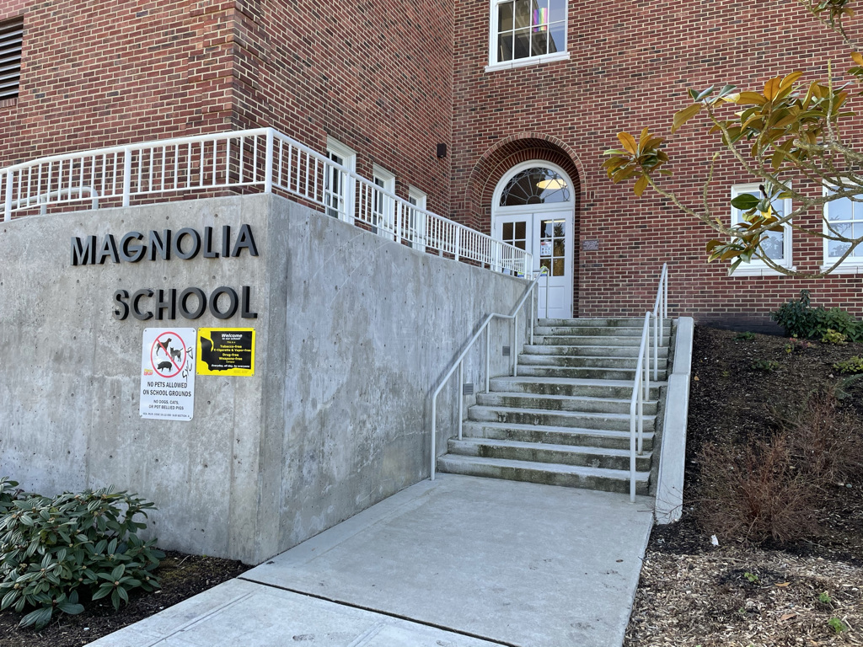
Drop Off and Pick Up Procedures
Kindergarten ~ Cohort A
Kindergarten students assigned to Cohort A will line up on dots leading up to the side door on Smith Street at 7:55 am. K Teachers will be at this entrance to greet students and confirm that adult family members have submitted an attestation. They will walk their cohorts into the building and up the staircase just in the door to their classrooms on the 2nd floor.
At 10:40 am, K Teachers will walk their students back out to these dots to hand students off to their adult family members for pick up.

Slide 12
Drop Off and Pick Up Procedures
Kindergarten ~ Cohort B
Kindergarten students assigned to Cohort B will line up on dots leading up to the side door on Smith Street at 11:40 am. K Teachers will be at this entrance to greet students and confirm that adult family members have submitted an attestation. They will walk their cohorts into the building and up the staircase just in the door to their classrooms on the 2nd floor.
At 2:25 pm, K Teachers will walk their students back out to these dots to hand students off to their adult family members for pick up.

Slide 13
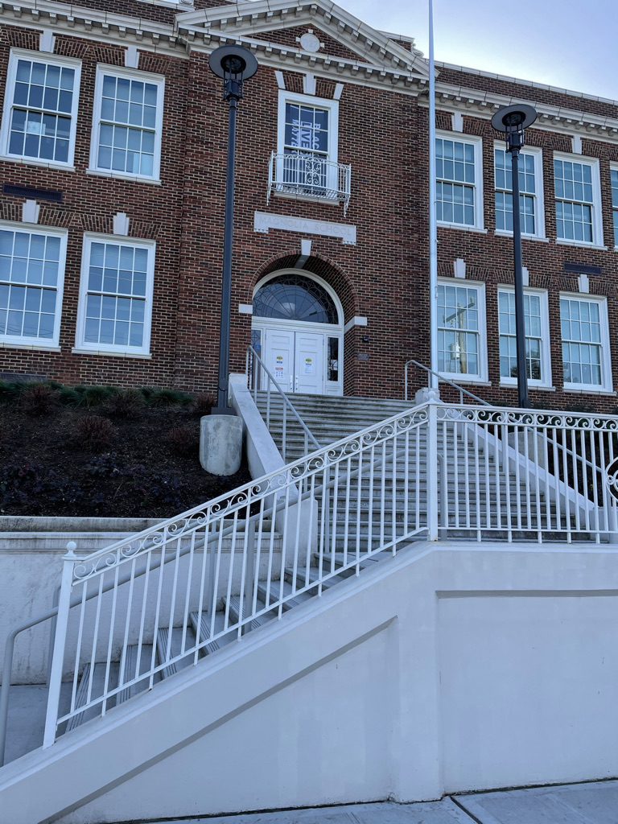
Drop Off and Pick Up Procedures
1st Grade ~ Cohort A
1st grade students assigned to Cohort B will line up on dots leading up to the front door on 28th Street at 7:55 am. 1st Grade Teac hers will be at this entrance to greet students and confirm that adult family members have submitted an attestation. They will walk their cohorts into the building and to their classrooms on the 1st or 2nd floor.
At 10:40 am, 1st Grade Teachers will walk their students back out to these dots to hand students off to their adult family members for pick up.

Slide 14
Drop Off and Pick Up Procedures
1st Grade ~ Cohort B
1st grade students assigned to Cohort B will line up on dots leading up to the front door on 28th Street at 10:40 am. 1st Grade Teac hers will be at this entrance to greet students and confirm that adult family members have submitted an attestation. They will walk their cohorts into the building and to their classrooms on the 1st or 2nd floor.
At 2:25 pm, 1st Grade Teachers will walk their students back out to these dots to hand students off to their adult family members for pick up.

Slide 15
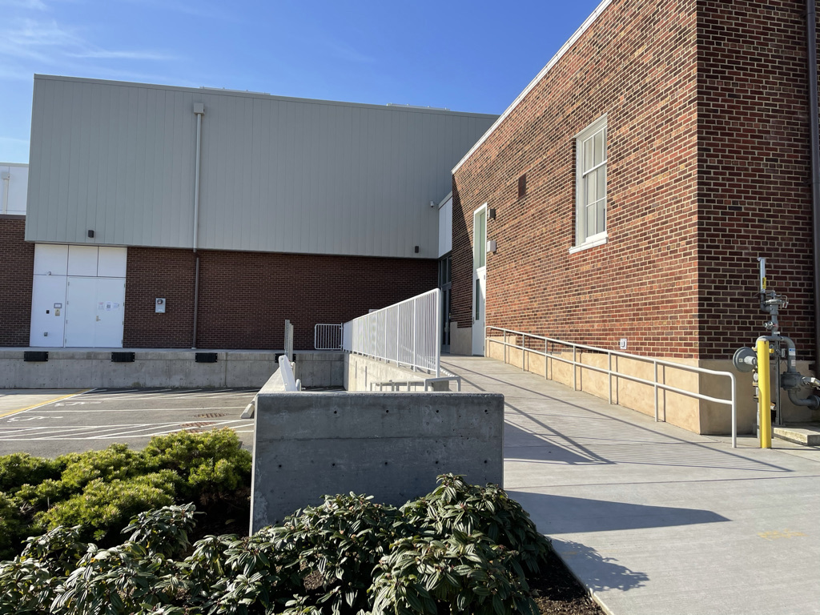
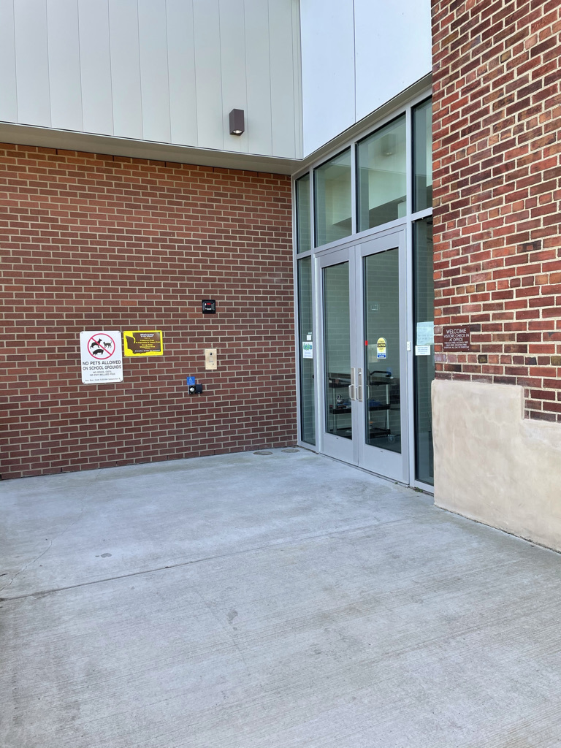
Drop Off and Pick Up Procedures
2nd & 3rd Grade ~ Cohort A
2nd and 3rd Graders assigned to Cohort A will line up on dots leading up to the back door entering the Commons (off the loading dock on Smith Street) at 8:00 am. 2nd & 3rd Grade Teachers will be at this entrance to greet students and confirm that adult family members have submitted an attestation. They will walk their cohorts into the building and upstairs to their classrooms on the 2nd floor.
At 10:45, 2nd and 3rd Grade Teachers will walk their students back out to these dots to hand students off to their adult family members for pick up.

Slide 16
Drop Off and Pick Up Procedures
2nd & 3rd Grade ~ Cohort B
2nd and 3rd Graders assigned to Cohort A will line up on dots leading up to the back door entering the Commons (off the loading dock on Smith Street) at 11:45 am. 2nd & 3rd Grade Teachers will be at this entrance to greet students and confirm that adult family members have submitted an attestation. They will walk their cohorts into the building and upstairs to their classrooms on the 2nd floor.
At 2:30 pm, 2nd and 3rd Grade Teachers will walk their students back out to these dots to hand students off to their adult family members for pick up.

Slide 17
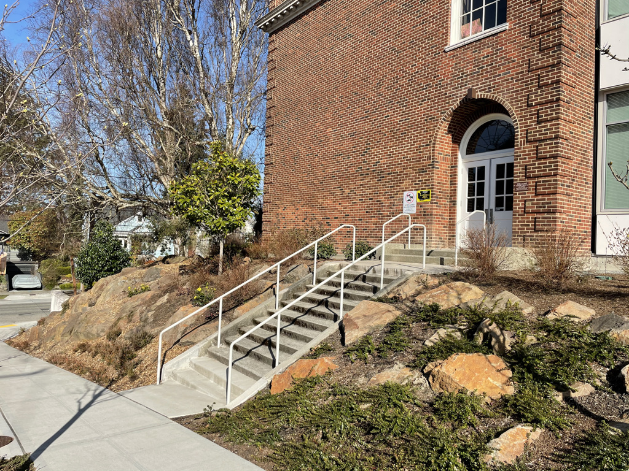
Drop Off and Pick Up Procedures
4th & 5th Grade ~ Cohort A
4th and 5th Graders assigned to Cohort A will line up on dots leading up to the side door on McGraw Street at 8:00 am. 4th and 5th Grade Teachers will be at this entrance to greet students and confirm that adult family members have submitted an attestation. They will walk their cohorts into the building and up the staircase just in the door to their classrooms on the 2nd floor.
At 10:45, 4th and 5th Grade Teachers will walk their students back out to these dots to hand students off to their adult family members for pick up.

Slide 18
Drop Off and Pick Up Procedures
4th & 5th Grade ~ Cohort B
4th and 5th Graders assigned to Cohort A will line up on dots leading up to the side door on McGraw Street at 11:45 am. 4th and 5th Grade Teachers will be at this entrance to greet students and confirm that adult family members have submitted an attestation. They will walk their cohorts into the building and up the staircase just in the door to their classrooms on the 2nd floor.
At 2:30, 4th and 5th Grade Teachers will walk their students back out to these dots to hand students off to their adult family members for pick up.

Slide 19
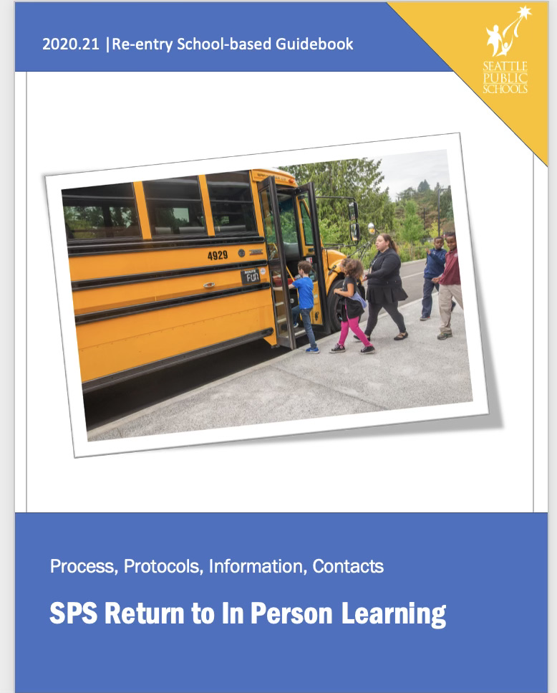
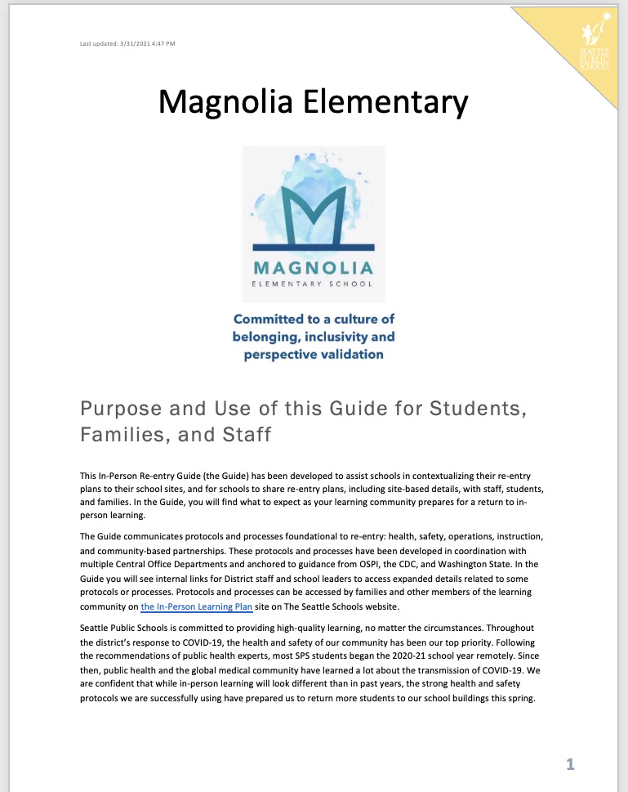
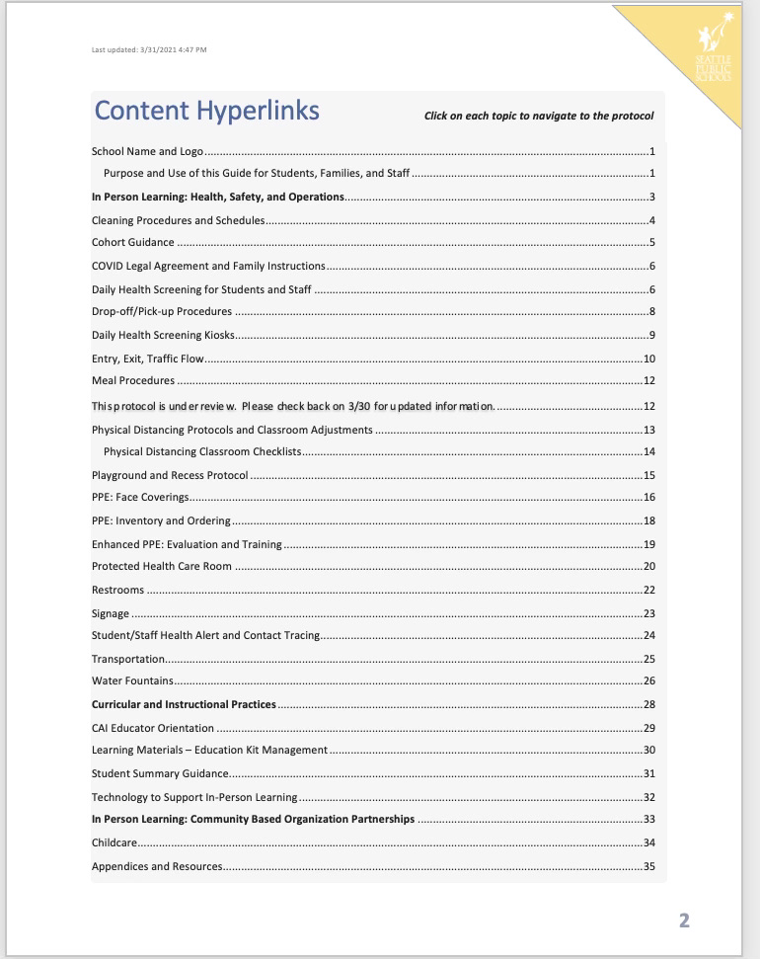
School Safety Plans
SPS School Re-Entry Guide ~ MES

Slide 20
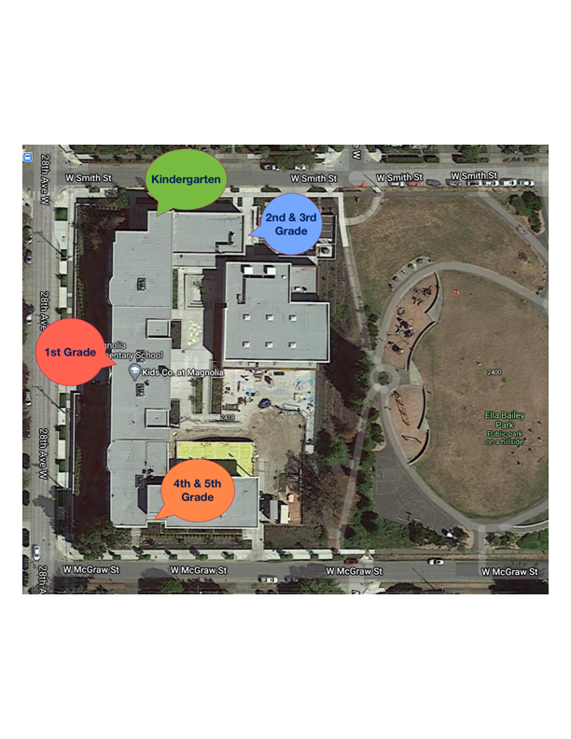
School Safety Plans
See SPS School Re-Entry Guide ~ MES
Entry, Exit, Traffic Flow

Slide 21
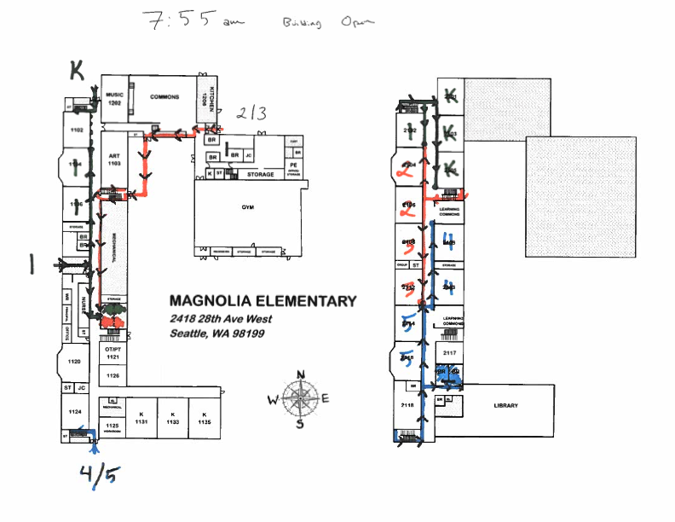
School Safety Plans
See SPS School Re-Entry Guide ~ MES
Entry, Exit, Traffic Flow

Slide 22
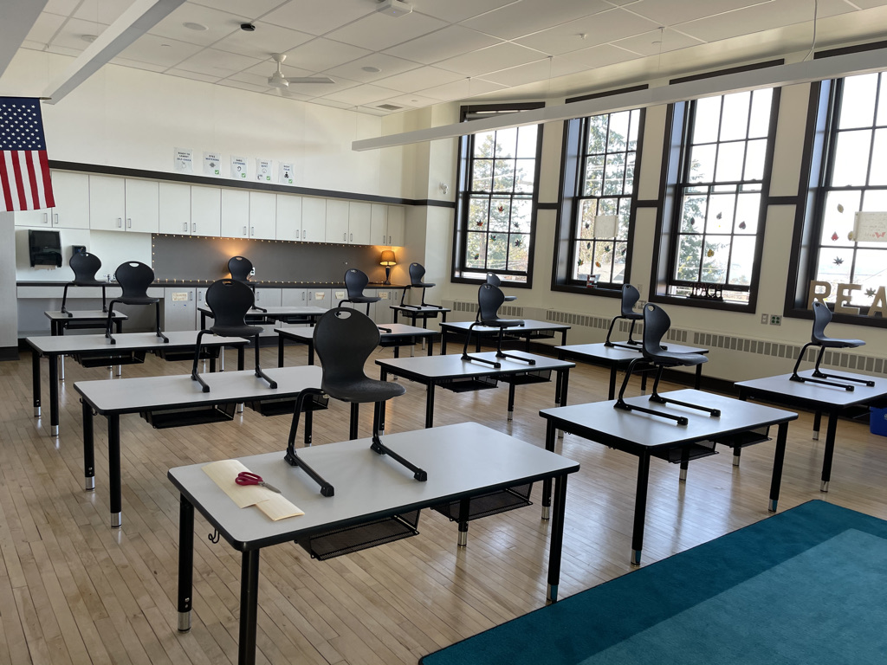
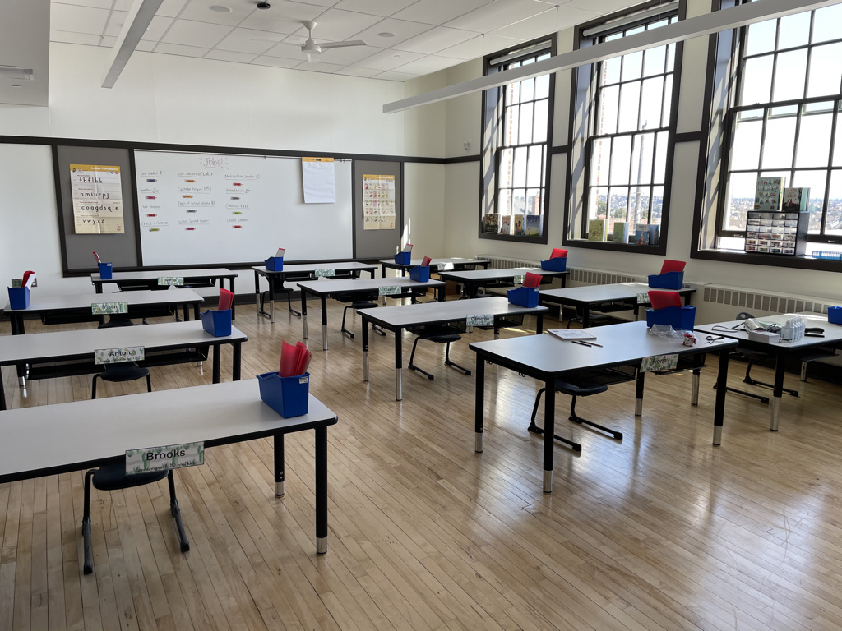
School Safety Plans
See SPS School Re-Entry Guide ~ MES
Classroom setup and assigned seating

Slide 23
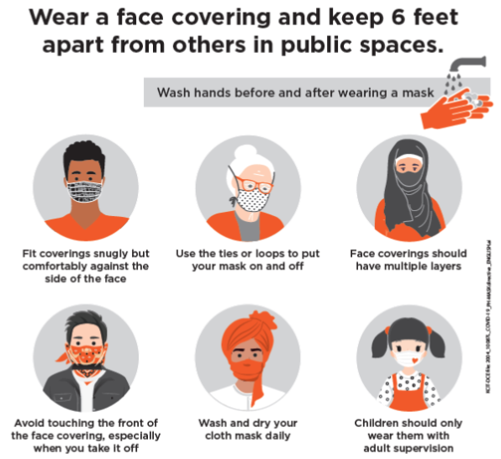
School Safety Plans
See SPS School Re-Entry Guide ~ MES
Face Coverings

Slide 24
School Safety Plans
See SPS School Re-Entry Guide ~ MES
Hand Hygiene

Slide 25
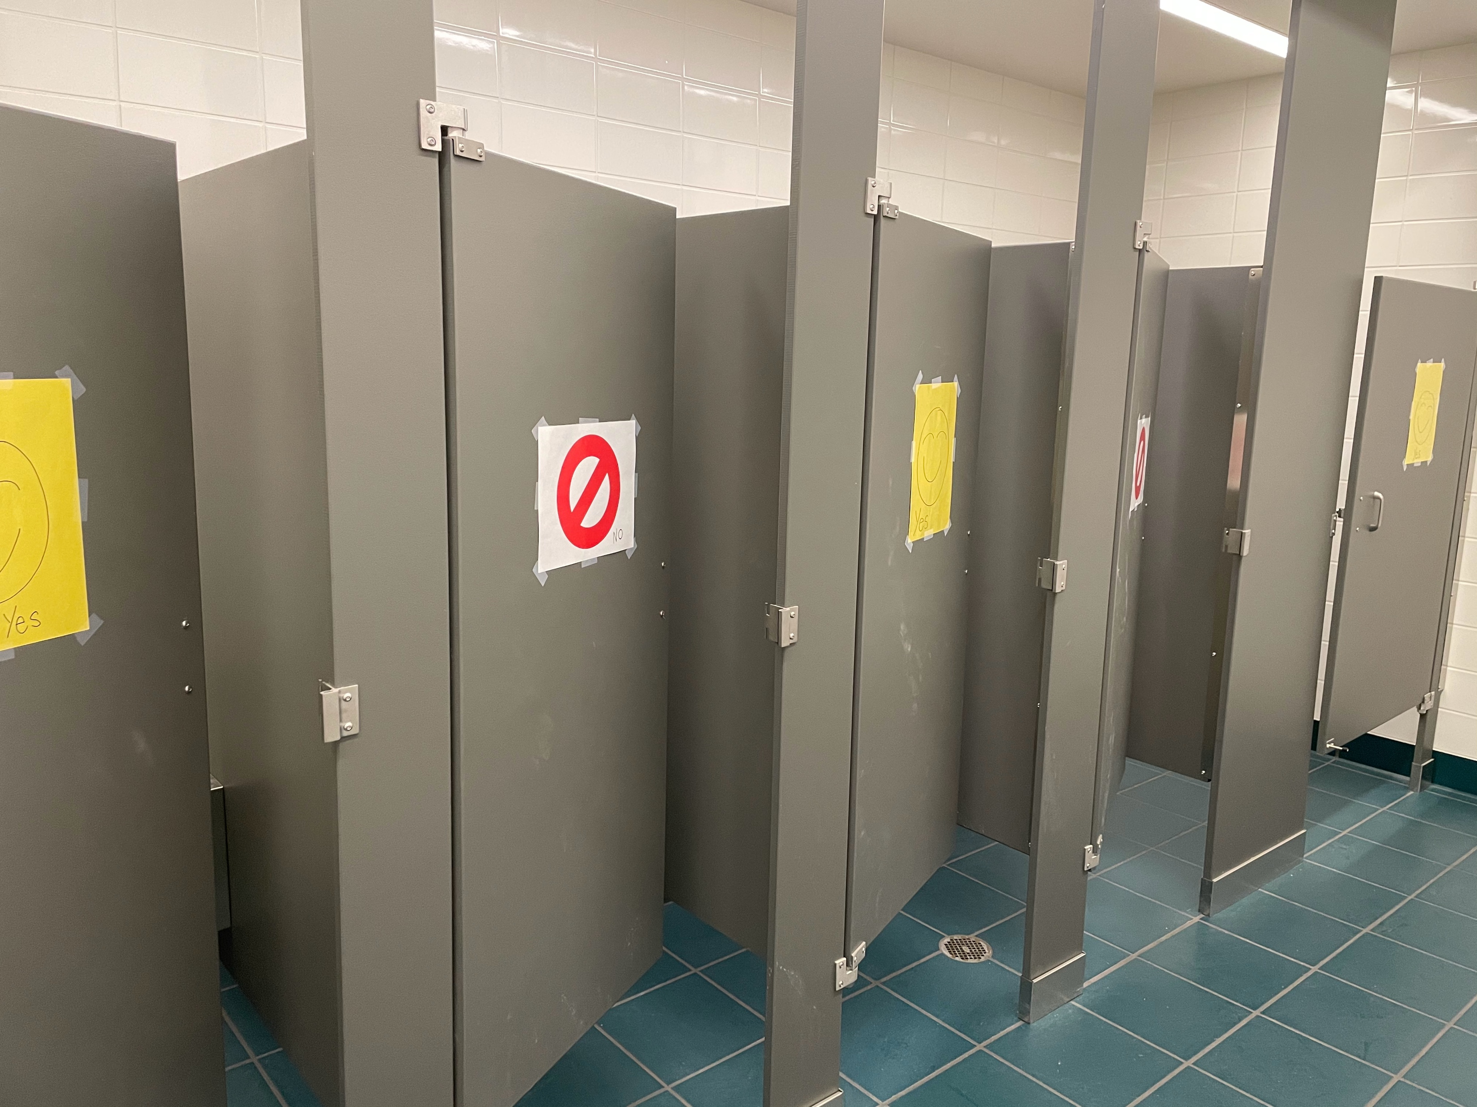
School Safety Plans
See SPS School Re-Entry Guide ~ MES
Restroom use
(photos of capacity signs, stall open & closed signs, sinks and handwashinig signs, kinder floor cues & pass hooks and passes coming soon!)

Slide 26
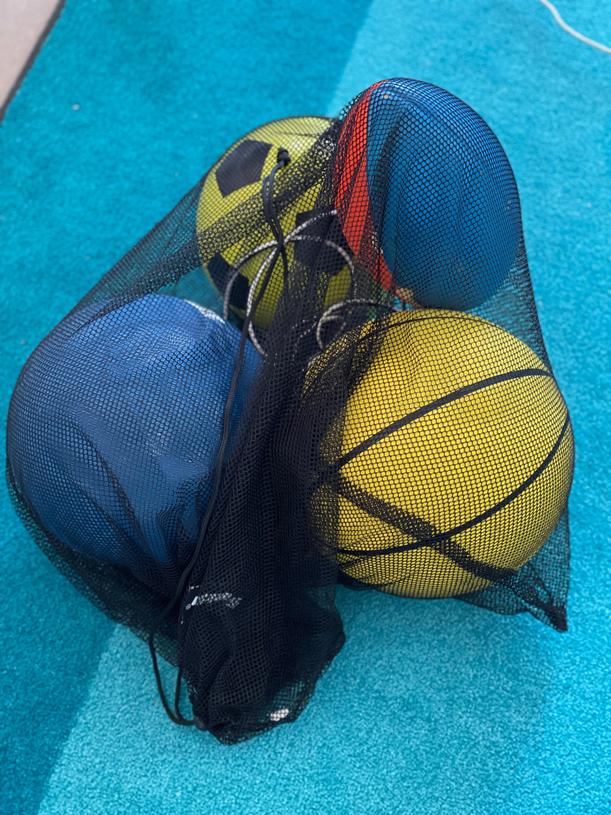
School Safety Plans
See SPS School Re-Entry Guide ~ MES
Recess

Slide 27
School Safety Plans
See SPS School Re-Entry Guide ~ MES
Spring Break Travel
From SPS Website Return to In-Person Learning FAQ
What is the recommendation for families for spring break?
We urge you to keep our school communities in mind when thinking about any travel plans and limit unnecessary travel.
As of March 20, this is the CDC travel guidance, which Washington will follow. We don’t have the staffing flexibility to accommodate switching students’ instructional models due to travel.
https://www.cdc.gov/coronavirus/2019-ncov/travelers/travel-during-covid19.html?CDC_AA_refVal=https%3A%2F%2Fwww.cdc.gov%2Fcoronavirus%2F2019-ncov%2Ftravelers%2Ftravel-in-the-us.html

Slide 28
Communication
SPS Welcome Letter ~ 3/30/21
Grade Level Team Teachers
Cohort Assignments ~ 3/31/21
MES Family Orientation ~ 3/31/21
Teacher Communication ~ 4/1/21 …

Slide 29
Schedules
A Day In The Life

Slide 30
Schedules
A Day In The Life

Slide 31
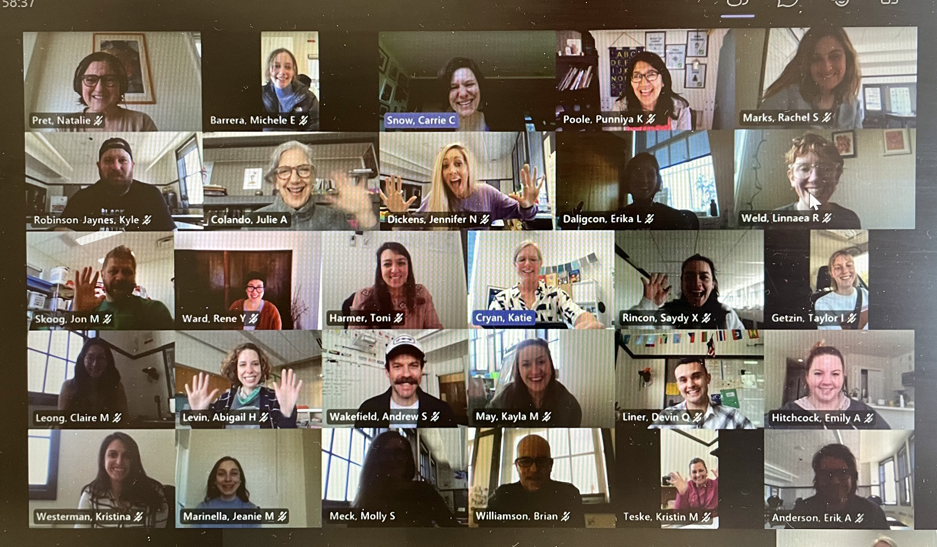
We can’t wait to see your students back in our building on Monday!

Slide 32
Q&A

