Slide 1


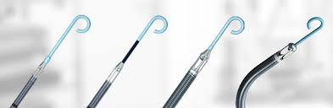

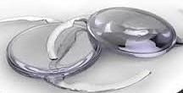
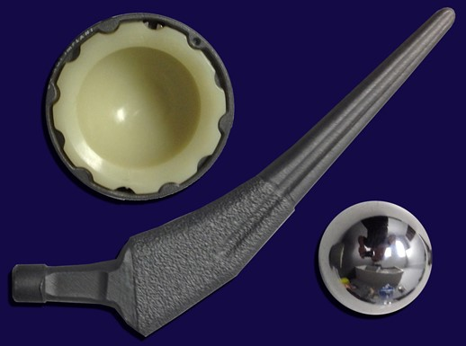

Building a Successful Clinical Inventory Optimization Program in Procedural Areas
WSHMMA
September 2025

Slide 2












Our Mission: Trackability, Visibility & Accurate Documentation
Solving Key Pain Points for Supply Chain and Clinicians
Supply Chain
Clinicians
Patients
with
Medical Devices & Supplies
Barcode Scanning
RAIN RFID
Electronic Shelf Labels

Slide 3
Procedural Areas – Highest Clinical & Financial Impact
Agenda
What are the key challenges to solve and why?
- Current market environment and challenges
- Impact on all key constituents
- Role of supply chain in building solutions
A framework for setting up a clinical inventory optimization program
- Data capture and management
- Operational protocols
- Analytical support
- Oversight & accountability governance

Slide 4
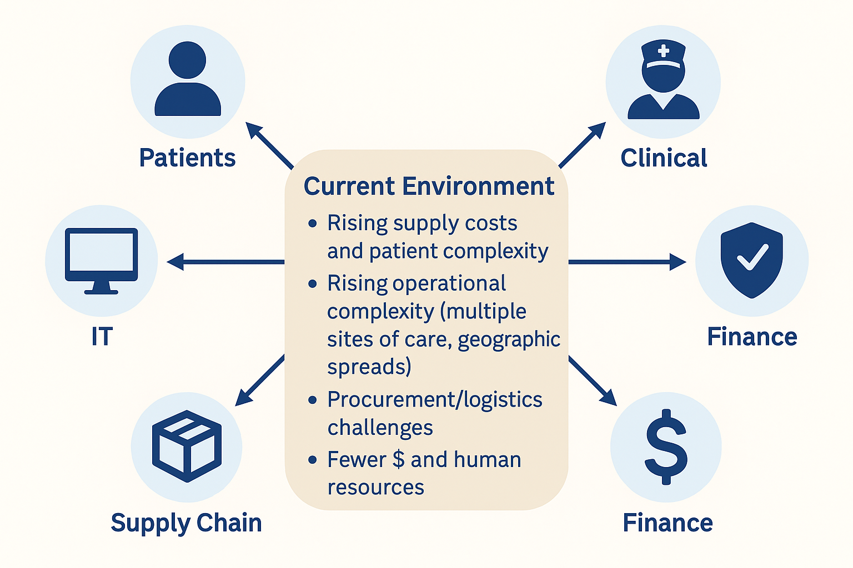
How Current Environment Manifests for Each Key Constituent

Slide 5
From the Administration/Finance Perspective
Many Dollars are at Stake
>5,000 different items on-hand
Tens of millions spent annually on supplies per department
8-20% worth of supplies at risk of waste and expirations monthly
~50% of procedures at risk for incorrect or incomplete supplies data
5
5

Slide 6
From the Risk Management Perspective
Critical Supply Chain Data Is Needed for Resource Budgeting, Planning & Risk Mitigation
How many days of on-hand inventory do I have?
Which critical supplies do I need?
What are clinically equivalent substitutes I can use?
What can I cut from purchasing if I need to redirect dollars?
How do I ensure that my supplies are safe to use (know where they come from, not expired or recalled, etc)?
6
6

Slide 7
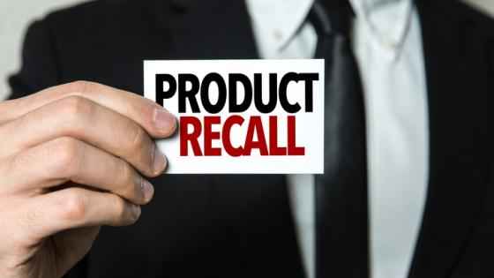
From Patient’s Perspective
Medical Device Recalls
600 - 1,200 medical device recalls issued per year, affecting 100s of millions of units
2-4% are Class I recalls – which pose a serious risk of injury or death - meaning several million units need to be tracked down, removed from shelves, and/or require clinical follow-up

Slide 8

From the Clinician’s Perspective
Daily Headaches for Clinical and Supply Chain Staff. . .
Operational & workflow impediments
Stock-outs & hoarding
Lack of visibility on availability and location
Lack of status on expiration or recall
Manual entry at the point of care
Missing item numbers or billing codes
Incorrect, incomplete or missing orders
Lack of actionable reporting & analytics
Limited data available
Inconsistent across an IDN
Difficult to mine
8
8

Slide 9

From the Clinical Leadership Perspective
. . . Risking Quality Of Patient Care. . .
Balancing Patient Care with Resource Challenges & Realities
Increasing patient acuity
Severe staffing shortages
Increasing resource needs
High financial pressures
9
9

Slide 10
From Supply Chain Perspective
Purchasing
EMR
The Data Gap
Contracting
Hospital
ERP
Clinical
Documentation
Systems
Billing
Distribution
Poor/No Inventory Visibility & Traceability
Procurement
Value Analysis
Clinical
Analysis
Point of Delivery
What’s on-hand?
Is it safe to use?
What’s been used?
What needs replenishment?
Point of Care

Slide 11
From IT/Information Management Perspective
Data Gaps Exacerbated by Multiple Complex Systems
Key Hospital Caregiver-Facing Systems
Key Hospital Administrative Systems
Admitting/ Scheduling
Billing
EHR
Procedural Documentation
AI Analytics
Supply Chain
Finance
IT
HR
Examples:
EPIC
CERNER
Siemens A2K
EPIC
CERNER
EPIC CERNER
GE McLab Merative Merge
McKesson Horizon
Philips Xper
Microsoft
Google
Apple
Oracle
Infor
Workday
Patient scheduling
Patient billing
Patient charting/
record repository
Patient documentation for specific procedures
Health Outcomes
Population health
Decision Support
Enterprise Resource Planning
Supply Chain Data Required

Slide 12
Supply Chain Role in Clinical & Financial Workflows
Supply Chain Data Flow
Procure
Manage
Use
Bill
Order
Pay
Ensure item is set up in item master w/relevant details and pricing according to contract terms
Manage item receipts, put-away, and other transactions
Ensure item is available and safe to use (not expired or recalled)
Find/Get/ Document item used in patient record
Charge for item used for a patient when billable
Determine reorder needs and place or submit item requisition
Issue PO, process invoice, and pay for item received
Tasks/Objectives
Part of Clinical Workflow
Part of Financial Workflow
Item Data Management
Application Support (ERP, EHR, Billing systems)
Analytics & Decision Support
12
Notes:
Lana
If you look at it from the SC process perspective, from procure to pay cycle, you can see that it touches key aspects of clinical and financial workflows. A clinician needs to be able to find an item when and where they expect to find it, they need to make sure it’s safe to use – not expired or recalled, they need to document it when used for the patient, and they need to make sure it’s charged for when billable. Each of these functions resides in different systems, managed by different constituents, but they all require 3 things: common references to an item, well functioning applications for managing the data, and ability to perform analytics for decision support. So any inefficiencies in the user workflows, data access or lack of needed information, have significant impact on multiple functions. And we know there are multiple impediments that exist in most organizations today causing these issues that need to be recognized and overcome.
What success looks like:
Efficient Workflow, Accurate data, and reliable decision support
Create an overlap between Supply Chain Data flow and Clinical Workflow – to show how supply chain piece needs to support the clinician in their workflow. And also how SC impacts Financial (billing); and how it supports the analytics – cost per case per physician, clinical outcomes for different items usage

Slide 13
Framework for Building a Clinical Inventory Optimization Program
A 3-Stage Program:
Stage 3: Analytics & Optimization
Perpetual inventory, items tracked from receiving to reordering, interfaces set up between relevant systems
Using the data and analytics to achieve meaningful and measurable improvements in operations & costs
Aligned/assigned roles & responsibilities with defined tasks and accountabilities
Stage 2: Organizational Alignment
Optimization of inventory (par levels, unused, wasted)
Use of same data for multiple constituents’ decision support (value analysis, finance, IT)
Improved contracts with suppliers (e.g., consignment agreements)
Stage 1: Full Automation
Daily/weekly/monthly inventory management protocols
Standardized operations workflows across multiple areas
Regular oversight from management
POC capture to EMR to billing
Item data management
Reordering/replenishment
Waste/expiration management
Notes:
13

Slide 14
Framework for Building a Clinical Inventory Optimization Program
A 3-Stage Program:
Stage 3: Analytics & Optimization
Perpetual inventory, items tracked from receiving to reordering, interfaces set up between relevant systems
Using the data and analytics to achieve meaningful and measurable improvements in operations & costs
Aligned/assigned roles & responsibilities with defined tasks and accountabilities
Stage 2: Organizational Alignment
Optimization of inventory (par levels, unused, wasted)
Use of same data for multiple constituents’ decision support (value analysis, finance, IT)
Improved contracts with suppliers (e.g., consignment agreements)
Stage 1: Full Automation
Daily/weekly/monthly inventory management protocols
Standardized operations workflows across multiple areas
Regular oversight from management
POC capture to EMR to billing
Item data management
Reordering/replenishment
Waste/expiration management
Notes:
14

Slide 15
Framework for Building a Clinical Inventory Optimization Program
A 3-Stage Program:
Stage 3: Analytics & Optimization
Perpetual inventory, items tracked from receiving to reordering, interfaces set up between relevant systems
Using the data and analytics to achieve meaningful and measurable improvements in operations & costs
Aligned/assigned roles & responsibilities with defined tasks and accountabilities
Stage 2: Organizational Alignment
Optimization of inventory (par levels, unused, wasted)
Use of same data for multiple constituents’ decision support (value analysis, finance, IT)
Improved contracts with suppliers (e.g., consignment agreements)
Stage 1: Full Automation
Daily/weekly/monthly inventory management protocols
Standardized operations workflows across multiple areas
Regular oversight from management
POC capture to EMR to billing
Item data management
Reordering/replenishment
Waste/expiration management
Notes:
15

Slide 16
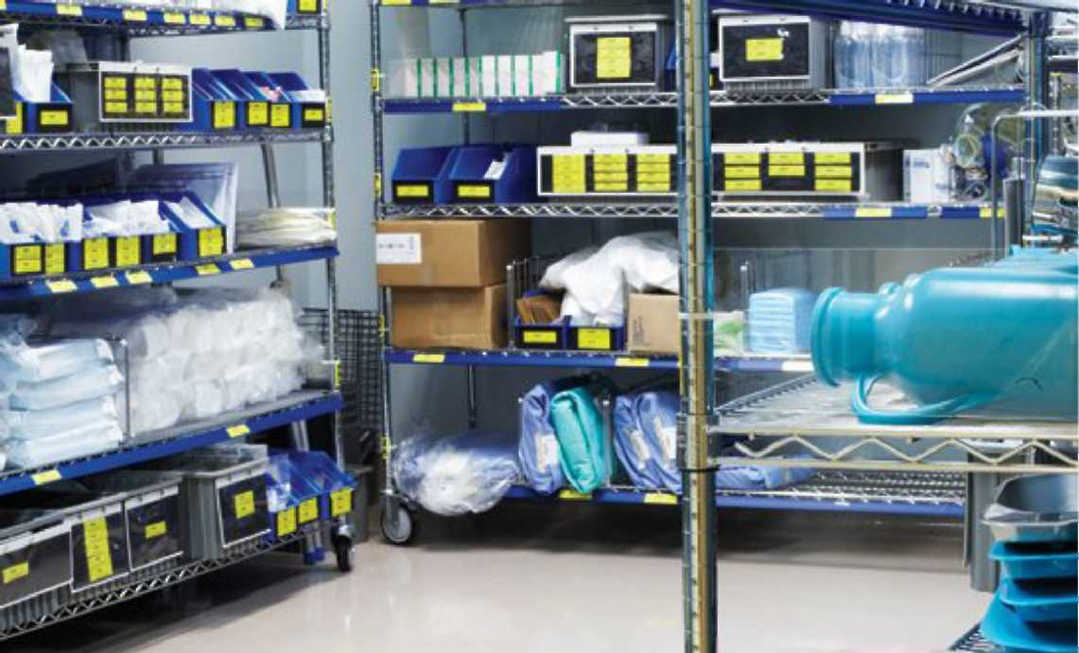
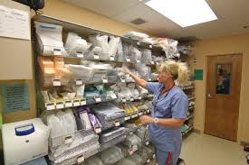
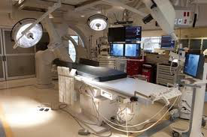

Item Data Efficiently Captured & Disseminated
Point of Delivery
Point of Care
Delivery Area/Dock & Disposal
Supply Room
Procedure Room
Flow of Medical Products and Devices
Data Capture & Feed
Hospital
ERP
System
Clinical
Documentation
Systems
Cloud Reporting & Analytics

Slide 17
Organizational and Process Realignment
Process realignment & defining roles & responsibilities
Set up clearly defined daily/weekly/monthly protocols for all inventory-related activities:
Auditing & Reordering
Receiving & restocking
Expiration management
Item data management
Set up close collaboration & coordination with multiple constituents:
Supply Chain
IT
Finance
Leadership oversight
Agree on a set of monthly KPIs for performance monitoring
Establish accountability for following through on desired objectives

Slide 18
Results Maintained with Actionable KPIs
KPIs guide improvement opportunities, monitor performance, and measure savings
Typical Sources of Savings:
Examples of KPIs Used include:
Frequency
Waste control
Expiring as % of total on-hand inventory: SKUs, Units, Value
Monthly
Inventory size reduction
Unused or infrequently used in the last 12 months as % of total on-hand inventory: SKUs, Units, Value
Quarterly
Product purchase rationalization
Purchased vs. consumed in relation to case volume: SKUs, Units, Value
Monthly
Clinical utilization management
Cost per each type of case per physician
Monthly

Slide 19
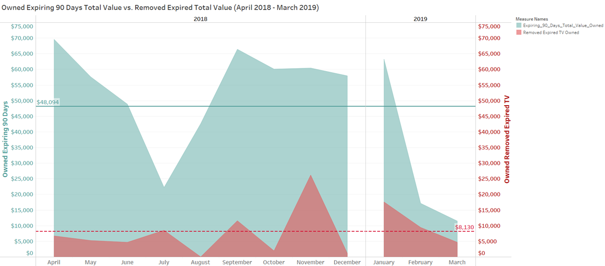
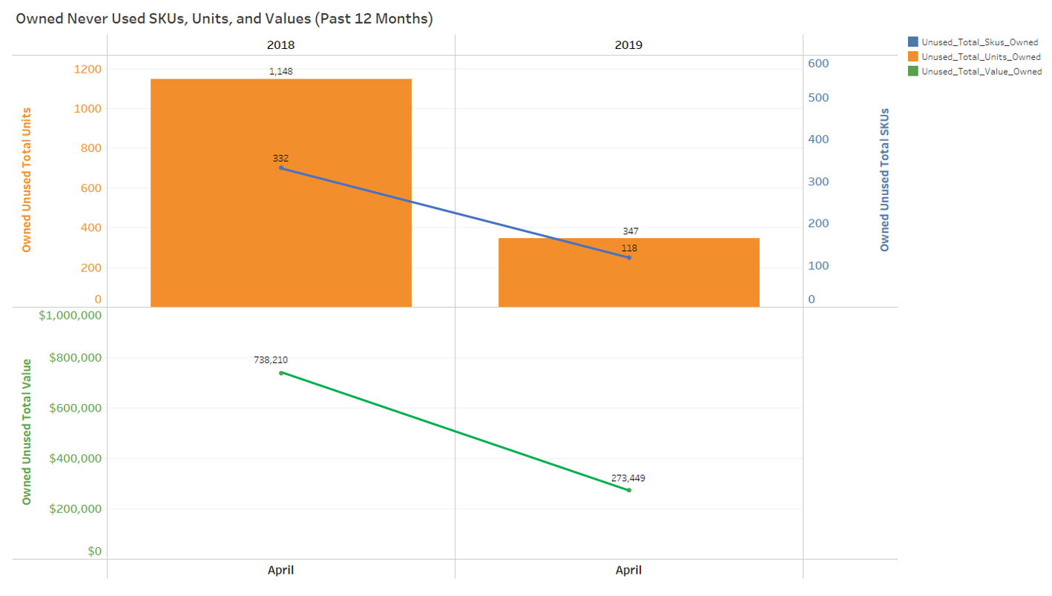
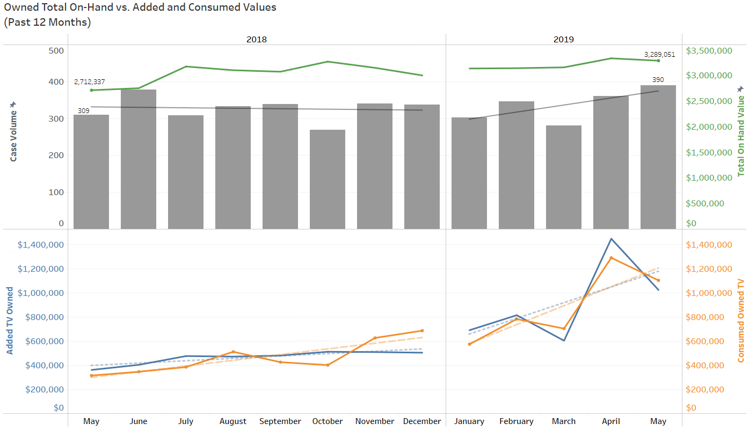
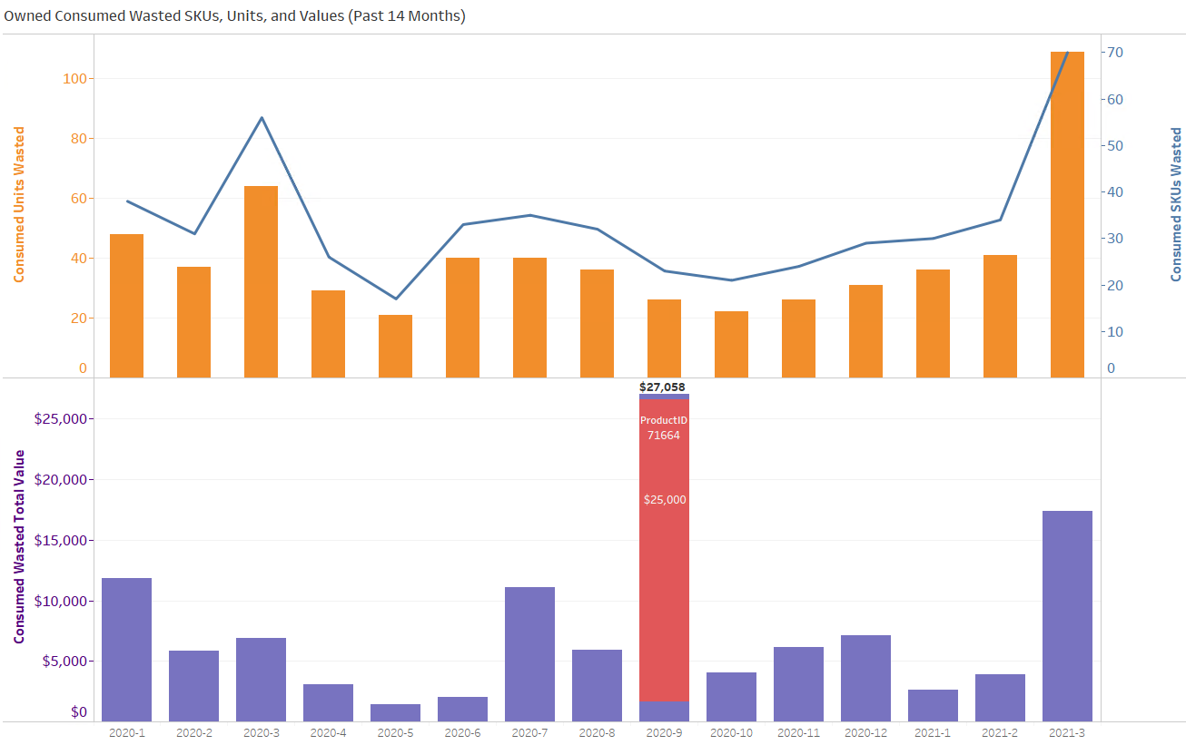

Building Actionable Key Performance Indicators (KPIs)
Expiration Management
Unused Inventory Reduction
Alignment of Purchased and Consumed Inventory
Clinical Utilization – Opened Not Used Items

Slide 20
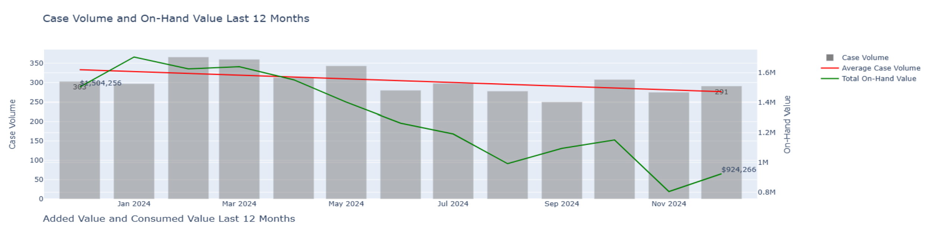
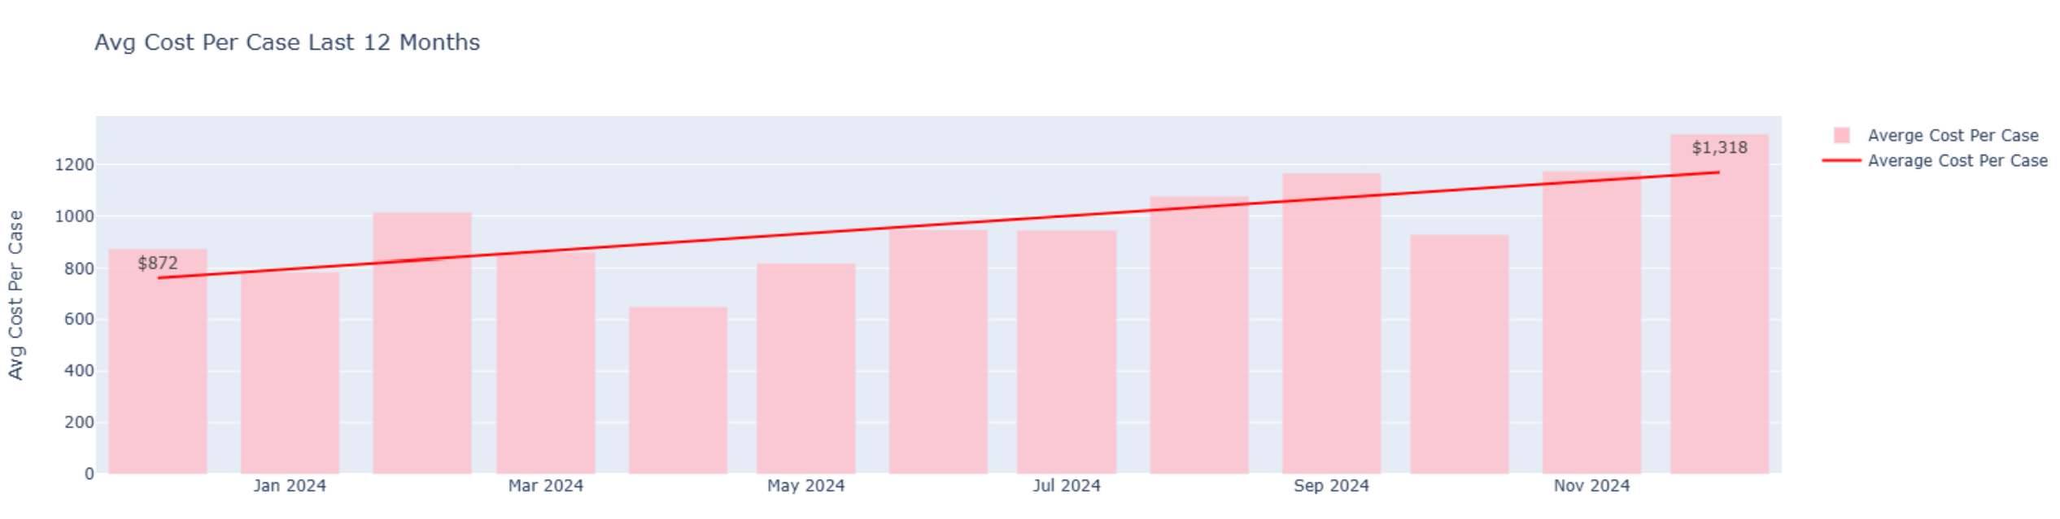
Inventory Optimization Program KPIs
Case Volume & Inventory On-Hand Value
Cost Per Case Trends

Slide 21
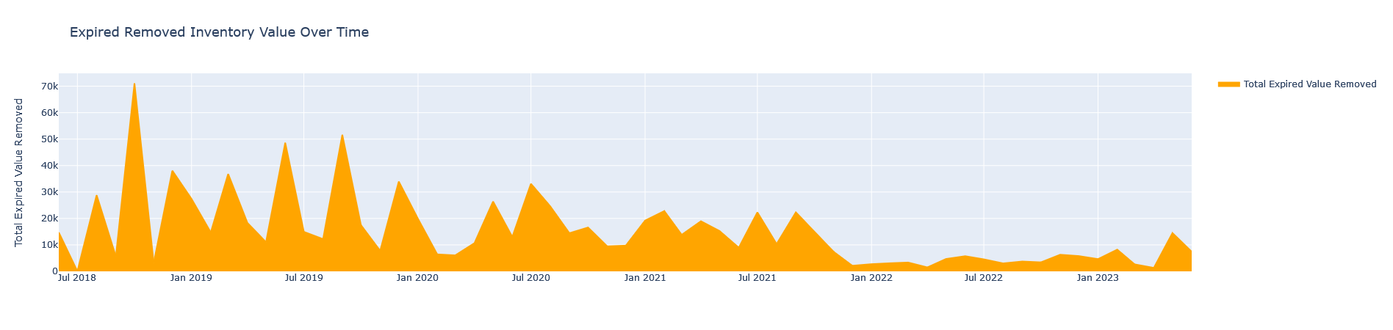
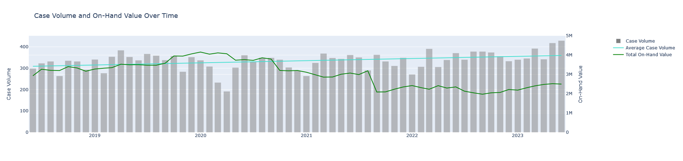
Inventory Optimization Program KPIs
Expiration Management
Inventory Size Optimization

Slide 22
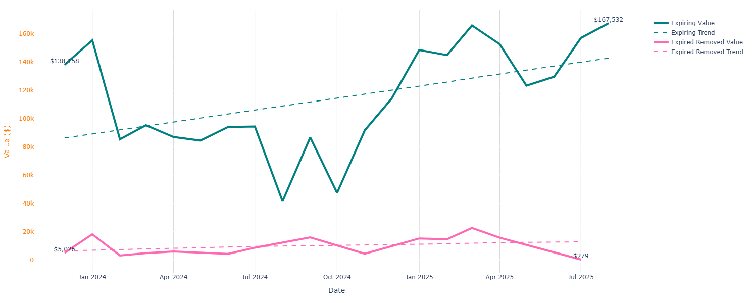
Inventory Optimization Program KPIs
At Risk of Expiration at 90 Days vs. Expired Removed

Slide 23
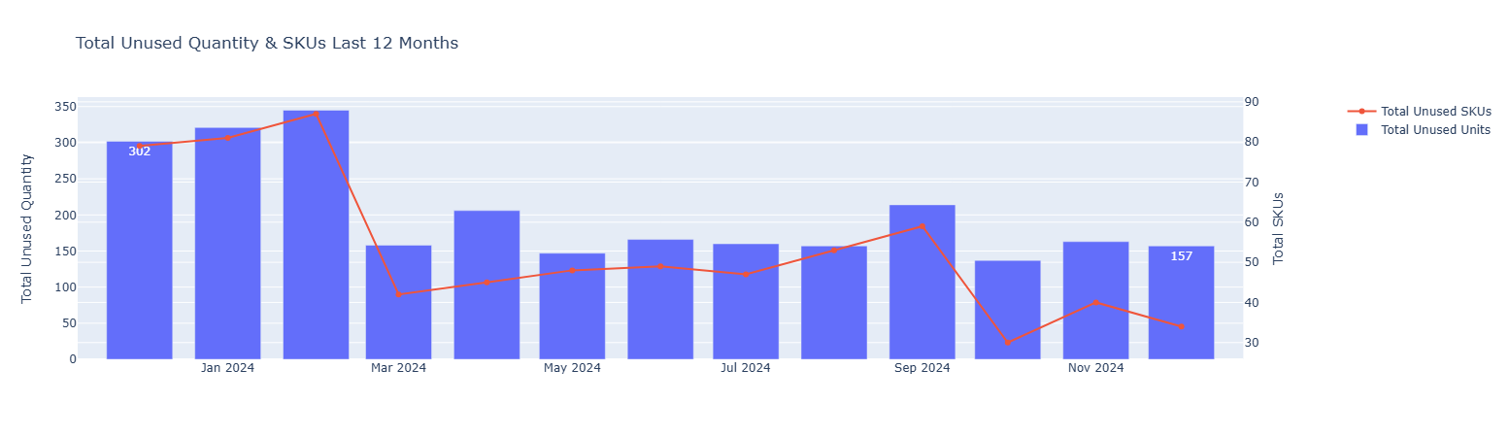
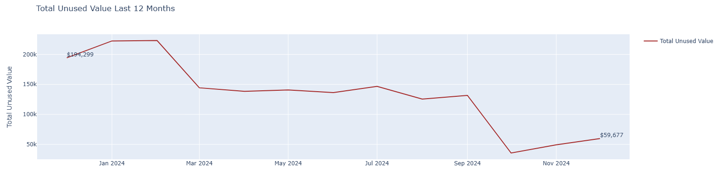
Inventory Excess - Unused Items
Unused Items

Slide 24
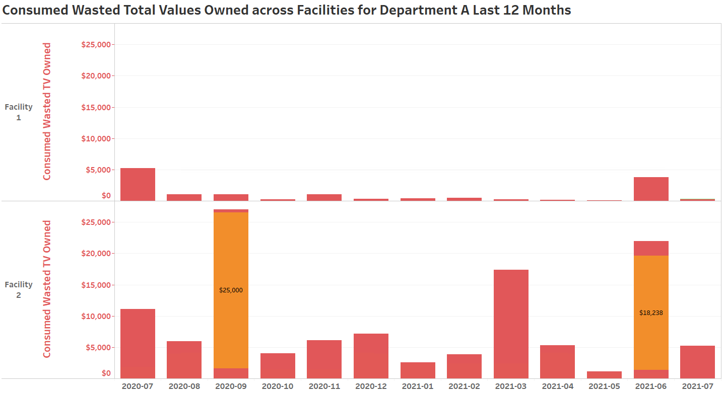
KPIs: Opened Not Used (Wasted)
Consumed Wasted Items
Mftr’s name
Category
Product ID
Product’s name
Diameter
Length
Feature
Catalog Number
Mftr’s name
Category
Product ID
Product’s name
Diameter
Length
Feature
Catalog Number
24

Slide 25
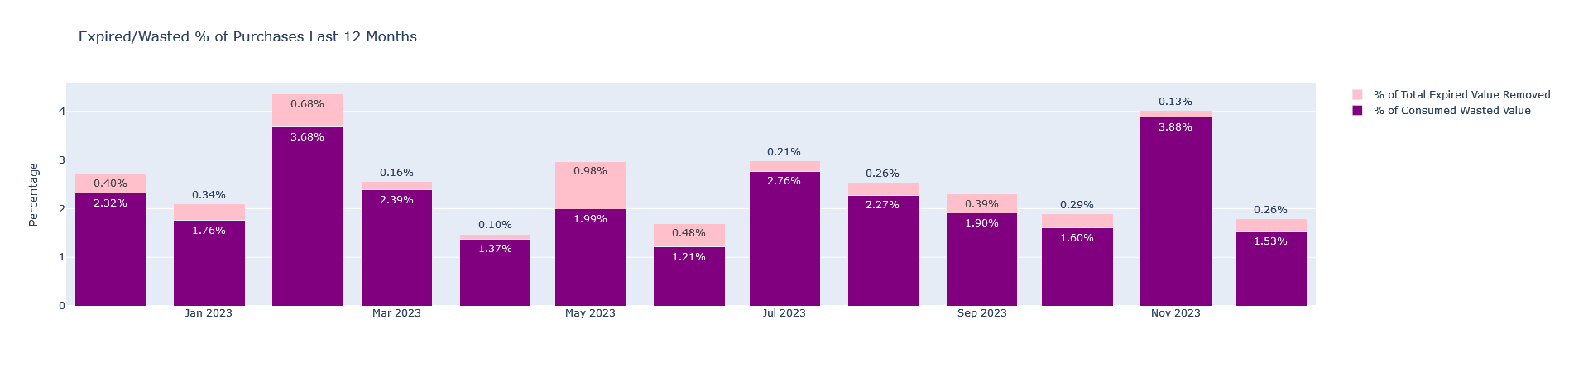
Expired/Wasted Product(s) as a % of Total Purchases
Expired & Consumed Wasted Items as % of Purchases
Avg: 2.63%
25

Slide 26
From a Product’s Perspective ….
A Story of Many Supply Chains & Unreliable Demand Data
Receipt
Putaway
Dispense
Use
Bill
Order
Pay
System Used
ERP
ERP
ERP
Clinical Documentation
Billing
ERP/MMIS
ERP/MMIS
Type of Supply
Med-Surg
Central Supply/Warehouse
Clinical preference (owned)
Procedural areas (cath, EP, IR, OR, GI)
Clinical preference (consigned)
Procedural areas (cath, EP, IR, OR, GI)
Specialty (i.e., trunk stock)
Procedural areas (cath, EP, IR, OR, GI)
NA
NA
NA
NA
Perpetual Status available
Mostly automated data entry
Partially automated data entry
Manual data entry, incomplete or inaccurate data
Perpetual Status NOT available; no data entry or tracking
26

Slide 27

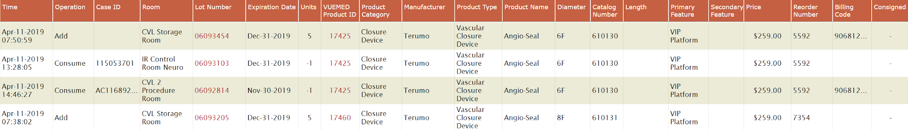
Item Data Centrally Managed for Effective Reporting & Analytics
Captured Data
Time, location, and item details associated with each VUEMED Product ID
Universal Item Master
Maintained and updated daily in the VUEMED cloud
Associated Data
Customer-specific data assigned to each SKU
Lot number
Serial number (if applicable)
Expiration Date
Time
Location
RFID-based data (EPC, Tag ID)
VUEMED Product ID (assigned to each unique SKU)
Product Brand Name
Product Catalog Number
Manufacturer
Product Category
Product Type
Diameter
Length
Product Features
UPN/DI/GTIN
Reorder number (as identified in the customer ERP/MMIS)
Price
Unit of Measure
Unit of Measure Quantity
Par Level
Reorder Level
Consignment Status
Billing Code
27

Slide 28

Next Steps: Predictive Analytics
Forecasting supply needs given specific procedure types and volumes
Supply demand planning based on actual scheduled cases
Examining cost per physician for same procedures
Eliminating variation & standardizing clinical practice/utilization
28

Slide 29

Next Steps: Standardization
Cost per Specific Type of Procedure per Physician Analysis
Summary Analysis Cost Per Case - Blinded
Physician | Procedure | Case Count | Avg $ per Case | Range*
A | Ablation-RFA | 43 | $ 7,587.42 | $ 10,692.74
B | Ablation-RFA | 16 | $ 7,092.05 | $ 11,265.49
C | Ablation-RFA | 42 | $ 8,668.23 | $ 12,475.22
D | Ablation-RFA | 78 | $ 9,405.21 | $ 15,341.92
Total | Ablation-RFA | 179 | $ 8,188.23 | $ 12,443.84
Can we break this information out by diagnosis type?
What accounts for cost difference?
Patient acuity
Equipment used (due to acuity)
Physician preference (if so)
Can we standardize?
Should we look into our supply contracts?
*Range is used as an indicator of acuity and calculated as the difference between the max and the min values. This sample indicates that there is a large disparity in case acuity from simple to complex.
29

Slide 30
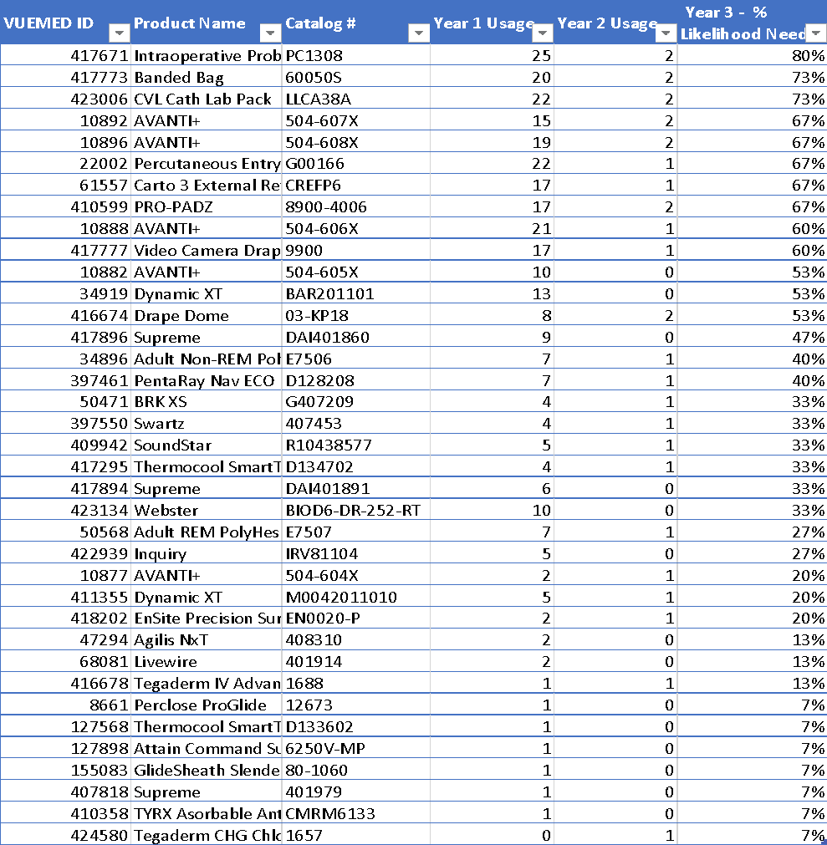
Next Steps: Procedure-Based Demand Planning
Ablation-RFA case example:
% likelihood the item would be needed
30

Slide 31

Lana Makhanik COO VUEMED, Inc.
lmakhanik@vuemed.com
www.vuemed.com ∞ lmakhanik@vuemed.com

