Slide 1

Treasurer Basics
Lana Gregg
Hazelwood PTA Council - Treasurer

Slide 2

Basics
Elected Official
Authorized custodian of funds
Receives all income and disperses all expenditures
Presents annual financial report and annual general meeting

Slide 3


Financial Tracking
Membership Dues
Fundraising Activities
Donations
All distributions
Prepares and gives financial report at meetings
This Photo by Unknown Author is licensed under CC BY

Slide 4

First 30 Days
Read the Bylaws
Review budget – current and past
Receipt book/checkbook
Training with outgoing Treasurer
Account book – this could be electronic
IRS tax information – do you know your EIN and when to file the 990 (must be filed electronically)
Review/audit report
Bank access and statements
Insurance
Notes:
Bylaws are important part of the unit. Everyone should be well acquainted with unit bylaws and standing rules
Most incoming treasurers will not take over duties until the start of the new fiscal year. Outgoing treasurer should “finish up” all end of year duties.
Outgoing treasurer should make arrangements for a professional or committee set up to do financial review/audit once bank statement for end of fiscal year has been
obtained and reconciled
New signature card…check with your local bank. Secretary may need to come and verify identity of new officers as well as one of the current signatures on the card. Some banks require outgoing officers to sign off the accounts.

Slide 5
Compliance
Annual 990 filings – must be filed electronically
State Good Standing
  Financial Review
  Financial End of Year Report
  Copy of 990 sent to state by 12/1
Monthly dues
Sales tax
Retention of records – generally 7 years

Slide 6
PTA bank accounts are for PTA use exclusively
The EIN is the official identification for the PTA. Personal social security numbers should be used only for personal identification of the signers.
Bank signers usually detailed in bylaws under Duties of Officers-Treasurer. The bank may require minutes, bylaws or resolutions to support those signers.
PTA’s should not use debit or credit cards.
Banking Guidelines

Slide 7
Whose Money is it?
The treasurer is the custodian of the money, it does not belong to the treasurer, the Executive Committee, the principal or the council. The money belongs to the general membership of the unit.
The treasurer is to disburse the money as directed by the Executive Board/Committee, by the membership and by the approved budget.
It is the treasurer’s duty to disburse money in accordance with good financial practices and according to the bylaws.

Slide 8

Insurance
  PTA’s should consider purchasing a Non-profit Institutional Fidelity Bonding Policy.
  The cost of the policy will depend upon the amount of funds handled by the PTA.
  Insuring companies do require specific internal controls
  PTA’s should consider general liability insurance to cover routine risks of meetings. The school district’s insurance may not cover PTA events even if they are on school grounds.
  Other insurance is available including medical coverage, event coverage, etc. Such investments are the judgment of individual PTA’s.
This Photo by Unknown Author is licensed under CC BY
This Photo by Unknown Author is licensed under CC BY

Slide 9

  All financial transactions must fall within the budget.
  The budget is proposed by a committee that includes the treasurer. Best practice is to have this committee meet before April 30 to have budget ready for approval at May meeting.
  The budget is based on past records, planned activities and goals.
  The budget must be approved by the general membership. Best practice is to have your budget approved at your last meeting of the year.
  Expenses that exceed the budget must be approved by the membership as a budget amendment.

Slide 10
Restricted Funds
Obligates the funds to a specific purpose
Due to IRS regulations the board cannot amend
Money raised must go to that specific purpose unless donors and notified and given the option to have their money refunded.
Best practice is to advertise in a general manner – i.e. money for PTA programs & projects.
Excess Funds
Money not spent goes back into the general funds and rolls over to the next year.
No IRS or PTA rule limiting carry over amounts

Slide 11
Emergency Reserve
Yes you have this in your budget
Recommended one-half to a full years expenditure obligations

Slide 12
Funding the Budget
PTA is primarily an education & advocacy group - not a money raising group
Focus should be on service-oriented projects
Purposeful fundraising should be done each year
Remember that you are fundraising to fund your budget in that fiscal year.
Use the 3-to-1 Rule: 1 Fundraising = 3 non-fundraising projects aimed at helping parents and children
A fundraising project should be for a definite purpose and should be in harmony with the PTA Purposes.
Notes:
Fundraising is done to fund the budget that was adopted by the general membership. Best practice says that the budget should be approved at your last meeting of the year. Your committee has taken in account all previous expenditures and income and made an educated assumption as to what you will be able afford the following year.
You do not build your budget according to how much money you have in your checking account at the end of the year!!!!!!

Slide 13

State Tax Exempt
Issued from State Department of Revenue
Each PTA must apply for their own
PTA can help with
  EIN / Letter of determination
  Unit in Good Standing status
  Group exemption number
Renew / New

Slide 14
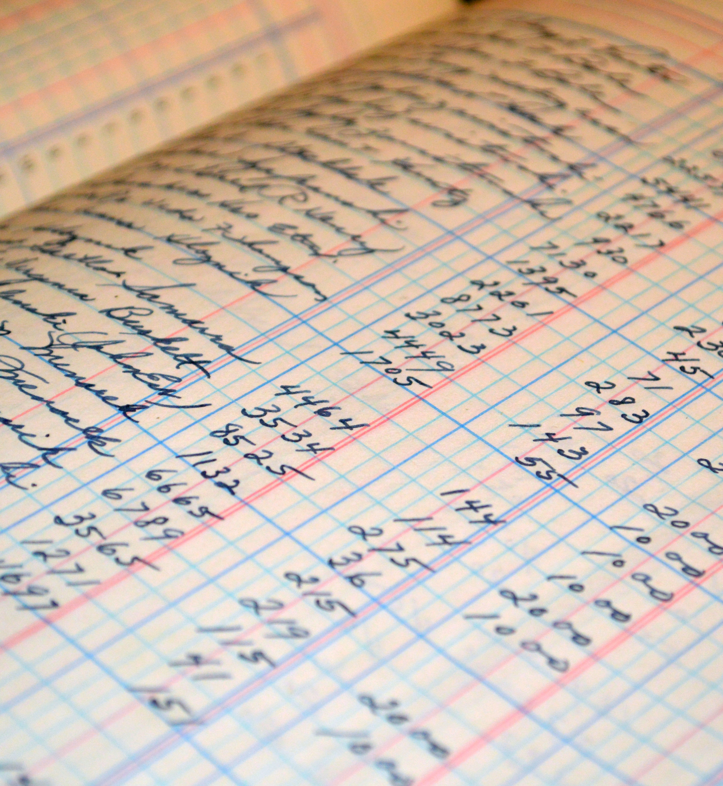
Bookkeeping
  Should be a method that allows detailed accounting by budget line; this could be on paper, spreadsheets or using computer accounting programs.
  Keep all checkbook entries current.
  Maintain a log of funds received and another of funds disbursed.
  Maintain accounting for each budget line.
  Maintain a paper trail for all financial activity from the counting of funds, to bank activity to reports.

Slide 15

Money Handling
  Cash and checks should be counted by two people, a tape run and a receipt signed by both counters.
  Receipts should be written in duplicate for all cash received: one copy to the chairman, one to treasurer.
  Checks received should be notated for purpose; record kept of checks
  Deposits slips should be made at the time the funds are counted, slips should be in triplicate: original to bank, copy to treasurer, copy to account reconciler.
This Photo by Unknown Author is licensed under CC BY-NC-ND

Slide 16
Money Handling
  Deposits should be made at the bank the same day funds are collected, whenever possible
  Deposits should be notated regarding purpose of funds collected.
  Cash should never be taken home or stored in car.
  Night deposit boxes at the bank are the best option, two people should go together to make the deposit.
This Photo by Unknown Author is licensed under CC BY-NC-ND

Slide 17
Money Handling
  Cash stored in school safe should be in a PTA lock box with only PTA access. Coordinate through school principal. The school is not responsible for the funds.
  Keep all supporting documents received with any cash, fund raiser, etc.
  The treasurer should be the only person making deposits at the bank.
  Never deposit funds into school or personal accounts.
This Photo by Unknown Author is licensed under CC BY-NC-ND

Slide 18

Dispersing Funds
  All disbursements are made by check, no cash payments for anything.
  Refunds are made by check and a receipt issued.
  Expenditures should fall within the budget.
  Expenditures should be authorized by two people, e.g. president and chairman. Vouchers should be submitted along with receipts. (Best practice)
Notes:
Best practice is to have vouchers attached to all receipts. Reinforcing the paper trail of expenditures.
Use Treasurer Tool Kit to cover more of the specifics of the slides that cover money handling & disbursements

Slide 19
Dispersing Funds
Checks are always signed by the treasurer. Bylaws may require second signature (suggested)
Presidents should only sign checks in the absence of the treasurer, or as co-signer on check if required.
Checks should be used in numerical order.
NEVER sign a blank check.
NEVER sign a check to cash.

Slide 20

Dispersing Funds
  A receipt, invoice or other documentation should be kept along with the voucher for every check written.
  Maintain a receipt for all purchases.
  Pay bills at least monthly upon submission of receipts, never pay with cash.

Slide 21

Reconcile Monthly
  Recommend that bank statements be reviewed and initialed by someone other than account signers (insurance company may require this)
  Recommend that you add to your standing rules to make it a duty of another elected officer who is not a signer, to review the bank statement each month.
  Have statements sent to both the treasurer and the reviewer; if possible. Online viewing of the accounts may suffice or make copies for reviewer.
  Reviewer should look for red flags including: checks showing up in non-sequential order, checks made out to cash, cash withdrawals, checks written out to non-approved vendors, checks written out for non-approved expenses, checks written out to individuals.

Slide 22


Reconcile Monthly
  The treasurer should provide the reviewer with evidence supporting any questionable transaction.
  Any discrepancies should be discussed with the treasurer, reviewer and president.
  Use of a service for collection of insufficient funds is recommended. Try calling the bank to see if there are funds available before depositing again.

Slide 23

Reports
  Prepare reports monthly. Beginning balance, itemize receipts and disbursements, and conclude with a balance on hand.
  All funds should be tracked separately by activity.
  The treasurer should have at all times a break down of budget usage.
  Prepare an Annual year-end report that reflects all activity from the first day through the last day of the fiscal year.
Notes:
A monthly treasurer report should be prepared whether there is a meeting or not. If there is not a meeting scheduled to present the information, the monthly report should be emailed to at least all members of the PTA board.
The monthly report should include beginning balance, itemized receipts and disbursement and the ending balance. This shows complete transparency of how much money is coming in and who checks are being written to. This keeps everyone in check and if there are any “red flags” they will be easier noticed.
Up-to-date numbers for each budget line need to be available as well.
These monthly reports will make preparing the Fiscal Year-end Report much easier.

Slide 24

Financial Review
  The books of the treasurer must be reviewed every year.
  Additional reviews should be held upon the change of treasurer.
  Ensure books are balanced and well documented.
  A report summarizing the examination will be written and signed by the examiners. The report must be adopted by the unit at the next meeting.

Slide 25

Taxes - 990
  All non-profit organizations including PTAs, must file the appropriate 990 form each year.
  Determined by the amount of gross receipts for the year.
  990’s must be filed by the 15th day of the 5th month following the close of the fiscal year. (Fiscal year ending June 30, the 990 is due November 15.) The 990 can be filed soon after the close of the fiscal year; do not wait for the deadline.
  Submit a copy of the 990-N email receipt or a copy of the filed 990, 990 EZ and Schedule A to MOPTA by 12/1

Slide 26
Sunshine Funds
“Sunshine funds” refer to a local PTA unit’s effort to provide assistance to an individual or family in the case of a catastrophic event, such as fire or other disaster. While these efforts are extremely well intentioned and admirable, using the funds of a local PTA for such a cause could result in that local PTA unit losing their tax-exempt status with the IRS. This is due to the “inurement of benefits rule”, which states the following:

Slide 27

Sunshine Funds
A section 501©(3) organization must not be organized or operated for the benefit of private interests, such as the creator or the creator’s family, shareholders of the organizations, other designated individuals, or persons controlled directly or indirectly by such private interests. No part of the net earnings of a section 501©(3) organization may inure to the benefit of any private shareholder or individual. A private shareholder or individual is a person having a personal and private interest in the activities of the organization.

Slide 28
Before you leave office
Make sure that all state and national portions of dues have been collected and forwarded to the state PTA office.
Prepare all financial records for audit
Make sure that the PTA’s books agree with the bank balance and outstanding checks, plus cash on hand
Prepare the annual report covering the term of office
Submit IRS Form 990, 990-EZ, 990-N, 990-T, or other IRS forms if required. Prepare other reports required by the government
Transfer of all records, reports, and files to the treasurer-elect.
Work with the treasurer-elect to obtain and file new signature cards with the bank
Arrange for bonding as required by the PTA
Forward the financial review/audit, annual end of year report and copy of IRS filing to the state PTA office
  Copy to president, secretary and copy for treasurer record

Slide 29
Treasurer Basics

Slide 30
Questions & Answers
We will go over chat questions or you can ask them now.
THANKS FOR ALL YOUR SUPPORT!

