Slide 1
MEMBERSHIP MATTERS!
Audio – Click on the mic icon to mute and unmute yourself. Make sure you are muted. Unmute your mic if you have any questions or comments
Camera – Click on the camera icon to turn on/off. Keep it on, so we can see you.
Steven Cook
Missouri PTA Board of Managers
-VP of Membership-
Hazelwood PTA Council
-Area VP-
stevenc@mopta.org
Chat Box - Feel free to use box to ask questions.
May 22, 2021

Slide 2
2021-2022 Membership Theme

Slide 3
More Members=Bigger Voice
Create a membership plan.
dates, percentages, strategies, tasks needed to be completed.
Create a membership theme.
catchy, kid-friendly, parent/teachers involvement
Membership kick-off
welcome ALL families, teachers, staff, give prizes,
Communication
monthly, share minutes/ideas
Revisit plan
how are things going, what can be done differently, continue to build memberships
EOY Membership Celebration

Slide 4
More Members=Bigger Voice
Create a membership plan.
Dates
Plan out events
Delegate jobs
SELL those memberships to EVERYONE!

Slide 6
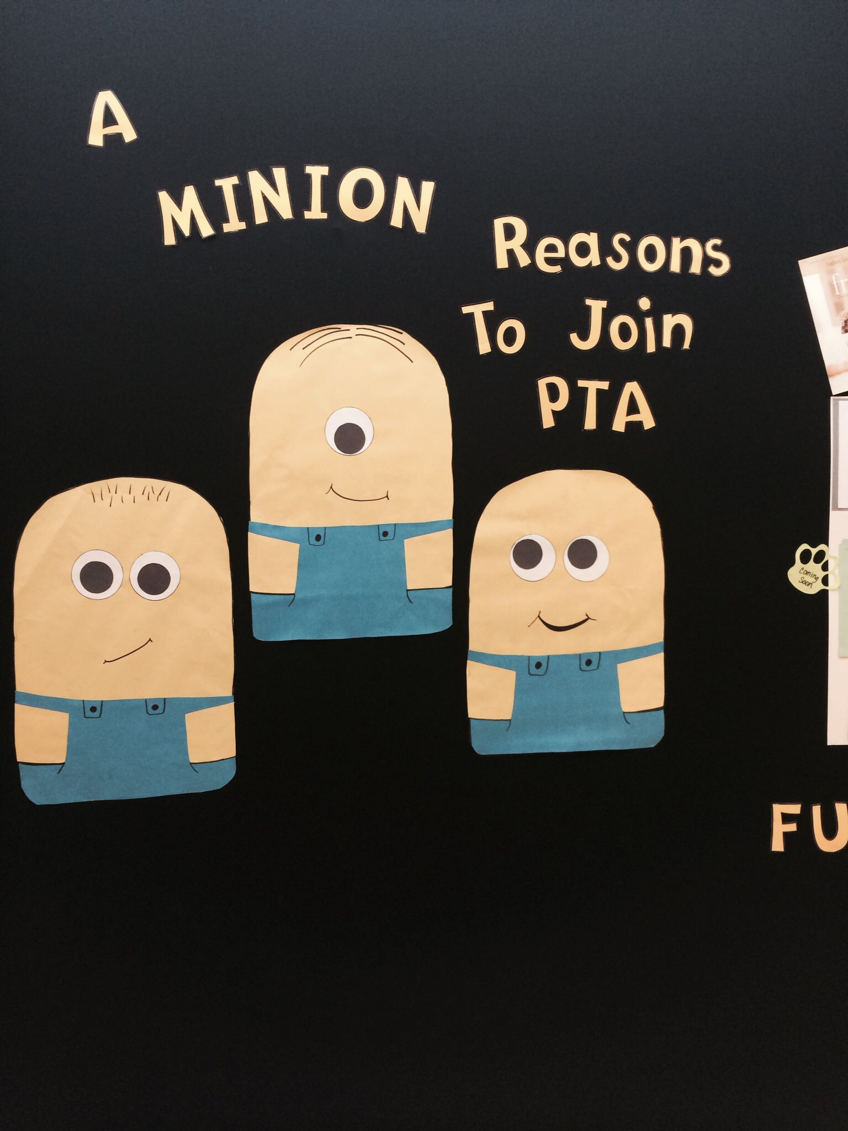
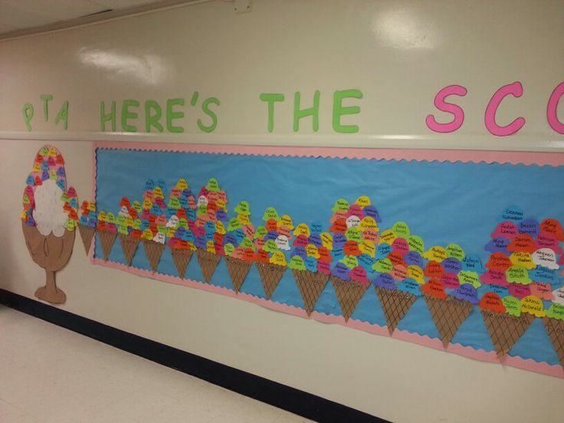
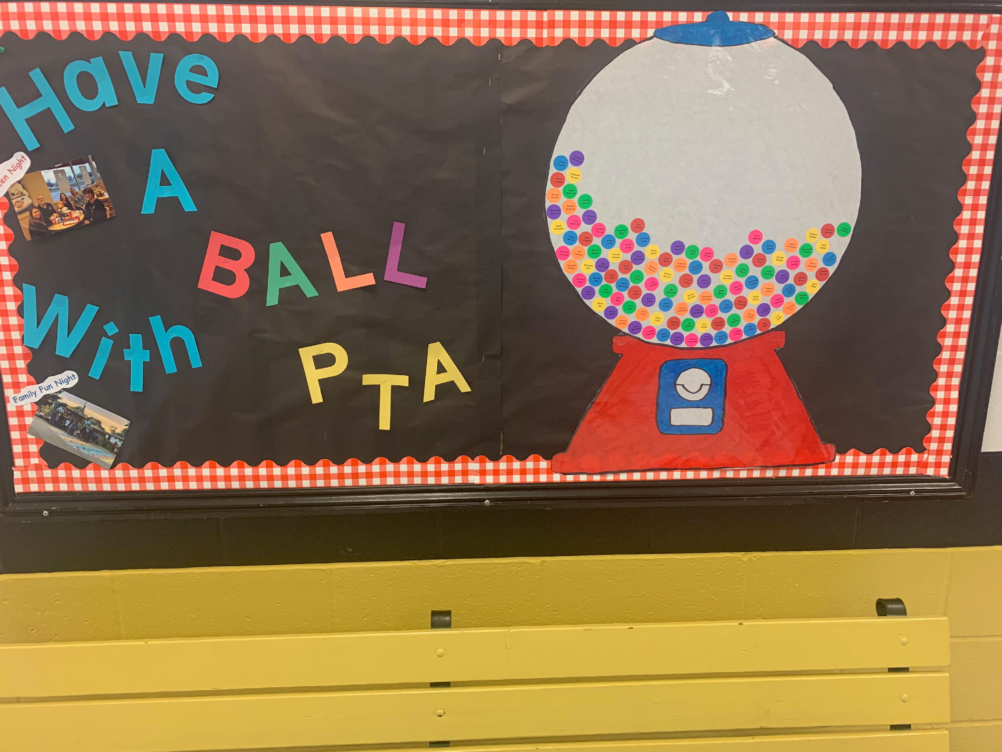
MEMBERSHIP THEMES
~ROCK IT OUT!~
Form a committee of parents, teachers, possibly students
Create an exciting, interactive theme
Share it throughout the school and all social media

Slide 7
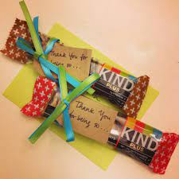
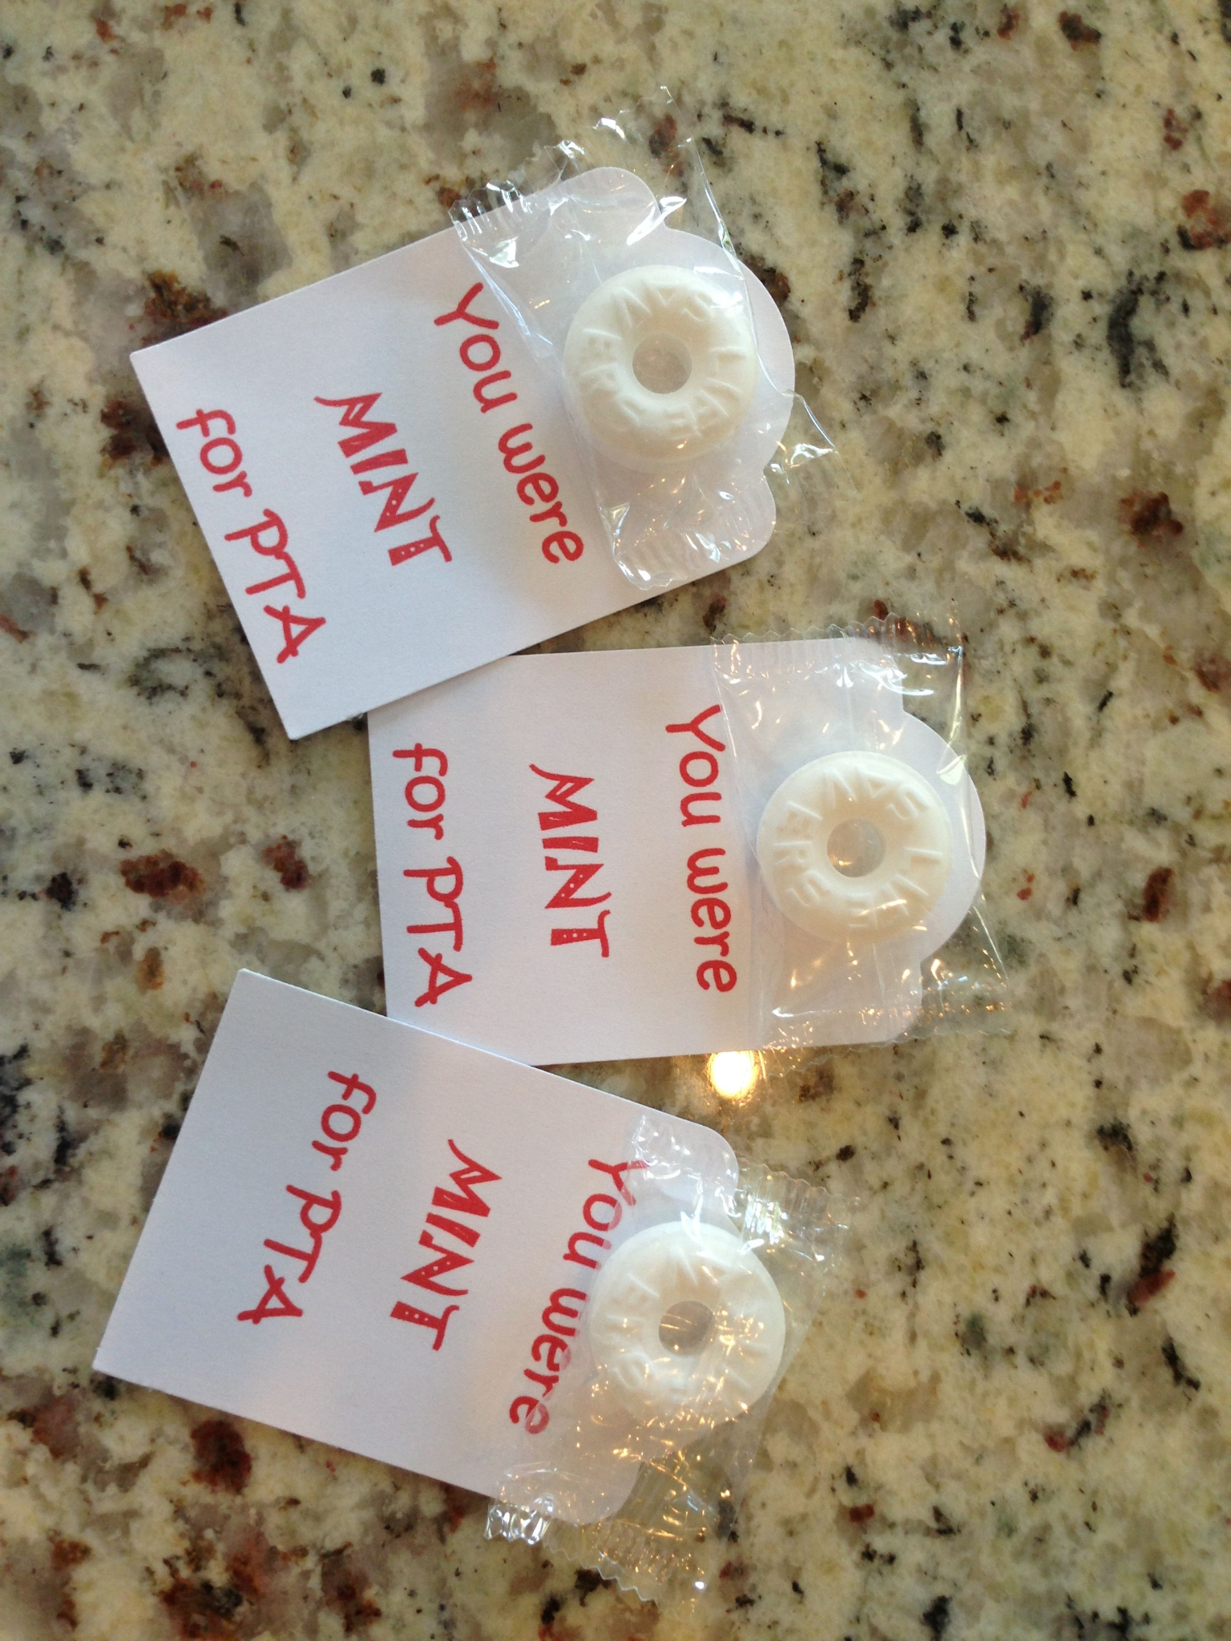
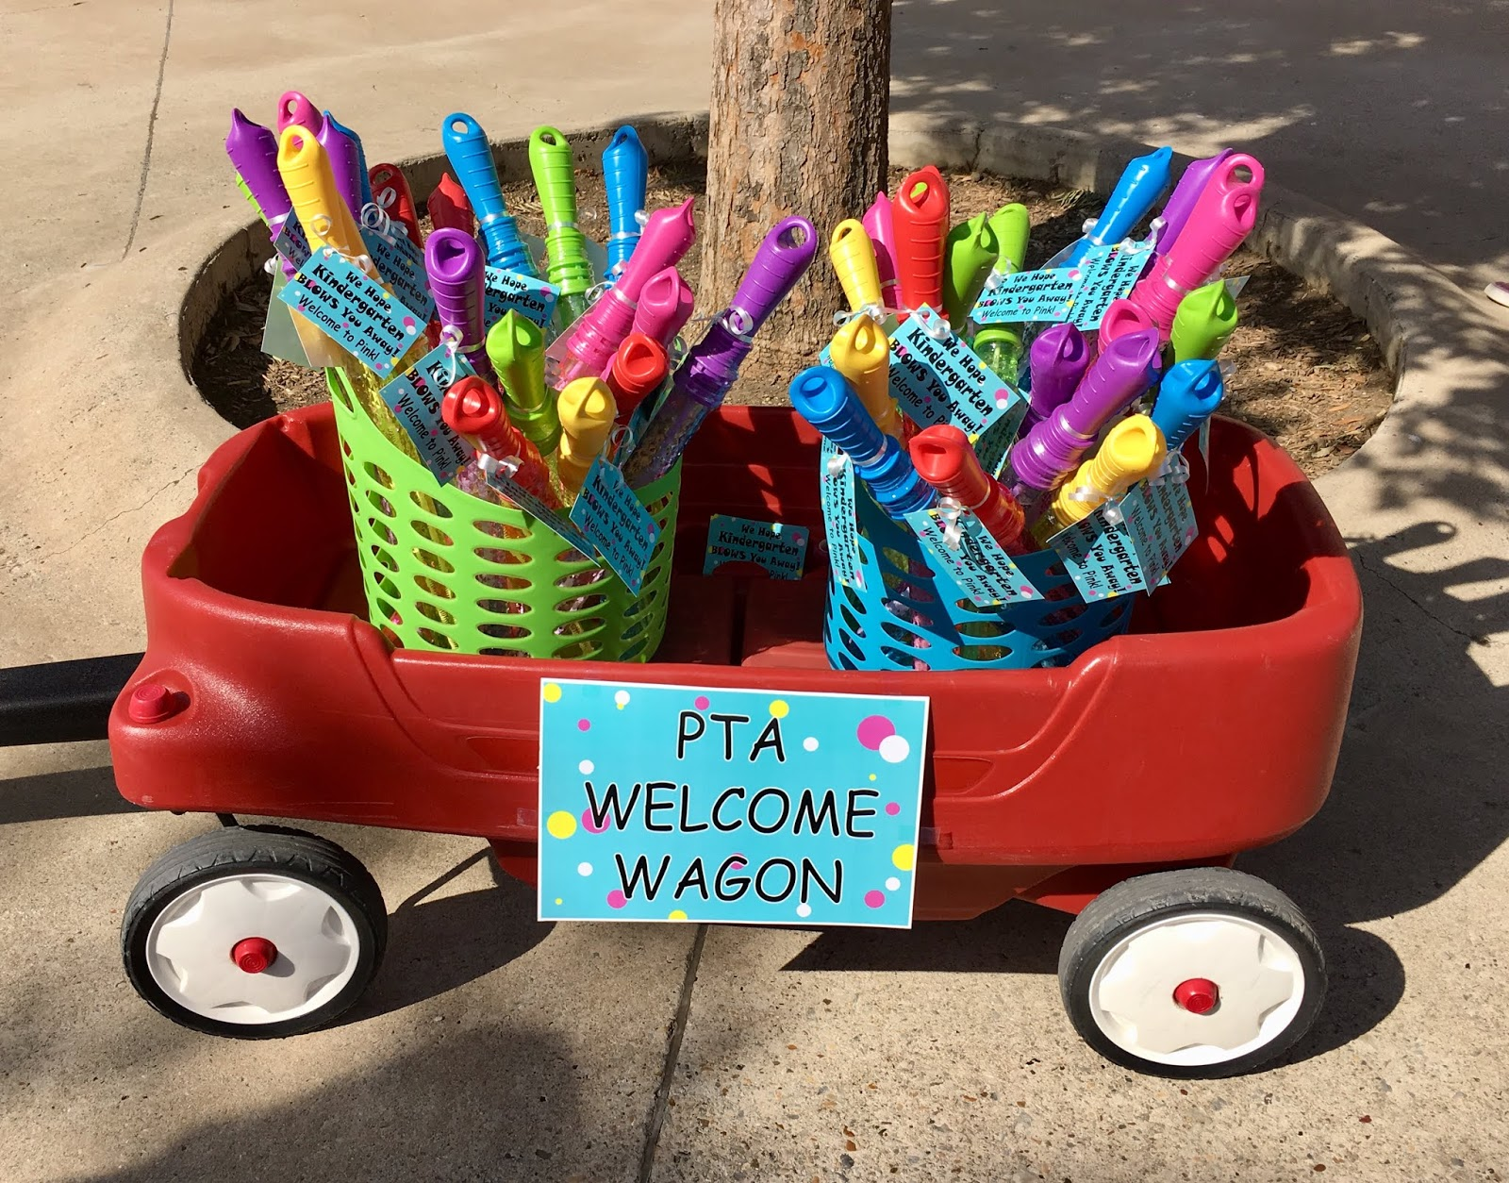
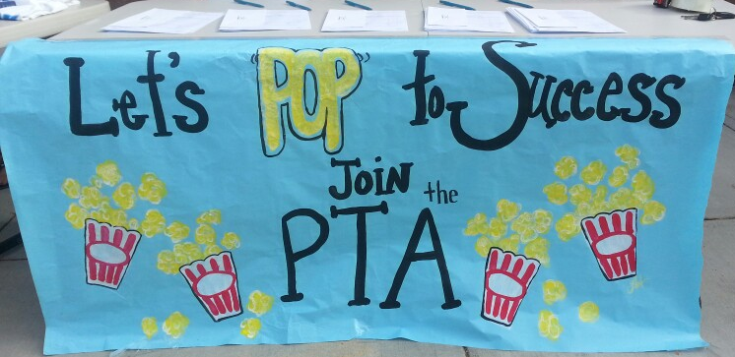
Membership Kickoffs ROCK!
Membership Kickoff ideas
Open house
Emails, phone calls, face to face
Small gifts with memberships
Teacher welcome wagon
Membership table at ALL events
ASK EVERYONE TO JOIN!
OTHER IDEAS??

Slide 8
ROCK Your Communication!
Communicate
Share membership growth and ideas
Emails, letters, phones calls with ALL membership
Share plans and delegate opportunities (everyone can help out)
Ask for feedback - grow from successes and challenges

Slide 9
REVISIT Your Plan!
What rocked? What didn’t?
Mid Year Check Up
Membership team meets
Discuss what has worked, what needs improvement.
Continue with events
Build Memberships - set new goal or continue with current one
EOY Wrap-up
Membership team meets
Discuss what has worked, what needs improvement.
Celebrate successes

Slide 10
Rock N Roll &
ASK EVERYONE!
Flyers sent home – add your links for Paypal, Venmo on website & social media https://forms.gle/wCPdAv8J2oWFwv1Z7
Handwritten invitations - School Board Members, District Administration, Mayor, City Councilman, State Representatives and Senators
Invitation - Business Memberships
Tiered Level incentives

Slide 11
Rock on and on and on!
Submit Dues online @ mopta.org with Paypal or mail in your payment
Send in Dues to Missouri PTA monthly – 1st of the month
Put the money back into promotions.
Keep in contact with your members.
i.e. membership newsletter, emails, Facebook Live, etc.
We can help conduct Zoom or physical SOI trainings.

Slide 12
Join us & Join PTA!

Slide 13
QUESTIONS & ANSWERS

