Slide 1

HSD PTA Council
School of Information
2021

Slide 2

chaos
COORDINATOR
HSD PTA Council Secretary
Cassie Massey
Notes:
Tell the story of why I call myself the Chaos Coordinator.
Share my PTA Story - joined PTA at the Elementary school where I work in 1998 to help with the school carnival. Since then I have held the following positions at the local unit - Secretary, Fundraising, Membership, President, Programs and currently I am the Treasurer. At the council level I have held the Secretary, President’s Aid, Programs and currently the treasurer. Four years ago I joined the state board as a Regional Director, I was the Events Coordinator and then these past three years I have been the Secretary.

Slide 3

Are you overwhelmed with the legal and practical perspective of being a PTA Unit Secretary??

Slide 4
Well Join the Club
We will learn duties and responsibilities of effectively being a unit secretary.
Some of which you will learn: motions, types of votes, recording accurate minutes, and much, much more!
After leaving, you will be have THE VISION to maintain relevant and accurate PTA business.

Slide 5
Role of the Secretary
The Secretary is responsible for keeping accurate records of the proceedings of the association.
Accuracy and timely preparation is key to this position.

Slide 6
Be Prepared
Have references and supplies with you at meetings:
Accurate list of current members
Bylaws copy (preserve the original)
Standing Rules copy
Agenda for the meeting
Minutes of the previous meeting of same group, including treasurer’s report
List of committees and their members
Miscellaneous office supplies
Purposes of PTA poster
Notes:
PTA PURPOSES
To promote the welfare of children and youth in home, school, places of worship, and throughout the community;
To raise the standards of home life
To advocate for laws that further the education, physical and mental health, welfare and safety of children and youth;
To promote the collaboration and engagement of families and educators in the education of children and youth;
To engage the public in united efforts to secure the physical, mental, emotional, spiritual, and social well-being of all children and youth; and
To advocate for fiscal responsibility regarding public tax dollars in public education funding.

Slide 7
The Tote Bag
Have a procedure book (binder) with tabs for each of these references, plus additional tabs as needed.
Use “pocket” or “sleeve” pages as needed for original documents.
Keep the procedure book and minutes in a tote or portable file box for ease of storage and transportation to PTA meetings.

Slide 8
Suggested Bylaws
Article VII, Section 3
The secretary shall:
Record and preserve the minutes of all meetings of the (local PTA name);
be prepared to read the records of any previous meetings;
preserve all records;
have a current copy of the bylaws;
maintain a current membership list; and
forward names and address of newly elected officers to the state office no later than March 31;

Slide 9
Take Minutes
Record all business transactions of all:
General membership/Unit meetings
Board meetings
Executive Committee meetings.
Special meetings.
Keep minutes brief and concise.

Slide 10
Content
Place in the minutes what was done.
Not what was said.
Not the opinion of the Secretary.

Slide 11
Document the
5 Ws
Who: Name of Assembly
What kind of meeting: Unit or Board
When: Date and time
Where: Location
Why: Regular or special meeting

Slide 12
Include in First Paragraph
State the fact the President and Secretary were present or the names of those fulfilling their responsibilities.

Slide 13
Sample: 5 Ws
The regular meeting of the board of XYZ Elementary PTA was called to order on March 19, 2013 at 7 PM by president Jane Doe in the school library.The secretary was present.
OR:
XYZ Elementary PTA
Board Meeting Minutes March 19, 2013
The regular meeting was called to order at 7 PM by President Jane Doe in the school library. The secretary was present.
OR:
Minutes of March 19, 2013
The special meeting of the board of XYZ Elementary PTA was called to fill a vacancy in the office of treasurer. The meeting was called to order at 7 PM by President Jane Doe in the school library. The secretary was present.

Slide 14
Document the Presence of a Quorum
A quorum is the minimum number of members necessary to conduct business, as defined in the unit’s current bylaws.
The quorum for a board meeting should be less than the quorum set for general membership/unit meeting.
A majority is defined as more than half.

Slide 15
Sample: Quorum
A quorum was present.
OR:
The following members were present(list names), a quorum was present.
Notes:
When having a board meeting, it is best to list who was present for the meeting. For general unit meetings you can have a sign in sheet and then attach to the minutes.

Slide 16
Document Routine Business
Record business in the order of which it was covered.
Agenda items should be recorded in separate paragraphs in the order which they were covered.

Slide 17
Sample:
Routine Business
The Opening Thought was presented.
The minutes of the (date) meeting were approved as (presented/read/corrected).
The treasurer’s report was printed showing a balance of $_____. The report was filed for financial review.
Correspondence was read including a thank you note from the faculty, a letter of resignation from John Smith, and a memo from the bank regarding night deposits.

Slide 18
Document Reports
Document reports in order of
presentation, such as
  Officers
  Committees
  The board (if at a general membership meeting)
Written reports should be attached to the minutes.
Reporting styles vary.
Keep it brief.

Slide 19
Sample:
Reports
President Doe announced the schedule of meetings for the year and thanked those who helped with the program on Saturday.
The principal reported on district news and adjustments in staff.
Cheery Sales reported that membership is at 150 and the incentive coupon is popular.
Patti Planner reported on the ABC committee, many more volunteers, funds and equipment are needed for the ABC event on Saturday. (Written report attached.)
Fundraiser chairman, Raisin Dough, reported sales of $10,000 from the catalog sales, profit expected to be $5,000. Prizes will be handed out at the assembly.

Slide 20
Record Actions Taken
Maker of the motion.
The second. (The name is not needed.)
Each motion word for word.
Results of the vote.
Decisions made by general consent.
Minutes DO NOT include a transcript of all that was said.
Ask that long motions be written by the maker for accuracy.
Clarify vague/rambling motions.

Slide 21
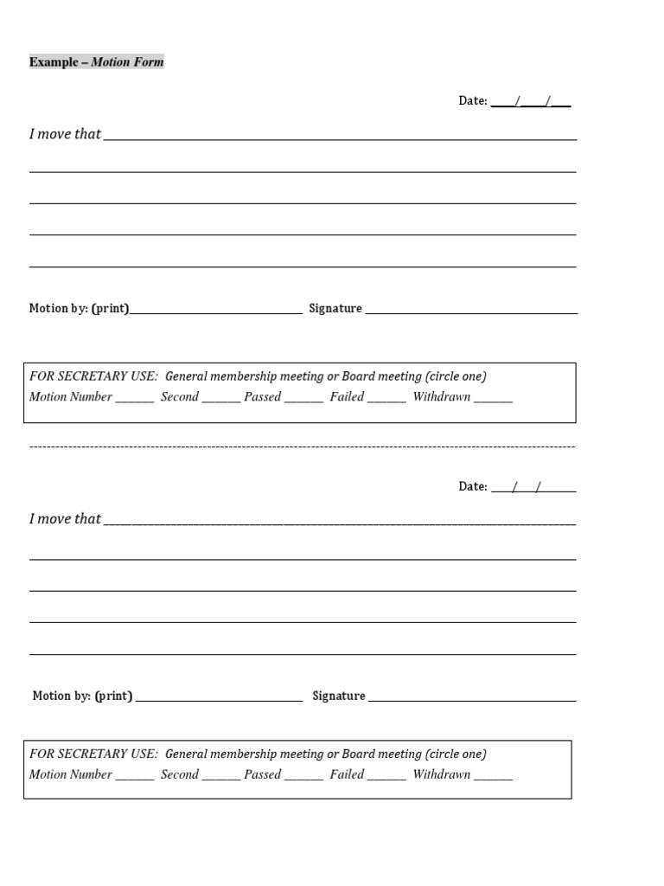

Slide 22
Sample: Motions
Missy Notable moved to spend $100 on the teacher appreciation project, using the miscellaneous budget. Seconded. Motion Carried.
By general consensus the carnival will be rescheduled for April 30.
Overly Eager moved to spend $1,000 on stage curtains. Seconded. After lengthy discussion the motion failed.

Slide 23
Document the Program
Include:
Speaker’s name
Program topic
It is not necessary to include the summary of the remarks.

Slide 24
Sample: Program
The program was the Fourth Grade Musical, ‘Spring Surprise’, under the direction of music teacher Mrs. Jones.
OR:
For the program, Dr. Eversmart, Superintendent, explained the items on the election. Board of Education members Jane Doe and John Smith answered questions.

Slide 25
Record the Adjournment
Include:
Time of adjournment
Any special circumstances
Whether business is finished or pending

Slide 26
Sample: Adjournment
President Doe thanked everyone for coming. There being no further business, the meeting adjourned at 8:15 p.m.
OR:
There being no further business, the meeting adjourned at 8:15 p.m. for the Open House.
OR:
Due to the late hour the meeting was adjourned at 10:15 and will resume tomorrow at 7:00 p.m.

Slide 27
Signature
Include:
Signature on permanent copy
Name of the recorder
Position of the recorder
The use of “Respectfully submitted” is no longer appropriate.

Slide 28
Sample: Minutes
XYZ Elementary PTA
Board Meeting Minutes March 19,2013
The regular meeting of XYZ PTA was called to order on March 19, 2013 by President Jane Doe at 7 PM in the school library. A quorum was present. The secretary was present.
The Opening Thought was presented. The minutes of the
February 17, 2013 meeting were approved as printed.
The treasurer’s report was printed showing a balance of
$8,457. The report was filed for financial review.
Correspondence was read regarding a thank you from
Mrs. Brady.
President Doe announced the schedule of meetings for
the year and thanked those that helped with the program
on Saturday.
The principal reported on district news and adjustments
in staff.
Cheery Sales reported that membership is at 150 and the
incentive coupon is popular.

Slide 29
Sample: Minutes Continued
Patti Planner reported on the ABC committee, many more
volunteers, funds and equipment are needed for the ABC
event on Saturday. (Written report attached.)
Fundraiser chairman, Raisin Dough, reported sales of $10,000 from the catalog sales, profit expected to be $5,000. Prizes will be handed out at the assembly.
Missy Notable moved to spend $100 on the teacher
appreciation project, using the miscellaneous budget.
Seconded. Carried.
By general consensus the carnival will be rescheduled for
April 30.
Overly Eager moved to spend $1,000 on stage curtains.
Seconded. After lengthy discussion the motion failed.
The program was the Fourth Grade Musical, “Spring Surprise” under the direction of music teacher Mrs. Jones.
There being no further business, the meeting adjourned
at 8:15 PM
Speed Writer, Secretary

Slide 30
Minutes Approval
Minutes must be approved by the body that conducted the business being reported, a quorum being present.
Example: Minutes from a Board Meeting are to be approved by the board. Unit Meeting minutes are to be approved by the General Membership.

Slide 31
Present Minutes for Approval
Minutes are presented to the members of the same group (board or unit).
  Printed copies (May email in advance.)
  Read aloud
Minutes are approved on the factual record of what was done, not the secretary’s report.

Slide 32
Correct Minutes
Minutes are reviewed by members
who were present at the last
meeting and corrections made if
necessary.
  Correct original copy:
    Note in the current minutes what was corrected .Make the correction in the previous minutes.
  Do not erase, scribble around or White Out the original copy
  Option: have a committee to review minutes, prior to meeting

Slide 33
Notate any corrections
Initial all individual corrections.
Note the date of approval
  at the bottom of each official copy of the minutes
  In the minutes of the meeting where the approval occurred.
“Approved ______” can be typed after the recorder’s information and filled in by hand with the date of approval

Slide 34
Preserve All Minutes
Minutes of the PTA are the permanent record of the organization and should be permanently stored.

Slide 35
Preserve minutes in a binder
  Handwritten minutes should be contained in a notebook or three ring binder
  Typed/Electronically printed minutes should be periodically bound and placed in a three ring binder.
  A copy of the electronic minutes may be kept on a flash drive as a second copy.

Slide 36
Store all minutes in a safe place
  Bound books should be carefully stored, permanently
  School librarians may be able to provide shelf space for the minutes
  PTA school closet or home storage should include dry containers and clear labels

Slide 37
Other Duties
Depending upon the needs of the PTA, especially the president, and the skills of the secretary, additional duties may be assigned.

Slide 38
Assist with Meeting Agendas
Sample: Typical board agenda
Call to order
Opening Thought/Flag Ceremony
Minutes of the previous meeting
Treasurer’s Report
Correspondence
Reports
  President
  Administrator
  Teacher Rep/State PTA Rep
  Officers (as appropriate)
  Chairmen (as appropriate—may include action items)
Unfinished business, no longer called old business,(items in need of continued business)
New business (items not yet addressed)
Adjournment

Slide 39
Conduct Correspondence as Requested by President
  Use letterhead
  Keep a copy of all correspondence at least through end of school year
  Give copies of select correspondence to involved parties
  Send out notices/make phone calls reminding members of meetings (especially board meetings)
  Send new officer names and addresses to Missouri PTA and your council

Slide 40
Miscellaneous Duties
Sign checks or documents as authorized by the bylaws of the association.
Assist the president during meetings as needed to help the meeting go efficiently.
In the absence of the president and all vice presidents, call the meeting to order and preside until a chair pro tempore is elected.

Slide 41
Communications
If not in place, establish a PTA email account to keep track of member contact info. Keep username/password to hand down after term.
Gmail is ideal – added benefit of google drive for storing and sharing PTA documents
Newsletters are a good way to communicate to audience. Many digital formats available.

Slide 42
Questions
Cassie Massey
HSD PTA Council Secretary
hsdptacouncil@gmail.com

Slide 43
QUESTIONS & ANSWERS
We will go over chat questions or you can ask them now.
THANKS FOR ALL YOUR SUPPORT!

