Slide 1
AGENDA for INES:
24 February, 14:30 CET – 15:45 CET
Update Meeting Project Exploration in the Middle East (UAE, Saudi Arabia and Others)
14:30 – Brief Introduction over the topics of the Meeting by IMIEU
14:40 – Quick update on projects in Saudi Arabia, UAE, and elsewhere in the Middle East,
and Turkey
15:00 – Update on EIC Calls and Other Developments on EU-level calls
15:10 – Update on Glossy Report
15:20 – Discussion
15:40 – Final Remarks and Conclusion

Slide 2
Update Meeting Project Exploration in the Middle East (UAE, Saudi Arabia and Others)
Update on Projects in Saudi Arabia, UAE, and Elsewhere (Middle East)
Frank Neumann, Anna Ossenkopp, Kunal Chowdhury
IMIEU - 24/02/2022

Slide 3
Update on Projects in Saudi Arabia
The Saline Water Conversion Corporation (SWCC) in Saudi Arabia is highly interested in mineral and metal harvesting from brine
SWCC is interested in desalination of sea water for domestic water utilization purposes
Besides these, they also expressed some interest in the nanotechnology-based Salinity Gradient Power technologies that were presented at the meeting with them in December

Slide 4
Update on Projects in the UAE
Interest from DEWA R&D Center of Dubai Electricity and Water Authority
Interest of Dubai Electricity and Water Authority in mineral harvesting from brine, less in power generation, as they have a shortage of fresh water.
Some Basic numbers:
In 2019, DEWA had an installed capacity of 11,400MW of electricity and 470 million imperial gallons of desalinated water per day.
DEWA plans a 250 MW pumped-storage hydroelectricity at Hatta using 880 million gallons of water 300 meter above a lower dam.
Follow-up action: meeting to present the methodologies, including some cost information; also ask further details of the hydro-electricity solution.

Slide 5
Update on Projects in the Middle East – Visitor centre Project
One company in the Middle East has plans to build and develop a visitor centre to showcase the validity of salinity gradient power technologies to stakeholders in the country and improve visibility
First step – Inventory of interest with partners
Second step – Identify the objectives and ambitions/budget of the company about the
demonstration site jointly with interested partners
Third Step – Site visit
Fourth Step – Draw up implementation plan

Slide 6
Update Meeting Project Exploration in the Middle East (UAE, Saudi Arabia and Others)
Update on EIC Calls for 2022
Kunal Chowdhury
IMIEU - 24/02/2022

Slide 8
EIC Pathfinder Open
Consortia Composition

Slide 9
Support Received if a Proposal is Accepted
Additional Benefits and Opportunities -

Slide 10
How to Apply and Deadline

Slide 11
Criteria for selection
Based on 3 Criteria –
Impact of the proposed technology
Excellence of the proposal and technology
Quality and Efficiency of Implementation

Slide 12
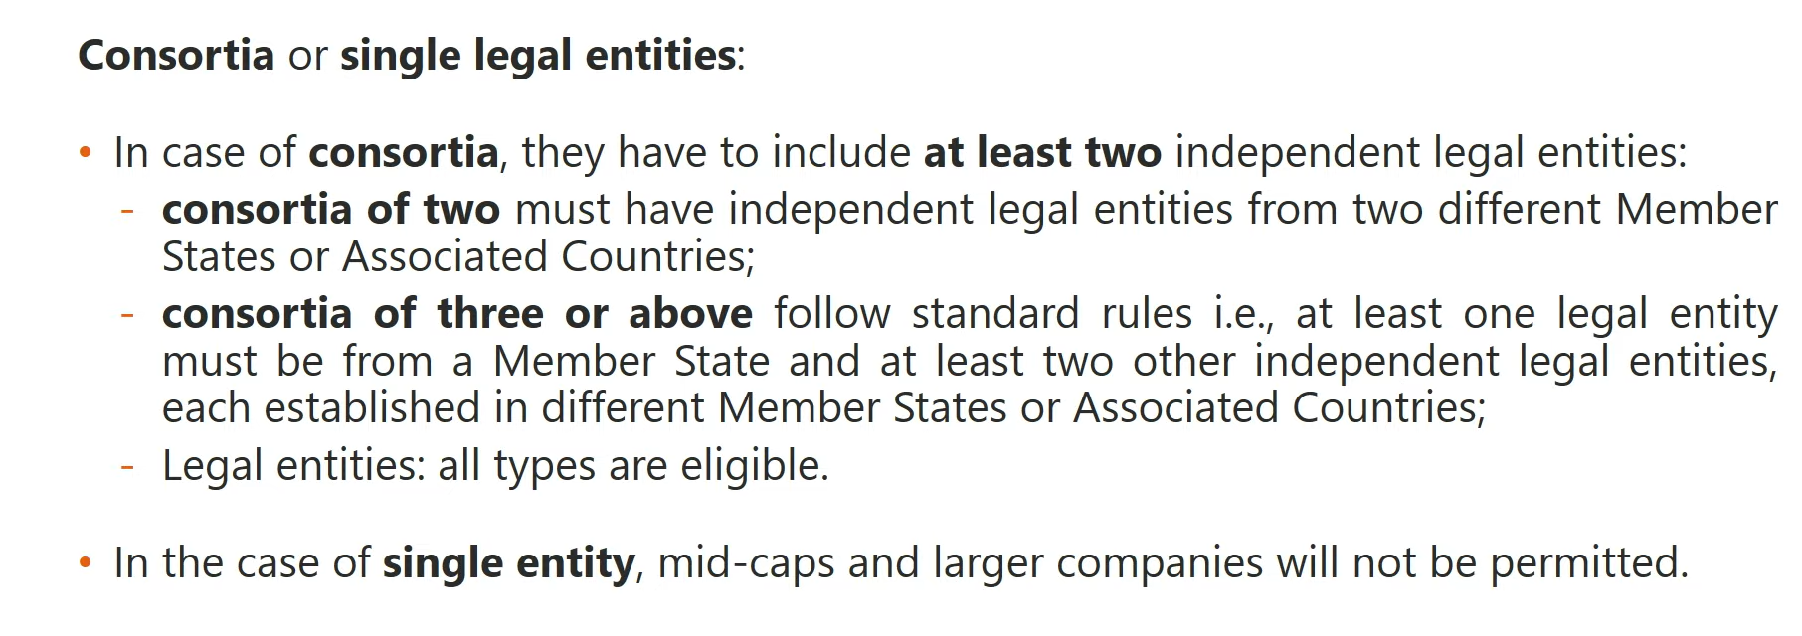
EIC Pathfinder Challenges
Consortia Composition

Slide 13
Support Received if a Proposal is Accepted

Slide 14
Criteria for selection
Based on 3 Criteria –
Impact of the proposed technology
Excellence of the proposal and technology
Quality and Efficiency of Implementation

Slide 15
Pathfinder Challenges for 2022
6 challenges for 2022 to be addressed by this call –
Carbon dioxide and nitrogen management
Mid-long-term systems-integrated energy storage
Cardiogenomics
DNA-based digital data storage
Alternative quantum information processing, sensing and communication
Turning healthcare from episodic paradigm to continuous

Slide 16
Summary

Slide 17
Update Meeting Project Exploration in the Middle East (UAE, Saudi Arabia and Others)
Update on INES Glossy Report for 2022
Frank Neumann, Anna Ossenkopp, Kunal Chowdhury
IMIEU - 24/02/2022

Slide 18
Update Meeting Project Exploration in the Middle East (UAE, Saudi Arabia and Others)
Received contributions: Universidad del Norte/ Barranquilla, SaltPower, REDstack, UNAM, IIT-Madras
Missing and will be provided soon: UNIPA, Sweetch Energy
Information yet to be gathered: Latest information from Singapore and South Korea, Japan
Frank Neumann, Anna Ossenkopp, Kunal Chowdhury
IMIEU - 24/02/2022

Slide 19
Update Meeting Project Exploration in the Middle East (UAE, Saudi Arabia and Others)
Final Remarks and Conclusion
Frank Neumann, Anna Ossenkopp, Kunal Chowdhury
IMIEU - 24/02/2022

Slide 20
Next INES Meeting
11/04/2022, 14:30 CET
Working Groups on brine from mining operations and geothermal power plants

Slide 21
Keeping in Touch
Websites:
www.imieu.eu
www.salinitygradientpower.eu

