Slide 1
Nanofluidics: Match of Current-Voltage Experiments and Simulations and Noise experiments with simulations
Dr. Vishal Nandigana,
Assistant Professor, Founder AIDESIGN PRIVATE LIMITED COMPANY,
Membrane Technology and Deep Learning Laboratory,
CFD Laboratory, Fluid Systems Laboratory,
Department of Mechanical Engineering,
IIT Madras, Chennai 600036, India

Slide 2
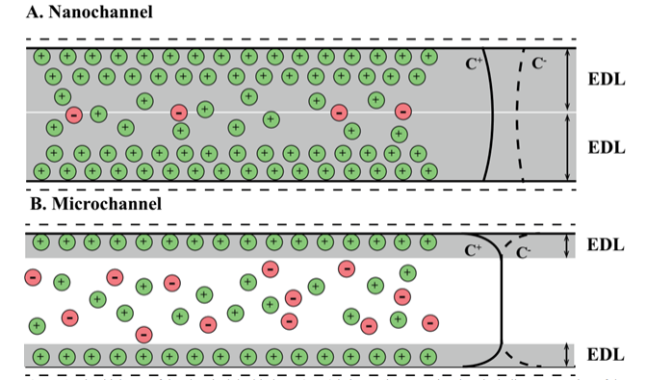
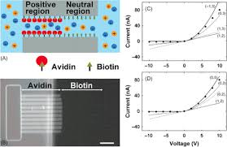
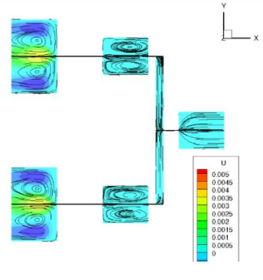
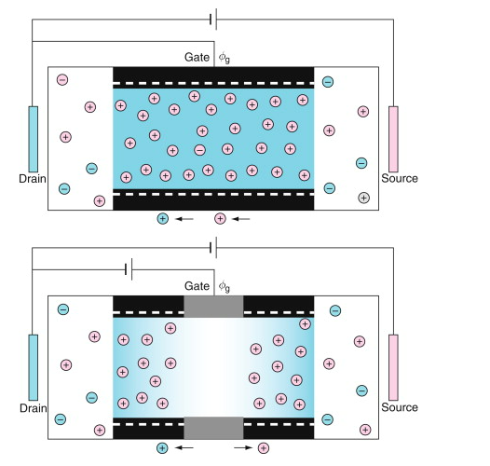
Need towards Next Generation Fluidic Electronics
Nanofluidics
Nanofluidic Diode
Nanofluidic Logic gate
Nanofluidic Transistor

Slide 3
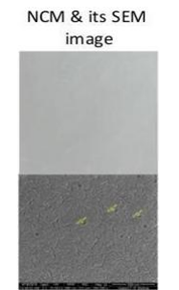
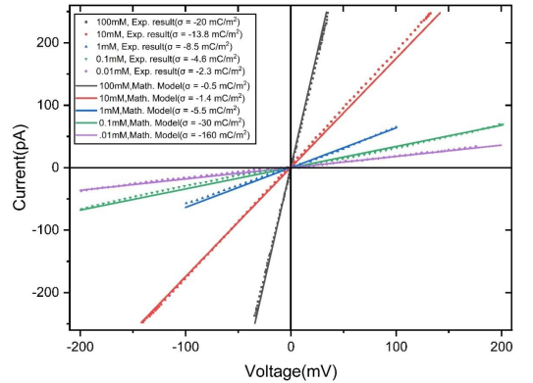
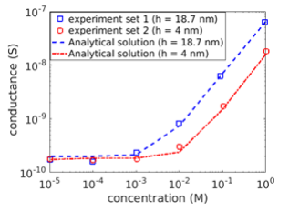
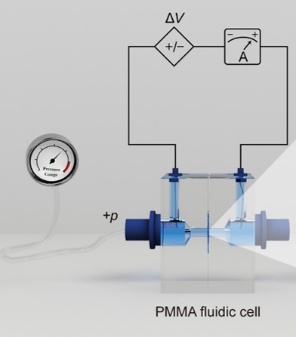
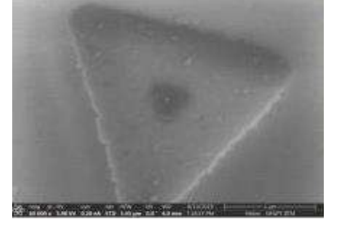
Step towards that need is Current-Voltage measurements match simulations and device physics of nanofluidics with design control, sustainability and product life cycle data
Nanocapillary membrane
Material Design Physics
3D nm scale Silicon Oxide with nm pore on Silicon substrate

Slide 4
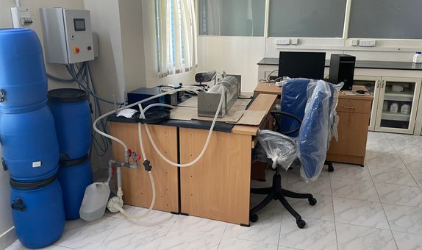
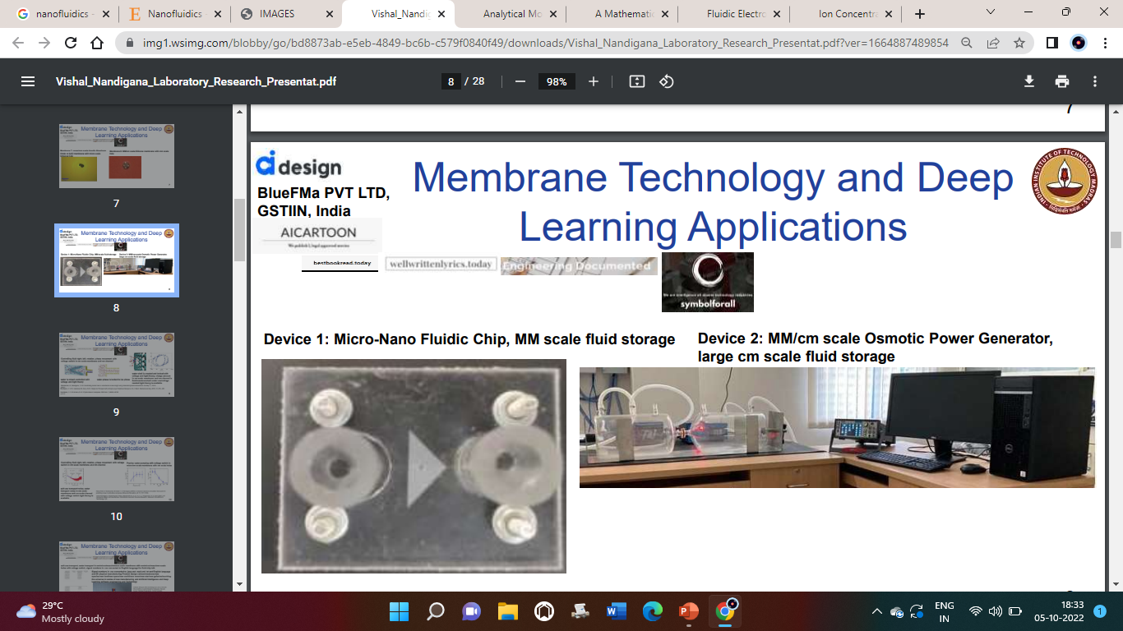
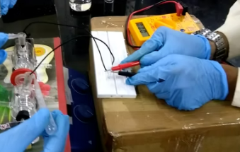
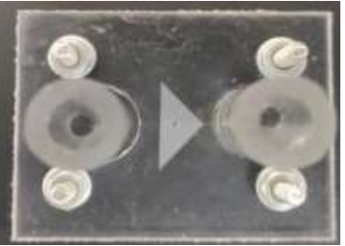
Nanofluidics Devices based Fluidic Electronics
Nanofluidics Devices Attached to Reservoir Design
(a) cm/mm size reservoir design
(b) µm/nm size reservoir design

Slide 5
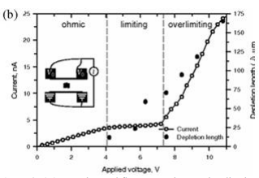

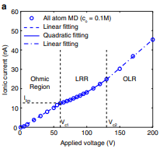
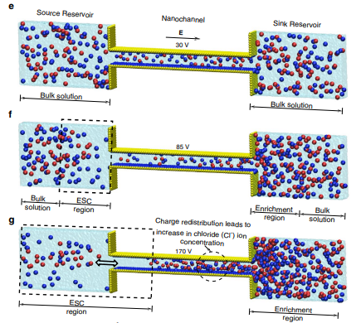
Nanofluidics Devices Attached to (b) µm/nm size reservoir design

Slide 6
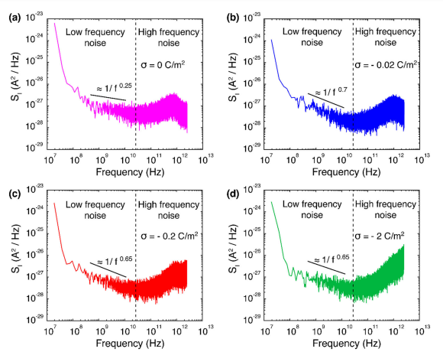
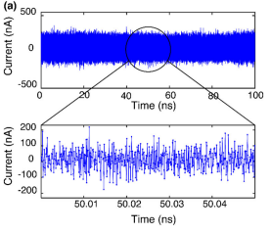
Nanofluidics Devices: Step Towards Noise currents measured in experiments match with simulations
Experiments in the field of 1/f noise in solid-state nanopores first time work of nanofluidics pore design revelations of current ion transport of the measurement scales of pA to nA scale currents.
Molecular Dynamics Simulations work of noise current ion transport measurements for the first predict of the 1/f time scale noise dynamics in nanofluidics

Slide 7
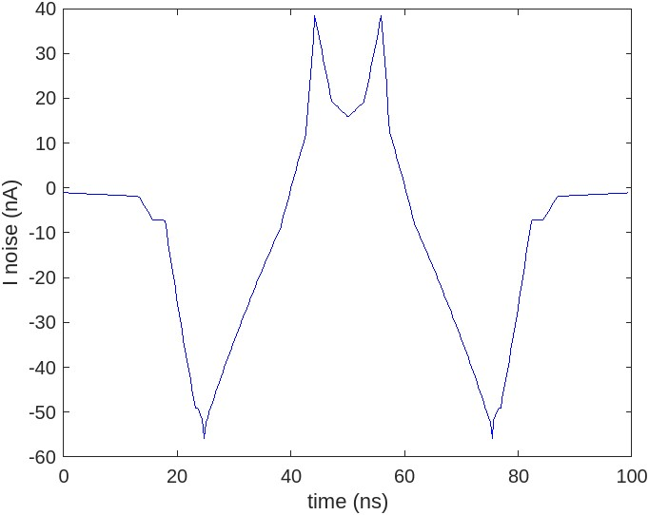
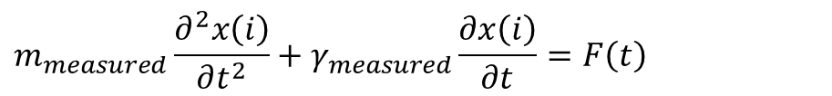
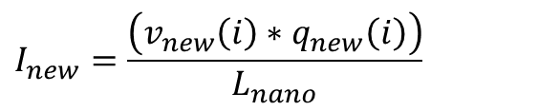
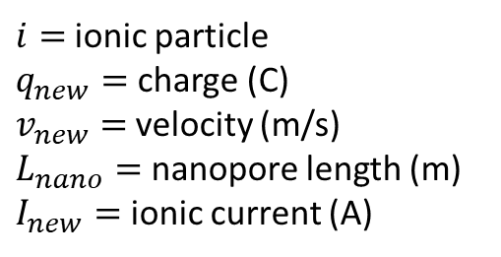
Nanofluidics Devices: Langevin Oscillator noise model dynamics
$i=$ionic particle
$q_{new}=$charge (C)
$v_{new}=$velocity (m/s)
$L_{nano}=$nanopore length (m)
$I_{new}=$ ionic current (A)
$$I_{new}=\frac{\left(v_{new}\left(i\right)∗q_{new}\left(i\right)\right)}{L_{nano}}$$
$$m_{measured}\frac{∂^{2}x\left(i\right)}{∂t^{2}}+γ_{measured}\frac{∂x\left(i\right)}{∂t}=F\left(t\right)$$
Velocity Verlet Algorithm
MD simulations
Ionic current with noise to match experiments
$$I_{new}^{updated}=wiener2\left(I_{new}\left(t_{new}\right)\right)+random\left(weiner2\left(I_{new}\left(random\left(t\right)\right)\right)\right)$$

Slide 8
Nanofluidics Devices: Langevin Oscillator noise model dynamics
$i=$ionic particle
$q_{new}=$charge (C)
$v_{new}=$velocity (m/s)
$L_{nano}=$nanopore length (m)
$I_{new}=$ ionic current (A)
$$I_{new}=\frac{\left(v_{new}\left(i\right)∗q_{new}\left(i\right)\right)}{L_{nano}}$$
$$m_{measured}\frac{∂^{2}x\left(i\right)}{∂t^{2}}+γ_{measured}\frac{∂x\left(i\right)}{∂t}=F\left(t\right)$$
Velocity Verlet Algorithm
Ionic current with noise to match experiments
$$I_{new}^{updated}=wiener2\left(I_{new}\left(t_{new}\right)\right)+random\left(weiner2\left(I_{new}\left(random\left(t\right)\right)\right)\right)$$
Experiments
Ionic current with noise does not scale exactly to the experiments using Langevin noise model to match exact current and noise measurements.

Slide 9
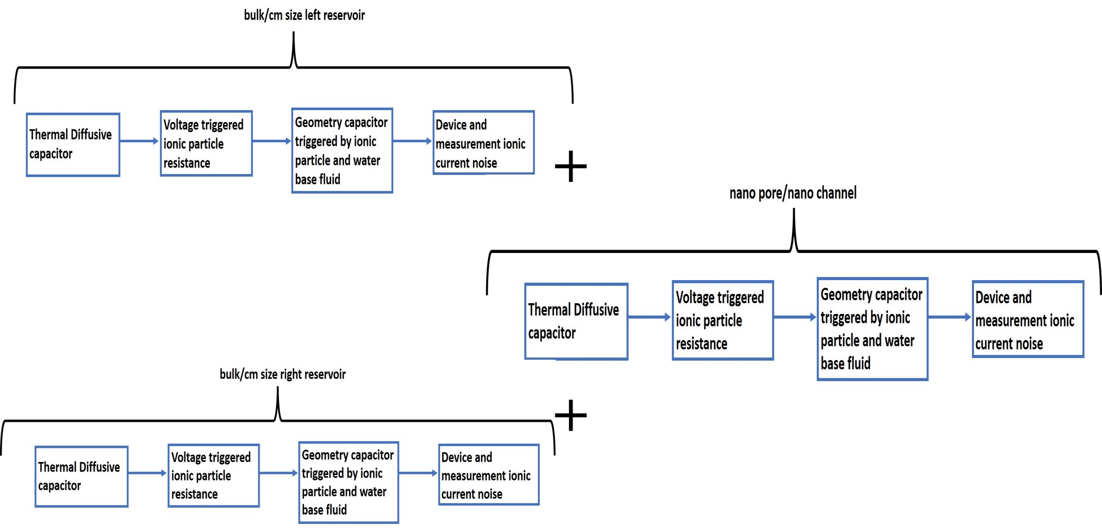
Nanofluidics Devices: Circuit theory GUI based Software package

Slide 10
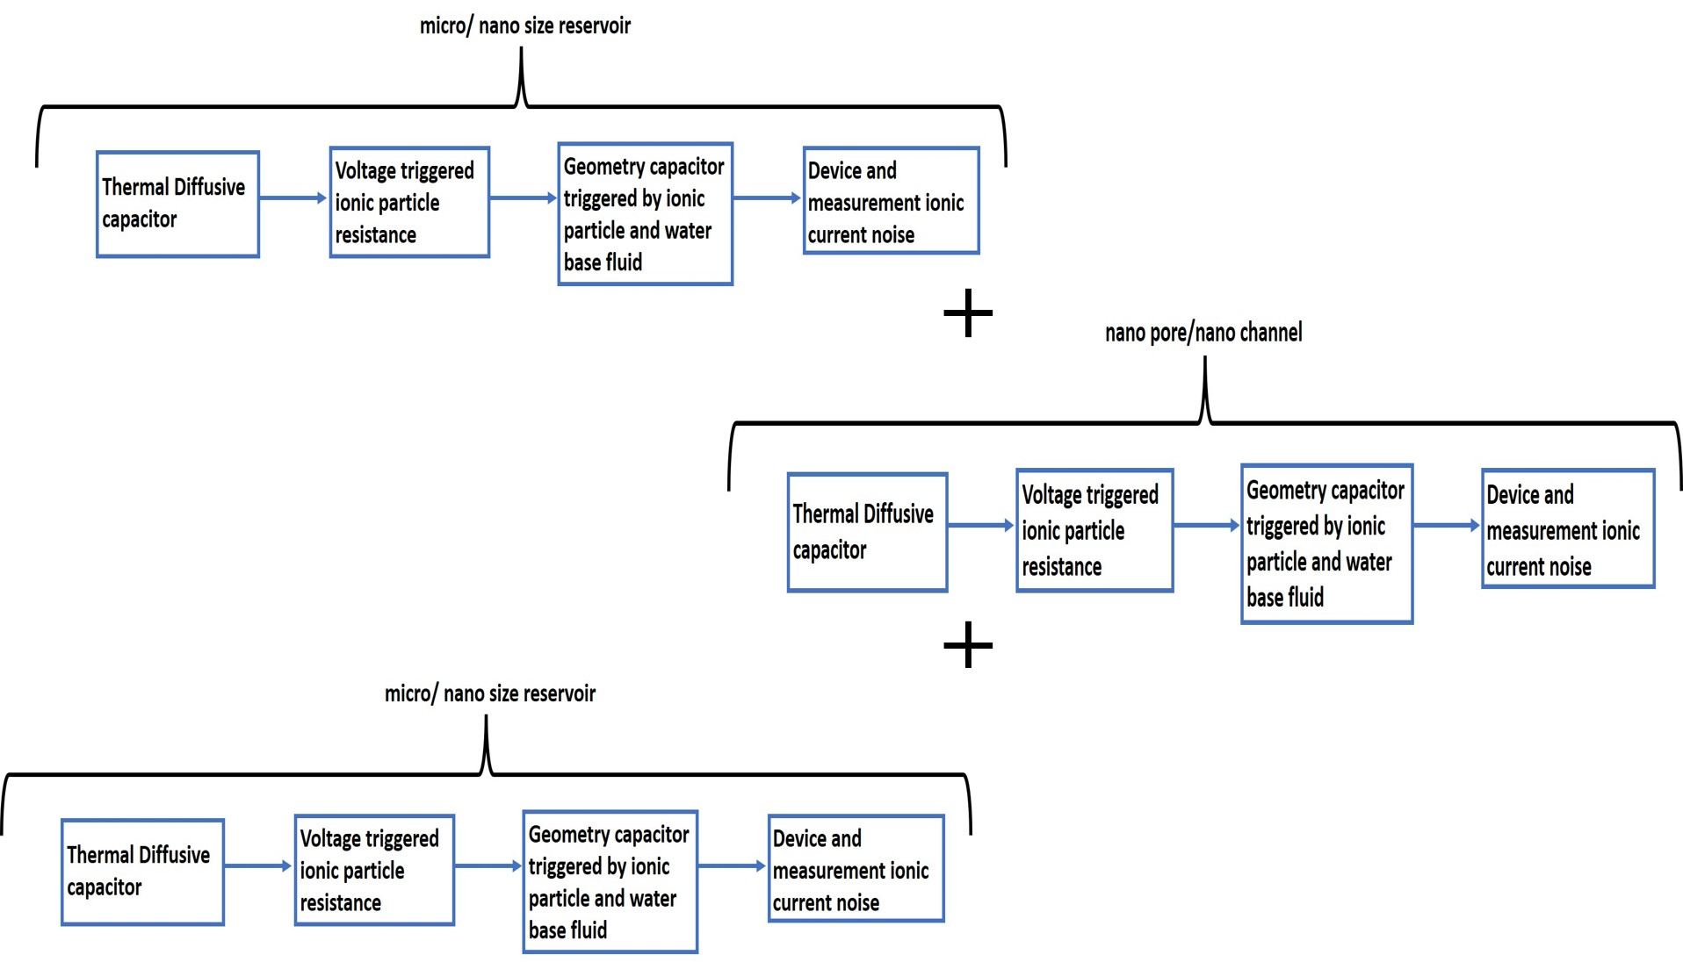
Nanofluidics Devices: Circuit theory GUI based Software package

Slide 11
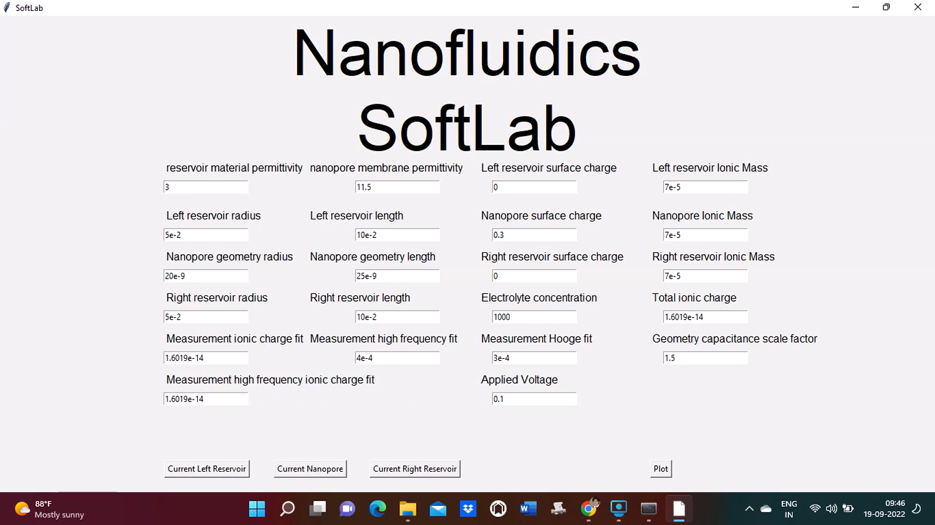
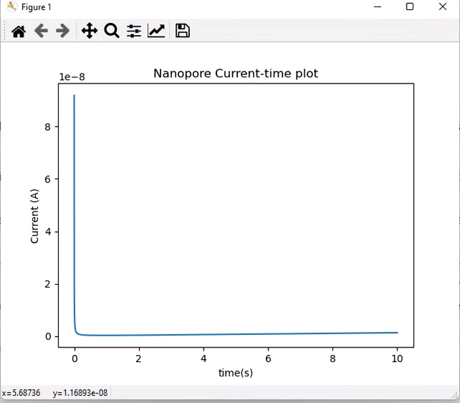
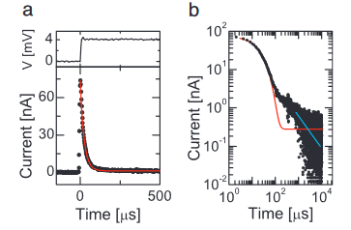
Nanofluidics Devices: Circuit theory GUI based Software package
Experiments

Slide 12
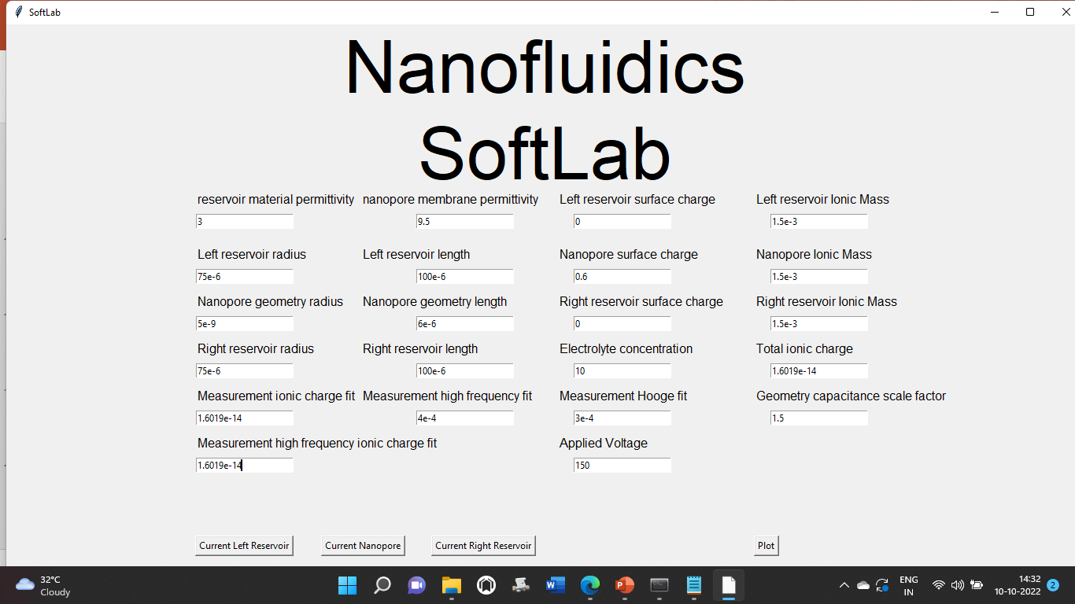
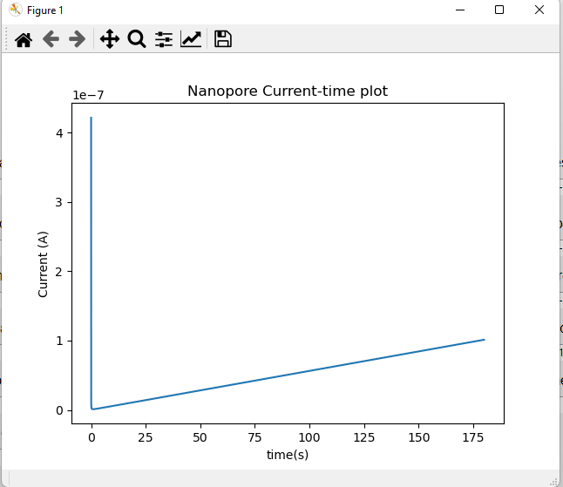
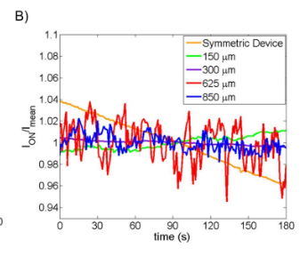
Nanofluidics Devices current noise: (b) µm/nm size reservoir design
Experiments
Experiments

Slide 13
Conclusions
Nanofluidics Current – Voltage experiments matches well with simulations for mm/cm size reservoir connected on either side of a nanopore of few nm diameter.
Nanofluidics Current – Voltage experiments matches well with simulations for µm/nm size reservoir connected on either side of a nanopore of few nm diameter and thick nanopores.
Nanofluidics Current noise in experiments matches well with simulations for mm/cm size reservoir connected on either side of a nanopore of few nm diameter.
Nanofluidics Current noise in experiments matches well with simulations for µm/nm size reservoir connected on either side of a nanopore of few nm diameter and thick nanopores.
Nanofluidics devices with design control, sustainability and product life cycle data is shown with experiments match with simulations and circuit theory.
Nanofluidics devices have need in next generation fluidic electronics, nanofluidic diode, nanofluidic logic gate, nanofluidic transistor for computing based applications.

