Slide 1
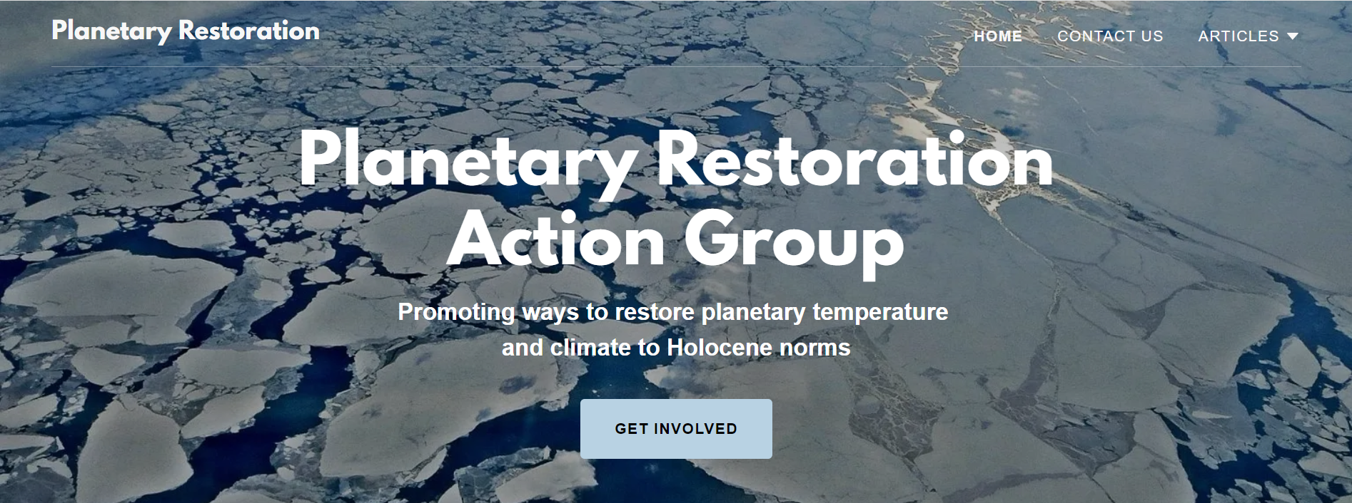
Why Increasing Albedo is More Urgent Than Removing Greenhouse Gases for Climate Policy
Robert Tulip, August 2022
https://planetaryrestoration.net/

Slide 2
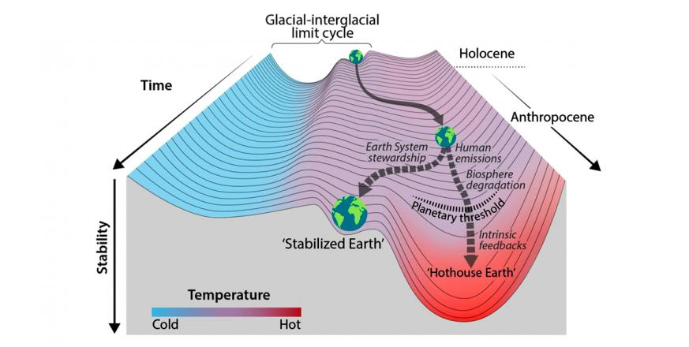
Why Increasing Albedo is More Urgent Than Removing Greenhouse Gases for Climate Policy
From Proceedings of the National Academy of Sciences - Trajectories of the Earth System in the Anthropocene
Will Steffen et al
August 6, 2018
GHG removal?
Brighten the planet
Emission Reduction
Business as usual
Slides by Robert Tulip

Slide 3
Brighten the planet
Greenhouse gas removal
Business as usual
Slides by Robert Tulip

Slide 4
The Summary for Policymakers in the 2019 IPCC Special Report: Global Warming of 1.5° C estimated the remaining carbon budget at 580 GtCO2 for a 50% probability of limiting warming to 1.5°C.
This excludes any action to brighten the planet due to concerns about “governance, ethics, and impacts on sustainable development”
What could a focus on albedo achieve?
Adding an average of 15 million tonnes (teragrams) of sulphur dioxide to the stratosphere every year from 2035 to 2070 has recently been calculated as likely to reduce average temperature rise by 2°C compared to baseline.
Source: D. G. MacMartin, D. Visioni , B. Kravitz, J.H. Richter, T. Felgenhauer, W. R. Lee, D. R. Morrow, E. A. Parson, and M. Sugiyama, Scenarios for modeling solar radiation modification, Proceedings of the National Academy of Science, August 2022

Slide 5
Cutting Emissions Is Not Enough
All this causes Committed Warming
+
=
2020 Emissions 15 Gt C
Effect of Annual Paris Pledges
+ 1 Gt C
Historic Emissions
670 Gt C (2022)
2030 Expected Emissions
16 Gt C
Meeting all national pledges to the Paris Accord would increase annual emissions by 1 Gt C by 2030
Climate Arithmetic
Emission reduction slows new emissions (right). It does nothing about the forty times larger committed warming effects of past emissions (left) which will produce Earth System Equilibrium at a higher temperature and higher sea level. Decarbonising the economy is marginal to stabilising the climate, which requires (1) rapid brightening of the planet and (2) removal of past emissions.
One gigatonne of carbon (GtC) (one billion tonnes) equals 3.7 Gt of CO₂ and equivalents. 1Gt = 1 cubic km of water.
Data from Oxford University https://globalwarmingindex.org/ and Climate Action Tracker (2019).
by Robert Tulip

Slide 6
Projected global emissions this century (2019 estimates) if Paris Accord pledges are exceeded.
Chart by Robert Tulip, data used with permission from https://climateactiontracker.org/data-portal/

Slide 7
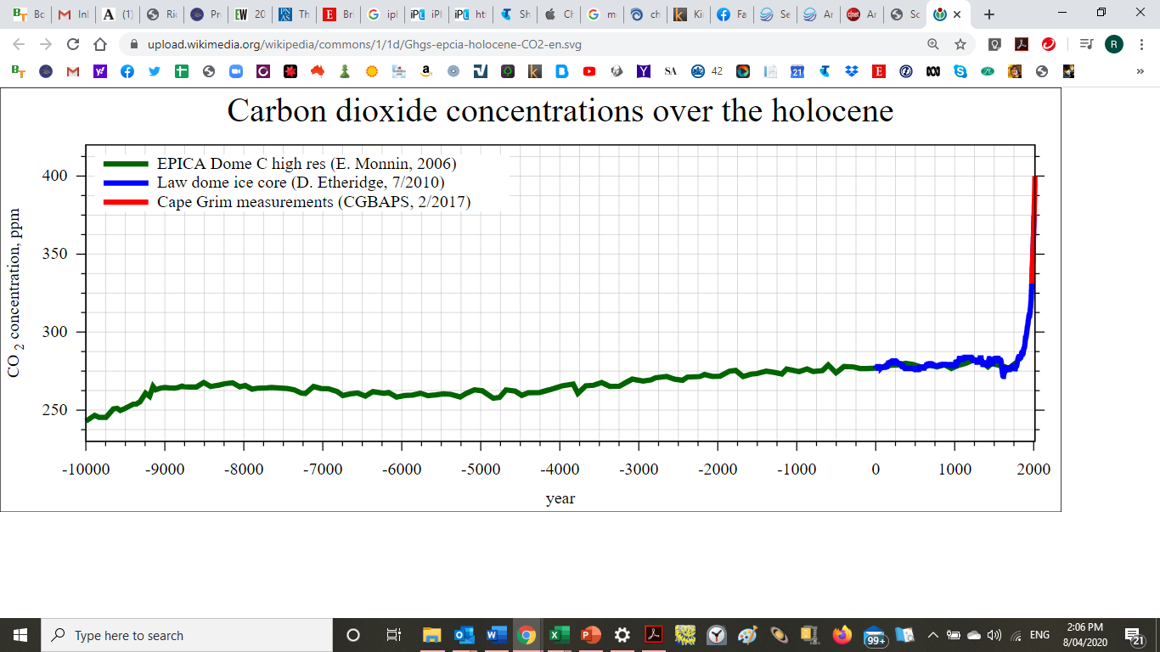
The Climate Instability Problem
Carbon Dioxide Concentrations over the Holocene
Unstable
Stable: ~280 parts per million

Slide 8
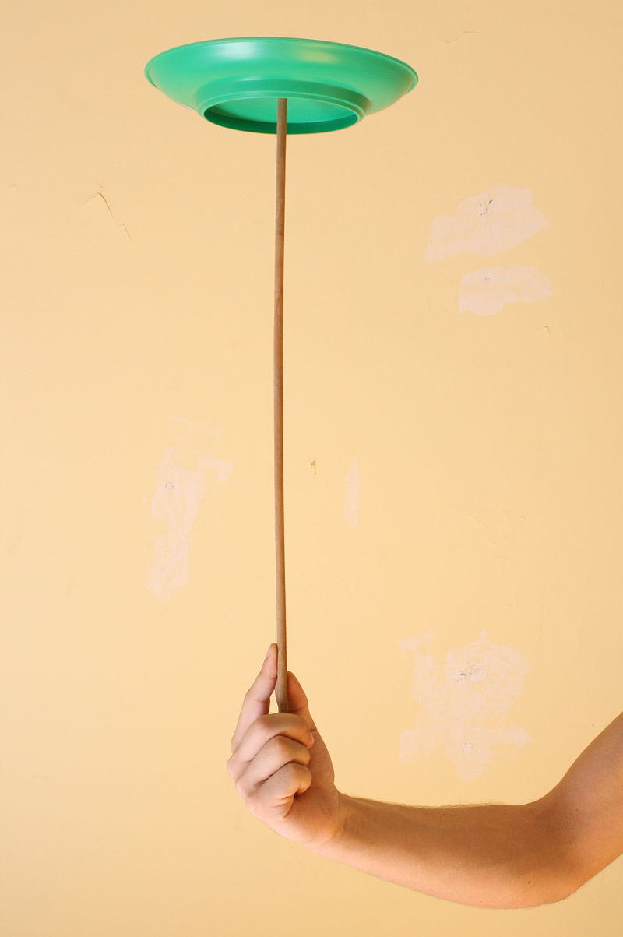
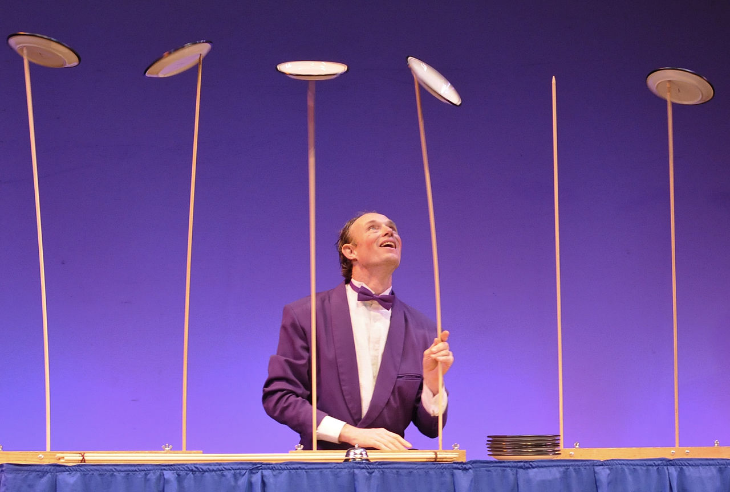
Stability?
This is the best outcome from net zero emissions

Slide 9
Net Zero leaves us above the danger line of 550 ppm CO2, plus warming from CO2 equivalents such as methane.
Climate Stability
That is a highly unstable result.
Even the hypothetical “Climate Stability” line is too slow to prevent dangerous tipping points unless we take action to increase albedo.
RCP is the Representative Concentration Pathways of Carbon Dioxide agreed by the IPCC
The urgent priority is to brighten the planet.
Myers and Smith, 2018

Slide 11
Climate Security Timeline
2080
2060
2040
2020
3. Cut emissions
Roof
2. Remove Greenhouse Gases
Convert carbon dioxide and methane
into useful commodities
Walls
1. Albedo Enhancement – Immediate cooling priority to brighten planet and reverse extreme weather, biodiversity loss, heating and sea level rise.
Foundations
By Robert Tulip

Slide 12
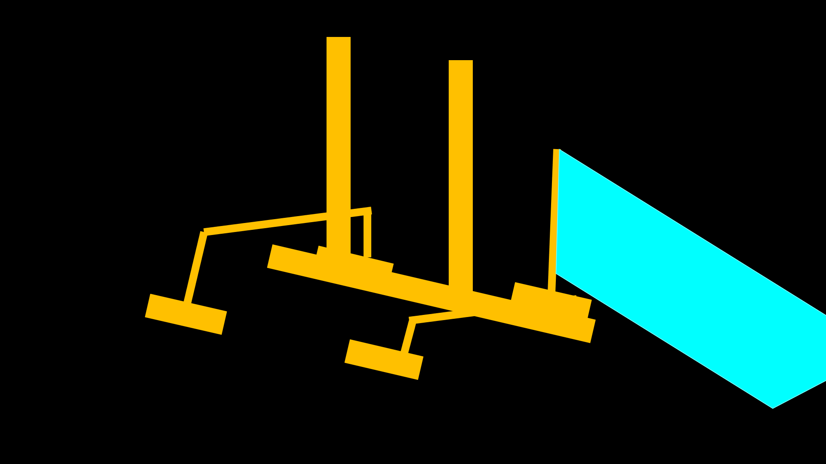
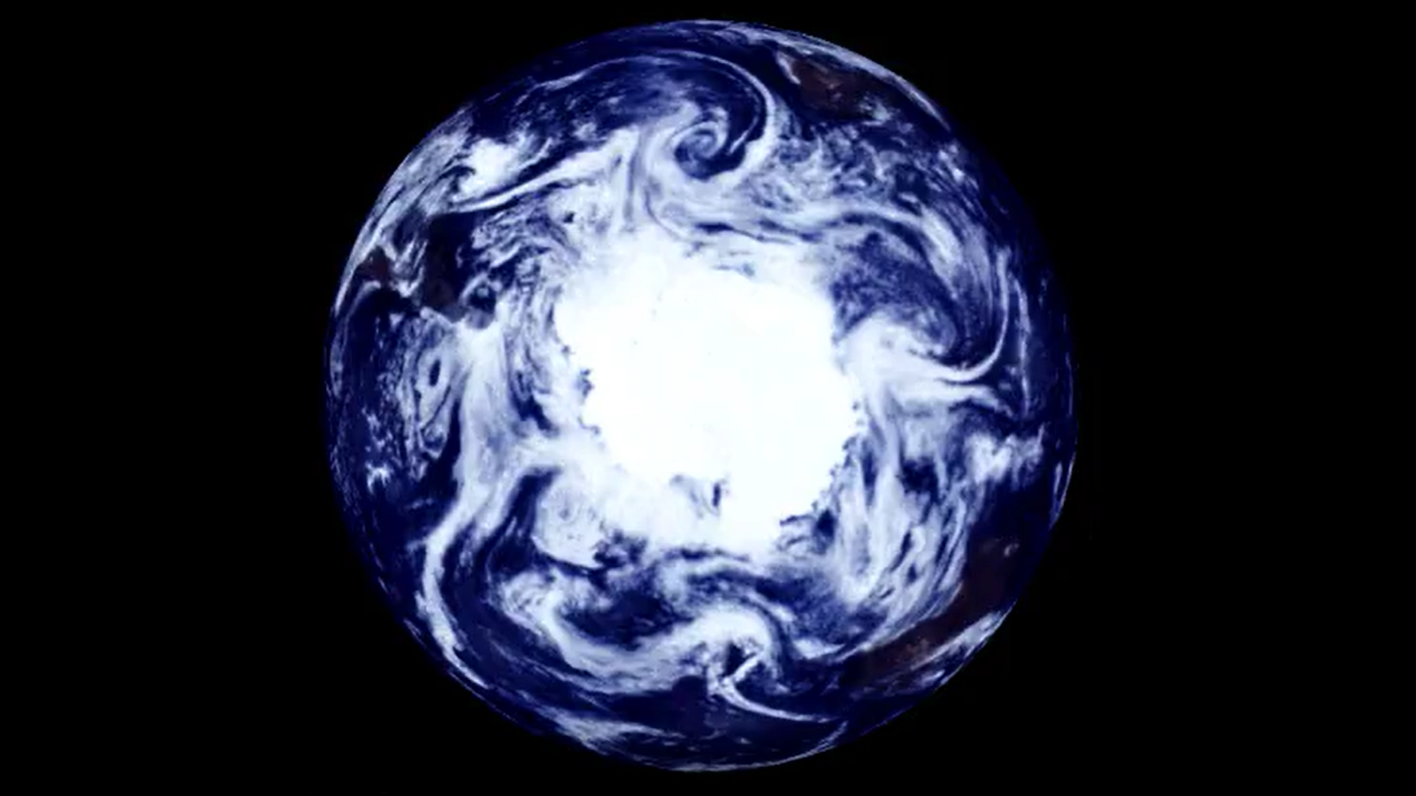
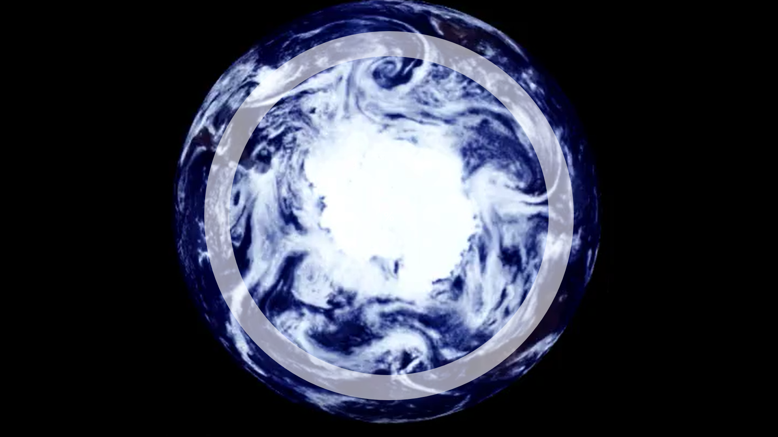
Marine Cloud Brightening to cool Antarctica
MCB schematic vessel from Paul Beckwith.
A Safe, Cheap and Quick Way to
Freeze Sea Ice
Limit Sea Level Rise
Protect Biodiversity
Prevent Glacier Melt
Cool Ocean Currents
Reduce Extreme Weather
Mitigate Climate Change
Increase International Cooperation for Peace, Stability and Security
Photo of Earth by NASA
Diagram by Robert Tulip

Slide 13
The Problem
Cut Emissions
Remove CO2
Solar Geoengineering

Slide 14
The Solution is to reverse IPCC Priorities
Brighten the Planet
Convert GHGs
Decarbonise the Economy

Slide 15
Why Albedo is More Important Than Greenhouse Gas Removal for Climate Policy
The Problem
Cutting emissions and removing greenhouse gases can’t stop climate tipping points
Politics and economics make cutting emissions difficult, expensive and slow.
The world situation is like a canoe headed for a waterfall
Viable cooling technologies lack funds, publicity and political support
The Solution
Reverse the IPCC priority order and put increasing albedo first
A brighter planet can avoid the climate danger zone.
Cooling technologies such as Marine Cloud Brightening are quick, safe and cheap
Fund large scale solar geoengineering research
Governments must cooperate to implement direct cooling measures.
Robert Tulip

Slide 16
Why Increasing Albedo is More Urgent Than Removing Greenhouse Gases for Climate Policy
From Proceedings of the National Academy of Sciences - Trajectories of the Earth System in the Anthropocene
Will Steffen et al
August 6, 2018
Brighten the planet
GHG removal?
Business as usual
Slides by Robert Tulip

Slide 17
Why Albedo is more important than Greenhouse Gas Removal for Climate Policy
Proceedings of the National Academy of Sciences
Trajectories of the Earth System in the Anthropocene
Will Steffen et al, August 6, 2018
“Stability landscape showing the pathway of the Earth System out of the Holocene and thus, out of the glacial–interglacial limit cycle to its present position in the hotter Anthropocene.
The fork in the road is shown here as the two divergent pathways of the Earth System in the future (broken arrows).
Currently, the Earth System is on a Hothouse Earth pathway driven by human emissions of greenhouse gases and biosphere degradation toward a planetary threshold at ∼2 °C, beyond which the system follows an essentially irreversible pathway driven by intrinsic biogeophysical feedbacks.
The other pathway leads to Stabilized Earth, a pathway of Earth System stewardship guided by human-created feedbacks to a quasi-stable, human-maintained basin of attraction.”
Slides by Robert Tulip

