Slide 1


Going AWOL
How Labor and Management Advocates can present an Arbitration Case

Slide 2
Who are we?
And why are we here?
Charlene MacMillan
Arbitrator (macmillanarb.net)
Sylvia Skratek
Mediator∙Arbitrator∙Dispute Systems Designer (Skratek.com)
Copyright © 2024 All rights reserved. No part of this presentation may be reproduced, stored in a retrieval system or transmitted, in any form or in any means-by electronic, mechanical, photocopying, recording or otherwise-without prior written permission.

Slide 3
Why do we have Labor Arbitration?
“...the habitual willingness of civilized men and nations to submit their differences of opinion to a factual test...” (Boland, 1943)
“...the tooth and claw of industrial warfare...” (Steelworkers v. NLRB, 1976)
…the final stage in the relationship between Unions and Management:
  Collective Bargaining Arbitration
  And it is the trade-off for the Union’s inability to strike during the life of an Agreement…thanks primarily to WWII

Slide 4




Why don’t you present a case to an arbitrator?
Why should you?

Slide 5

Can you?
Do you have Reasoning Ability? Are you a critical thinker? Are you analytical?
Do you have an understanding of Labor Relations?
Can you make difficult decisions?
Do you have the ability to participate in adversarial proceedings?

Slide 6
Where does arbitration begin?
1
Grievance
Procedure
2
Decision to
Arbitrate
3
Selecting an
Arbitrator
Moving toward the hearing
4
Pre-hearing
Preparation
*
From Informal Complaint
to Filing for Arbitration
5
Hearing is
In Session!
6
Closing
the hearing
And where does arbitration end?
*Weeks (not days) before
Notes:
6

Slide 7
The Grievance Procedure
Grievance definition-Is the issue covered?
Steps of the procedure-has each step been fully utilized?
Time limits-have the time limits been followed at each and every step?

Slide 8
Avoid Misuse of the Process
Union Representative who wants to get re-elected
Supervisor who does not want to lose face
Union wants to amend the contract
Company wants to centralize decision-making
First level representatives who are not trained

Slide 9
Decision to Arbitrate
What is your case?
The issue
The facts
The evidence to support the facts
What is the other side’s case?
Their issue
Their facts
The evidence to support their facts

Slide 10
Pre-Hearing Considerations

Slide 11

Selecting the Arbitrator
Actual contract language
“...qualified non-industry arbitrator...shall be a non-attorney/lawyer who meets certain minimum standards, including no prior affiliation [with the Employer or the Union] and on the FMCS or AAA labor arbitrator rosters”

Slide 12
The Hearing Procedures
Stipulation of the Issue and perhaps the uncontested facts
Opening Statement
Presentation of Case by the Initiating Party
  Discipline/Discharge: Management goes first
  All other matters: burden of proof is on the Union
  Calling of Witnesses

Slide 13
The Hearing-continues
Opposing Party’s Presentation
  Rebut the evidence presented by the Moving Party
  Questions by the Arbitrator
  Closing the Hearing
  And the Opinion and the Award arrive!
    An Opinion states the reasoning behind the Award
    The Award is the actual decision

Slide 14
Opening Statement
Develop the blueprint of your case
  Relevant Facts
  Relevant Issues
  How do your exhibits relate to your theory of the case?
  How do your witnesses relate to your theory of the case?
  Provide the Arbitrator with a thumbnail sketch:
    What the case is about
    What the issue is
    What resolution is being sought

Slide 15
Stipulations
Statement of the Issue: what are you asking the Arbitrator to decide?
Relevant Contractual Provisions
Joint Exhibits
  CBA
  Grievance
  Grievance trail (may be combined with the grievance)
  Others that the parties can agree upon
Relevant, undisputed facts

Slide 16
Your Witnesses are telling the story of the Case
Prepare them for the hearing
  Review their testimony with them
  Tell them what to expect at the hearing

Slide 17
Witnesses should...
... Answer without bias
  …not appear reluctant to testify to facts even if they favor the other side
  ... Not argue with the advocates
    Never argue with the Arbitrator
    Lose their temper or engage in any negative behavior
    ...Refrain from offering information not asked for in the questions
    Leave all questioning to the advocates and the arbitrator

Slide 18
Witnesses should...
... not answer a question if there is an objection-wait for the Arbitrator’s ruling on the objection
...be reminded that objections are made by the advocates, not a witness
... testify about the facts, not their opinion, not their feelings, not their perception
...respond truthfully if asked whether they were prepped for the hearing

Slide 19
Witnesses should...
...be alert and serious
... think before answering a question
...make certain they understand the question
...observe decorum at the hearing and during recesses
...avoid treating serious matters with levity or contempt for the other side
...dress neatly

Slide 20

Cross Examination!!!!
Strikes terror in everyone
  The witness is terrified
  The advocate is terrified
  The Arbitrator is terrified

Slide 21

Calming the witness
Prepare them to be fully truthful on direct examination
Advise them to strengthen their testimony on cross; reaffirm the testimony they gave on direct examination
Identify which aspects of their testimony will most likely be subject to cross and work with them to become comfortable prior to the hearing
Remind them not to be misled by the other side
  Do not allow the other side to incorrectly restate their testimony
  If they do, then they should clarify their testimony don’t answer “Yes” or “No” but “What I said was...”

Slide 22
Alleviating your fears
Don’t do it
Don’t cross examine
Think twice before cross examining
Then think again
FOCUS: ARE THERE ANY AREAS THAT YOU ABSOLUTELY MUST REBUT?

Slide 23
Because...
You should be telling your story through your witnesses
And not relying on the other side’s witnesses

Slide 24

Calming the Arbitrator’s fears
“I have no cross examination”
“No questions for this witness”
Too many times you will just give the other side the chance to strengthen their direct testimony

Slide 25


Evidence
At arbitration, rules of evidence are relaxed.
Your exhibits should include any materials on which a reasonable person could rely.
Don’t exclude the difficult or unflattering evidence.
Make every effort to present the ‘best evidence’ at the hearing.

Slide 26
Evidence
Organize your exhibits --whatever works for you. Notebooks, folders, etc., You must be able to find your exhibits!
Organize the exhibits in the order that you anticipate entering them
Make certain that you have copies for:
  Yourself
  Witnesses
  Opposing advocate
  Arbitrator

Slide 27

Entering the Exhibits
Hand the document to the witness
  [To witness] “Have you seen this document before?” Yes.
  [To witness] “How are you familiar with this document?”
The witness’s answer is the foundation – it shows the witness knows something about the document.
  [To Arbitrator] “Please enter this document as Union Exhibit 1.”

Slide 28
Objections to evidence
Hearsay
Something, said or written outside the hearing, that is being offered as true. “My mechanic told me the brakes on my car were defective.”
An affidavit offered in lieu of testimony is inherently hearsay.
Document speaks for itself (when having witness read a document into evidence).
Not the best evidence

Slide 29

Objections to Testimony
The form or substance of the question
  Ambiguous
  Compound
  Argumentative
  Repetitious
  Confusing
  Leading

Slide 30
More objections…
Calls for speculation
Assumes facts not in evidence
Badgering the witness
Nonresponsive Answer

Slide 31

Oral Closing Arguments
Prepared before the hearing starts
  Should know the other party’s evidence through the lower steps of the grievance procedure
  This is your Last Chance to Persuade
  Identify key undisputed facts
  Identify key disputed facts
  How do the key facts support your side’s theory of the case
  Last Chance to attack the other side’s facts and theory of the case and
  Highlight their weaknesses

Slide 32
Why Oral?
Case is ready for decision making immediately after the hearing
Everything is fresh in everybody’s mind
Justice is not unreasonably delayed
Eliminates the formality of filing a written brief
Cost efficient
And if the other side prefers a post hearing brief....let them write it...but you can still do an oral closing—without the other side present

Slide 33
Oral Summation
Make it Clear
1
Make it impossible for the Arbitrator to misunderstand
2
Make your requested remedy clear
3
Rehearse, Rehearse, Rehearse...
4

Slide 34
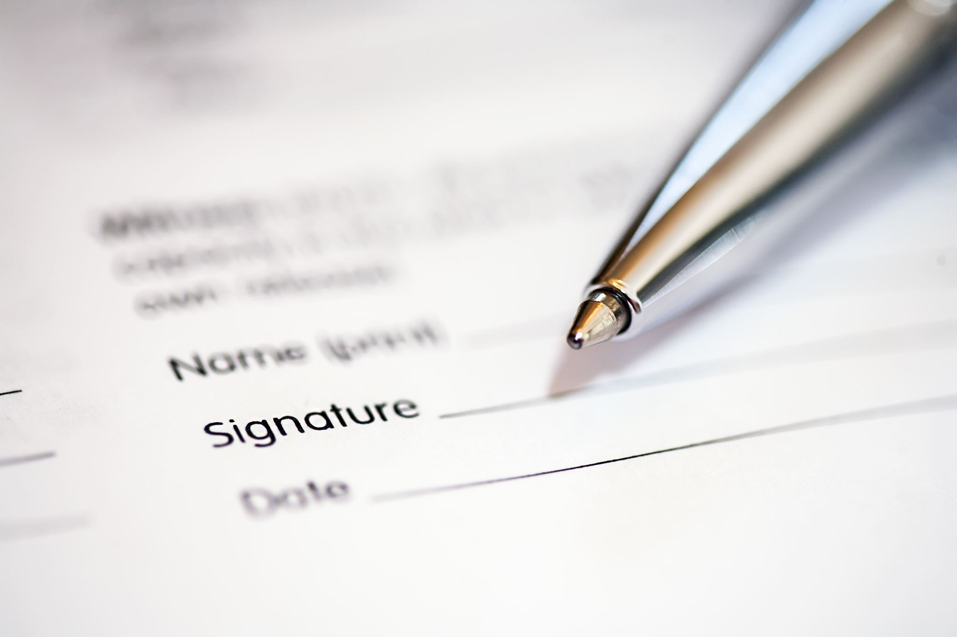
Written Closing Arguments
1. Focus on the Issue
2. Provide the controlling provisions of the Agreement
3. Then provide an analysis
  This is the issue, these are the controlling provisions, this is why the facts and provisions support our position
  Are there any sub-issues? If so, repeat 1-3
  Then provide the Conclusion that you want the Arbitrator to reach

Slide 35
Resources
PERC provides training on collective bargaining and grievances and can also customize training for your organization. https://perc.wa.gov/training-labor-relations/
  The Negotiation Project: a specialized subset of PERC training. Innovative conflict prevention program that explores how academic theories and research apply in Washington state public sector labor relations. Through online and eventually in-person discussions, advocates can improve their skills and better manage conflicts. TRAINING NEGOTIATION PROJECT – Washington State Public Employment Relations Commission

Slide 36
Resources
Dooley, Andrea L. The Beginner’s Guide to Labor Arbitration Practice Tips & Strategies for Improving Your Case (2020) ThriftBooks, www.thriftbooks.com. $19.95
Champions of Conflict: Learn how to be a better advocate in collective bargaining, grievance handling, and labor arbitration from an experienced arbitrator, mediator, and former advocate. Welcome to Champions of Conflict - by Andrea Dooley (substack.com)
Hill, Marvin F. Hill, Jr. and Sinicropi, Anthony V. Improving the Arbitration Process: A Primer for Advocates. Willamette Law Review, Volume 27, Number 3. (A bit tough to find but worth looking for!) Available for a price through HeinOnline.

Slide 37
Resources
National Public Employer Labor Relations Association (National PELRA): training in labor-management relations, collective bargaining, negotiation and the grievance arbitration process. Also offers a labor relations certification CLRP, or certified labor relations professional. https://npelra.org
Association of WA Cities (AWC): annual Labor Relations Institute conference provides training on labor relations matters. For public sector management-side practitioners only. https://wacities.org/events-education/conferences
FMCS Institute: training to both management and union practitioners, including a course called Arbitration for Advocates for experienced advocates looking to develop their skills at presenting cases at arbitration. https://www.fmcs.gov/services/education-and-outreach/fmcs-institute/

Slide 38
Resources
Labor Education and Research Center | Georgetown (southseattle.edu)
Labor Education and Research Center Courses - University of Oregon (uoregon.edu)
University of Michigan, Center for Labor and Community Studies: Grievance and Introduction to Arbitration
Wayne State University-Advanced Grievance Handling, Labor@Wayne, Walter P. Reuther Library

Slide 39

SAVE THE DATE!
April 30-May 3, 2025
Join us at the National Academy of Arbitrators’ Annual Meeting in Seattle
There will be an in-depth Going AWOL track for Advocates
With hands on opportunities to develop your skills
A Certificate of Completion will be provided
Stay in touch with us at GoingAWOL.org to receive information about the track

Slide 40
For the things we have to learn before we can do them, we learn by doing them.
Aristotle
Woodhaven, 1979

Slide 41

Goingawol.org

