Slide 1
Change in Opportunity from 2024 to 2025 in the CVCPG Boundaries
Data form 2024 and Draft 2025 CTCAC/HCD Opportunity Map

Slide 2
What is the CTCAC/HCD Opportunity Map?
The goal of the of the map is to identify areas in every region of the state whose characteristics have been shown by research to be associated with positive economic, educational, and health outcomes for low-income families – particularly long-term outcomes for children. As such, the Map is intended to inform efforts to advance the “Affirmatively Furthering Fair Housing” (“AFFH”) objective of increasing access to opportunity.
AFFH means taking meaningful actions, in addition to combating discrimination, that overcome patters of segregation and foster inclusive communities free from barriers that restrict access to opportunity based on protected characteristics. Specifically, affirmatively furthering fair housing means taking meaningful actions that, taken together:
Address significant disparities in housing needs and in access to opportunity,
Replacing segregated living patters with truly integrated and balanced living patterns,
Transforming racially and ethnically concentrated areas of poverty into areas of opportunity, and
Fostering and maintaining compliance with civil rights and fair housing laws.

Slide 3
Summary of Analysis:
This is a summary of analysis comparing boundaries of the Chollas Valley Community Planning Group (CVCPG) area within the city of San Diego of the 2024 state of California Tax Credit Allocation Committee & California Department of Housing and Community Development (CTCAC/HCD) Opportunity Map to the 2025 Draft CTCAC/HCD Opportunity Map.
Bottom line up front: The CVCPG area from 2024 to 2025 has less opportunity in 2025 than it did in 2024. The CVCPG continues to see new projects built out of step with the General Plan and Community Plan elements and Affirmatively Furthering Fair Housing (AFFH) requirements.

Slide 4
Change in population
In the 2024 map, there was a population of 50,582 people living in the CVCPG area.
In the Draft 2025 map, there is a population of 49,749, a decrease of 833 or 1.6%
The following data are average results of all 10 census tracts. It must be stated that the normalization for average was not based on each individual person, but rather each of the census tracts vs. one another. There are 10 census tracts in the CVCPG area.
Briefly, there appears to be a positive result in childhood education. But when considering the state modified the indicator to a three-year rolling average for high school graduation rate, reading, math, and student poverty vs. the use of a single year, thus negating the initial excitement that those indicators are really improving. *Page 11 of the Draft 2025 Methodology for Opportunity and High-Poverty & Segregated Area Mapping Tools October 2024

Slide 5
Normalized results for year-over-year change vs. the median area
Adult Education:
2.1% Negative
Employment:
No Change
Median Home Value:
$5,039 Negative
Environmental Burden:
No Change
Math Proficiency:
5.7% Positive
Reading Proficiency:
1.6% Positive
High School Graduation Rate:
1.6% Positive
Students not in Poverty:
2.2% Negative
Share Below Poverty Level:
1.8% Negative
Above 200% Poverty:
1% Negative

Slide 6
If the statement above is true, the opposite must also be true: To AFFH, Low and Moderate Resource areas need to include fewer zones that allow for multiple home development

Slide 7
High and Highest Resource areas account for 66% of the city but ONLY 27% of new homes were permitted for those areas.
SO WHY ARE ANY NEW AFFORDABLE HOMES BEING CREATED IN HIGH POVERTY, SEGREGATATED, AND LOW OPPORTUNITY AREAS?
COMPLY WITH AFFH NOW NO MORE EXCUSES!

Slide 8
The opposite must also be true. Reducing multiple homes in high poverty, segregated, and low resource areas will AFFH through the advancement of anti-racist zoning.

Slide 9
The City Continues to Approve new 100% affordable housing projects in Low Opportunity areas, such as the CVCPG area, counter to the AFFH mandate to create real choice for individuals and families

Slide 10
San Diego’s Affordable Housing Permits Now Program:
As an example, the 5356 Naranja project comprises 138 units of low and extremely low-income restricted apartments in a five-story building where minimum setbacks in the front, sides and rear were waived, maximum height requirement waived, and access to open space waived by the city so the developer could “reduce construction costs.”
Additional cost reductions include no parking and “building alternatives.” This project has also taken advantage of the density bonus allowed with a 500% density bonus. In addition, the city has waived $428,392 in development impact fees. This project is projected to produce more revenue from laundry and vending machine sales for the owner than produce in property tax each year.
Source* California Tax-Exempt Bond Financed (4%) Applications Requesting Federal and State Credits

Slide 11
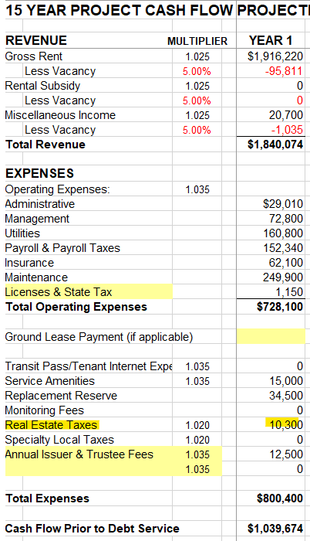
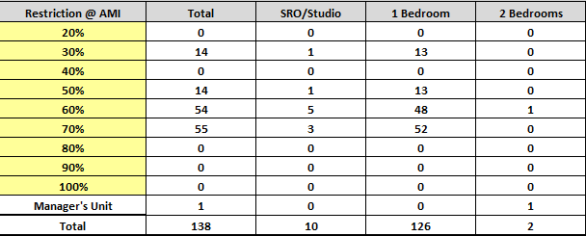
5256 Naranja Project – “Affordable Housing Permits Now” program

Slide 12
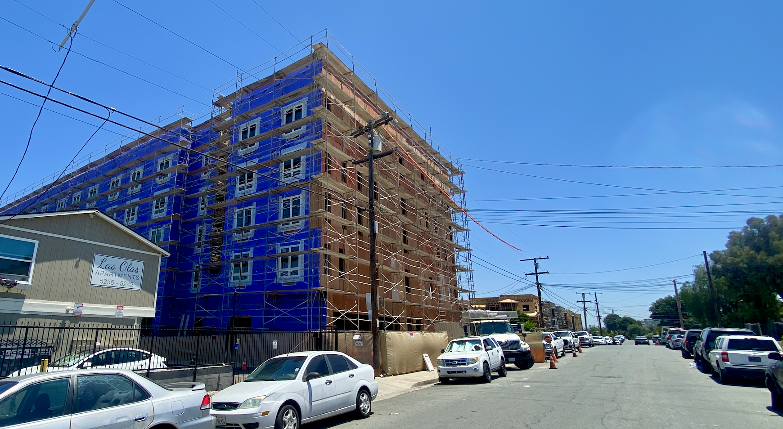
5256 Naranja Project – “Affordable Housing Permits Now” program

