Slide 1
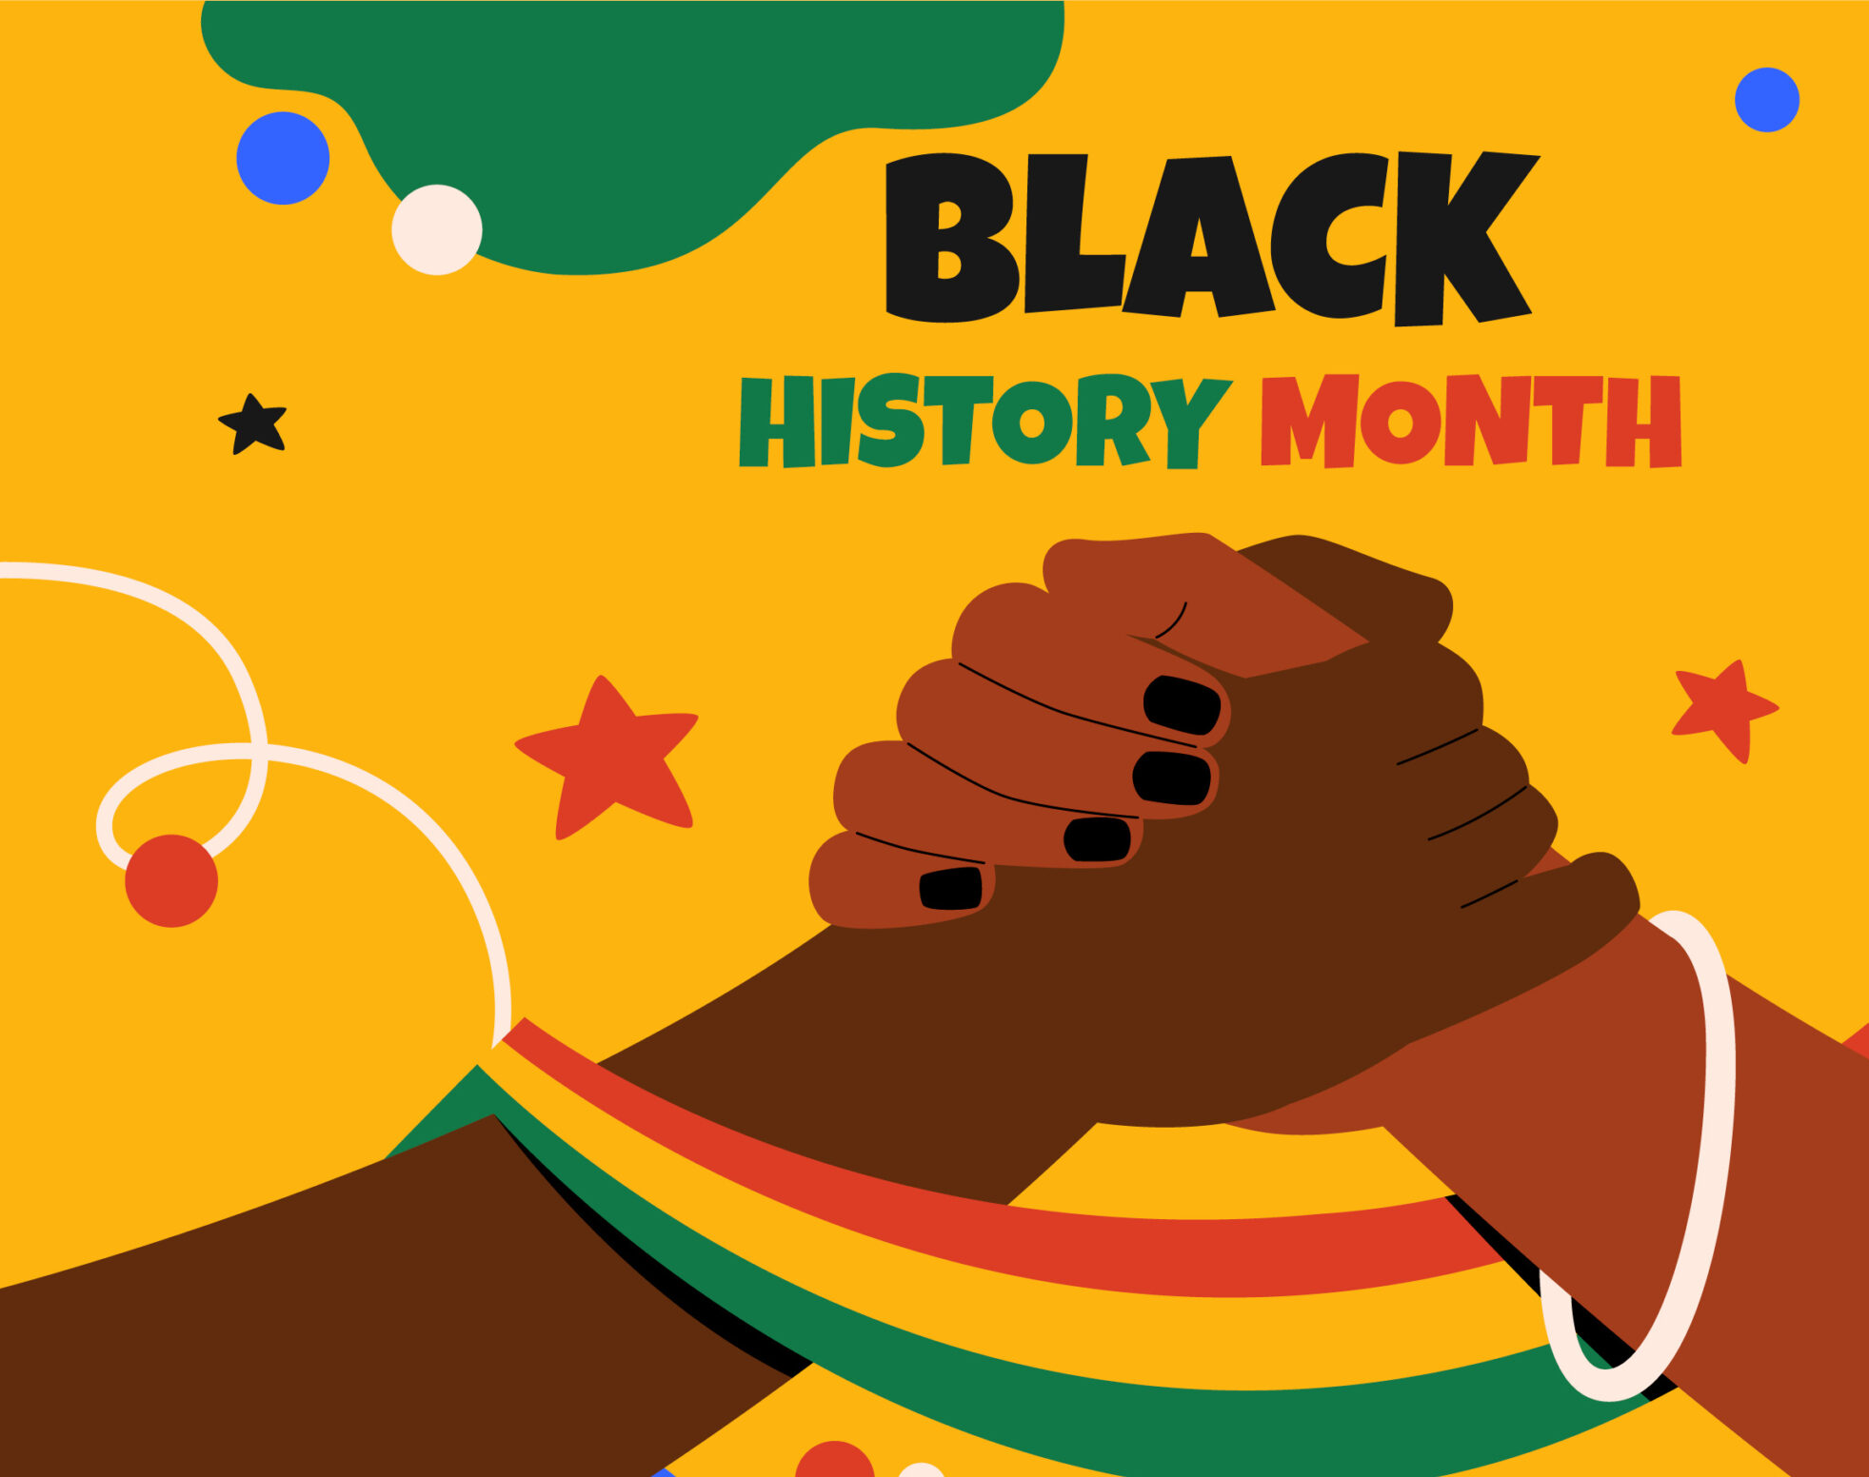
Honouring Our Heritage and History
Power, Wealth, and Wisdom

Slide 2

Learning Objectives
Describe the key features and achievements of the Kingdom of Kush and the Mali Empire.
1
Explain how these civilisations influenced trade, leadership, culture, and global history.
2
Reflect on how ancient African power shapes identity and pride today.
3

Slide 3
Key Vocabulary
Civilisation
Legacy
Empire
Trade
Wealth
Influence

Slide 4
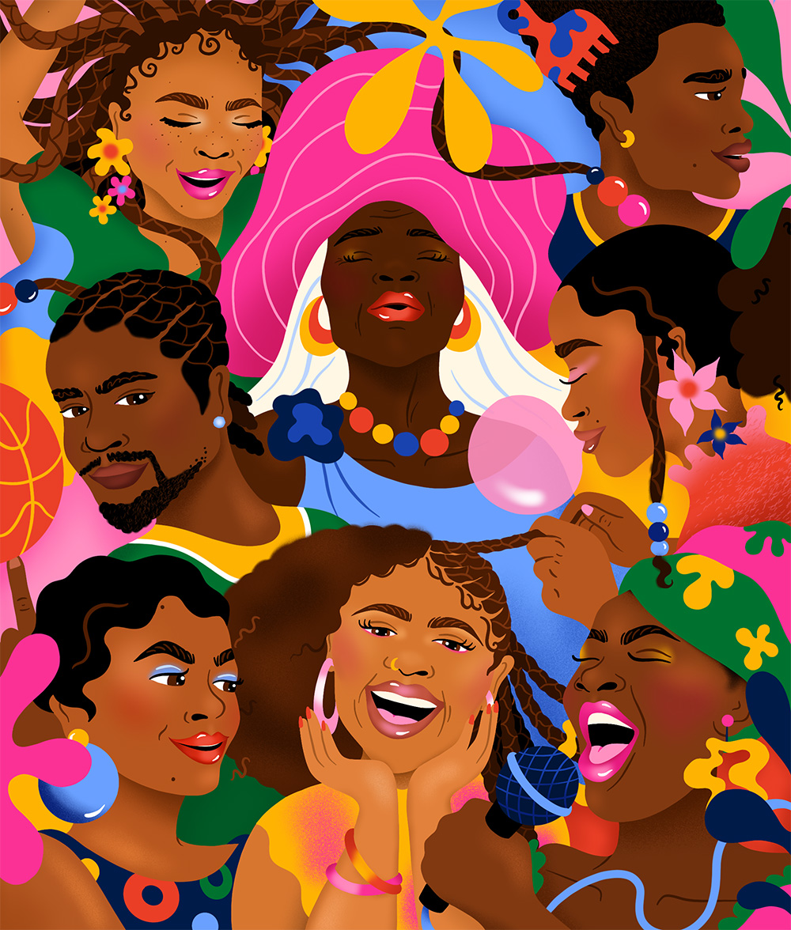
Beyond Slavery
“Black history is…”
How many of these are about slavery or civil rights?
What else might Black history include?

Slide 5
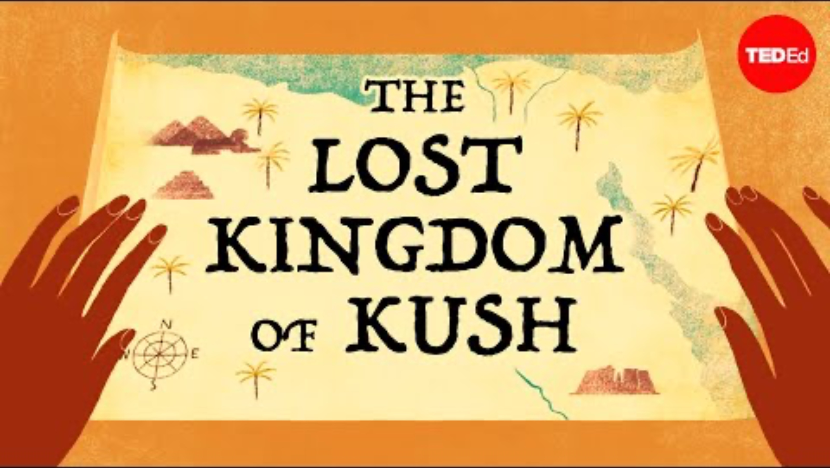
The Kingdom of Kush
How does Kush challenge stereotypes about Africa’s past?
Why is the leadership of queens like Amanirenas so significant for this period?

Slide 6
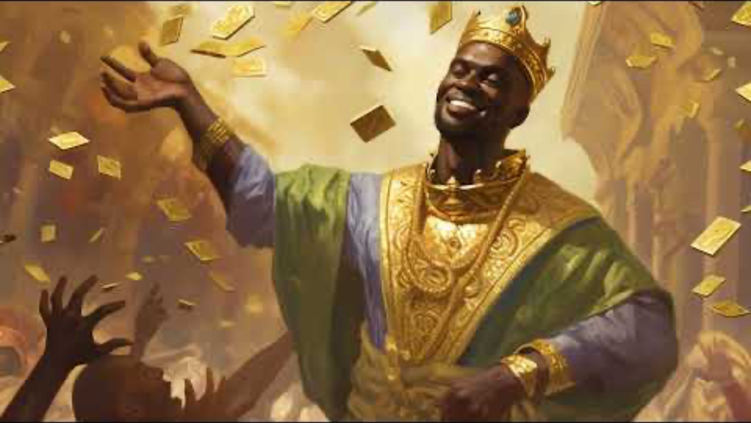
The Mali Empire
“Why was knowledge and learning as important as gold in Mali?
“What does Mansa Musa’s story tell us about Africa’s global importance in the Middle Ages?

Slide 7
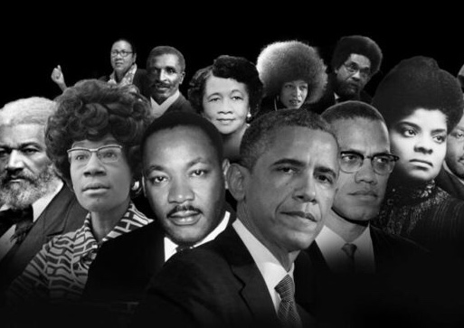
Power and Legacy
Divide students into pairs or small groups (3–4).
Give half a Kush fact sheet and half a Mali fact sheet
Students answer on paper or discuss:
What was this civilisation best known for?
How did it gain and use its power?
What achievements still inspire pride today?

Slide 8

Reflection Our Past, Our Pride
“What surprised you most about these empires?”
“How does this change how you see Black history?”
“What lessons can we learn from Kush and Mali today?”
“One achievement from today that makes me proud is…”
“I stand firm in power and pride because…”

