Slide 1
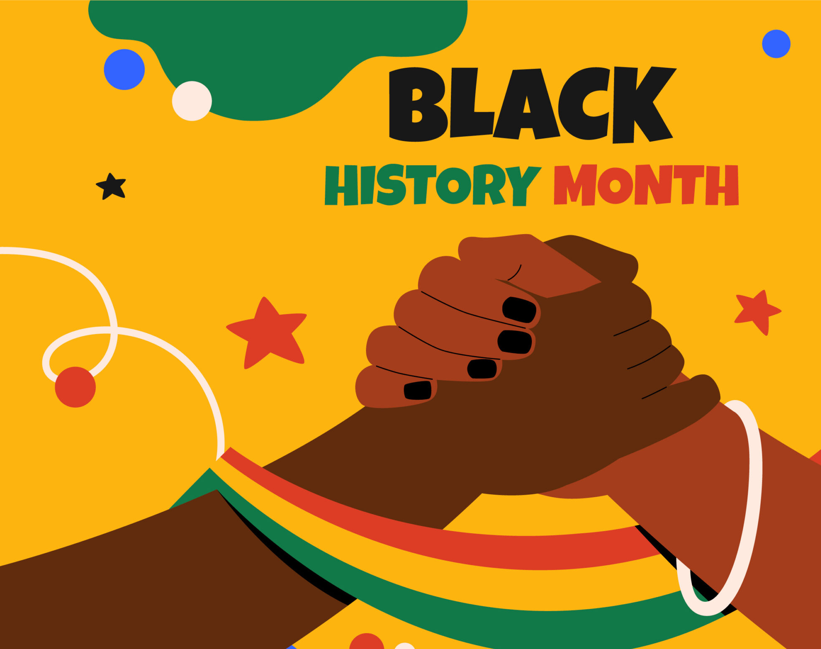
Honouring Our Heritage and History
Art, Innovation, and Global Connections

Slide 2
Learning Objectives
Describe the key features, achievements, and global impact of the Kingdom of Benin and Great Zimbabwe.
1
Explain how trade, art, architecture, and diplomacy shaped these societies.
2
Reflect on how Africa’s global connections challenge stereotypes and shape identity today.
3

Slide 3
Key Vocabulary
Legacy
Diplomacy
Architecture
Trade networks
Innovation
Empire

Slide 4
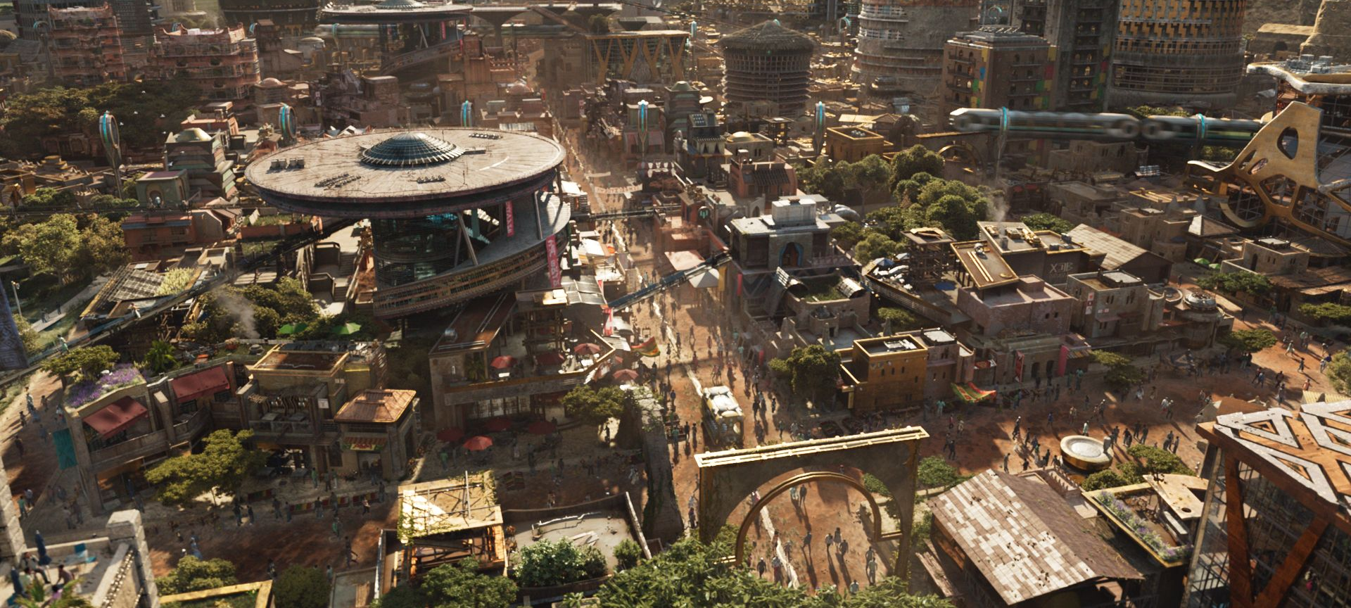
What Makes a Civilization “Advanced”?

Slide 5
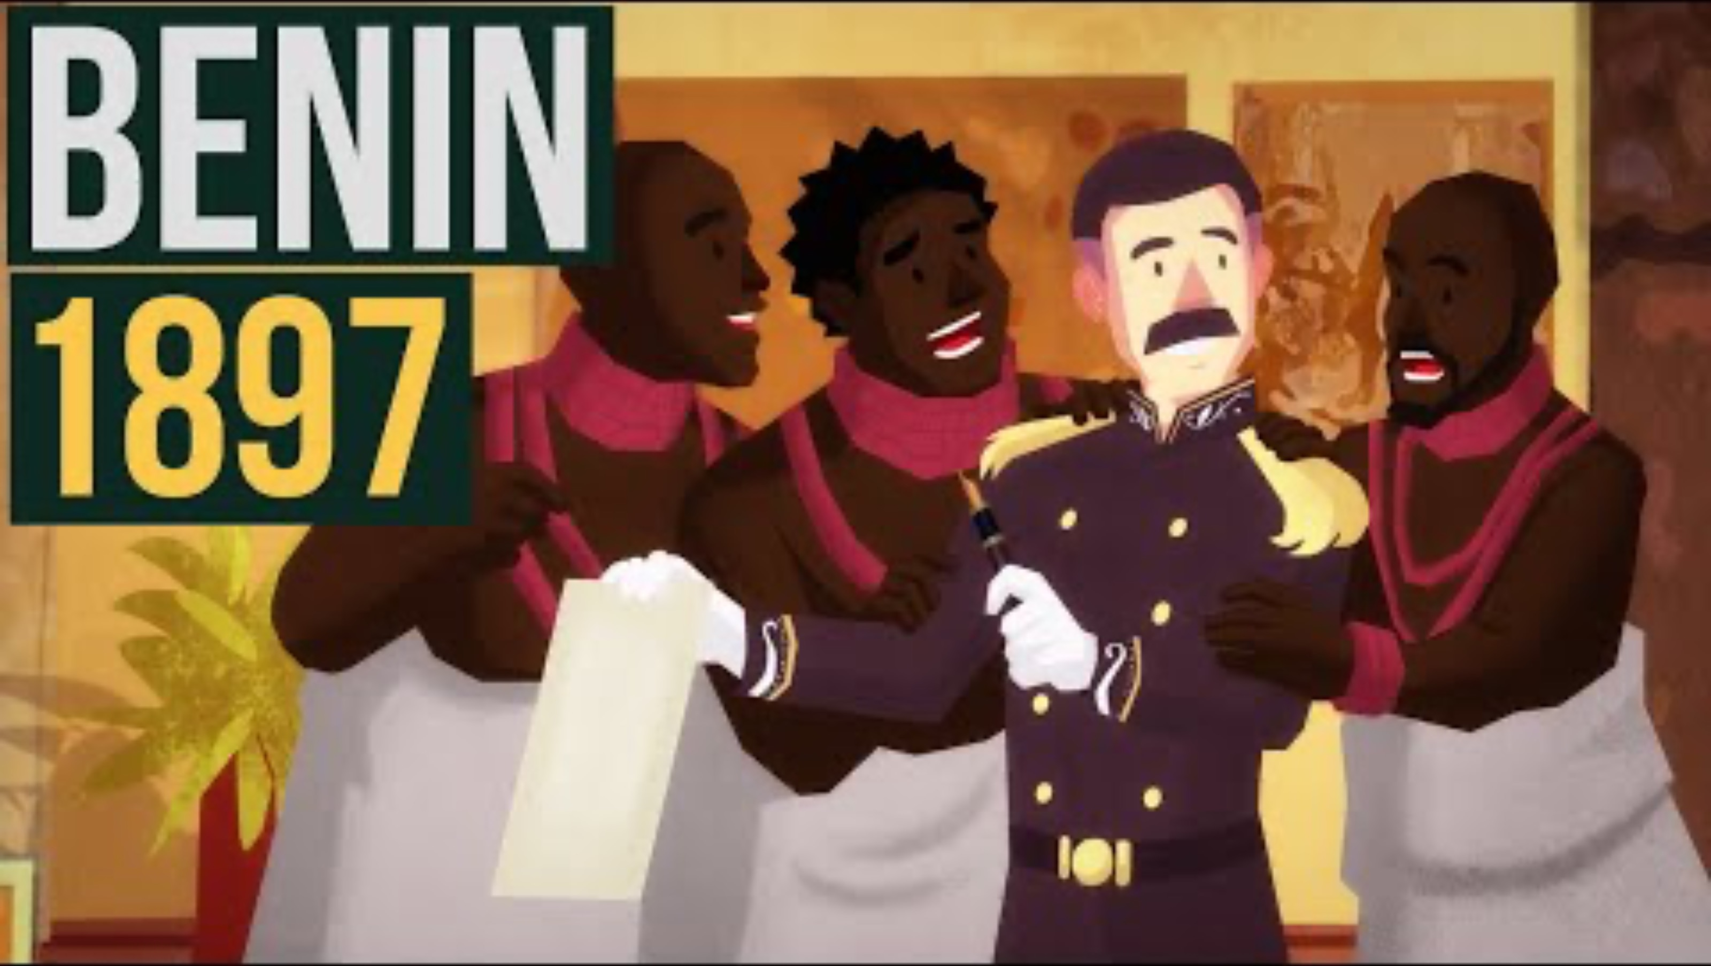
The Kingdom of Benin: Art and Power
Time Period: c. 1200 – 1897 CE
Location: Modern southern Nigeria.
Government: Ruled by the Oba (king) and an organised council. Highly structured political system.
Benin City: Famous for its urban planning, wide streets, palaces, temples, and giant defensive walls stretching for thousands of kilometres.

Slide 6
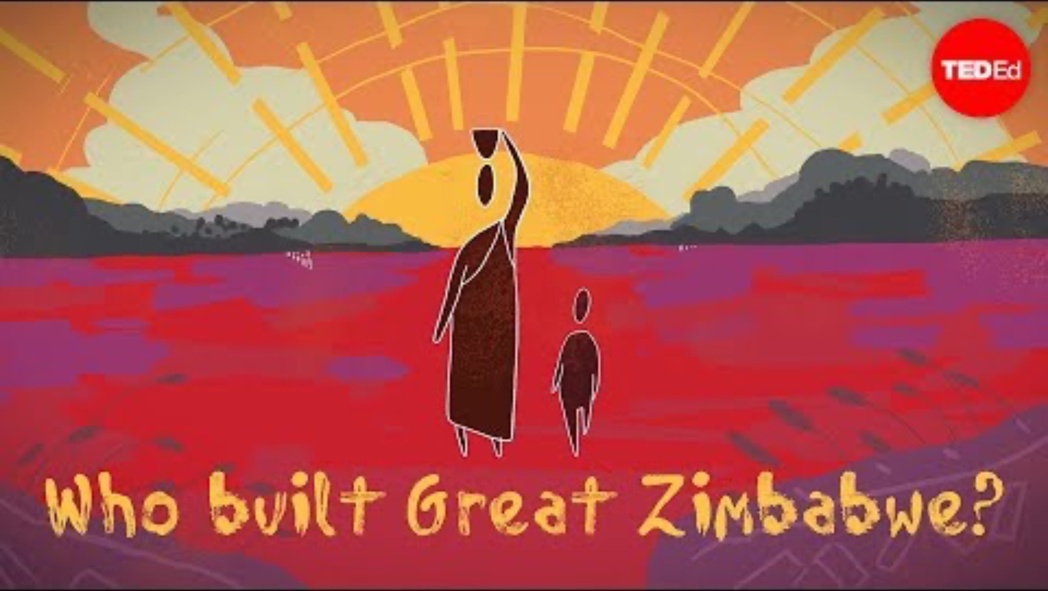
Great Zimbabwe: Stone and Trade
Time Period: c. 1100 – 1500 CE
Location: Modern Zimbabwe.
Architecture: Built entirely from stone without mortar, evidence of advanced engineering.
Society: Ruled by a powerful king (Mambo) who controlled trade and spiritual life. Complex society with farmers, metalworkers, traders, and religious leaders.

Slide 7
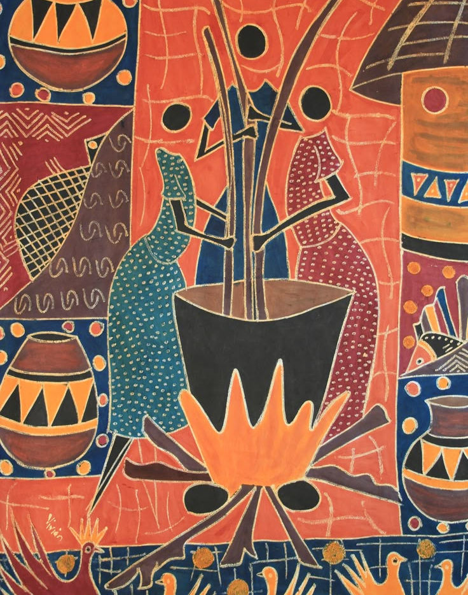
Art, Architecture, and Influence
Split the class into small groups.
Half receive a short Benin fact sheet; half receive a Great Zimbabwe fact sheet.
Each group discusses and answers:
  What achievements made this civilisation advanced?
  How did it connect with the wider world?
  What values or qualities does its legacy show?

Slide 8
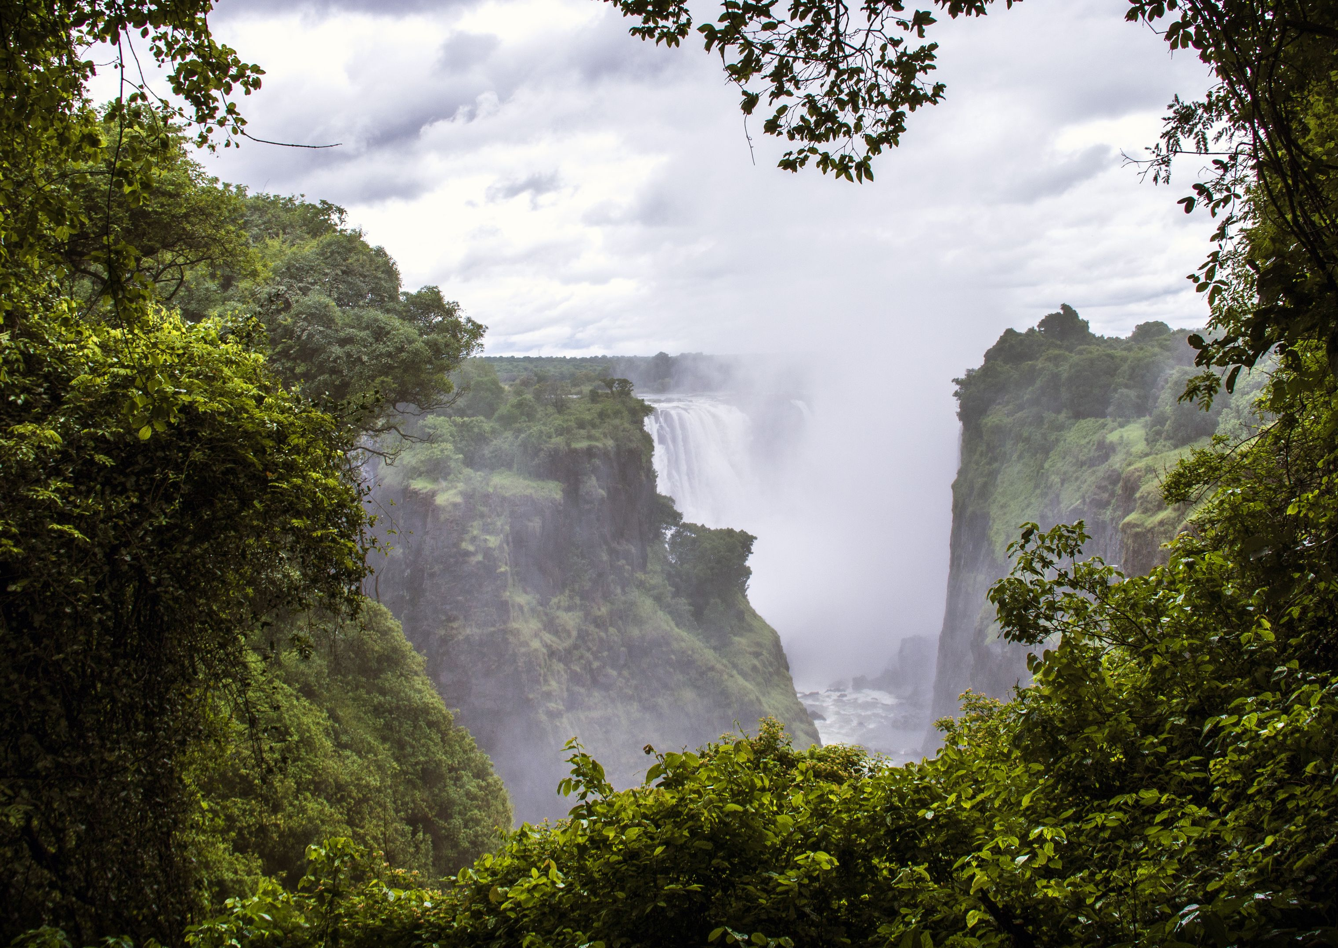
Reflection – Africa in the World
“What surprised you most about Benin or Great Zimbabwe?”
“How do these stories challenge what people often think about Africa’s past?”
“What lessons can we take from their creativity and innovation?”
“One achievement from Benin or Great Zimbabwe that I’ll remember is…”
“It matters today because…”

